Slide 1
nacvso CONFERENCE June 11–17, 2017)
HOSTED BY COUNTY OF SAN DIEGO OFFICE OF MILITARY & VETERANS

Slide 2
Nacvso president’s reception
JUNE 11, 2017
USS MIDWAY

Slide 3
A wonderful experience onBOARD uss midway

Slide 4
PRESIDENT’S RECEPTION TIMELINE
JUNE 11, 2017 (Sunday)
Start | End | Event | Location
4:45PM | 5:15PM | Depart to the MIDWAY | TOWN & COUNTRY
5:30PM | 8:30PM | Welcome Party HANGER BAY USS MIDWAY | USS MIDWAY
5:45PM | 9:30PM | Welcome Speeches Dining and Entertainment! | USS MIDWAY
9:30PM | 9:45PM | Lively Fireworks on Flight Deck | USS MIDWAY
9:45PM |  | Depart for Town & County Hotel | USS MIDWAY

Slide 5
“Welcome PARTY” USS MIDWAY
STATION MENU
TRAY PASSED APPETIZERS
GARLIC SHRIMP SHOTS
roasted poblano sauce
HERB CHICKEN SKEWER
Marinated chicken, lemon beurre blanc
CAPRESE SKEWER
ANCHO MARTINI STATION
ANCHO CHICKEN MARTINI
Ancho chili red sauce, cheesy hominy grits, chipotle cream, cilantro, green onions… presented in large martini glass
SHORT RIB STATION
BONELESS BRAISED BEEF SHORT RIB
Port wine demi
GARLIC MASH POTATOES
PASTA STATION
ORECCHIETTE PASTA
WITH SAUSAGE FENNEL SAUCE
PENNE PASTA
WITH PINK VODKA SAUCE
DESSERT
WARM BROWNIE HOT FUDGE SUNDAES
CHEESE DISPLAY
AWARD WINNING ARTISAN CHEESES
SLIDER STATION
BUILD YOUR OWN SLIDERS (BEEF & CHICKEN)
COFFEE
REGULAR & DECAF | SUGAR & HALF & HALF

Slide 6
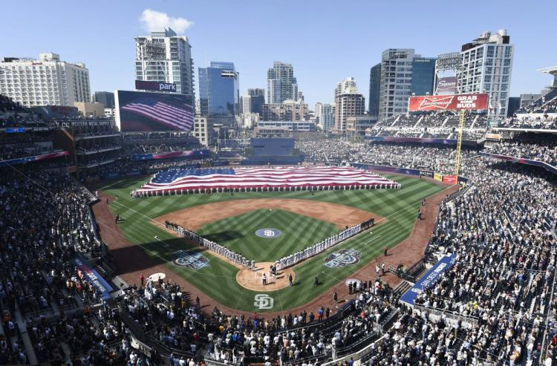
Nacvso “fun diego” week schedule
JUNE 12, 2017 (Monday)
Start | End | Event | Location
5:00PM | 7:00PM | “Play Ball" | Town & Country Hospitality Suite
7:00PM | 10:00PM | SD Padres Baseball Game | Petco Park
10:00PM |  | Depart SD Padres Baseball Game | Petco Park

Slide 7
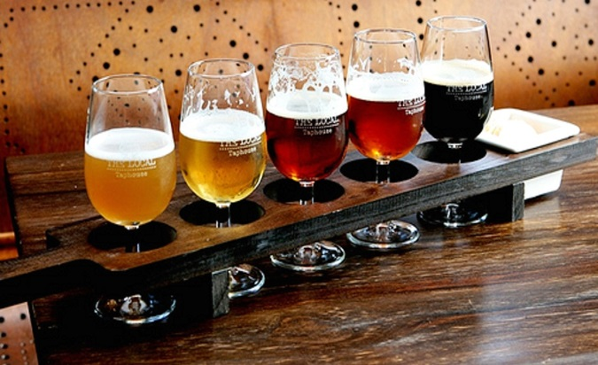
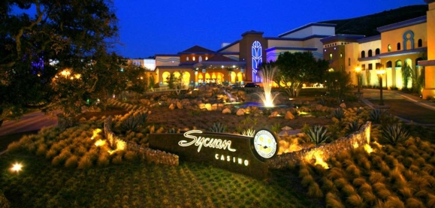
Nacvso “fun diego” week schedule
JUNE 13, 2017 (Tuesday)
Start | End | Event | Location
10:00AM | 3:00PM | San Diego County Fair | Del Mar
3:30PM | 9:30PM | San Diego County Fair | Del Mar
5:00PM | 7:00PM | "Tour of Beers" | Town & Country Hospitality Suite
6:00PM | 10:00PM | "Casino Night" | Sycuan Casino

Slide 8
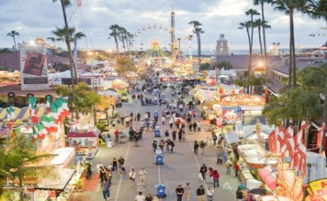
Nacvso “fun diego” week schedule
JUNE 14, 2017 (Wednesday)
Start | End | Event | Location
TBD |  | World Famous San Diego Zoo | San Diego
TBD |  | Golfing | Riverwalk Golf Course
10:00AM | 3:00PM | San Diego County Fair | Del Mar
3:30PM | 9:30PM | "Zoo Night" | Town & Country Hospitality Suite
6:00PM | 10:00PM | "Casino Night" | Barona Casino

Slide 9
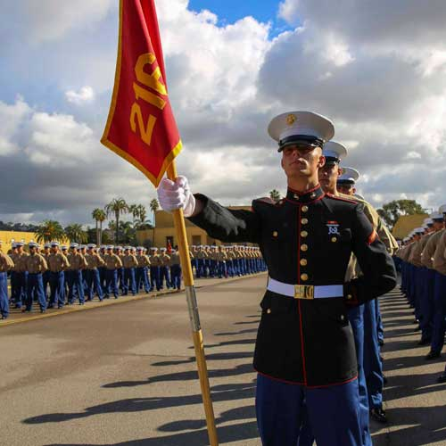
Nacvso “fun diego” week schedule
JUNE 15, 2017 (Thursday)
Start | End | Event | Location
7:00PM |  | NACVSO Banquet | Town & Country Ballroom
JUNE 16, 2017 (Friday)
Start | End | Event | Location
6:00AM | 12:00PM | Marine Corps Boot Camp Graduation | MCRD San Diego

Slide 10
Marine corps boot camp graduation
JUNE 16, 2017 (Friday)
Start | End | Event | Notes
6:00AM |  | Gate opens for MCRD Graduation | NO WEAPONS ALLOWED Entry through Gate #5 Washington St. Drivers License, passenger photo ID, auto insurance. Parking: Russell, Hochmuth, and Iwo Avenues
6:00AM | 8:00AM | Breakfast Buffet | Bay Restaurant, Neville Road Bldg. 132 or OYO
8:00AM | 8:30AM | Commanding General Morning Colors Ceremony | Commanding General HQ on Russell Ave between Seminole & Korea Rd. Parking on either end of Shepard Parade Deck.
8:30AM | 9:45AM | MCRD Graduation Seating | Shepard Field Parade Deck
10:00AM | 12:00PM | MCRD Graduation Ceremony

