Slide 1
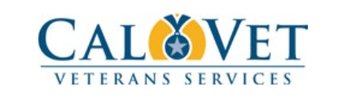
California Veterans Service Representative Academy (CVSRA) and Accreditation
Jennifer Hubbard-Beath
June 2024

Slide 2
Overview:
Accreditation academy provides training to CalVet authorized veterans representatives in preparation for the accreditation exam.
Goal of Classroom training is to provide strong foundational knowledge of federal and state veteran benefit programs to insure quality claims advocacy from the start and reduce backlog of claims appeals.
Accreditation is required for all Veteran Services Officers and Veteran Services Representatives to receive CalVet POA 044.
Accredited persons have access to VA claims files and veterans personal information (SSN, Birthday)
The CVSRA Academy is VA OGC approved.

Slide 3
Who should be accredited
Employee of CVSO office, primarily (50%) providing veterans services work (must be under the supervision of the VSO)
Working at least part-time 20+ hours week
That will receive either regular supervision and monitoring or annual training to assure continued qualification as a representative in the claim process; and

Slide 4
Academy Structure:
In-person, 8 classes per year
4 Northern CA and 4 Southern CA.
Generally – Jan/Feb, Apr/May, Jul/Aug, Oct/Nov
3 month training period
Phase 1
On-The-Job Training/ VA online TRIP training
Phase 2 and EXAM

Slide 5
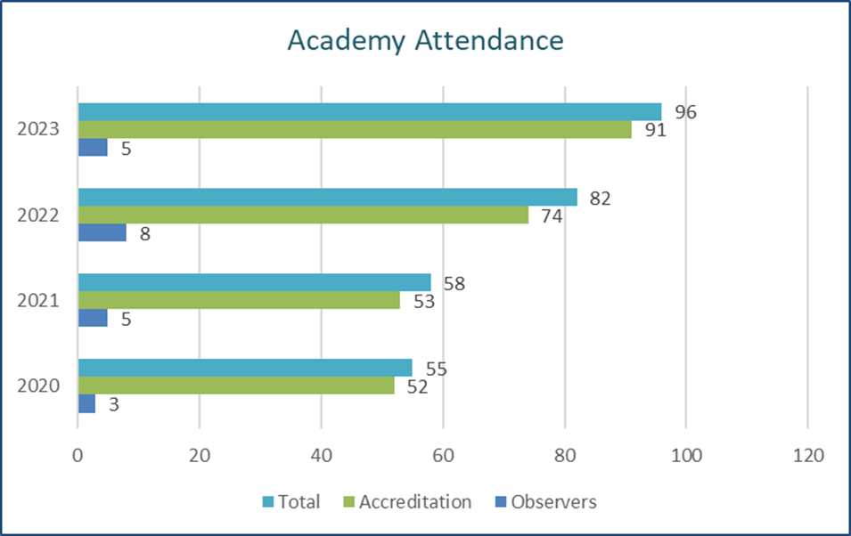
Number of participants: 2023 highest yet 96, FY 7/2023-6/2024 = 114

Slide 6
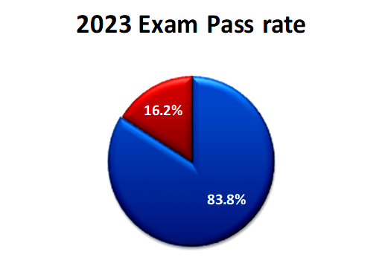
Exams: 2023 pass rate 84%, 2024 so far 87%

Slide 7
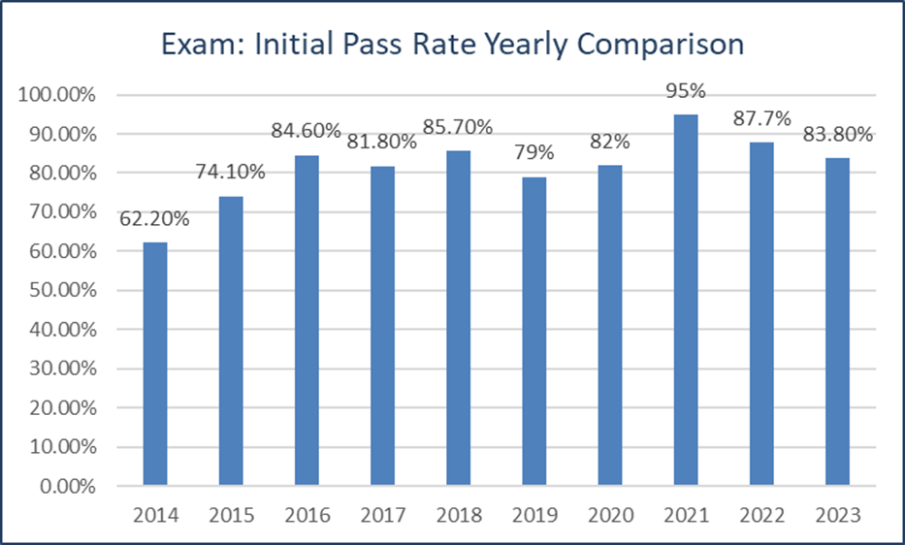

Slide 8
Accreditation and VA System Access
Form 21, Accreditation
CalVet accreditation not official until name appears on OGC website with 044 POA.
Processing can take up to 6 weeks
VA System Access and PIV Card
Oakland = James.Little6@va.gov
LA = cassady.brown@va.gov
San Diego = Piv.vbasdc@va.gov
!!! Let CALVET KNOW when staff leave CVSO OFFICE !!!
2 things to do
Remove active status on VetPro
Send email to: Training.PIV@calvet.ca.gov .
(will go to DO’s and me to deactivate PIV and remove accreditation)

Slide 9

Thank you for your time
Training.PIV@CalVet.CA.Gov

