Slide 1
District Offices: Updates & Notes
February 13, 2024
(CVSO Conference Presentation by the District Managers)

Slide 2
CALVET District Offices Agenda
District Offices (DO) – what do we do?
→ Appeals & Public Contact, DO Review, CDCR team
DO Oakland staff list
DO Los Angeles staff list
DO San Diego staff list
PACT Act numbers
PIV card process with the appropriate VARO

Slide 3
What do we do?
Quick Answers:
Appeals
Public Contact
Electronic Claims Review
Incarcerated veterans
In the next slides, we will discuss these further – as three different team functions. After the discussion of each function, we will provide the usual data we show you at every conference.

Slide 4
Appeals & Public Contact
CalVet DO Staff are co-located with the VA Regional Offices.
We represent veterans in BVA hearings and various USDVA hearings (pre-determination, COD, due process). This is about 40-50% of our staff’s workload.
Our staff also work with clients in-person and on the phone – filing claims and decision review requests, evaluating and developing case files, following up on pending claims
Work with CVSO staff calling or emailing for guidance.
Work with VA staff seeking VSO assistance clarifying claims or reaching out to unresponsive veterans or survivors.

Slide 5
BVA Hearings
Quarter period | Oakland DO | Los Angeles DO | San Diego DO
Jan-Mar 2023 | 104 | 42 | 33
Apr-Jun 2023 | 108 | 52 | 33
Jul-Sep 2023 | 97 | 57 | 15
Oct-Dec 2023 | 54 | 26 | 5
2023 TOTAL | 363 | 177 | 86
Please reach out to us if the appellant reaches out to you.
Remember, even if we are notified early, we have to work our cases according to hearing date.

Slide 6
BVA Decisions for CalVet Cases
Federal Fiscal Year Oct 22 to Sep 23 | Allow w/o Remand | Allow w/ Remand | Remand | Denied | Other | Total | Grant Rate
Direct Review | 43 | 10 | 72 | 58 | 25 | 208 | 25%
Evidence Review | 25 | 6 | 34 | 20 | 14 | 99 | 31%
Hearings | 138 | 54 | 111 | 66 | 83 | 452 | 42%
Nice grant percentage… but scary hearings total.

Slide 7
Federal Fiscal Year Oct 22 to Sep 23 | Total Decided
Direct Review | 208
Evidence Review | 99
Hearings | 452
759 BVA Decisions

Slide 8
BVA Decisions for CalVet – continued
Current FY Oct 23 to Jan 24 | Allow w/o Remand | Allow w/ Remand | Remand | Denied | Other | Total | Grant Rate
All BVA Reviews | 82 | 48 | 97 | 58 | 40 | 325 | 40%
Sorry, recent data doesn’t show lane breakdown… but out of total decisions made so far, 55% of decisions are from the Hearings Lane.

Slide 9
BVA Anticipated Hearings by Regional Office
 | Oakland VARO |  | Los Angeles VARO |  | San Diego VARO
 | Docket | Hearings | Docket | Hearings | Docket | Hearings
2nd Q – Jan to Mar 2024 | 18 | 121 | 28 | 179 | 12 | 82
3rd Q – Apr to Jun 2024 | 23 | (138) | 40 | (240) | 16 | (96)
Let’s see, in Oakland… 23 dockets @ 6 hearings/docket is around 138/3 months = 46/month
In LA, 40 dockets = 80 hearings/month
In SD, 16 dockets = 18 hearings/month
6-8 hearings are scheduled per docket.
Usually, more than half have CalVet POA.

Slide 10
DO Review Queue (VetPro)
CalVet DO staff reviews electronic claims prior to submission to the Federal VA.
Electronic claims are packaged via VetPro, according to appropriate prescribed VA form, or what is referred to in VetPro as the primary form.
End of month cut off is 12 noon. Anything submitted into the queue after 12 noon at last workday of the month, we cannot guarantee appropriate review and submission to the VA.
Follow up with VA IPC for claims that have been received in VBMS but does not have established EP or VA issued erroneous RFA (request for application) letter.

Slide 11
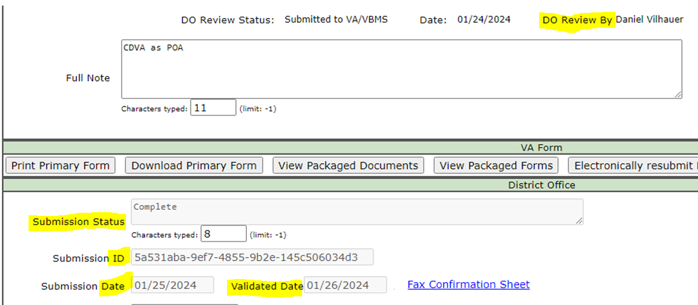
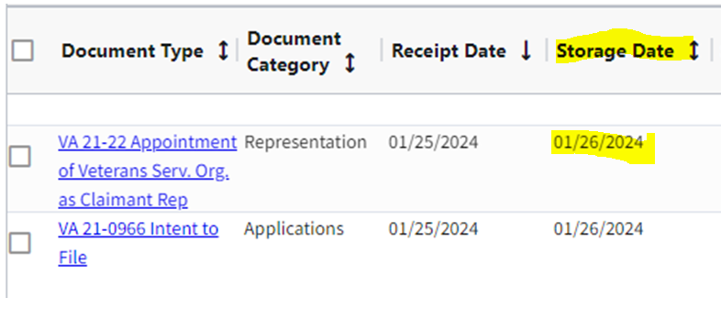
VetPro Claims Submission Status:
Electronic claim submissions that went through DO Review will show the name of the DO Reviewer.
When VetPro Submission Status is at Complete, the VetPro Validated Date will match the VBMS eFolder document Storage Date.
VetPro Claim Activity snip
Yup, same date.
VBMS snip

Slide 12
Electronic Claims via VetPro DO Review
 | Oakland DO | Los Angeles DO | San Diego DO
Jan-Mar 2023 | 3595 | 3451 | 1212
Apr-Jun 2023 | 3614 | 3952 | 2179
Jul-Sep 2023 | 4373 | 4455 | 1682
Oct-Dec 2023 | 3623 | 4542 | 1265
2023 TOTAL | 15,205 | 16,400 | 6,338

Slide 13
Electronic Claims via VetPro DO Review
These are the options available for our DO Reviewers.
We rarely use the Manually Fax button.
When we return to the County, we put a message on the box allotted. If our message doesn’t fit, then our DO Reviewer will send an email to the County Rep on the Claim Activity.
October to December 2023 | Returned Claims %
Oakland District Office | 17%
Los Angeles District Office | 11%
San Diego District Office | 12%

Slide 14
Common Discrepancies (Or Reasons Why DO Reviewers Return Electronic Claims)
Minor Issues: | Such As:
Incomplete forms | Missing signature (veteran, survivor or representative’s)
Forms not properly completed | Missing mark on claim program type (FDC/BDD), benefit block or claimant block.
Incorrect decision dates | Using RFA letter date, old RD date, SOC. Most recent decision please.
Missing forms in claim package | No SHA part A for BDD
Missing or corrupted attachments | Password protected, corrupted
Claim via DO Review but no POA | No 21-22 in package nor any indication one was previously submitted for CDVA
Missing zip code generates error | Zip code needs to be updated on Veteran’s Profile Page

Slide 15
Common Discrepancies - continued (Or Reasons Why DO Reviewers Return Electronic Claims)
More Serious Issues:
Submitting VBA 21-22 through VetPro District Office Review (DOR), then submitting the claim direct to the USDVA (bypassing the DO Review).
Submitting a Supplemental Claim, Higher-level Review and or Board Appeal direct to the USDVA/BVA bypassing DOR

Slide 16
DO’s CDCR Representatives
CalVet District Office (DO) staff assigned specific California State prisons (per SB 776, implemented FY 2018-19).
Our Reps act as VA exam liaisons between VA contract vendors and CDCR POCs
Correspondence with incarcerated veterans regarding claims (filing and pending), to include CVSO information for those about to be released.
In-person interviews: when requested, is necessary, and/or when workload allows in that jurisdiction.
Presentations for veterans groups within their assigned facilities, to bring awareness to our incarcerated veteran about our programs
BVA virtual hearings at that state prisons

Slide 17
CalVet Reps - CDCR Liaison Program
 | Claims Filed | VAEs held | In-Person Interviews | Letters to veterans | Retro | Adjusted Monthly | Full Monthly Entitlement
Jan-Mar 2023 | 88 | 94 | 95 | 270 | $ 513,119 | $ 21,217 | $ 61,060
Apr-Jun 2023 | 77 | 53 | 75 | 155 | $ 98,042 | $ 23,061 | $ 70,721
Jul-Sep 2023 | 89 | 103 | 101 | 330 | $ 95,657 | $ 11,699 | $ 30,300
Oct-Dec 2023 | 83 | 101 | 80 | 266 | $ 105.801 | $ 8,784 | $ 44,609
2023 Total | 337 | 351 | 351 | 1021 | $ 812, 619 | $ 64,761 | $ 206,690

Slide 18
Oakland DO Staff list
Appeals Team
Steven Smith (Staff Services Manager II)
Leonora (Cora) Sarmiento
Agnes Manalo
Ma Cristina Enriquez-Perez
Elizabeth Grassetti
Manuel Lavalle (Rancho office)
Judy Cortez-Garcia
Rancho BCP position (hiring process)
Oakland vacancy (posted)
DO Review Team
Diane Susbilla (Team Lead)
Daniel Vilhauer
Walter Huey
Teri Markus

Slide 19
Oakland DO Staff list - continued
Incarcerated Veterans Team (aka CDCR team)
Liz Hargrove-Washington (Staff Services Manager I)
Mary Donovan
Vacant position #1 (hiring process)
Vacant position #2 (posted)
Vacant position #3 (posted)

Slide 20
Oakland District Office General Information
Oakland DO Point-of-Contact (POCs)
Appeals team:
For decision review guidance, email Steven –Steven.Smith@calvet.ca.gov
For hearing schedule confirmations & inquiries, email Cora – Leonora.Sarmiento@calvet.ca.gov
DO Review team:
The DO Reviewer of your claim activity
Diane.Susbilla@calvet.ca.gov
CDCR team:
Elizabeth.Hargove-Washington@calvet.ca.gov
Oakland Office (Main):
1301 Clay St. Rm 1130N
Oakland, CA 94612
Open Tue, Wed & Thurs
9:00 AM to 3:00 PM
Phone 510.286.0627
Fax 510.286.0653
Rancho Office:
3046 Prospect Drive
Rancho Cordova, CA
Currently on appointments-basis
Phone 916.364.6774
Corporate inbox: Oakland.Oakland@calvet.ca.gov

Slide 21
Los Angeles DO Staff list
Alberto M. Alpasan, Jr. – District Manager
Front Office - Vacant
DO Review Team
Appeals Team
Isabella Alejandrino (recent hire)
Porcia Andrada
Esther Luna
Sandra Matrecitos
Darlene Dunlap – Appeals Team Manager
Maria Alatorre
Babes Navarra
Joberde Metellus
Vacancy
Vacancy
CDCR Team
Maura Meade
Matthew Grimm

Slide 22
Los Angeles DO Staff list - continued
LA District Office General Information
LA District Office POC
11000 Wilshire Blvd. Ste. 505
Los Angeles
(213) 620-2755
Corporate mail:
CDVALA@va.gov (you can send PII as long as you encrypt)
For issues relating to appeals(hearings or to discuss appeals issues):
Darlene Dunlap
Darlene.Dunlap@calvet.ca.gov
Darlene.Dunlap344@va.gov

Slide 23
San Diego DO Staff
Support-Appeals
Support (no appeals or HLRs)
Tony Devore, Staff Service Manager I
Angel Bribiesca
Adam Clark
Josephine (Josie) Grafilo
Judith (Judy) Roach
1 Vacant position
Eugenia Agis
1 Vacant position
CalVet-CDCR Liaison
Roberto Avila

Slide 24
San Diego District Office General Information
San Diego District Office
8810 Rio San Diego Dr. Rm 1162
San Diego, CA 92108
Open to the Public:
Tue., Wed., Thur. 8am-3:30pm
Public Line: (619) 400-0070
Fax Line: (619) 491-9201
San Diego Corporate Email:
state.vbasdc@va.gov
San Diego Office Point of Contacts (POC)
Claim Guidance, AMA Decisions/Guidance, Board hearings & Board Appeals, email Tony Devore tony.devore@va.gov
CDCR (Incarcerated Veterans), email Roberto Avila Roberto.avila@calvet.ca.gov

Slide 25
PACT Act numbers
(From VA Dashboard, as of February 2, 2024)
California accounts for 8.15% of veterans nationwide
Total number of PACT Act related claims received 100,835 – this accounts for 7.37% of all PACT Act claims nationwide
National Statistics (08/10/2022 – 01/27/2024)
729,632 PACT Act claims approved by VA
75.4% approval rate
159.9 average days to complete

Slide 26
What are PIV cards?
PIV cards are federal VA-issued cards that allow accredited representatives ‘read-only’ access to the electronic folders (eFolders) of veterans/survivors who appoint CDVA/CalVet as their POA for VA-purposes.
These are issued by the appropriate VA Regional Office that has jurisdiction in your area/County.
At the back of each PIV card, it says:
“This credential is the property of the U.S. Government. Counterfeiting, altering, or misusing violates Section 499, Title 18 of the U.S. Code.”

Slide 27
PIV Process (Los Angeles VARO jurisdiction )
New PIV Card
Email LARO HR once applicant's accreditation is verified in VA OGC
Applciant completes all forms and return to LARO HR
Self-schedule for fingerprinting
Notify LARO HR once fingerprinting is completed
LARO HR will notify VSC Front Office staff once results are available
VSC Front Office will create a VA account for new applicant and notify VA SSD
VA SSD will notify LARO HR to adjudicate case in USAccess
VSC Front Office sponsors new EE in USAccess
VA SSD will notify new applicant to schedule a visit to LARO for PIV issuance

Slide 28
PIV Process Los Angeles VARO - continued
PIV Card Renewal
Send request for renewal no less than 30 days from actual expiration date of the PIV Card
Send the information in an encrypted email to CDVALA@va.gov in the following format:
LARO Front Office will sponsor the employee and notify LARO SSD
LARO SSD will reach out to employee to self-schedule a visit to the PIV office for card issuance
Birthplace (City, State/ Country) | Last Name | First Name | Middle Name, or NMN | Suffix (if any) | DOB (MM/DD/YYYY) | SSN

Slide 29
PIV Process (Oakland & San Diego Jurisdictions)
Oakland VARO jurisdiction
San Diego VARO jurisdiction
Once accredited, please contact Oakland VARO POC:
VBAOAKPOA@va.gov
Jim Little will respond with required forms and checklist of required training certificates. Please submit all requirements together.
Please respond to all VA PIV emails promptly, to avoid delays with your application.
Once accredited, please email:
VBASDCPOA@va.gov
PIV.VBASDC@va.gov
Matthew Lamb or Matt Null will respond with required forms and checklist of required training certificates. . Please submit all requirements together.

Slide 30

PIV Process - continued
Since PIV cards are the property of the U.S. Government, these should be returned to the Federal VA.
Resigned, retired and terminated state and county employee PIV cards need to be returned to the appropriate VA Regional Office that has jurisdiction over our offices.
VA requires a police report for lost/stolen PIV cards – otherwise, no PIV card renewal.

Slide 31
Alberto Alpasan
Los Angeles District Manager
Alberto.Alpasan@calvet.ca.gov
LADO@calvet.ca.gov
(213) 620-2755
Melaina Anker-Youngberg
San Diego District Manager
Melaina.Anker@va.gov
State.VBASDC@va.gov
(619) 400-0070
Zmae Raymundo
Oakland District Manager
Zheriemae.Raymundo@calvet.ca.gov
Oakland.Oakland@calvet.ca.gov
(510) 286-0627

