Slide 1
VA S.A.V.E. Training
Cassandra Meredith, LCSW, BCD
Suicide Prevention Community Engagement and Partnership Coordinator
VA Northern California Healthcare System
Cell: 916-717-3479
Cassandra.meredith@va.gov

Slide 2
Before We Begin:
Suicide is an intense topic for some people.
If you need to take a break, or step out, please do so.
Immediate Resources:
National Suicide Prevention Lifeline: 988
Service members and Veterans: Press 1 to connect with the Veterans Crisis Line.
1-800-273-8255 is still functional.
Notes:
Today we will discuss ways that everyone can contribute to a safer environment for Veterans at risk for suicide. We understand that this is a sensitive topic and that people in attendance today may have had personal experiences involving suicide. If you find you need to take a break, please do so. Feel free to reach out to me at the end of the presentation if you need support. If you find you need to talk to someone at any time, you can call the National Suicide Prevention Lifeline at 988 (service members and Veterans should press 1 to connect with the Veterans Crisis Line). Why don’t we all put this number into our phone contacts right now?

Slide 3
Overview
Objectives
Facts about Veteran Suicide
Common Myths vs. Realities
VA S.A.V.E. Steps
Resources
Notes:
This program is focused on preventing suicide attempts and saving lives that might otherwise be lost to suicide. It is designed to train everyone who knows a Veteran to be a “gatekeeper.” The role of gatekeepers is connecting those at risk for suicide with people who can help them. You can save lives by being sensitive to people in distress and by connecting them with care.

Slide 4
Objectives
By participating in this training, you will:
Have a general understanding of the scope of Veteran suicide within the United States.
Know how to identify a Veteran who may be at risk for suicide.
Know what to do when you identify a Veteran at risk.

Slide 5

Take a moment to consider:
What are your biggest questions around suicide and talking to people in crisis?

Slide 6
Facts About Veteran Suicide

Slide 7
Suicide is a National Public Health Problem
Suicide is a national public health issue for both Veterans and the general population.
For every death by suicide, approximately 135 individuals are impacted.
Notes:
Suicide is a national issue. In 2020, over 45 thousand Americans died by suicide and until recently, suicide rates were steadily increasing over time.
Societal factors, such as economic disparities, race/ethnicity/LGBT disparities, homelessness, social connection and isolation, and health and well-being, play additional roles in suicide.
Coronavirus Disease 2019 (COVID-19) pandemic has also placed additional strain on our Nation and on individuals and communities
Our nation grieves with each suicide, necessarily prompting the collective tireless pursuit of evidence-based clinical interventions and community prevention strategies, critical to the implementation of VA’s National Strategy for Preventing Veteran Suicide.
Cerel, J., Brown, MM., Maple, M., Singleton, M., van de Venne, J, Moore, M., & Flaherty, C., How many people are exposed to suicide? Not six. Suicide and Life-Threatening Behavior, (2018) https://doi.org/10.1111/sltb.12450
Turecki, G., Brent, D.A. (2016) Suicide and suicidal behavior. Lancet. 387:12271,227–39.
Zalsman G., Hawton, K., Wasserman, D., van Heeringen, K., Arensman, E., Sarchiapone, M., … Zohar, J. (2016) Suicide prevention strategies revisited: 10-year systematic review. Lancet. 3:646–59.
Department of Veterans Affairs (2018). National Strategy for Preventing Veteran Suicide. Washington, DC. Available at https://www.mentalhealth.va.gov/suicide_prevention/docs/Office-of-Mental-Health-and-Suicide-Prevention-National-Strategy-for-Preventing-Veterans-Suicide.pdf.

Slide 8
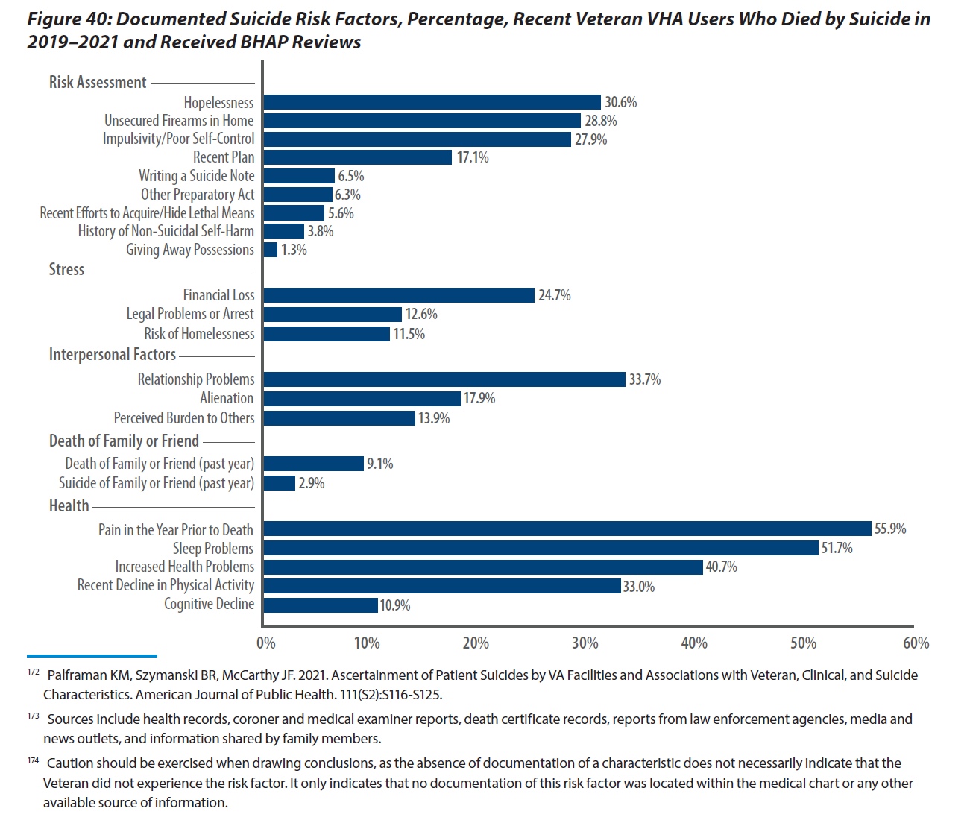
Suicide Decedents, Recent Veteran VHA Users with Behavioral Health Autopsy Program Reviews

Slide 9
Key Findings: 2023 National Veteran Suicide Prevention Annual Report

Slide 10
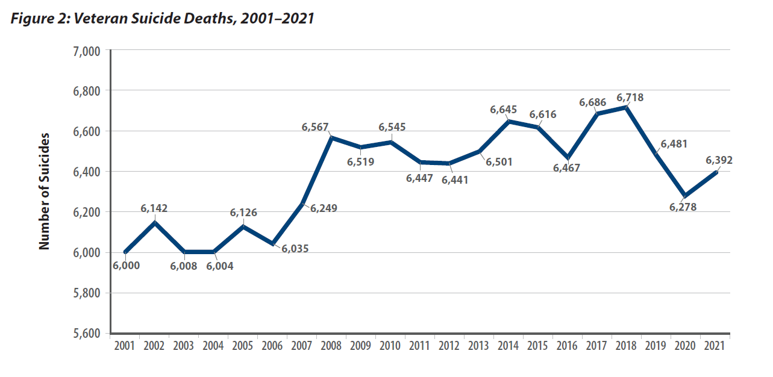
Veteran Suicide Deaths, 2001-2021
Notes:
Average Number of Suicides Per Day⁴⁸
In 2021, there were on average 127.2 suicides per day among U.S. adults, including 17.5 per day among Veterans and 109.6 per day among non-Veteran adults.
Among all U.S. adults, including Veterans, the average number of suicides per day rose from 81.0 per day in 2001 to 127.2 in 2021. The average number per day among U.S. adults was highest in 2018 (127.4 per day).
The average number of Veteran suicides per day rose from 16.4 in 2001 to 17.5 in 2021. For U.S. adults, the average number of suicides per day was highest in 2018 for Veterans (18.4 per day). Of the on-average 17.5 Veteran suicides per day in 2021, approximately 38.1% (6.7 per day) were among Recent Veteran VHA Users49 and 61.9% (10.8 per day) were among Other Veterans.

Slide 11
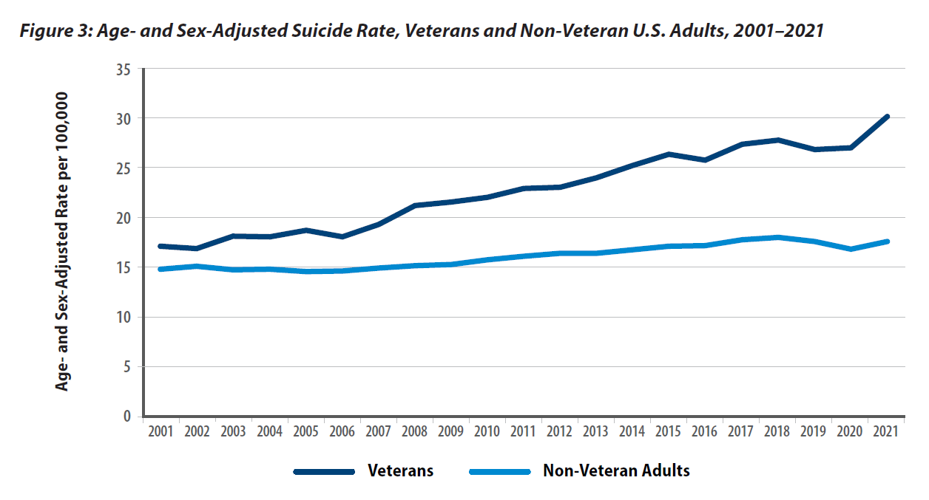
Age- and Sex-Adjusted Suicide Rates, Veterans and
Non-Veteran U.S. Adults, 2001-2021
Notes:
From 2001 to 2021, the Veteran population decreased by 27.0%, from 25.8 million to 18.8 million. During this same timeframe, the non-Veteran U.S. adult population increased by 28.4%, from 186.5 million to 239.5 million. In this context, it is important to assess suicide mortality rates, which convey the incidence of suicide relative to the size of the population.
Unadjusted suicide rates represent the number of suicide deaths relative to the population’s time at risk of being observed with a suicide death.50 Rates are reported as suicides per 100,000.51 Direct adjusted rates are used for comparisons while adjusting for population differences, such as age and sex distributions.52 To describe the burden of suicide in a given population and period, we use unadjusted rates. To compare rates across populations or periods, we use direct adjusted rates.53
The unadjusted suicide rate for Veterans was 23.3 per 100,000 in 2001 and 33.9 per 100,000 in 2021. For non-Veteran U.S. adults, the suicide rate was 12.6 per 100,000 in 2001 and 16.7 per 100,000 in 2021.
In 2021, Veterans between ages 18- and 34-years old had an unadjusted suicide rate of 49.6 per 100,000, while the rate was 35.5 per 100,000 for those between ages 35- and 54-years old; 29.9 per 100,000 for those between ages 55- and 74-years old; and 32.1 per 100,000 for those aged 75-years-old and older.
In 2021, the unadjusted suicide rate of Veteran men was 35.9 per 100,000 (3.5% higher than in 2020) and it was 17.5 per 100,000 for Veteran women (23.7% higher than in 2020).
Age- and sex-adjusted suicide rates from 2001 to 2021 are presented in Figure 3 for Veterans and non-Veteran U.S. adults, by year. The difference in age- and sex-adjusted rates was greatest in 2021, when the age- and sex-adjusted rate for Veterans was 71.8% greater than that of non-Veteran adults.
Bivariate comparisons indicated that Veteran age- and sex-adjusted suicide rates were significantly greater in 2021 than in 2019 or 2020.

Slide 12
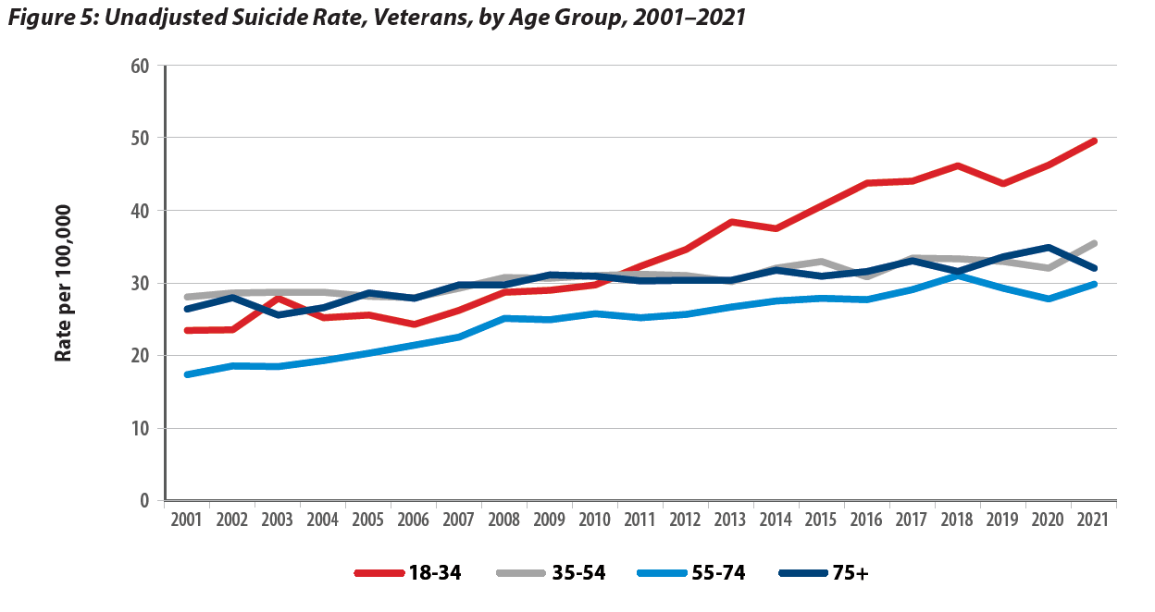
Unadjusted Suicide Rate Per 100,000, Veterans, by Age Group, 2001-2021
Notes:
Page XX, Figure 5
From 2001 through 2020, the unadjusted suicide rate among Veterans:
Ages 18-34: Increased by 95.3%
Ages 35-54: Increased by 12.9%
Ages 55-74: Increased by 58.2%
75 and older: Increased by 21.2%
From 2019 through 2020, suicide rates among Veterans between the ages of 18 and 34 increased, while rates for each other age group decreased.

Slide 13
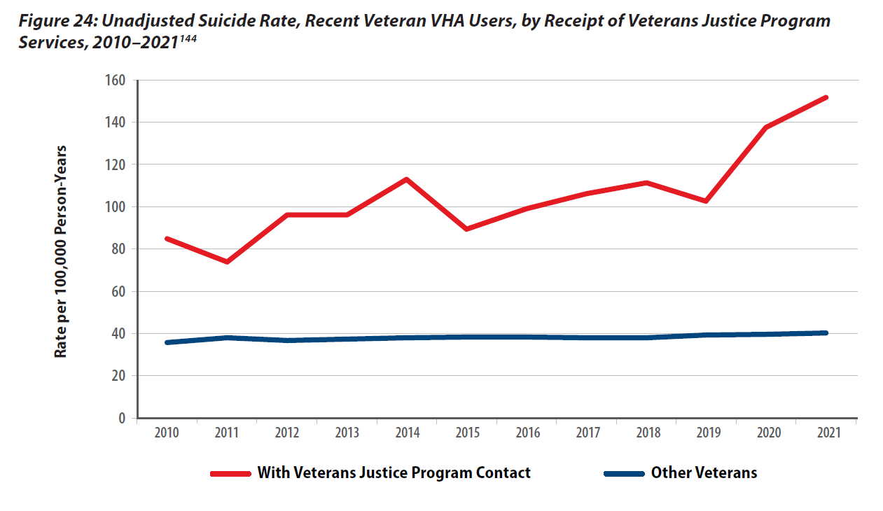
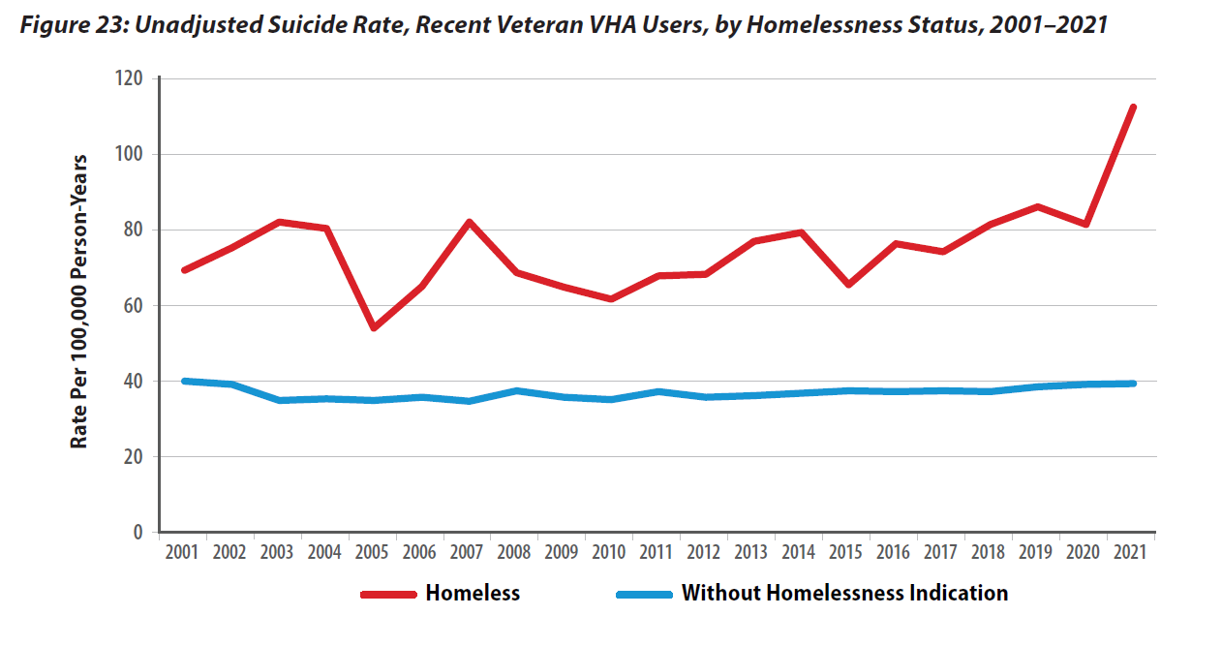
Additional Risk Factors

Slide 14
California Data California Veteran and Total California, and National Suicide Deaths and Rates by Age Group, 2021
Age Group | California Veteran Suicide Rate | California Suicide Rate | National Veteran Suicide Rate | National Suicide Rate
Total | 28.9 | 13.2 | 33.9 | 18
18-34 | 37.4 | 12.8 | 49.6 | 18.8
35-54 | 28.4 | 12.6 | 35.5 | 18.2
55-74 | 26.3 | 12.8 | 29.9 | 16.2
75+ | 28.9 | 18.3 | 32.1 | 20.3
Notes:
Cassie
And to give more local context to this issue, here are some numbers from CA suicide rates in 2021. We can see that the Veteran suicide rates are almost twice that of the general CA population and in 2019 alone – we lost 473 Veterans to suicide just here in CA.

Slide 15
Suicide is a Complex Issue with No Single Cause
Suicide is often the result of a complex interaction of risk and protective factors at the individual, community, and societal levels.
Risk factors are characteristics that are associated with an increased likelihood of suicidal behaviors. Protective factors can help offset risk factors.
To prevent Veteran suicide, we must maximize protective factors while minimizing risk factors at all levels, throughout communities nationwide.

Slide 16
Risk and Protective Factors
Risk
Protective
Prior suicide attempt
Mental health issues
Substance abuse
Access to lethal means
Recent loss
Legal or financial challenges
Relationship issues
Unemployment
Homelessness
Access to mental health care
Sense of connectedness
Problem-solving skills
Sense of spirituality
Mission or purpose
Physical health
Employment
Social and emotional well-being
Goal: Minimize risk factors and boost protective factors
Notes:
Risk factors are characteristics that are associated with an increased likelihood of suicidal behaviors. Some risk factors for suicide include: prior suicide attempt history, certain mental health conditions, access to lethal means, and stressful life events, such as divorce, job loss, or the death of a loved one.
Protective factors can help offset risk factors. These are characteristics associated with a decreased likelihood of suicidal behaviors. Some protective factors for suicide include access to mental health care, feeling connected to other people, and positive coping skills.

Slide 17
Access to Lethal Means is a Risk Factor
Notes:
Notes: This is a bridge between risk/protective factors section and the lethal means conversation.

Slide 18
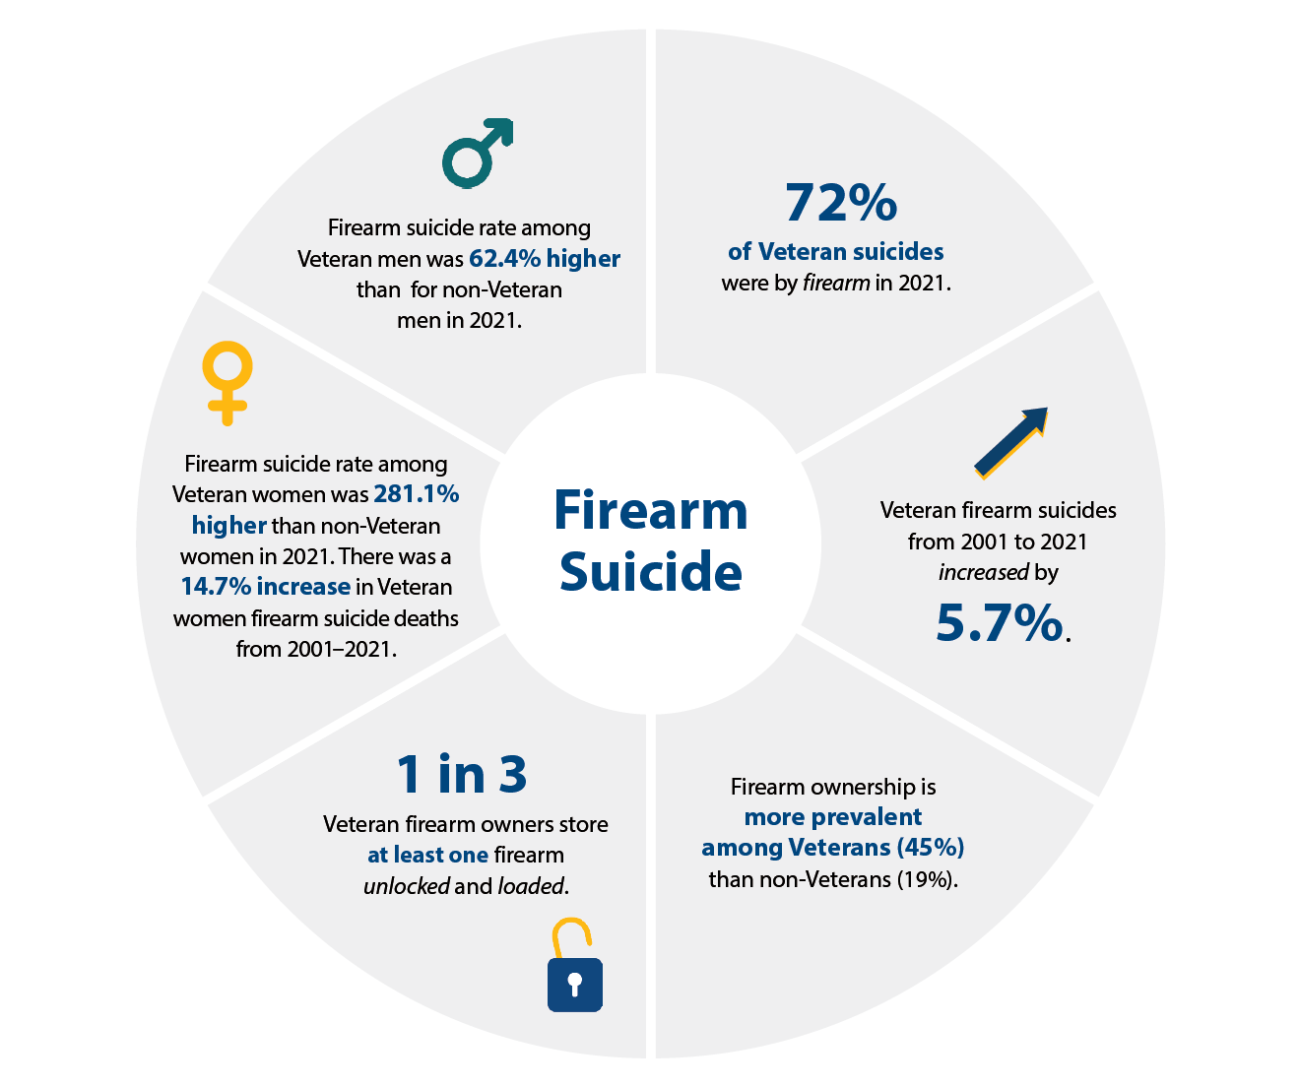
Firearm Suicide

Slide 19
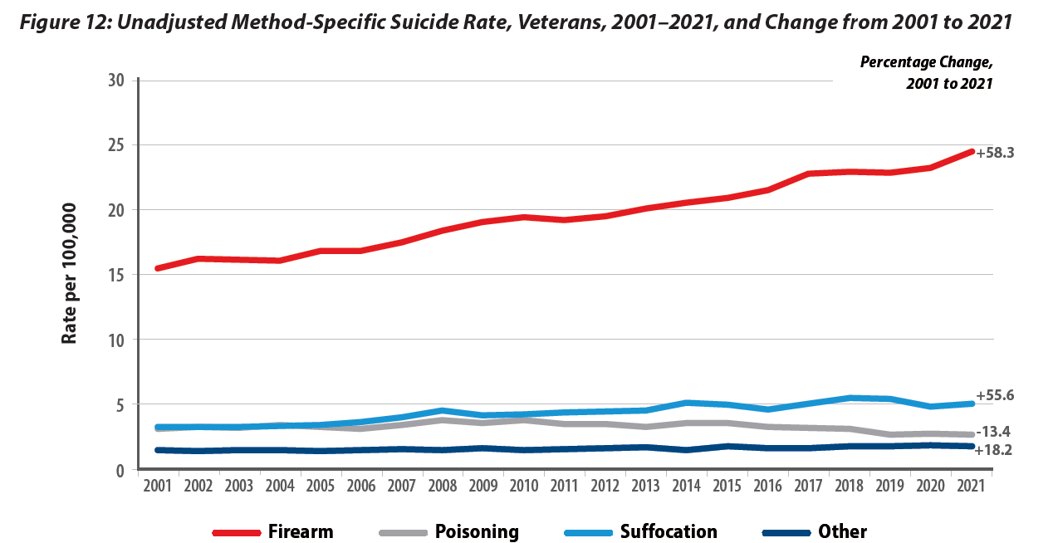
Suicide Deaths, Methods Involved, 2021 and Difference From 2001*
Notes:
Page XX, Table 1
Among U.S. adults who died from suicide in 2020, firearms were more commonly involved among Veterans (71.0%) than non-Veterans (50.3%).
In 2020, firearms were involved in 72.1% of suicides by male Veterans, up from 70.6% in 2019 and in 48.2% of suicides by female Veterans, down from 48.4% in 2019.
Among Veteran suicides
From 2001-2020:
Firearms increased +4.5%
Poisoning decreased -4.8%
Suffocation increased +0.9%
Other means decreased -0.6%

Slide 20
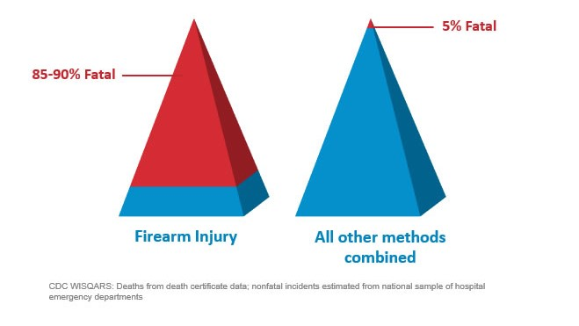
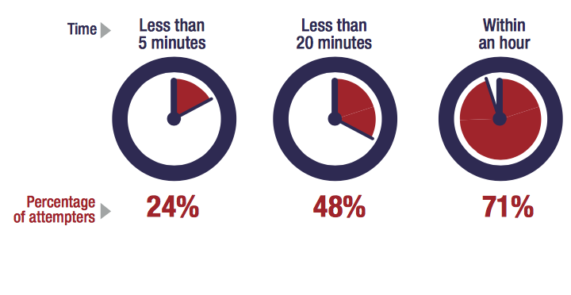
Most Suicidal Crises are Brief
Time from Decision to Action < 1 hour
Source: Simon, T.R., Swann, A.C., Powell, K.E., Potter, L.B., Kresnow, M., and O’Carroll, P.W. Characteristics of Impulsive Suicide Attempts and Attempters. SLTB. 2001; 32(supp):49-59.
Source: CDC WISQARS and US Dept. of Veterans Affairs
https://www.mirecc.va.gov/lethalmeanssafety/facts/
Notes:
Building in time and space between the impulse to act and the means to harm one’s self saves lives.
While some suicidal crises last a long time, most last minutes to hours. In one study of suicide attempt survivors:
47 percent said it took less than one hour between their decision to attempt suicide and their actual attempt.
24 percent said it took less than five minutes for them to act.
The time between when a person decides to die by suicide and they act on the decision is often very short. A 2005 study found that 71% of attempters estimating that the process took less than an hour. This reality underscores the importance of reducing access to means for those who are at elevated risk for suicide, until the risk period passes.
Access to lethal means increases suicide risk for everyone living in the home
Acute phase of a suicidal crisis is often brief.
Building in time and space—even 30-60 minutes—between impulse to act and the means to harm one’s self saves lives
We know that people rarely “substitute” one means for another. So, it is important to restrict whichever means they have in mind to use.
Means matter—how a person attempts suicide impacts how fatal the injury will be.
About 90% of firearm-related suicide attempts are fatal, as compared to approximately 5% of suicide attempts by all other mechanisms combined
Most who survive a nonfatal suicide attempt do not go on to die by suicide
Building in time and space between the impulse to act and the means to harm one’s self saves lives.
While some suicidal crises last a long time, most last minutes to hours. In one study of suicide attempt survivors:
47 percent said it took less than one hour between their decision to attempt suicide and their actual attempt.
24 percent said it took less than five minutes for them to act.

Slide 21
What is Lethal Means Safety?
In the context of suicide prevention, safe storage of lethal means is any action that builds in time and space between a suicidal impulse and the ability to harm oneself.
Effective lethal means safety education and counseling is collaborative and Veteran-centered. It respects the important role that firearms and medications may play in Veterans’ lives and is consistent with their values and priorities.

Slide 22
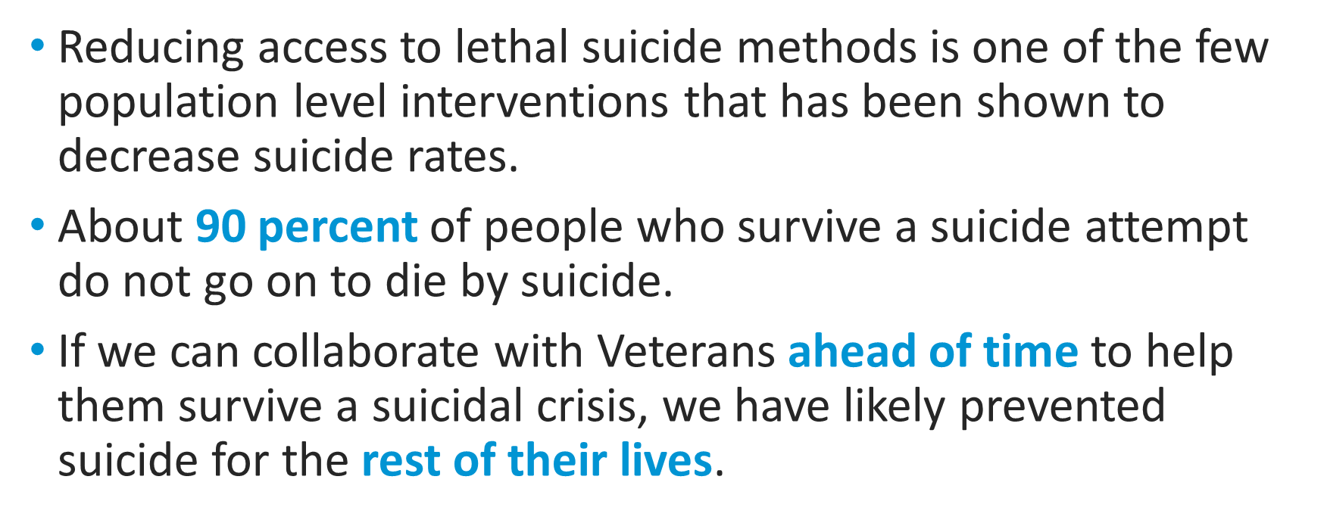
Lethal Means Safety Works
Notes:
In 1997, Australia instituted stricter gun safety measures, including minimum age restrictions, psychological evaluations, background checks, and waiting periods. The firearm suicide rate steadily declined by 4.7% each year, and researchers did not see a substitution effect.
The Israeli Defense Force saw a 40% reduction in the suicide rate among soldiers when it restricted soldiers’ access to firearms during weekend leave.
Firearm-related suicides in Indiana and Connecticut declined after those states enacted legislation allowing law enforcement officers to seize firearms from individuals they deem a risk to themselves or others.
Full citations:
- Kapusta, N. D., Etzersdorfer, E., Krall, C., & Sonneck, G. (2007). Firearm legislation reform in the European Union: Impact on firearm availability, firearm suicide and homicide rates in Austria. The British Journal of Psychiatry, 191(3), 253–57.
- Lubin, G., Werbeloff, N., Halperin, D., Shmushkevitch, M., Weiser, M., & Knobler, H. Y. (2010). Decrease in suicide rates after a change of policy reducing access to firearms in adolescents: A naturalistic epidemiological study. Suicide and Life-Threatening Behavior, 40(5), 421–24.
- Kivisto, A. J., & Phalen, P. L. (2018). Effects of Risk-Based Firearm Seizure Laws in Connecticut and Indiana on Suicide Rates, 1981–2015. Psychiatric Services, 69, 855–62.

Slide 23
Common Myths vs. Realities
Notes:
Even though suicide is a major public health concern, there are a lot of common myths and misinformation about suicide. Let’s talk about some of these. Having accurate information about suicide makes it easier to reach out to others and help them.

Slide 24

Common Myths vs. Realities
Myth
Reality
People who talk about suicide are just seeking attention.

Slide 25

Common Myths vs. Realities
Myth
Reality
No matter how casually or jokingly said, suicide threats should never be ignored and may indicate serious suicidal feelings. Someone who talks about suicide provides others with an opportunity to intervene before suicidal behaviors occur.

Slide 26
Common Myths vs. Realities
Myth
Reality
If I ask someone if they are thinking about killing themselves, it will give them the idea and encourage them to do it.
Notes:
Cassie

Slide 27
Common Myths vs. Realities
Myth
Reality
Talking about suicide not only reduces the stigma, but also can be a relief for someone who is experiencing suicidal thoughts as they will be relieved that someone cares to know, and listen.

Slide 28
Common Myths vs. Realities
Myth
Reality
The only one who can really help someone who is suicidal is a mental health counselor or therapist.

Slide 29
Common Myths vs. Realities
Myth
Reality
Special training is not required to safely raise the subject of suicide. Helping someone feel included and showing genuine, heartfelt support can also make a big difference during a challenging time.

Slide 30
Common Myths vs. Realities
Myth
Reality
Once someone becomes suicidal, they will always be.
Notes:
Cassie

Slide 31
Common Myths vs. Realities
Myth
Reality
Suicidal crises are typically short-term, time-limited instances that are based on the desire to control painful emotions.
With professional help, ongoing support and treatment, people who have had suicidal thoughts can live long, healthy lives.
Notes:
Beer goggle example

Slide 32
The Steps of VA S.A.V.E.

Slide 33
VA S.A.V.E.: Teaching Communities How to Help Veterans at Risk for Suicide
VA S.A.V.E. will help you act with care and compassion if you encounter a Veteran who is in suicidal crisis.
Signs of a suicidal crisis/at-risk person
Ask the question
Validate
Encourage treatment and Expedite getting help.
Notes:
Cassie

Slide 34

Signs of Suicidal Thinking
Learn to recognize these warning signs:
Hopelessness, feeling like there is no way out
Change in sleep
Feeling like there is no reason to live
Change in mood (Rage, anger, agitation)
Engaging in risky activities without thinking
Increasing alcohol or drug use
Withdrawing from family and friends
Notes:
Amanda
Substantial change from the norm

Slide 35
Signs of Suicidal Thinking
The presence of any of the following signs requires immediate attention:
Thinking about hurting or killing themselves
Looking for ways to die
Talking about death, dying, or suicide
Self-destructive or risk-taking behavior, especially when it involves alcohol, drugs, or weapons

Slide 36

Asking the Question
Know how to ask
the most important question of all…

Slide 37
Asking the Question
“Are you thinking about killing yourself?”

Slide 38
Asking the Question
Do’s | Don’ts
DO ask the question if you’ve identified warning signs or symptoms. | DON’T ask the question as though you are looking for a “no” answer. “You aren’t thinking of killing yourself, are you?”
DO ask the question in a natural way that flows with the conversation. | DON’T wait to ask the question when someone is halfway out the door.
Notes:
Use direct words and phrases, such as “killing yourself” and “suicide,” when asking about suicidal thoughts. Avoid using vague phrases such as “hurting yourself,” as these can have different meanings to different people. To emphasize this point, you can ask participants why it is so important to ask this question directly instead of indirectly. What may be the outcome of asking indirect questions? (Answer: indirect answers!)
Ask a direct question if warning signs (“invitations”) are evident. When “invitation statements” have been made, it can be helpful to use them as springboards to directly ask about a person’s risk for suicide. (E.g., “I want to better understand what you mean by ‘ending it all.’ Are you thinking about killing yourself?”)
Phrase questions in a way that indicates openness to listening and remain nonjudgmental no matter the answer. This is extremely important, as it will help the Veteran understand that people are willing to listen.
The question should not be an afterthought. It should be asked promptly once someone indicates that they may be at risk for suicide.
There may not be an optimal time to ask the question, and doing so may be discomforting. Acknowledge this and encourage participants to ask the question anyway.

Slide 39
Asking the Question: Check-In & Practice
What are your thoughts about “Asking the question”?
What initial concerns do you have?

Slide 40

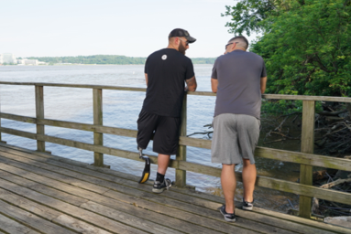
Validate the Veteran’s Experience
Talk openly about suicide. Be willing to listen and allow the Veteran to express his or her feelings.
Recognize that the situation is serious.
Do not pass judgment.
Reassure the Veteran that help is
available.

Slide 41
Validate the Veteran’s Experience: Check-In & Practice
Who can share a validating statement?
Turn to a partner and practice the following:
In response to an “invitation statement” such as, “Everything is so hard. I feel like a drag on my friends.”
Start by telling your partner, “Everything will be fine.” (Partner should respond.)
Shift instead to a statement that validates their feelings. (Partner should respond.)
What did you notice?
Notes:
Examples of validating statements include:
“Anyone in your situation would feel that way.”
“Of course you’re overwhelmed.”
“You have been struggling with a lot.”
“This would be too much for anyone to handle.”
Direct participants to turn to a partner and practice the following, in response to an “invitation statement” such as, “Everything is so hard. I feel like a drag on my friends”:
Start by telling your partner, “Everything will be fine.” (Partner should respond.)
Shift instead to a statement that validates their feelings. (Partner should respond.)
Pause to have participants reflect on the exercise. Ask: What did you notice?

Slide 42
When Talking with a Veteran at Risk for Suicide
Remain calm.
Listen more than you speak; Limit questions and let the Veteran do the talking.
Maintain eye contact.
Act with confidence.
Do not argue.
Use open body language.
Use empathy and compassion
Avoid problem solving
Be honest — let the Veteran know that there are no quick solutions, but help is available.
Notes:
Amanda
Open body language signals interest in the other person and in the conversation. Maintain a relaxed posture, lean in closer, use direct eye contact, and nod in agreement to show your Veteran that you’re present in the moment with them.

Slide 43

Encourage Treatment and Expedite Getting Help
What should I do if I think someone is suicidal?
Don’t keep the Veteran’s suicidal behavior a secret.
Do not leave him or her alone.
Try to get the person to seek immediate help from his or her doctor or the nearest hospital emergency room.
Call 911.
Reassure the Veteran that help is available.
Call the Veterans Crisis Line at 988 and Press 1.
Notes:
No keeping secrets- if someone says they will talk to you about an issue “only if you promise not to tell anyone,” it’s important to be up front in saying you cannot make that promise because you care about them and want them to get any help that they may need. You don’t want to keep a secret and regret it.

Slide 44
What to Do if a Veteran Expresses Suicidal Ideation During a Phone Call
Keep the caller on the line (do not hang up or transfer).
Remain calm.
Obtain identifying information on the caller (name, phone number, and current location).
Conference call to VCL (don’t hang up until VCL responder has the call).
Enlist co-workers for assistance via Instant Messaging in Teams.
If caller disconnects, call back immediately. If no answer, dial 911 and VCL (988 and Press 1.).
Tip: Practice conferencing in calls at your desk with coworkers.

Slide 45
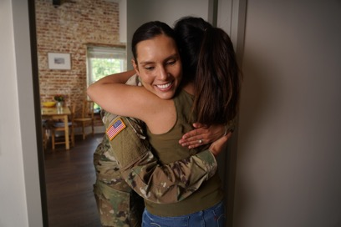
Practice Sessions
Goal: To develop a level of comfort and confidence in asking about suicide and helping a Veteran who is thinking about suicide.
Notes:
[Practice Sessions are a chance to practice VA S.A.V.E. skills. Encourage everyone to participate, but don’t worry if someone does not want to do it. It’s okay if they want to just watch. Flexibility is a strength here.
Depending on your group(s) and your time, you can have 1 or more role plays with a volunteer, or brainstorm role play responses with the whole group.
Use that attached role play materials to help your colleagues practice VA S.A.V.E. Keep slide 36 with the steps of VA S.A.V.E. visible for people to use.
Be positive and encouraging. Take a gentle, coaching approach. This is a sensitive issue, and a new skill for many people. If you mean well, and are doing your best, with VA S.A.V.E. skills, it will likely work out well.
Wrap up during last 5 min of the hour.

Slide 46
Practice Sessions
Imagine that you are talking to a friend, family member, or co-worker whom you know well. You also know this person has been having a lot of personal problems lately and seems to be withdrawing from activities, and overall seems “down” much of the time. They mention that everything feels “hopeless.”
Step 1: As you begin your conversation with them, listen for the problems that they believe suicide would solve and listen for a sign — an invitation statement. When you hear a warning sign, find a way to ask the question, e.g., “You seem very overwhelmed right now. Are you thinking about suicide?”
Step 2: As you listen, make sure to validate their experience or feelings. Continue to listen and try to expedite them to the appropriate level of care.
Switch roles.

Slide 47
Remember
VA S.A.V.E.
S
A
V
E
Signs of suicidal thinking should be recognized.
Ask the most important question of all.
Validate the Veteran’s experience.
Encourage treatment and Expedite getting help.

Slide 48
Call to Action: 7 Themes
Promote firearm secure storage for Veteran suicide prevention
Implement and sustain community collaborations focused upon community-specific Veteran suicide prevention plans
Continue expansion of readily accessible crisis intervention services
Improve tailoring of prevention and intervention services to the needs, issues, and resources unique to Veteran subpopulations
Advance suicide prevention meaningfully into non-clinical support and intervention services, including financial, occupational, legal, and social domans
Increase access to and utilization of mental health across a full continuum of care.
Integrate suicide prevention within medical settings to reach all Veterans.
Notes:
Promote secure firearm storage for Veteran suicide prevention. Firearm ownership and storage practices vary among Veterans.35 One in 3 Veteran firearm owners store at least 1 firearm unlocked and loaded. This unsafe storage practice is more frequent among Veteran firearm owners who seek VHA care (38.0%) than among other Veterans who own firearms (31.9%).36 As seen across years of Veteran suicide data, Veteran suicide deaths disproportionately involve firearms; Veteran suicide rates exceed those of non-Veterans; and differentials in suicide rates by Veteran status are greater for women than for men. Promoting secure storage of firearms has been found to reduce suicide — this is not about taking away firearms but about promoting time and space during a time of crisis.37
Implement and sustain community collaborations focused upon community-specific Veteran suicide prevention plans. Over 60% of Veterans who died by suicide in 2021 were not seen in VHA in 2020 or 2021, and over 50% had received neither VHA nor VBA services. In order to reach all Veterans, we must continue to expand our work in the community through the SP 2.0 Community Based Intervention (CBI) Program. This includes the joint VA and Substance Abuse and Mental Health Services Administration (SAMHSA) Governor’s Challenge to Prevent Suicide Among Service members, Veterans, and their Families, which encompasses all 50 states, 5 territories and work in over 1,700 local community coalitions. This also includes the SSG Fox SPGP awarding $52.5 million to 80 community-based organizations in 43 states, the District of Columbia and American Samoa in fiscal year (FY) 2023.
3. Continue expansion of readily accessible crisis intervention services. The Nation saw a reduction of access to mental health services initially during the COVID-19 pandemic.38,39 Veterans desired access that was not in-person and available whenever they needed it40 and VHA care rapidly expanded remote care services delivery.41 Continued expansion of access to 24/7/365 services through the VCL 988 expansion and through COMPACT Act implementation paved the way for more emergency services for Veterans in acute suicidal crisis to be provided at no cost, whether enrolled in VA or not.42
Improve tailoring of prevention and intervention services to the needs, issues, and resources unique to Veteran subpopulations. Creating culturally sensitive and responsive interventions to meet each population’s needs will be required to address what 2021 revealed to us, with growing rates in American Indian/ Alaska Native Veteran populations, younger Veterans, transitioning Service member populations, women Veterans and more, as seen in the data for 2021. A one-size-fits-all Veteran suicide prevention strategy will not be effective in meeting the needs of the diverse population of Veterans.
Advance suicide prevention meaningfully into non-clinical support and intervention services, including financial, occupational, legal, and social domains. Suicide risk factors include issues outside of mental health and require meaningful upstream interventions across the Nation, as denoted in the White House Strategy Reducing Military and Veteran Suicide (2021).43 Impacts related to homelessness and legal issues were seen for Veterans in 2021, as outlined above. A whole-of-Nation approach for upstream interventions in employment, housing, legal support, and financial strain is needed to address Veteran suicide prevention.
6. Increase access to and utilization of mental health services across a full continuum of care. The COVID-19 pandemic saw increased distress in the Veteran population44 with initial decreases in utilization of mental health services, while telemental health services expanded. During the pandemic, weekly patient encounters at VHA decreased by 3% for ongoing suicide attempt care, while new treatment initiation for suicide attempts decreased 30%.45 Making access as easy as possible to a continuum of evidence-based mental health treatments is an important part of the public health approach to suicide prevention.
Integrate suicide prevention within medical settings to reach all Veterans. Our data again showed that a significant percentage of VHA Veterans who died by suicide did not have a VHA mental health or substance use disorder diagnosis. We need to creatively address the needs of those at risk who may never seek mental health services and who may have other risk factors outside of mental health (e.g., pain, cancer, sleep disturbance) through expansion of suicide screening, assessment, and safety planning into all medical settings, within VHA and within community care.

Slide 49
Signs of Suicidal Thinking
What signs did you identify?

Slide 50
Asking the Question
What did you notice about your “ask”?

Slide 51
Validate the Veteran’s Experience
What did your partner do or say that was validating?

Slide 52
Encourage Treatment and Expedite Getting Help
What did you do to expedite getting help?
How comfortable would you be recommending resources?

Slide 53
Debrief
Thought, feelings, or questions about the exercise?
Notes:
The nice thing about VA S.A.V.E. training is that no one expects you or me to have all the answers. The Suicide Prevention Program is happy to follow up with you about any outstanding questions you may have.

Slide 54
Resources
Notes:
Customize the Resources section based on your audience

Slide 55
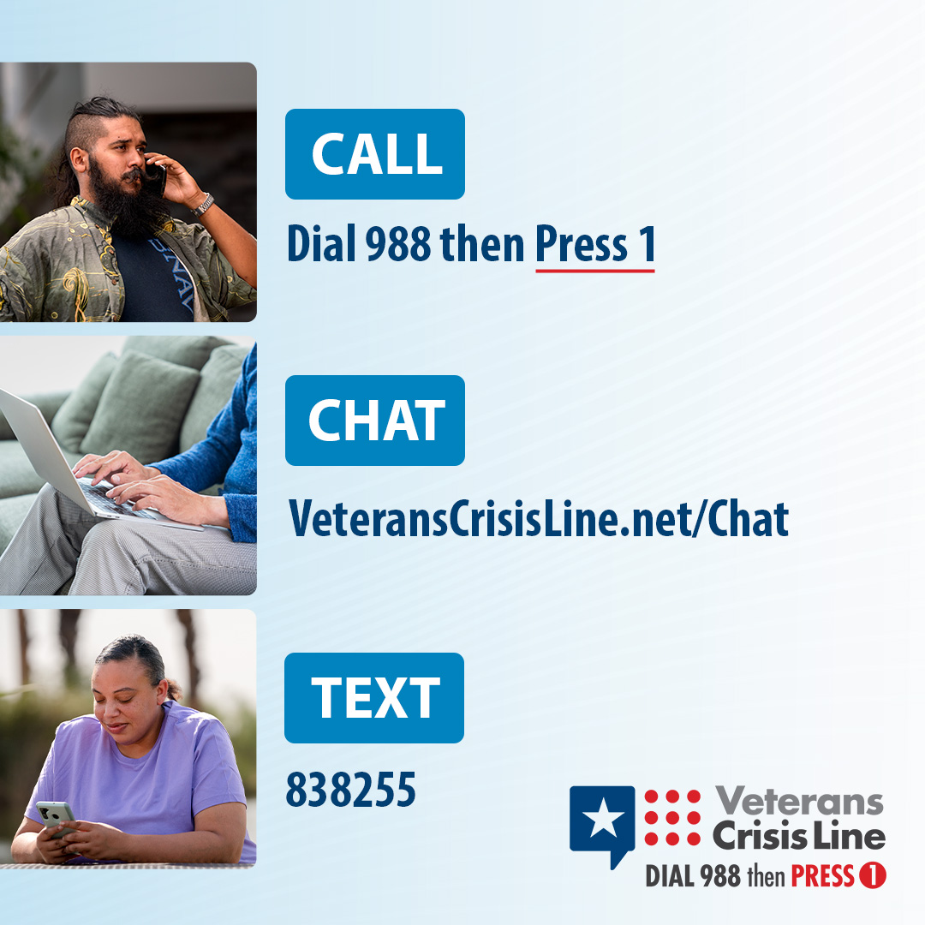
Free, Confidential Support 24/7/365
Veterans
Service members
Family members
Friends
Notes:
Veterans Crisis Line: The Veterans Crisis Line connects Veterans in crisis and their families and friends with qualified, caring VA responders through a confidential toll-free hotline, online chat, or text. Veterans and their loved ones can call 988 and Press 1, chat online, or send a text message to 838255 to receive confidential crisis intervention and support 24 hours a day, 7 days a week, 365 days a year. More information is available at https://www.veteranscrisisline.net/.

Slide 56
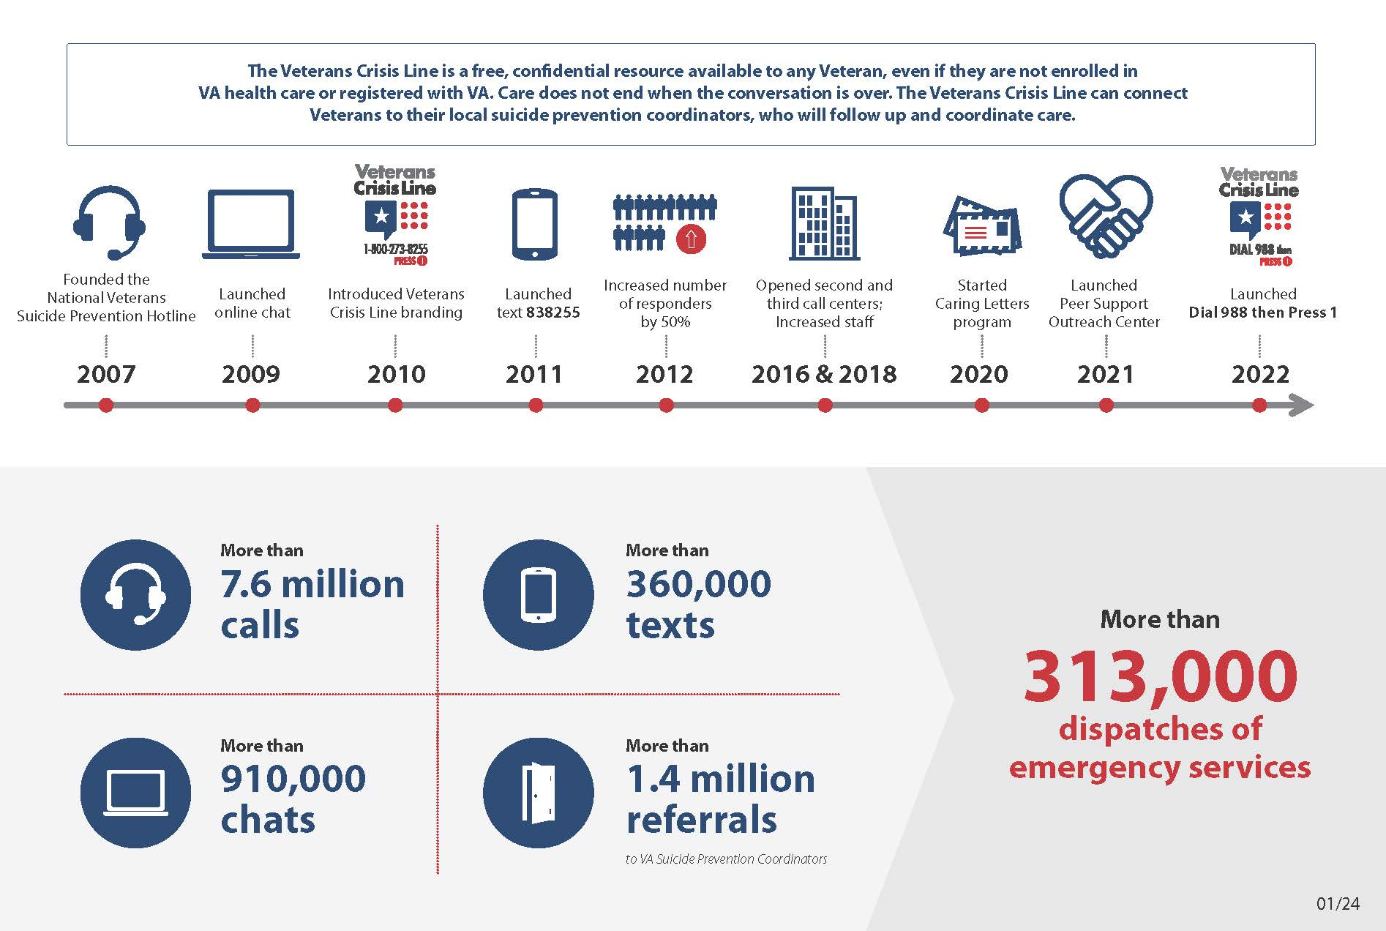
Graphic can be found at Spread the Word (veteranscrisisline.net)

Slide 57
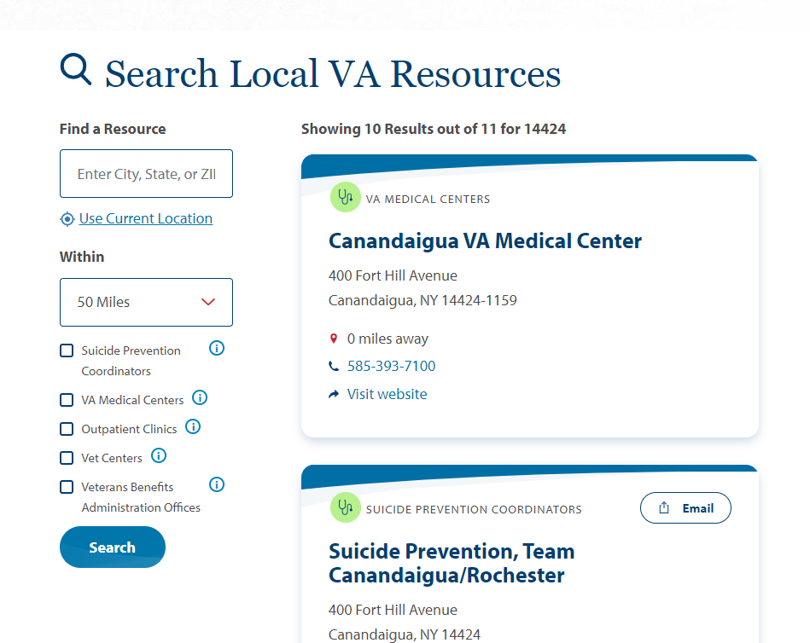
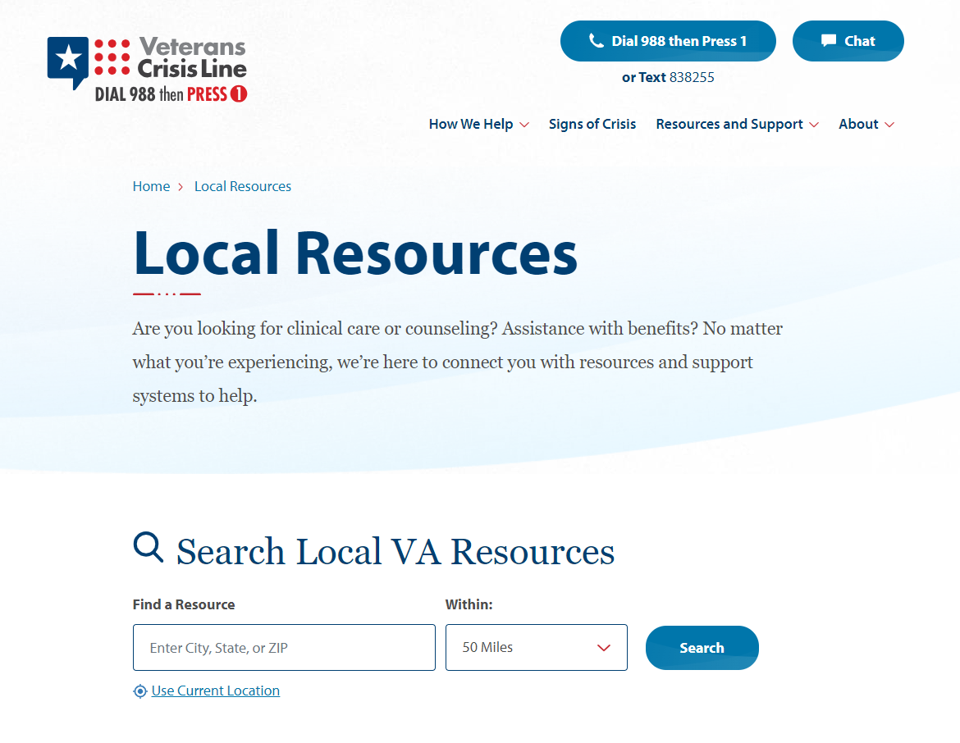
VeteransCrisisLine.net/ResourceLocator
Notes:
After using the Resource Locator to find your local SPC, you can call or email them for clinical support, VA SAVE training, or event support. This example displays results of a search for resources in Fargo, North Dakota, which connects visitors to SPC Tammy Monsebroten, pictured here.

Slide 58

VeteransCrisisLine.net/ResourceLocator
Notes:
After using the Resource Locator to find your local SPC, you can call or email them for clinical support, SAVE training, or event support. This example displays results of a search for resources in Fargo, North Dakota, which connects visitors to SPC Tammy Monsebroten, pictured here.

Slide 59
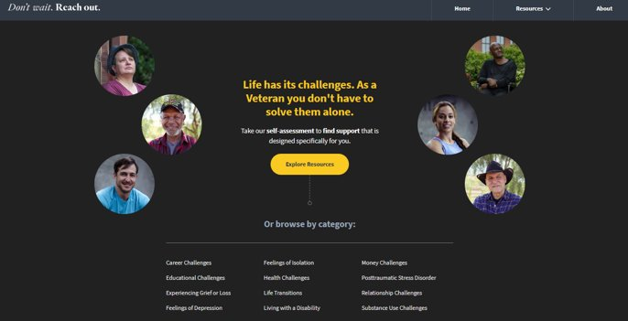
Don’t Wait. Reach Out.
Find the right Veteran Resources Quickly and Easily
Don't Wait. Reach Out. (va.gov)

Slide 60
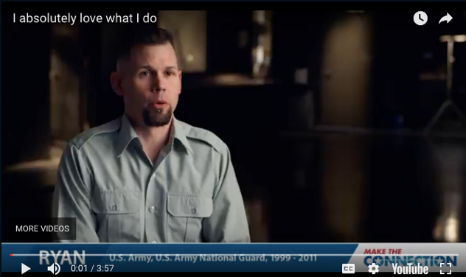
Make the Connection
Online resource featuring hundreds of Veterans telling their stories about overcoming mental health challenges.
https://maketheconnection.net/conditions/suicide
Notes:
Make the Connection: This online resource connects Veterans, their family members and friends, and other supporters with information and solutions to issues affecting their lives. More information is available at https://maketheconnection.net/.

Slide 61
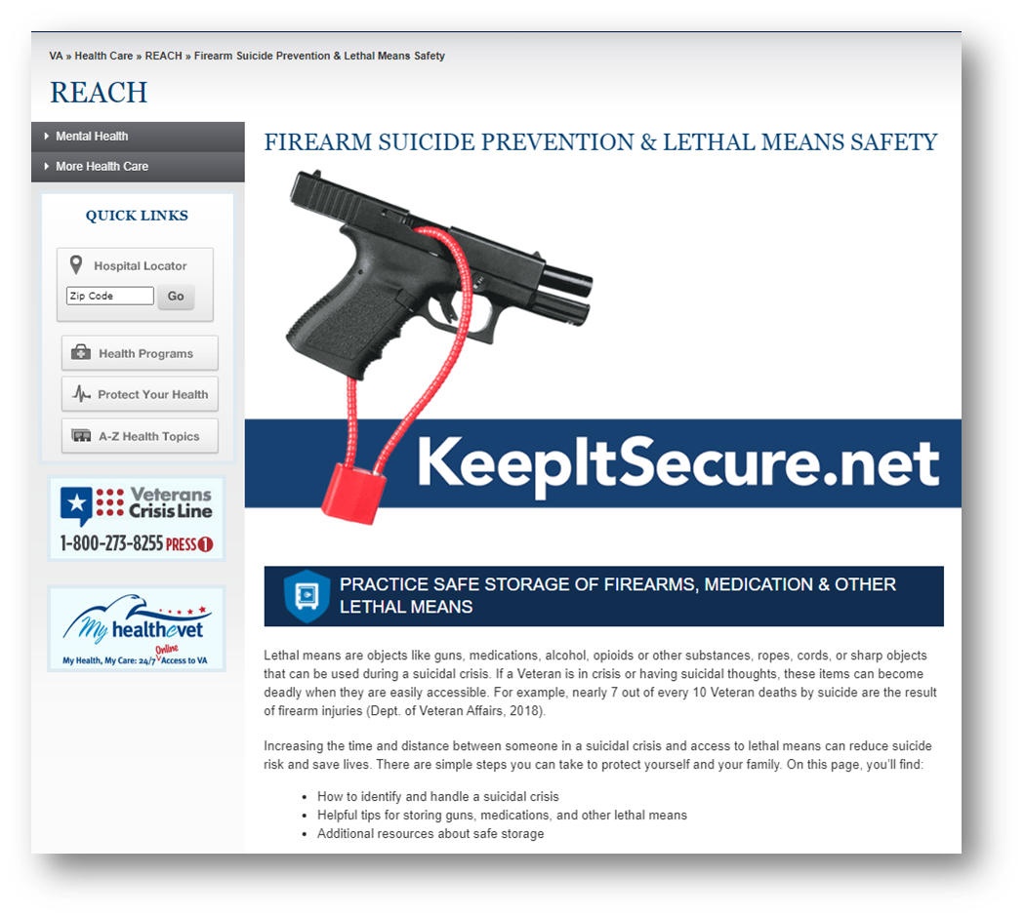
Practice safe storage of firearms, medications and other lethal means
Visit www.keepitsecure.net to learn more about the importance of firearm and other lethal means safety.
Nearly half of all Veterans own a firearm, and most Veteran firearm owners are dedicated to firearm safety.
Firearm injuries in the home can be prevented by making sure firearms are unloaded, locked, and secured when not in use, with ammunition stored in a separate location
There are several effective ways to safely secure firearms. Learn more and find the option that works best for you and your family from the National Shooting Sports Foundation at www.nssf.org/safety

Slide 62
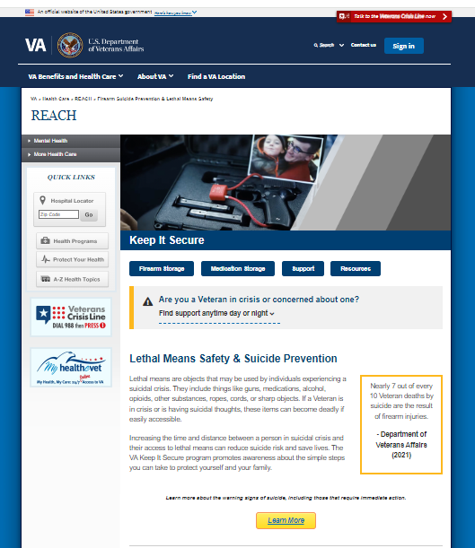
Practice secure storage of firearms, medications and other lethal means
Visit www.keepitsecure.net to learn more about the importance of firearm and other lethal means safety
Nearly half of all Veterans own a firearm, and most Veteran firearm owners are dedicated to firearm safety
Firearm injuries in the home can be prevented by making sure firearms are unloaded, locked, and secured when not in use, with ammunition stored in a separate location
There are several effective ways to safely secure firearms. Learn more and find the option that works best for you and your family from the National Shooting Sports Foundation at www.nssf.org/safety

Slide 63
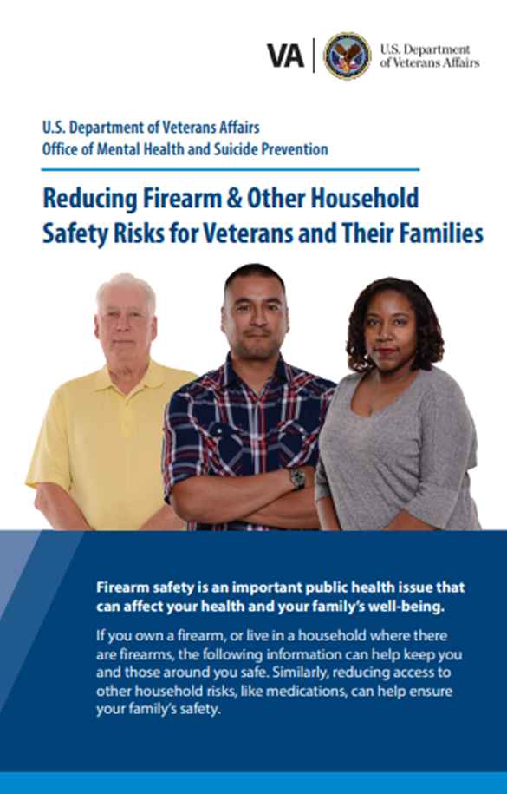
New Lethal Means Safety Resources
Reducing Firearm & Other Household Safety Risks Brochure provides best practices for securely storing firearms and medications along with advice for loved ones on how to talk to the Veteran in their life about safe storage.

Slide 64
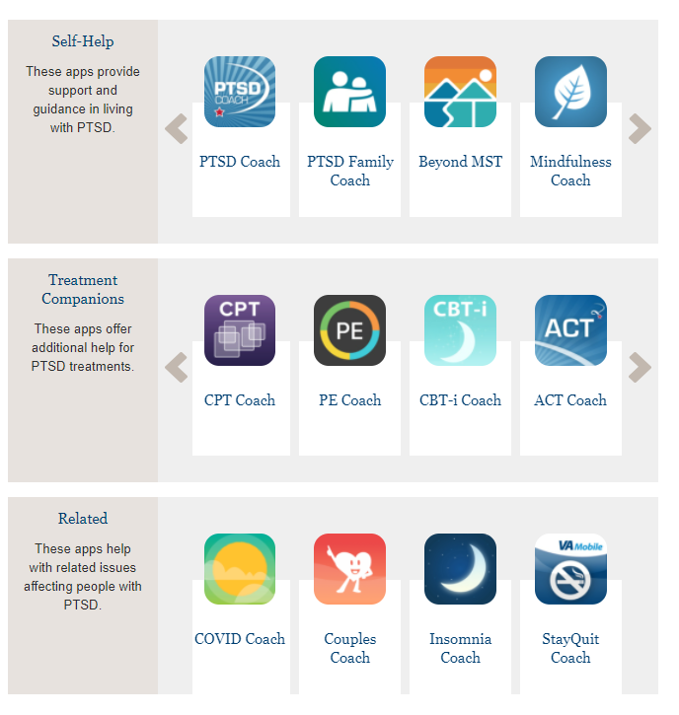
Mental Health Mobil Apps. Mobile Apps - PTSD: National Center for PTSD (va.gov)

Slide 65

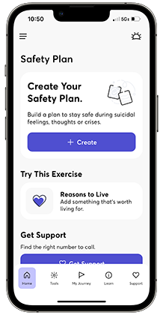
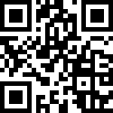
Check out the new Safety Plan app!
Safety Plan helps Veterans create a personalized step-by-step action plan to keep themselves safe during a crisis. It is highly customizable and provides access to coping tools, self-assessment measures, and crisis support resources like the Veterans Crisis Line. Download the app today by using the QR code, or by visiting the App Store or Google Play.
Note: Safety Plan is a U.S. Department of Veterans Affairs app, developed by the National Center for PTSD Dissemination and Training Division and the Office of Mental Health and Suicide Prevention.
Notes:
The Safety Plan app is for anyone who has experienced thoughts about suicide or self-harm. The app helps you make a safety plan, share your safety plan with loved ones, and use tools to manage distress.
With Safety Plan you can:
Create a custom step-by-step action plan to keep yourself safe during a crisis
Make a list of your own personal reasons to live (and add photo and video reminders)
Try different coping strategies and activities
Access crisis support resources, like the Veterans Crisis Line
Track your mood and other mental health symptoms
Set personal goals and track your progress
During a crisis, it can be hard to think clearly. If you ever experience thoughts about suicide or self-harm, having a Safety Plan can help keep you safe.

Slide 66
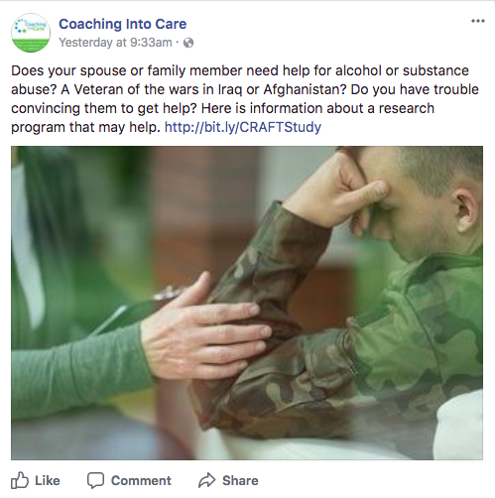
Coaching into Care
Program for families and loved ones of Veterans, helping them encourage the Veteran in their lives to seek support.
CALL 888-823-7458
Notes:
Coaching into Care (1-888-823-7458): A national telephone service of the VA, Coaching into Care aims to educate, support, and empower family members and friends who are seeking care or services for a Veteran. More information is available at https://www.mirecc.va.gov/coaching/.

Slide 67
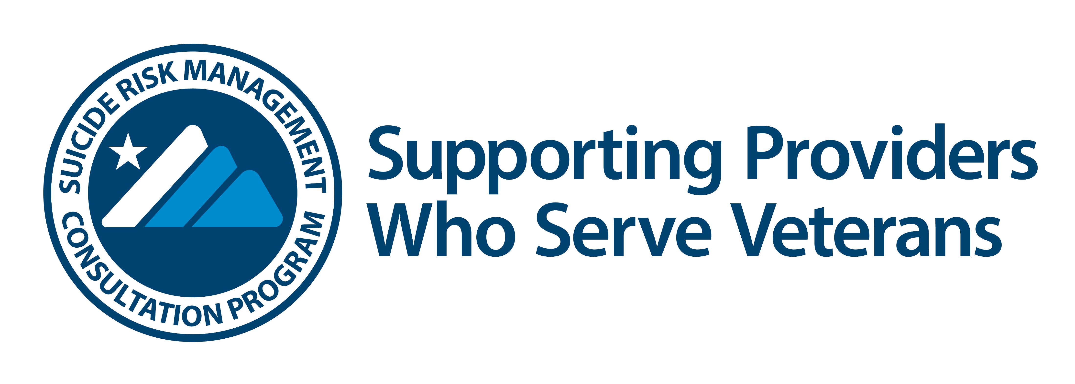






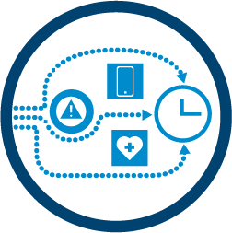
Provider support after a suicide
loss (Postvention)
Risk assessment
Free consultation and resources for any provider in the community or VA who serves Veterans at risk for suicide.
Request a consult: srmconsult@va.gov
Lethal means safety counseling
Conceptualization of suicide risk
Best practices for documentation
Strategies for how to engage
Veterans at high risk
www.mirecc.va.gov/visn19/consult

Slide 68
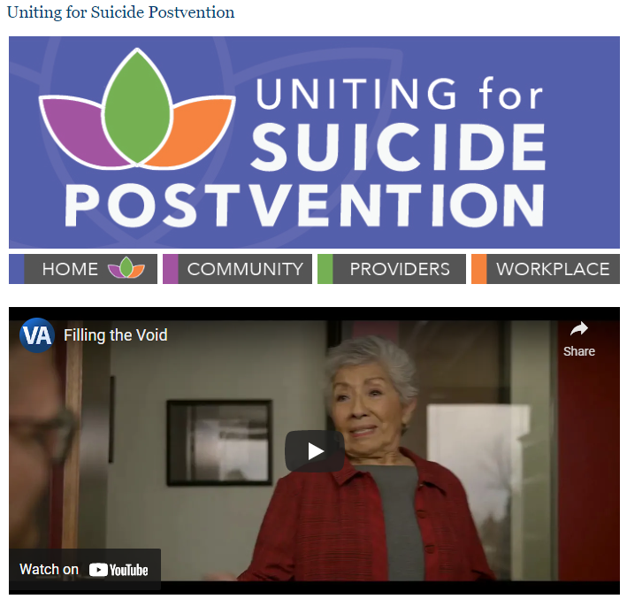
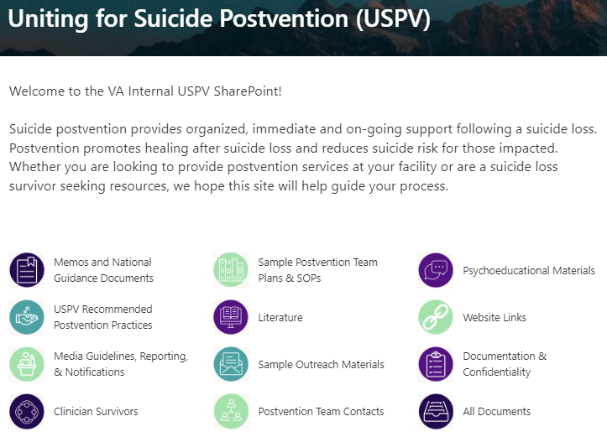
Uniting for Suicide Postvention
USPV offers resources and support to those impacted by suicide loss to promote healing and reduce suicide risk.
SRM also offers consultation to facilities / leaders (e.g., planning postvention responses, developing postvention teams) and providers (e.g., to process a patient suicide loss)
https://www.mirecc.va.gov/visn19/postvention/
Notes:
Uniting for Suicide Postvention Website - An externally facing website that offers resources, guidance and support to those affected by suicide loss. The website offers cinematic films and interviews with suicide loss survivors, podcasts featuring suicide prevention experts, and infographics about suicide loss and ways to help.
Uniting for Suicide Postvention SharePoint- An internal VA SharePoint that features national and VA guidelines that support key components of postvention work including safe messaging guidelines, tools to establish postvention teams, and recommendations for how to provide postvention services at the facility level.

Slide 69
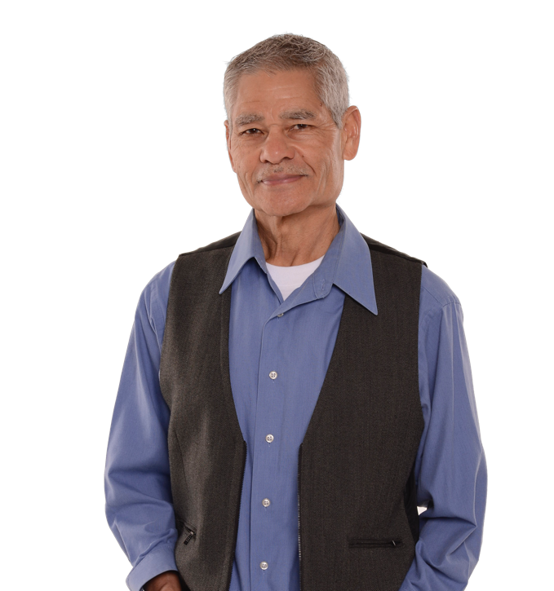
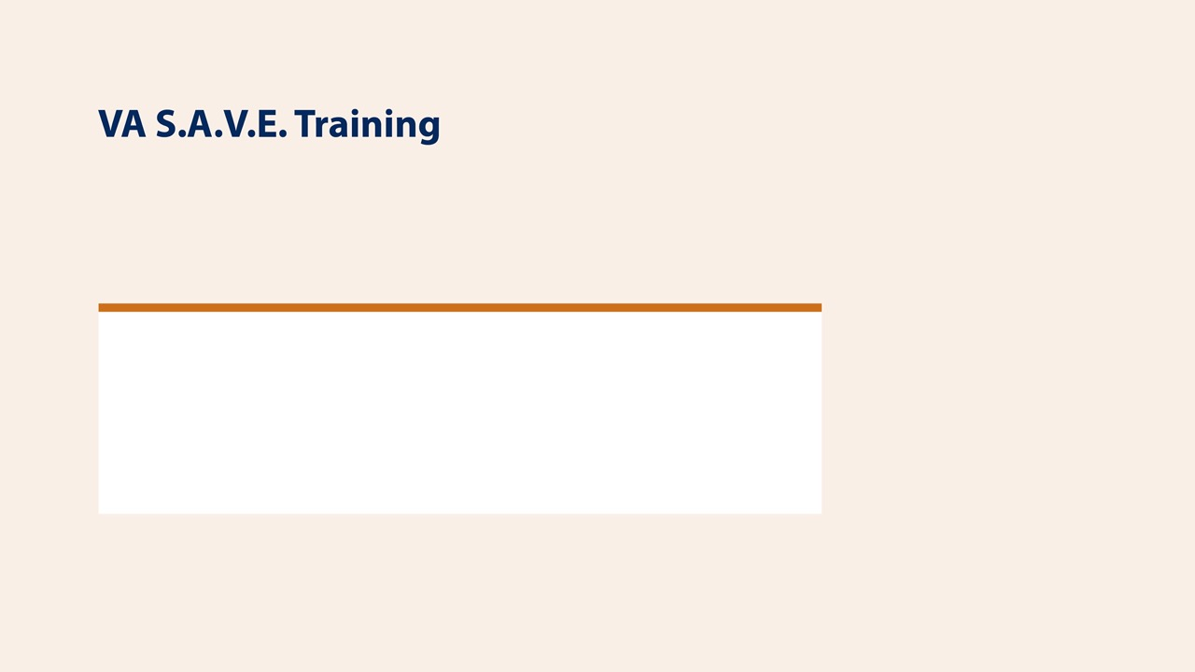

This free suicide prevention training video is less than 25 minutes long and available to everyone, 24/7. It's offered in collaboration with the PsychArmor Institute.
Available online for free: https://psycharmor.org/courses/s-a-v-e/

Slide 70
Uniting for Suicide Postvention
USPV offers resources and support to those impacted by suicide loss to promote healing and reduce suicide risk.
SRM also offers consultation to facilities / leaders (e.g., planning postvention responses, developing postvention teams) and providers (e.g., to process a patient suicide loss)
https://www.mirecc.va.gov/visn19/postvention/
Notes:
Uniting for Suicide Postvention Website - An externally facing website that offers resources, guidance and support to those affected by suicide loss. The website offers cinematic films and interviews with suicide loss survivors, podcasts featuring suicide prevention experts, and infographics about suicide loss and ways to help.
Uniting for Suicide Postvention SharePoint- An internal VA SharePoint that features national and VA guidelines that support key components of postvention work including safe messaging guidelines, tools to establish postvention teams, and recommendations for how to provide postvention services at the facility level.

Slide 71
Questions?

