Slide 1


Mental Health Support For The Veteran Community
Empowering Heroes & Their Families

Slide 2
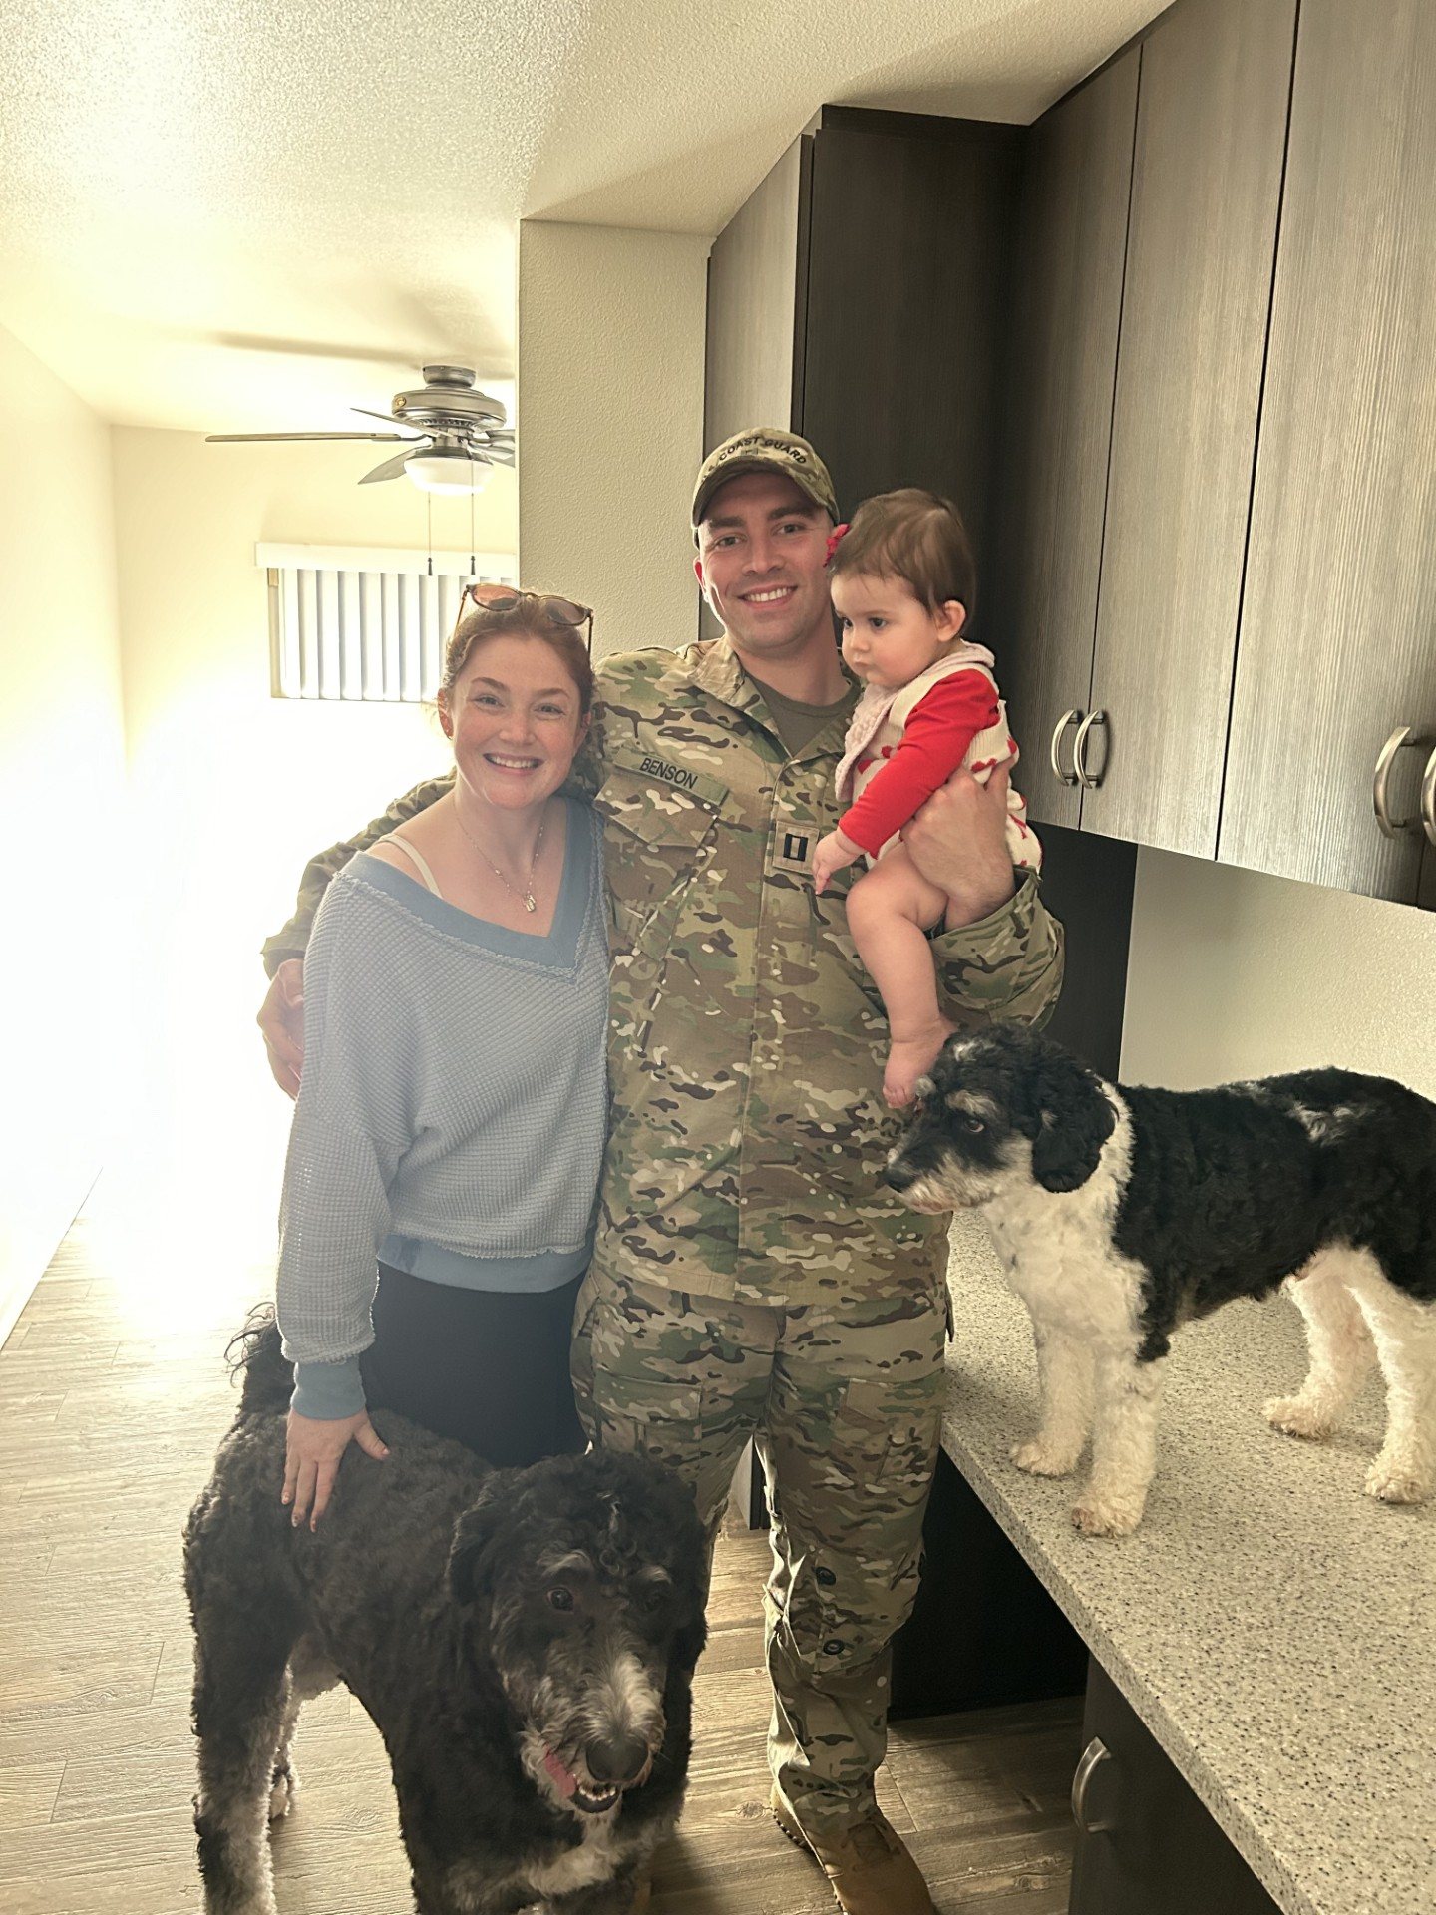
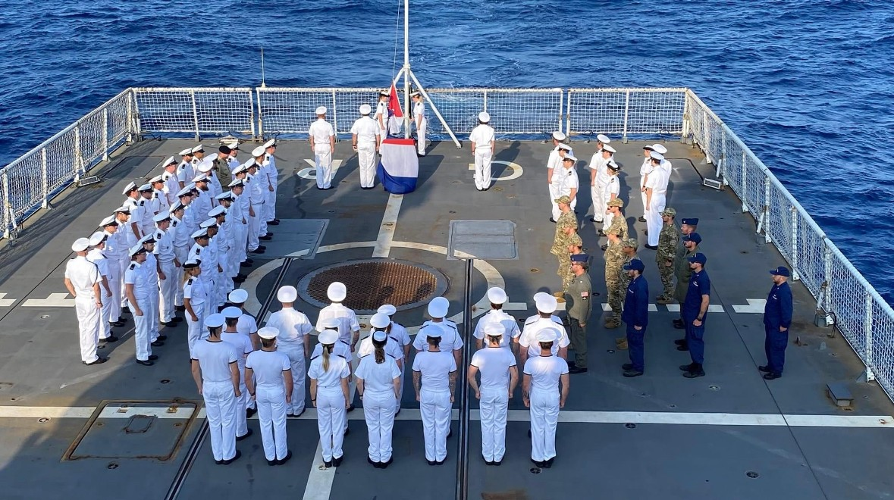

Taylor Benson
Southwest Region Military Community Manager
(CA & NV)
Spouse of an Active-Duty Coastie
Married for 3 years – San Diego is our 2nd Duty Station
1yo daughter and 2 dogs
Masters in Healthcare Administration
I have been working in healthcare for the last 8 years
Served patient populations from NICU babies to those in their final days

Slide 3

Trusted Partner For The VA
Access: We were the first VA partner to deliver virtual mental health services nationally.
Proven: Telemynd delivers more than 80K hours of therapy & psychiatric services to veterans every year.
Personalized: Our team comprises of former military members and beneficiaries who understand the unique challenges that they are faced with.
Providers: Fast and convenient access to care is supported through our national network of licensed clinicians who are passionate about filling the unmet need within the military.

Slide 4
Virtual Mental Health Efficacy for Veterans
Each unique virtual patient admission averages 14 more days of care than in-person services.
24% increase in completion rate for virtual services vs in-person.
20% decrease in no-shows and cancelations for virtual services vs in-person.
  Logistical reasons (e.g., increased flexibility in scheduling, reduced travel time) increase preference for online treatment.
Tele-therapy can be as effective if not more effective than in-person interventions in reducing symptoms of PTSD.
  Veterans may prefer online over in-person groups because visiting a VA medical center and/or a major metropolitan area and attending a group, in particular where one sits in a confined space with other veterans discussing military experiences, can trigger PTSD symptoms and/or anxiety.
If medication intervention is being utilized the higher enrollment and treatment adherence for telemental health delivery resulted in a greater likelihood of receiving an effective treatment dose than in-person services.
Strong group cohesion and veteran-to-veteran support were achievable via telehealth. Telemynd is creating Veteran Groups
  Virtual Behavioral Health Treatment Satisfaction and Outcomes Across Time
  Systematic review of lessons learned from delivering tele-therapy to veterans with post-traumatic stress disorder
  Online Telehealth Delivery of Group Mental Health Treatment Is Safe, Feasible, and Increases Enrollment and Attendance in Post-9/11 UˌSˌ Veterans
4

Slide 5


Quality Care: California By The Numbers
Avg. Wait Time for VAMC Provider:
40 days (in larger metro areas 70+)
Avg. Wait Time for In-Network Community Provider:
20 days for Urgent Need
40 days for Standard Care
Avg. Wait Time for Telemynd Provider:
4 days for Urgent Need
12 days for Standard Care
98%
98%
87%
Of first-time users return to continue treatment following their initial session
Of users say they would refer us to a friend or family member
Of clinicians YOY are still actively seeing clients today.

Slide 6
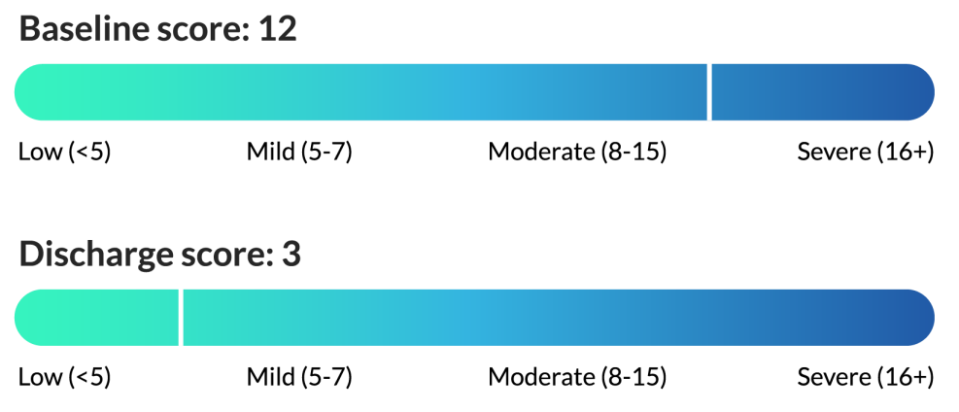
Intensive Support Program: Passive Suicidality
MyCare IntensiveSupport Program is a short-term enhanced intervention that provides targeted virtual behavioral health support for people experiencing passive suicidality, to help reduce and prevent emergency hospitalizations.
8-12 weeks of intensive mental health support
All delivered virtually through the Telemynd platform
Includes psychiatric care, psychotherapy, and care coordination
Provides a transition plan to ongoing care after the program ends
Performance Outcomes
Since launch, MyCare Intensive Support Program has shown marked improvementsin participants’ baseline to discharge scores.
4 Days
From Enrollment To Appointment
75%
Improvement In Beck Scores Over Treatment Duration

Slide 7


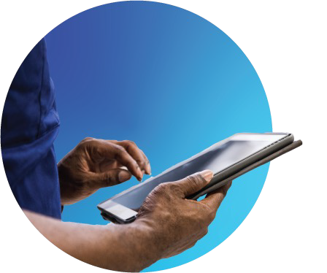
How The Process Works
Step 1: Initiate
Step 2: Match
A Telemynd care team members verifies benefits and the patient preferences, coordinating their appointment with a personalized mental health provider for effective support.
Step 3: Reporting
Veterans: clear and legible reports are securely shared with VAMC as required.
Veterans: Visit their VAMC who can refer them to Telemynd via the VA Community Care Network.

Slide 8





Me n t a l H e a l t h I s O u r Mi s s i o n
NPI: 1831672989
TAX ID: 82-4957103
Contact Info:
Taylor Benson: 336-309-0218
tbenson@telemynd.com

Slide 9
Clinical Operations Overview
Top 5 Assessments
PHQ-9
Commonly Requested Services
Constraints
BSS
Therapy for children ages 5+
School-based therapy
Treatment for PTSD/Military-specific therapy
Immediate notes shared to MTF/PCM for ADSM
Passive Suicidality
Couples Therapy/Marital Counseling
Anxiety & Stress Management
Deployment Readiness
High-acuity eating disorders
MAT/SUD addiction treatment
Active suicidality
No DEA controlled medications
GAD-7
PCL-5
PHQ-9A
Here’s What Is Coming
Standard therapy group sessions
Specialized care for eating disorders

