Slide 1
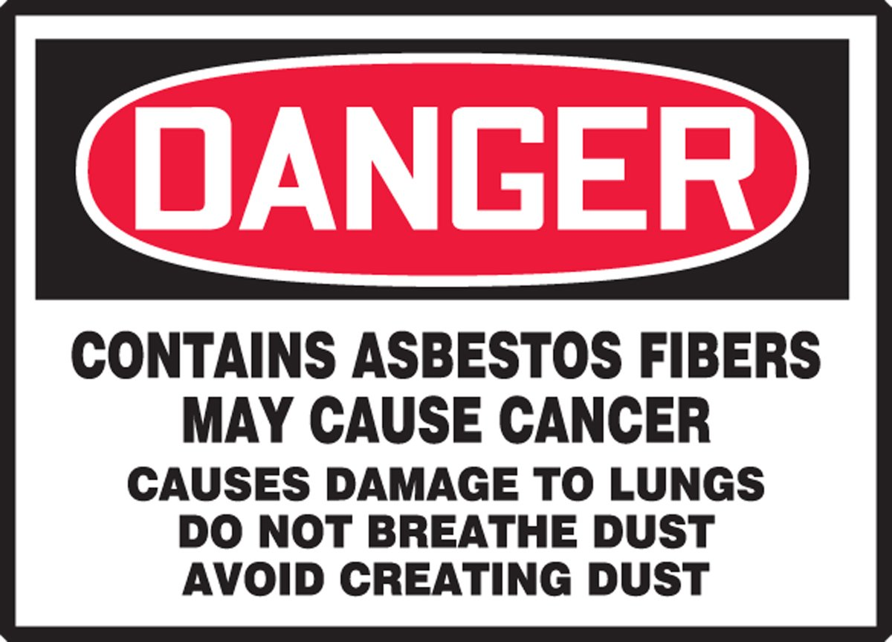
Serving veterans affected by asbestos-diseases and collaborating with VSOs to assist veterans in their communities
888-327-8271
Veterans Asbestos Claims Assistance
Asbestos.com brought to you by The Mesothelioma center

Slide 2

How we help veterans
Free help center
Support Literature
Medical diagnostic information
Mesothelioma Doctor Match Assistance
Connecting with financial help – grants, legal, VA, travel assistance
Understanding VA Claims Evidence Development
Nexus Statements
Exposure Summaries
Connecting with local VSOs

Slide 3
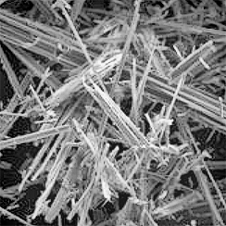

Asbestos Exposure
Fibrous Minerals - resistant to heat and corrosion
Safe in solid form - dangerous when they release fibers
Latency Period - The latent period for development of disease due to exposure to asbestos ranges from 10 to 45 or more years between first exposure and development of disease.
Used in construction materials, insulation, pipe lagging, brake pads, clutch faces, flex gaskets, fireproofing, fire resistant PPE

Slide 4
Elements of a successful VADC claim
Nothing is presumptive for asbestos claims – must prove medical connection and military exposure
PACT Act does not cover pre Persian Gulf War or 9/11 Asbestos Exposure
Must have a valid diagnosis
VA requires a nexus statement from a medical specialist stating that asbestos is the cause of the diagnosis
Must be able to prove exposure to asbestos during military service - a majority of lifetime exposure
https://www.va.gov/disability/eligibility/hazardous-materials-exposure/asbestos/

Slide 5
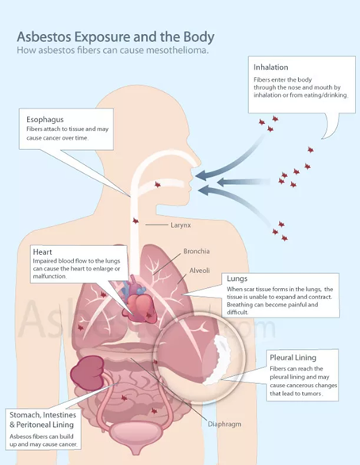
VA Asbestos Related Claims
Conditions the VA recognizes
· interstitial pulmonary fibrosis, or asbestosis
· pleural effusions and fibrosis
· pleural plaques
· mesotheliomas of pleura and peritoneum
· cancers of the
- lung
- bronchus
- gastrointestinal tract
- larynx
- pharynx, and
- urogenital system, except the prostate.
· All persons with significant asbestosis develop cor pulmonale, heart disease secondary to disease of the lung or its blood vessels, and those who do not die from cancer often die from heart failure secondary to cor pulmonale.
M21-1, Part VIII, Subpart iii, Chapter 7, Section A

Slide 6
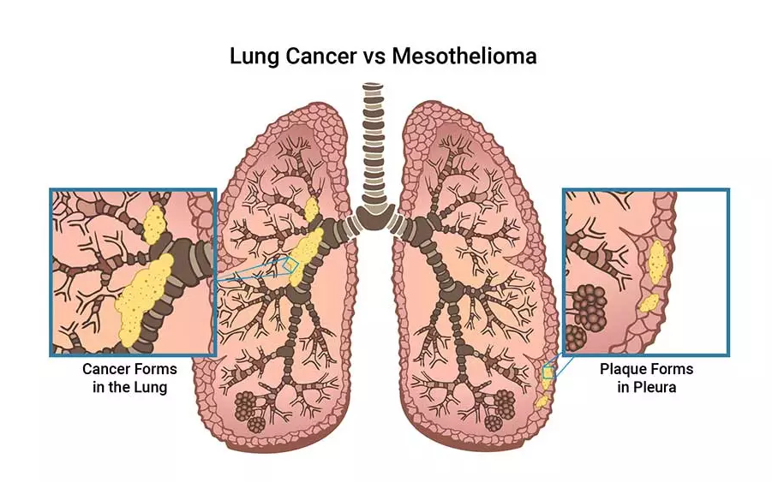
Mesothelioma Cancer
Is not lung cancer – affects the linings of organs
4 Types – Pleural (lungs) Peritoneal (abdomen)
Pericardial (heart), Testicular
Most commonly caused by asbestos exposure
Veterans make up 30% of 2,500 DX each year
Pathology states malignant mesothelial cells = mesothelioma
Aggressive – patients who are treated by specialty center have more options
https://wwwˌasbestosˌcom/mesothelioma/

Slide 7
Diagnostic Testing
Asbestos lung disease testing must have two components
Chest imaging - CT scan is gold standard for dx
Pulmonary Function Test (PFT) - Spirometry
Pulmonary Lung Specialists are best trained to DX RLD/ILD
Can differentiate between COPD and Restrictive Lung Disease/ Interstitial LD
Asbestos related cancer requires tissue biopsy and pathology report
Nexus statements for cancers other than mesothelioma must be written by an oncologist

Slide 8
Nexus Statements
Must include the connection between the current diagnosis and asbestos
The opinion should be expressed as follows:
1. “is due to” (100% sure)
2. “more likely than not” (greater than 50%)
3. “at least as likely as not” (equal to or greater than 50%)
Must also include a medical rationale for making the conclusion
Evidence based - refer to scans, pathology report, underlying asbestos lung disease, consistent with latency period of exposure during service

Slide 9

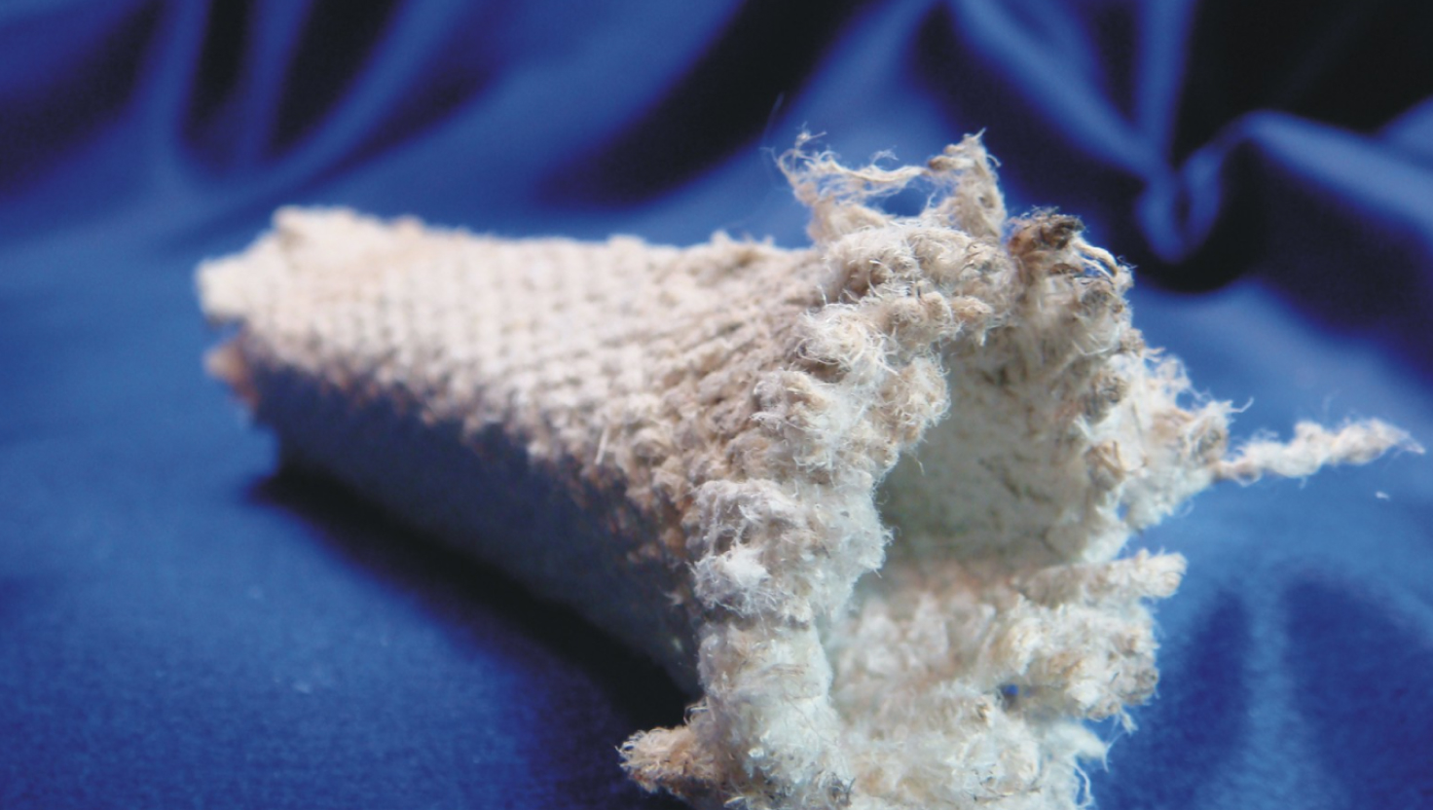
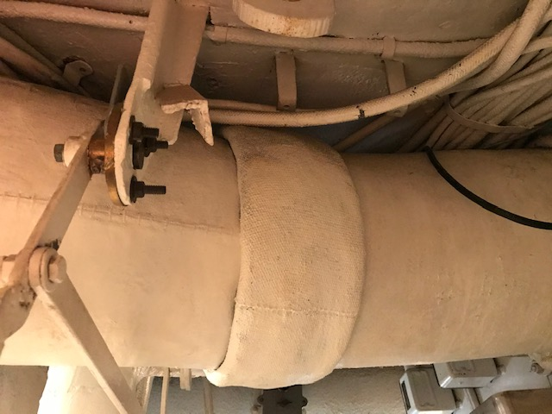

Asbestos Exposure Summaries
Do not assume that the VA knows how a veteran was exposed to asbestos based on MOS
Provide detailed summaries of the 5 W’s and How the veteran was exposed - duty locations, ships, specific equipment
Buddy Statements and Pictures if possible

Slide 10
Asbestos Exposure Summaries
Questions to ask veterans to develop asbestos claim
Do you think you had more exposure during your service?
Where, when how were you exposed to asbestos?
If Navy or Coast Guard – Rating – is Highly Probable?
Shipyard or Drydock maintenance periods?
What type of equipment did you work with?
Vehicle and/or equipment maintenance/ PMCS and or services?
Brakes, insulation,construction,demolition,BDA in combat?
Did you work outside of your MOS or work details doing maintenance etc?
What type of work did you do before and after military service?
Did you receive any training or PPE for handling asbestos in service and/or civilian career?

Slide 11
Asbestos Exposure Summaries
Calculating asbestos exposure if there is civilian exposure
VA looks at number of years of asbestos exposed work
Not all exposure is equal – must illustrate that to the VA
1 year on a Navy ship is 365/24/7 Exposure = 8,760 hours of exposure
1 year in a factory (50 weeks/ 40 hr/wk) = 2,000 hours of exposure
OSHA Asbestos regulations – 1971, 1976, 1983, 1986 – each lowered the PEL – Permissible Exposure Limit
https://wwwˌoshaˌgov/laws-regs/federalregister/1994-08-10
Many civilian employers implemented asbestos safety procedures to avoid exposure liability – most began in late 1970’s early 1980’s
Helps to demonstrated less civilian exposure after safety regulations

Slide 12
How to contact our team
Come see us at our table
Aaron Munz: aaron@asbestos.com
Phone: 888-327-8271

