Slide 1


Dealing With Proposals to Reduce a Rating or Sever Benefits
Spring 2023 Professional Training Conference
Winter 2023 Professional Training Conference
Winter 2023 Professional Training Conference
2024 Winter Professional Training Conference
Presenters:
Katrina J. Eagle, Esq.
Jim Radogna, VA Accredited Agent

Slide 2
Proposals to Reduce Ratings
When do VA proposals to reduce a rating most commonly occur?
After a routine future examination
After a C&P exam ordered for an increased rating claim
After a C&P exam ordered for a TDIU claim

Slide 3
Reexaminations per M21
Do not establish a future examination control in cases when
The disability is static, without material improvement over five years
The disability is permanent in character and of such nature that there is no likelihood of improvement
The Veteran is over 55 years of age (except under unusual circumstances or where required by regulation)
The evaluation is the prescribed schedular minimum within its DC
The evaluation is 10 percent or less, or
The combined evaluation would not change even if the reexamination resulted in a reduced evaluation for one or more disabilities.
M21 IV.ii.1.A.1.d (updated September 15, 2021)

Slide 4
But…What’s New?
Comp Service Policy Letter 21-01 Updated Guidance on Routine Future Examination Requests (October 7, 2021)
Effective immediately, routine future examinations shall only be requested when:
Mandated by a provision found in 38 CFR Part 4 (e.g., 38 CFR § 4.28, 4.128, 4.129, and in evaluation criteria found in diagnostics codes like 7528 Malignant neoplasms of the genitourinary system), or
Necessary to reduce an evaluation in accordance with 38 CFR § 3.344
Link to Policy Letter: https://driveˌgoogleˌcom/file/d/1Akv0rd8dRkj6BqGQIOUrnUUwyLPPagvL/view?usp=sharing
Notes:
Discussion points: how many of you have worked on claims or appeals involving hearing loss or tinnitus? How many of your clients are service-connected for hearing loss, rated 0%? These are very common claims – and can be very difficult to prove. VA’s regulations also make it so that your hearing has to be really quite bad before you get a compensable rating.

Slide 5
How is VA Doing?
A report released by the VA in July 2018, titled “Unwarranted Medical Reexaminations for Disability Benefits,” said of approximately 53,700 veterans’ cases subjected to reexaminations in a six-month review, 19,800 (37%) were unwarranted
So, not surprisingly, VA tends to ignore it’s own guidelines…

Slide 6
Does VA follow the Rules?
What is supposed to happen before VA reduces a rating?

Slide 7
Stabilized Ratings – 5 Year Rule
38 C.F.R. § 3.344(a). For ratings in effect for 5 years or more, the RO must review “the entire record of examinations and the medical-industrial history … to ascertain whether the recent examination is full and complete … Examinations less full and complete than those on which payments were authorized or continued will not be used as a basis of reduction.”
If one C&P exam is taken out in isolation from the rest of the record, and that one exam says that the disability has improved while the rest of the records do not show that, the VA cannot base their proposal of a VA rating reduction on that one exam.

Slide 8
Stabilized Ratings – 5 Year Rule
38 C.F.R. § 3.344(a): Stabilization of disability evaluations, cont’d:
If the disability is subject to temporary and episodic improvement, e.g., manic depressive or other psychotic reaction, . . . etc., it will not be reduced on any one examination, except in those circumstances in which all the evidence of record “clearly warrants the conclusion that sustained improvement has been demonstrated.”
Notes:
Discussion points: how many of you have worked on claims or appeals involving hearing loss or tinnitus? How many of your clients are service-connected for hearing loss, rated 0%? These are very common claims – and can be very difficult to prove. VA’s regulations also make it so that your hearing has to be really quite bad before you get a compensable rating.

Slide 9
Stabilized Ratings – 5 Year Rule
38 C.F.R. § 3.344(a): Stabilization of disability evals, cont’d:
Ratings on account of diseases which become comparatively symptom-free after prolonged rest, e.g., residuals of phlebitis, arteriosclerotic heart disease, etc., will not be reduced on examinations reflecting the results of bed rest
Notes:
Discussion points: how many of you have worked on claims or appeals involving hearing loss or tinnitus? How many of your clients are service-connected for hearing loss, rated 0%? These are very common claims – and can be very difficult to prove. VA’s regulations also make it so that your hearing has to be really quite bad before you get a compensable rating.

Slide 10
Stabilized Ratings – 5 Year Rule
38 C.F.R. § 3.344(a): Stabilization of disability evaluations, cont’d:
Rating boards encountering a change of diagnosis must exercise caution in the determination as to whether a change in diagnosis represents no more than a progression of an earlier diagnosis, an error in prior diagnosis or possibly a disease entity independent of the service-connected disability.
Notes:
Discussion points: how many of you have worked on claims or appeals involving hearing loss or tinnitus? How many of your clients are service-connected for hearing loss, rated 0%? These are very common claims – and can be very difficult to prove. VA’s regulations also make it so that your hearing has to be really quite bad before you get a compensable rating.

Slide 11
Stabilized Ratings – 5 Year Rule
38 C.F.R. § 3.344(a): Stabilization of disability evaluations, cont’d:
Even though material improvement in the physical or mental condition is clearly demonstrated, the VA “will consider whether the evidence makes it reasonably certain that the improvement will be maintained under the ordinary conditions of life.”
Notes:
Discussion points: how many of you have worked on claims or appeals involving hearing loss or tinnitus? How many of your clients are service-connected for hearing loss, rated 0%? These are very common claims – and can be very difficult to prove. VA’s regulations also make it so that your hearing has to be really quite bad before you get a compensable rating.

Slide 12
Stabilized Ratings – 5 Year Rule
38 C.F.R. § 3.344(b): Doubtful cases:
If doubt remains, after according due consideration to all the evidence developed, the rating agency will continue the rating in effect.
The rating agency will determine on the basis of the facts in each case whether 18, 24, or 30 months will be allowed to elapse before re-examination will be made.
Notes:
Discussion points: how many of you have worked on claims or appeals involving hearing loss or tinnitus? How many of your clients are service-connected for hearing loss, rated 0%? These are very common claims – and can be very difficult to prove. VA’s regulations also make it so that your hearing has to be really quite bad before you get a compensable rating.

Slide 13
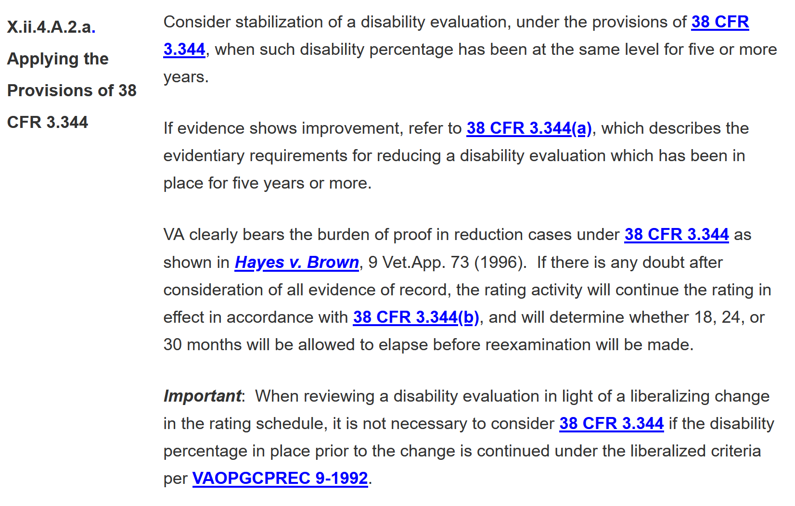
Stabilized Ratings – M21
Notes:
Discussion points: how many of you have worked on claims or appeals involving hearing loss or tinnitus? How many of your clients are service-connected for hearing loss, rated 0%? These are very common claims – and can be very difficult to prove. VA’s regulations also make it so that your hearing has to be really quite bad before you get a compensable rating.

Slide 14
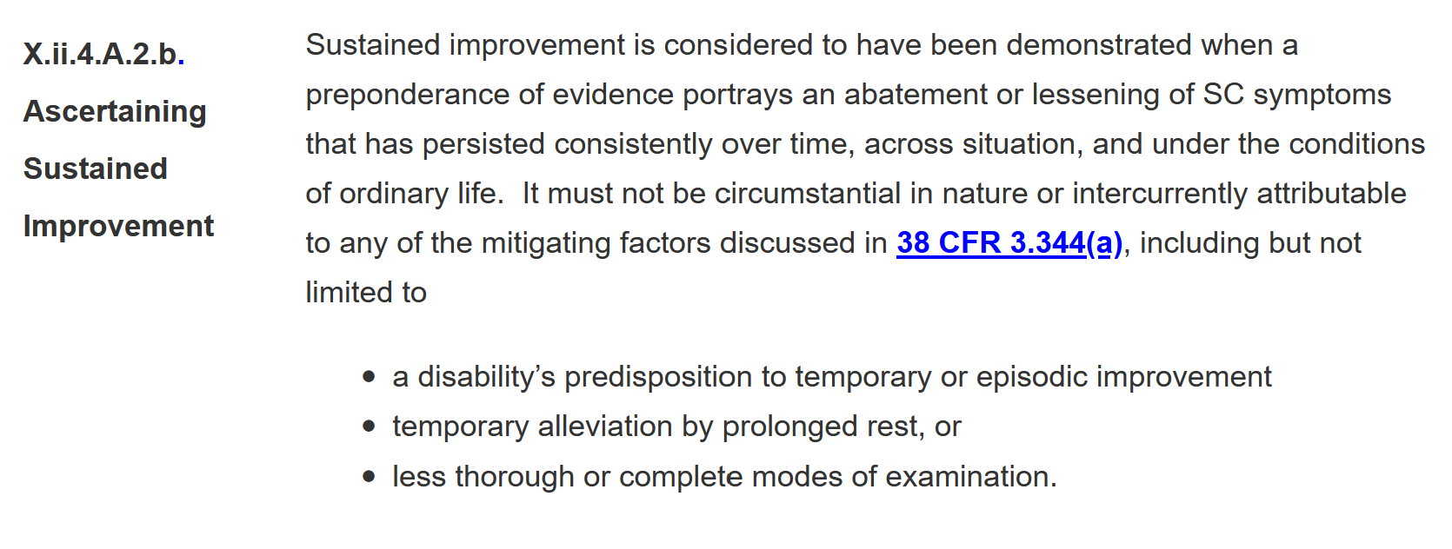
Stabilized Ratings – M21
Notes:
Discussion points: how many of you have worked on claims or appeals involving hearing loss or tinnitus? How many of your clients are service-connected for hearing loss, rated 0%? These are very common claims – and can be very difficult to prove. VA’s regulations also make it so that your hearing has to be really quite bad before you get a compensable rating.

Slide 15
Preservation of Service Connection – 10 Year Rule
38 C.F.R. § 3.957: Service Connection:
“Service connection for any disability or death granted…which has been in effect for 10 or more years will not be severed except upon a showing that the original grant was based on fraud or it is clearly shown from military records that the person concerned did not have the requisite service or character of discharge.”
Notes:
Discussion points: how many of you have worked on claims or appeals involving hearing loss or tinnitus? How many of your clients are service-connected for hearing loss, rated 0%? These are very common claims – and can be very difficult to prove. VA’s regulations also make it so that your hearing has to be really quite bad before you get a compensable rating.

Slide 16
Preservation of Service Connection – 10 Year Rule
38 C.F.R. § 3.957: Service Connection, cont’d:
“The 10-year period will be computed from the effective date of VA’s finding of service connection to the effective date of the rating decision severing service connection. The protection afforded in this section extends to claims for DIC.”
Notes:
Discussion points: how many of you have worked on claims or appeals involving hearing loss or tinnitus? How many of your clients are service-connected for hearing loss, rated 0%? These are very common claims – and can be very difficult to prove. VA’s regulations also make it so that your hearing has to be really quite bad before you get a compensable rating.

Slide 17
Preservation of Disability Rating – 20 Year Rule
38 C.F.R. § 3.951(b): Preservation of disability ratings:
“A disability which has been continuously rated at or above any evaluation of disability for 20 or more years for compensation purposes . . .will not be reduced to less than such evaluation except upon a showing that such rating was based on fraud.”
If the rating fluctuated for twenty years, it can’t be reduced below whatever the lowest rating was during those twenty years
Notes:
Discussion points: how many of you have worked on claims or appeals involving hearing loss or tinnitus? How many of your clients are service-connected for hearing loss, rated 0%? These are very common claims – and can be very difficult to prove. VA’s regulations also make it so that your hearing has to be really quite bad before you get a compensable rating.

Slide 18
Protection of 100% Ratings
38 C.F.R. § 3.343(a): Continuance of total disability ratings:
“Total disability ratings, when warranted by the severity of the condition…and not granted because of IU will not be reduced, in the absence of clear error, without examination showing material improvement in physical or mental condition. Exam reports showing material improvement must be evaluated in conjunction with all of the facts of record, and consideration must be given particularly to whether the veteran attained improvement under the ordinary conditions of life”
Notes:
Discussion points: how many of you have worked on claims or appeals involving hearing loss or tinnitus? How many of your clients are service-connected for hearing loss, rated 0%? These are very common claims – and can be very difficult to prove. VA’s regulations also make it so that your hearing has to be really quite bad before you get a compensable rating.

Slide 19
Protection of 100% Ratings
"Material improvement" is more than a temporary remission of a chronic condition
To find that there has been a "material improvement," the VA must:
  Compare the exam that led to the 100% rating to the pre-reduction exam
  Consider the entire medical history of the particular disease or injury
  Look to see whether there has been a change to the veteran's ability to "function under the conditions of daily life."
If all of these criteria are not met, there has not been a material improvement
Notes:
Discussion points: how many of you have worked on claims or appeals involving hearing loss or tinnitus? How many of your clients are service-connected for hearing loss, rated 0%? These are very common claims – and can be very difficult to prove. VA’s regulations also make it so that your hearing has to be really quite bad before you get a compensable rating.

Slide 20
Protection of 100% Ratings
38 C.F.R. § 3.343(c): Individual Unemployability
If VA determines that a reduction in a 100% rating is warranted, but the record reflects that the veteran is unable to engage in substantially gainful employment by virtue of his or her service-connected disability, the veteran must be awarded a total rating based on TDIU
Moreover, once a veteran is in receipt of benefits at the total rating level based on TDIU, the VA may not reduce the benefits unless “clear and convincing evidence” establishes that the veteran is capable of “actual employability”
Notes:
Discussion points: how many of you have worked on claims or appeals involving hearing loss or tinnitus? How many of your clients are service-connected for hearing loss, rated 0%? These are very common claims – and can be very difficult to prove. VA’s regulations also make it so that your hearing has to be really quite bad before you get a compensable rating.

Slide 21
Protection of 100% Ratings
A private medical opinion stating that the claimant has not medically improved since the 100 percent evaluation was assigned or continued can be crucial in these cases.
Notes:
Discussion points: how many of you have worked on claims or appeals involving hearing loss or tinnitus? How many of your clients are service-connected for hearing loss, rated 0%? These are very common claims – and can be very difficult to prove. VA’s regulations also make it so that your hearing has to be really quite bad before you get a compensable rating.

Slide 22
Protection From Reductions Based on Revisions to the Rating Schedule
The Secretary shall from time to time readjust this schedule of ratings in accordance with experience. However, in no event shall such a readjustment in the rating schedule cause a veteran’s disability rating in effect on the effective date of the readjustment to be reduced unless an improvement in the veteran’s disability is shown to have occurred. 38 U.S. Code § 1155
Notes:
Discussion points: how many of you have worked on claims or appeals involving hearing loss or tinnitus? How many of your clients are service-connected for hearing loss, rated 0%? These are very common claims – and can be very difficult to prove. VA’s regulations also make it so that your hearing has to be really quite bad before you get a compensable rating.

Slide 23

QUESTIONS?

Slide 24
What About Unprotected Ratings?
Generally speaking, VA can’t (or shouldn’t) reduce an unprotected rating (i.e., less than 5 years) unless:
There has been an actual improvement in the disability
This improvement creates an increased ability to function in life and at work
The reexamination report is thorough, and
The entire medical history of the disability has been reviewed
Notes:
Discussion points: how many of you have worked on claims or appeals involving hearing loss or tinnitus? How many of your clients are service-connected for hearing loss, rated 0%? These are very common claims – and can be very difficult to prove. VA’s regulations also make it so that your hearing has to be really quite bad before you get a compensable rating.

Slide 25
What About Unprotected Ratings?
The M21 Manual provides requirements that the VA raters must follow when adjudicating rating reductions:
In all rating reduction cases, to include those involving an evaluation that has not been in effect for five years or otherwise stabilized, a reduction in the evaluation may only be effectuated if the improvement
is shown by a thorough examination adequate for rating purposes, as required in 38 CFR 4.2 and 38 CFR 4.10, and
reflects an improvement in ability to function under the ordinary conditions of life, including employment.
M21-1 III.iv.8.D.1.b.
Notes:
Discussion points: how many of you have worked on claims or appeals involving hearing loss or tinnitus? How many of your clients are service-connected for hearing loss, rated 0%? These are very common claims – and can be very difficult to prove. VA’s regulations also make it so that your hearing has to be really quite bad before you get a compensable rating.

Slide 26
Analyzing Rating Reduction Proposals
When analyzing any proposal to reduce, REMEMBER…
Any proposed reduction must be based upon review of the entire history of the veteran’s disability
The VA must determine whether there has been an actual change in the disability
Any improvement must reflect an improvement in the veteran’s ability to function under the ordinary conditions of life and work
Examination reports reflecting any such change must be based on thorough examinations
Notes:
Discussion points: how many of you have worked on claims or appeals involving hearing loss or tinnitus? How many of your clients are service-connected for hearing loss, rated 0%? These are very common claims – and can be very difficult to prove. VA’s regulations also make it so that your hearing has to be really quite bad before you get a compensable rating.

Slide 27
Analyzing Rating Reduction Proposals
A reduction in a veteran’s disability evaluation is NOT permitted merely because a later adjudicator has a different opinion on how the evidence or the rating schedule should be interpreted.
VA bears the burden of proof in establishing, by a preponderance of the evidence, that a reduction is warranted under the relevant regulations.
Notes:
Discussion points: how many of you have worked on claims or appeals involving hearing loss or tinnitus? How many of your clients are service-connected for hearing loss, rated 0%? These are very common claims – and can be very difficult to prove. VA’s regulations also make it so that your hearing has to be really quite bad before you get a compensable rating.

Slide 28
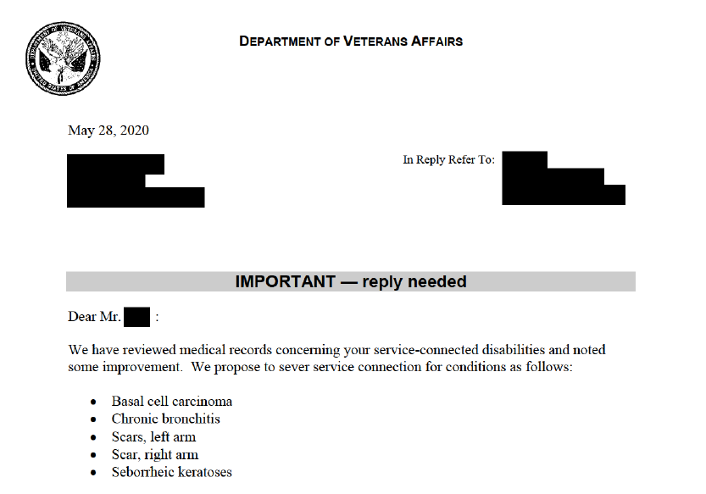
Severing Service Connection
Notes:
Discussion points: how many of you have worked on claims or appeals involving hearing loss or tinnitus? How many of your clients are service-connected for hearing loss, rated 0%? These are very common claims – and can be very difficult to prove. VA’s regulations also make it so that your hearing has to be really quite bad before you get a compensable rating.

Slide 29
Severing Service Connection
VA can only properly sever service connection for a veteran’s disability if there is finding of fraud, if a clear and unmistakable error was made in the decision that granted service connection or the VA discovers that the veteran did not have the required length or character of service
In cases where the veteran has been service connected for the condition for ten years or more, VA can no longer sever SC on the basis of CUE
The process for severing service connection is identical to that for reduction of benefits, and the due process protections are the same
Notes:
Discussion points: how many of you have worked on claims or appeals involving hearing loss or tinnitus? How many of your clients are service-connected for hearing loss, rated 0%? These are very common claims – and can be very difficult to prove. VA’s regulations also make it so that your hearing has to be really quite bad before you get a compensable rating.

Slide 30
Severing Service Connection
Per 38 C.F.R. § 3.105(d):
VA has established that “service connection will be severed only where evidence establishes that it is clearly and unmistakably erroneous (the burden of proof being upon the Govt). A change in diagnosis may be accepted as a basis for severance action if…
Notes:
Discussion points: how many of you have worked on claims or appeals involving hearing loss or tinnitus? How many of your clients are service-connected for hearing loss, rated 0%? These are very common claims – and can be very difficult to prove. VA’s regulations also make it so that your hearing has to be really quite bad before you get a compensable rating.

Slide 31
Severing Service Connection
Per 38 C.F.R. § 3.105(d):
…the examining physician(s) certify that, in light of all accumulated evidence, the diagnosis on which service connection was predicated was clearly erroneous.
This certification must be accompanied by a summary of the facts, findings, and reasons supporting the conclusion.”
Notes:
Discussion points: how many of you have worked on claims or appeals involving hearing loss or tinnitus? How many of your clients are service-connected for hearing loss, rated 0%? These are very common claims – and can be very difficult to prove. VA’s regulations also make it so that your hearing has to be really quite bad before you get a compensable rating.

Slide 32
Severing Service Connection
In order to sever SC, VA must show more than that there is just a difference of opinion
For instance, if one C&P examiner diagnoses a veteran with depression, and he is granted service connection based on that opinion, the fact that a later C&P examiner instead diagnoses the veteran with a personality disorder is not enough in and of itself to sever service connection
The VA is required to look at the evidence as a whole to determine whether the original grant of service connection was clearly erroneous
An inadequate medical opinion should not suffice to establish that a prior diagnosis is clearly and unmistakably erroneous
Notes:
Discussion points: how many of you have worked on claims or appeals involving hearing loss or tinnitus? How many of your clients are service-connected for hearing loss, rated 0%? These are very common claims – and can be very difficult to prove. VA’s regulations also make it so that your hearing has to be really quite bad before you get a compensable rating.

Slide 33
Proposal to Sever Due to Fraud
38 U.S.C.S. § 6103 provides that a person who knowingly makes a false or fraudulent statement concerning any claim for VA benefits forfeits his or her rights to VA benefits
The decision as to whether the evidence warrants formal consideration of forfeiture due to fraud is made by the VARO Regional Counsel
If the affected claimant receives an adverse decision from the VARO, he or she may appeal this decision to the BVA, and if the Board denies the claim, an appeal may be taken to the CAVC
Notes:
Discussion points: how many of you have worked on claims or appeals involving hearing loss or tinnitus? How many of your clients are service-connected for hearing loss, rated 0%? These are very common claims – and can be very difficult to prove. VA’s regulations also make it so that your hearing has to be really quite bad before you get a compensable rating.

Slide 34
Appealing Reductions / Severances
A claimant facing a reduction or severance must be given prior notice of the proposed adverse action and given 60 days after the notice within which to submit evidence for the purpose of showing that the adverse action should not be taken
The claimant has a right to a predetermination hearing but it must be requested within 30 days from the date of the notice of the proposed adverse action
If a hearing is requested, VA cannot reduce/sever until after the hearing is conducted
DO NOT file an appeal in response to a proposal to reduce or sever; simply respond to the VA notice letter
Notes:
Discussion points: how many of you have worked on claims or appeals involving hearing loss or tinnitus? How many of your clients are service-connected for hearing loss, rated 0%? These are very common claims – and can be very difficult to prove. VA’s regulations also make it so that your hearing has to be really quite bad before you get a compensable rating.

Slide 35
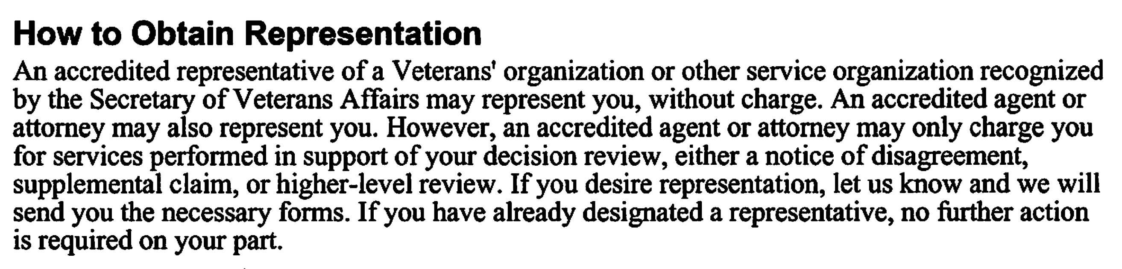
Appealing Reductions / Severances
Notes:
Discussion points: how many of you have worked on claims or appeals involving hearing loss or tinnitus? How many of your clients are service-connected for hearing loss, rated 0%? These are very common claims – and can be very difficult to prove. VA’s regulations also make it so that your hearing has to be really quite bad before you get a compensable rating.

Slide 36
Appealing Reductions / Severances
If the claimant does not submit evidence within the 60-day period (and a hearing isn’t requested), a final rating decision will be prepared. The veteran is notified of the final rating decision and the award of benefits will be reduced. A new 60-day period begins from the date of the final decision. The reduction goes into effect on the last day of the month on which the new 60-day period expires.
Keep in mind that if you choose a hearing, it will give you additional time to rebut VA’s proposal to reduce or sever. However, if you are not successful in reversing VA’s proposed action, it is likely that VA will assess an overpayment for the period in excess of the due process period.
Notes:
Discussion points: how many of you have worked on claims or appeals involving hearing loss or tinnitus? How many of your clients are service-connected for hearing loss, rated 0%? These are very common claims – and can be very difficult to prove. VA’s regulations also make it so that your hearing has to be really quite bad before you get a compensable rating.

Slide 37
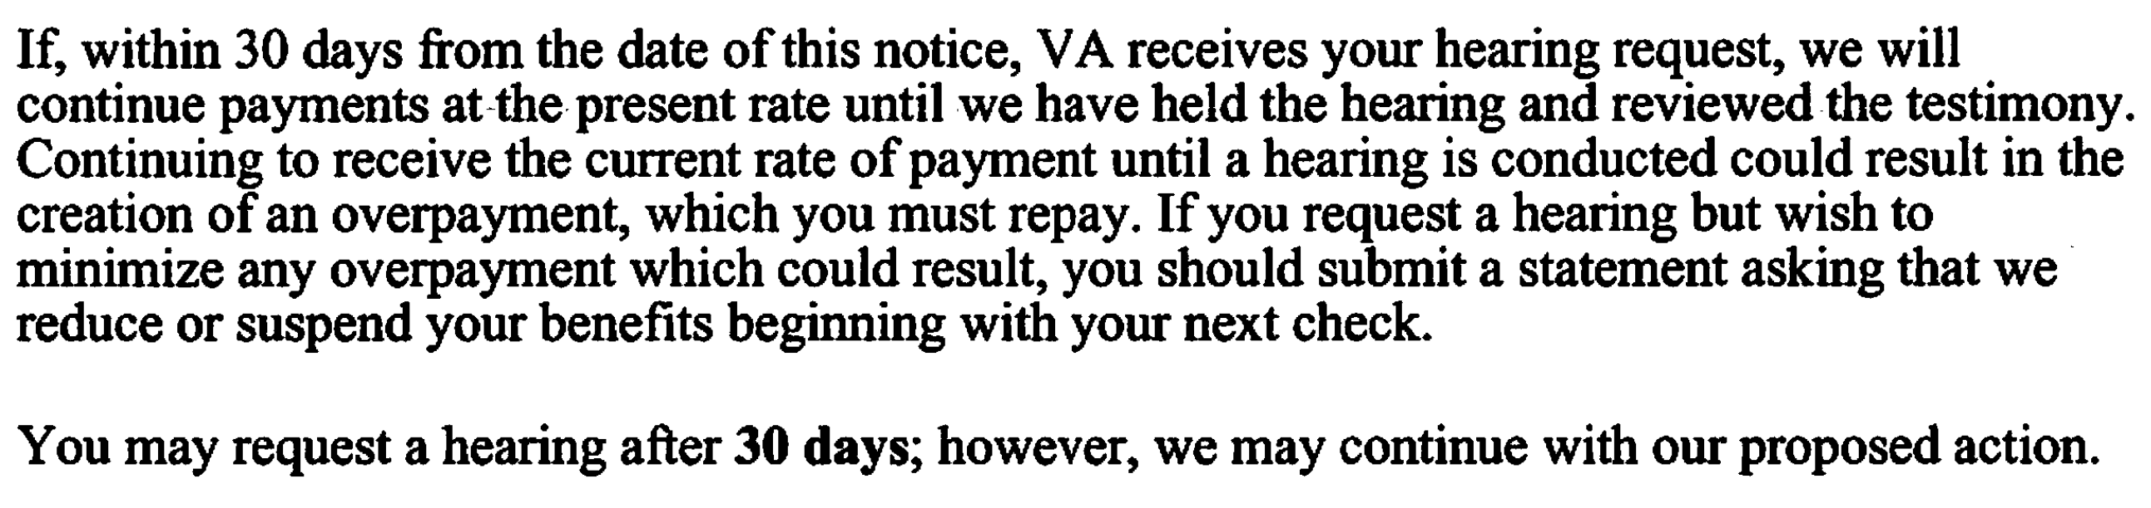
Appealing Reductions / Severances
Notes:
Discussion points: how many of you have worked on claims or appeals involving hearing loss or tinnitus? How many of your clients are service-connected for hearing loss, rated 0%? These are very common claims – and can be very difficult to prove. VA’s regulations also make it so that your hearing has to be really quite bad before you get a compensable rating.

Slide 38
Appealing Rating Reductions & Severances
Improper rating reductions or severances, in which the decision is now final, may be appealed just like any adverse VA decision
Submit lay evidence from those who witness the effect that the disability has on the Veteran’s daily life
Lay statements can be completed by the veteran themselves, a spouse, family members, co-workers, etc.
Consider a private medical opinion that shows that the veteran’s condition has not improved (reduction) or is c0nnected to service (severance)
Hold VA accountable to their own regulations and M21 guidance. They often ignore it!
Notes:
Discussion points: how many of you have worked on claims or appeals involving hearing loss or tinnitus? How many of your clients are service-connected for hearing loss, rated 0%? These are very common claims – and can be very difficult to prove. VA’s regulations also make it so that your hearing has to be really quite bad before you get a compensable rating.

Slide 39
QUESTIONS?

Slide 40
More Questions?
Feel free to contact us about questions from this training or ANYTIME you have a question about a claim:
CACVSO@eagleveteranslaw.com

