Slide 1


Options For Responding To An Adverse VA Decision
Spring 2023 Professional Training Conference
Winter 2023 Professional Training Conference
Winter 2023 Professional Training Conference
2024 Winter Professional Training Conference
Presenters:
Katrina J. Eagle, Esq.
Jim Radogna, VA Accredited Agent

Slide 2
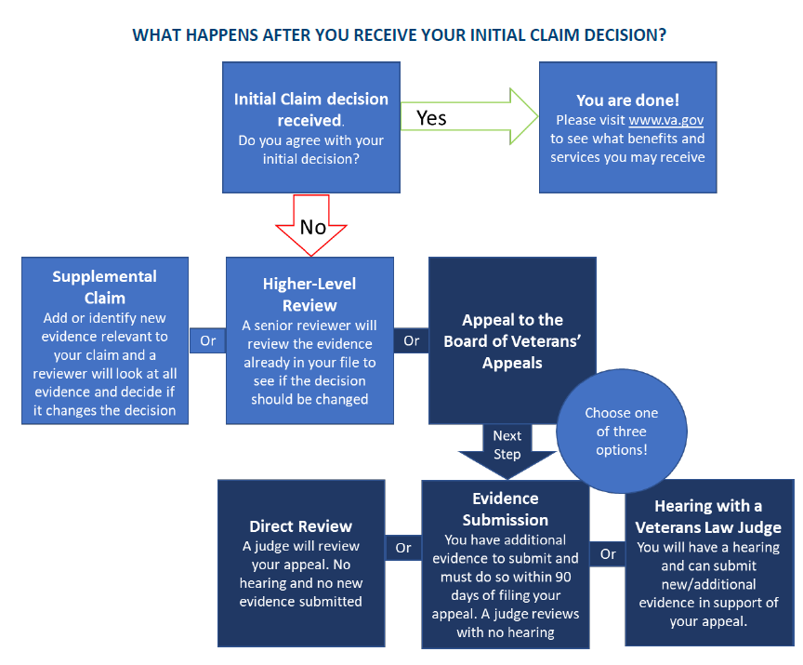
Your Claim is Denied, What Then?

Slide 3
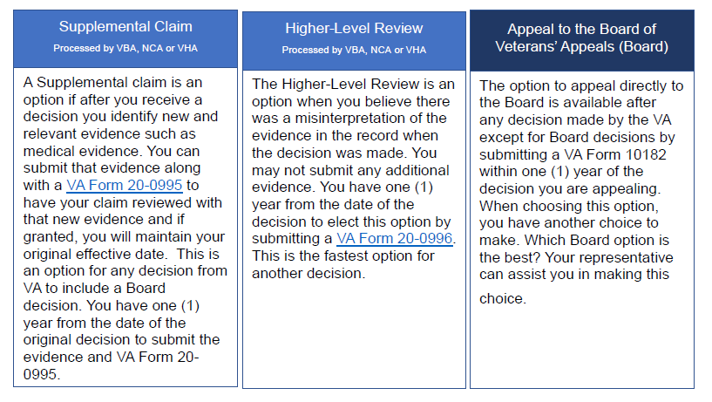
Your Claim is Denied, What Then?

Slide 4
What To Look For in VA Decision Notices
Each Notice provided by VA under 38 U.S.C. § 5104(a) must include all of the following:
Identification of the issues adjudicated.
A summary of the evidence considered.
A summary of the applicable laws and regulations.
Identification of findings favorable to the claimant.
Identification of elements not satisfied leading to the denial.
An explanation of how to obtain or access evidence used in making the decision.
Identification of the criteria that must be satisfied to grant service connection or the next higher level of compensation.

Slide 5
Analyzing the Rating Decision
Does the decision address all claimed issues? If not, why not?
Does the decision properly address each issue in the Reasons for Decision section (or just boilerplate)?
Does the decision not take favorable findings into account?
Are effective dates and ratings correct?

Slide 6
Analyzing the Rating Decision
What evidence is listed as reviewed?
Is everything there that you submitted with claim?
Did VA obtain/add any more evidence between claim and decision (e.g. VA medical opinion, TERA memo, RRC* request or response)?
Did the added evidence have a negative effect on the decision? If yes, was the evidence properly obtained by VA?
* Records Research Center

Slide 7
Analyzing the Rating Decision
Is ALL of the evidence actually addressed in the decision?
What reasoning does VA provide for how the evidence was evaluated? (i.e., why was one piece of evidence given more weight than another?)
Is negative evidence given improper weight (e.g., reliance on an inadequate C&P exam)?
Is positive evidence given improper weight (e.g., ignoring private medical opinions, DBQs or lay evidence)?

Slide 8
What Direction Does the the Rating Decision Point to?
The answer to these questions should guide you:
Is additional evidence needed to support the claim? (be honest with yourself!)
Is there a clear error of fact or law (or just a difference of opinion on how evidence was weighed)?
Did VA follow their own guidance in making the decision?
Did VA fulfill its duty to assist the Veteran?
Can you identify any patterns?
Different paths for different issues?

Slide 9
Which Lane at VARO?
Option 1: File Supplemental Claim (Form 20-0995)
Must have new and relevant evidence to file (or identify evidence for VA to gather
Can have RO hearing
Duty to Assist applies
If appeal period is still open, date of initial claim is preserved
If VA decides that evidence submitted is not new and/or relevant, they will deny the claim without addressing the merits (make sure your evidence is actually new and relevant)

Slide 10
New and Relevant Evidence
38 CFR § 3.2501
(a) New and relevant evidence. The new and relevant standard will not impose a higher evidentiary threshold than the previous new and material evidence standard under § 3.156(a).
(1) Definition. New evidence is evidence not previously part of the actual record before agency adjudicators. Relevant evidence is information that tends to prove or disprove a matter at issue in a claim. Relevant evidence includes evidence that raises a theory of entitlement that was not previously addressed.
(2) Receipt prior to notice of a decision. New and relevant evidence received before VA issues its decision on a supplemental claim will be considered as having been filed in connection with the claim.

Slide 11
New and Relevant Evidence?
VA denies claim for knee injury because disability was not incurred or aggravated by service. Veteran files Supplemental Claim with private medical records showing his knee has gotten worse.
New? = Yes
Relevant? = No
Doesn’t tend to prove or disprove a matter at issue in a claim.
Doesn’t raise a theory of entitlement that was not previously addressed.

Slide 12
New and Relevant Evidence?
VA denies claim for knee injury because disability was not incurred or aggravated by service. In its denial, VA doesn’t take into consideration a letter from Veteran’s doctor submitted with the original claim. Veteran files Supplemental Claim with another copy of the doctor’s letter.
New? = NO
Relevant? = MAYBE
Evidence is already in the record, therefore it’s not new
It does tend to prove or disprove a matter at issue in the claim but it still likely won’t be accepted because it’s not new

Slide 13
Which Lane at VARO?
Option 2: File Higher Level Review (Form 20-0996)
Will not consider any evidence received after the prior decision notification date, i.e., record is closed
You may request an Informal Conference by telephone to discuss errors in prior decision (argument is NOT additional evidence!)
If you miss the phone calls (2 attempts), the higher-level reviewer will issue a decision without your input
NO official transcript like in a hearing – only “HLR Informal Conference Worksheet” which “summarizes the discussion…”
If your argument isn’t noted in the informal conference worksheet, you likely have little recourse (can’t do a HLR of a HLR)

Slide 14
Which Lane at VARO?
Option 2: File Higher Level Review (continued)
You may submit a written statement that identifies errors of fact or law along with the application form instead of requesting an informal conference
Can use a 21-4138 form or your letterhead but be careful that statement contains argument only
If possible, identify error(s) on HLR form (20-0996) to avoid written statement being overlooked/ignored
If error is obvious, consider filing Claims Accuracy Review (CAR) within 30 days of prior decision
NOTE: HLRs have a much lower grant rate than Supplemental Claims but can be effective with Duty to Assist errors (e.g., failure to schedule C&P exam) or simple effective date issues

Slide 15
Evidence vs. Argument
Evidence: military records, medical opinion, treatise article, treatment records, lay statement
Argument: reasons why a VA adjudicator improperly weighed evidence
Evidence: the Veteran submits a statement that his work duties took him near the base perimeter
Argument: the representative contends that service connection should be granted for diabetes on a presumptive basis because personnel records show the Veteran served in Vietnam

Slide 16
Remember… You Can Still Have A Real VARO Hearing
Hearings are permitted upon request before VA issues a notice of decision on an initial or supplemental claim. 38 CFR §3.103(d)

Slide 17
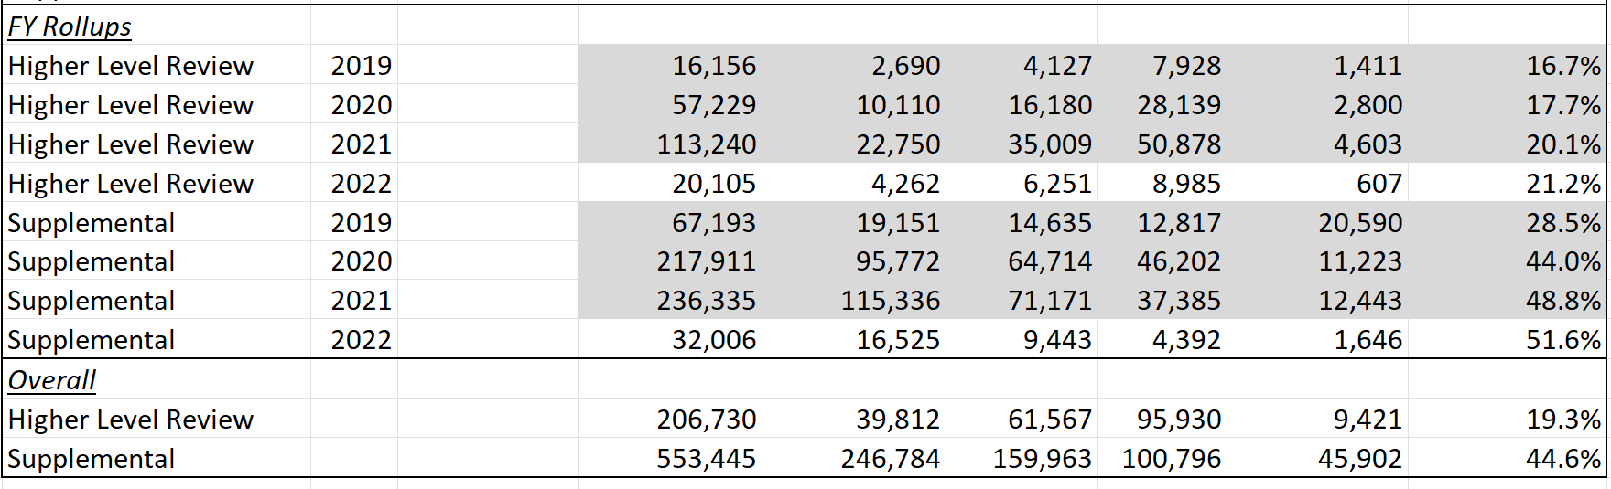
Which Lane at VARO?
The VARO success rates may influence which lane you choose*
BLUF: you are more than twice as likely to get a grant in the Supplemental Claim Lane
* As of 4th Quarter 2021

Slide 18
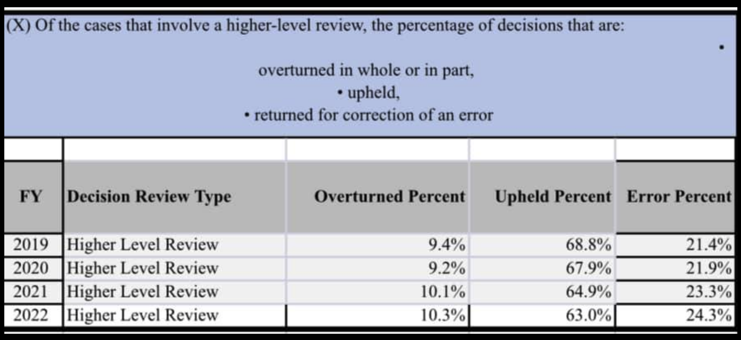
Which Lane at VARO?
Higher Level Reviews are only successful in overturning decisions about one in ten times*
* As of March 2022

Slide 19
Upping Your HLR Winning Odds
Higher Level Review Best Practices:
Be realistic about the quality of your evidence. You’ll rarely win an argument about which evidence VA likes better.
Don’t overestimate your charm and persuasiveness. DROs are busy and sometimes would rather not hear from you. Focus on your written argument skills.
If attacking an inadequate C&P exam (and you sometimes should!), be very detailed and realistic about the inadequacies.
But remember that a duty to assist error will likely get you another negative C&P exam. Is that what you really want?
Whenever possible, cite to the M21 or VA training materials (VA Intranet). Regs and case law are typically ignored at this level.
*

Slide 20
Claims Accuracy Request (CAR)
Expedited HLR that replaces the old VSO 48 hour period
For situations where a decision contains an “obvious error of fact or law which is an undisputable error that, by its significance, must change the decision affecting a compensation or pension award”
Participants who simply disagree with the judgment of the decision maker, or the weight assigned to certain evidence, must contest the decision using the current review system
Must be filed within 30 days of decision
Submit on a VA Form 20-0996 with “Claim Accuracy Request” or CAR prominently noted on the application
No informal conference allowed
Can’t do a CAR of a CAR, CAR of HLR or HLR of CAR
If CAR is rejected VA will process as a normal HLR
*

Slide 21

QUESTIONS?

Slide 22
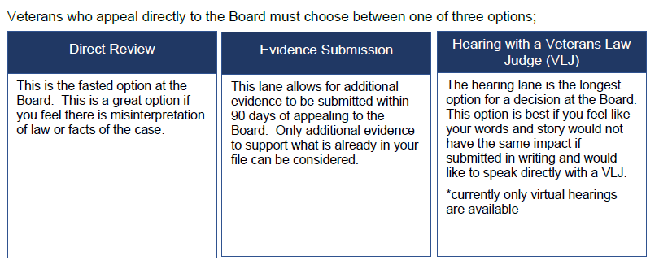
Which Lane at BVA?
NOTE: An appeal that is moved from one docket to another will retain its original docket date. 38 CFR § 20.800(a)(2)

Slide 23
Which Lane at BVA?
Option 3a: File BVA Direct Docket (Form 10182)
Cannot submit any additional evidence
Can submit additional argument in writing*
Can switch to evidence or hearing lane (within 60 days of submission or 1 year of decision)
Can opt out of BVA lanes completely and return to RO via Supplemental Claim lane; must notify BVA
* A written argument can be submitted at any time in all BVA lanes

Slide 24
Which Lane at BVA?
Option 3b: File BVA Evidence Docket (Form 10182)
Can add additional evidence but must do so within 90 days of filing (hard deadline)
Can switch to direct docket or hearing lane so long as no evidence submitted previously (within 60 days of submission or 1 year of decision)
Must notify BVA of lane change

Slide 25
Which Lane at BVA?
Option 3c: File BVA Hearing Docket (Form 10182)
Can add additional evidence within 90 days after hearing (but NOT before)
Can switch to direct docket or evidence lane so long as hearing not yet held (within 60 days of submission or 1 year of decision)
Must notify BVA of lane change
Hearings can be held in DC, at RO, or virtually from anywhere

Slide 26
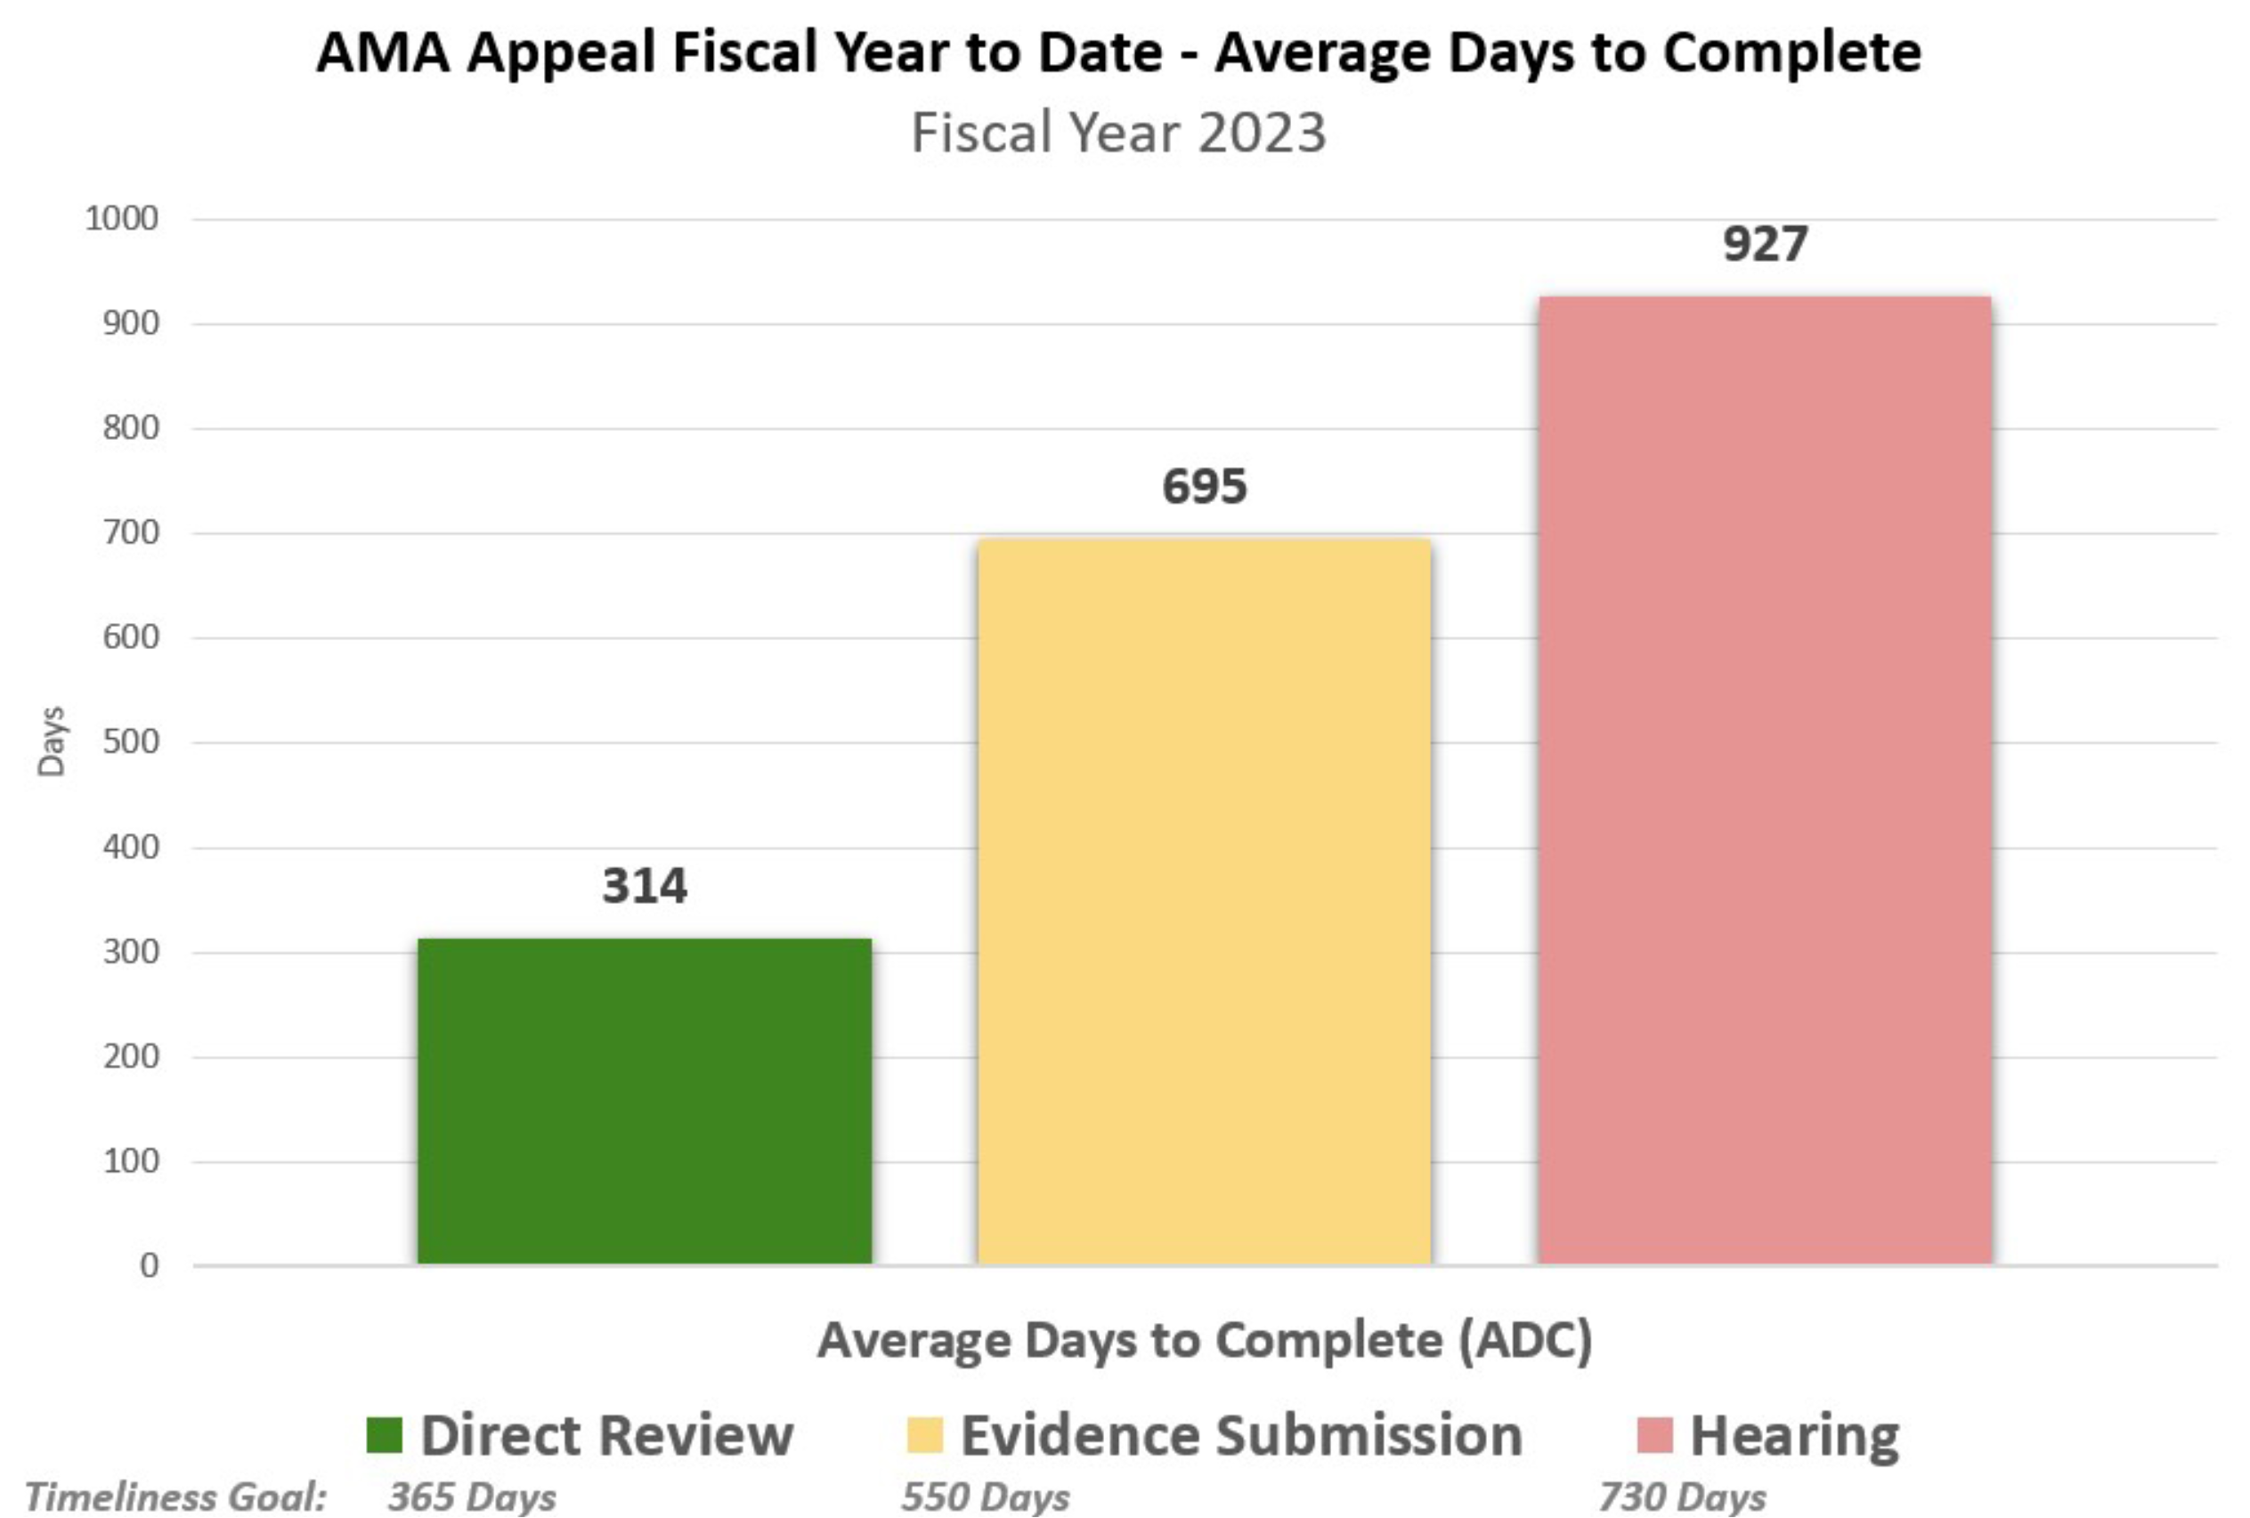
Which Lane at BVA?
The Board’s rates of completion may influence which lane you choose

Slide 27
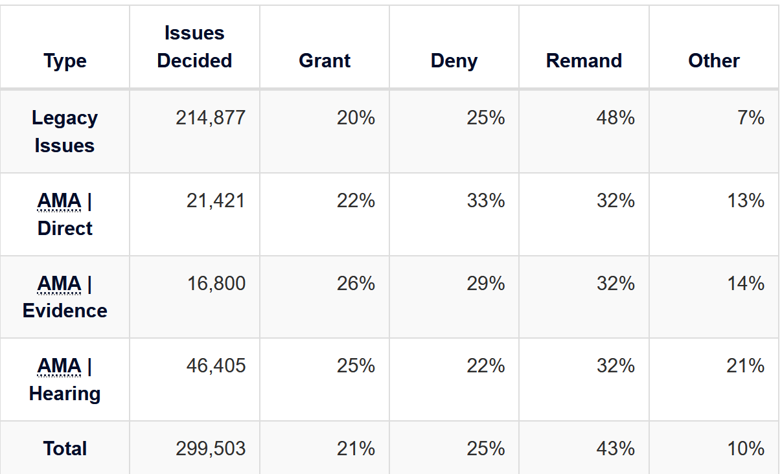
Which Lane at BVA?
The Board’s success rates may also influence which lane you choose
NOTE: The Hearing Lane has historically had the highest grant rate but that seems to have changed in the most recent update (2023)

Slide 28
Which Lane at BVA?
The Board will advance an appeal for following reasons:
Age 75 and older
Failing health*
Severe financial hardship*
Natural disaster*
COVID-19*
* Requires specific supporting documentation with AOD motion. 38 CFR § 20.800(c)(1)

Slide 29
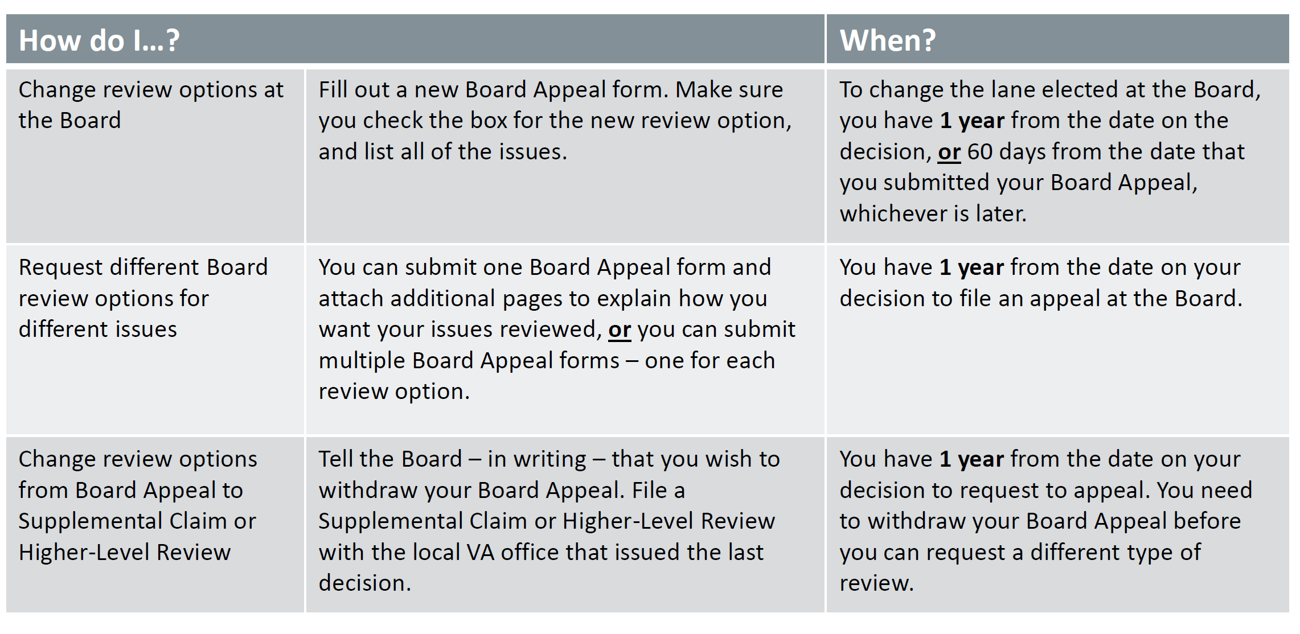
Board Appeal FAQs

Slide 30
BVA Decisions
BVA can make different decisions for different issues (e.g. grant vs. remand vs. denial).
When BVA grants an issue, make sure AOJ implements it correctly and timely.
When BVA denies an issue, decide within 120 days whether to appeal to CAVC or not, or file Supplemental Claim with N&R evidence.
When BVA remands an issue, track according to enumerated remand instructions
BVA will not keep jurisdiction over remanded appeals in the AMA; a new NOD or other review option must be filed after AOJ decision on remand.

Slide 31
Analyzing the BVA Decision
Does the decision address all of the evidence submitted?
Was evidence submitted within the allowable evidentiary windows?
Were all claimed conditions adjudicated?
Does the decision indicate that more evidence is necessary?
Does the decision question the Veteran’s credibility?

Slide 32
QUESTIONS?

Slide 33
More Questions?
Feel free to contact us about questions from this training or ANYTIME you have a question about a claim:
CACVSO@eagleveteranslaw.com

