Slide 1






Prop 1: Homekey+ & Behavioral Health Transformation CACVSO Fall Training Conference October 22, 2024

Slide 2

Agenda
Overview
Homekey+ / BHCIP
BHSA
Resources
Notes:
Roberto – through last slide.

Slide 3


Mental Health for ALL
California is transforming our entire mental health and substance use disorder (SUD) system.
The result: better behavioral health care for ALL Californians.

Slide 4
Our Commitment to Californians
More Mental Health Care & Substance Use Treatment for All
Nation-Leading Behavioral Health Investments- Services, Facilities, and Housing
Accountability for Results
Partnership - City/County, Public/Private, Local/State, Stakeholders
Action Needed Now

Slide 5
Interagency Coordination
Ensuring California Veterans are the most
Connected, Protected, and Respected in the nation.
DHCS, HCD, and CalVet working to implement capital investments from AB 531 for supportive housing and treatment settings.
BCSH and CalHHS Co-Chair of the California Interagency Council on Homelessness; CalVet membership.
Support the successful implementation of the BHSA, including housing interventions.
Coordination to transform the ways that health funds supportive housing and how housing provides places to improve the social determinants of health.

Slide 6
Interagency Coordination
History of Partnership
CalVet, HCD, CalHFA
$600 Million in new affordable, transitional, and permanent supportive housing
VHHP collaboration / 8 Rounds
100 projects awarded / 6561 units total
CalVet and DHCS
MHSA Grant Program
Mental health service programs for County Veteran Service Offices
Veterans Benefits Enhancement Program
Federal / State partnership to improve health outcomes for veterans and their families through increased connections with CVSOs, CalVet, and VHA.

Slide 7
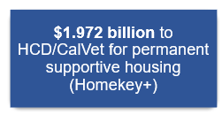
Prop 1 Overview: Infrastructure Bond Funding & BHSA
$1.065 billion
Behavioral Health Infrastructure Bond Act
$6.38 billion
$1.972 billion to HCD/CalVet for permanent supportive housing (Homekey+)
90% County Allocations
Behavioral Health Services Act (BHSA)
effective July 2026
$4.4 billion to DHCS for behavioral health treatment settings (BHCIP)
Proposition 1
10% State-Wide Investments
Notes:
BHSA, MHSA Transformation ( start with BHSA, then compare infrastructure bond programs, then jump into Homekey + details.
Infrastructure Bond Funding: + Treatment Sites
AB 531 /Prop 1 Behavioral Health Infrastructure Bond Act provides $6.38 billion with up to $4.4 billion for competitive grants for counties, cities, tribal entities, non-profit and private sector towards behavioral health treatment settings. (The remaining $2.2 billion is for supportive housing)
Of the $4.4 billion available for BH treatment sites, $1.5 billion will be awarded through competitive grants ONLY to counties, cities and tribal entities. $30 million will be set aside for tribes ONLY.
DHCS competitive grant requirements similar to the BH Continuum Infrastructure Program requirements (2022-2024).
Additional requirements, due to the provision of receiving bond funding, are outlined in the request for application.
+ Permanent Supportive Housing

Slide 8


$1.065 billion worth of housing investments for veterans who are homeless, are risk of homelessness, or experiencing chronic homelessness and who have mental health need or a substance use disorder.
CalVet and HCD will coordinate to determine methodology and distribution of funds, as well as supportive service plan standards.
Notes:
California’s veteran population is roughly 1.5 million 2nd only to Texas.
2023 US HUD Point In Time Count reports that California accounts for 30 percent of all veterans experiencing homelessness in the United States (10,589 veterans) and close to half of all unsheltered veterans nationally (48% or 7,436 veterans).
Total number of homeless veterans in California has decreased by roughly 7,384 individuals since an reported high of 17,973 in 2009.
Upwards of 50 percent or more of homeless veterans suffer from mental health issues and upwards of 70 percent or more are affected by SUD.
The challenges of 30% AMI with Veterans

Slide 9
“Veteran” is defined as a person who served in the active military, naval, or air service, and who was discharged or released under conditions other than dishonorable.
For projects serving Veterans, it will be critical to ensure providers have experience and cultural competency specific to Veterans.
Notes:
California’s veteran population is roughly 1.5 million 2nd only to Texas.
2023 US HUD Point In Time Count reports that California accounts for 30 percent of all veterans experiencing homelessness in the United States (10,589 veterans) and close to half of all unsheltered veterans nationally (48% or 7,436 veterans).
Total number of homeless veterans in California has decreased by roughly 7,384 individuals since an reported high of 17,973 in 2009.
Upwards of 50 percent or more of homeless veterans suffer from mental health issues and upwards of 70 percent or more are affected by SUD.
The challenges of 30% AMI with Veterans

Slide 10
Proposition 1 Homekey+ Overview
Cari Scott, Assistant Deputy Director
Division of State Financial Assistance
Program Design and Implementation Branch

Slide 11
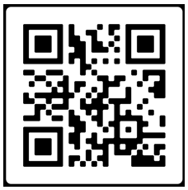
Program Overview
Modeled on HCD’s existing Homekey program grants for housing with supportive services
HCD and CalVet to coordinate on Veterans program
Program Summary and Stakeholder Questions released in September that highlights threshold requirements, Eligible Project Types, and funding priorities.
Notes:
1. Staying true to the Homekey model, Homekey+ will emphasize the acquisition and rehabilitation of existing buildings, or other project types, that can be quickly converted or constructed for permanent affordable housing, generally within 12 months of award. Since its inception in 2020, Homekey has funded 259 projects and 15,850 affordable homes for Californians exiting homelessness.
Releasing (soon) program overview that will cover more details, and outline key questions for stakeholders to inform NOFA development.
2. CalVet and HCD will coordinate to determine methodology and distribution of funds, as well as the supportive service plan standards and other program areas of expertise such as:
USDVA Disability/Pension Claims and Compensation
Legal Aid
Veteran Cultural Competency

Slide 12
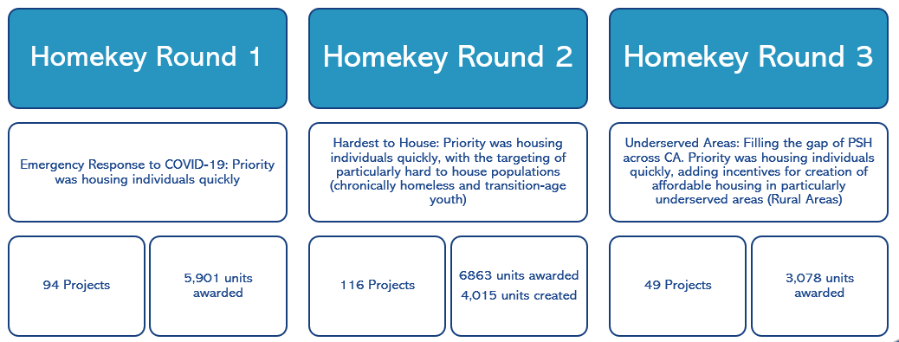
What is the Homekey Program?
Homekey+
Homekey is an opportunity for state, regional, and local public entities to develop a broad range of housing types, including but not limited to hotels, motels, hostels, single-family homes and multifamily apartments, manufactured housing, and to convert commercial properties and other existing buildings to permanent or interim housing for the target population.
Notes:
To put it simply, HK is a grant to jurisdictions to be creative with housing types in order to quickly create housing for the Target Population of Homeless, Chronically Homeless, or at Risk of Homelessness, this is 30% AMI or below. The jurisdiction is to create a housing product due to the needs in their particular community.
To repeat, the funds provide jurisdictions the flexibility to take advantage of specific opportunities available within their community that will result in the speedy acquisition and creation of new homes.
Easy right?!

Slide 13
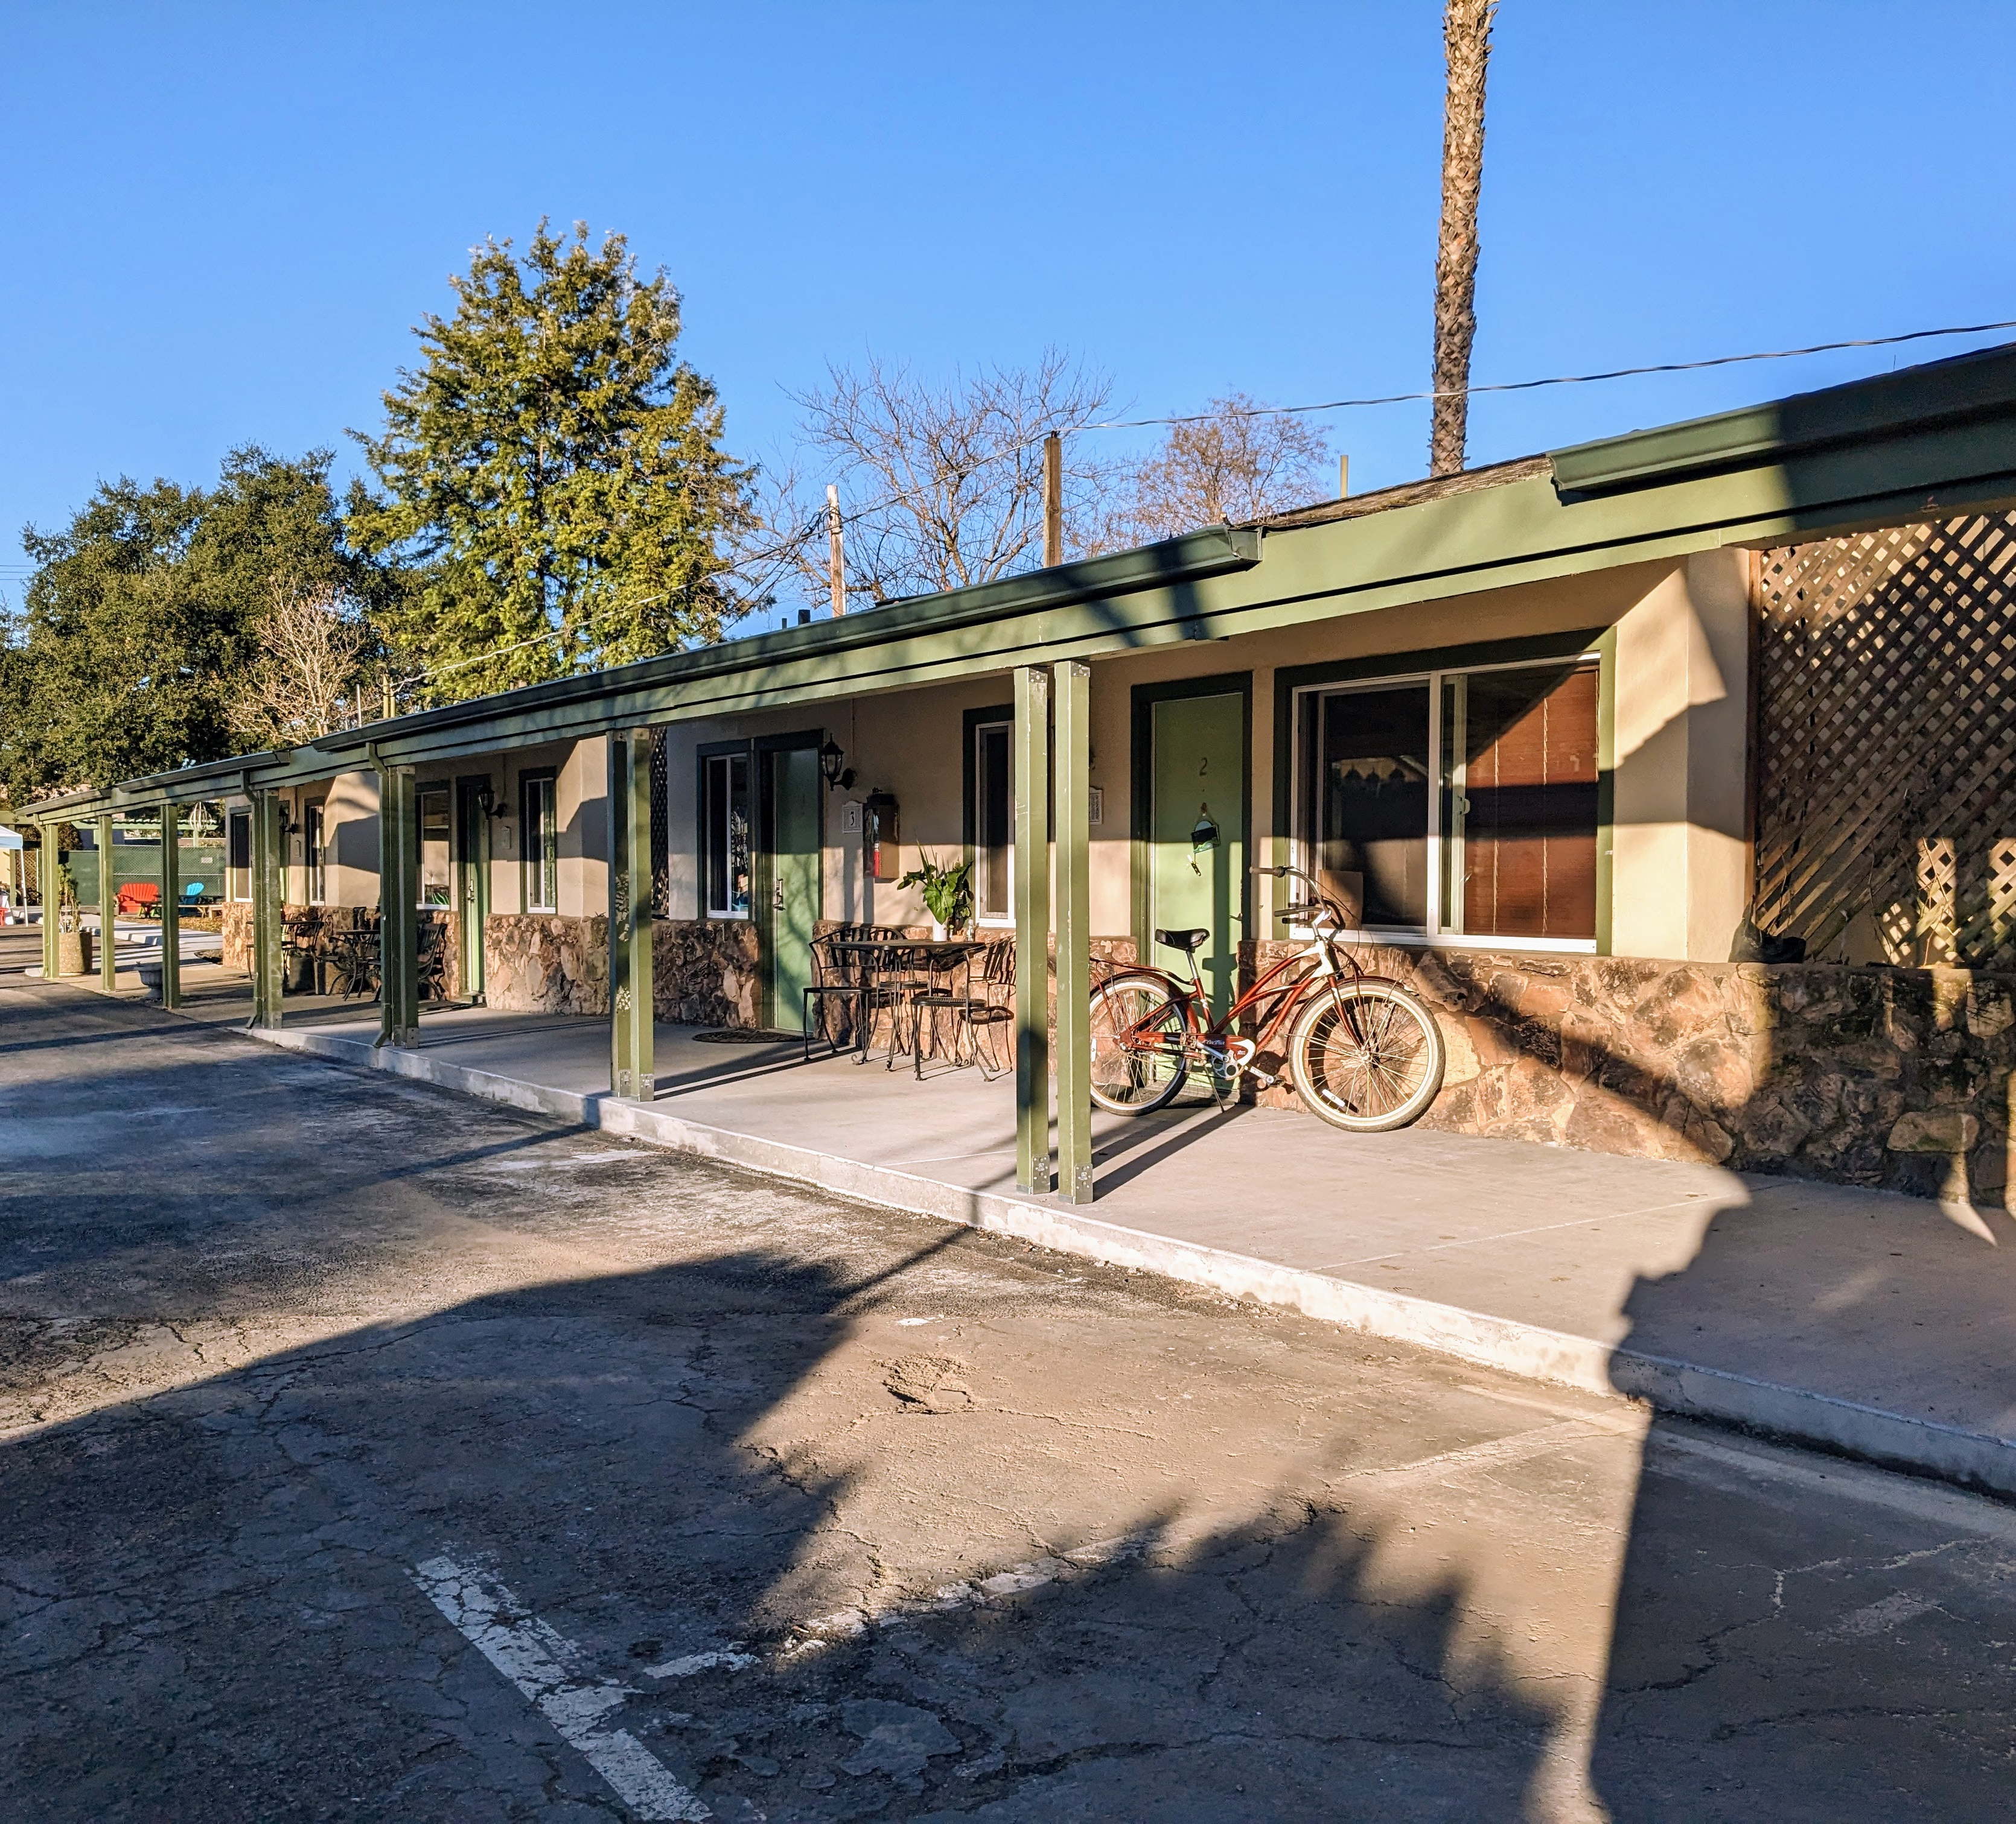
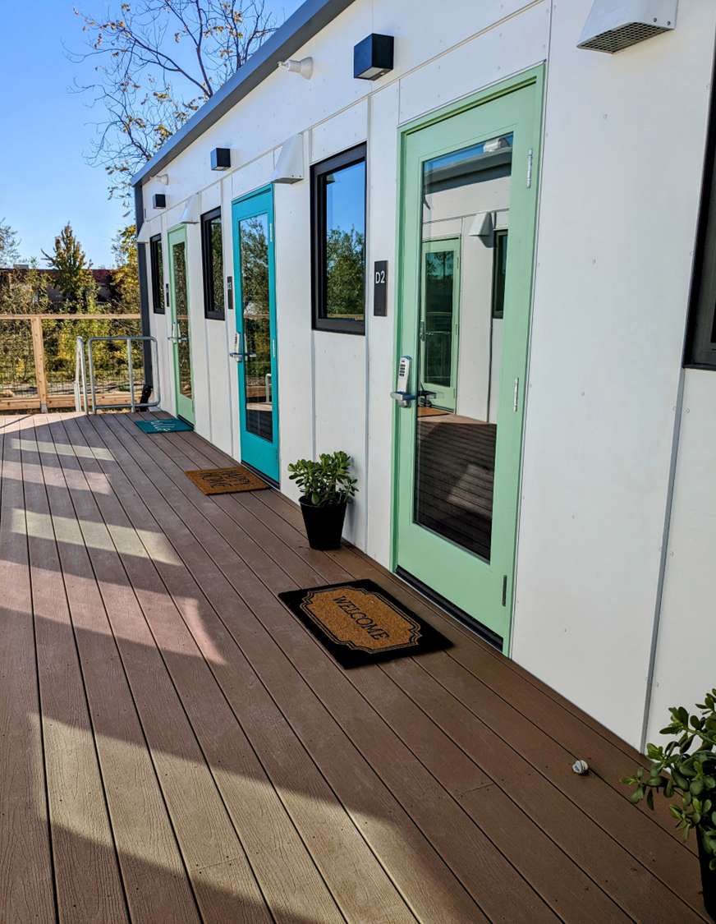
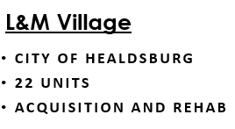
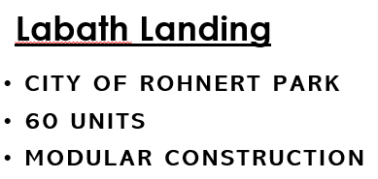
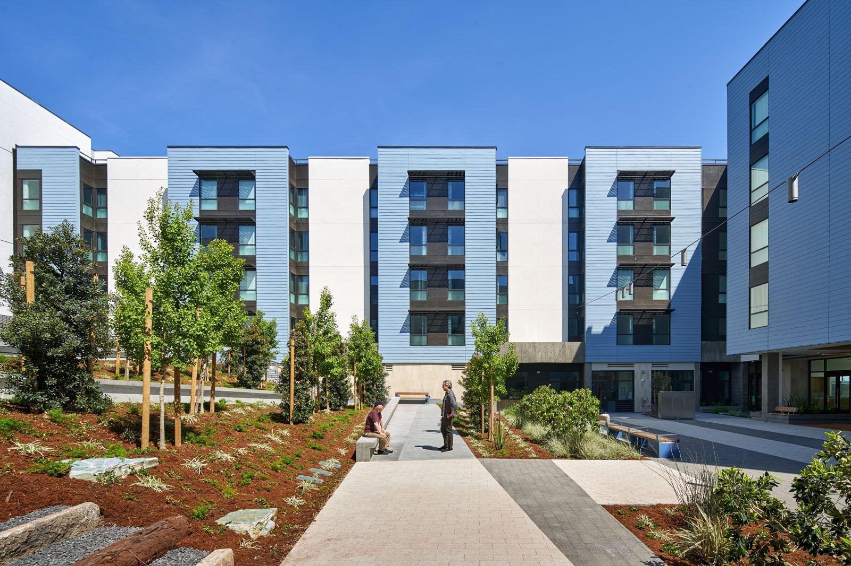
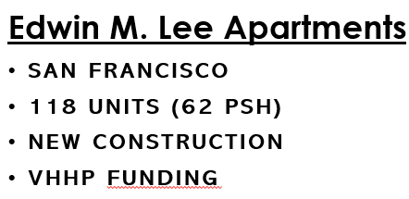
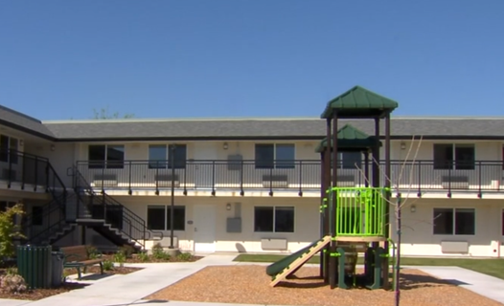
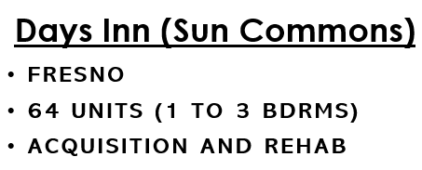

Slide 14
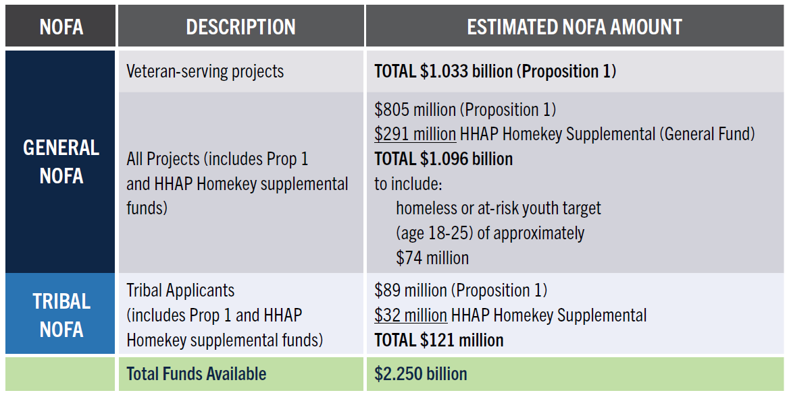
Funding Breakdown
Notes:
1. Staying true to the Homekey model, Homekey+ will emphasize the acquisition and rehabilitation of existing buildings, or other project types, that can be quickly converted or constructed for permanent affordable housing, generally within 12 months of award. Since its inception in 2020, Homekey has funded 259 projects and 15,850 affordable homes for Californians exiting homelessness.
Releasing (soon) program overview that will cover more details, and outline key questions for stakeholders to inform NOFA development.
2. CalVet and HCD will coordinate to determine methodology and distribution of funds, as well as the supportive service plan standards and other program areas of expertise such as:
USDVA Disability/Pension Claims and Compensation
Legal Aid
Veteran Cultural Competency

Slide 15
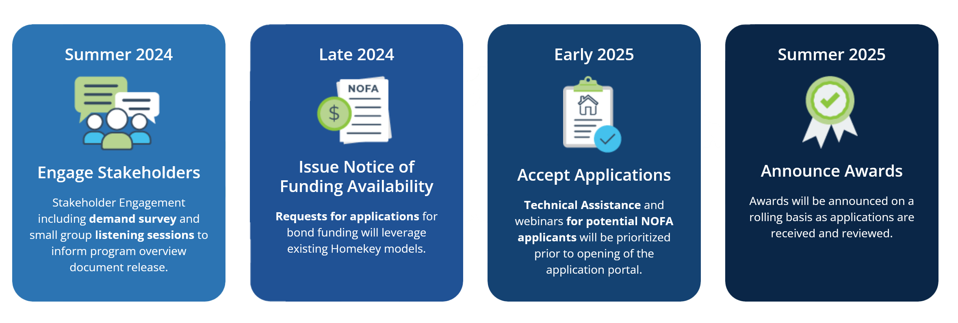
Timeline
Below outlines high-level timeframes for several milestones that will inform requirements and resources. Additional updates on timelines and policy will follow throughout the project.
Notes:
Program Overview released 9/19 to put out additional more detailed info, and to solicit stakeholder input. We will have listening sessions next to help inform the NOFA. NOFA Release (General and Tribal) - November 2024, Pre-Application Consultations - Beginning January 2025, Application Portal Opening - Mid-to-Late January 2025, Final Application Due Date - Various depending on Project Type: Gap Financing Projects: Applications - due one (1) month from the date the application portal opens. Regional Pools (includes new construction cost containment projects - due four (4) months from the date the application portal opens. Tribal Projects: Application deadline will be open-ended until all funds are disbursed. Award Announcements - Continuous beginning May 2025
What’s next: Listening Sessions, targeted audiences, tailored to specific sections that we’d like to get more feedback on.

Slide 16
Program Overview
The Basics:
Eligible applicants include Cities, Counties, public housing authorities with co-applicant development partners.
Permanent Supportive Housing requiring 55-year affordability term
Acquisition, conversion, new construction
Extremely low income (<30% AMI)
Homeless, Chronically Homeless, or at-risk of homelessness AND a Behavior Health Challenge
Emphasis on Project Readiness – 12 to 24 months to completion depending on project type
Supportive services required
Notes:
1. Staying true to the Homekey model, Homekey+ will emphasize the acquisition and rehabilitation of existing buildings, or other project types, that can be quickly converted or constructed for permanent affordable housing, generally within 12 months of award. Since its inception in 2020, Homekey has funded 259 projects and 15,850 affordable homes for Californians exiting homelessness.
Releasing (soon) program overview that will cover more details, and outline key questions for stakeholders to inform NOFA development.
2. CalVet and HCD will coordinate to determine methodology and distribution of funds, as well as the supportive service plan standards and other program areas of expertise such as:
USDVA Disability/Pension Claims and Compensation
Legal Aid
Veteran Cultural Competency

Slide 17
Program Overview
Emphasis on Sustainable Operations:
Minimum of 3 years of operating match, although priority will be given to projects that demonstrate operating sustainability over the 15 years reviewed in the application.
Starting in July 2026, 30% of each county’s Behavioral Health Services Act (BHSA) allocation must be spent on housing interventions. Guidance on allowable expenditures will be released by DHCS in early 2025. Counties may choose to utilize portions of this allocation to provide operations funding for Homekey+ projects which can provide long-term operational sustainability.
Prospective applicants are highly encouraged to engage with the applicable County Behavioral Health Department to determine how BHSA dollars may be used to support allowable housing costs for individuals with behavioral health conditions that meet the eligibility for BHSA services.
Notes:
Over-the-Counter Application and Award Process: Applications will be reviewed on a first-come, first-serve basis, and awards made to eligible projects until funding is exhausted, with priority given to projects with sustainable operations.
While project-based vouchers continue to be an excellent source of operational sustainability, the availability of vouchers varies by community.

Slide 18
Program Overview
NEW!! Gap Financing:
For Permanent Supportive Housing projects with prior HCD awards which meet the population targeting requirements of Homekey+ but have not started construction due to the inability to secure tax credits or existing funding gaps – THIS INCLUDES VHHP FUNDED PROJECTS.
The intent is to move projects forward that are otherwise “shovel ready” and thereby quickly increase the number of units available.
**Must be able to demonstrate project is fully funded with Homekey+ funding and commence construction within 6 months **
Notes:
This is kind of a scenario of projects that are at risk of not moving forward, so by funding the gap we not only just gain HK+ units, we are saving an entire project.

Slide 19

Behavioral Health Infrastructure Bond Funding
Behavioral Health Continuum Infrastructure Program (BHCIP)
Homekey+
Behavioral Health Treatment Settings Residential treatment beds with 30-year deed restriction, Planning, Design, Permitting, Construction | Uses | Permanent Supportive Housing Acquisition, construction, rehabilitation of hotel/motel or other sites that can be converted to permanent housing
Expand behavioral health infrastructure Can not use grant to fund services Certify will not exclude justice involved or youth in foster care Contract in place if offering Medi-Cal Services | Requirements | Those at risk/experiencing homeless AND a behavior health challenge Extremely low income (<30% AMI) Veteran status, for vet specific units 5-year supportive services required; seeking long term sustainability
Competitive Grants | Funding type | Competitive Grants
Counties, Cities, Tribal Entities, non-profit and private sector | Eligible Applicants | Counties, Cities, Public Housing Authorities, Tribal Entities (Can partner with developers)
RFA: July 17, 2024. Due: Dec. 13, 2024 |  | NOFA: Nov. 2024 Apps: Beginning Jan 2025
Notes:
Behavioral Health Continuum Infrastructure Program (BHCIP)
Of the $4.4 billion available for BH treatment sites, $1.5 billion will be awarded through competitive grants ONLY to counties, cities and tribal entities. $30 million will be set aside for tribes ONLY.
Modeled on prior rounds of BHCIP and Homekey
Homekey+
Modeled on prior versions of Homekey

Slide 20
Behavioral Health Transformation
Marlies Perez, BHT Project Executive
CA Department of Healthcare Services

Slide 21
Behavioral Health Services Act (BHSA)
Behavioral health services in California are now funded by a mix of insurance, county funds, and the MHSA/BHSA.
The BHSA is the first major structural reform of the Mental Health Services Act since 2004. It expands and increases the types of supports available to Californians in need by focusing on gaps and priorities.
Focuses on the most vulnerable and at-risk, including set-asides for children and youth.
Broadens the target population to include individuals with substance use disorder.
Updates allocations for local services and state directed funding categories, including housing supports.
Clearly advances community-defined practices as a key strategy of reducing health disparities and increasing community representation.
Revises county processes for planning and reporting.
Improves transparency and accountability.

Slide 22
Behavioral Health Transformation Milestones
Below are high-level timeframes for several milestones that will inform requirements and resources. Additional updates on timelines and policy will follow throughout the project.
Started Spring 2024
Started Summer 2024
Beginning Late 2024
Summer 2026
Stakeholder Engagement
Stakeholder engagement including, public listening sessions, will be utilized through all milestones to inform policy creation.
Bond BHCIP: Round 1 Launch Ready
Requests for Applications (RFA) for up to $3.3 billion in funding leveraging BHCIP.
Policy Manual and Integrated Plan Guidance
Policy Manual chapters and Integrated Plan guidance will be released for public comment in phases.
Integrated Plan
New integrated plans, fiscal transparency, and data reporting requirements go-live in July 2026 (for next three-year cycle)

Slide 23
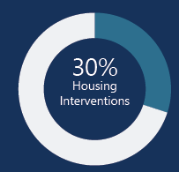
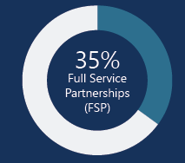
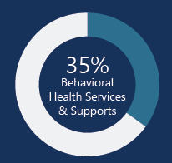
BHSA County Funding Allocations
90% of Total Funds
Local Service Funding Categories:
Housing Interventions – 30%
Full Service Partnerships (FSP) – 35%
Behavioral Health Services and Supports (BHSS) –35%
Includes “outreach and engagement” as allowable service
At least 51% of BHSS shall be used for Early Intervention
At least 51% of Early Intervention shall be used to serve individuals who are 25 years of age or younger.

Slide 24
County Allocations: 1. BH Housing Interventions – 30%
For children and families, youth, adults, and older adults living with SMI/SED and/or SUD who are experiencing or at risk of homelessness.
50% is prioritized for housing interventions for the chronically homeless with BH challenges.
Includes rental subsidies, operating subsidies, shared and family housing, capital, and the non-federal share for certain transitional rent.
Up to 25% may be used for capital development.
Not limited to Full Service Partnerships partners or persons enrolled in Medi-Cal.
County flexibility:
Allows small county exemption for 2026-29 and on-going if approved by DHCS.
Provides flexibility for the remaining counties commencing with the 2032-2035 planning cycle on the 30% requirement based on DHCS criteria for exemptions.

Slide 25
County Allocations: 2. Full-Service Partnerships (FSP) Programs – 35%
Includes mental health, supportive services, and SUD treatment services.
Medication-Assisted Treatment (MAT)
Community-defined evidence practices (CDEP)
Assertive Community Treatment /Forensic Assertive Community Treatment, Supported employment, & high fidelity wraparound are required.
Small county exemptions are subject to DHCS approval.
Establishes standards of care with levels based on criteria.
Outpatient behavioral health services, either clinic or field based, necessary for on-going evaluation and stabilization of an enrolled individual.
On-going engagement services necessary to maintain enrolled individuals in their treatment plan inclusive of clinical and non-clinical services, including services to support maintaining housing.

Slide 26
County Allocations: 3. Behavioral Health Services and Supports (BHSS) – 35%
Includes early intervention, outreach and engagement, workforce education and training, capital facilities, technological needs, and innovative pilots and projects.
A majority (51%) of this amount must be used for Early Intervention services to assist in the early signs of mental illness or substance misuse.
A majority (51%) of these Early Intervention services and supports must be for people 25 years and younger.

Slide 27
30% Housing Interventions
Per Welfare and Institutions Code Section 5830, county programs for housing interventions may include:
Rental subsidies
Operating subsidies
Shared housing (including recovery housing)
Family housing
Nonfederal share for Transitional Rent
Other housing supports, as defined by DHCS, including the community supports
Capital development projects
Project-based housing assistance, including master leasing

Slide 28
Proposed Housing Intervention Allowable Settings
Housing Intervention funding will be allowable, without time-limits, in the following permanent settings:
Apartments
Supportive housing
Master-lease apartments
Single room occupancy
Shared housing (i.e., living with roommates)
Recovery Housing
Assisted Living (Adult Residential Care Facilities, Residential Care Facilities for the Elderly, Unlicensed Room and Board)

Slide 29
Target Populations for Housing Interventions Each county shall establish and administer a program for housing interventions to serve persons who are chronically homeless, experiencing homelessness, or are at risk of homelessness, and meet one of the following two conditions:
Eligible children and youth who meet one of the following:
Are chronically homeless or experiencing homelessness or are at risk of homelessness.
Are in, or at risk of being in, the juvenile justice system.
Are reentering the community from a youth correctional facility.
Are in the child welfare system pursuant to Section 300, 601, or 602.
Are at risk of institutionalization.
Eligible adults and older adults who meet one of the following:
Are chronically homeless or experiencing homelessness or are at risk of homelessness.
Are in, or are at risk of being in, the justice system.
Are reentering the community from prison or jail.
Are at risk of conservatorship pursuant to Chapter 3 (commencing with Section 5350) of Part 1 of Division 5.
Are at risk of institutionalization.

Slide 30
Permanent Supportive Housing
BHSA Specifications
Rental subsidies
Operating subsidies
Shared housing (including recovery housing)
Family housing
Nonfederal share for Transitional Rent
Other housing supports, as defined by DHCS, including the community supports
Capital development projects
Project-based housing assistance, including master leasing
Permanent Supportive Housing should be implemented in-line with HUD Guidance.
Permanent Supportive Housing settings may be funded through rental subsidies, and operating subsidies:
Rental subsidies can be established either as scattered-site (multiple locations) or project-based assistance (one location), including master leasing.
Operating subsidies may cover housing related supports such as unit repairs, housing retention focused participant assistance funds, and resources to avoid evictions such as mediation.
All settings must identify access to behavioral health services and accommodate for Medication Assisted Treatment.

Slide 31
Bond Behavioral Health Continuum Infrastructure Program (BHCIP)

Slide 32
Bond BHCIP Round 1: Launch Ready
May 14, 2024: DHCS released the Bond BHCIP Program Update, which will provide up to $4.4 billion in funding for mental health and substance use disorder facilities statewide.
July 17, 2024: DHCS Request for Applications posted
$1.5 billion open only to counties, cities, and tribal entities ($30 million minimum to be awarded to tribal entities).
$1.8 billion open to counties, cities, and tribal entities, as well as nonprofit and for-profit organizations.
Funds awarded by Spring 2025.

Slide 33
Round 1: Launch Ready Pre-Application Consultation (PAC) *Data and following graphs are based on the 134 submitted PAC requests as of 9/19/2024
PAC Overview
All applicants are required to complete a PAC before submitting a Bond BHCIP Round 1: Launch Ready application.
Deadline to request a PAC was October 15, 2024.
Pre-application consultations occurring until November 14, 2024.

Slide 34
Stakeholder Engagement and Policy Manual

Slide 35



Stakeholder Engagement
DHCS seeks feedback from stakeholders and the public which may be taken into consideration as DHCS continues to develop policy and guidance related to BHT.
Public Listening Session
Public Listening Session
Public Listening Session
Behavioral Health Services Act and Substance Use Disorder
Behavioral Health Services Act Housing Interventions
Behavioral Health Services and Supports and Full Service Partnership
July 30th
September 12th
October and November
July 25th
August 27th
October 8th
Behavioral Health Services Act
Revenue Stability Workgroup
Behavioral Health Services Act
Revenue Stability Workgroup
Quality and Equity Advisory Committee
Find past recordings and theme reports on Behavioral Health Transformation Webpage.

Slide 36
Policy Manual
Instead of releasing guidance across multiple Behavioral Health Information Notices, DHCS plans to release an electronic policy manual that contains all BHT requirements and guidance together in a single source to be released in phases beginning in early 2025. The policy manual will include the following:
Information for counties on how to complete the Integrated Plan and facilitate community planning processes.
Other key areas of BHT implementation including BHSA funding and service requirements.
The draft Policy Manual will be open for public comment at the end of 2024.

Slide 37
Community Engagement

Slide 38
County Behavioral Health: Advisory Boards
Consists of 10-15 members, including one member from local governing body
Also includes: Consumers, or the parents, spouses, siblings, or adult children of consumers, who are receiving or have received behavioral health services (at least on aged 25 or younger).
Counties with a population of 100,000 plus, also include a veteran or veteran advocate.

Slide 39
Community Stakeholder Process: Integrated Plan for Behavioral Health Services and Outcomes
Meaningful stakeholder engagement throughout the process.
County BH Advisory Board required to conduct a public health on the draft Integrated Plan at the close of a 30-day public comment period.
County BH Advisory Board shall review adopted plan and make recommendations to local MH/SUD/BH Agency.
Local MH/SUD/BH Agency must provide written explanations to local governing body and DHCS for County BH Advisory Board recommendations not included in final integrated plan.

Slide 40
BHSOAC
New perspectives added to BHSOAC with 27 voting members (up from 16 members):
Two Persons who have or had a SUD
One person who is 25 years of age or younger and has or has had a MH/SUD/or co-occurring disorder.
Family member of an adult or older adult who has or has a SUD and family member of a child or youth who has or has had a SUD.
Current or former county behavioral health director
Professional with expertise in housing and homelessness
Representative of an aging or disability organization
Person with knowledge and expertise in community-defined evidence practices and reduction BH disparities
Representative of a children and youth organization
Veteran or a representative of a veterans organization
Notes:
Pass to Roberto

Slide 41
Engage
Tell us about TA, resources needed, and send us questions:
BCSH, HCD, CalVet: Homekey@hcd.ca.gov
CHHS, DHCS: BHTinfo@dhcs.ca.gov
Stay engaged for upcoming guidance
Listening Sessions Late October
Homekey+ NOFA Late 2024
Pre-Application Consultations Beginning January 2025
Participate in local BHSA 3-Year Integrated Plan updates
BHSA Housing Intervention Guidance from DHCS Early 2025
Local Plan development through June 2026
Notes:
Roberto – through last slide.

Slide 42
Resources:
The Governor’s Mental Health for All Webpage
CalVet Voter Approved Bond Webpage
CalHHS Behavioral Health Transformation Webpage
DHCS Behavioral Health Transformation Webpage
HCD Homekey + webpage
Homekey + Fact Sheet

Slide 43
Contacts:
CalVet
VHHP@calvet.ca.gov
CalHHS and DHCS
BHTinfo@dhcs.ca.gov
BCSH and HCD
Homekey@hcd.ca.gov

Slide 44
Questions

