Slide 1
District Offices:
Updates & Notes
June 11, 2024
(CVSO Conference Presentation by the District Managers)

Slide 2
Agenda
District Offices (DO) Data and Updates
Board Data for CalVet-represented appellants
BDD Program Requirements
38 CFR 14.631 POAs and Disclosure of Claimant Information
38 CFR 20.1304 Request for a Change in Representation
38 CFR 14.632 Standards of Conduct
FYI: Last 7 slides shows staff list and POC’s for each District Office

Slide 3
District Office CDCR Liaison Program
 | Claims Filed | VAEs held | In-Person Interviews | Letters to veterans | Retro | Adjusted Monthly | Full Monthly Entitlement
2023 Total | 337 | 351 | 351 | 1021 | $ 812, 619 | $ 64,761 | $ 206,690
Jan-Mar 2024 | 94 | 140 | 99 | 185 | $ 71,306 | $ 13,132 | $ 33,888
April 2024 | 47 | 29 | 37 | 65 | $ 42,096 | $ 5,122 | $ 14,501
2024 YTD Total | 141 | 169 | 136 | 250 | $ 113,402 | $ 18,854 | $ 48,389

Slide 4
District Office Reviewed Electronic Claims
 | Oakland DO | Los Angeles DO | San Diego DO
2023 (Jan-Dec) | 15,205 | 16,400 | 6,338
Jan-Mar 2024 | 4643 | 5295 | 1575
April 2024 | 1802 | 2094 | 562
2024 YTD Total | 6445 | 7389 | 2137

Slide 5
D.O. Reviewed Electronic Claims
Returned Claims % | Oct-Dec 2023 | Jan-Mar 2024
Oakland District Office | 17% | 8%
Los Angeles District Office | 11% | 10%
San Diego District Office | 12% | 13%

Slide 6
BVA Hearings (Held and Scheduled)
 | Oakland DO | Los Angeles DO | San Diego DO
2023 (Jan-Dec) | 363 | 177 | 86
Jan-Mar 2024 | 64 | 69 | 27
Apr-Jun 2024 | 100 | 87 | 31
2024 YTD Total | 164 | 156 | 58
Please reach out to us if the appellant reaches out to you.
Remember, even if we are notified early, we have to work our cases according to hearing date.

Slide 7
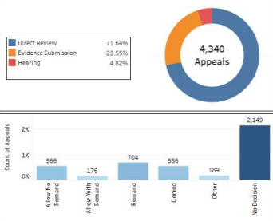
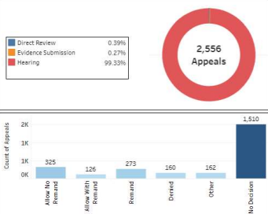
BVA Appeals Data for CalVet POA
All VAROs outside CA
CA only

Slide 8
Total: 2,556

Slide 9
1,510 appellants waiting on a BVA decision
(as of 5/28/24)

Slide 10
273 BVA Remands
At least half could have been Supplemental Claims
Or granted, if they obtained evidence.
162 Others:
Dismissed as without merit
Withdrawn by appellant
Died while waiting

Slide 11
BVA Appeals: Other Options
The 10182 Hearing lane is not the only option – please review the rating decision and advise the veteran/survivor of other options.
Denied for no confirmed diagnosis – submit medical evidence showing actual diagnosis with VAF 20-0995.
No treatment records? Tell them they need to actually see the doctor.
They have relevant evidence to submit, but insist on Board appeal – suggest 10182 Evidence lane option and emphasize the shorter wait time.
Seriously and/or terminally ill? If it really must be an appeal, 10182 Direct or Evidence lane would be better, to lessen the chance that they die waiting on their appeals.

Slide 12
BDD Program Requirements
BDD – Benefits Delivery at Discharge. For a pre-discharge claim to qualify for processing under the BDD Program, the following requirements must be met:
The service member must have a known date of discharge
Must be 180 to 90 days from discharge at the time of filing
Available to report for examinations for 45 days from the date the claim was received by the VA.
Provide a substantially complete copy of the service treatment records (STRs) from the current qualifying period of service, AND
Provide a completed Separation Health Assessment (SHA) Part A, Self Assessment – in addition to having the MEPS (Report of Medical Exam and Report of Medical History) in the claim packet.

Slide 13
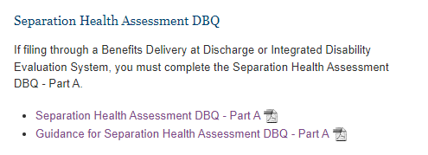
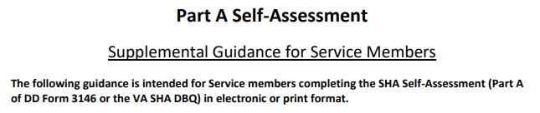
BDD Program Requirements
https://www.benefits.va.gov/compensation/dbq_publicdbq.asp
https://www.benefits.va.gov/compensation/docs/SHA_DBQ_Part_A_Guidance.pdf

Slide 14
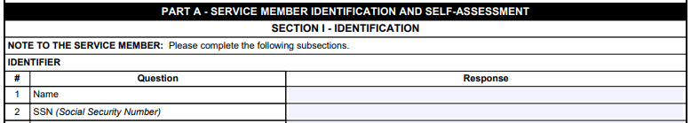
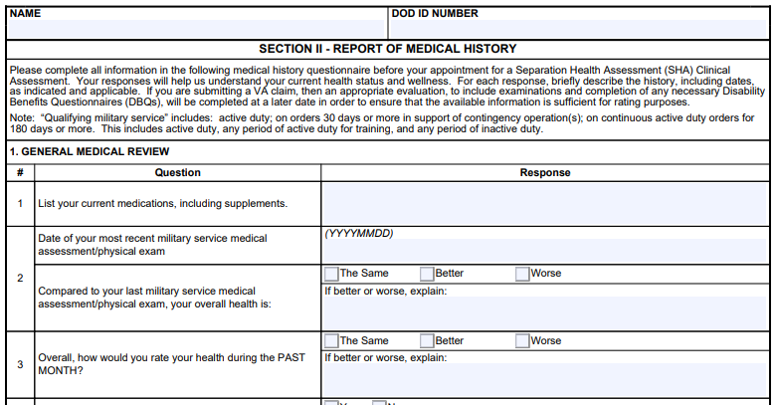
BDD Program Requirements
https://www.benefits.va.gov/compensation/docs/SHA_DBQ_Part_A_Self-Assessment.pdf
Page 1
Page 3
15 pages total – service member needs to set aside time to answer it

Slide 15
BDD Program Requirements
(BDD Continued) The following requirements must be met:
Finally, submit claim on the prescribed form – currently, that’s the VAF 21-526ez, and please submit all necessary forms with it, to avoid unnecessary development.
Example:
Include VAF 21-0781 when claiming PTSD.

Slide 16
BDD Program Exclusion
The following will be excluded from the BDD Program:
Claims received from service members (SM) with less than 90 days remaining on active duty
Contentions added with less than 90 days remaining on active duty
Claims where SM did not provide a copy of STRs for the current period of service
Claims where the SM did not provide a completed SHA-Part A
Claims from SM who are unable to report for examinations

Slide 17
BDD Program Exclusion
The following will be excluded from the BDD Program:
Claims involving terminally ill service member (SM)
Claims requiring case management for SM:
  Very seriously injured/ill (VSI) or seriously injured (SI)
  SPC – special category person who suffered loss of body part
  Actively enrolled in IDES program
Claims involving a SM awaiting discharge while hospitalized in a VA or military treatment facility
Claims requiring a character-of-discharge (COD) determination

Slide 18
Powers of Attorney (POA) and
Disclosure of Claimant Information
Per 38 CFR §14.631:
VA Form 21-22 or 21-22a is required to represent a claimant before the U.S. Department of Veterans Affairs (VA)
VA Form 21-22 also authorizes VA’s disclosure of information to any person or organization representing a claimant before the VA.
Appointment using a VA Form 21-22 is for the entire organization (i.e. CalVet, DAV, AmVets) as the claimant’s representative.
A properly completed and valid VAF 21-22 contains the signatures of the claimant and an accredited veterans service representative.

Slide 19
Powers of Attorney (POA) and
Disclosure of Claimant Information
38 CFR §14.631(a)(1) clarifies the signatures as:
The signature of the claimant, or
Claimant’s guardian, or
In the case of an incompetent, minor, or otherwise incapacitated person without a guardian, the following in the order named—spouse, parent, other relative or friend (if interests are not adverse), or the director of the hospital in which the claimant is maintained
Incompetent, minor or otherwise incapacitated –
Use VA Form 21-0972

Slide 20
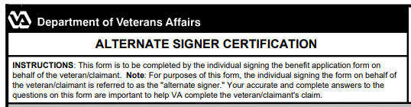
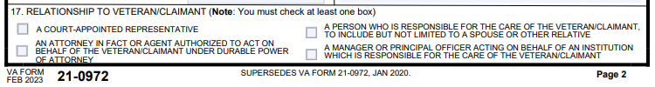
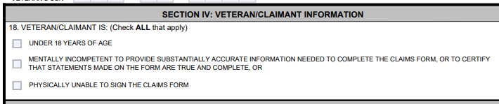
Quick View: VA Form 21-0972 Alternate Signer Certification

Slide 21
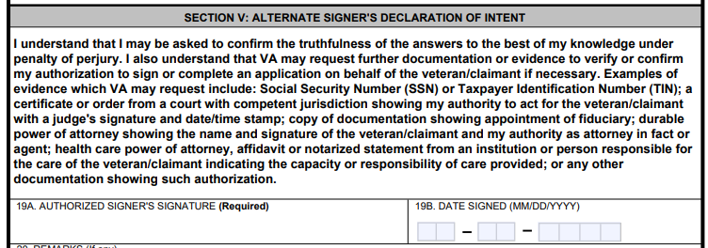
Quick View: VA Form 21-0972 Alternate Signer Certification

Slide 22
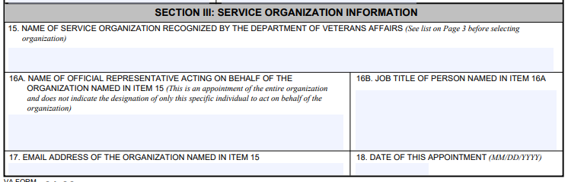
Powers of Attorney (POA) and
Disclosure of Claimant Information
38 CFR §14.631(b) clarifies on the representative:
As an appointment of the entire organization as the claimant’s representative

Slide 23
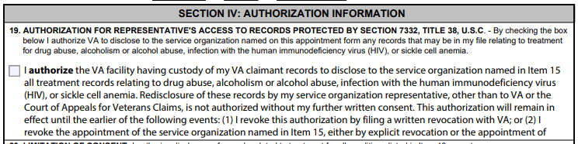
POA and Disclosure of Claimant Information
Disclosure of veteran/claimant information outside the VA/BVA or CAVC is not authorized without further written consent of the claimant. This is strictly for VA-representation purposes.
Notice on VA Form 21-22

Slide 24
POA and Disclosure of Claimant Information
Repeat: We are not authorized to share the veteran’s information to third parties without the consent of the veteran/claimant.
Remember that our access to VA systems is based on our need-to-know, for the purposes of assisting claimants with the submission of claims and decision review requests.
As a PIV-card holder, we signed the Rules of Behavior (ROB) and one of the bullet there states:
I will not make any unauthorized disclosure of any VA sensitive information through the use of any means of communication including but not limited to e-mail, instant messaging, online chat, and web bulletin boards or logs.

Slide 25
Powers of Attorney (POA) and
Disclosure of Claimant Information
38 CFR §14.631(c) states an organization, agent or attorney may withdraw representation before VA:
If such withdrawal would not adversely impact claimant’s interests;
If a claimant persists in a course of action that the organization or individual providing representation reasonably believes is fraudulent or criminal;
If the claimant fails to uphold an obligation to the organization or individual providing representation regarding the services of the organization or individual;
Or other good cause for withdrawal exists

Slide 26
Powers of Attorney (POA) and
Disclosure of Claimant Information
Per 38 CFR §14.631 (e) and (f):
Only one organization, representative, agent, or attorney will be recognized at one time in the prosecution of a particular claim. All transactions concerning the claim will be conducted exclusively with the recognized organization, representative, agent, or attorney of record until notice of a change, if any, is received by the appropriate office of VA.
A POA may be revoked at any time. A properly executed new 21-22 shall constitute revocation of an existing POA.

Slide 27
Changing POA While Appeal is Pending
§ 20.1304 Rule 1304. Request for a change in representation.
(a) Request for a change in representation within 90 days following Notice of Disagreement. An appellant and his or her representative, if any, will be granted a period of 90 days following receipt of a Notice of Disagreement, or up to and including the date the appellate decision is promulgated by the Board, whichever comes first, during which they may submit a request for a change in representation.
(b) Subsequent request for a change in representation. Following the expiration of the period described in paragraph (a) of this section, the Board will not accept a request for a change in representation except when the appellant demonstrates on motion that there was good cause for the delay. Examples of good cause include, but are not limited to, illness of the appellant or the representative which precluded action during the period; death of an individual representative; illness or incapacity of an individual representative which renders it impractical for an appellant to continue with him or her as representative; and withdrawal of an individual representative.

Slide 28
Changing POA While Appeal is Pending
(§ 20.1304 Rule 1304(b) continued)
Such motions must be in writing and must include:
the name of the veteran;
the name of the claimant or appellant if other than the veteran (e.g., a veteran's survivor, a guardian, or a fiduciary appointed to receive VA benefits on an individual's behalf) or the name of any substitute claimant or appellant;
the applicable Department of Veterans Affairs file number;
and an explanation of why the request for a change in representation could not be accomplished in a timely manner.
Such motions must be filed at the following address:
Board of Veterans' Appeals, P.O. Box 27063, Washington, DC 20038.

Slide 29
Changing POA When Appeal is Pending
(§ 20.1304 Rule 1304(b) continued)
Depending upon the ruling on the motion, action will be taken as follows:
  Good cause not shown. If good cause is not shown, the request for a change in representation will be referred to the agency of original jurisdiction for association with the appellant's file for any pending or subsequently received claims upon completion of the Board's action on the pending appeal without action by the Board concerning the request.
  Good cause shown. If good cause is shown, the request for a change in representation will be honored

Slide 30
Changing POA When Appeal is Pending
A change in POA is allowed when a motion is filed within 90 days from the date the appeal is docketed (please check BVA Notification).
A motion to change POA after the 90 day window has elapsed will only be allowed if there is good cause.
If good cause is not found, the motion will be denied and the Board will proceed with their action (38 CFR §20.1304(b)(1)).
38 CFR §20.1304 REVIEW

Slide 31
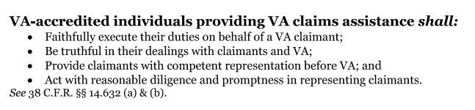
Standards of Conduct for Accredited Representatives
38 CFR §14.632 establishes the standards of conduct for all who are accredited to represent veterans before the U.S. Department of Veterans Affairs (VA).

Slide 32
Standards of Conduct for Accredited Representatives
38 CFR §14.632(c) specifies that VA-accredited individuals shall not:
(1) Violate the standards of conduct as described in this section;
(2) Circumvent a rule of conduct through the actions of another;
(3) Engage in conduct involving fraud, deceit, misrepresentation, or dishonesty;
(4) Violate any of the provisions of title 38, United States Code, or title 38, Code of Federal Regulations;
(5) Enter into an agreement for, charge, solicit, or receive a fee that is clearly unreasonable or otherwise prohibited by law or regulation;
(6) Solicit, receive, or enter into agreements for gifts related to services for which a fee could not lawfully be charged;

Slide 33
Standards of Conduct for Accredited Representatives
[38 CFR §14.632(c) continued] VA-accredited individuals shall not:
(7) Delay, without good cause, the processing of a claim at any stage of the administrative process;
(8) Mislead, threaten, coerce, or deceive a claimant regarding benefits or other rights under programs administered by VA;
(9) Engage in, or counsel or advise a claimant to engage in acts or behavior prejudicial to the fair and orderly conduct of administrative proceedings before VA;
(10) Disclose, without the claimant's authorization, any information provided by VA for purposes of representation; or
(11) Engage in any other unlawful or unethical conduct.

Slide 34
Standards of Conduct for Accredited Representatives
If VA determines that a VA-accredited representative violated the standards of conduct, VA may suspend or cancel our accreditation.
VA may also collaborate with enforcement authorities if it is suspected that our actions may have implications under State or other Federal laws.
What happens if we violate a standard of conduct or engage in any other unlawful or unethical conduct?

Slide 35
District Managers
Zmae Raymundo
Oakland District Manager
Zheriemae.Raymundo@calvet.ca.gov
Oakland.Oakland@calvet.ca.gov
(510) 286-0627
Alberto Alpasan
Los Angeles District Manager
Alberto.Alpasan@calvet.ca.gov
LADO@calvet.ca.gov
(213) 620-2755
Melaina Anker-Youngberg
San Diego District Manager
Melaina.Anker@va.gov
State.VBASDC@va.gov
(619) 400-0070
Questions?

Slide 36
Oakland DO Staff list
Appeals Team
Steven Smith, Appeals Team Supervisor
Leonora (Cora) Sarmiento
Agnes Manalo
Ma Cristina Enriquez-Perez
Elizabeth Grassetti
Judy Cortez-Garcia
Manuel Lavalle (Rancho office)
Liam Williams (Rancho office)
Oakland vacancy (hiring process)
DO Review Team
Diane Susbilla, DOR Team Supervisor
Daniel Vilhauer
Walter Huey
Teri Markus
Vacant Position (hiring process)

Slide 37
Oakland DO Staff list - continued
Incarcerated Veterans Team (aka CDCR team)
Liz Hargrove-Washington, CDCR Team Supervisor
Mary Donovan
Tera Ireland
Sofia Martin Del Campo (Recent hire)
Daryl Neff (Recent hire)

Slide 38
Oakland District Office General Information
Oakland DO Point-of-Contact (POCs)
Appeals team:
For decision review guidance, email Steven –Steven.Smith@calvet.ca.gov
For hearing schedule confirmations & inquiries, email Cora – Leonora.Sarmiento@calvet.ca.gov
DO Review team:
Diane.Susbilla@calvet.ca.gov
The DO Reviewer of your claim activity
CDCR team:
Elizabeth.Hargove-Washington@calvet.ca.gov
Oakland Office (Main):
1301 Clay St. Rm 1130N
Oakland, CA 94612
Open Tue, Wed & Thurs
9:00 AM to 3:00 PM
Phone 510.286.0627
Fax 510.286.0653
Rancho Office:
3046 Prospect Drive
Rancho Cordova, CA
Only for hearings & appointments
Phone 916.364.6774
Corporate inbox: Oakland.Oakland@calvet.ca.gov

Slide 39
Los Angeles DO Staff list
Alberto M. Alpasan, Jr. – District Manager
DO Review Team
Front Office - Vacant
Porcia Andrada
Esther Luna
Sandra Matrecitos
Isabella Alejandrino
Vacancy
Appeals Team
Darlene Dunlap, Appeals Team Supervisor
Maria Alatorre
Babes Navarra
Joberde Metellus (Part-time)
Delores McLemore (Recent hire)
Jason Burton (Recent hire)
Vacancy
CDCR Team
Maura Meade
Matthew Grimm

Slide 40
Los Angeles District Office General Information
LA District Office POC
11000 Wilshire Blvd. Ste. 505
Los Angeles
(213) 620-2755
Corporate mail:
CDVALA@va.gov (you can send PII as long as you encrypt)
For issues relating to appeals(hearings or to discuss appeals issues):
Darlene Dunlap
Darlene.Dunlap@calvet.ca.gov
Darlene.Dunlap344@va.gov

Slide 41
San Diego DO Staff List
Support-Appeals
Support (no appeals or HLRs)
Tony Devore, Claims Support Supervisor
Angel Bribiesca
Adam Clark
Josephine (Josie) Grafilo
Judith (Judy) Roach
Arnold Cantong
Eugenia Agis
1 Vacant position
CalVet-CDCR Liaison
Roberto Avila

Slide 42
San Diego District Office General Information
San Diego District Office
8810 Rio San Diego Dr. Rm 1162
San Diego, CA 92108
Open to the Public:
Tue., Wed., Thur. 8am-3:30pm
Public Line: (619) 400-0070
Fax Line: (619) 491-9201
San Diego Corporate Email:
state.vbasdc@va.gov
San Diego Office Point of Contacts (POC)
Claim Guidance, AMA Decisions/Guidance, Board hearings & Board Appeals, email Tony Devore tony.devore@va.gov
CDCR (Incarcerated Veterans), email Roberto Avila Roberto.avila@calvet.ca.gov

