Slide 1
County Veterans Service Office Audit
February 12, 2024

Slide 2
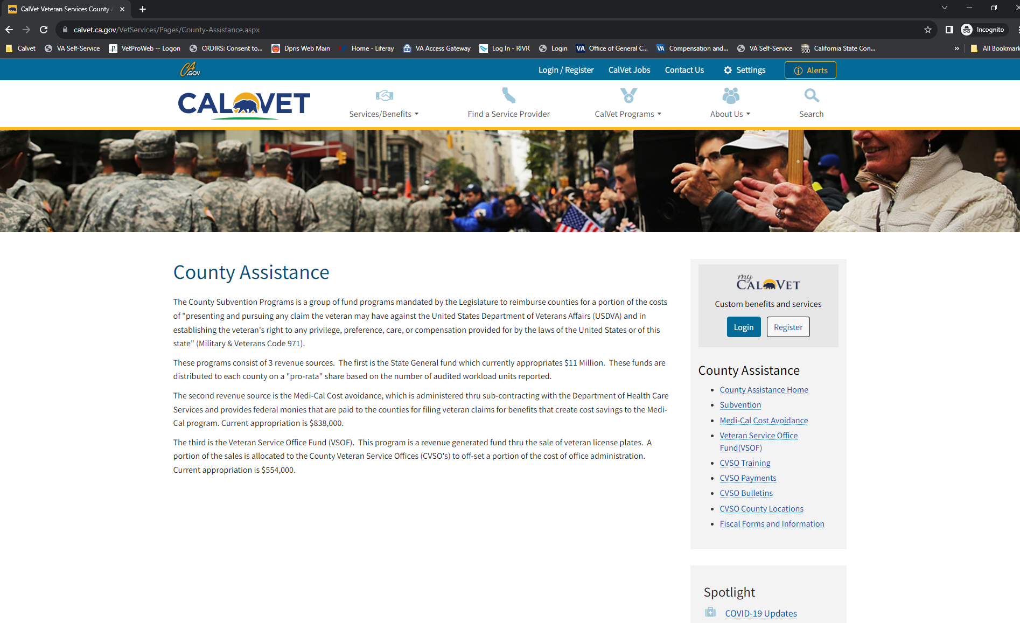
County Veterans Service Office Audit

Slide 3
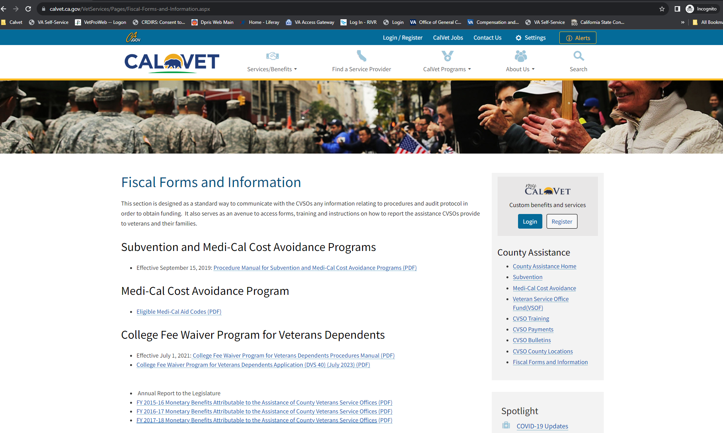
County Veterans Service Office Audit

Slide 4
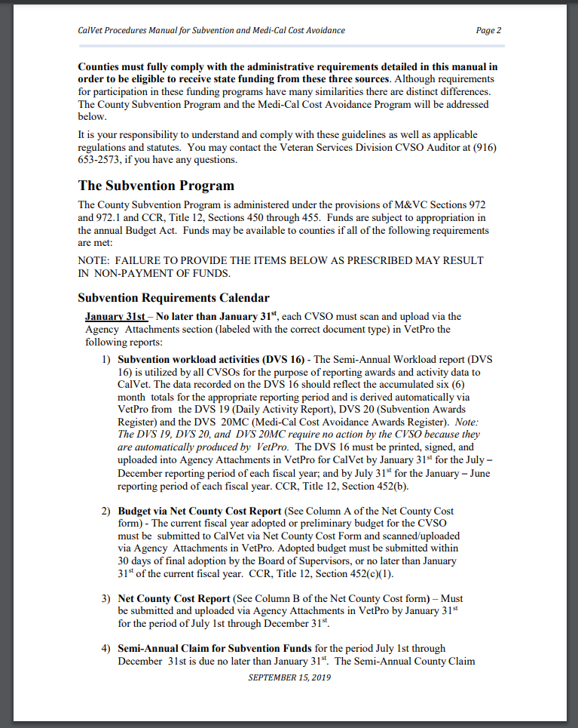
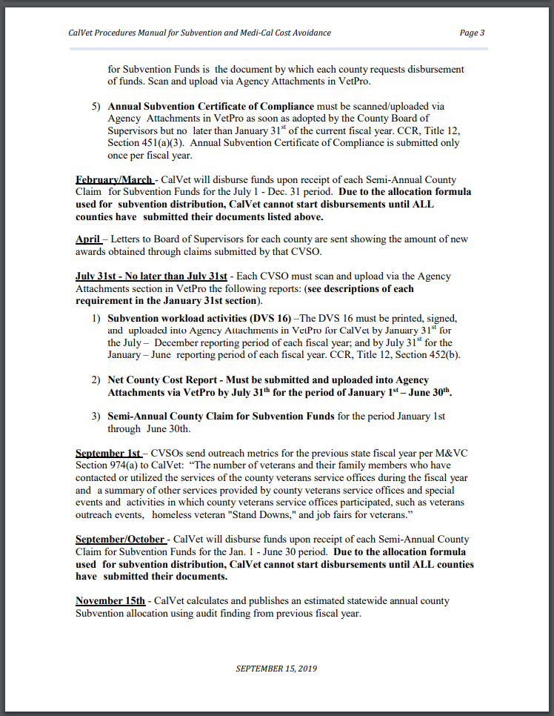
County Veterans Service Office Audit – Fiscal Year (July 01, 2023 – June 30, 2024)

Slide 5
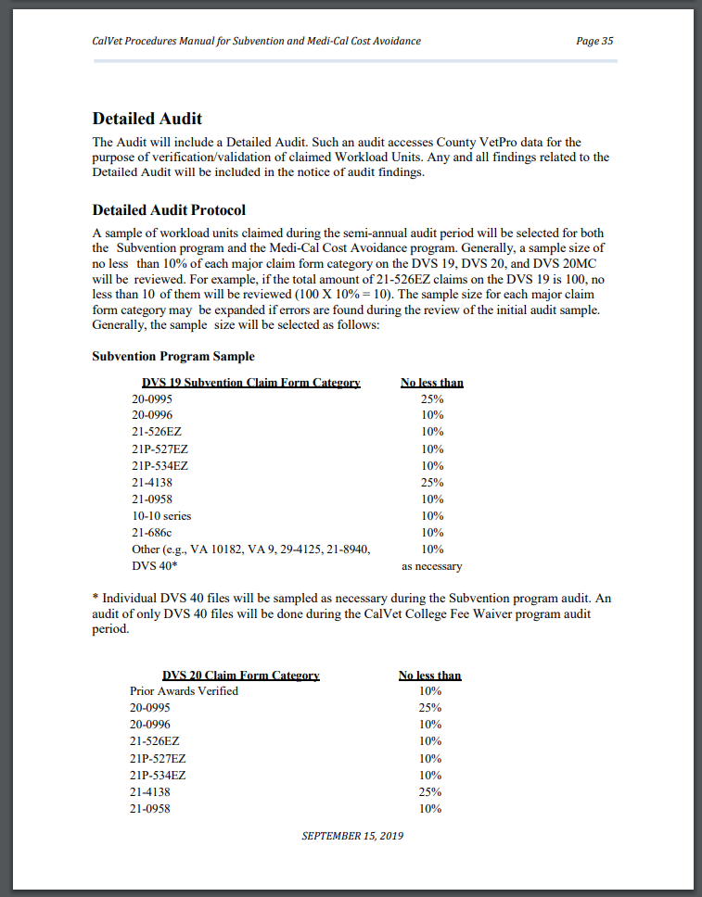
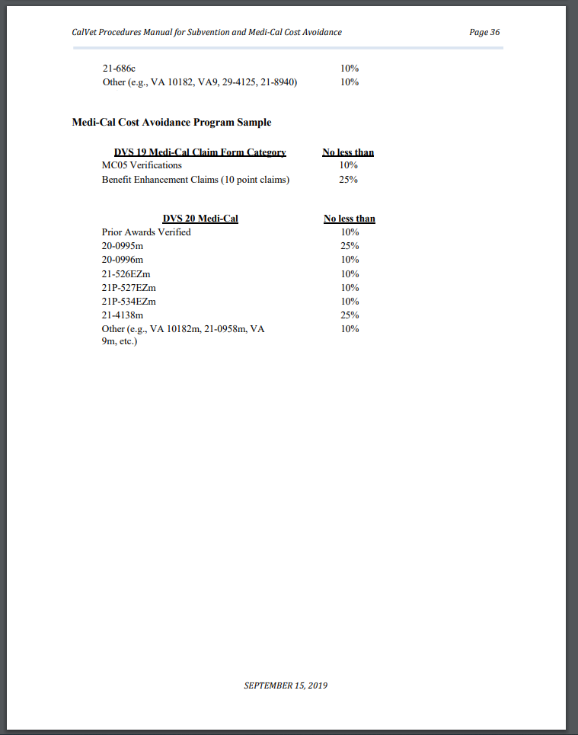
County Veterans Service Office Audit (Audit Sample Size)

Slide 6
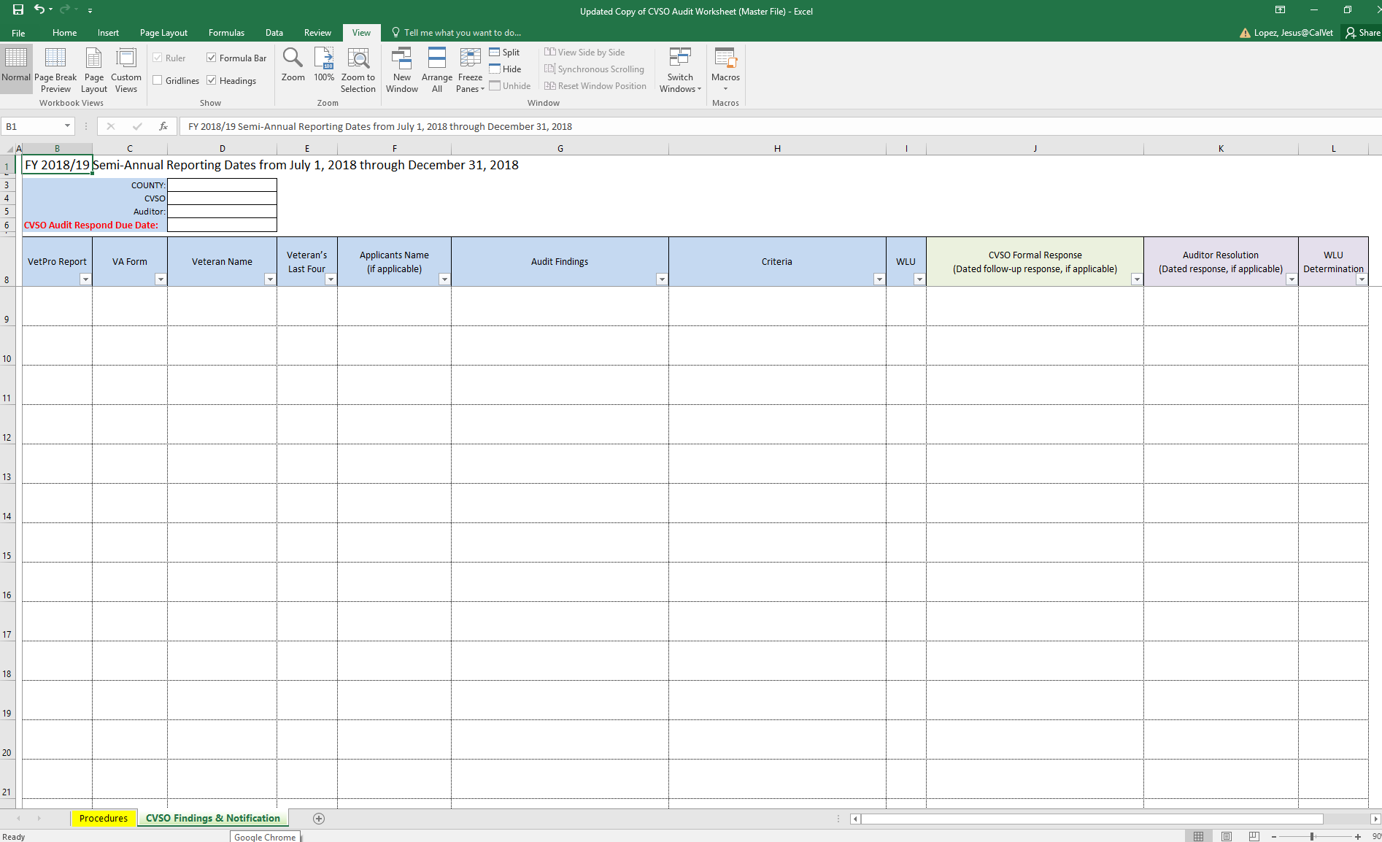
Audit Findings

Slide 7
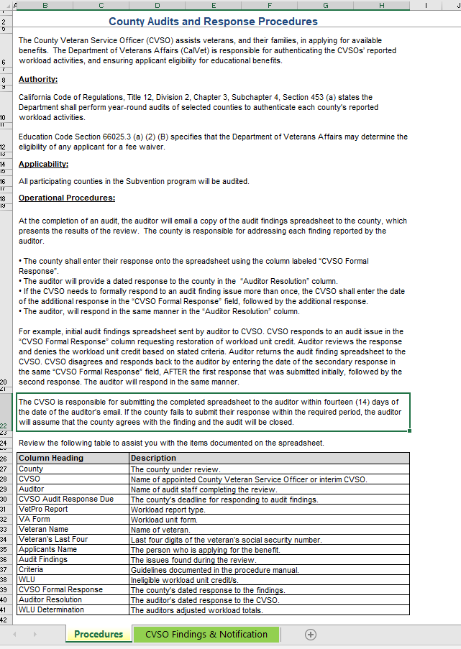
Audit Findings

Slide 8
Contact Information
Jesus Lopez
County Veterans Service Office Auditor
(916) 503 – 8002
Jesus.Lopez@calvet.ca.gov

