Slide 1
Local Interagency Network Coordinators (LINCs)
Spring Training Conference
June 10, 2024

Slide 2
LINCs – What We Do
Provide outreach to service members, veterans, and their families
Understand what many veterans organizations do and do not do, by working, meeting and collaborating with them often
Make referrals with established service provider networks
Provide leadership and advocacy to local communities
Assist with local emergencies

Slide 3
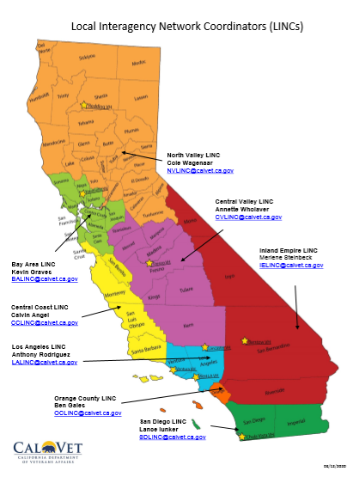
8 LINC Regions

Slide 4
LINCs Meet Two Significant Needs
They connect veterans, active duty, reservists, national guard and their families to veteran benefits.
  Areas include, VA Claims Processing, benefits acquisition, emergency housing, education, health care, mental health, employment assistance, and more.
They explain entire benefits process;
  Federally - various areas of VA, Congressional Reps Statewide - CalVet, EDD, DoR, State School VRCs, Regionally – JVS, US Vets, Cohen Clinic, Countywide – MVA, VPAN, DMH and locally – services for specific cities.

Slide 5
Most Common LINC Requests
VA/CA State Veteran Educational Funding Info
Understanding How VA works
Fed’l, State, County, City, NP Veteran Benefits Info
Contacts for Veteran Housing, Healthcare, Mental Health, Employment, & Education
VA/CalVet Home Loan info
Description/Uses of CalTAP
Local College VRC Contacts
Distinction of benefits for Active Duty, Reserves & NG
Assistance in acquiring various CalVet benefits and services

Slide 6
CVSO Collaboration
Alfred Sims – Solano County CVSO
Matt McCoy – Butte County CVSO
Darlyn Escalante – Santa Clara County CVSO
Rochelle Arnold – Sacramento County CVSO

Slide 7
Questions

Slide 8
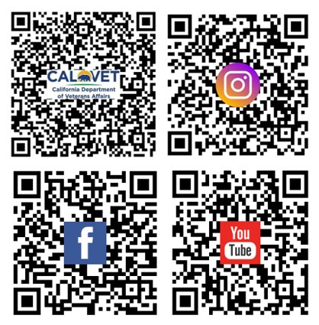
San Diego – Lance Iunker
  SDLINC@calvet.ca.gov
Inland Empire – Merlene Steinbeck
  IELINC@calvet.ca.gov
Los Angeles – Anthony Rodriguez
  LALINC@calvet.ca.gov
Orange – Ben Gales
  OCLINC@calvet.ca.gov
Central Coast – Calvin Angel
  CCLINC@calvet.ca.gov
Central Valley – Annette Wholaver
  CVLINC@calvet.ca.gov
Bay Area – Kevin Graves
  BALINC@calvet.ca.gov
North Valley – Cole Wagenaar
  NVLINC@calvet.ca.gov

