Slide 1
Digestive system change
June 2024 Kimberly Dickerson, DRO/RQRS

Slide 2
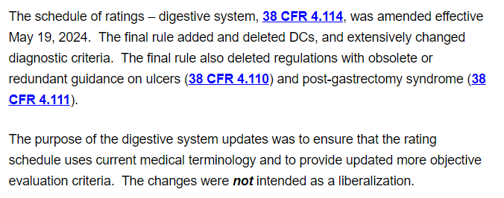
Purpose of the change

Slide 3
Digestive Rating Schedule Changes
05/22/1964 (earliest listed in 38 CFR 4.114 eCFR)
03/11/1969
09/15/1975
03/18/1976
05/31/2001
05/19/2024

Slide 4
Digestive Change Effective May 19, 2024 Highlights
The Schedule for Rating Disabilities of the Digestive System changed effective 5/19/2024
Completely new rule for defining “weight loss and nutrition” under 4.112
4.114 intro changed for which DCs can be separate and which cannot
BRAND NEW DC:
DC 7206 GERD
DC 7207 Barrett’s Esophagus
DC 7303 Chronic complications of upper GI surgery
DC 7352 Pancreas transplant
DC 7355 Celiac disease
DC 7356 Gastrointestinal dysmotility syndrome
DC 7357 Post pancreatectomy syndrome
Only 4 DCs remained unchanged:
DC 7311 Residuals of injury to the liver
DC 7331 Peritonitis, tuberculosis, active or inactive
DC 7342 Visceroptosis, symptomatic, marked
DC 7343 Malignant neoplasms of the digestive system

Slide 5
Weight loss and nutrition
38 CFR 4.112:
“Substantial Weight Loss” means involuntary loss greater than 20% of baseline
“Minor Weight Loss” means involuntary loss between 10-20% of baseline
“Baseline Weight” means clinically documented average weight for 2 years preceding onset of illness
“Undernutrition” means deficiency resulting from insufficient intake of one or multiple essential nutrients, or the inability of the body to absorb, utilize, or retain such nutrients.

Slide 6
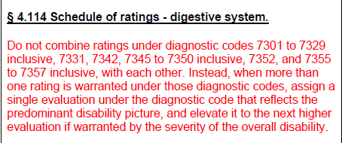
Separate or combined evaluations?

Slide 7
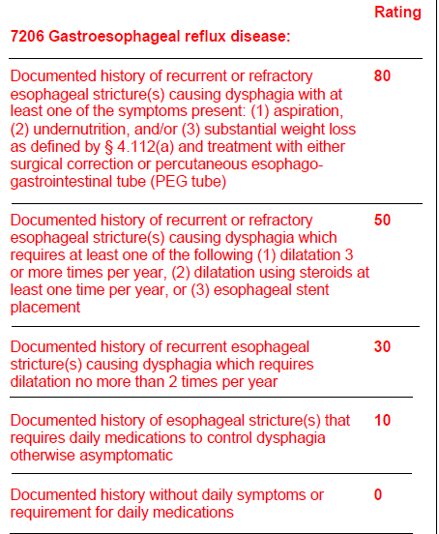

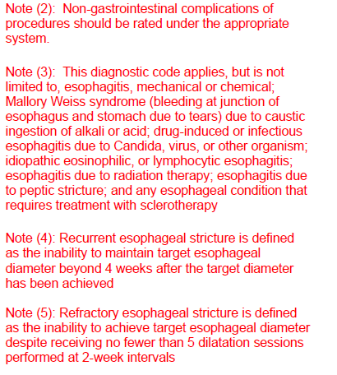
DC 7206 GERD (finally, right? Or not?)

Slide 8
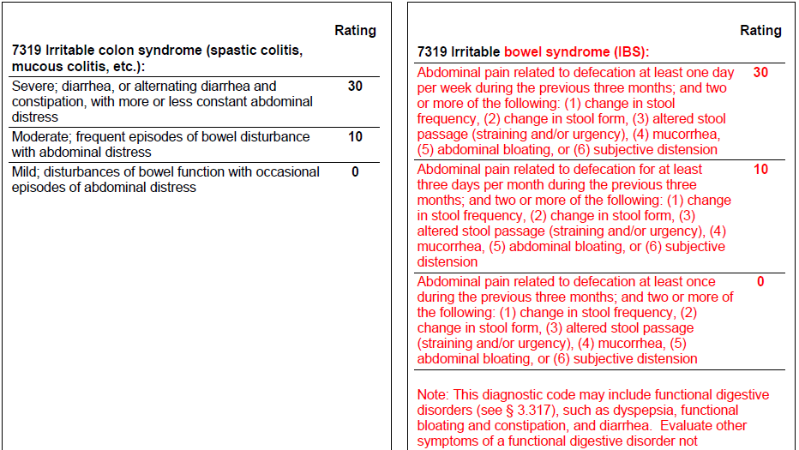

DC 7319 IBS

Slide 9
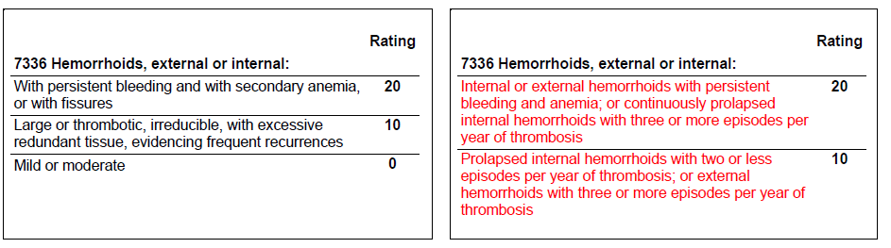
DC 7336 Hemorrhoids

Slide 10
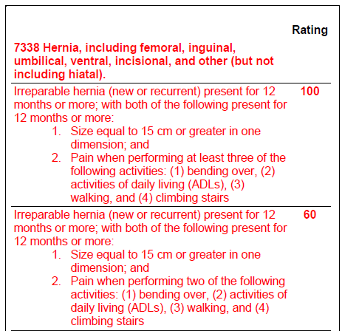
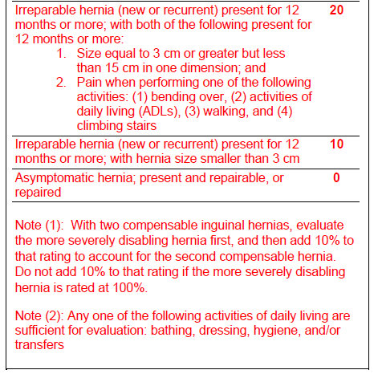
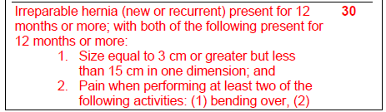
DC 7338 Hernias

Slide 11
What do we do now for all those claims pending before 5/19/2024?
For claims pending prior to 5/19/2024:
Eff 05/19/2024, the DBQs have been changed to accommodate the new criteria
Exams must include BOTH the criteria for the digestive condition BEFORE the change and AFTER the change to the rating schedule.
This will likely result in lots of deferred decisions
Consideration must be given to the criteria before and after the change
The higher evaluation will be assigned based on whichever will warrant a higher evaluation—old or new criteria
In ratings, a discussion of both the old and new criteria must be given
Ratings in existence prior to the change in the rating schedule cannot be reduced simply because the criteria changed (38 CFR 3.951)
***This is the SAME guidance for every change in the rating schedule***

Slide 12
What about new or increase claims received on or after 5/19/2024?
For claims received on or after 5/19/2024:
Only the new criteria will be used to evaluate disabilities
The law does not allow for a reduction solely based on a change in the criteria (38 CFR 3.951)
The law does not allow for a reduction based on one exam for evaluations that have been in effect for more than 5 years (38 CFR 3.44)
If the new criteria provides a higher evaluation, we will assign it. If it would be a lower evaluation, we will continue the prior evaluation (**the first time, see last statement)

Slide 13
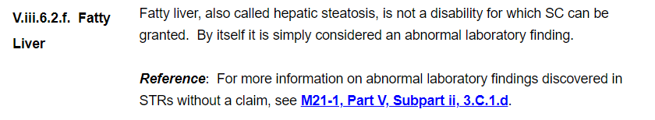
Also…
**Not new**

Slide 14
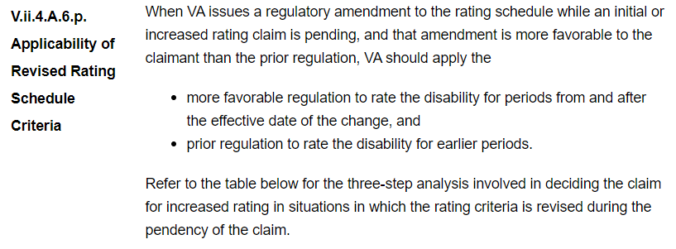
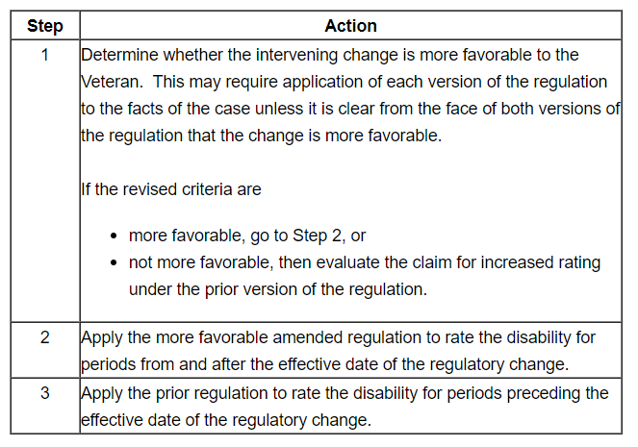
Effective dates

Slide 15

Got all that?

