Slide 1
California Transition Assistance Program (CalTAP) Overview
Alyssa Albright
Training and Evaluation, CalTAP

Slide 2
Agenda
CalTAP Mission
Thank You
Upcoming Events
Future Collaboration

Slide 3
CalTAP Mission
Connect service members, veterans, and their families of all eras to their earned benefits-via pathways
Online Curriculum
Virtual/Hybrid Workshops
Department of Defense Installations (DoD)
Institutions of Higher Learning/California Community Colleges
CalTAP 360-Specialized Trainings
In-Person Workshops
Department of Defense Installations (DoD)
Institutions of Higher Learning/California Community Colleges
Notes:
How we do it

Slide 4
CalTAP Pathways
Designed to inform and connect veterans of all eras to their earned federal and state benefits as well as provide continued support and assistance as their needs change over time through five pathways:
Core Curriculum
Education
Employment
Entrepreneurship
Veteran Cultural Competency for Service Providers

Slide 5
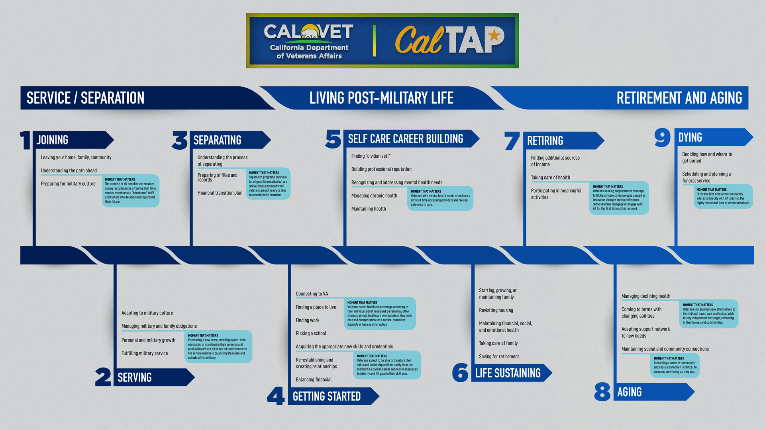
Notes:
Explain the moments that matter.

Slide 6
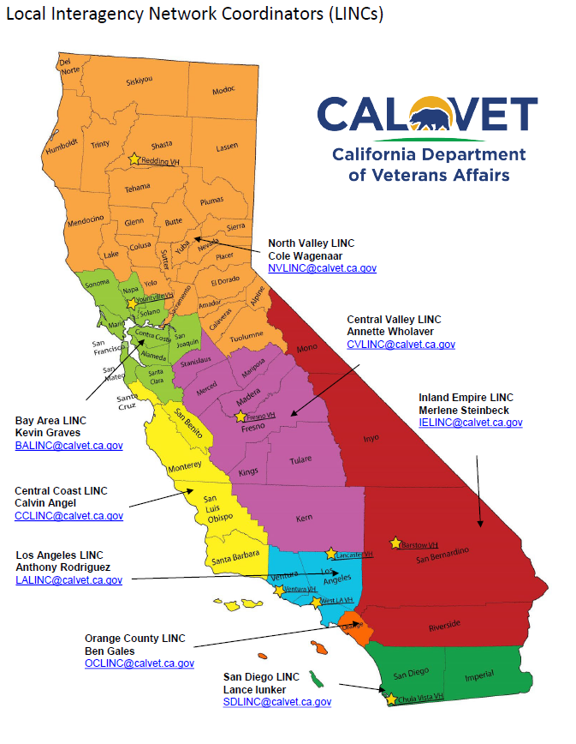

Slide 7
Local Interagency Network Coordinators (LINCS)
Provide outreach to service members, veterans, and their families
Make referrals and work directly with established service provider networks
Assist with local emergencies
Provide leadership and advocacy to local communities

Slide 8
Community Partners: Federal, State, Local
Veteran Readiness & Employment
Department of Labor Veterans
US Vets Outside the Wire
Work for Warriors
Employment Development Department
Veterans Legal Institute
Swords to Plowshares
California Institutions of Higher Learning
County Veteran Service Offices
VA HealthCare Administration
Vet Centers
Support The Enlisted Project
US Customs & Boarder Protection
California Department of Corrections & Rehabilitation
Veteran Business Outreach Centers
Small Business Administration
Notes:
Community based system of care

Slide 9
County Veteran Service Office Support
Thank You

Slide 12
Upcoming Events
Location | Date of Event
Miramar | 2/12/2024
Lemoore | 2/21/2024
Camp Pendleton | 2/23/2024
Marine Corps Recruit Depot | 2/27/2024
Ventura | 2/28/2024
Los Angeles SFB | 2/29/2024
Fort Irwin | 3/1/2024
Beale ANG | 3/2/2024
March ARB | 3/7/2024
Twentynine Palms | 3/14/2024
Vandenberg | 3/29/2024
Lemoore | 4/3/2024
Beale AFB | 4/18/2024
ATG San Diego | 4/30/2024
Ventura | 5/15/2024
Marine Corps Recruit Depot | 5/21/2024
Miramar | 5/23/2024
Camp Pendleton | 5/30/2024
Lemoore | 6/5/2024
Los Angeles SFB | 6/6/2024
Location | Date of Event
Fort Irwin | 6/17/2024
Camp Pendleton | 7/2/2024
Beale AFB | 7/25/2024
ATG San Diego | 7/30/2024
Miramar | 8/8/2024
Ventura | 8/14/2024
Marine Corps Recruit Depot | 8/27/2024
Fort Irwin | 9/4/2024
March | 9/13/2024
Twentynine Palms | 9/19/2024
Lemoore | 9/21/2024
Vandenberg | 9/27/2024
Los Angeles SFB | 10/3/2024
Beale AFB | 10/15/2024
Camp Pendleton | 10/17/2024
Marine Corps Recruit Depot | 10/27/2024
Ventura | 11/13/2024
Miramar | 11/14/2024
ATG San Diego | 12/3/2024
Fort Irwin | 12/13/2024

Slide 13
Future Collaboration
Quick Survey

Slide 14
Thank you for your continued support.
Alyssa.Albright@calvet.ca.gov
Training & Evaluation, CalTAP
916-809-0016

