Slide 1
CalVet Home Loans
Brad Pedersen
CalVet Home Loans

Slide 2

CalVet Home Loans
CalVet Home Loans is a state agency dedicated to providing low- cost home loans to veterans purchasing homes in California. This benefit is offered to veterans as a “thank you” for the sacrifices made for our state and nation.

Slide 3




What is the difference between CalVet and VA?
VA is a federal benefit that can be used to purchase a home anywhere in the US.
VA is a loan guaranty not a loan.
CalVet is a state benefit and we fund all our loans through the sale of tax-exempt bonds at no cost to the taxpayers of thestate of California.

Slide 4

So How Do We Underwrite?
CalVet manually underwrites every loan to expand the homeowner benefit to include “complex credit profile” veterans. It is a very personal process.
Follow Federal VA guidelines
VA handbook for source document
No automated underwriting systems are used
No minimum FICO scores
No pricing overlays for income, asset, employment
Property appraisals are accepted with no additional overlays other than health and safety items
5

Slide 5
Short Sale, Foreclosure, VA loan in use
CalVet has the unusual ability to help veterans who experienced a short sale or foreclosure while using their VA loan eligibility.
CalVet may stretch remaining eligibility or offer a compromise with a down payment.

Slide 6
The CalVet Loan Limits
Maximum Loan Amount:
$958,187 to $1,437,281
Depending upon the county property is located in.

Slide 7
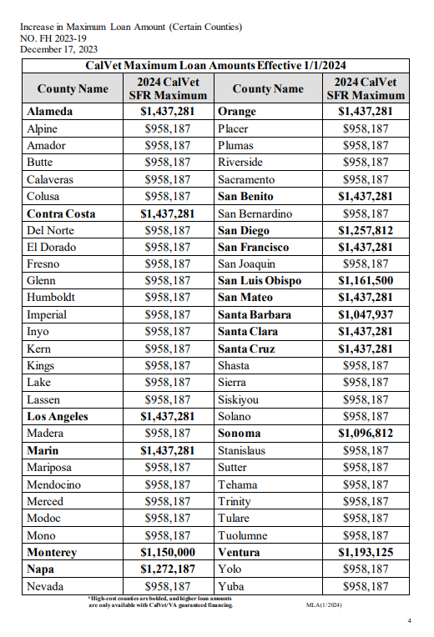

Slide 8

We Really Do Care
CalVet has consistently sustained one of the lowest cancellation rates as reported in the National Delinquency Survey conducted by the Mortgage Bankers Association.
This is measureable proof of CalVet’s commitment to keep veterans and their families in their homes. (Cancellation compares to foreclosure.)

Slide 10
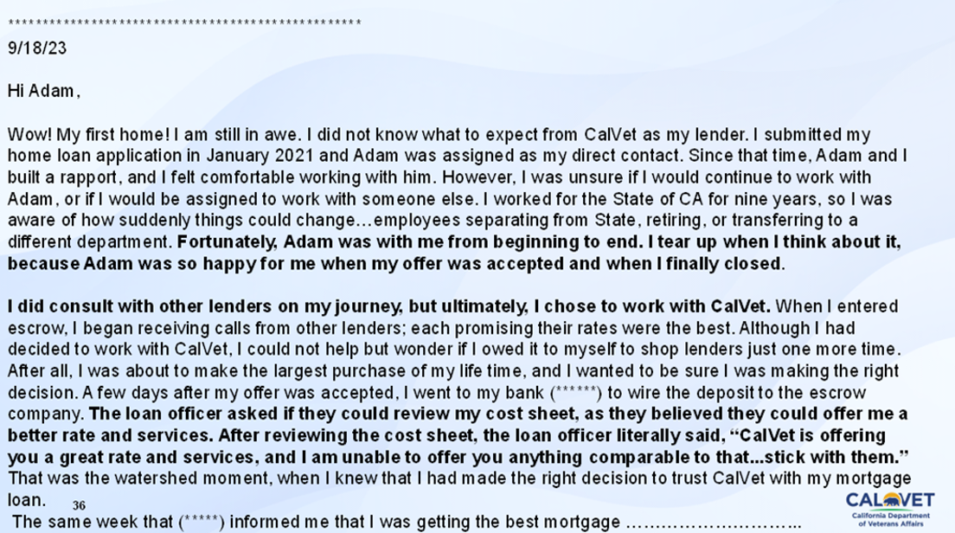

Slide 11
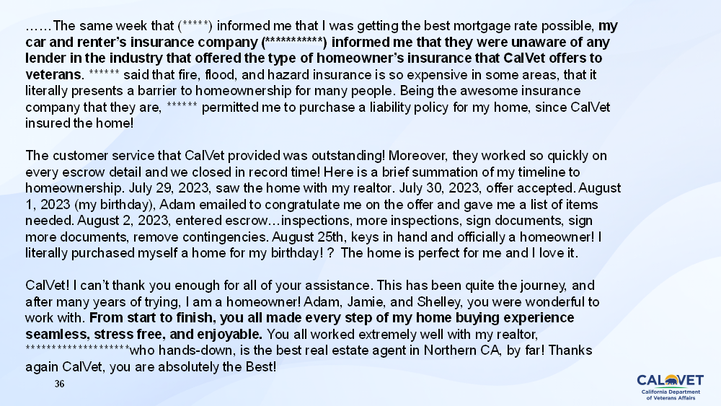

Slide 14



Quick Review: What are the benefits?
CalVet Home Loans provides veteran friendly underwriting terms.
CalVet owns and services the loan for the life of the loan.
CalVet provides superior insurance products
Low deductible, full replacement fire, hazard, earthquake and flood insurance.
CalVet guarantees the home will be rebuilt in full with material of like kind and quality, (guaranteed replacement cost), subject to the deductible and special conditions.

Slide 15
From: Veteran
Sent: Tuesday, August 17, 2021 9:22 AM
To: NVLINC@CalVet <NVLINC@calvet.ca.gov>
Subject: Fire
CAUTION: This email originated from outside of CalVet! Do not click links, open attachments, or reply, unless you recognize the sender's email address and know the content is safe!
Hi, my name is “Veteran”. I live/lived ------------------------------------------ Grizzly Flats Ca 95636
We’re we’re evacuated under order from the Caldor fire last night. The home is under a Calvet loan. I haven’t ever missed one payment. We are in need of help please?
Living in my home was my wife, L. My 89 year old mother. And my daughter. Im afraid we’re now homeless, and don’t know what to do.
I can be reached at --- --- ----
Thank you for your time

Slide 16
From: Cole@CalVet
Sent: Tuesday, August 17, 2021 10:01 AM
To: Veteran>
Subject: RE: Fire
Veteran,
If you need a safe place to go immediately there is an evacuation center at the Diamond Springs Fire hall 3734 China Garden Road, Diamond Springs, CA 95619.
Once you’re safe please reach out to the CalVet insurance provider at 800-626-1613. You can also call the CalVet Home Loans Protection Unit at 866-421-6978.
I’ve also attached a veteran’s resources sheet for El Dorado County. In the housing section there are numbers for Volunteers of America (916-228-3153) and El Dorado Veteran Resources (530-621-5146). Both of these may have additional resources for veterans.
I’m going to call your phone after I send this to talk it through.
Cole
North Valley LINC
California Department of Veterans Affairs
1227 O Street, Sacramento, CA 95814
Serving California’s Veterans and Their Families.

Slide 17
From: Cole@CalVet <Cole.@calvet.ca.gov>
Sent: Tuesday, August 17, 2021 10:17 AM
To: Steve@CalVet <Steve@CalVet.ca.gov>
Cc: Patrick@Calvet <Patrick@calvet.ca.gov>; Gary@CalVet <Gary@calvet.ca.gov>
Subject: FW: Fire
Steve,
Just as a heads up, I spoke to this veteran by phone this morning. He and his family are safe now, but he may have lost his home in the Calder Fire (El Dorado County) last night. I gave him the number for the insurance company and the Home Protection Unit. Just let me know if there’s any other way for me to help out.
Cole
North Valley LINC
California Department of Veterans Affairs
1227 O Street, Sacramento, CA 95814
Serving California’s Veterans and Their Families.

Slide 18
From: Gary@CalVet
Sent: Tuesday, August 17, 2021 11:01 AM
To: Cole@CalVet <Cole.@calvet.ca.gov>; Steve@CalVet <Steve.@CalVet.ca.gov>
Cc: Patrick@Calvet <Patrick.@calvet.ca.gov>
Subject: RE: Fire
Hi Cole,
Steve has already been in touch with “the Veteran” this morning and CalVet will provide him housing as long as he is evacuated. If his home is a total loss, we will be with him every step of the way. Thank you for the heads up.
Thank you,
Gary
Loan Production Operations Manager
California Department of Veterans Affairs
CalVet Home Loan Division
Gary@calvet.ca.gov

Slide 19

Ask For Help!!! Down Payment & Costs Assistance Programs
CalVet has various programs call for current updates
3% deferred payment loan for closing fees
Realtor groups assistance
CalHFA programs
Counties Mortgage Assistance Program (MAP)
Workforce Initiative Subsidy for Homeownership (WISH)

Slide 20
VA Form 26-10291
One feature of your Department of Veterans Affairs (VA)-guaranteed loan is that the loan is assumable. An assumption is where a purchaser agrees to purchase your home by taking over your mortgage obligation and property ownership. If the assumer (purchaser) is an eligible Veteran with sufficient entitlement, your assumption may also include a Substitution of Entitlement (SOE). The assumer (purchaser) must meet VA's SOE requirements listed below. Any qualified purchaser (including a non-Veteran) may assume the remaining balance of your VA-guaranteed loan. The purchaser must meet VA's credit and income underwriting standards and the loan must be current at the time of closing. If the assumption is approved, you will no longer be responsible for the mortgage payment on the VA-guaranteed loan. However, your entitlement will still be tied to the loan unless the assumption includes a SOE. To complete an assumption with a SOE, the assumer must be an eligible Veteran who meets VA's SOE requirements and who is willing to substitute their entitlement for yours. … (partial form)

Slide 21
How do I apply?

Slide 22
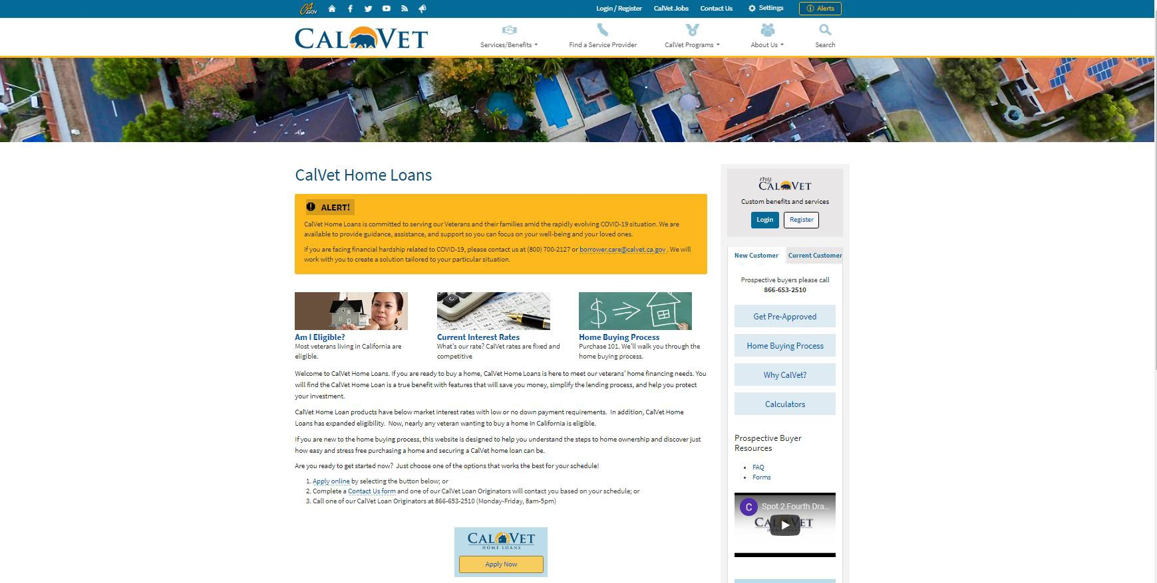

Slide 23
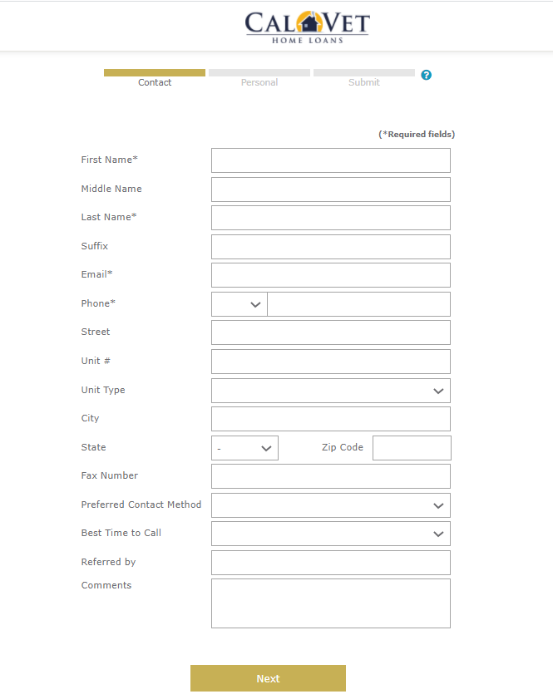

Slide 26
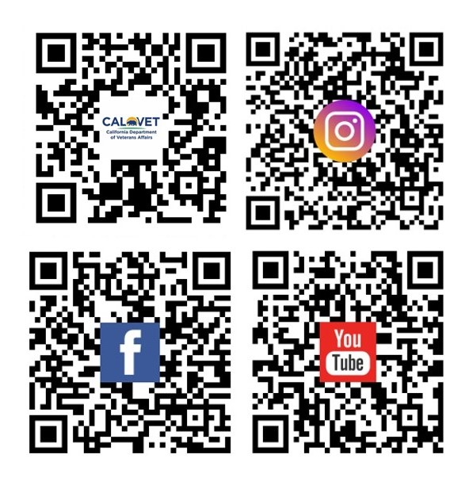
California Department of Veterans Affairs
CalVet Home Loans
1-800-952-5626
www.calvet.ca.gov
Brad Pedersen
(866) 653-2510
(916) 747-4137
brad.pedersen@calvet.ca.gov
www.calvet.ca.gov/homeloans

