Slide 1
VA Debt Management Center (DMC)
Veterans Service Organization Presentation
Updated November 13, 2023

Slide 2
Agenda
DMC overview
Debt establishment
Understand collection processes
Ask VA Tips
Debt resolution options
Risks of non-payment
Questions

Slide 3
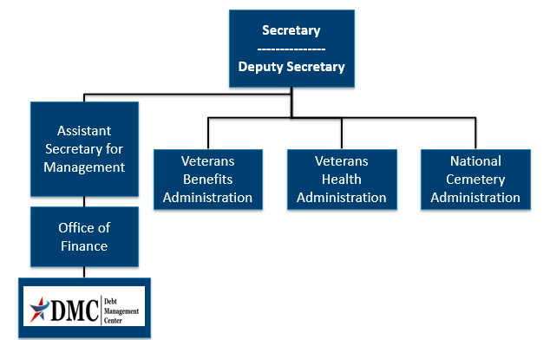
Organization Chart

Slide 4
DMC Mission
Provide distinctive, high quality accounts receivable services through a compassionate and value-added approach, empowering our stakeholders to focus on core missions.

Slide 5
Debt Establishment
RO/RPO Receives information
Education Certification
Change in circumstances affecting benefit eligibility or entitlement
RO/RPO Processes Claim/Award
Evaluates eligibility/ entitlement
Issues payments and establishes debts
Sends a letter when payments are issued or debt created
DMC Collects Debts
Sends collection letters for debts
Processes collection actions

Slide 6
Debt Establishment
Compensation/ Pension
Changes in income or net worth
Active-duty time or drill pay days
Change in dependency
Fugitive felon status or incarceration
Payments issued after death of beneficiary
Education
Withdrawal from class
Not attending class
Class did not count toward graduation
Change in active-duty status
General
Failure to obtain Release of Home Loan Liability
Duplicate or erroneous payments issued

Slide 7
Collection Process
DMC sends Notice of Indebtedness letters, monitors accounts, and advises debtor of any delinquency, including the requirement to refer their account to Treasury
DMC Sends 1st Letter
30 or 90 days
DMC Sends 2nd Letter
30 days
DMC Sends 3rd Letter
If DMC receives payment, next collection letter is deferred
Debt is Referred to Cross Servicing
60 days
Debt is Referred to Treasury Offset Program
60 days

Slide 8
Relief, Resolution, and Referrals
DMC sends Debt Notice
Debtor contacts DMC
· Pay In Full
· Benefits Offset in Full or in Part
· Payment plan
· Compromise
· Waiver/Waiver Reconsideration
· Dispute
· Temporary Suspension
No Action/Payment
· Benefits offset in Full
· Referral to:
- TOP
- Cross-Servicing

Slide 9
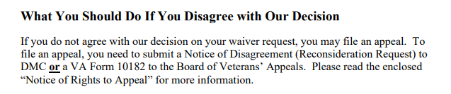
Appealing a Waiver Decision
Language from Committee on Waivers and Compromises (COWC) letter:
*** Veterans should not use VA form 10182, 20-0996, or 20-0995 to appeal a waiver decision with DMC***

Slide 10
Appealing a Waiver Decision
Send to | Form to use | Info to include | Reviewed by | Stops collection?
DMC | None- request must be in writing | Indicate request is for reconsideration of waiver decision, include support for reconsideration | COWC | No
BVA | VA Form 10182 | Complete form including signature | Board of Veterans Appeals | No

Slide 11
VA Debt Portal for Veterans
Debt Portal: https://wwwˌvaˌgov/manage-va-debt/
Veterans can log in to view balances
FAQ’s
Email notifications to Veterans
Online VA Form 5655 Financial Status Report (FSR)
More enhancements to come

Slide 12
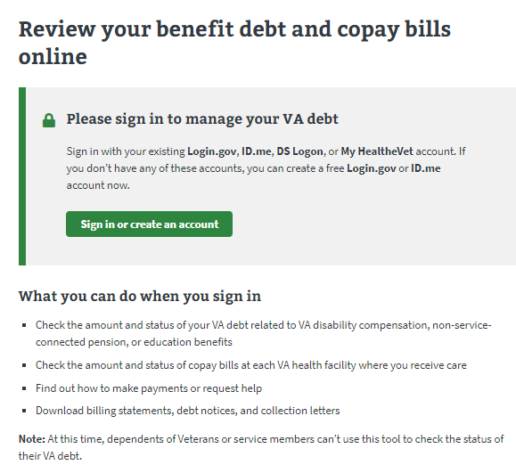
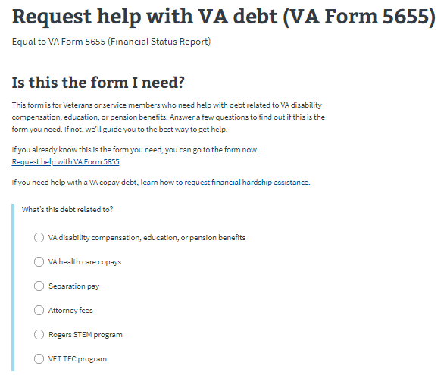
Online VA Form 5655

Slide 13
Ask VA (AVA)- DMC Tips
Located at https://askˌvaˌgov/
DMC has a PDF guide for VSOs on how to use AVA for DMC inquiries

Slide 14
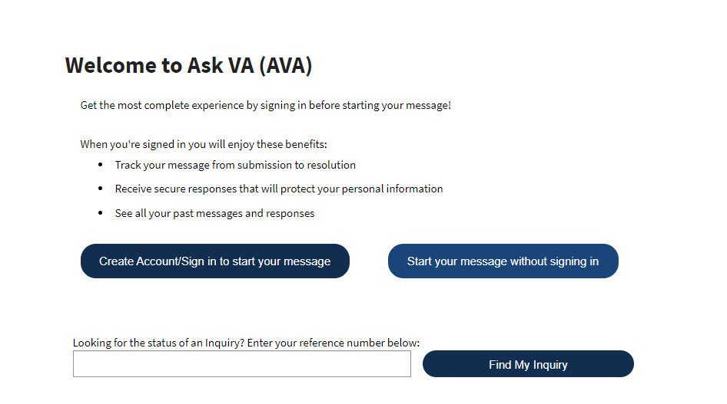
AVA- DMC Tips

Slide 15
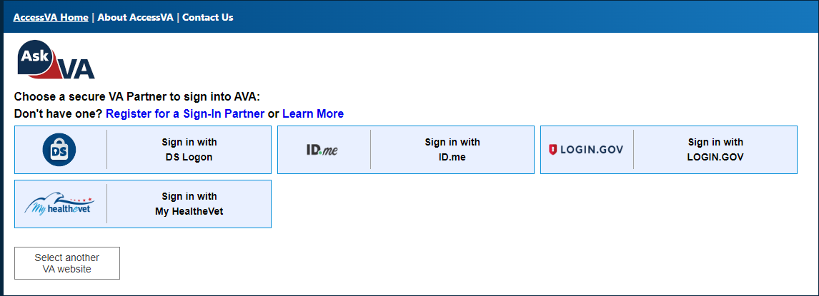
AVA- DMC Tips

Slide 16
AVA- DMC Tips

Slide 17
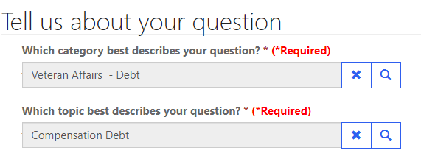
AVA- DMC Tips
Options to reach DMC are found under “Veteran Affairs- Debt” category and then topics are used to select the type of debt for proper routing

Slide 18
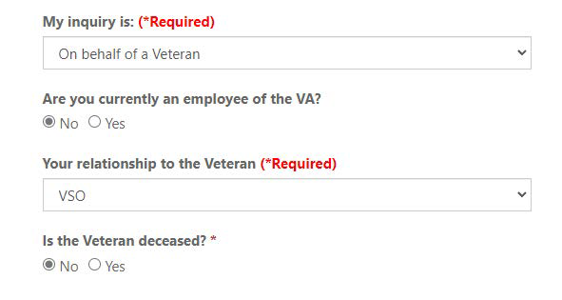
AVA- DMC Tips

Slide 19
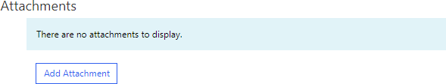
AVA- DMC Tips
The option to Add Attachment is on the last page before submission

Slide 20
Federal Debt Collection Laws
The Debt Collection Act of 1982
Authority for collection by administrative offset
The Debt Collection Improvement Act (DCIA) of 1996
Agencies required to refer delinquent non-tax debts to the Department of Treasury at 180 days
Digital Accountability and Transparency Act (DATA) of 2014
Changed referral requirement for delinquent non-tax debts from 180 days to 120 days

Slide 21
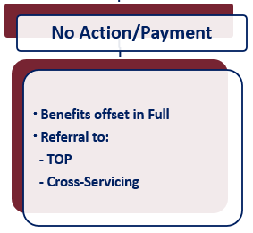
What if Payment is not Made?
Future VA benefits awarded will be withheld to satisfy debt
Department of Treasury
Offset of Federal payments
Referral to private collection agencies
Administrative Wage Garnishment Program

Slide 22
VHA Debts
For questions about medical care and pharmacy services copayment debt, contact the Health Resource Center:
1-866-400-1238
VA has options for Veterans who suffer from difficult financial circumstances and struggle to pay VA copayments:
Health Resource Center: 1-866-400-1238
https://wwwˌvaˌgov/COMMUNITYCARE/revenue_ops/Financial_Hardshipˌasp

Slide 23
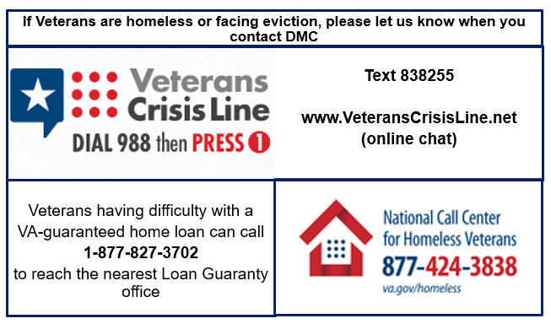
At Risk Veterans

Slide 24

Become a Debt Superstar (Contact DMC)
https://www.va.gov/manage-va-debt/ | Veteran Debt Portal
https://ask.va.gov | Online inquiry system
800-827-0648 | DMC Veteran Toll Free Line
612-970-5688 | Fax
612-970-5737 | DMC VSO Only Line

Slide 25
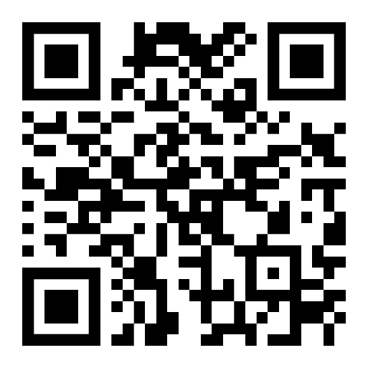
DMC Presentation Survey
DMC values your time and feedback on our presentation. We would appreciate it if you’re able to complete the survey below.
https://wwwˌsurveymonkeyˌcom/r/DMCVSO

Slide 26
Additional Information

Slide 27
Pay in Full
Pay by check: mail the check, payment coupon(s) and/or letter to:
VA Debt Management Center
Bishop Henry Whipple Federal Building
P.O. Box 11930
St. Paul, MN 55111-0930
Pay online: wwwˌpayˌvaˌgov
Pay by telephone: 800-827-0648

Slide 28
Withholding VA Benefits
Automatic 36-month repayment plan for compensation and pension debts
Full amount of benefit payment will be withheld until debt is paid in full for education debts
If debtors have financial hardship, please have them contact DMC
VA Form 5655, Financial Status Report, is required for any reduced withholding arrangement beyond 60 months

Slide 29
Compromise
Debtors should send letter to DMC indicating “compromise offer” and specifying amount
Offer should be a “lump sum”
Offer must include VA Form 5655
DMC refers offers to the Committee on Compromises
*** Payment should not be sent until the debtor receives a decision accepting the offer***

Slide 30
Waiver
Debtors have 180 days from date of first DMC debt letter to request waiver
Request must be:
Made in writing and submitted to DMC
Include VA Form 5655 Financial Status Report
Explain why debtor is unable to repay the debt
Received in the first 30 days for Education or 90 days for C&P debt to stop collection action

Slide 31
Dispute
Debtors can dispute the existence or amount of the debt created by VBA
Dispute must be in writing
DMC forwards disputes to the Regional Office/Regional Processing Office of jurisdiction

Slide 32
Temporary Suspension
Disaster Relief
Case by case financial hardship
Does not extend timeline to request waiver

