Slide 1
Housing First

Slide 2
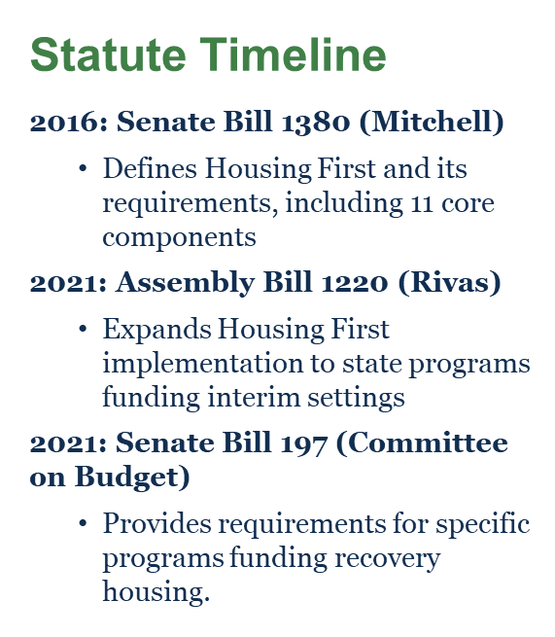
What is Housing First?
Housing First: The evidence-based model that uses housing as a tool, rather than a reward, for recovery and that centers on providing or connecting [people experiencing homelessness] to permanent housing as quickly as possible. Housing First means voluntarily services and housing lease not contingent on participation in services. (Welfare and Institutions (WIC) § 8255(d)(1))
Harm Reduction: an evidence-based approach that is critical to engaging with people who use drugs and equipping them with life-saving tools and information to create positive change in their lives and potentially save their lives.
Notes:
SHAWN (5 minutes, 2:15 – 2:20pm EST).

Slide 3
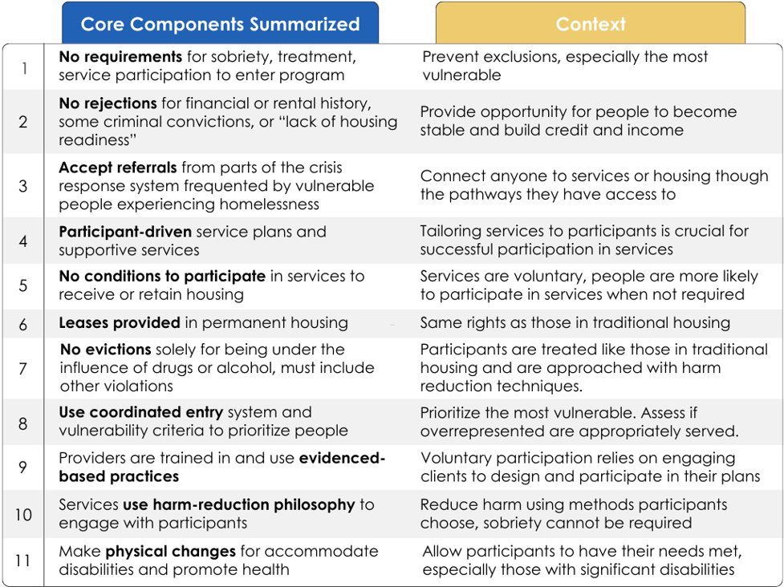
Housing First Core Components
Notes:
The experience of military service is rewarding to all who served. But for some who experience trauma, military service can be the cause of major mental health challenges, Many of those challenges lead to substance use as a coping mechanism, but add the potential of anxiety and depression around reintegration, well that cocktail is the main reason for homelessness amongst the veteran population. Its tempting to think that high housing costs is the main driver, but affordability is more of a contributing factor, especially amongst the veterans who reintegrate with mental health disorders. If you add the taxing experience of extended homelessness, then the result is a major substance use disorder and compounding mental health disorders…a runaway train heading for a boulder on the tracks.

Slide 4
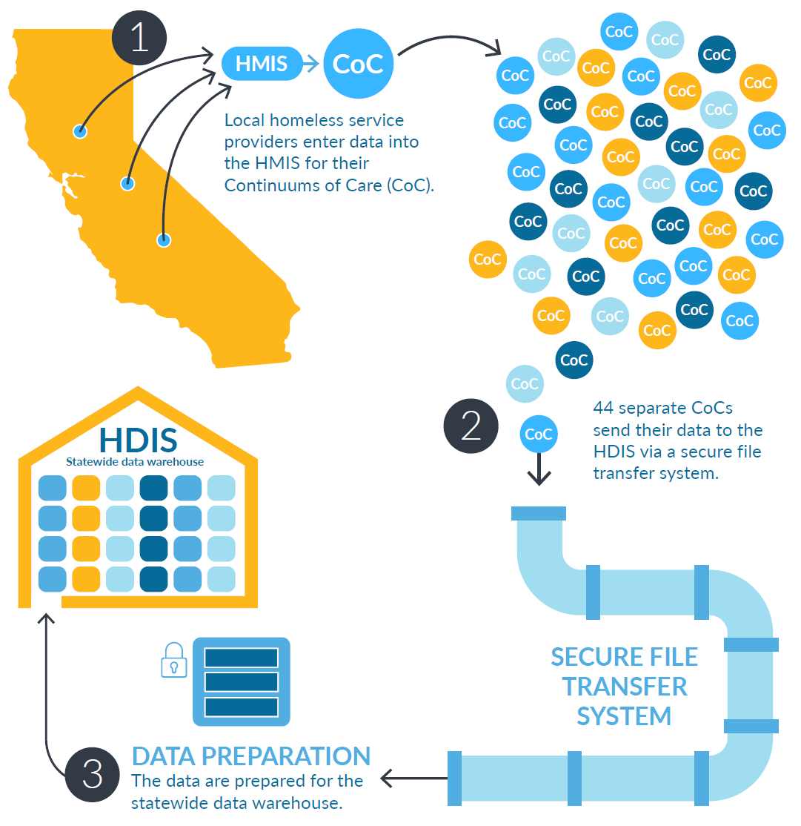
Homeless Data Integration System (HDIS)
    Services are entered by the 44 Continuum of Care (CoC) entities providing prevention, outreach, emergency sheltering, rapid rehousing, other permanent housing, and other services.​
    Cal ICH collects data on a quarterly basis by working with the 44 CoCs.​
    Once ingested into HDIS, data is standardized, cleansed, de-duplicated, and matched, which makes the data much more accurate when looking at statewide figures.

Slide 5
Veteran Homelessness Data
PIT Count (2023) | All Californians | California Veterans | Veteran % in California
Experiencing Homelessness | 181,399 | 10,589 | 5.8%
Unsheltered Homeless | 123,423 | 7,436 | 6.0%
HDIS Measure (FY22-23) | All Californians (accessing services) | California Veterans (accessing services) | Veteran % in California
# of People Accessing Services While Experiencing Homelessness | 326,377 | 17,224 | 5.3%
% of People Over 50 Years Old | 27% | 63% | --
% of People With a Disabling Condition | 48% | 77% | --
# of People Exiting to Permanent Housing | 72,298 | 5,913 | 8.2%
Notes:
Veterans account for 5.3% of all Californians accessing services while experiencing homelessness, and they account for 8.2% of Californians exiting homelessness to permanent housing.

Slide 6
What the Research Tells Us
Strong evidence exists that the Housing First model leads to quicker exits from homelessness and greater housing stability over time compared with treatment as usual.
In 2010, one demonstration project in the VA setting, which did not randomly assign Veterans to Housing First versus treatment as usual, found that Veterans who utilized the Housing First model had reduced time to housing placement (from 223 to 35 days) and higher housing retention rates than treatment as usual (98% vs. 86%).
Moderate evidence exists that the Housing First model may result in reduced use of emergency department services, fewer hospitalizations, and less time hospitalized compared with treatment as usual although the meta-analysis found considerable variability between its examined studies.
Some evidence exists that the Housing First model improves health outcomes associated with mental health, substance abuse or physical health.
A randomized trial of Housing First found improved health outcomes for people living with human immunodeficiency virus/acquired immunodeficiency syndrome (HIV/AIDS).
Notes:
SHAWN (5 minutes, 2:15 – 2:20pm EST).

Slide 7
Housing First in Supportive Housing Programs
What is supportive housing?
“Housing with no limit on length of stay, that is occupied by the target population, and that is linked to onsite or offsite services that assist the supportive housing resident in retaining the housing, improving their health status, and maximizing their ability to live and, when possible, work in the community” (California Health and Safety Code Section 50675.2(h))
Supportive Service Plan (SSP) and Property Management Plan (PMP)
Plans utilizing best practices include services and support to address trauma, demographic disparities and continually integrate the voice of residents with lived experience to inform program services and procedures.
Collaboration and coordination are required between the development, supportive services, property management teams, local jurisdiction, and community-based organizations, all contributing to the residents' success.

Slide 8
Supportive Services Plans (SSP)
Types of Services
Case management, peer support, service coordination, transportation, physical and mental health care, substance use and addiction treatment, employment and education services, benefits counseling and advocacy, food bank, and other social services
Policies and Processes
SSPs include description of service delivery model, including but not limited to policies and processes for assisting residents with:
housing application process
community-building and crisis intervention
property management-related issues to prevent eviction
SSPs also include staffing, budget, and plans for interaction with Coordinated Entry System

Slide 9
Housing First Roles & Responsibilities
    Recognition and acceptance of two strong industrial interests coming together:
    Property Management: Owner/investors’ interest in maintaining property
    Service Provision: Individual tenants' interest in housing stability and pathway to thriving
    Successful Housing First implementation requires property management and a services team
    Property management performs tenant screening and selection
    Service provider advocacy and accommodation activities at application
    Significant overlap of responsibilities requires clear identification of roles and balance among interests

Slide 10
Tenant Screening & Selection
Screening and selection are not interchangeable terms.
Tenant Screening: Methods for discovering attributes of the potential tenant
Tenant Selection: Using criteria for eligibility and screening results to make lease decision
Power differential between tenant selector and potential tenant
Possible unclear application timelines, information symmetry with respect to eligibility criteria
Unclear informing of potential tenants about conditions within the property
No data to understand if potential tenants are informed about available units in the same way regardless of their level of services needs
Service provider in position to bridge interests of ownership and that of individual tenants
Advocate for potential tenants through the application process
Liaise between potential tenant and property management

Slide 11
Shared Understanding
A plan is not enough. It can be completed by anyone—or just one person. Housing First roles, responsibilities, and commitments must be clarified in a formal agreement that:
    Provides clarity and specificity around how screening strategies will or will not result in tenancy denial
    Provides clarity and specificity around the responsibilities of screening and selection
      Clear identification of orgs with a role in screening and determining eligibility of potential tenant
      Clear identification of the sequence of screening and selection activities
      Triangulate specific responsibilities with supporting documentation like job duty statements
    Outlines commitments, in active voice, to make service providers available to help in application process
      Consistency in making potential applicants aware of assistance available through service provider
      Strong coordination among property management and service provider

Slide 12
Serving Veterans who are Hard-to-Serve
Engagement
Service funding may not always match the higher degree of difficulty.
Serving tenants with mental health and/or substance use disorders is most effective with peer support and attentive comprehensive case management and case conferencing.
Service delivery must be trauma-informed and time-sensitive.
Credibility
Understand the unique needs and culture of the populations being served to provide competent and holistic care.
Relatability is key for trust-building.

