Slide 1

U.S. Department of Veterans Affairs
Veterans Benefits Administration
Medical Disability Examination Office

Slide 2
Current Updates and Achievements
Completed 2 million ESRs in FY24 faster than any previous year
Provide examinations worldwide
Continued contract expansion for program oversight and examination coverage
Native American, rural Veterans and claims clinic support utilizing mobile medical units
Expanding technologies
Boothless audiology exams
Wearable home sleep monitoring device (At home Sleep Study)
Portable Visual Field Testing (VFT)

Slide 3
ESRs Completed by FY-VBA & VHA
113.3% Growth
Data Source: Historical Oracle Business Intelligence Enterprise Edition (OBIEE) data as of 31 December 2023

Slide 4
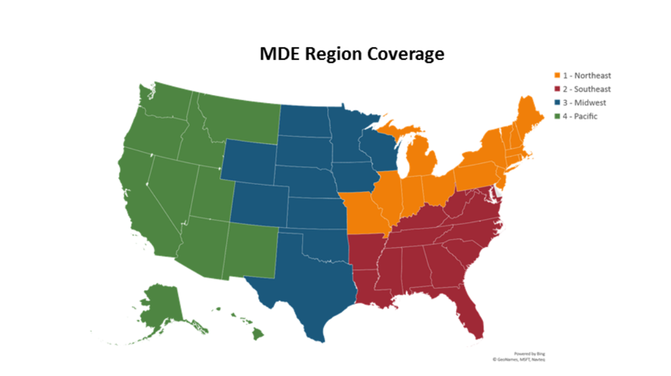
MDE Region Coverage

Slide 5
Region Assignments
MDE vendors operate in some/all areas
Region 1, 2, 3, 4
These are the general regions for compensation and pension claims for Veterans residing in the United States
Leidos QTC Health Services/VES/OSHS (All Regions)
Loyal Source Government Services (LSGS) (R4 only)
Pre-Discharge
Specific for IDES and BDD claims within continental United States
Leidos QTC Health Services/VES/OSHS
International
All claims outside of the continental United States (including US Territories)
Includes all claim types, to include IDES/BDD
VES/Leidos QTC Health Services

Slide 6
Examination Process Overview
Veteran submits claim
VA determines need for examination
Exam requested with vendor
Vendor determines if acceptable clinical evidence or tele-C&P is applicable for examination
Vendor schedules appointments for each contention/
MDE
Veteran reports to examinations
Vendor finalizes examination reports
Vendor returns examination results to VA
VA adjudicates claim

Slide 7
How VA Distributes C&P Examination
VHA resources are considered first and fully utilized when performing C&P examinations
If VHA does not have capacity or capability to complete an examination type, a MDE vendor will receive the examination request
VBA users are mandated to use the Examination Request Routing Assistant (ERRA)
Veteran’s zip code and VHA capacity in that zip code determines whether to route to VHA or Contractor

Slide 8
Example of govDelivery Email
Our records show that you filed a disability benefits claim and need to attend a Compensation & Pension (C&P) examination to complete your claim.
In the coming days, you will receive a phone call from Vendor X. We have included all their contact information, along with how it will display on your landline device, to schedule your examination appointment(s).
Vendor X Inc.
1-(000) 000-0000
VA EXAM-Vendor X (CallerID Display)
12345 (Text ID Display)
It is important not to miss your scheduled exam, so please confirm the date, time, and location for your appointment.
If you are unable to attend your examination because you are COVID positive, please contact:
Vendor X Inc.
1-(000) 000-0000
You can establish an account with Vendor X to view any upcoming appointments by registering at: Vendor X website/ (Vendor X.com) upon receiving an activation email.
You may also contact the VA at 1 (800) 827-1000.
An overview of the exam process can be obtained at: https://www.va.gov/disability/va-claim-exam.asp
For information related to frequently asked questions and examination tips, visit us at: https://wwwˌvaˌgov/disability/va-claim-exam/
If you have new non-VA medical records and/or diagnostic test results, please submit them to VA before your appointment using the address below:
Department of Veterans Affairs
Evidence Intake Center
P.O. Box 4444
Janesville, WI 53547-4444

Slide 9
Exam Communications
VBA and MDE vendors utilize a combination of methods to inform Veterans and Servicemembers of their C&P examination appointments
VBA will email Veterans/SMs when ESR is submitted to an MDE vendor
Email provides vendor name, phone number and caller ID
MDE vendors will use telephone, text, and email to communicate
Allows for Veteran’s preferred options of communication
MDE vendors portal access is available to every Veteran/SM to track appointment(s)
If positive contact is not made, MDE vendors can/will “Reserve Schedule”
If Reserve Scheduling is utilized, appointment details will be sent via mail

Slide 10
Gender Preference
The vendor will offer a choice of a male or female provider in these situations:
For reproductive health, breast, rectal, or mental health exam, or
If the claim is related to a mental or physical health condition resulting from military sexual trauma (MST)
The claimant should notify the MDE vendor of their provider preference at the time the appointment is scheduled

Slide 11
Examiner Qualifications - General
General C&P disability examinations are completed by generalists. The term "generalist" is ordinarily applied to health care professionals who don't practice within the confines of a particular disability, body system specialization or one discrete area of medicine.
Examiners who are certified to complete general C&P disability examinations include:
Physicians (including MDs and DOs)
Mid-level clinicians, such as a physician assistant or nurse practitioner, when the examination does not require a specialist

Slide 12
Examiner Qualifications-Specialists
A specialist examination is any examination that is conducted by a clinician who specializes in a particular field. All vision, hearing, dental, and psychiatric examinations must be conducted by a specialist as follows:
Vision examinations must be conducted by a licensed ophthalmologist or by a licensed optometrist.
Hearing loss examinations must be completed by a state-licensed audiologist.
Dental examinations should be performed by a dentist or oral and& maxillofacial surgeon.
Initial psychiatric examinations must be performed by
board-certified or board-eligible psychiatrists
licensed doctorate-level psychologists, or
the following other mental health professionals, under the close supervision of a board-certified or board-eligible psychiatrist or licensed doctorate-level psychologist:
doctorate-level mental health providers
psychiatry residents, and
clinical or counseling psychologists completing a one-year internship or residency
A diagnosis of Traumatic Brain Injury (TBI) must be made by a physiatrist, psychiatrist, neurosurgeon, or neurologist.
These clinician types as well as generalist clinicians who have completed the DEMO TBI training module may complete TBI examinations.

Slide 13
Travel Reimbursement
Travel for Veterans (not Service Members) is reimbursable in the Unites States and its Territories only
For Veterans residing in the U.S. Territories, MDE vendors have processes in place to pay for travel outside of U.S territories at no cost to the Veteran (MDE vendor initiated)
Alaska travel is handled by VHA travel office
Hawaii may require travel to other islands
This is handled directly with the MDE vendor

Slide 14
Examiner Training and Oversight
MDE vendor examiners must complete the same C&P certification training as VHA examiners prior to completing any examination.
MDEO develops and provides additional training to address hot topics and error trends.
MDEO conducts approximately 1,000 oversight audits on examination reports completed by MDE vendor examiners each month.
MDEO also conducts special focused reviews on specific examination types, providers, or based on error trends to provide additional oversight and feedback to the MDE vendors.

Slide 15
What Happens If A Veteran Receives A Bill?
Procedure: If you are contacted by a Veteran who received bill(s) related to their C&P examination(s) conducted by a MDE Vendor, please advise the Veteran to immediately contact the MDE Vendor involved for resolution.
The Veteran should provide to the MDE Vendor:
A copy of the bill received
Identify the date/location of the appointment

Slide 16
MDEO Inquiry Resolution
MDEO receives inquiries from a variety of sources, including:
Office of the Undersecretary for Benefits, White House Hotline, Congressional Offices, Regional and District Offices, Veterans Service Organizations, Veterans Health Administration, Office of the Inspector General
Most inquiries involve:
Veteran travel issues, appointment scheduling conflicts, examiner complaints, issues claims processors are experiencing with examination requests, Exam Management System inquiries
When an inquiry is received, MDEO takes the following actions:
Logs and tracks all inquiries
Thoroughly reviews the inquiry
Review VA Systems
Thoroughly review the Veteran’s file, and any completed exams, if applicable
Contact MDE vendor(s) for action
Contact Veterans for more information or to report resolution
MDEO strives to resolve all inquiries in 10 days or less
MDEO can pursue additional avenues to address emergent issues in a shorter time period

Slide 17
MDE Vendor Mobile Units Overview
Mobile units can provide:
General Medical and Specialties
Diagnostic testing
Handicap Accessible
Wheelchair lifts and ramps
Fully self-contained
Own power supply
Internet ready (file upload and download capabilities)

Slide 18
MDE Vendor Mobile Unit Overview (cont.)
MDE vendors currently utilize over 30 mobile units:
Owned and operated by MDE vendor(s)
Contract does not currently require mobile units
Usage/location determined by MDE vendor(s)
Used to augment provider network
Rural areas
High volume locations
Targeted needs
Special uses (homebound, terminally ill, tribal regions)

Slide 19
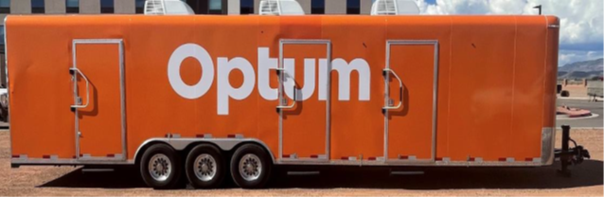
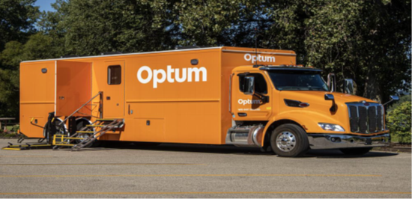
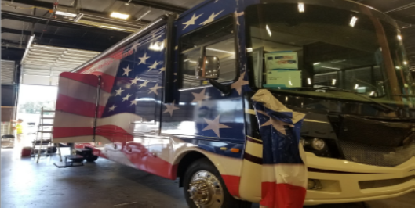
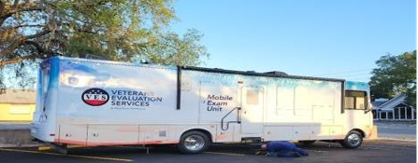
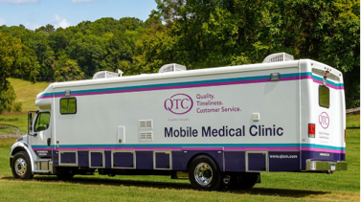
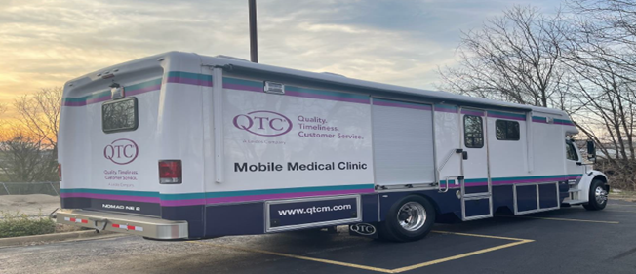
Mobile Medical Unit Types

Slide 20
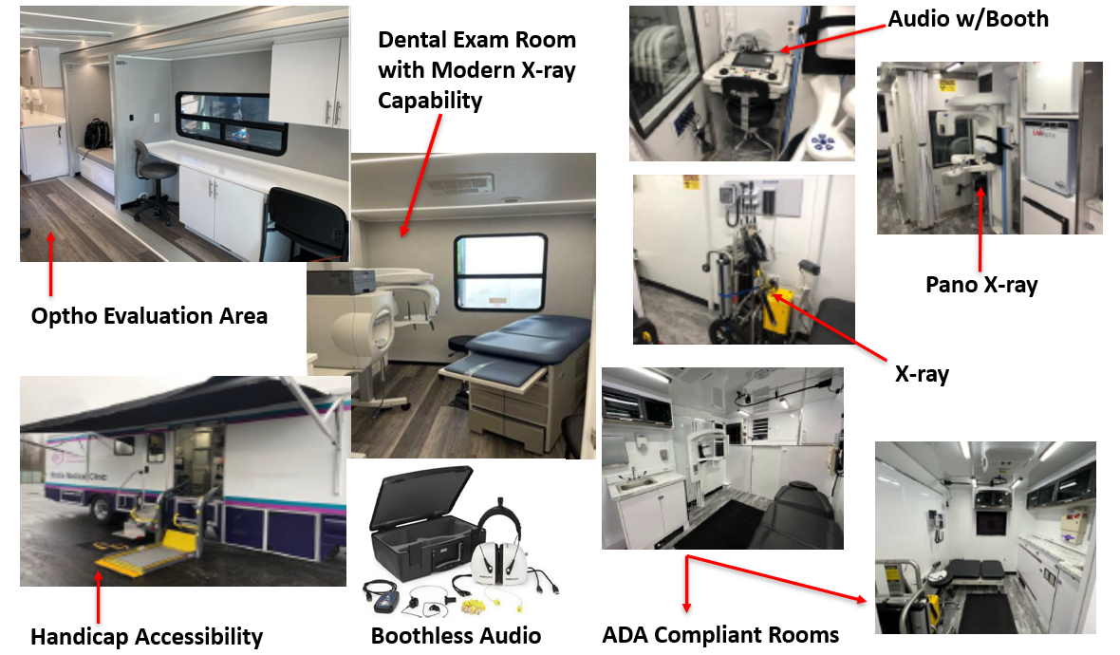
Mobile Unit Photos

Slide 21
Additional Examination Resources
How To File A VA Disability Claim | Veterans Affairs
Information on filing claims and submitting evidence
VA Claim Exam (C &P Exam) | Veterans Affairs
Answers to commonly asked questions about VA claims exams
VA Claim Exam (C&P Exam) Information and Exam FAQ Links | Veterans Affairs
Provides information on the examination process and links to additional claims related pages
Inquiries can be submitted to MDEO via:
Contract Examination Inquiry Submissions, or
VAVBAWAS/CO/Contract Examination Inquiries
These links are for internal use only

Slide 22

Questions

