Slide 1

Medi-Cal Cost Avoidance Program
CACVSO Mentorship Committee
David West, Chair – Nevada County VSO
Darlyn Escalante, Co-Chair – Director Santa Clara VSO
February 15, 2024

Slide 2


What Are you Hoping to Learn?

Slide 3
objectives
Gain understanding of the CalVet process and requirements for effective participation in the Medi-Cal Cost Avoidance Program.
Gain a better understanding of how to process MC-05 referrals and best practices for contacting veterans or surviving spouses referred to your office
Discuss further opportunities for increased funding for VSOs

Slide 4
References
Procedures Manual for Subvention and Medi-Cal Cost Funding
The Medi-Cal Cost Avoidance Program is administered under the provisions of M&VC Section 972.5, CCR, Title 12, Section 454 and an interagency agreement between CalVet and the Department of Health Care Services (DHCS).
ACWDL 19-13: NON-COMPLIANCE WITH MEDI-CAL ELIGIBILITY REQUIREMENTS
In accordance with Title 22, CCR, Sections 50185 and 50763, Medi-Cal applicants and beneficiaries must, as a condition of eligibility, apply for and/or retain OHC when there is no premium cost to the applicant or beneficiary, such as insurance available to veterans of U.S. military service or their dependents. Additionally, as mentioned in the “Requirement to Apply for or Accept Unconditionally Available Income” section above, applicants and beneficiaries must, as a condition of eligibility, take all actions necessary to obtain UAI such as benefits available to veterans of U.S. military service or their spouses/dependents. Applicants and beneficiaries who indicate they are U.S. military veterans, or the spouses/dependents of U.S. military veterans, are required to apply for veteran benefits available through the VA.
ACWDL 16-04 Military Verification and Referral Form
Veterans' Benefits (sccgovˌorg)- MC HB: Non-MAGI MC Chapter 15 Veterans Benefits

Slide 5
STATE FUNDING SOURCES
County Subvention Program
Medi-Cal Cost Avoidance Program
Veterans Service Office Fund (License plates)

Slide 6
MEDI-CAL COST AVOIDANCE PROGRAM
The Medi-Cal Cost Avoidance Program reimburses counties for “activities” CVSO’s perform that result in cost avoidance or savings to the Medi-Cal program.
Total Funding is $838,000 per fiscal year
Funds are distributed on a pro-rata basis using allowed Medi-Cal Workload Units (WLUs).
1 MC-05 Verification = 1 WLU
1 claim open or Benefit Enhancement = 10 WLUs (up to 30 per MC-05 per fiscal year)
The actual value of a Medi-Cal workload unit changes annually based upon the amount of funding available for Medi-Cal Cost Avoidance and the total number of workload units allowed statewide for all participating CVSO’s.
FY 2022-23 2nd six-months, 1 WLU = $65
Claimed Semi-annually

Slide 7

PROCEDURE MANUAL FOR SUBVENTION AND MEDI-CAL COST AVOIDANCE
Awards Register Overview
The Medi-Cal Cost Avoidance Program is administered under the provisions of M&VC Section 972.5, CCR, Title 12, Section 454 and an interagency agreement between CalVet and the Department of Health Care Services (DHCS).
Federal Medi-Cal funds may be available for distribution to CVSO if all of the following requirements are met:
An "Annual Agreement" approved by the Board of Supervisors must be submitted to CalVet by scan/upload via Agency Attachments in VetPro no later than January 31st (see below).
(2) Workload activity reports (DVS 19 and DVS 20MC) must be fully and accurately completed.
Both reports are automated in VetPro and available to CalVet via VetPro
Read the Procedures Manual
Page 14 – Medi-Cal Cost Avoidance Program Calendar
Page 15 – Medi-Cal Cost Avoidance Program Payments
Page 16 – Eligible Medi-Cal Aid Codes
Page 16 – Program Documentation
Page 16 – Forms & Document Templates
Page 17 – Annual Medi-Cal Cost Avoidance Program Certificate of Compliance

Slide 8
Why is this Program Important?
Current federal law mandates that any person who is in receipt of public assistance must apply for any additional benefit that she or he is eligible for.
Opportunity to increase funding for your office
Veterans eligible for VA healthcare could have monthly medication costs reduced.
Opportunity to maximize benefits for veterans, Dependents and/or Surviving Spouses
Opportunities to develop additional revenue streams and colloborations

Slide 9
Historical Data

Slide 10
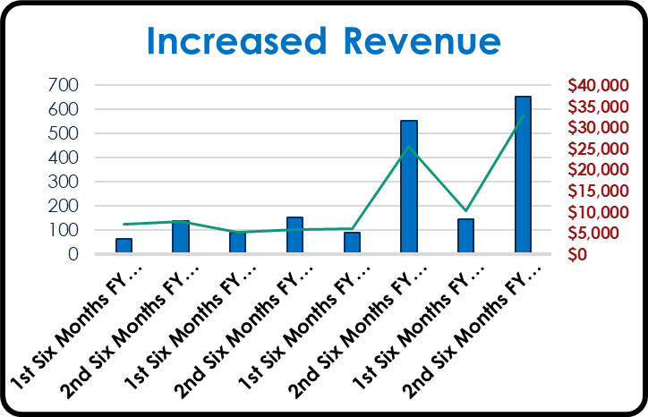
Increased Revenue
Through collaborative efforts with county DSS, Nevada County has increased revenue by 300%

Slide 11
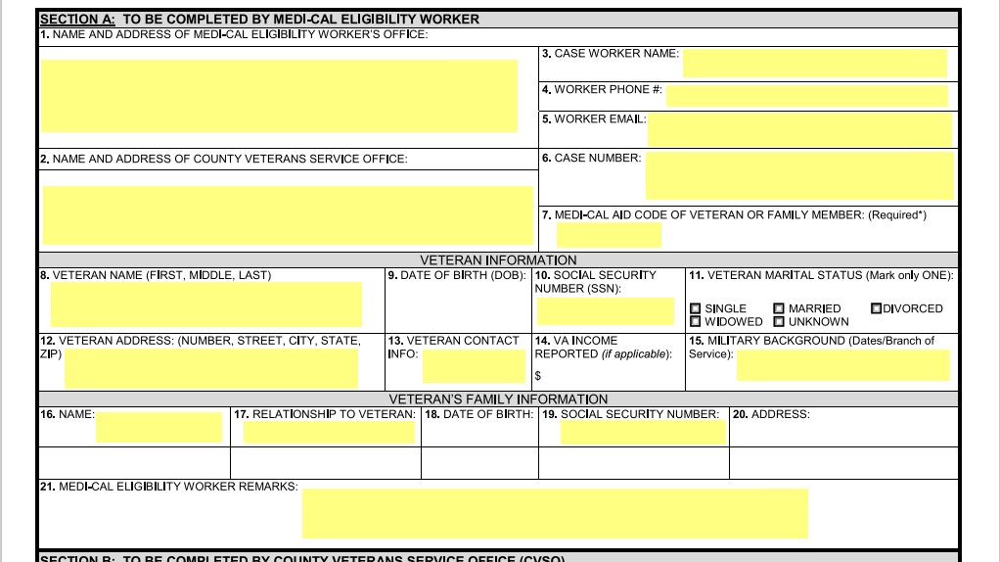
MC-05 Referral Process
Must have following information:
Office of Referral
CVSO Office Address
Case Worker
Worker Email
Case Number
Aid Code
Name
Social Security #
If Surviving Spouse/Dependent
Must be identified
Social Security number must be provided

Slide 12
Referral Process
The referral process is already an existing part of the Intake process for Medi-Cal, it is NOT added work.
It does not require veteran to complete process.
MC-05 Referral is a “Condition” of the applicant’s eligibility. It is not optional.
Effective 2024, Veterans monetary benefits are no longer included in total earned income when applying for Medi-Cal.
Education is key when collaborating with DSS, emphasize importance of this program, poor collaboration results in losing potential resources for Veterans.

Slide 13
WORKFLOW
Veteran/Dependent applies for Medi-Cal at County Office and self reports “veteran/dependent of veteran” status
The Medi-Cal eligibility worker will fill out Section A of the MC 05 form if a Medi-Cal applicant/beneficiary or anyone in the household indicates they have a military background.
The Medi-Cal eligibility worker will submit MC-05 to VSO.
The VSO will utilize any VA resources and confirm VA benefits eligibility (if any) and complete Section B of the MC 05 Form. This may include VA compensation, Health, and enhancement of current benefits
The VSO will make a copy of the completed MC 05 form and keep it for case file records. The CVSO will then return the original MC 05 form to the Medi-Cal eligibility worker within 24 hours.
The VSO will contact veteran and/or Dependent to schedule appointment for benefits review and determine eligibility for benefit enhancements.
The Medi-Cal eligibility worker will review the MC 05 form to complete/determine Medi-Cal eligibility. If the applicant/recipient is in receipt/eligible for VA Health, the applicant must accept any unconditionally available income for which they appear eligible followed by § 50186 of Title 22 of the California Code of Regulations.

Slide 14
Entering MC-05s in VetPRO
Must have following information:
Office of Referral
CVSO Office Address
Case Worker
Worker Email
Case Number
Aid Code
Name
Social Security #
If Surviving Spouse/Dependent
Must be identified
Social Security number must be provided

Slide 15
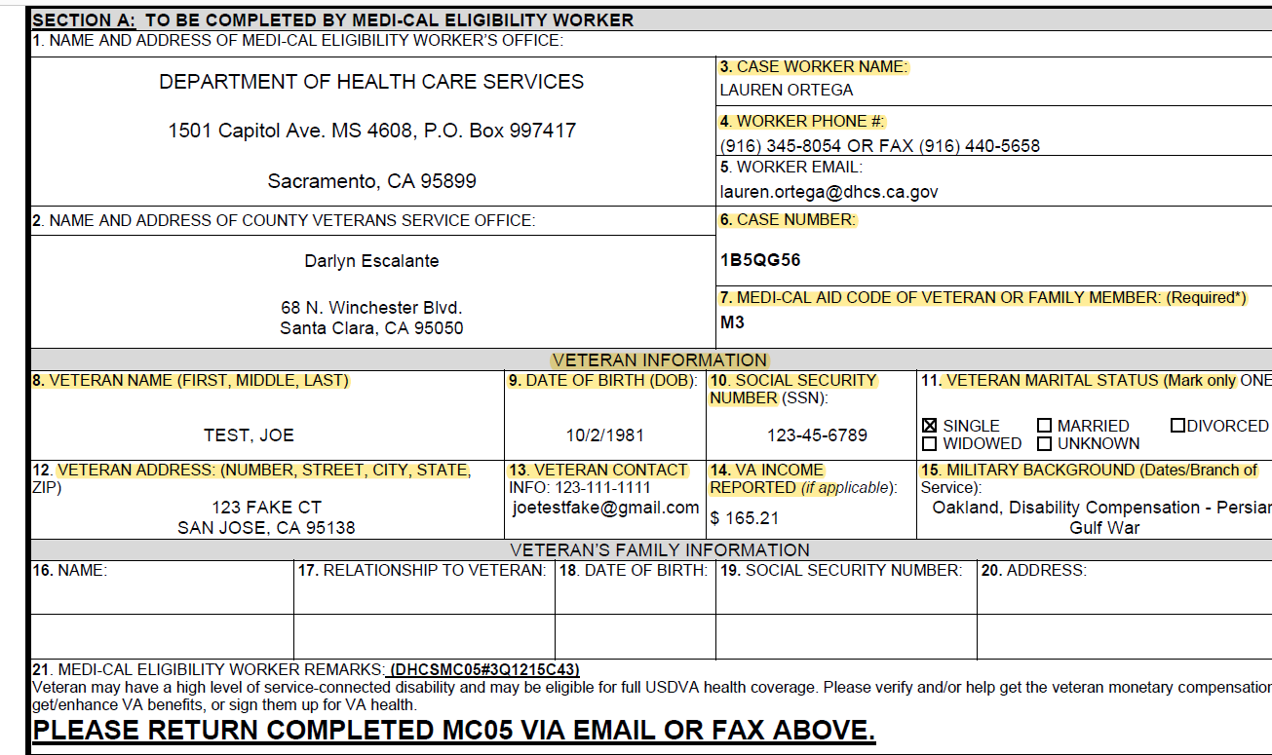
MC-05 Form
SECTION A:
This section will be completed by the county Medi-Cal Eligibility Worker.
Verify all pertinent information is included in Section A before verifying income, especially Medi-Cal Aid Codes.
NO Medi-Cal Eligibility Aid Code, NO workload unit credit.

Slide 16
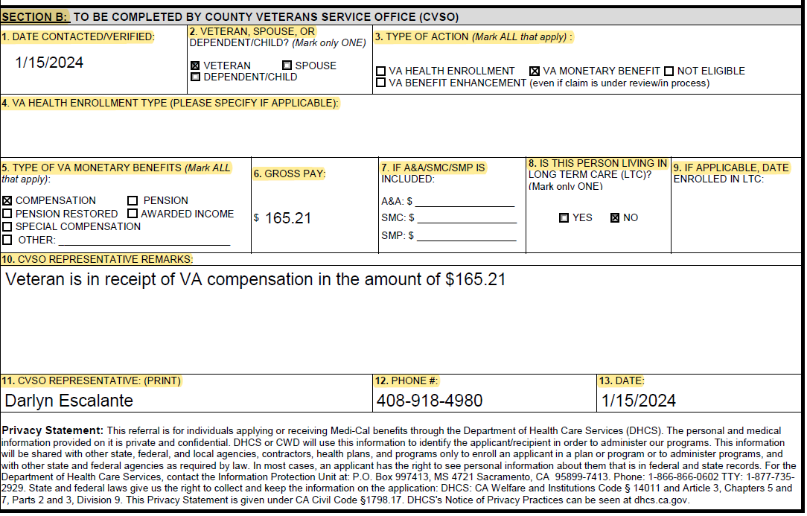
Completing MC-05
SECTION B:
This section will be completed by VSO staff
Compensation vs Pension
If VA monetary benefit has cents value ($.21), they are receiving disability Compensation benefits.
If VA monetary benefit is a whole dollar amount ($1.00), they are receiving NSC Pension benefits.

Slide 17
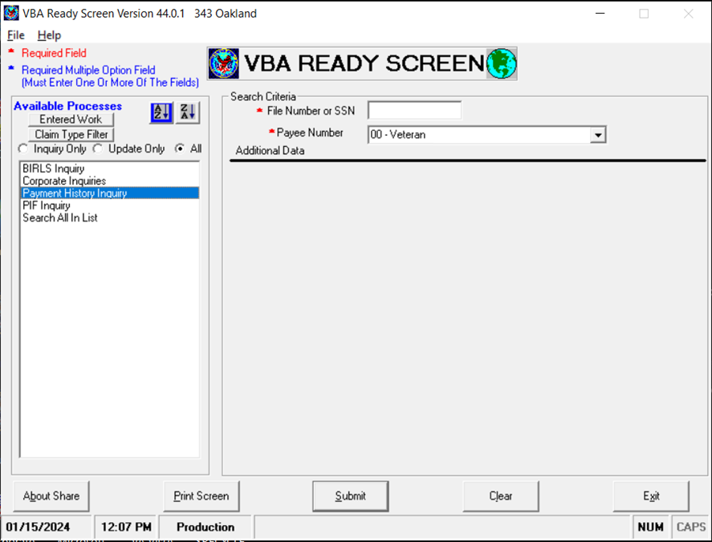
Verifying VA Benefits
There are four different avenues to verify VA benefits
1-800-827-1000
Must have veterans SSN
DOB
Branch of Service
CVSO Hotline (Inside Line)
(855) 225-0709
Pension Management Center (PMC) Hotline
(612) 713-8975
SHARE through VBMS
Must have POA

Slide 18
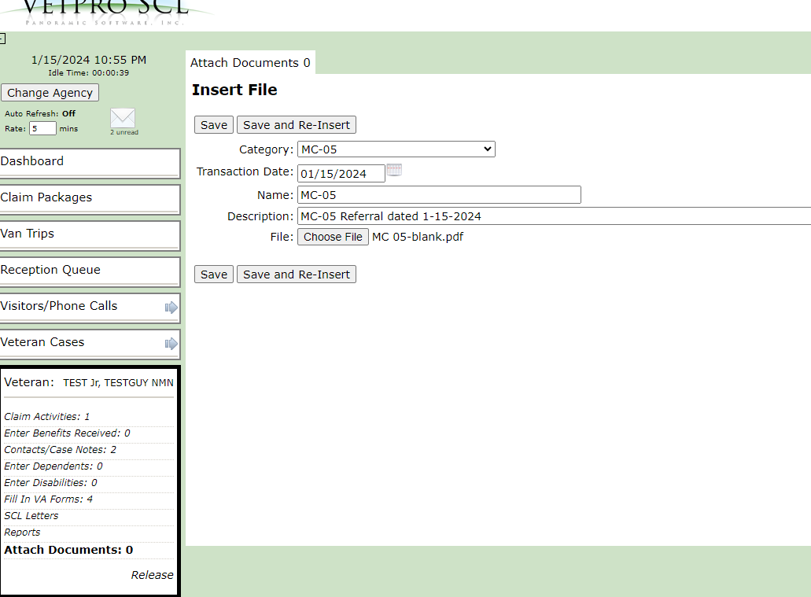
In VetPro
SAVING THE MC-05 Form
Open the Veteran’s profile in Vetpro
Click on the “Attach Documents” tab
Index the attached document following the example to the right.
Click “Save”

Slide 19
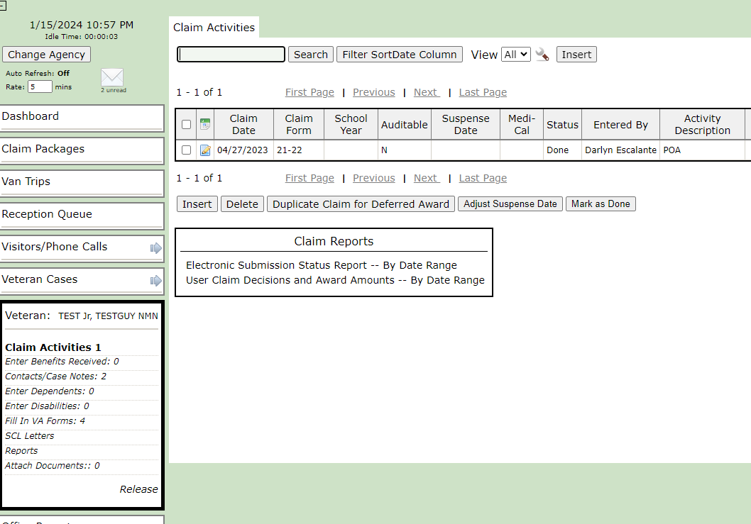
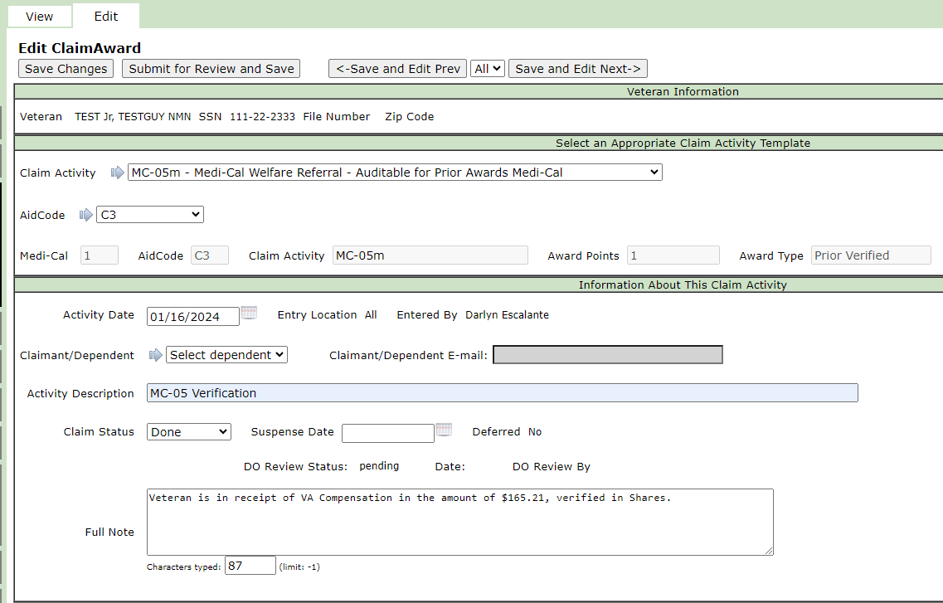
Claim Activity
After saving the MC-05, click on the “Claim Activity tab” and click “Insert” to create a new Claim Activity.
Select the “MC-05m-Medi-Cal Welfare Referral-Auditable for Prior Awards Medi-Cal” from the drop-down menu.
Select the assigned Aid Code (found on the MC-05 section A)
Write “MC-05 Verification” as the Activity Description.
Change the Claim Status to “Done”
Enter the remarks you included on the MC-05 form. This will include the verified benefit or non receipt of benefits, and avenue of which this was obtained . See example.
1
2
3
4
5

Slide 20
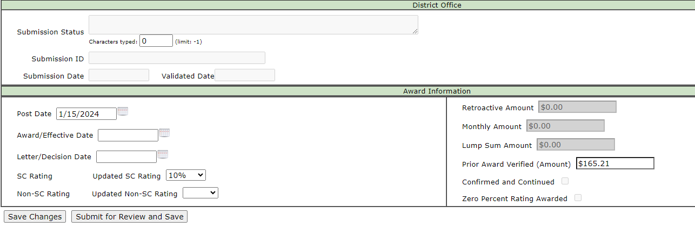
Claim Activity cont.
5
7
6
8
Enter the date.
Enter the Veteran’s rating or Non-SC Rating,
Enter the monetary benefit you verified.
Click “Save”

Slide 21
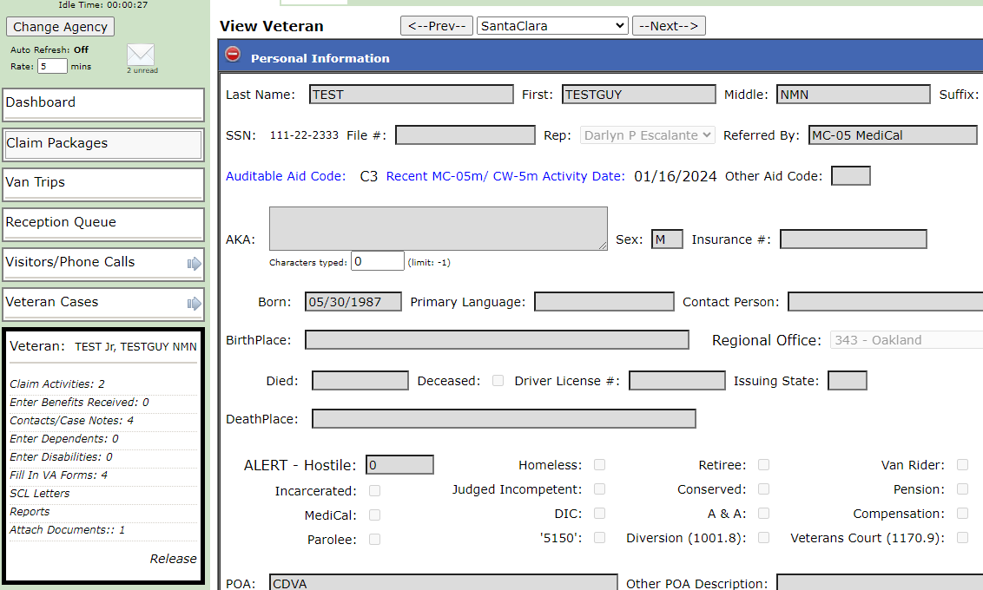
Veteran Profile
After completing the claim activity, go back to the veteran’s profile page.
Here you will find the Auditable Aid Code highlighted in blue.

Slide 22
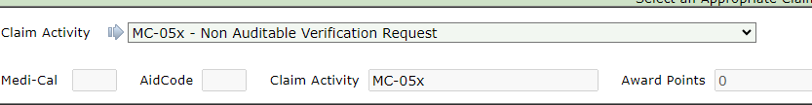
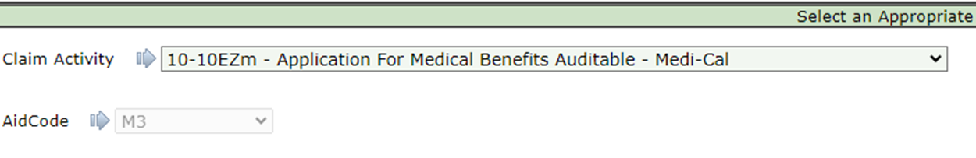
Other Claim Activities
Duplicate MC-05s
Only one new or Benefit Enhancement claim can be submitted per referral per fiscal year (fiscal year is defined as the period from July 1st to June 30th).
When entering a duplicate MC-05 in VetPro, select the MC-05x claim activity from the drop-down menu. Complete all other sections as shown in previous slides for creating a claim activity.
Benefits Enhancements- VA Healthcare Application

Slide 23
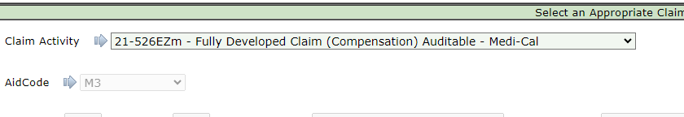
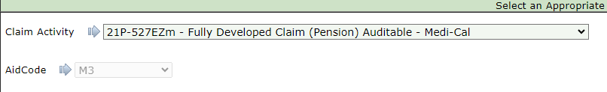
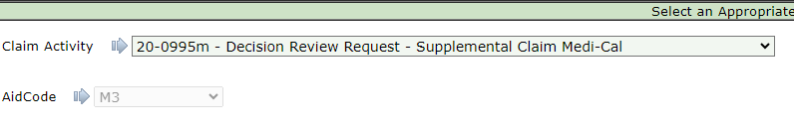
Benefits Enhancements- Disability Compensation Application
Benefits Enhancements- NSC Pension Application
Benefits Enhancements- Supplemental Appeal Application

Slide 24
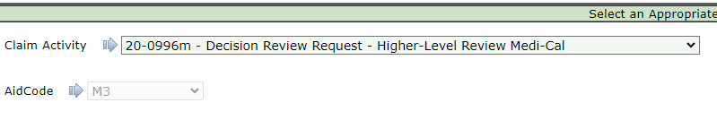
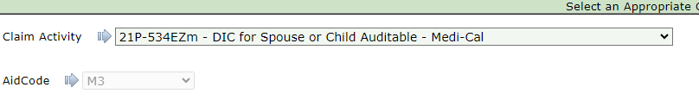
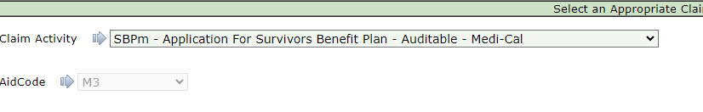
Benefits Enhancements- Higher Level Review Application
Benefits Enhancements- Survivor’s Pension/DIC Application
Benefits Enhancements- Survivor’s Benefits Plan Application

Slide 25
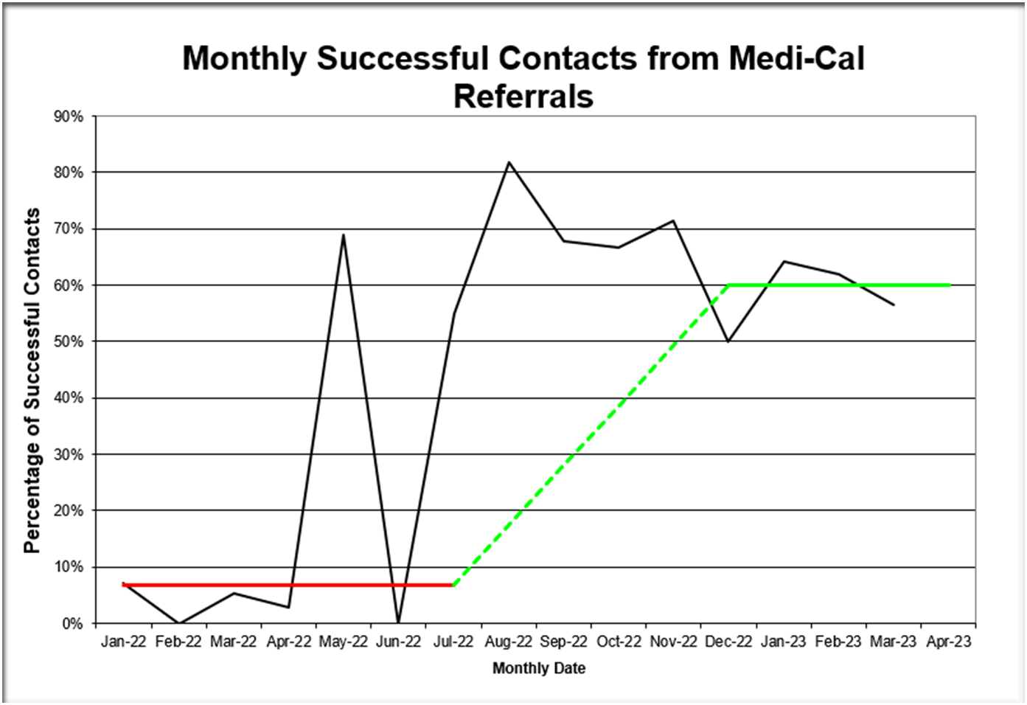
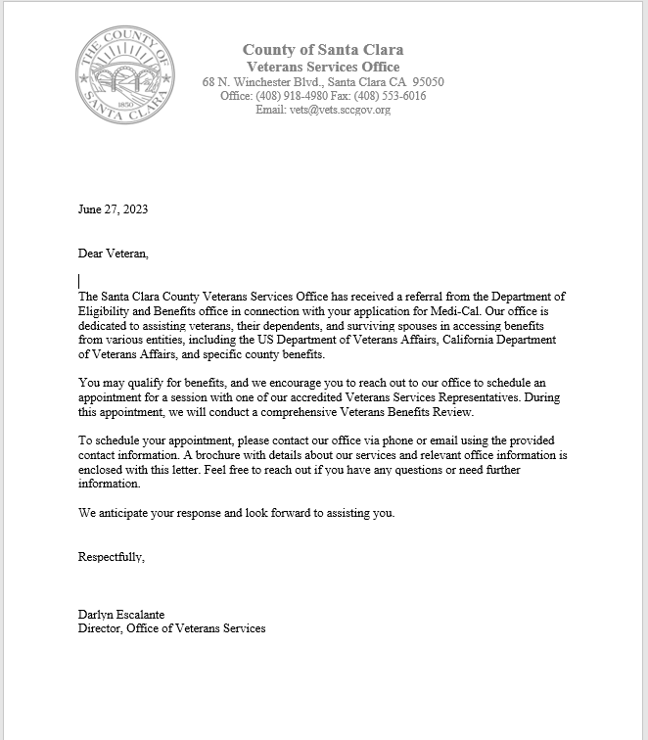
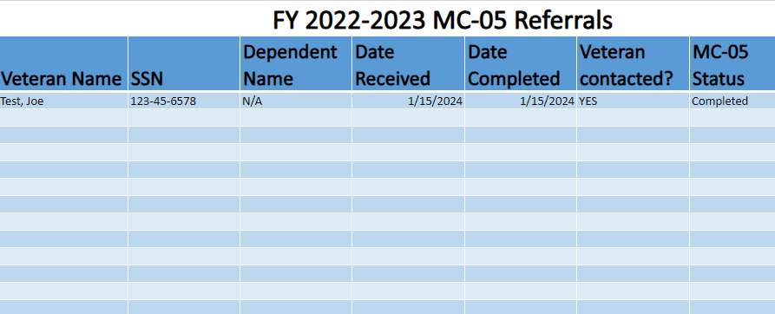
Best practices
Develop a letter template that can be sent to veteran/surviving spouse informing them they may be entitled to VA benefits
Create an internal tracking log of all incoming MC-05s to avoid duplicating verifications within a fiscal year.

Slide 26
Identified Gaps
Discontinued referrals
Missed opportunities for Dependents and Surviving Spouses
Opportunities for Improvement
Reinstatement of referrals
Identify veteran’s dependents and surviving spouses on referrals
Create ACE or Flash that staff can refer to and that can be integrated into Intake Workflow process
Create a listing of all known veterans and veteran’s dependents/surviving spouses currently aided that can be referred at next RRR
Build open and continuous communication line between designated DEBs and VSO Supervisors
Have a “veteran status” entry option available for the case narration tool

Slide 27
Challenges & opportunities
Some DSS views this process as EXTRA work, however, the referral process is already an existing part of the Intake for Medi-Cal applications, it is NOT added work.
It does not require veteran to complete process.
MC-05 Referral is a “Condition” of the applicant’s eligibility. It is not optional. Some DSS will waive referral, this is not in best interest of the veteran, especially since effective 2024, Veterans monetary benefits are no longer included in total earned income when applying for Medi-Cal.
Education is key when collaborating with DSS, emphasize importance of this program, poor collaboration results in losing potential resources for Veterans.

Slide 28
Positive Engagement Suggestions
Must be timely & accurate in response
Educate on benefits

Slide 29
Next Steps
Nevada County VSO Staff is asked to contact five referrals per week for a total of 20 per month
CoAutomation Committee on developing program specific reports
Opportunities for additional revenue to NCVSO
Submitting applications for Medi-Cal/CalFresh
Enhanced Care Management (ECM)
Projected $100,000 revenue opportunity
Seeking additional opportunities through Prop 1

Slide 30
Questions?

