Slide 1

Minority and Underrepresented Veterans Division

Slide 2
Vision & Mission
Vision
Mission
The Minority and Underrepresented Veterans Division will ensure that all veterans have equal access to their benefits regardless of race, ethnicity, religion, gender, gender identity, or sexual orientation.
Promote usage of State and Federal veteran benefits, programs, and services.
Advocate on behalf of minority and underrepresented Veterans by identifying gaps in services or barriers to access.
Lead initiatives that educate the public.

Slide 3
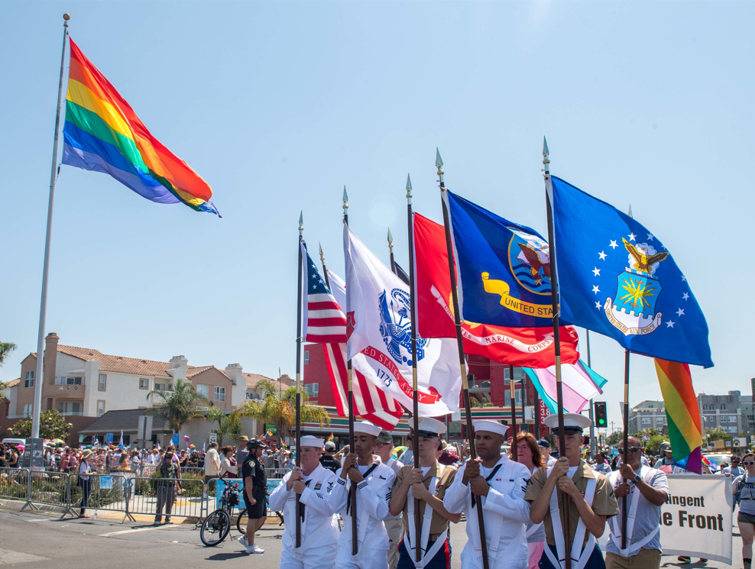
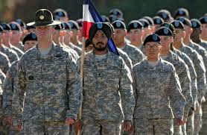
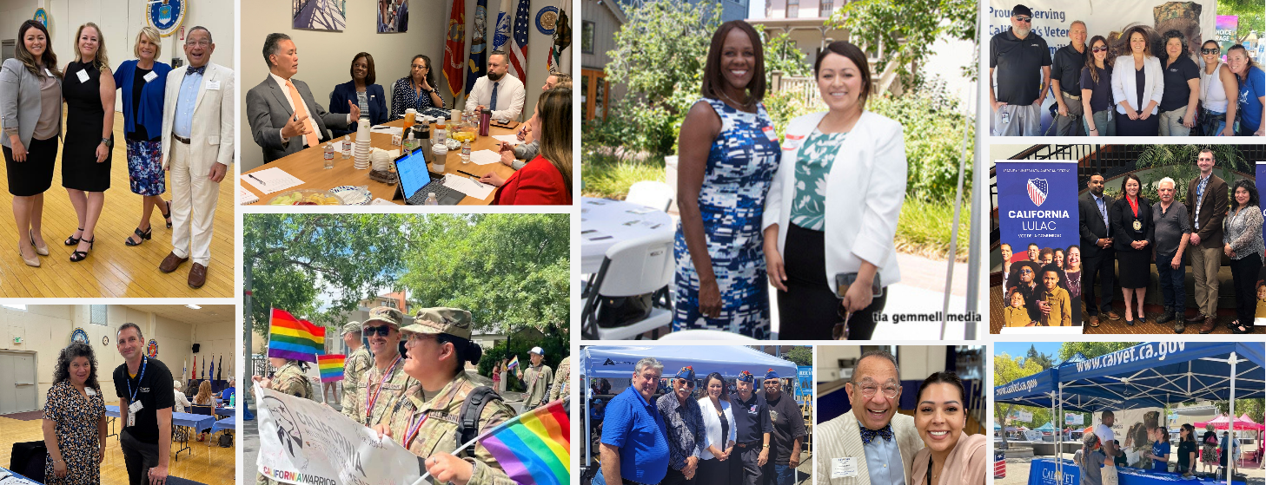
Overview
Quick Facts & Demographics
Assistance from MUVD
CalVet Pathway to Citizenship Program
Tribal Veterans Outreach Program
CalVet LGBTQ Inclusion Program
Future Initiatives
MUVD Roster
Contact Information

Slide 4

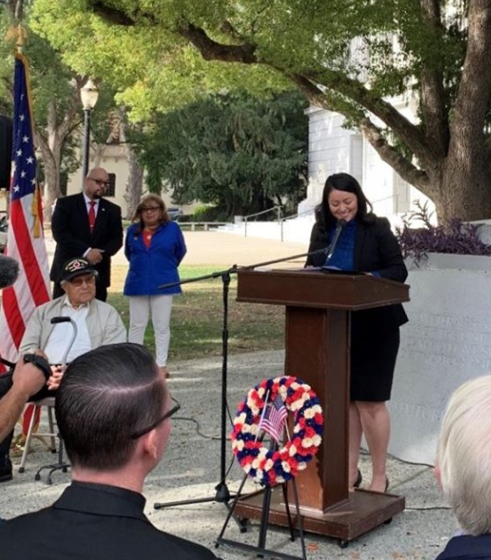
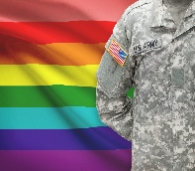
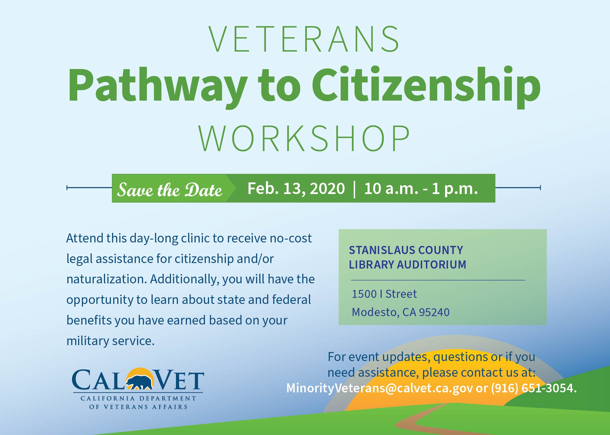
National and California Minority Veteran Quick facts:
The Minority & Underrepresented Veterans Division represents 47% of the 1.6 million California veteran population.
California is home to nearly 20,000 Native- American veterans. We have three times the number of Native veterans compared to other states.
Our state has the highest population of LGTBQ veterans. Many veterans from this population are disconnected from their benefits and services.
California is the first state department to develop a citizenship program for veterans and their family members. We are the first state to address the issue of deported veterans.

Slide 5
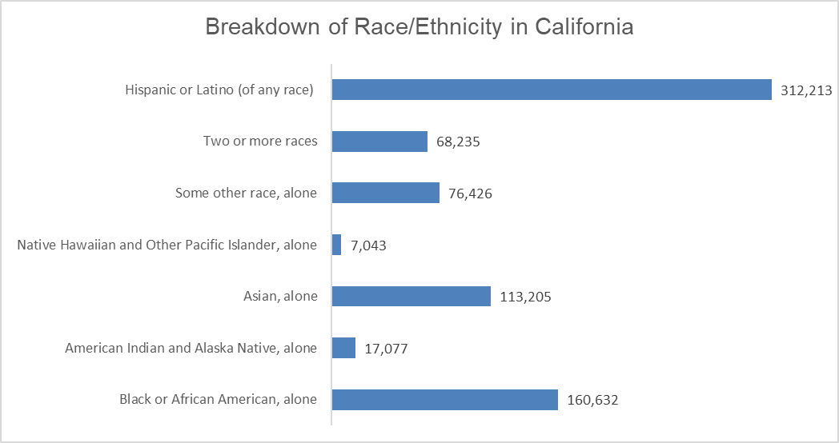
Demographics
California minority veterans are 754,831 or 47% of all veterans
Notes:
California veterans are the most diverse than any other state in the nation.
We have the highest amount of every race breakdown except Black/African American veterans who mostly reside in Georgia, Florida, and Texas.

Slide 6
Assistance from CalVet MUVD
Bolster outreach and service delivery to rural, tribal, women, minority, LGBTQ, and other underserved veterans
Promote the use of VA and CalVet benefits, programs, and services by minority veterans.
Support and initiate activities and events that educate about the unique needs of minority veterans.
Target outreach efforts to minority veterans through community networks.
Advocate on behalf of minority veterans by identifying gaps in services and making recommendations to improve service delivery within their facilities.

Slide 7
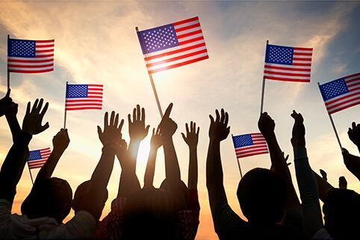
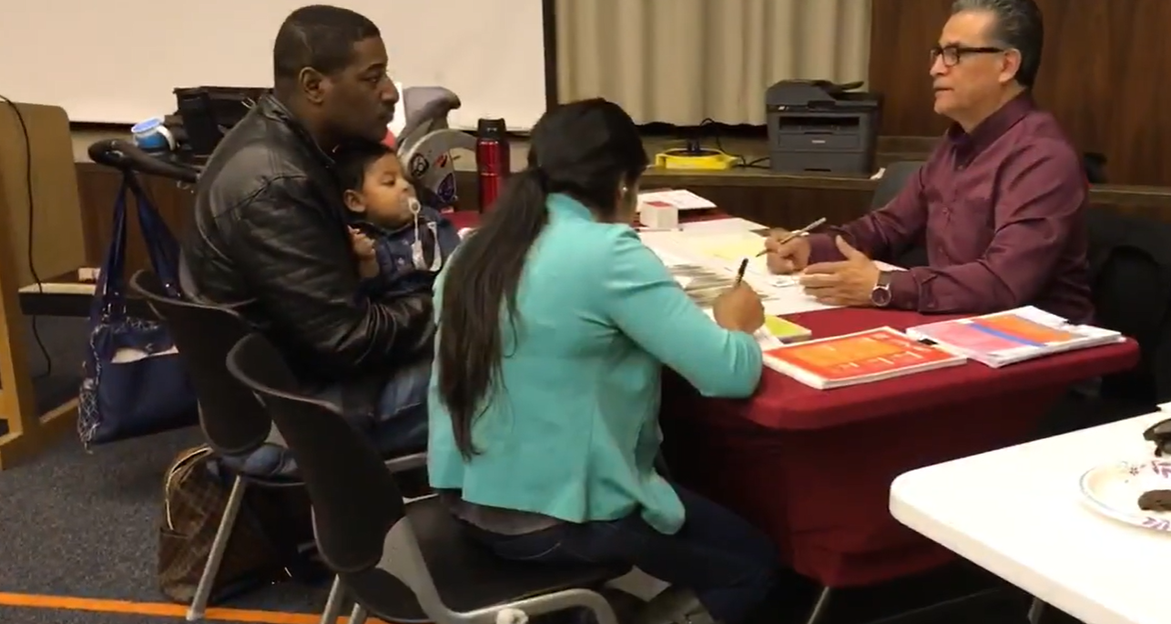
CalVet Pathway to Citizenship (PTC) Program
Launched In 2018
Partnership with the Governor's Office, the California Department of Social Services (CDSS), and community immigration services
Free service to veterans and their dependents
Expedited Naturalization
Since 2018
16 workshops
Assisted over 650 veterans
Federal Legislation
Veterans' Pathway to Citizenship Act of 2021
Veteran Deportation Prevention and Reform Act of 2021

Slide 8
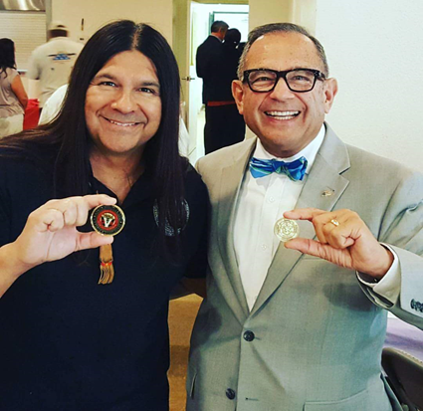
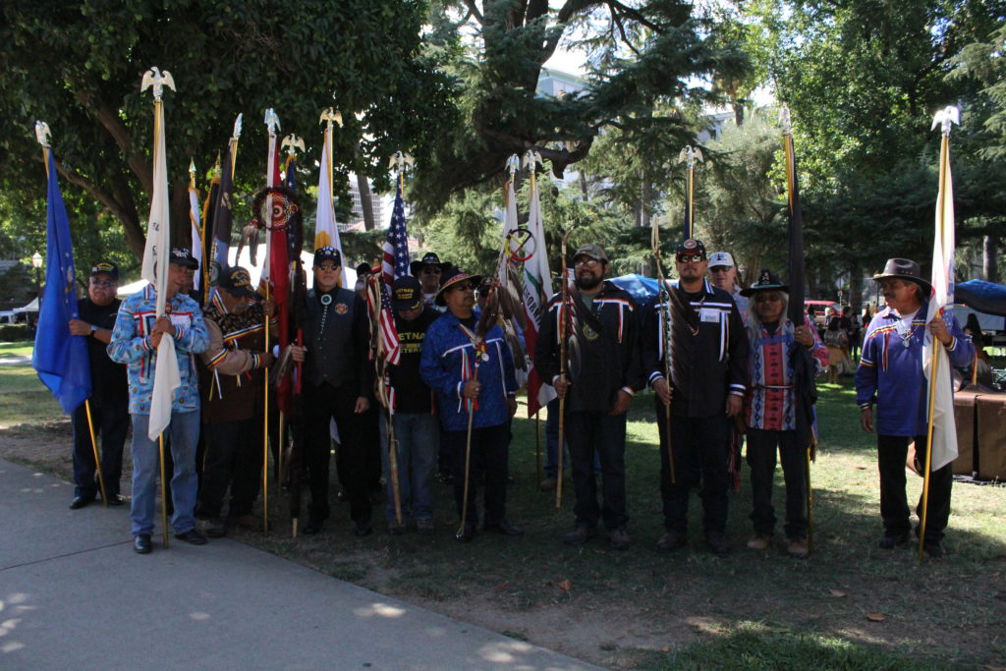
Native American Veterans Advocacy
109 federally recognized tribes in California
Natural disaster assistance with CalOES
Coordinated with CalOES to provide over 10,000 masks to CA Tribes
Tribal Nations Conference (2019) hosted by the California Tribal Chairperson's Association and the Governor’s Office
Outreach to Northern/Rural California Tribes
Outreach pertaining to VA Benefits and Programs for Native American Veterans.
Collaboration with the VA Advisory Committee on Tribal and Indian Affairs
56th Annual Native American Day (2023)

Slide 9
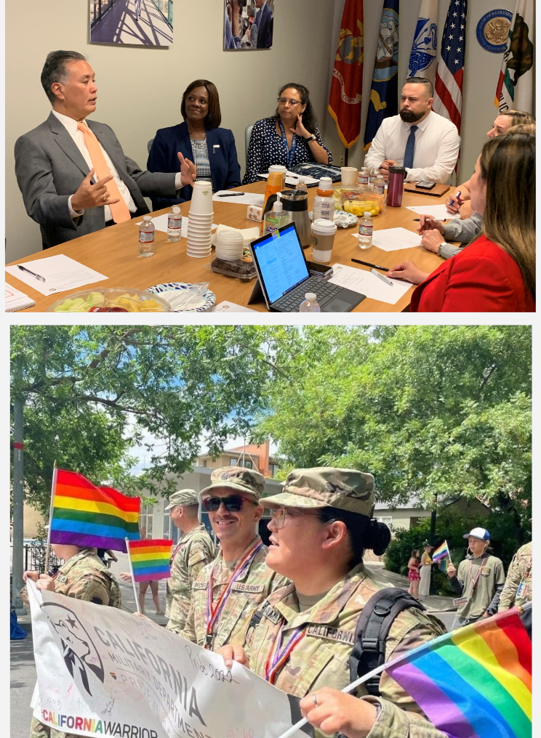
LGBTQ Veteran Inclusion Program
CalVet believes in building support for LGBTQ Veterans and their families that promotes resilience in the face of challenges.
Program Launched in 2014
Events Hosted
In 2014, CalVet was the first state in the nation to host an LGBTQ veterans leadership forum
2 LGBT CalVet Conferences
LA County LGBT Veterans Meeting
LGBTQ Veteran Inclusion Forum
2 Discharge upgrade events
2 DADT Celebrations

Slide 10
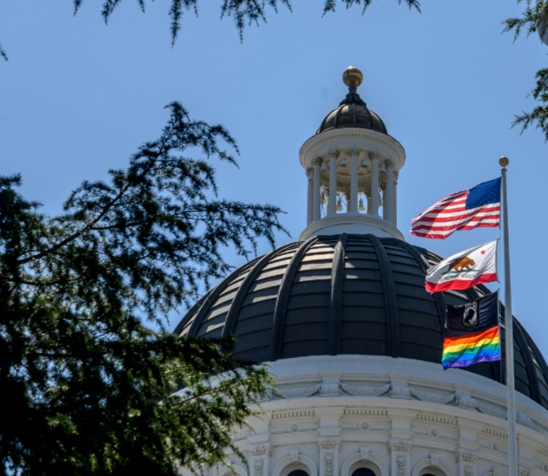
Future Division Initiatives and Goals
Veterans in Civic Engagement!
(coming soon)
Rural California Veterans Network Building (done!)
Website Revamp
(done!)
AB 1994 will strengthen representation in state government of minority and underrepresented veterans. The bill adds the Deputy Secretary of Minority and Underrepresented Veterans Affairs to those deputies whose appointments are specified in statute.
California Department of Veterans Affairs Tribal Consultation Policy

Slide 11
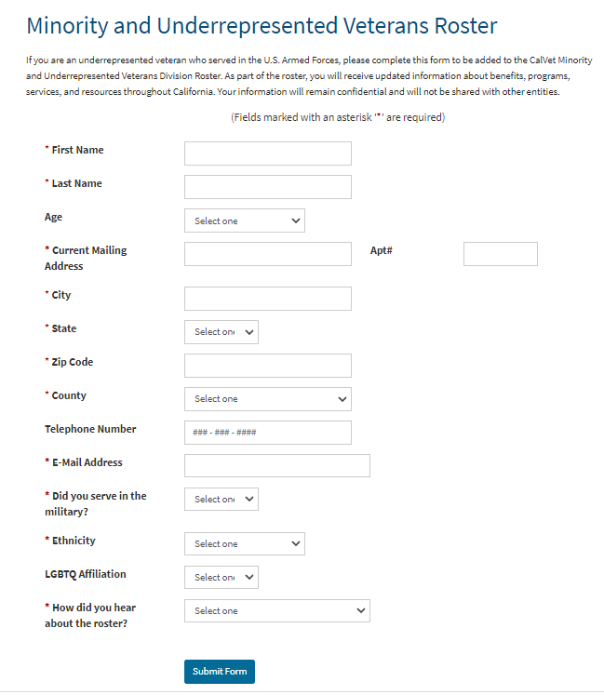
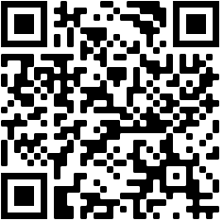
Minority and Underrepresented Veterans Roster
Receive updated information about benefits, programs, services, and resources throughout California.
Since it’s launch, over 12,500 minority and underrepresented veterans have joined.
Sign up for our Roster!

Slide 12
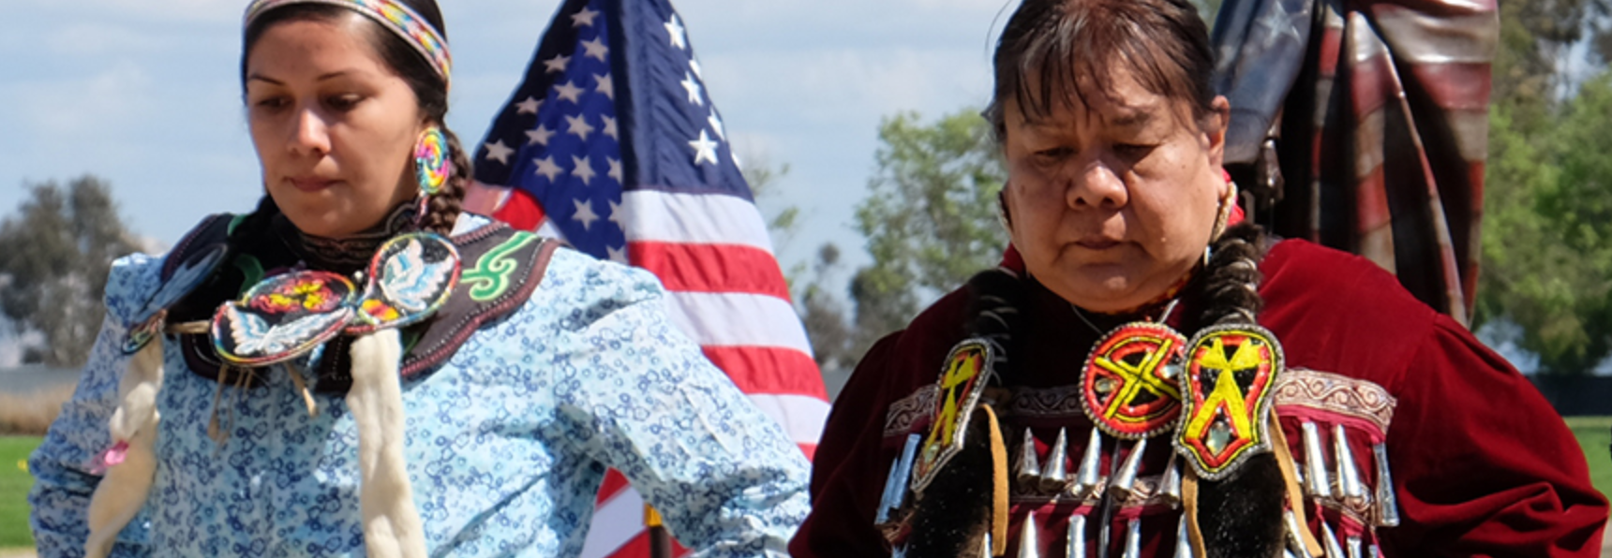
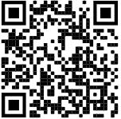
Contact us!
Email: minorityveterans@calvet.ca.gov
Phone: (916) 651-3054
Website: www.calvet.ca.gov/minorityvets
Facebook: https://www.facebook.com/CalVetMinorityVets
Team:
Christina Salazar, Office Technician | Christina.Salazar@calvet.ca.gov
Nate Stewart, Staff Services Manager I | Nathaniel.Stewart@calvet.ca.gov
Rakesh “Ricky” Pal, Program Analyst | Rakesh.Pal@calvet.ca.gov
Jose Ayon, Program Analyst | Jose.Ayon@calvet.ca.gov

Slide 13
Xóchitl Rodriguez Murillo Deputy Secretary 916-651-5040 Xochitl.RodriguezMurillo@calvet.ca.gov

