Slide 1



Customized Programs for Men, Women, Veterans/First Responders & Active Duty Military
For Addiction, Co-occurring Disorders & Mental Health
Experts in Addiction Treatment Since 1987
Get Started
www.newdawntreatmentcenters.com

Slide 2

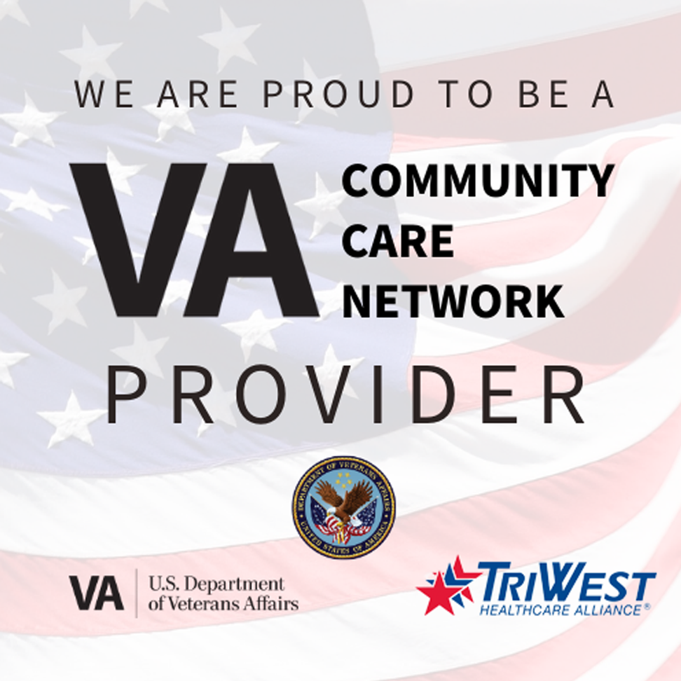


Who is New Dawn?
New Dawn’s addiction recovery programs have helped thousands of individuals in the Sacramento area successfully recover from substance abuse for over 30 years. Our Psychiatrists, Addiction Counselors and Master’s Level Therapists are experts in helping individuals overcome their addiction once and for all. Our relapse rates are extremely low, and we are one of the only addiction recovery centers in the country to offer a 1 year sobriety guarantee when completing the 90 day residential program. We offer residential treatment, intensive outpatient/PHP, detox, mental health IOP/PHP and sober living programs.
Locations in Northern California and Reno Nevada
Next Page

Slide 3

Mission and Values
Part of what makes New Dawn’s rehabilitation programs so effective is our ability to support the entire recovery process by offering a complete continuum of care, from medically monitored Detox and Residential Treatment to Day Treatment, Intensive Outpatient, and Aftercare. Our clinical staff are also highly respected in their fields, and are have dedicated their lives to helping other overcome their struggles with addiction. All of the services we offer are CARF accredited, which ensures that we are collecting feedback from our patients on a regular basis. We use this feedback to constantly make improvements to our rehab and eating disorder programs. For this reason, we receive 95% program satisfaction rates on average from our graduating clients
Family Owned Since 1987
Full Continuum of Care

Slide 4

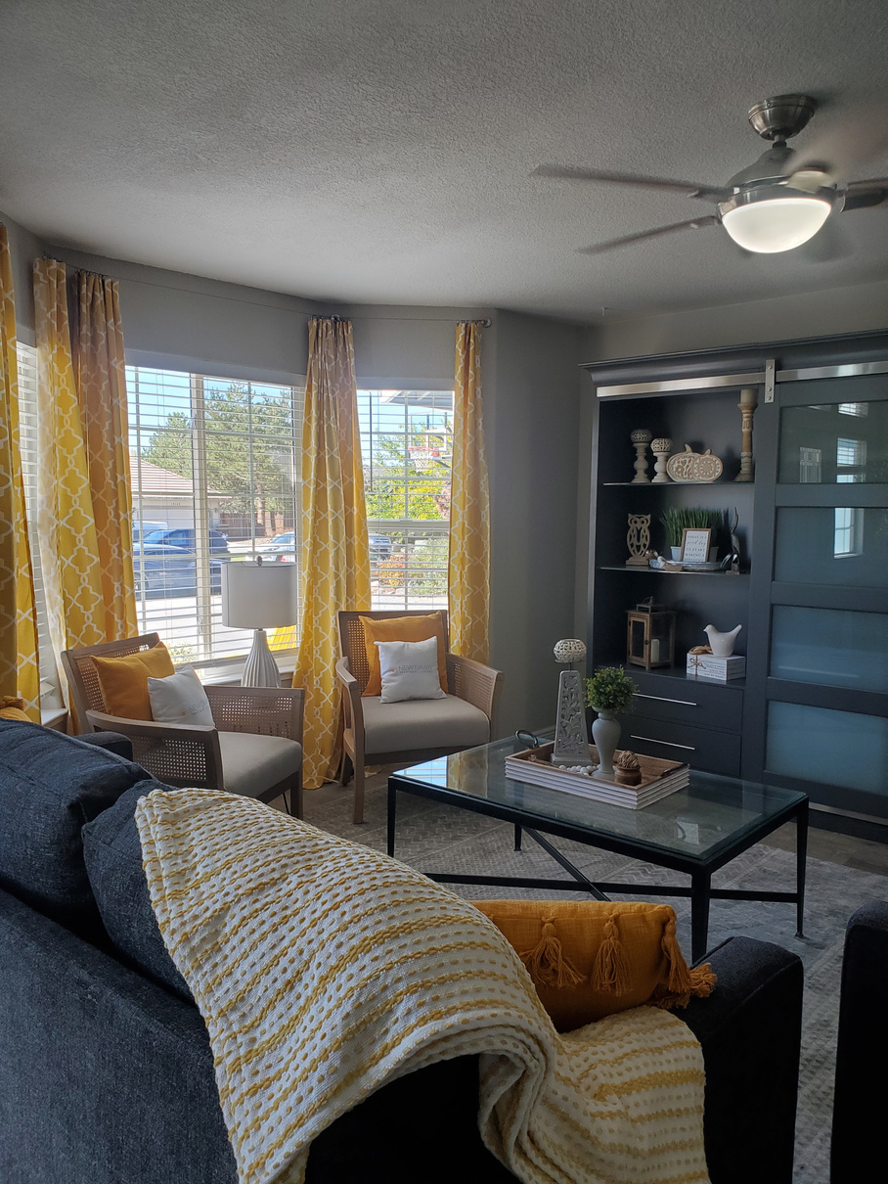
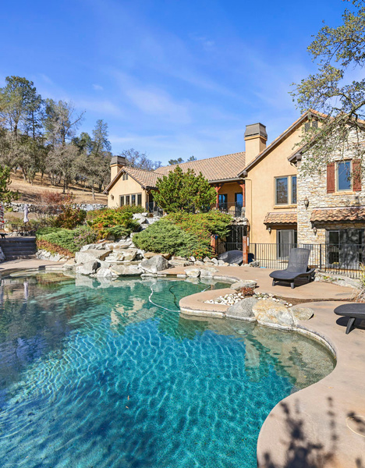
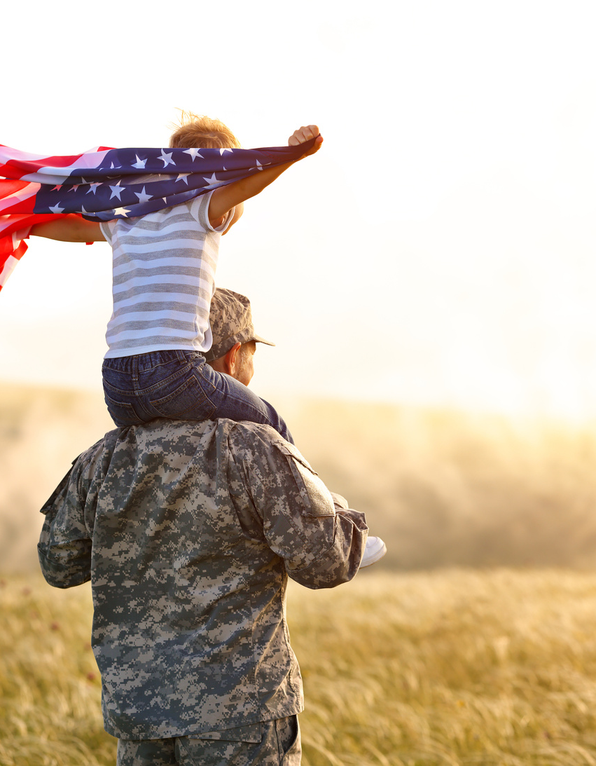

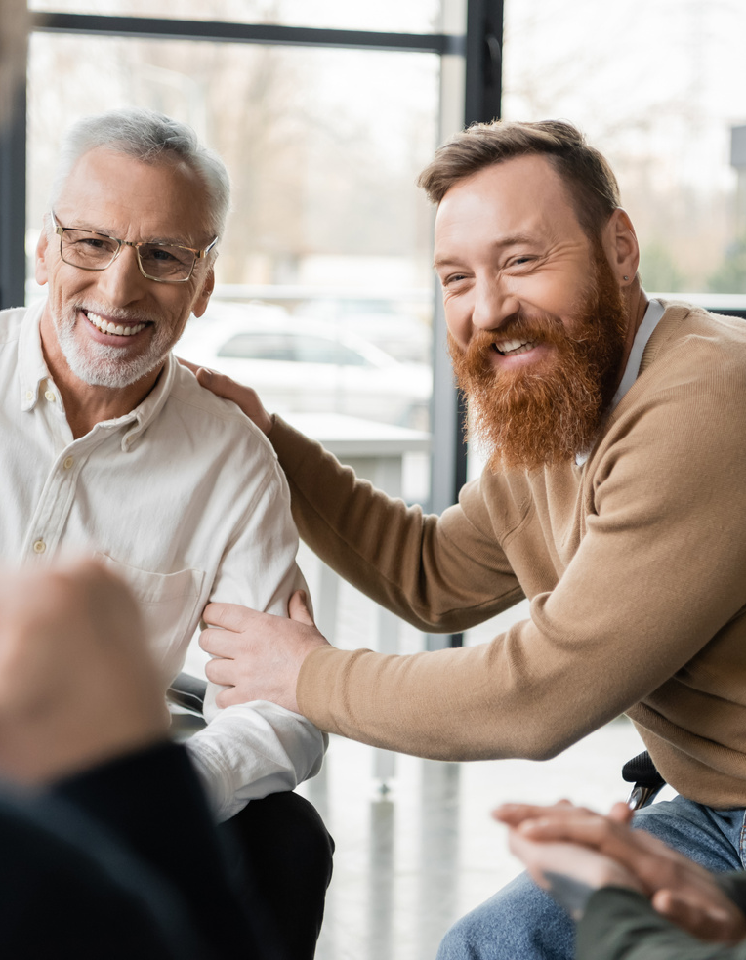

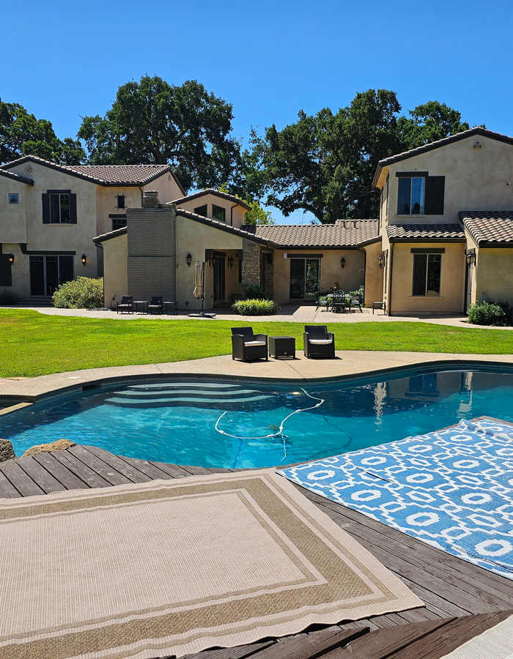

Overview of Services
Detox
Residential SUD
Men’s
Women’s
Luxury SUD
Veterans Program
Outpatient SUD
Outpatient Mental Health
Sober Living
Aftercare/Alumni

Slide 5
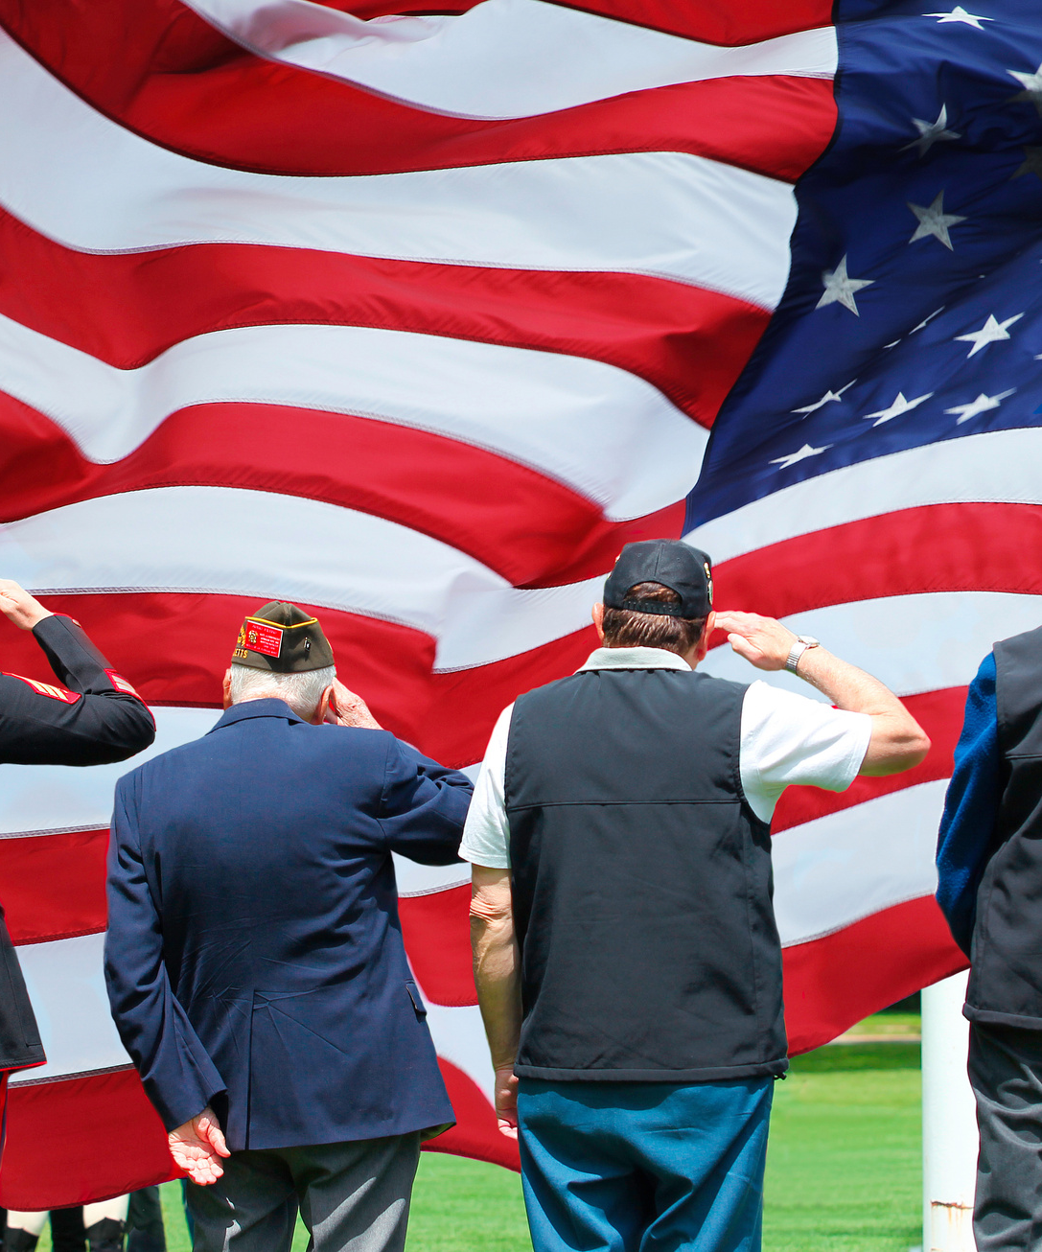
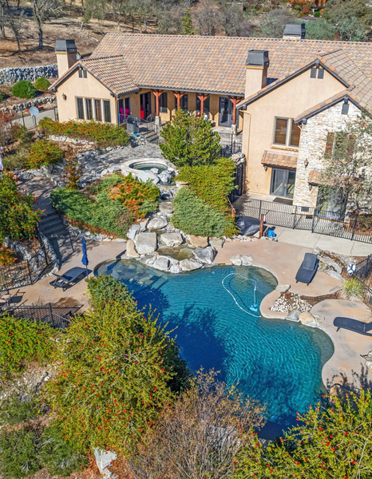
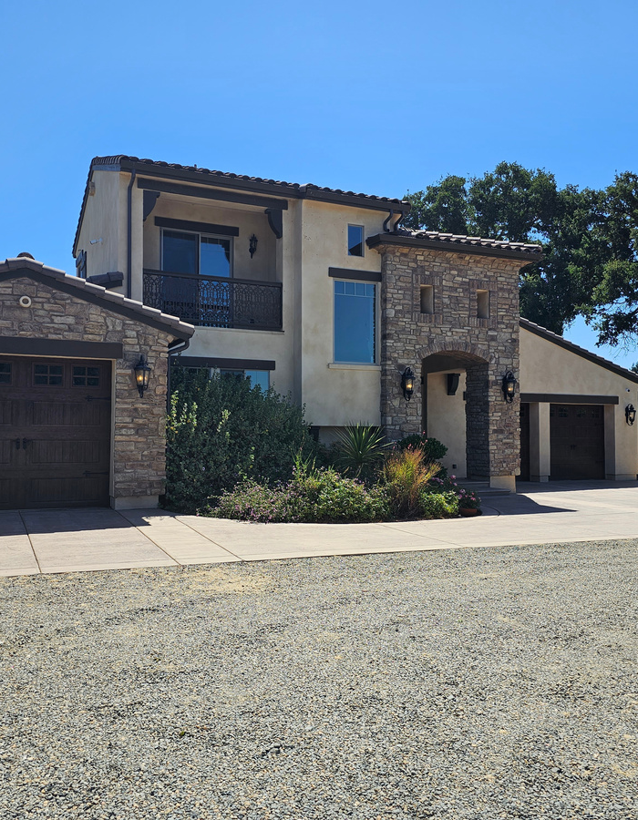
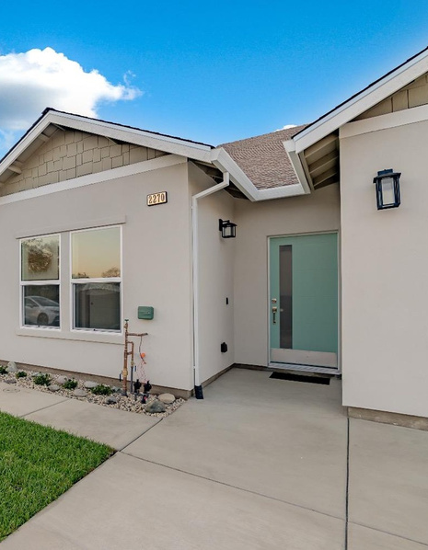
Specialized Programs for Veterans
Luxury Detox & Residential - Loomis, CA
Luxury Sober Living - Wilton, CA
Mental Health IOP/PHP with Optional Supervised Housing

Slide 6
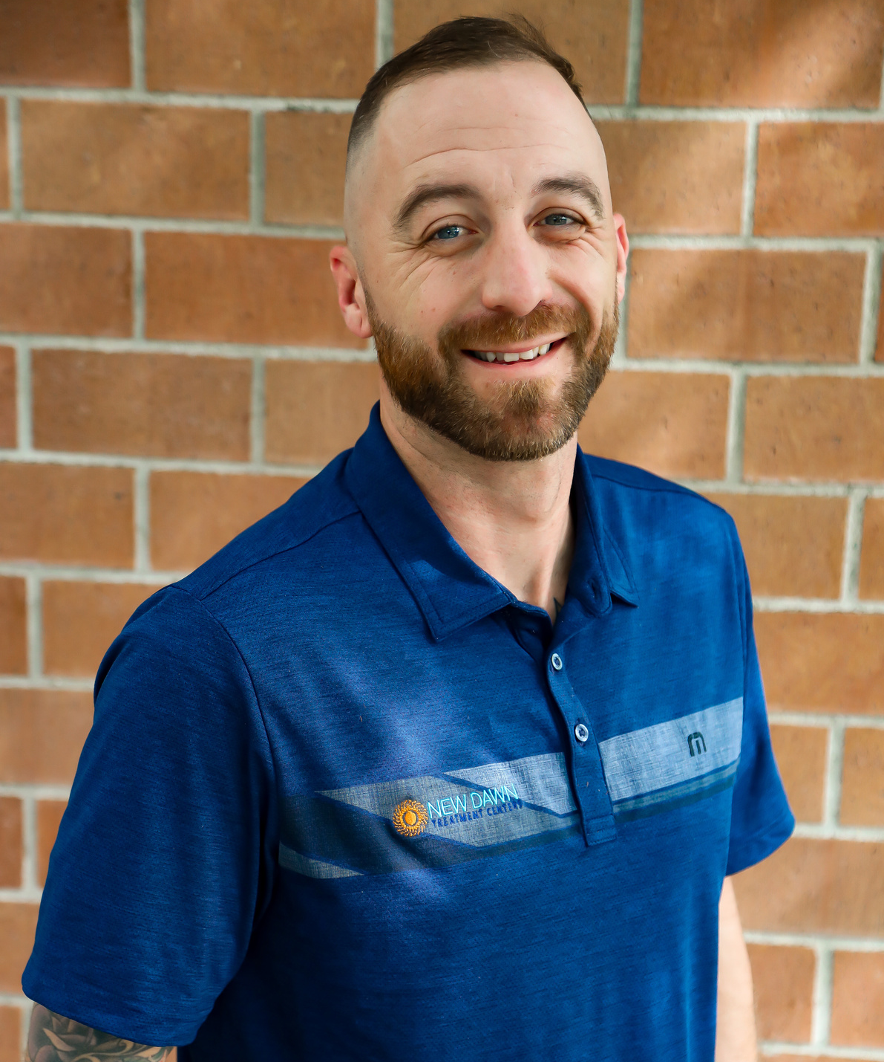
Some of Our Veteran Employees
Lee Hanna - VA Outreach Liaison
Lee, a 100% Disabled Veteran, served as an Airborne Infantryman in the United States Army, deploying to Afghanistan with the 173rd Airborne from Vicenza, Italy, and 2ID from Ft. Lewis, WA. With extensive experience leading and fighting alongside Infantrymen from diverse backgrounds, Lee establishes rapport with our Veteran clients, fostering an environment where they feel understood. He adeptly navigates them through the VA process and facilitates necessary referrals for treatment.
During treatment, Lee aids in securing housing, employment, and vital resources for Veterans. Armed with a Bachelor's in Communication Studies with a specialization in Conflict Resolution from SFSU, Lee utilizes his expertise when Veterans face crises, ensuring they receive the support they need.

Slide 7
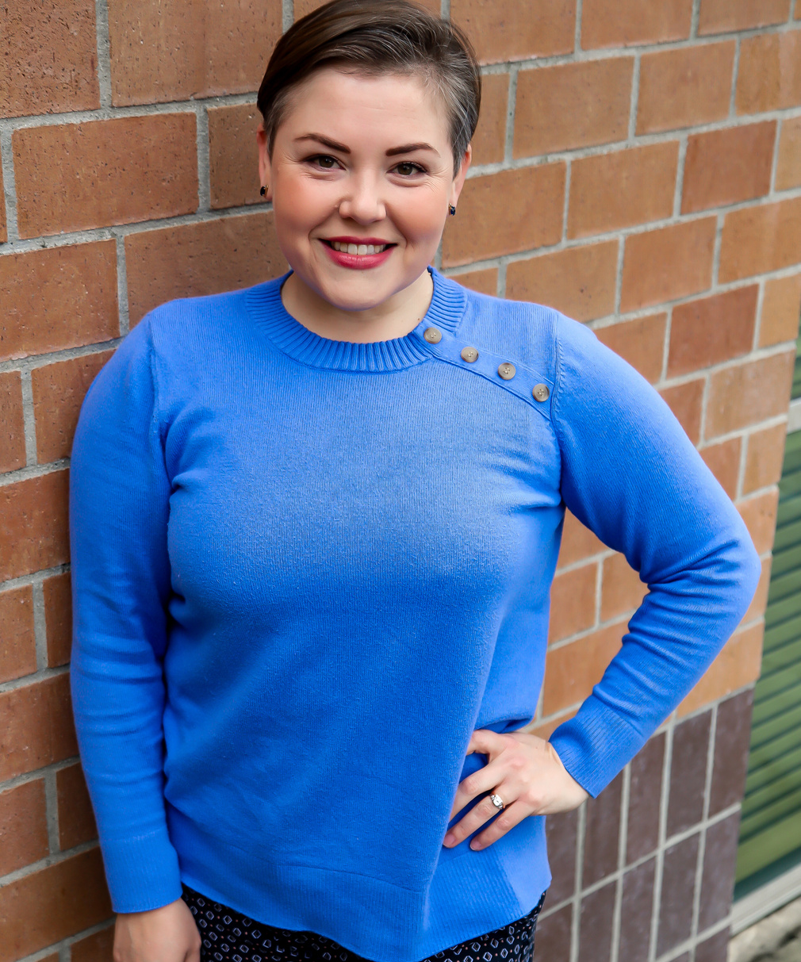
Some of Our Veteran Employees
Kimberly Pickens - Outreach Specialist
Kimberly is an OEF/OIF combat Veteran and an incoming member of the Nevada Air National Guard. She studied Biology at Truckee Meadows Community College, The University of Nevada Reno, and is currently pursuing a Bachelor's in Sociology through the American Military University.
Beyond her duties as an outreach specialist with New Dawn Treatment Centers and her academic and military service, Kimberlyis deeply involved in supporting her fellow Veterans. As a Nevada Veteran Advocate and a CAMO Court-Reno Mentor, she provides invaluable guidance and assistance to veterans living in her community and is on a team of dedicated supporters, providing a second chance for current and prior military members who have been arrested for misdemeanors like drunk driving or domestic violence, aiding them to become more successful in their active duty and veteran lives. Additionally, as the co-founder of the Northern Nevada Veterans Block Party, she and her team members are reducing silos within their Veteran community; They are bringing together all organizations that offer support and services to Veterans in Northern Nevada in fun and welcoming ways, focusing on resources and camaraderie.

Slide 8
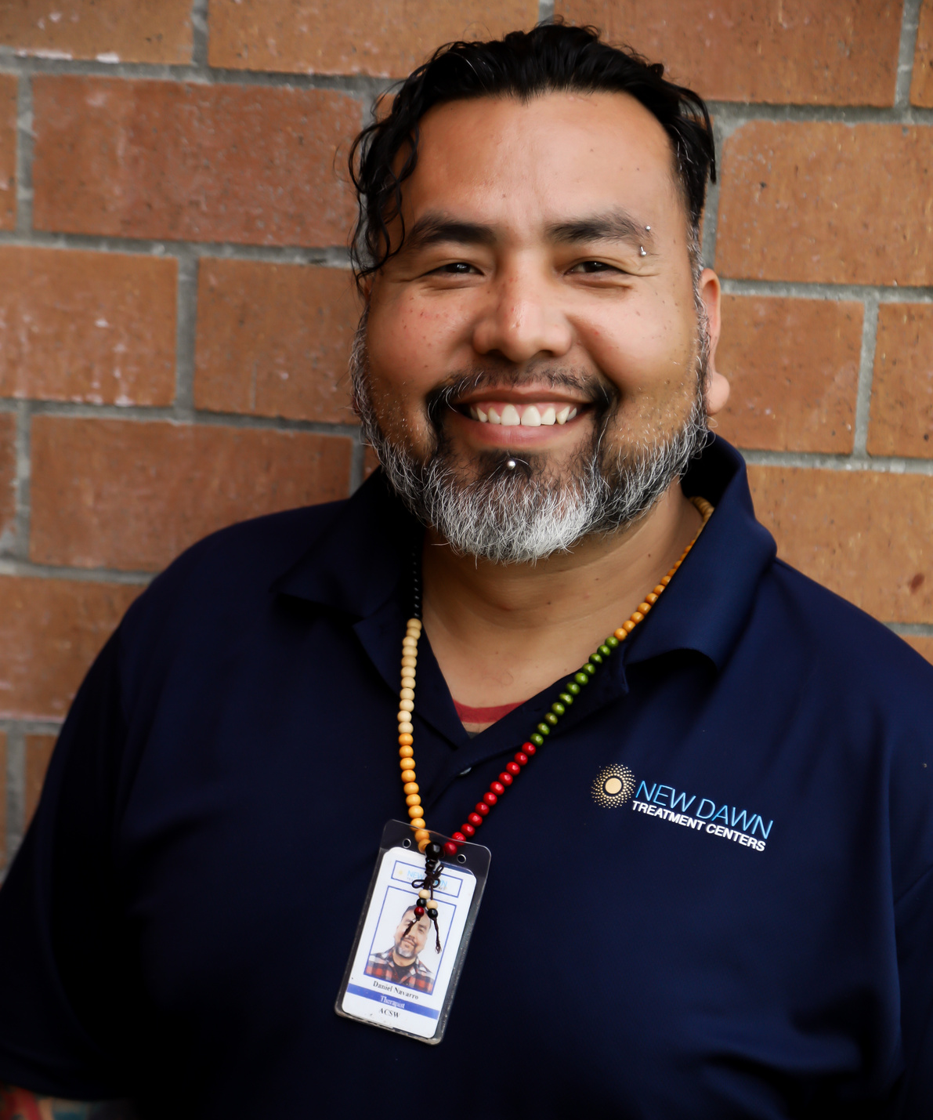
Some of Our Veteran Employees
Daniel Navarro - Therapist/Mental Health Clinic IOP/PHP
Daniel Navarro is a retired combat veteran who served in the United States Marines for 20 years. Daniel has lived experience dealing with substance use and mental health related issues, with the understanding that 3.7 million veterans had a mental health disorder and/or substance use disorders and that 9.5 million U.S. adults experienced both mental illness and a substance use disorder, Daniel wanted to continue serving is community by helping others who suffer from the same.
Daniel was accepted to the Military/Master’s in Social Work (MSW) program offered at the University of Southern California where he completed his program.
Daniel possesses a comprehensive experience working with personnel one on one or in groups of great diversity of ethical and cultural backgrounds. Moreover, Daniel possesses extensive knowledge in project and risk assessments, and dealing with complicated recovery patients dealing with complex mental illnesses and addiction which may result in challenging requirements for communication and decision-making skills. Daniel is proficient in activities that promote rehabilitation treatment, conflict resolution, active listening and resiliency.
Daniel believes in empowering the people to be “the person who they were meant to be” and not “what the addiction led them to be.” Danielunderstands that family plays a big role in a person’s recovery and practices different modalities to best fit the clients needs. Modalities such as Acceptance and Commitment Therapy (ACT), Cognitive Behavioral Therapy (CBT), Dialectal Behavior Therapy (DBT), Mindfulness and Narrative Therapy. Daniel expresses his passion for the wholistic approach to recovery, because he believes that “there are no limits when people have an open mind and have different approaches to their recovery.”
Daniel is connected and severs as a Peer leader in different veteran organizations such as the Wounded Warrior Project, Team Red White and Blue, Team Rubicon Disaster Response, the Mission Continues and the Veterans of Foreign Wars. These organizations caters not only to our Nations Finest but their families and communities as well.

Slide 9

CHALLENGES VETERANS EXPERIENCE GETTING
TREATMENT
ARTS Orientation Process
30 Days of waiting time to get into VA residential treatment facilities
Veterans are unaware of how to get benefits
30 Days of waiting time to get into VA residential treatment facilities
Within that waiting time Vets overdose, decide they don’t need/want treatment, suicide, or end up in jail.

