Slide 1

Office of Administrative Review Program Overview
February 2024
Presented By: Timothy Sirhal, Executive Director, Office of Administrative Review (OAR) Jane Chi, Chief, Office of Administrative Review (OAR)

Slide 2
VBA’s AMA Promise
In 2017, VBA realigned appeals policy and operational control under what is now the Office of Administrative Review (OAR) to provide more timely, effective reviews of claims decisions through consolidated Decision Review Operations Centers (DROCs). This allowed for the following:
Improved customer experience with the appeals process.
Fair and independent claim review.
Opportunity for Veterans and dependents to be heard and actively participate in the process.

Slide 3
VBA’s AMA Claims & Legacy Appeals
 | VBA’s AMA Claims | Over four years since fully implementing in February 2019, VBA has issued decisions on 1,834,429 AMA claims (1,339,613 Supplemental claims and 494,816 Higher-Level Reviews (HLR)). VBA has consistently achieved timely completions of supplemental claims and HLRs In FY23, HLR timeliness was 77.1 days and supplemental timeliness was 114.7 days. In FY24, HLR timeliness is 102.5 days and supplemental timeliness is 136.9 days. Priority – continue to meet timeliness goals; target improvements based on program experience and customer/stakeholder feedback.
 | VBA’s Legacy Appeals | When AMA was implemented in February 2019, VA’s legacy appeals inventory was over 383K. VBA owned over 268K of that inventory. Since February 2019, as of EOM December 2023, VBA reduced its inventory by approximately 236K. At end of December 2023, VBA had 32,859 total legacy appeals remaining (51.5K in the Department overall). Priority – further reduce legacy appeals.
Data as of end of month December 2023.
Notes:
As of EOM November 2023 – total of 53,441 in VA’s legacy pending inventory
VBA -> 32,852 (61.5%)
Board -> 20,589 (38.5%)
* Supplemental completion data is representative of all supplemental claims; received within 1 year (952,146) and received greater than 1 year (307,239).
Slides 20 and 21 provide breakout tables of the filing windows for supplemental receipts and completions.

Slide 4
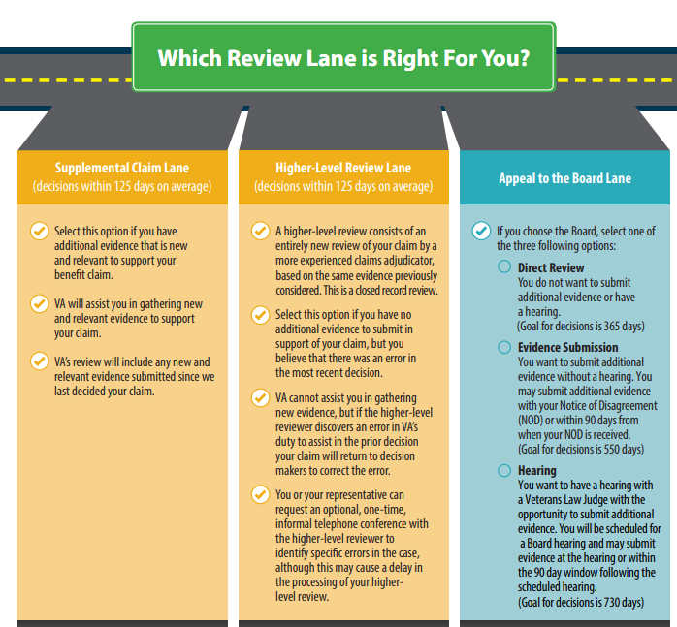
Review Options
Notes:
Considerations in determining which option:
• Do you have new evidence to submit or would you like VA to help you gather evidence not previously considered? – Supplemental Claim – Board Appeal: Evidence Submission or Hearing dockets
• Do you think the VA decision-maker made a mistake and would like someone with more experience to review the same evidence? – Higher-Level Review – Board Appeal
• Do you want your claim to be reviewed directly by a Veterans Law Judge? – Board Appeal

Slide 5
AMA Disagreement Rates
How often are claimants challenging rating decisions? Comparison with Previous 12 Months
Lane | December 2021 – November 2022 (prior 12 months) | December 2022 – November 2023 (last 12 months)
Supplemental Claim | 10.5% | 15.3%
Higher-Level Review | 8.2% | 9.8%
Appeal to Board | 4.1% | 3.8%
Notes:
Supplemental Claims = True Supplementals (i.e., OFO work, supp claims received within 1 year of decision)
Data Insight => Provides the % lane choice to where claimants are challenging OFO C&P rating decisions
Trending pattern in comparison to previous last 12 months data pull: (since EOM, February 2023)
Supplemental continues to increase: 10.9% (Feb.) -> 12.7% (May) -> 13.0% June -> 13.4% (July) -> 13.8% (August) ->14.1% (September) -> 14.6% (October) -> 15.3% (November)
HLR steadily increasing monthly: 8.5% (Feb.) -> 9.4% (May) -> 9.5% (June) -> 9.6% (July) -> 9.7% (August) -> 9.8% (September/October/November))
Board continues to trend downwards: 5.0% (Feb.) -> 5.0% (May) -> 4.9% (June) -> 4.8% (July) -> 4.6% (August) -> 4.4% (September) -> 4.3% (October) -> 4.1% (November)
Methodology:
Numerator is number of receipts within each respective category / bucket.
Denominator is based on OFO C&P rating decisions production during same 12 months.
-- Removes OFO Supplemental Production received more than 1 year from consideration.
Data Reference Comparison to a Prior Period:
Lane May 2022 – April 2023 May 2021 – April 2022
(last 12 months) (prior 12 months)
Supplemental 12.3 % 12.9 %
Higher-Level Review 9.3 % 7.0 %
Appeal to Board 5.1 % 4.3%

Slide 6
VBA AMA Workload Distribution
RO VSCs
Supplemental Claims
DROC St. Petersburg
DROC Seattle
AMA Higher-level reviews (HLRs)
AMA HLR Returns
AMA Board Full Grants
DROC D.C.
Receipts
Legacy Remands and AMA support
Pension, Foreign, CLCW, Radiation, and Manila
AMA Board Remands
In FY2018, VBA established Decision Review Operations Centers (DROCs) to process AMA HLRs and Board decisions
Important: OAR also has a small subset of personnel to process restricted claims
Notes:
VBA Workload Distribution helps to showcase who processes what work.
The St. Petersburg and Seattle DROCs are responsible for processing AMA higher-level reviews, Board AMA grants and remands, and AMA higher-level review returns (Seattle also processes Pension). The DROC D.C. is a virtual station and is not physically located in DC; DROC DC is responsible for processing legacy remands and Pension.
Specialized processing centers have assigned appropriate higher-level reviewers to conduct reviews related to their areas of specialized processing, such as exposure to mustard gas, or contaminated water at Camp LeJeune.

Slide 7
Higher-Level Review (HLR) Process
One of three decision review options under AMA.
Must file the HLR one-year from date of prior decision.
Claimants can request an informal conference.
A de novo review of a prior decision by a higher-level reviewer.
VA cannot assist with gathering new evidence for the HLR.
If the higher-level reviewer, discovers an error in VA’s duty to assist in the prior decision, the issue(s) under the HLR will be returned for corrective action.

Slide 8
Informal Conferences
If selected, VA will contact the claimant or their representative identified on the HLR for (VA Form 20-0996) to schedule a time to discuss the HLR.
Opportunity to identify errors in fact or law and discuss why the decision should be changed.
It is not a formal hearing so there will be no transcripts for the call.

Slide 9
Duty to Assist Errors
A duty-to-assist error occurs when VA did not make reasonable attempts to gather evidence VA should have obtained.
Once identified, VA will issue a decision identifying the error.
The higher-level review decision (HLR) will then close and return the issue(s) for corrective action.
Corrective action for a duty to assist error requires VA to consider new and relevant evidence; therefore, the claim is continued until corrective actions are complete and a new decision is issued.
VA will send a notification letter explaining the actions being taken to correct the error.

Slide 10
How to Request a HLR
These practices help VBA address the correct issues for the Veteran and assist in the efficient processing of the HLR.
List the contentions on the VA Form 20-0996 exactly the way they are listed in the prior rating decision.
This will help avoid potential confusion over which issue is being reviewed, especially if the same body part/system has more than one evaluation.
Do not submit new evidence with the request, unless you are submitting a Supplemental Claim on VA Form 20-0995.

Slide 11
VA and VSO Partnership
Dedicate time to familiarize and understand the process – reach out to the local VA Regional Office if there are questions about the claims process.
Use va.gov as a resource, and help your veterans get familiar with the website.
Many questions can be answered there, saving your time to assist with more complicated issues.

Slide 12

Questions?

