Slide 1


Open Forum Q&A
Spring 2023 Professional Training Conference
Winter 2023 Professional Training Conference
June 2024 Professional Training Conference
Presenters:
Katrina J. Eagle, Esq.
Jim Radogna, VA Accredited Agent

Slide 2
Topics
Citing the M21 manual in an appeal
Review: PACT Act / TERA Claims
PACT Act Effective Date Scenarios

Slide 3
Statutes, Regulations And Case Law
Statutes, also known as codes, represent legislation that has been formally written and passed by Congress. They typically set forth broad legal concepts rather than delving into exhaustive specifics.
Regulations, also known as rules, are written by agencies to supplement those laws. Specifically, VA Regulations (Title 38) are created by the Office of the Secretary of Veterans Affairs to implement the statutes promulgated by Congress. These regulations are often more detailed and specific in nature, serving as a roadmap for both individuals and the agency in their application and compliance.
Case Law: These are binding (precedential) decisions made by the Veterans’ Court, the Federal Circuit, and the Supreme Court. These decisions often involve interpreting Congressional intent within statutes or addressing inconsistencies between statutes and regulations. If a court determines that VA misinterpreted Congress’s intent, it may invalidate a regulation. These legal precedents play a crucial role in shaping veterans’ benefits and ensuring proper implementation of laws and regulations.

Slide 4
The M21 Manual
The M21 serves as a comprehensive guide for processing and adjudicating claims and appeals related to compensation, pension, and other benefits for Veterans and their dependents.
It draws its authority from the statutes and regulations outlined in Title 38, which governs the Department of Veterans Affairs benefits.
When there is a conflict, relevant statutes and regulations take precedence over procedural guidance in the M21.
The M21 procedures are designed to assist VBA employees in properly adjudicating claims, ensuring fair, accurate and consistent decisions.
Generally, the M21 explicitly identifies the actions that claims processors must take as well as those they may not take.
The provisions of the M21 manual are mandatory for VA adjudicators to follow, however, they do not hold the same obligatory status for the Board of Veterans’ Appeals (BVA).

Slide 5
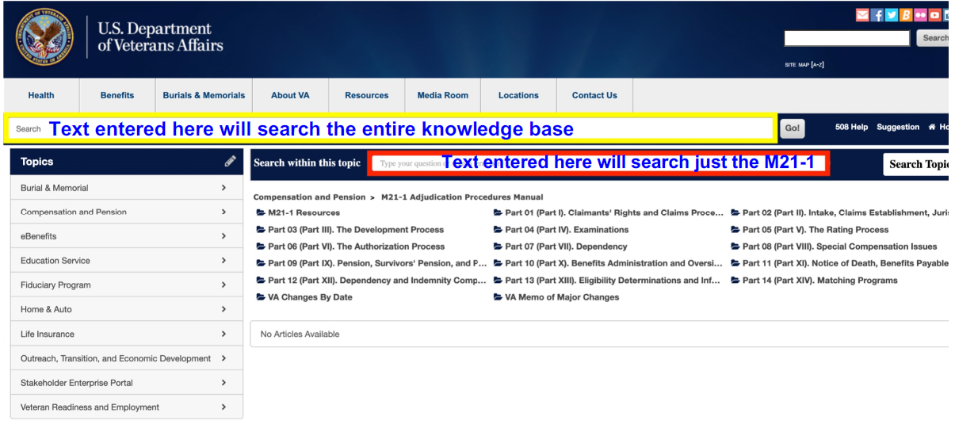
Searching the M21-1
https://wwwˌknowvaˌebenefitsˌvaˌgov/system/templates/selfservice/va_ssnew/help/customer/locale/en-US/portal/554400000001018/topic/554400000004049/M21-1-Adjudication-Procedures-Manual

Slide 6
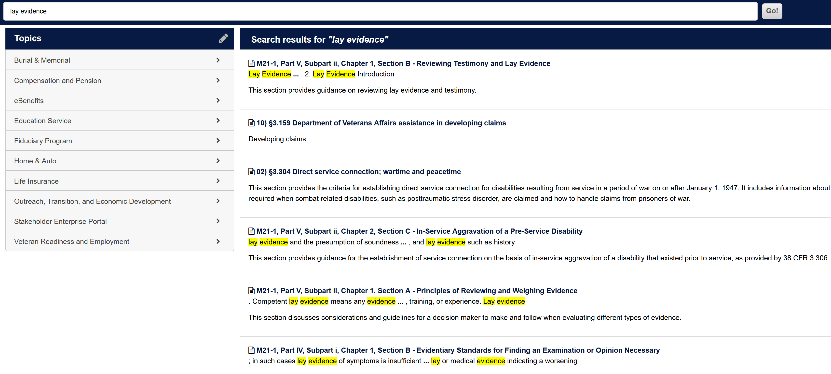
Searching the M21-1 – Example #1
Rating decision denies mental health condition but ignores excellent lay statement from veteran. We want to cite to M21 in the HLR to show that VA is required to consider lay evidence.

Slide 7
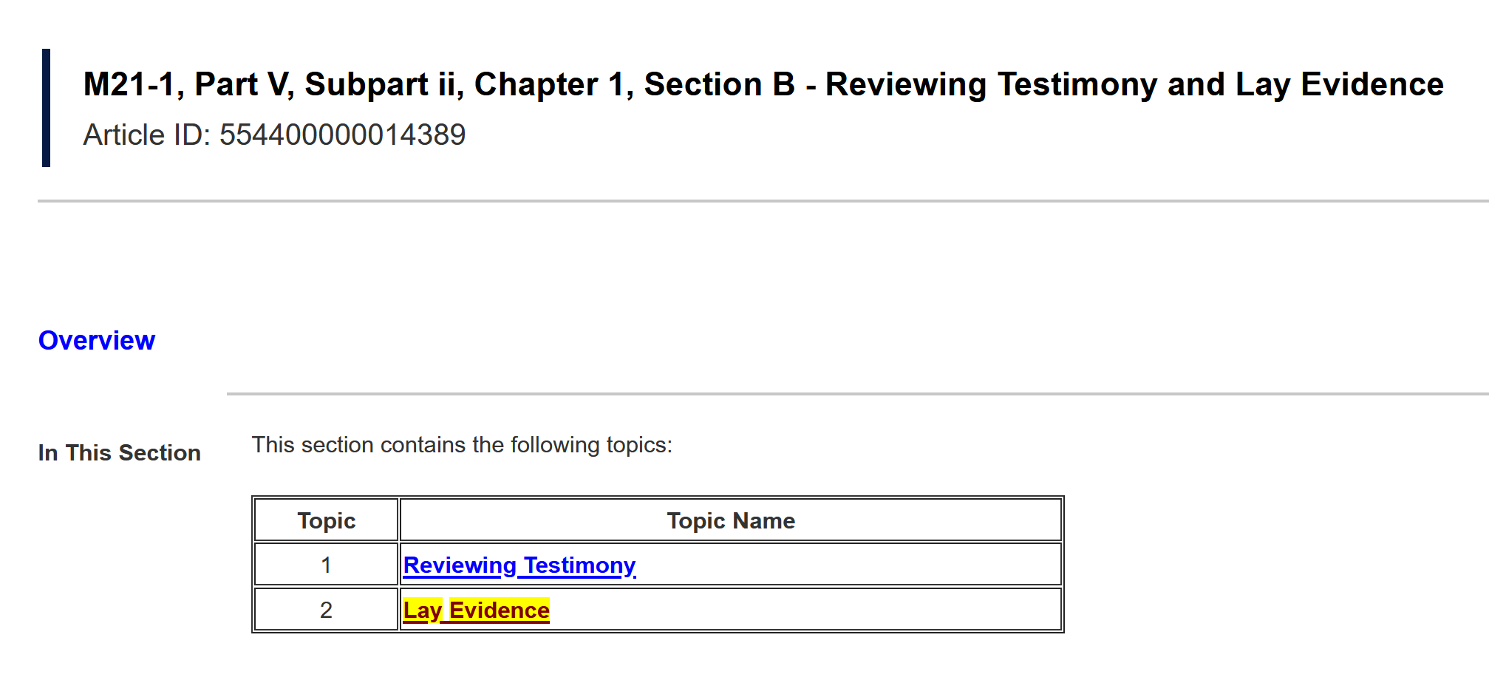
The M21 Citation

Slide 8
The HLR Argument
The 5/9/2024 Rating Decision Narrative ignored evidence of in-service events relating to Veteran’s current diagnosis of unspecified mood disorder. Veteran submitted a credible and competent lay statement detailing in-service events leading to his current disability (uploaded to VBMS on 7/17/2023). The events detailed in this statement are supported by 2 medical professionals: 1) 11/17/2022 DBQ by a private psychologist and 2) 5/2/2024 C&P exam by a contract examiner.
Per M21-1 V.ii.1.B.2.a., lay statements may be acceptable for establishing service incurrence. There is NO evidence in the record that weighs against the Veteran’s credible and competent statements. As such, service connection for unspecified mood disorder should be granted.

Slide 9
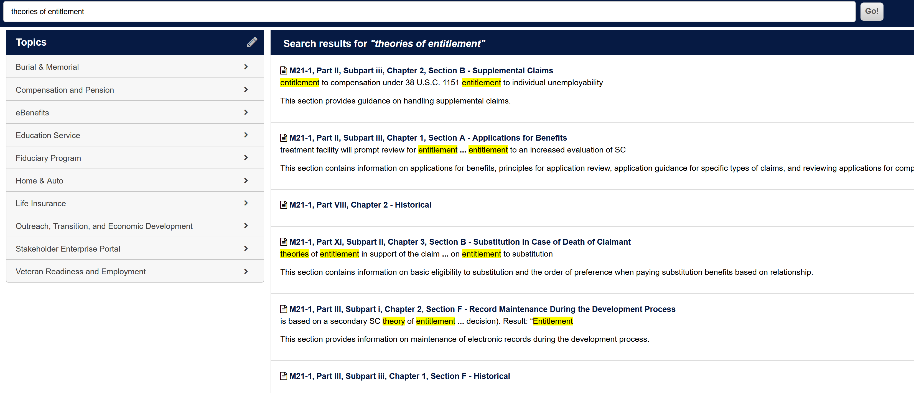
Searching the M21-1 – Example #2
Rating decision grants service connection CAD for Guam veteran and assigns 8/10/2022 effective date. Veteran originally claimed service connection secondary to his service-connected diabetes, NOT as a PACT Act presumptive. We want to cite to M21 in the HLR to show that VA is required to all theories of entitlement.

Slide 10
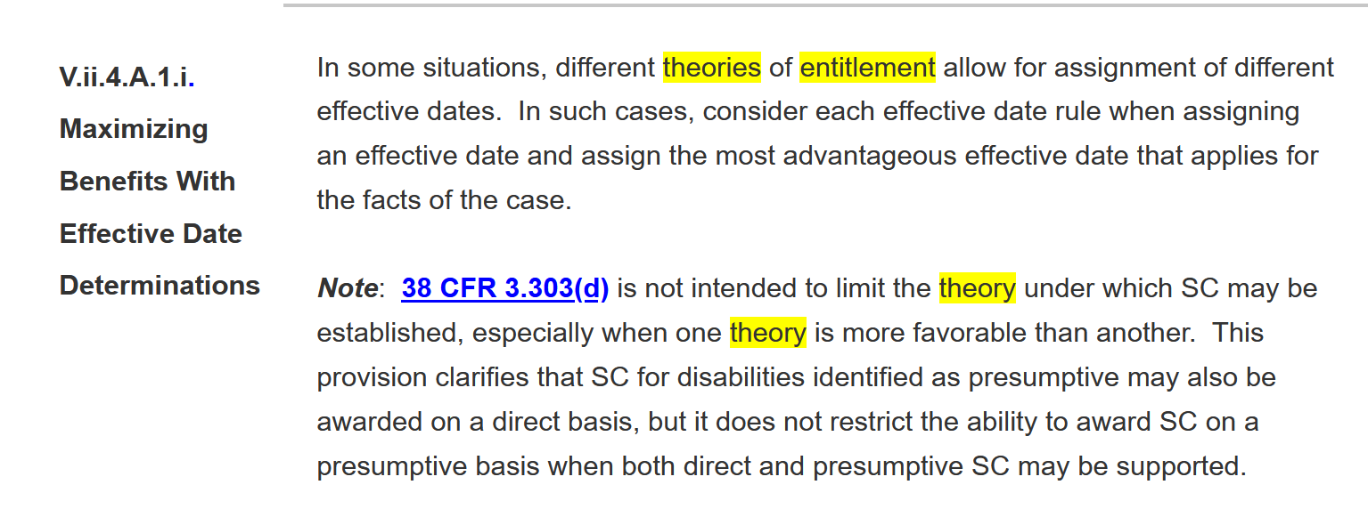
The M21 Citation

Slide 11
The HLR Argument
The RO failed to adjudicate the Veteran's claim for coronary artery disease as secondary to his service connected Diabetes Mellitus Type 2. (See 1/21/2022 medical nexus opinion and articles uploaded to VBMS 1/27/2022).
**THE FOLLOWING M21-1 GUIDANCE REQUIRES THAT PACT ACT CLAIMS MUST BE CONSIDERED ON DIFFERENT THEORIES OF ENTITLEMENT**
M21-1 V.ii.4.A.1.i. – “In some situations, different theories of entitlement allow for assignment of different effective dates. In such cases, consider each effective date rule when assigning an effective date and assign the most advantageous effective date that applies for the facts of the case.”
As such, the Veteran is entitled to an effective date of 10/28/2019 for his coronary artery disease.

Slide 12
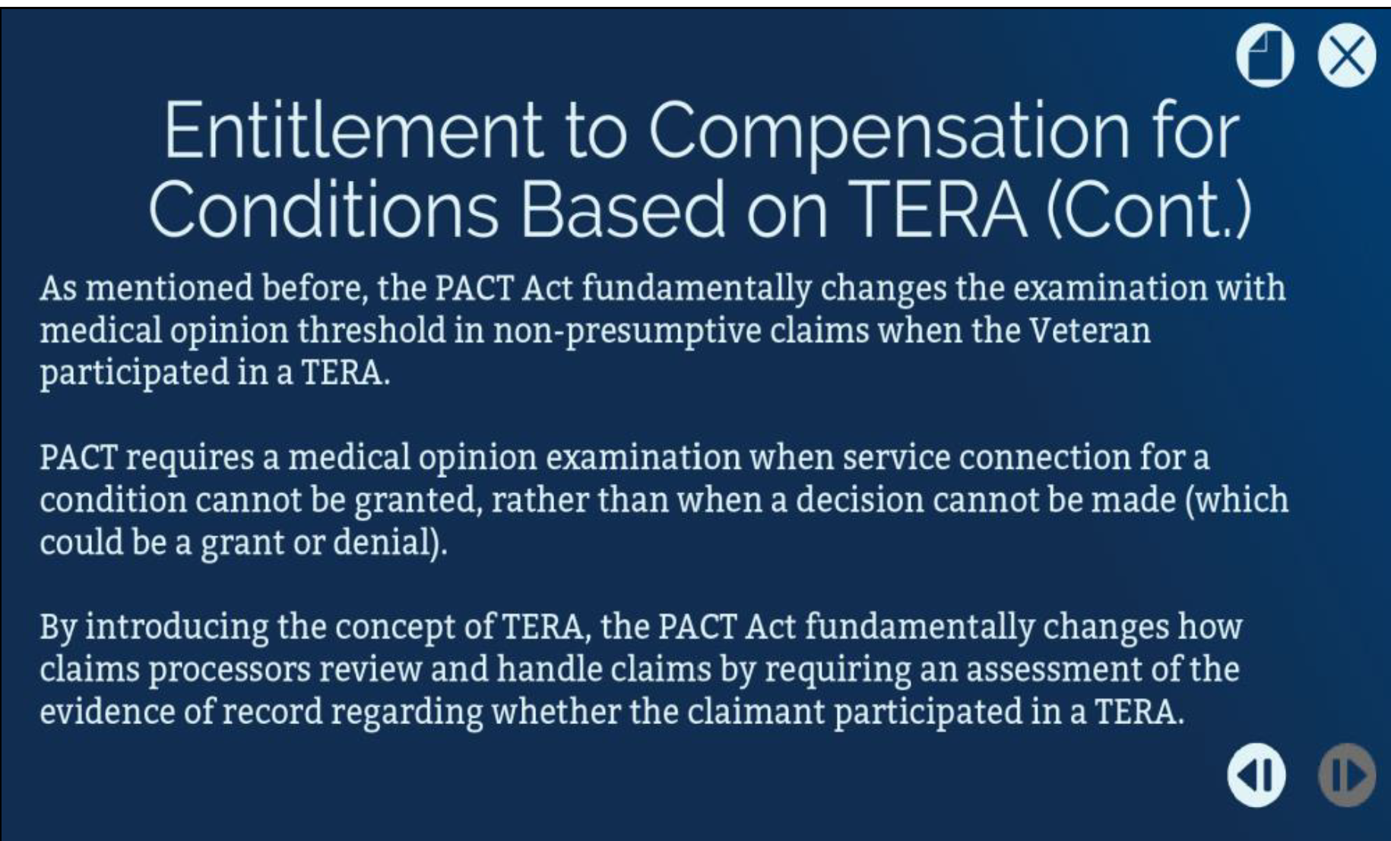
Review: Pact Act/TERA Claims

Slide 13
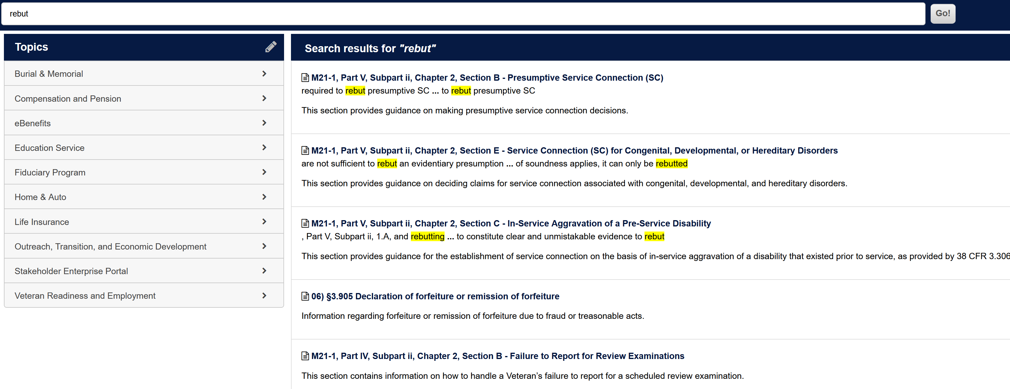
Searching the M21-1 – Example #3
VA erroneously ordered a C&P medical opinion for a Gulf War veteran entitled to presumptive service connection for fibromyalgia. C&P examiner wrote a negative opinion and rater denied SC. We want to cite to M21 in the HLR to show that the burden of proof for VA to rebut a presumption is very high and the examiner did not reach that standard.

Slide 14
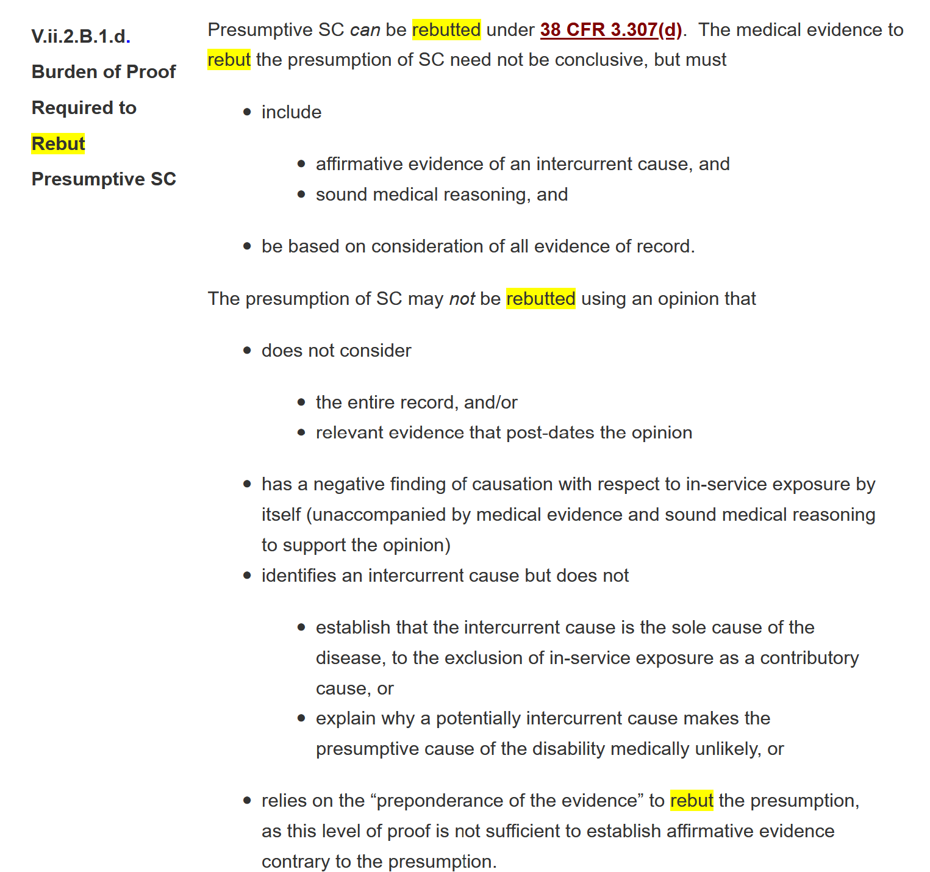
The M21 Citation

Slide 15
The HLR Argument
Veteran is entitled to resumptive service connection for fibromyalgia but was erroneously denied based upon an inadequate C&P medical opinion.
Per M21 V.ii.2.B.1.d., "The presumption of SC MAY NOT be rebutted using an opinion that does not consider the entire record…”
The C&P medical opinion cited to deny the veteran's presumption of service connection violates M21 guidance on the burden of proof required to rebut presumptive service connection as well as VA regulation 38 CFR § 3.307(d). As such, please grant service connection for fibromyalgia without further delay.

Slide 16
Review: PACT Act / TERA Claims
38 USC § 1168 – Medical nexus examinations for toxic exposure risk activities (TERA)
Medical Examinations and Medical Opinions.—
Except as provided in subsection (b), if a veteran submits to the Secretary a claim for compensation for a service-connected disability … with evidence of a disability and evidence of participation in a TERA during active military [service], and such evidence is not sufficient to establish a service connection for the disability, the Secretary shall—
provide the veteran with a medical examination … and
(B) obtain a medical opinion (to be requested by the Secretary in connection with the medical examination under subparagraph (A)) as to whether it is at least as likely as not that there is a nexus between the disability and the TERA.
(b) Exception.— Subsection (a) shall not apply if the Secretary determines there is no indication of an association between the disability claimed by the veteran and the TERA for which the veteran submitted evidence.

Slide 17
Review: PACT Act / TERA Claims
Under § 1168, VA is required to provide the Veteran a medical evaluation with a medical-nexus opinion when the Veteran claims a non-presumptive disability and records show participation in TERA.
So, when filing a PACT Act claim, these are the key steps that may require your attention:
Make sure the 526EZ and any supporting personal statements are as detailed as possible.
Even if you were not the POA who filed the claim, go back and review what the Veteran claimed. Supplement as needed!
Look for VA’s TERA Memo to be uploaded to Veteran’s file, then review it carefully!
Are all relevant claimed toxins properly noted in the TERA Memo?
Look for VA to upload ESR, then review it carefully!
Did VA ask for a nexus opinion? Were they right to??
Did VA tab relevant evidence from Veteran’s VBMS file in the ESR?
Look for VA exam reports and MOs, review them carefully!
Did VA examiner answer all questions asked?
Did VA examiner address all claimed toxic exposures?

Slide 18
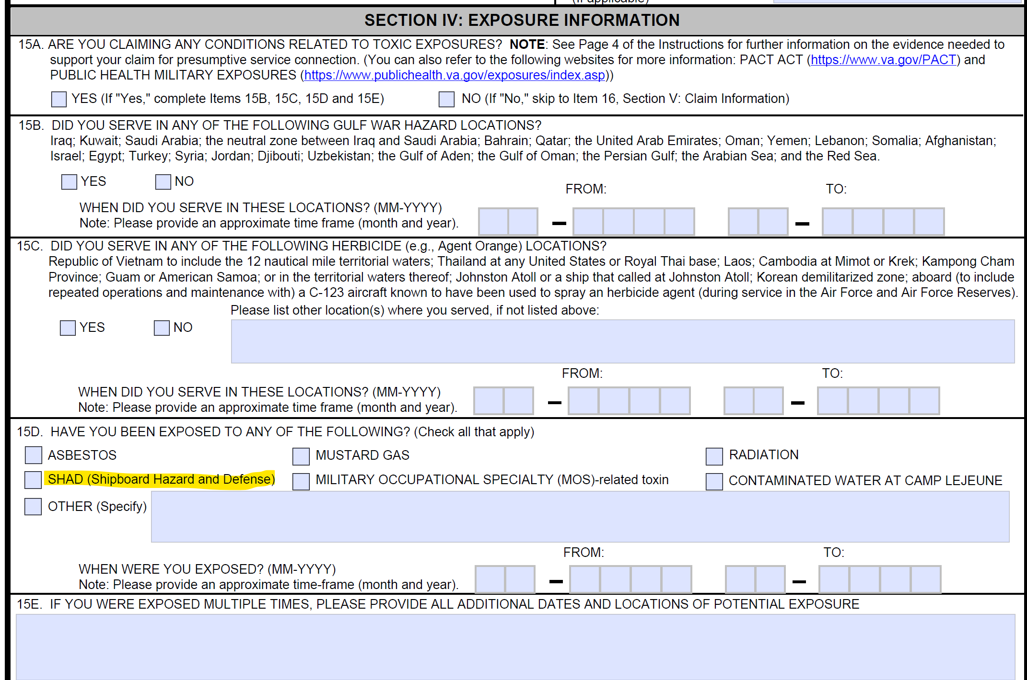
Review: PACT Act / TERA Claims
From VA Form 21-526EZ, page 10:

Slide 19
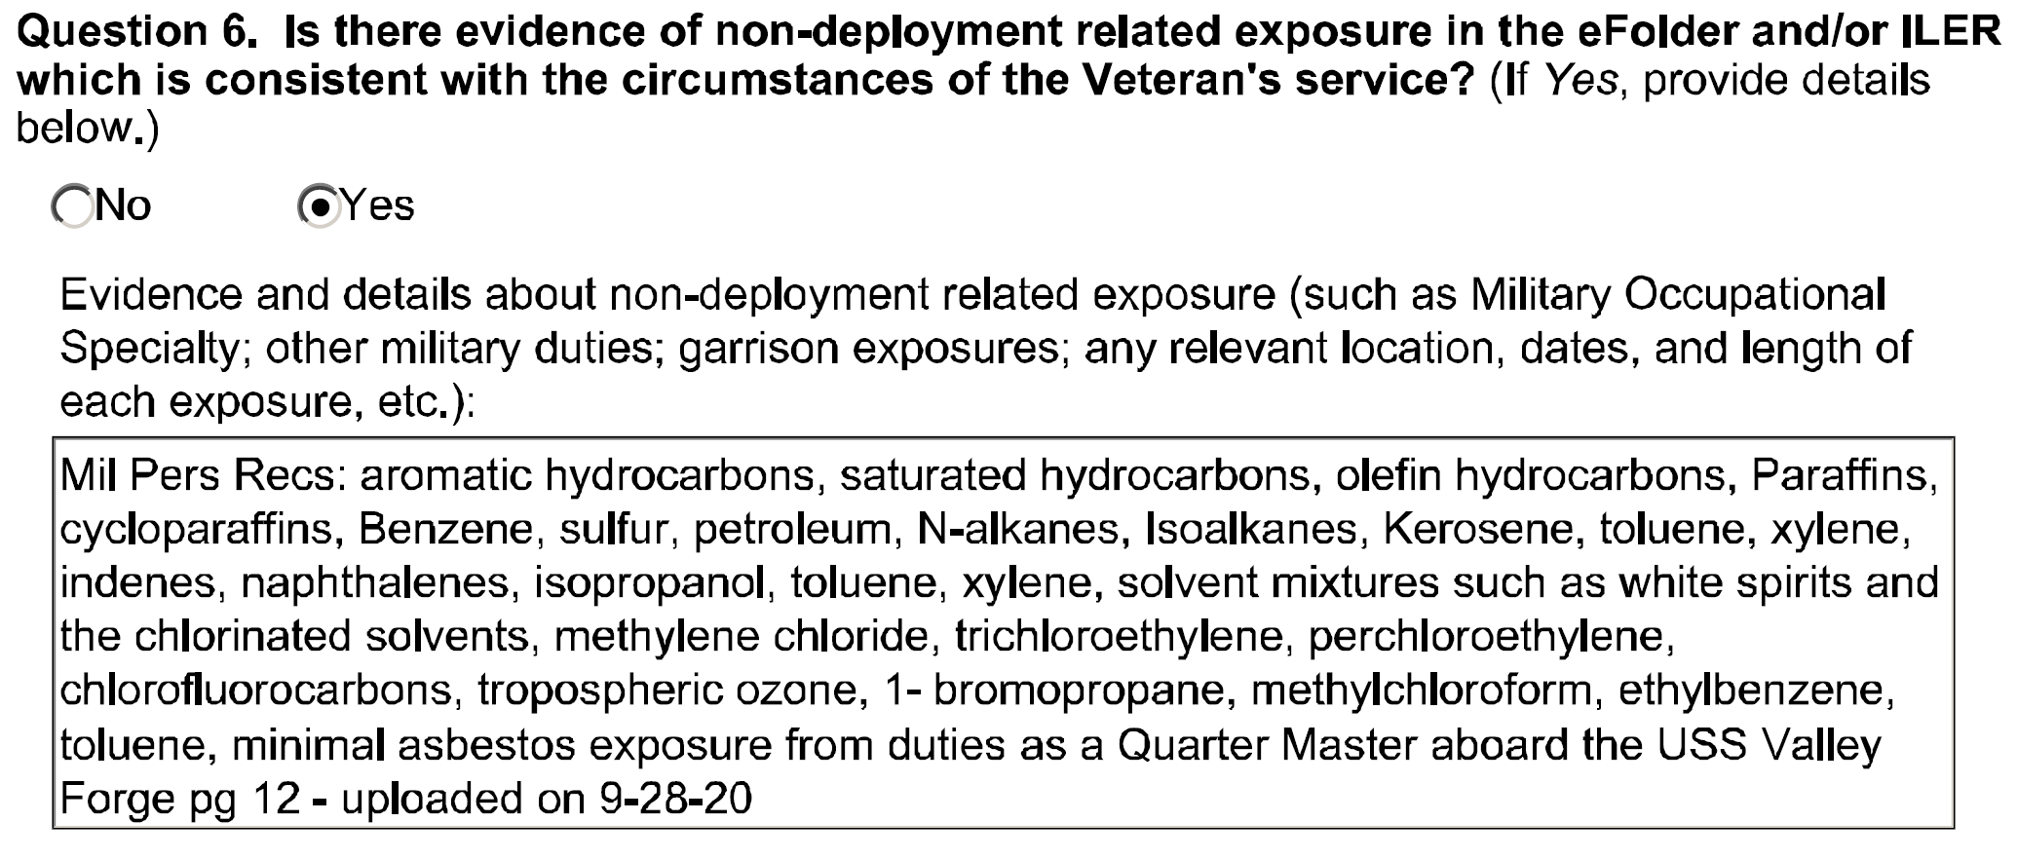
Review: PACT Act / TERA Claims
It’s important to review the entire TERA memo, but this is the key section:

Slide 20
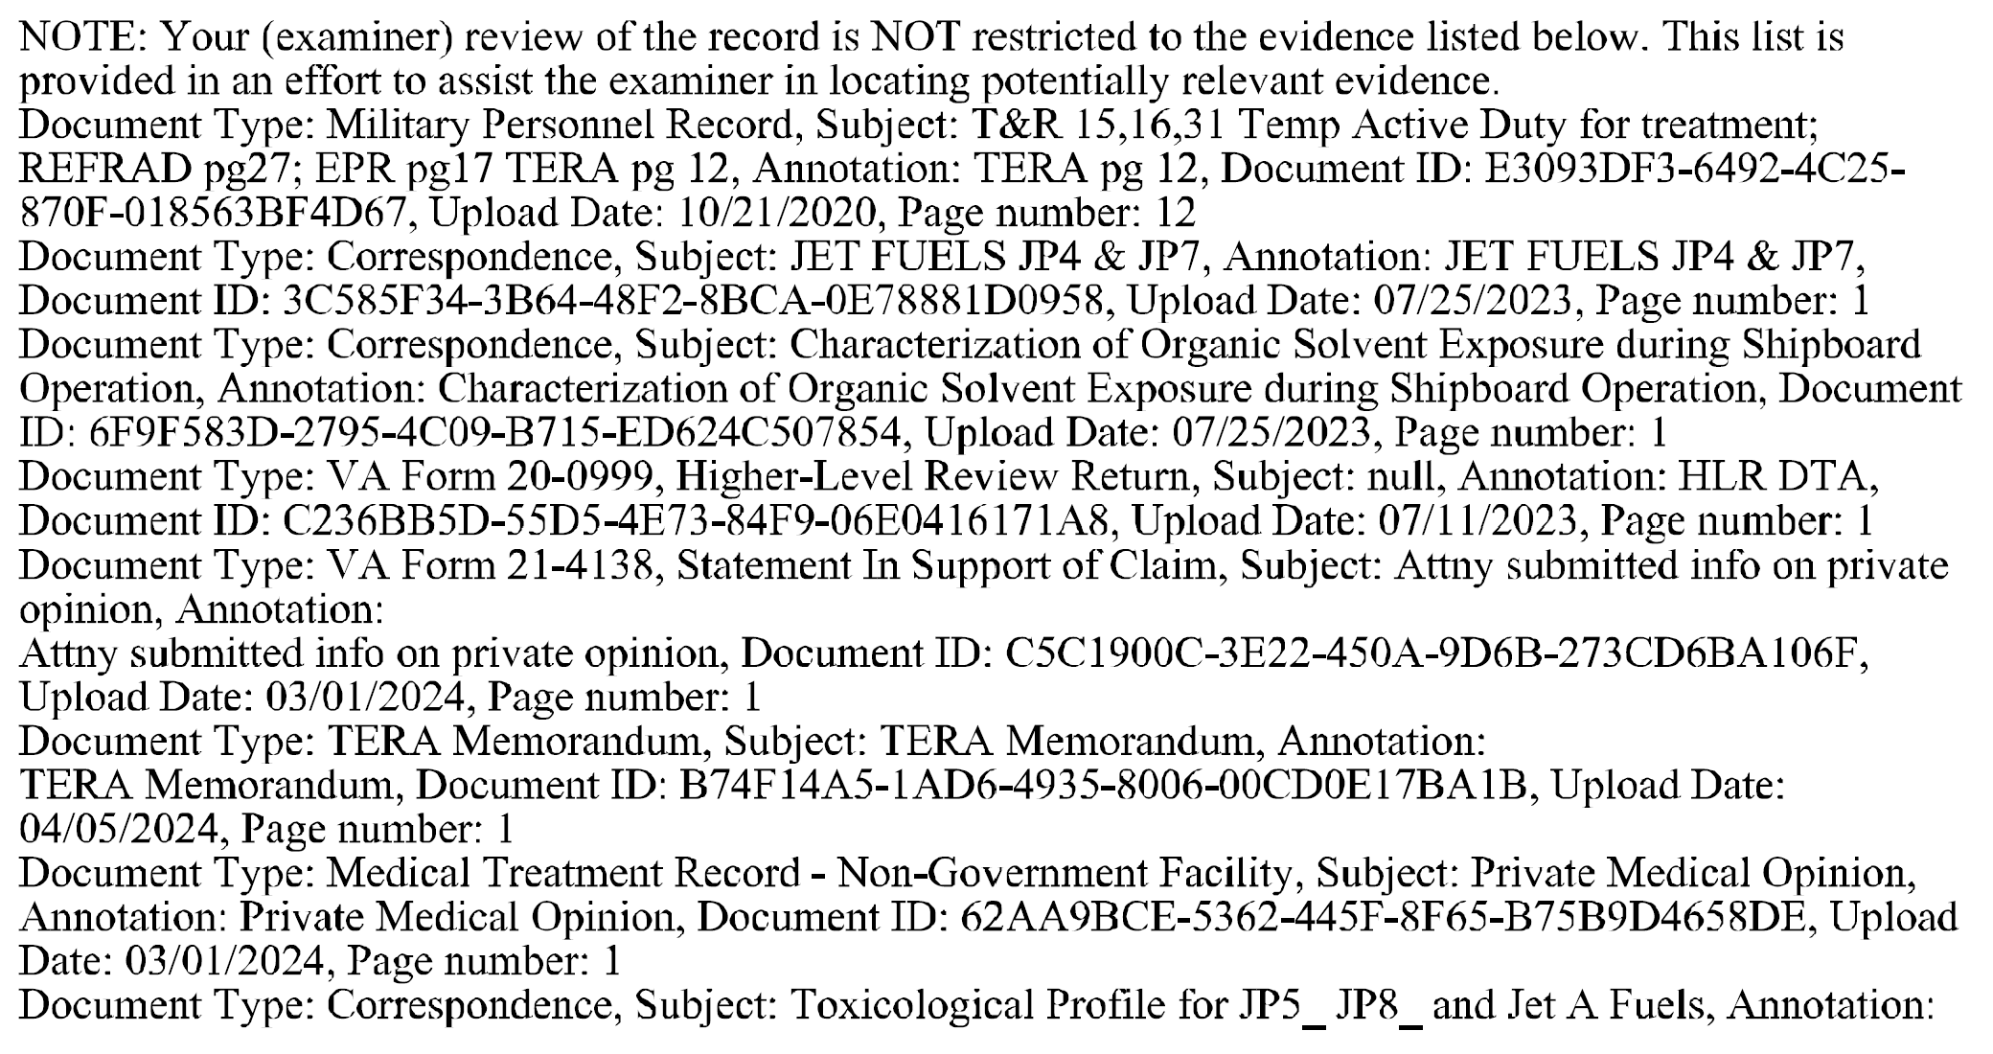
Review: PACT Act / TERA Claims
ESRs can be hard to decipher at first, but read enough of them, and it gets easier. RIF!

Slide 21
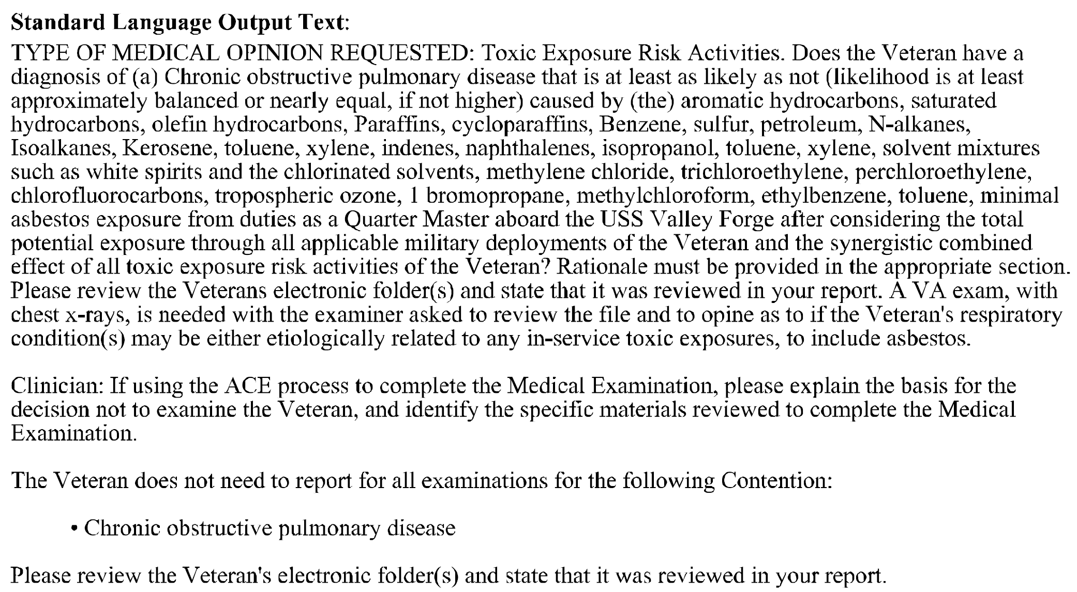
Review: PACT Act / TERA Claims
ESRs can be hard to decipher at first, but read enough of them, and it gets easier. RIF!

Slide 22
Review: PACT Act / TERA Claims
Pop Quiz: which of the following PACT Act-related claims require VA to obtain a medical-nexus opinion?
Veteran files a claim for hypertension; she served in the Persian Gulf 9/1990 to 12/1990.
Yes (HTN is not presumptive for PGW Veterans).
2. Veteran files a claim for Parkinson’s disease; he served at Camp Lejeune 2/1988 to 2/1989.
Yes (Veteran’s service is after CLCW presumptive period).
3. Veteran files for COPD; he served in Vietnam from 6/1968 to 6/1969.
Yes (COPD is not presumptive for Vietnam era).
4. Surviving spouse files for DIC; Veteran’s COD was bladder cancer, he served in Guam from 5/1977 to 4/1979.
No (bladder cancer is presumptive and Guam is presumptive to 7/31/1980).
5. Surviving spouse files for DIC; Veteran’s COD was glioblastoma, he served in Thailand from 2/1970 to 2/1972.
No (glioblastoma is an exception to § 1168 development).

Slide 23
Review: PACT Act / TERA Claims
Non-presumptive claims must be liberally construed under PACT Act provisions. The law does not require a Veteran to claim participation in a TERA for PACT Act procedures to apply – but it sure does help!
Two case studies that underscore how the PACT Act benefits Veterans and Claimants:
US Army Veteran, served 7/1965 to 7/1967, foreign service in Germany only, MOS = Cook.
VAF 526EZ filed for CAD and chronic myelogenous leukemia (CML); submitted a personal statement detailing his in-service exposure to TCE, Toluene, other cleaning solvents, pesticides used routinely to spray kitchen area.
TERA memo noted MOS-related toxins: “Exposure to chemicals to clean and maintain equipment, lead exposure, asbestos.”
VA examiner returned negative medical opinions, so we will obtain expert nexus opinions.
In this case, what is the most valuable evidence that VA developed?

Slide 24
Review: PACT Act / TERA Claims
Second case study that underscores how the PACT Act benefits Veterans and Claimants:
US Navy Veteran, served 9/1962 to 9/1964, service records confirm participation in SHAD Project “Flower Drum, Phase I” off coast of Hawaii in 1964.
DOD Fact Sheet confirms exposures to Sarin gas and Sulfur dioxide (SO2) for all participants.
Veteran diagnosed with PD in 1996, files claim in 2010 and specifically noted exposure to sarin gas during Project SHAD, submitted treating physician’s nexus opinion. VA denied claim.
Veteran died in 2014, PD listed as contributing cause.
Surviving spouse files for DIC in 5/2022.
VA confirmed Veteran participated in SHAD, but TERA Memo only noted exposure to Mustard Gas; VA examiner said no nexus b/n PD and Mustard Gas, so VA denied DIC claim.
On May 21, 2024, we filed HLR requesting proper TERA Memo and new/proper MO.
On June 6, 2024, VA granted DIC, used 2011 MNO linking sarin gas and SO2 to PD!

Slide 25

PACT Act Effective Date Scenarios

Slide 26
PACT Act Effective Date Scenario #1-3
Guam Veteran is diagnosed with CAD on December 1, 2021.
Files claim for CAD on January 15, 2023.
Effective Date is August 10, 2022 (can’t be earlier than date of law).
Thailand Veteran is diagnosed with CAD on December 1, 2021.
Files claim for CAD on January 15, 2024.
Effective Date is January 15, 2023.
Guam Veteran is diagnosed with CAD on September 1, 2022.
Files claim for CAD on January 15, 2023.
Effective Date is January 15, 2023 (because he didn’t continuously meet all of the criteria for benefits).

Slide 27
PACT Act Effective Date Scenarios #4-6
Thailand Veteran dies of CAD in November 2020, DIC filed in January 2021.
DIC claim denied in October 2021.
Surviving spouse requests reevaluation in October 2022.
Effective date is November 2020 (because this is a reevaluation).
Guam Veteran dies of CAD in November 2020, DIC filed in January 2021.
DIC claim granted in October 2022.
Effective date is August 10, 2022 (because this is a pending claim, not a reevaluation).
Thailand Veteran dies of hypertension in November 2020, DIC filed in January 2021.
DIC claim granted in October 2022.
Effective date is November 2020 (because hypertension allows retroactivity).

Slide 28
PACT Act Effective Date Scenarios #7-8
Iraq Veteran is diagnosed with COPD on December 1, 2021.
Files an ITF on August 14, 2023.
Files claim on August 12, 2024.
Effective Date is August 10, 2022.
Iraq Veteran is diagnosed with COPD on December 1, 2022.
Files an ITF on August 14, 2023.
Files claim on August 12, 2024.
Effective Date is August 14, 2023 (because he didn’t continuously meet all of the criteria for benefits).

Slide 29
PACT Act Effective Date Scenario #9
Iraq Veteran is diagnosed with COPD on December 1, 2021.
Files an ITF on August 14, 2023.
Files a supplemental claim for denial of knee condition on June 15, 2024.
Files claim for COPD on August 12, 2024.
Effective date is August 12, 2024 (because ITF attached to supplemental claim and was no longer valid for COPD claim).

Slide 30
PACT Act Effective Date Scenario #10
Thailand veteran filed claim in July 2017.
Board of Veterans’ Appeals grants service connection for diabetes, peripheral neuropathy and hypertension based on conditions beginning within one year of discharge.
VA Regional Office assigned an effective date of August 10, 2022.
Did the RO get it right?
No, this veteran was not granted service connection pursuant to the PACT Act but because his conditions began within one year of discharge, so PACT Act was irrelevant to his case, including effective date limitations. Effective date should be July 2017.

Slide 31
PACT Act Effective Date Scenario #11
Veteran served at Korat AFB in Thailand as refueling specialist.
Filed claim for Parkinson’s disease in July 2017.
BVA grants service connection for Parkinson’s in July 2023.
Veterans Law Judge clearly stated that veteran was exposed to herbicides at Korat on a direct, fact-found basis.
Regional Office assigns effective date of August 10, 2022.
Did the RO get it right?
NO, the Board granted service connection on a DIRECT basis, not a presumptive PACT Act basis. Correct effective date is July 2017.

Slide 32
PACT Act Effective Date Scenario #12
Surviving spouse filed DIC claim in January 2008, was denied, and did not appeal denial.
She refiled in September 2022, seeking reevaluation of the 2008 denial.
VA Regional Office grants DIC with an effective date of August 10, 2022.
Did the RO get it right?
No, the PACT Act does not limit effective dates for DIC recipients in most circumstances. Correct effective date is January 2008.

Slide 33
PACT Act Effective Date Scenario #13
Thailand veteran dies from CAD in January 2018.
Spouse files for DIC within one year and is denied in August 2018.
Spouse appeals to BVA.
BVA grants pursuant to the PACT Act in July 2023.
The Award Letter from the AOJ stated:
Regional office assigns effective date of August 10, 2022.
Do the RO get it right?
No, but surviving spouse will likely have to submit a new 21-534EZ with reevaluation requested in Section VII in order to get an earlier effective date of January 2018.

Slide 34
PACT Act Effective Date Scenario #14
Veteran served in the Navy from 1966 to 1970 but does not qualify for BWN.
Veteran filed for Parkinson’s in June 2020.
Veteran submitted an independent medical nexus opinion linking his conditions to exposure to various toxins on ships he was on.
C&P TERA medical opinion is positive and VA grants service connection with effective date of August 10, 2022.
Did the RO get it right?
No, because the veteran submitted an independent medical opinion prior to the TERA medical opinion, he is entitled to an effective date of June 2020.

Slide 35
PACT Act Effective Date Scenario #15
Veteran served in the Navy from 1968 to 1972 but does not qualify for BWN.
Veteran filed for DMII, CAD and numerous complications in July 2018.
RO denies claims and veteran appeals to BVA evidence lane.
He submitted an independent medical nexus opinion linking his conditions to exposure to various toxins on ships he was on.
BVA grants all conditions based on the IMO. Decision makes NO mention of PACT Act or TERA.
RO grants an effective date of August 10, 2022.
Did the RO get it right?
No, BVA granted based on DIRECT service connection, not PACT Act presumption. Thus PACT Act effective date provisions don’t count.

Slide 36
PACT Act Effective Date Scenario #16
Vietnam Veteran files an ITF for hypertension and dementia secondary to hypertension on August 13, 2023.
VA grants hypertension with an effective date of August 10, 2022.
VA also grants dementia secondary to hypertension with an effective date of August 13, 2023.
Did VA get it right?
Yes, the effective date provisions of the PACT ACT apply to new presumptions only. Dementia is not a presumptive condition.

Slide 37
PACT Act Effective Date Scenario #17
Vietnam Veteran files an ITF for diabetes and diabetic peripheral neuropathy secondary to diabetes on on August 13, 2023.
VA grants diabetes with an effective date of August 10, 2022.
VA also grants diabetic peripheral neuropathy with an effective date of August 13, 2023.
Did VA get it right?
NO, diabetic peripheral neuropathy is a complication of diabetes. For effective date purposes, a secondary disability is distinguished from and treated differently than a complication of a disease.
What’s the difference between a secondary condition and a complication?
When the rating directs that a given disability is to be rated based on complications, the complications are considered increased manifestations of the primary disability. (DC 7913 for diabetes has such a note). Secondary conditions are considered separate disabilities.

Slide 38

QUESTIONS?

Slide 39
More Questions?
Feel free to contact us about questions from this training or ANYTIME you have a question about a claim:
CACVSO@eagleveteranslaw.com

