Slide 1
VetProWeb
User Training
Panoramic Software. Inc. | CACVSO Fall Virtual Training Conference October 22,2024

Slide 2
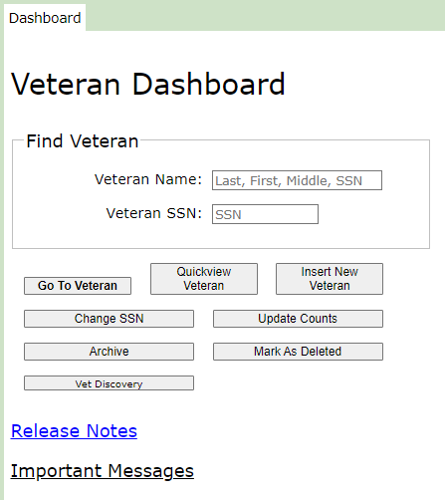
Training Topics
Administrator Functions
Agency Page – Audit functions, Auto Fill
User management - Add, Remove, Change User Level
Dependent Grid
Claims Grid
Reports- Audit, Office, Vet Rep and Agency Metrics
Claim / Award Action Space
VA Claims, Auditable vs Non- Auditable
DVS 40 College Fee Waiver
MC-05m referrals
Vet Discovery --Transferring Veteran Files from CVSO -> CVSO
Questions?
Notes:
May require more than one slide

Slide 3
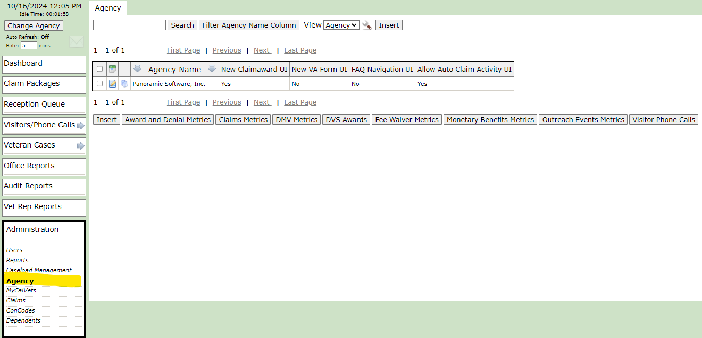
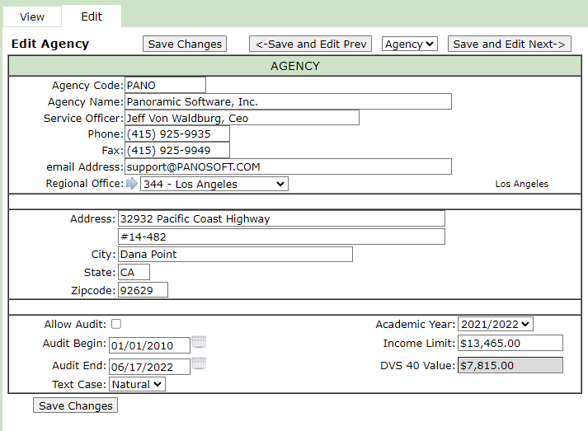
Administrator Functions – Agency Page
Notes:
May require more than one slide

Slide 4
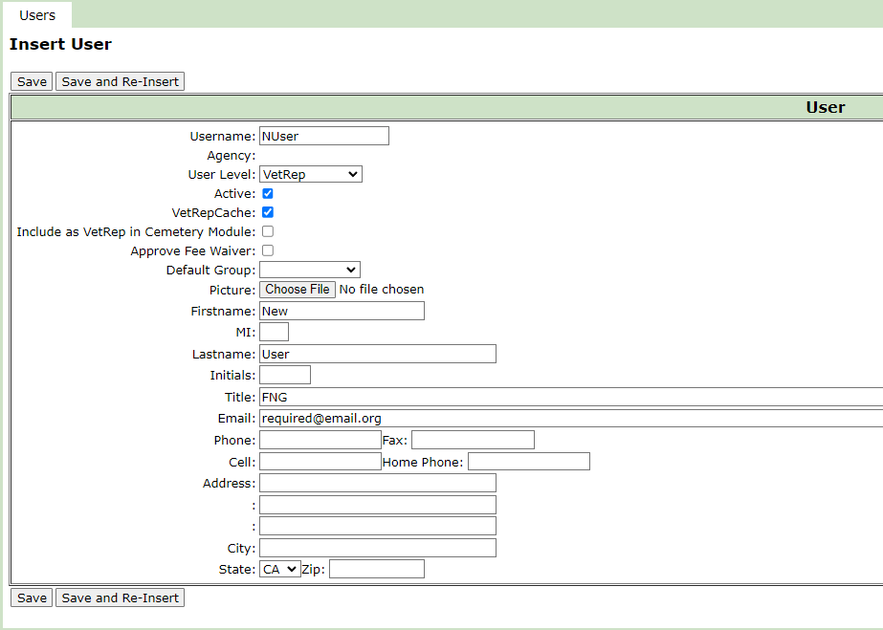
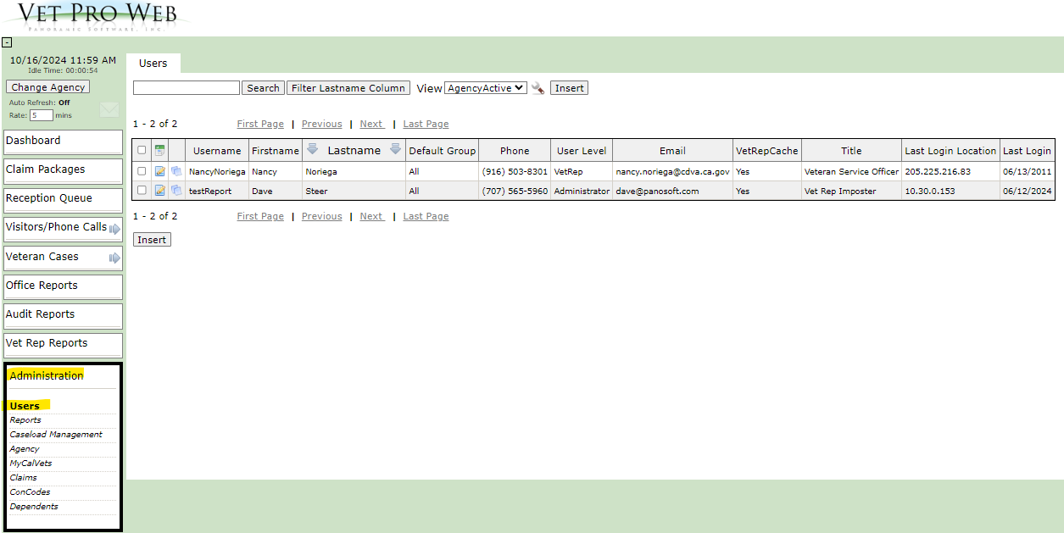
Administrator Functions – User Management
Notes:
May require more than one slide

Slide 5
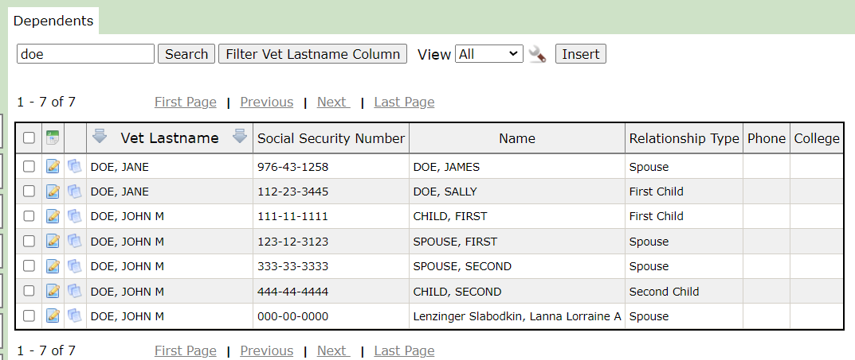
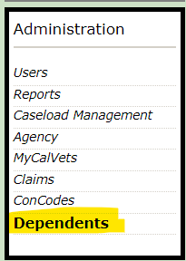
Administrator Functions – Dependent Grid
Notes:
May require more than one slide

Slide 6
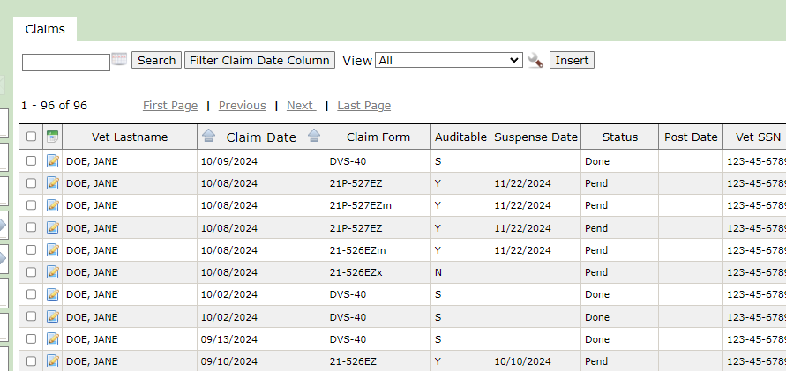
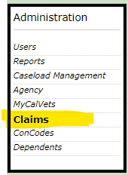
Administrator Functions – Claims Grid
Notes:
May require more than one slide

Slide 7
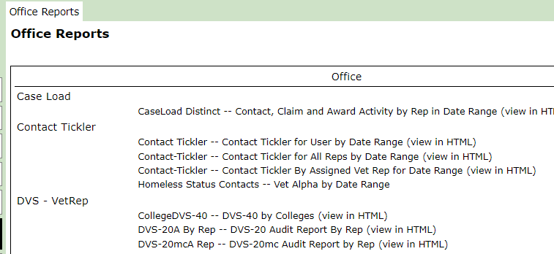
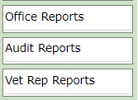
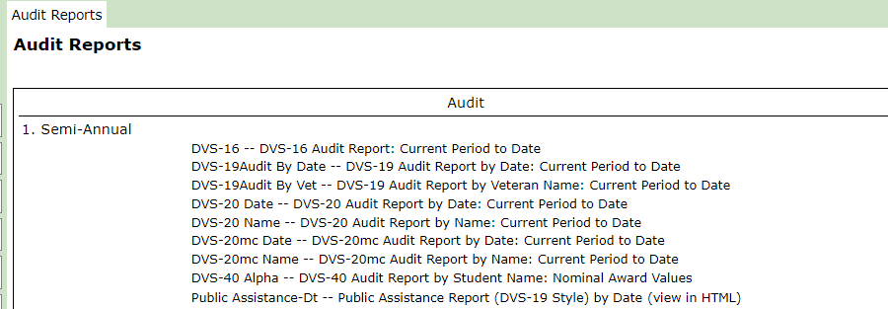
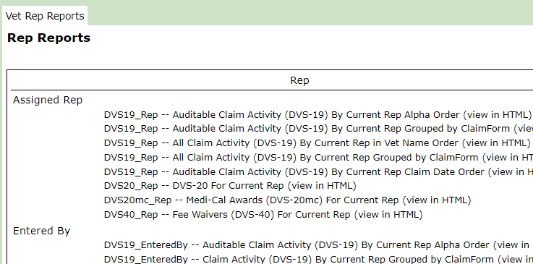
Administrator Functions – Reports
Notes:
May require more than one slide

Slide 8
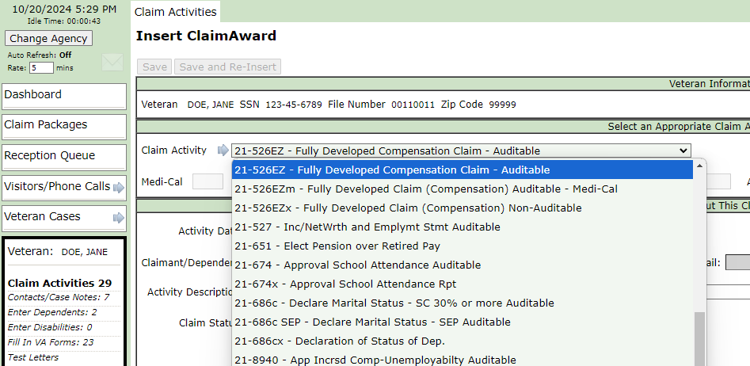
Claim / Award Action Space – VA Claims, Auditable vs Non- Auditable

Slide 9
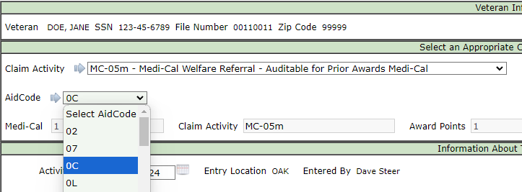
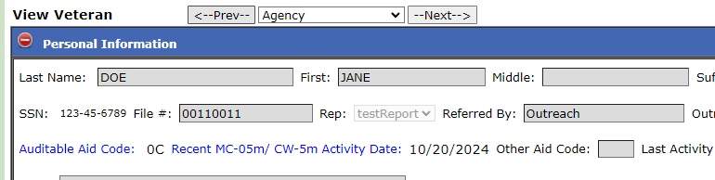
Claim / Award Action Space – MC-05m referrals

Slide 10
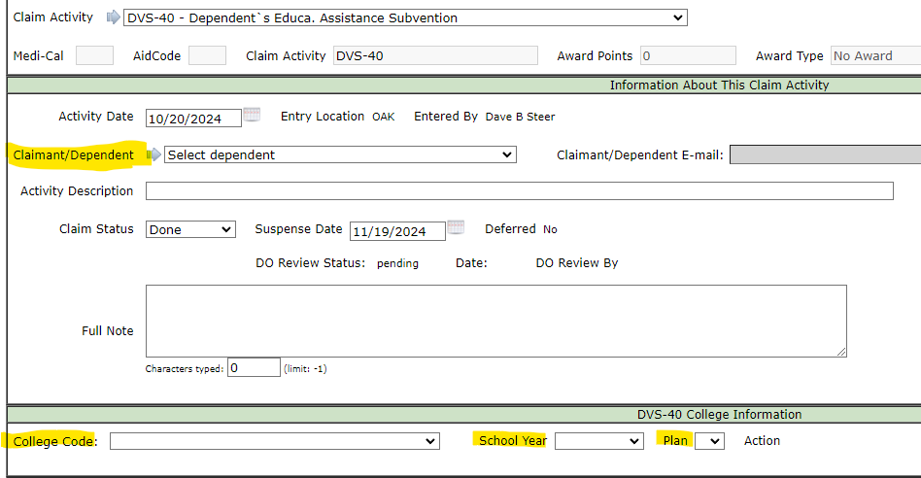
Claim / Award Action Space – DVS 40 College Fee Waiver

Slide 11
DVS-40 College Fee Waiver Program– Common Issues EMAIL ADDRESS
Students cannot access the Code Letter that your office has issued
Verify student email address on Dependent Information page ensure there are no typos
Have student check JUNK/ SPAM folders for sender: noreply@vetpro.us
Student can add noreply@vetpro.us to their email contacts, especially if they use Gmail

Slide 12
DVS-40 College Fee Waiver Program– Common Issues Student SSN
College cannot access their Award Certificate
Verify Dependent SSN one more time before approving
Request copy of SSN card as part of the evidence that the student is required to submit and add to Veteran Attached Docs

Slide 13
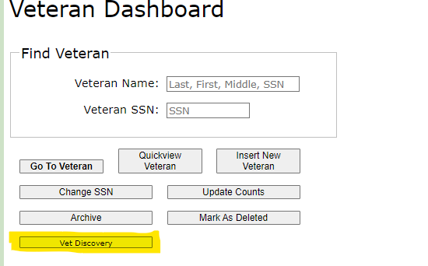
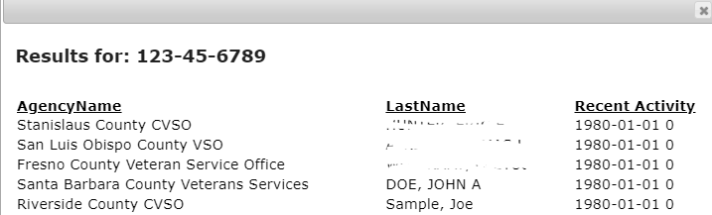
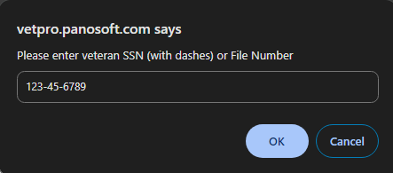
Vet Discovery – Requesting Files from other CVSOs

Slide 14
VetPro Changes – Automation Committee and User Support
Changes for your Office Only – Contact Panosoft Support
support@panosoft.com or dave@panosoft.com
Fee Waiver issues: cfw@calvet.ca.gov
Changes that affect all VetPro users – Automation Committee

Slide 15

Thank you for serving Veterans!
Thank you for using VetPro!

