Slide 1
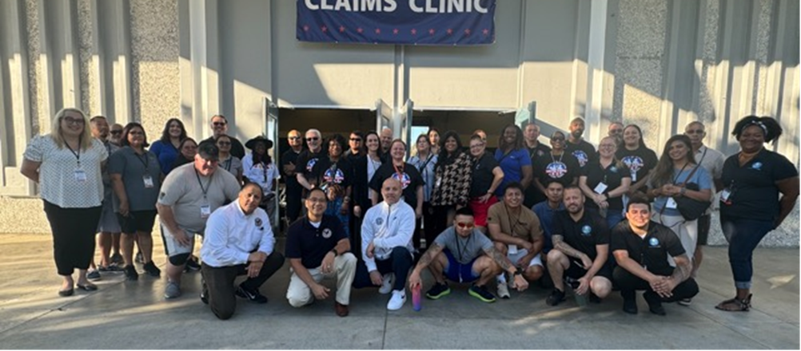
How to host a Claims Clinic
A Step by Step Guide

Slide 2
Define Objective and Goals
Objective:
Provide essential claims assistance to veterans
Goals:
Increase awareness and accessibility of claims services
Foster community engagement

Slide 3
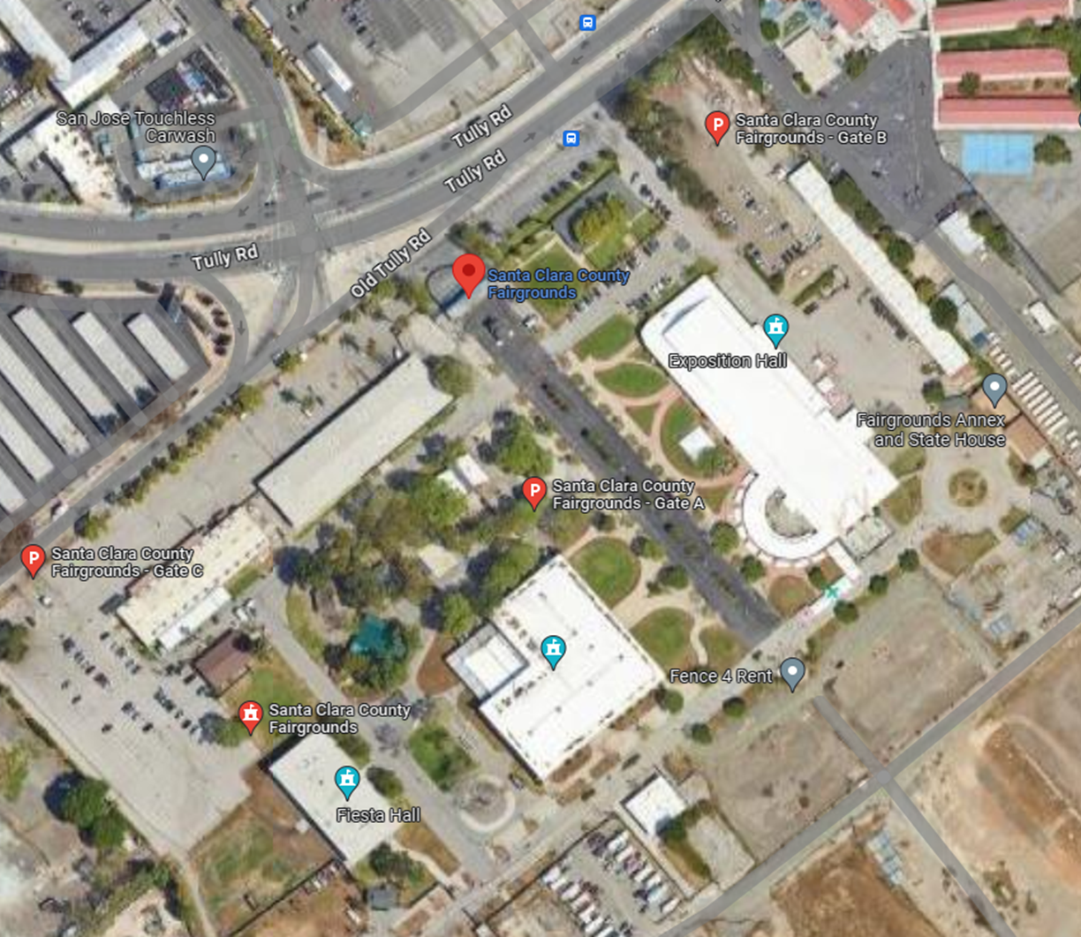
Assessing Space
Considerations
Features needed
Internet/Wi-Fi accessibility
Privacy for consultations
Restrooms
ADA compliant (MDEO requirements pictures)
Protection from weather
Outdoor space for mobile units
Location Ideas
Community centers
fairgrounds
banquet halls

Slide 4
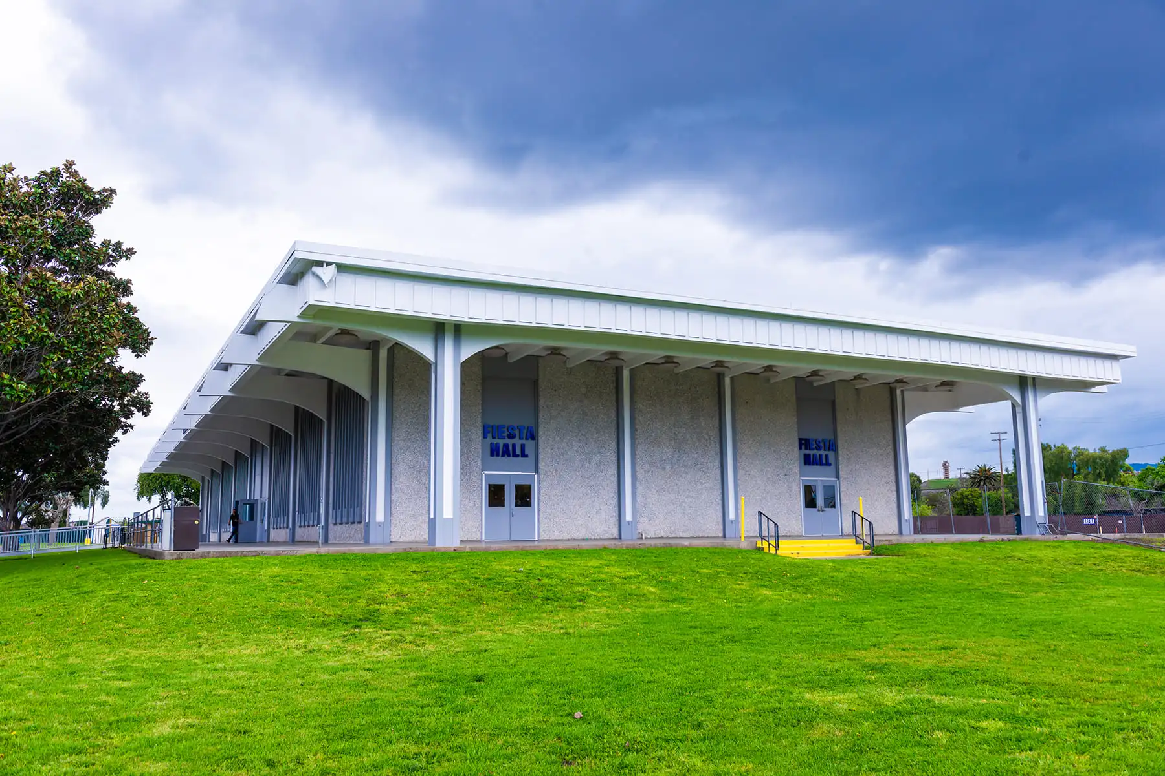
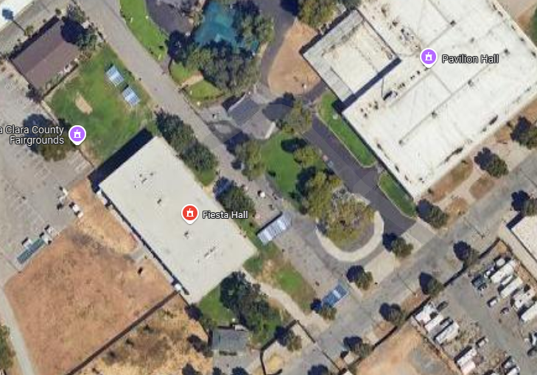
Fiesta Hall- 10,000 sq ft

Slide 5
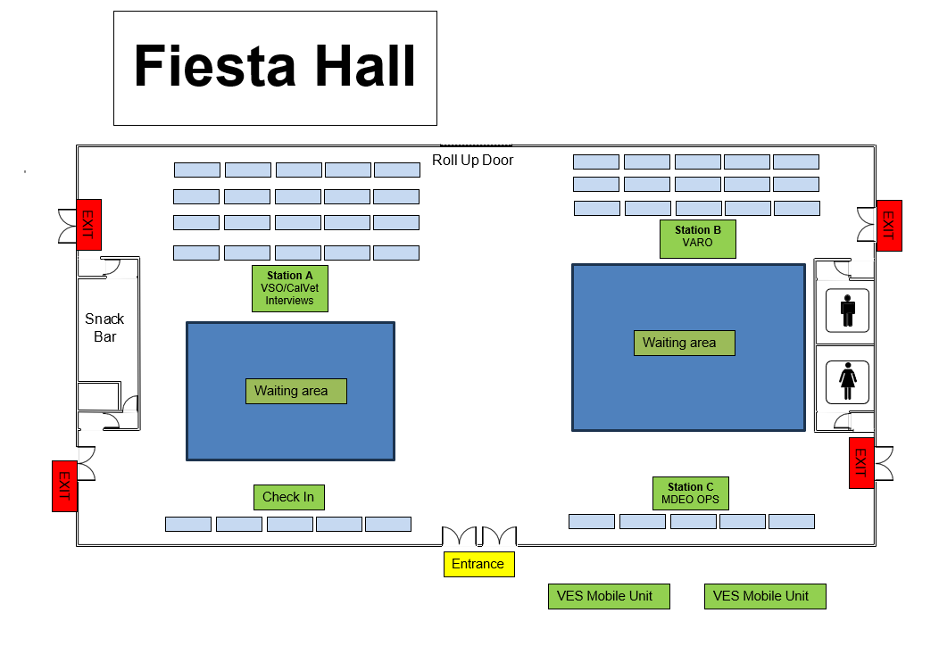

Slide 6
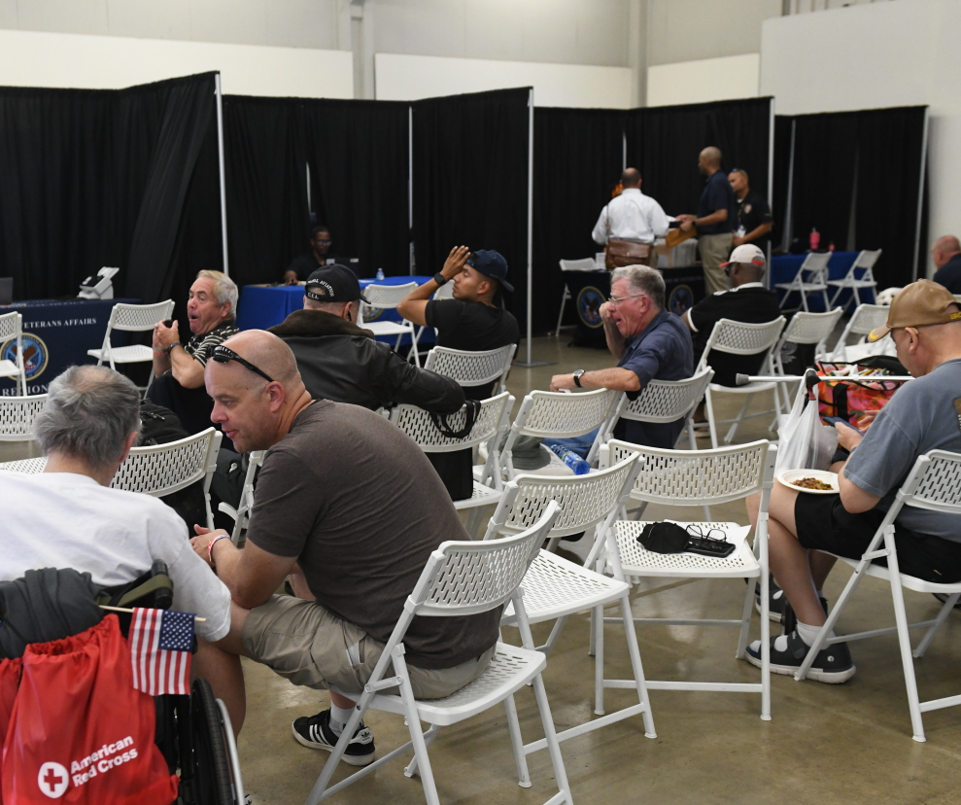
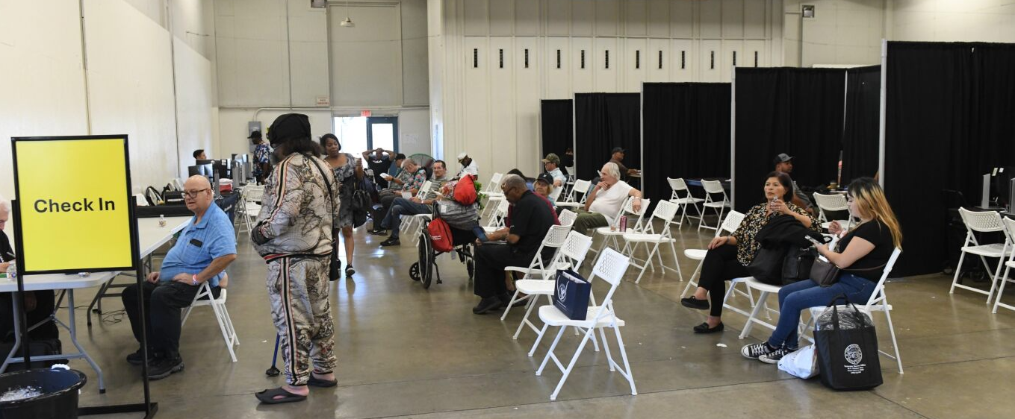

Slide 7
Assessing Budget & Event Duration
Budget Considerations
Food and beverages for staff, volunteers, clients
Venue rental costs
Tables/chairs/ privacy options
Overnight security (for mobile units and equipment)
Supplies (extension cords, signs, banners)
Childcare
Duration
How Many Days?
Consider length of the event: one day vs. multiple days
Factors to Consider:
Volume of participants
Availability of resources

Slide 8
Staffing Capacity
Assessment
Evaluate available accredited staff to process claims
Volunteer resources (way finders)
Determine training needs for staff and volunteers

Slide 9
Timeline for Planning
Begin planning at least 6 months in Advance
Month1
Contact Marty Caraway –VBA VSO Liaison
Schedule initial meetings or calls with stakeholders.
County leadership
VBA regional office
CalVet
MDEO
Month 2
Confirm commitments from each stakeholder regarding their involvement
Secure internal logistics (venue, catering, supplies, staffing needs)
Establish cadence for check ins (monthly check ins with weekly check on the last month)
Month 3-4
Organize a joint meeting or workshop with all stakeholders to foster collaboration.
Define roles and responsibilities, workflow process.
Create SAVE the DATE flyers to disseminate
Discuss registration process/ marketing strategies (VERA Link)
Establish metrics/ success indicators (# of claims with exams?)
Month 5
Host weekly meetings with stakeholders to finalize layout, workflow, registration
Finalize and distribute event flyers with registration information
POST EVENT
Evaluation and Feedback collection

Slide 10
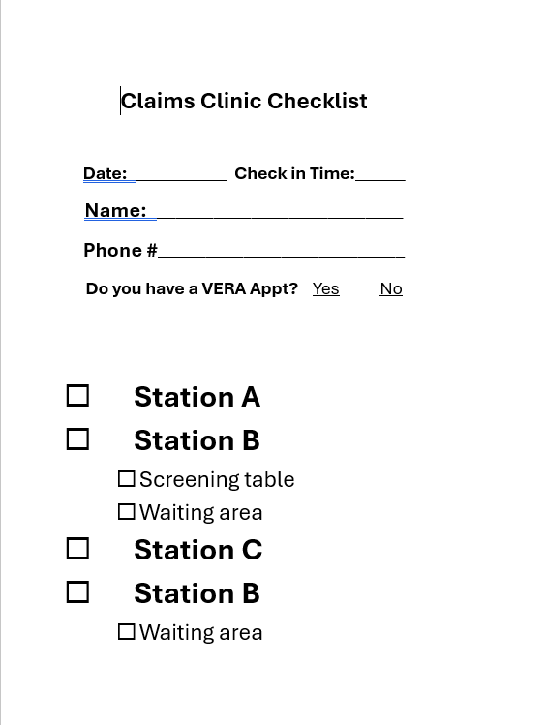
WORKFLOW
Separate by 4 Stations
Check in stations A (VBA)
Check in stations B (VSO)
A- VSO/CalVet
B- VARO
C-MDEO/ C&P examiners

Slide 12
Tips
Complete POA’s and Claims in advance if possible
Assign dedicated VSRs for:
Walk ins
Scheduled appts
Non claim related items (income verifications, ID cards, claim status)
Prepare veterans for long waits
Have water, food or snacks available

Slide 13
Santa Clara County Stand Down/Claims Clinic
3 days
20 VSRs from 6 VSOs (thank you! LA, San Mateo, Nevada, Sonoma, and San Francisco County!
8 CalVet
40 VARO
13 MDEO and VES
Over 100 vendors at the Stand Down (500+ employees and volunteers)
2004 attended the Stand Down/Clains Clinic
406 claims submitted
124 C&P exams (some claims adjudicated on the same day-awaiting report)

Slide 14
Questions?

