Slide 2
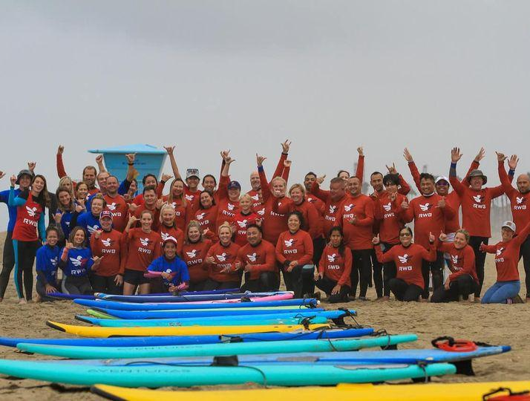
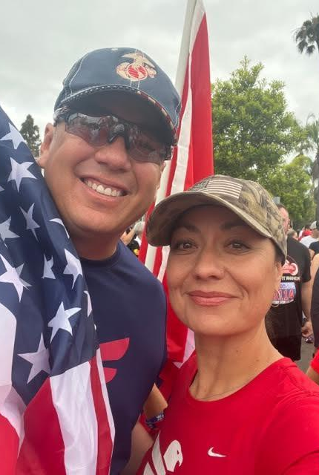
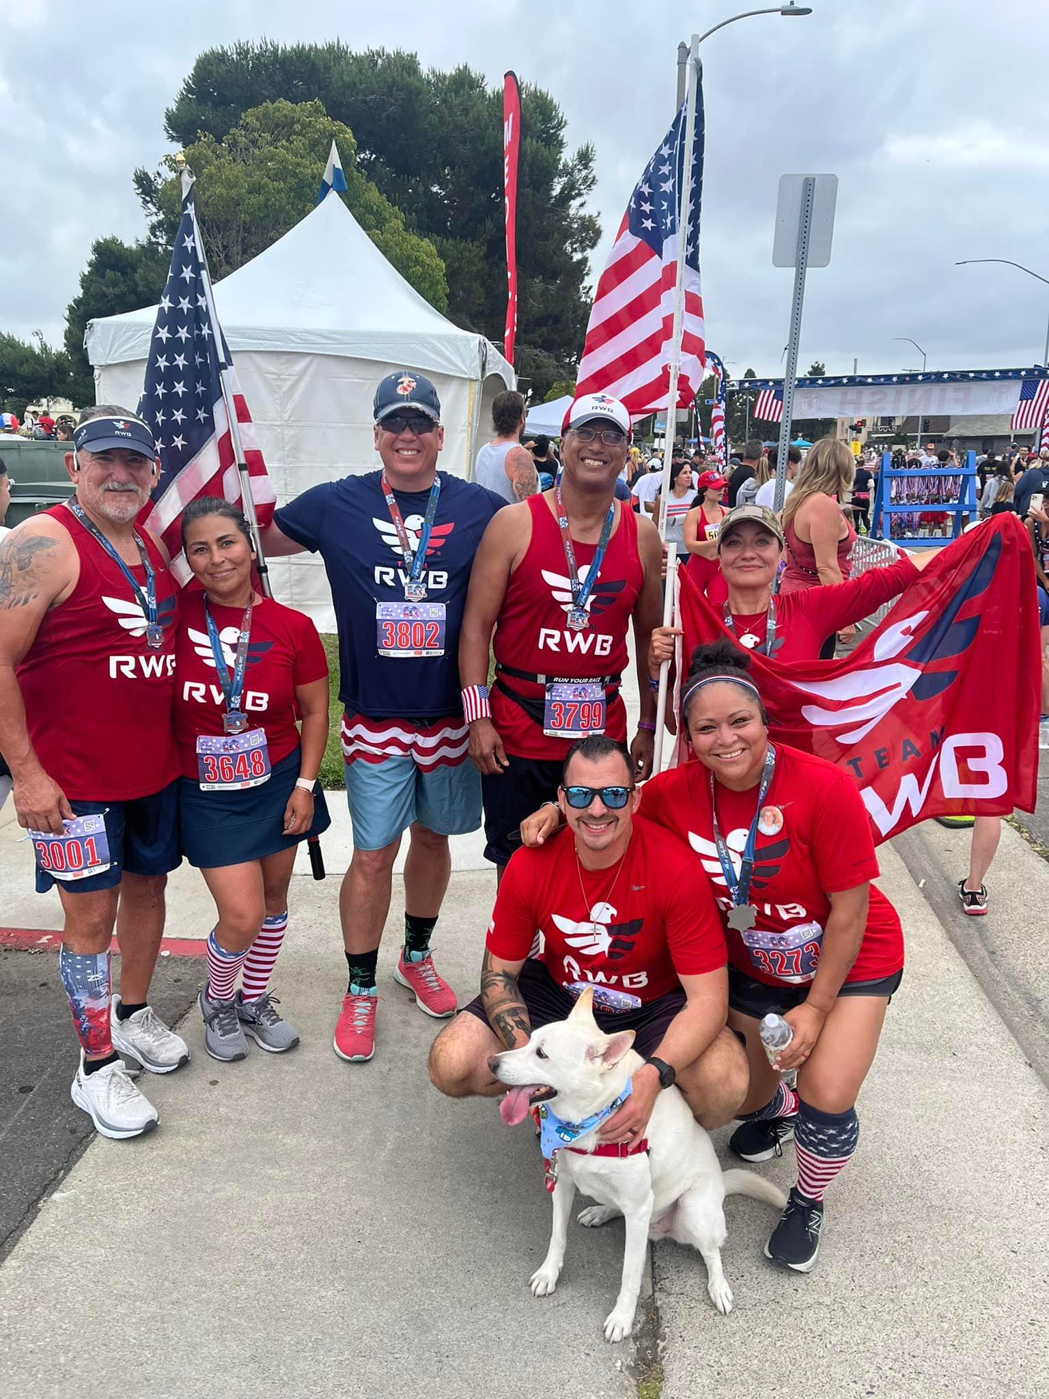
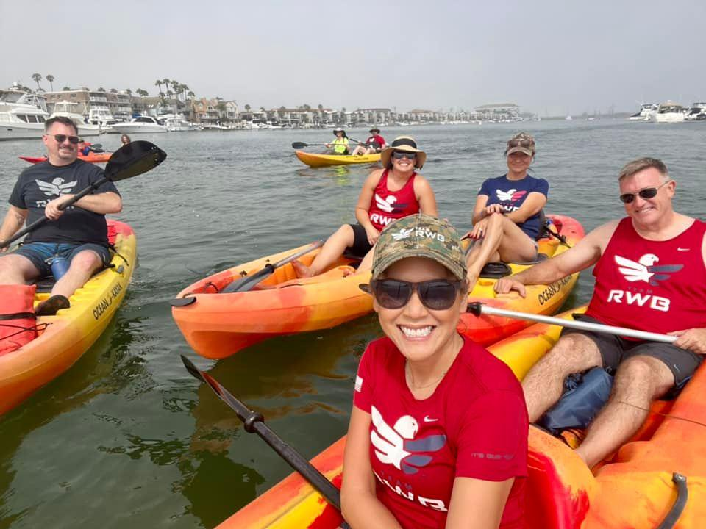
Jodie Merkle
CA State Coordinator for Team RWB
California-native
Daughter of a Veteran Marine
Married to a Veteran Marine and have 2 boys
10-year Eagle
6-year Volunteer Eagle Leader
Left my job of 26 years to join the Team RWB staff in July 2023
Hobbies: hiking, camping, backpacking and working with our Veteran Community

Slide 3
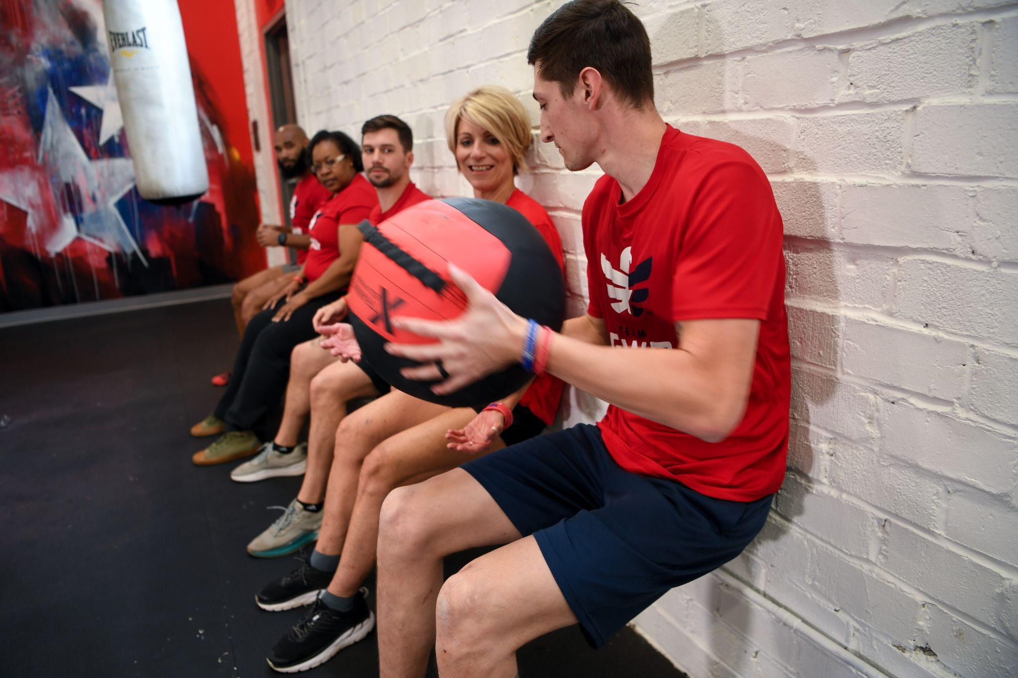

WHAT IS TEAM RWB?
Team RWB is a nonprofit organization forging America’s leading health and wellness community for veterans.
Team RWB offers veterans and supporters real-life and virtual opportunities to build a healthier lifestyle.
Team RWB’s community is more than 200,000 members strong. You can join the team at teamrwb.org or by downloading and signing up for the Team RWB App.
MISSION
To enrich the lives of veterans
VISION
To forge America’s leading health and wellness community for veterans

Slide 4
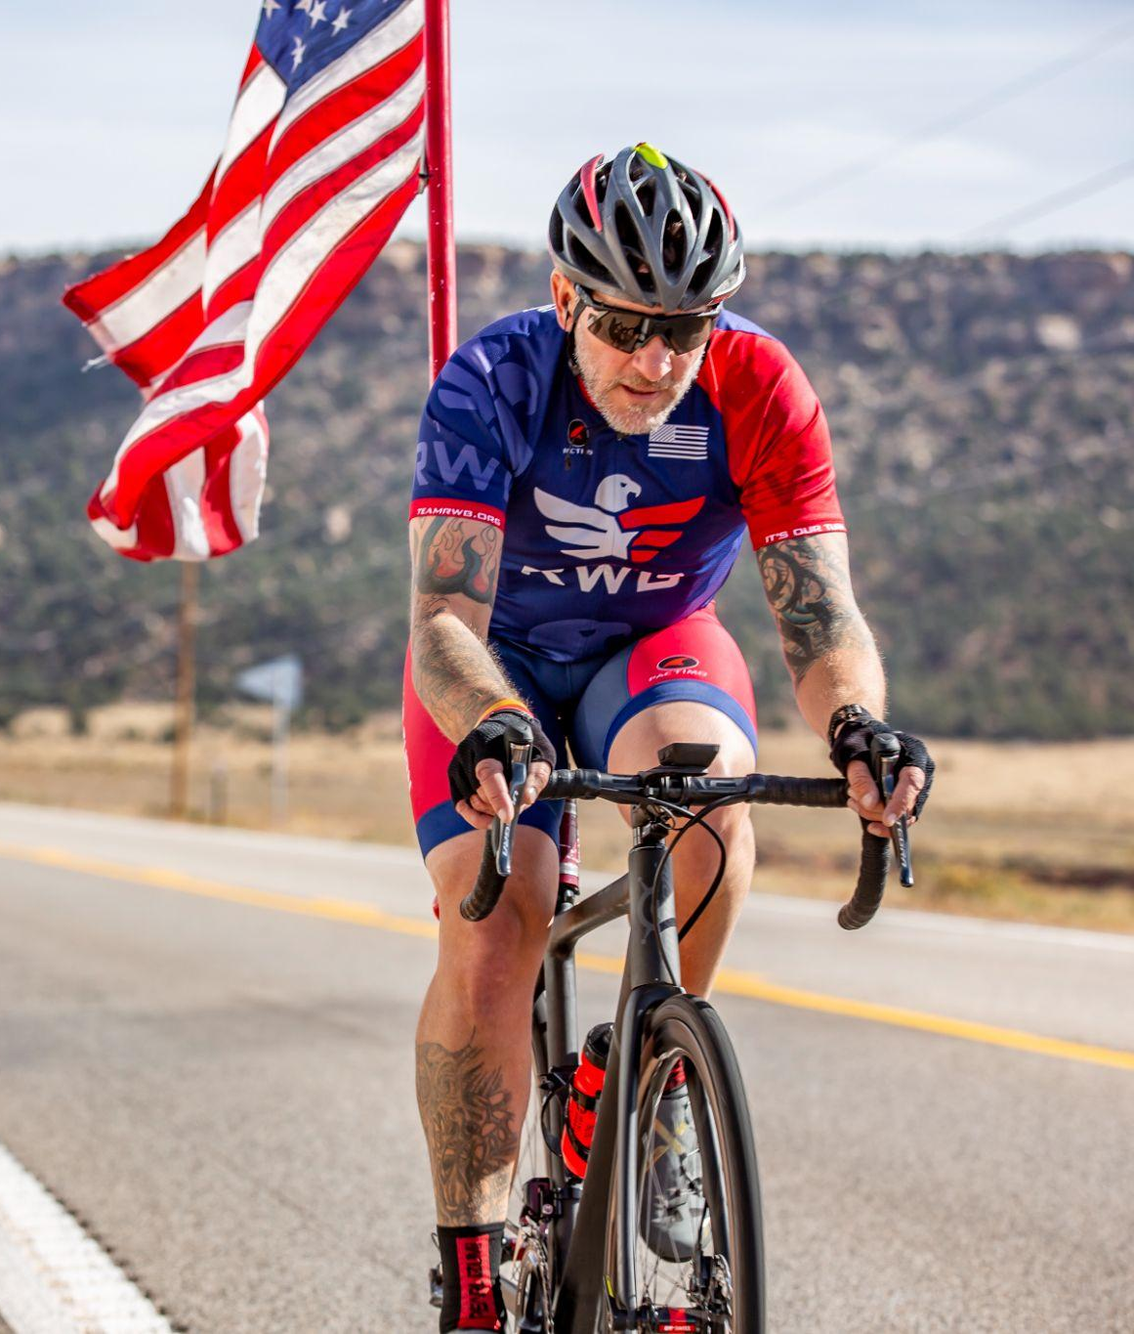
WHY TEAM RWB?
In the military, we pushed the limits of our well-being to support the mission
Moving into civilian life, many veterans carry that mission-first mindset, often neglecting their own health in the process
We can improve our lives and be our best selves for our families, communities, and the country with a strong focus on health and wellness
Team Red, White & Blue exists to guide veterans in building a healthier lifestyle
Notes:
In the military, we put MISSION FIRST - our own well being can be put on the back burner.
Transitioning out, our health is often less of a priority. Early morning PT is not something that we want to revisit!
BUT, physical health has a ripple effect into mental and emotional health. It’s critical that we incorporate health and wellness into our lives so that we can be our best selves for OURSELVES, OUR FAMILIES, OUR COMMUNITIES & OUR COUNTRY
Team RWB exists to walk beside veterans as we build a healthier lifestyle

Slide 5
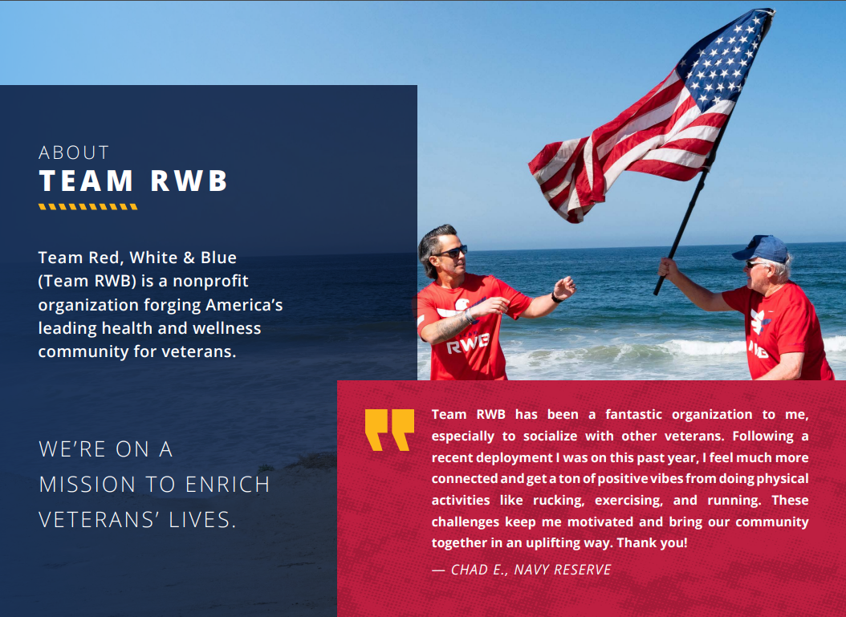
Notes:
You’ve got the WHY and the WHAT for RWB, so let’s go into HOW to get involved with the team…

Slide 6
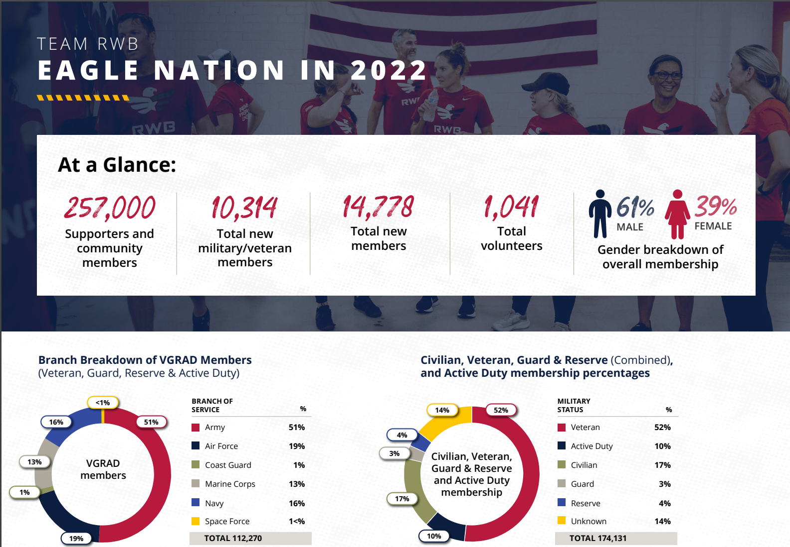
Notes:
You’ve got the WHY,WHAT and WHO for RWB, so let’s go into HOW to get involved with the team…

Slide 7
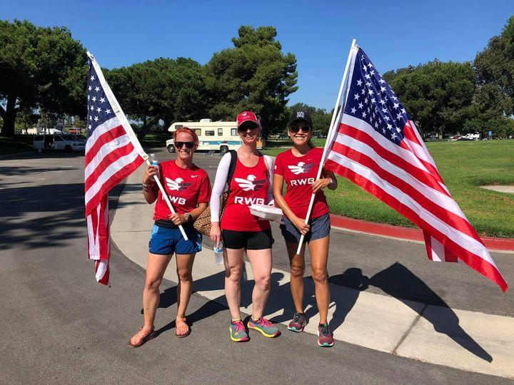
Veteran or Civilian, We Wear the Same Uniform
Veterans, veteran supporters, & families are all welcome at Team RWB events
We are all on the same team; we all wear the signature red Eagle shirt as our ‘uniform’
Veteran members receive their red shirt for free during signup
Veteran supporters support the mission by ordering a shirt via the Team RWB Shop
Notes:
INCLUSIVE! We wear the same uniform!

Slide 8
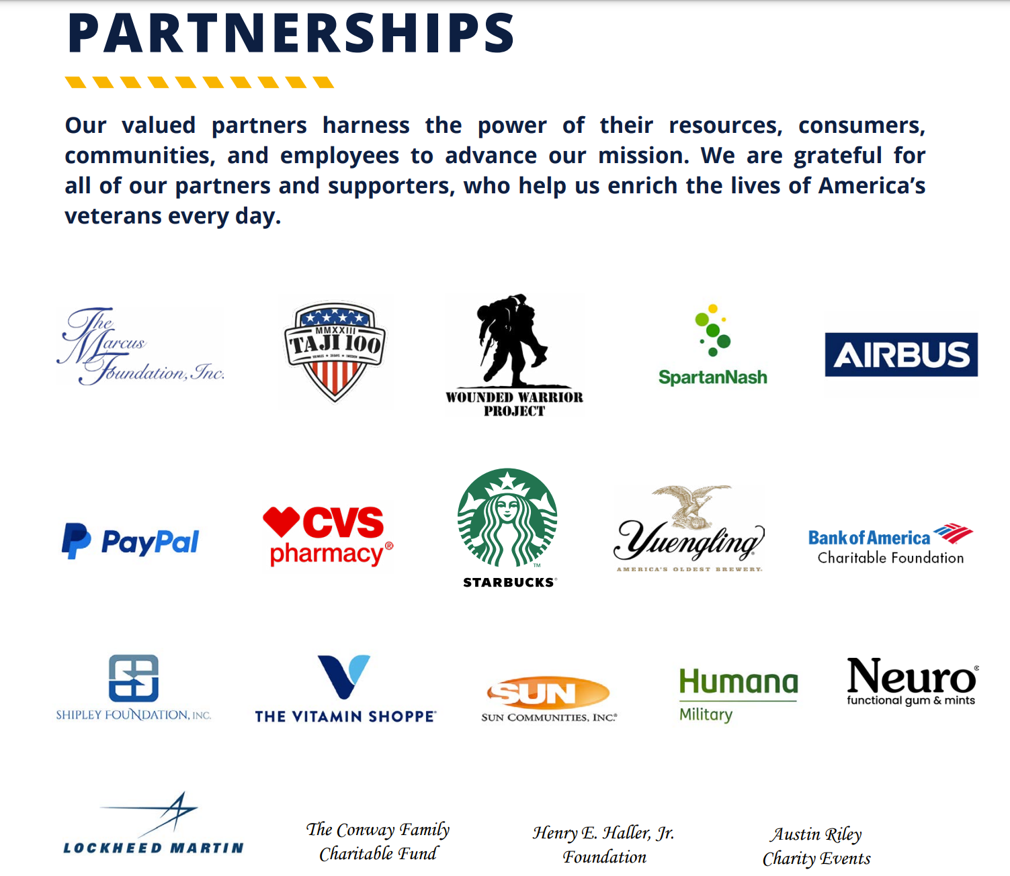
Team RWB Partners

Slide 9






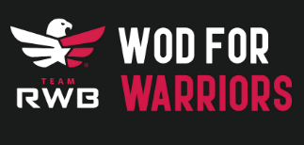




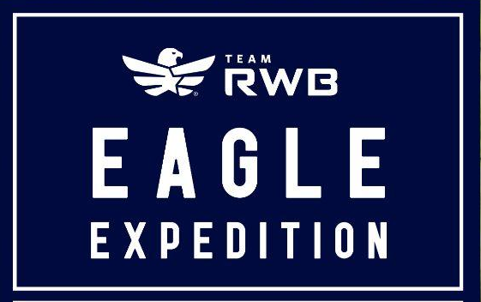

Find Your Tribe
Events Benefiting Team RWB
Large Eagle Gatherings
Team RWB Signature Events
Fundraising Bibs

Slide 10
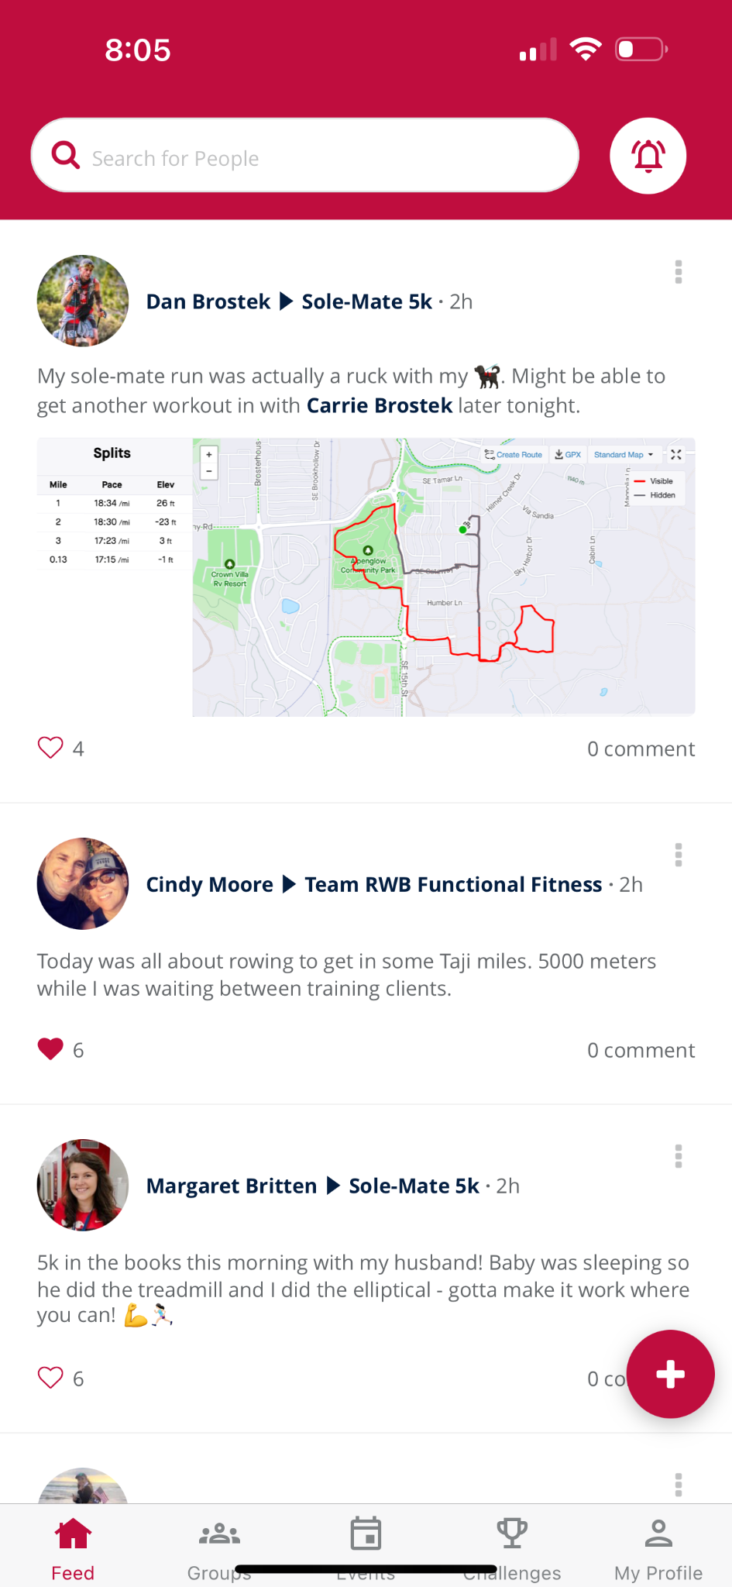
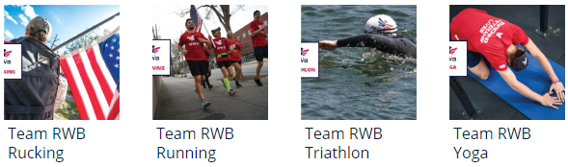
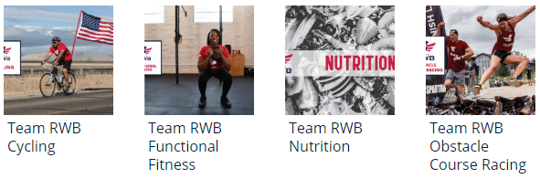
Our teamroom,
The Team RWB App
Interact with, challenge, and motivate your teammates
Learn about upcoming events
Create your own events and invite members to join you!
Participate in virtual challenges and events to support your health and wellness journey
Join one of these Activity Groups:
Your feed, groups, events, monthly missions, and more are available via the Team RWB App!

Slide 11
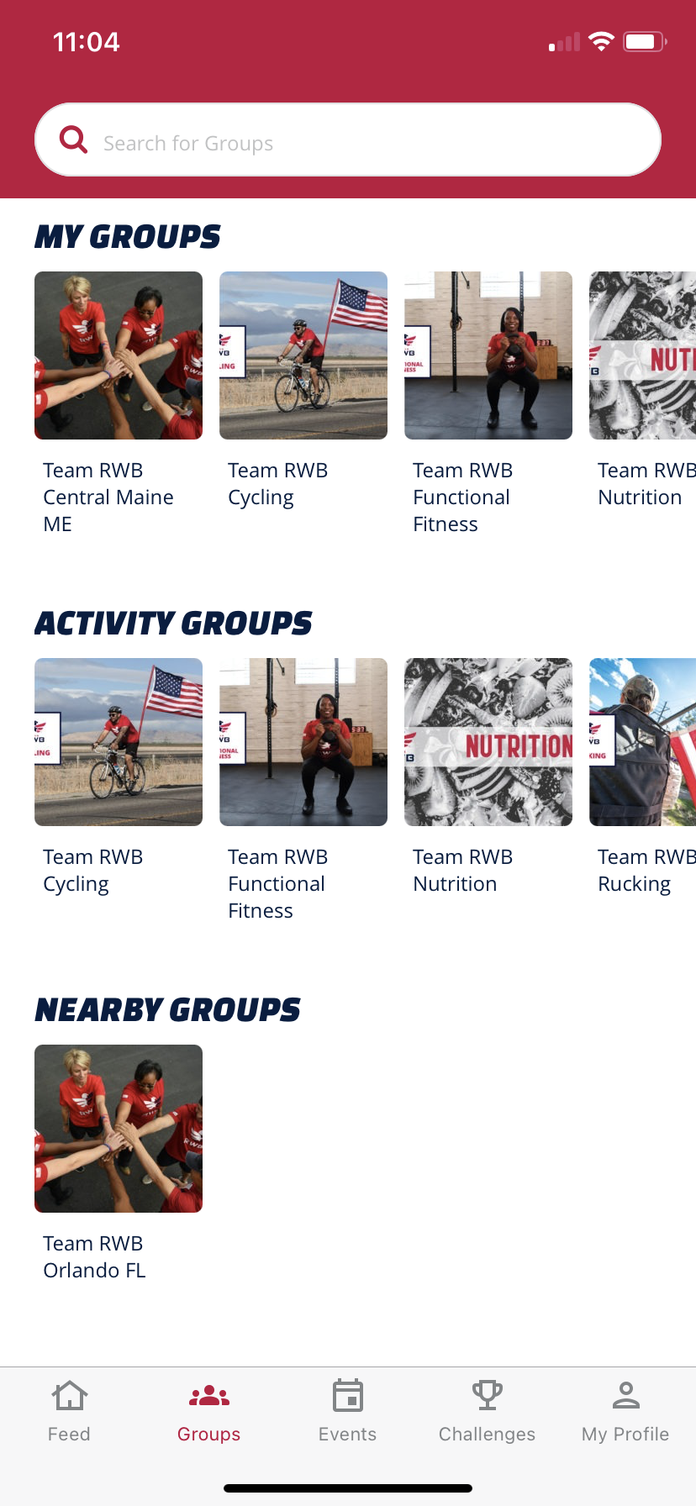
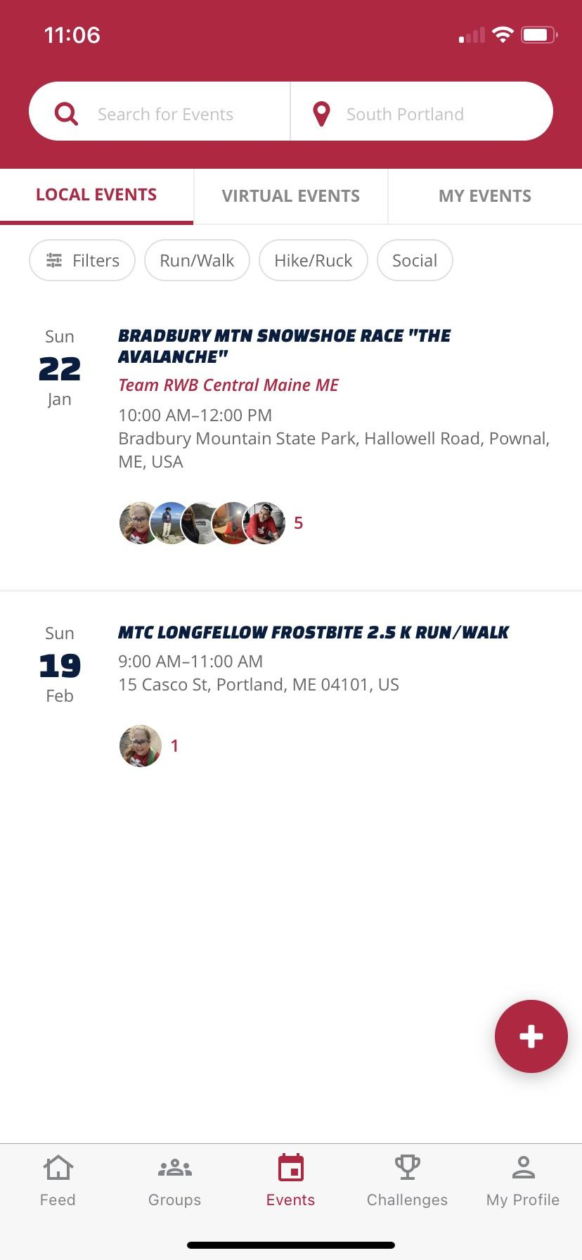
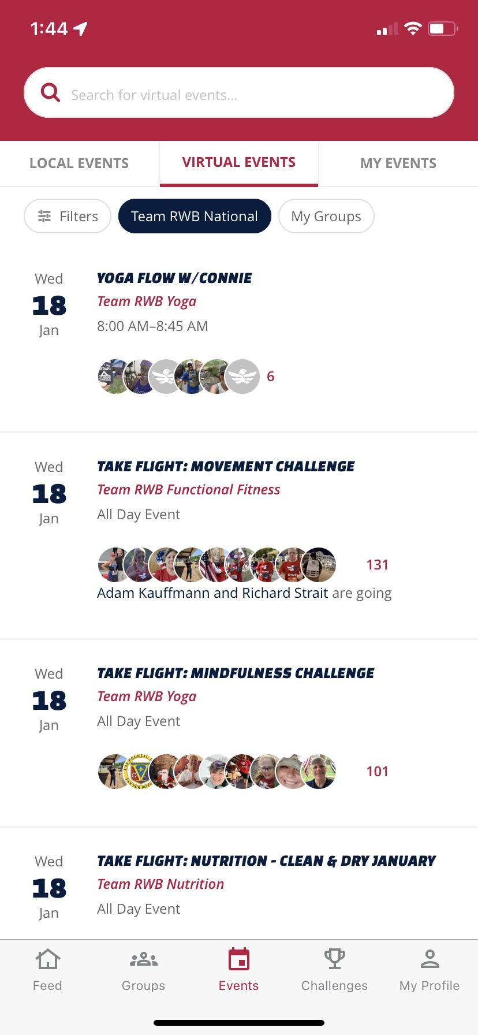
GROUPS
IN-PERSON EVENTS
VIRTUAL EVENTS
Notes:
We don’t have a video of app capability, so walk through features with audience using these screen shots

Slide 12
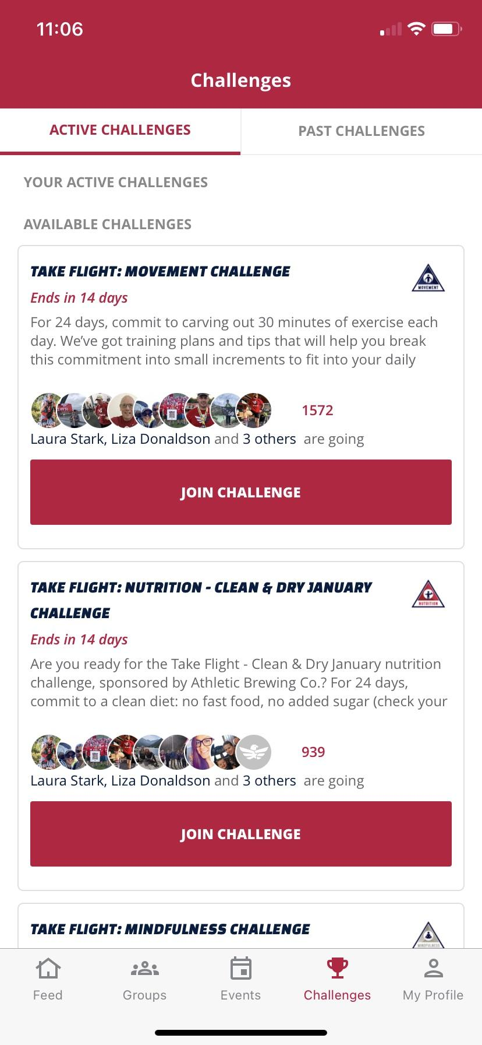
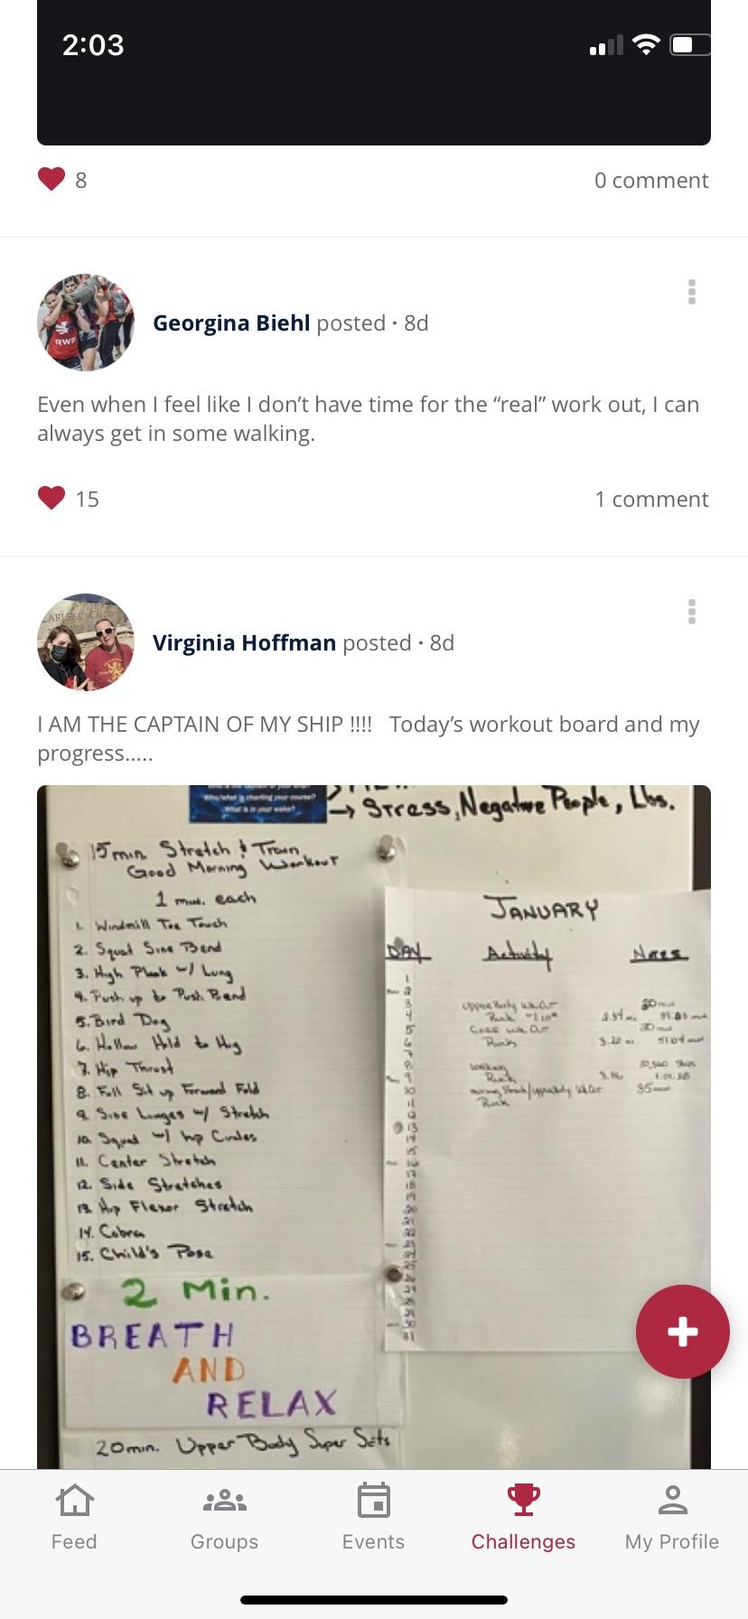
MISSIONS AND CHALLENGES
COMMUNITY
Notes:
We don’t have a video of app capability, so walk through features with audience using these screen shots - focus on COMMUNITY

Slide 13
Engage With A Chapter: In-Person Events
Fresno
Inland Empire
Los Angeles
Orange County
Sacramento
San Diego
San Francisco
San Jose
Solano County
Stockton
Ventura County
Notes:
You can view this map at and take a locally relevant screenshot at: https://www.google.com/maps/d/edit?mid=1eA7swIm1bn8Rf3q7cblNVEGQ9JDcl6as&usp=sharing
If something on the map is out of date, please contact your Area Director and we will get it fixed for you.

Slide 14
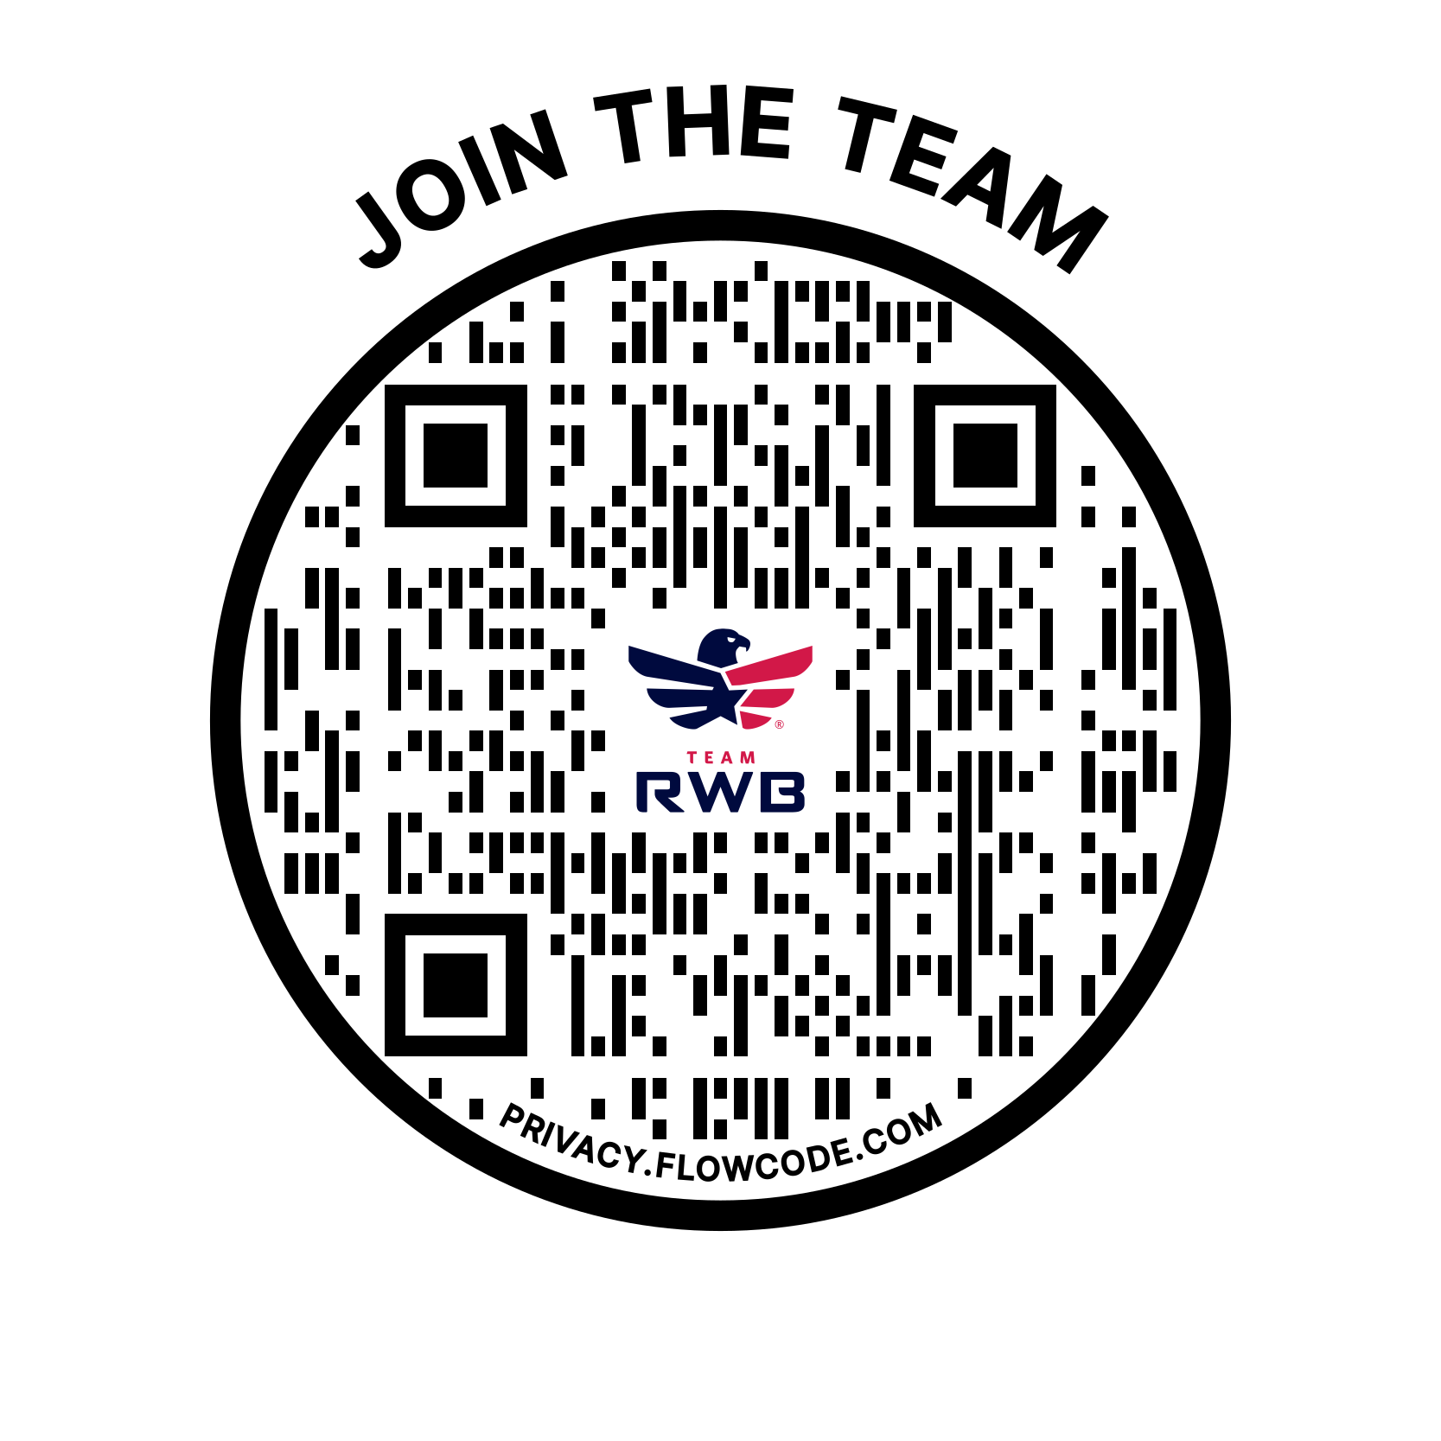
Are you ready to answer the call and enrich your life in THE health and wellness community for veterans?
Notes:
Step 1: Sign up at www.teamrwb.org! You’ll be assigned to a chapter based on your address.
Step 2: Download the app or check out the members section of our website to see what’s out there, both in-person and virtually! Join groups that are of interest to you and starting connecting with Eagles!
Step 3: Follow your local chapter and Team RWB on the app and social media and start sharing your #EagleFire!

