Slide 1
Mental Health Act Grant Program & Incarcerated Veterans Program
Samuel Griffin
February 12, 2024

Slide 2
Program Overview
The Mental Health Services Act (MHSA) was passed by California voters in 2004 and is funded by a one percent income tax on personal income in excess of $1 million per year. It is designed to expand and transform California's behavioral health system to better serve individuals with, and at risk of, serious mental health issues, and their families.
$1.27M in grant funds available
https://wwwˌcalvetˌcaˌgov/VetServices/Pages/Mental-Health-Grant-Program-For-Countiesˌaspx

Slide 3
Funding Prioritization
In addition to the expectations and mental health strategies listed in 1-B, funding awards will also be prioritized based on the following program models:
CVSOs that directly or indirectly partner with California Community Colleges to provide veterans and their family members behavioral healthcare on school campus
CVSOs that directly or indirectly provide veterans with legal services.
CVSOs that directly or indirectly provide veterans assistance with housing or assisted living support for senior veterans.
CVSOs that directly or indirectly provide veterans assistance with aging services.

Slide 4
Thanks to FY 22/23/24 Participated Counties
Alameda
Contra Costa
Fresno
Imperial
Los Angeles
Monterey
Nevada
Orange
Riverside
San Bernardino
San Francisco
Santa Clara
Solano
Sonoma

Slide 5
FY 23/24/25 Grants Awards
We are currently evaluating RFA’s
Will notify Counties via email once awards are granted

Slide 6
Application Scoring
Applications are reviewed by a panel comprised of CalVet staff and rated on a 100-point scale. All final funding decisions are made by the CalVet Deputy Secretary for Veteran Services.
Section A: Statement of Need (10 points)
Section B: Proposed Service/Project (30 points)
Section C: Proposed Implementation Approach (40 points)
Section D: Performance Assessment and Data (20 points)

Slide 7
Funding Concerns
Fringe benefits above State/Federal average
Swag
Agency/unrelated expenses
Capital expenditures
Food and beverage
Costs outside of mental health outreach and treatment programs

Slide 8
Contact Information
Samuel Griffin
Operations Manager
Veterans Services Division
California Department of Veterans Affairs
samuel.griffin@calvet.ca.gov
(916) 503-8073
Phillip Leggett
Mental Health Coordinator
Veterans Services Division
California Department of Veterans Affairs
phillip.leggett@calvet.ca.gov
(916) 503-8327

Slide 9
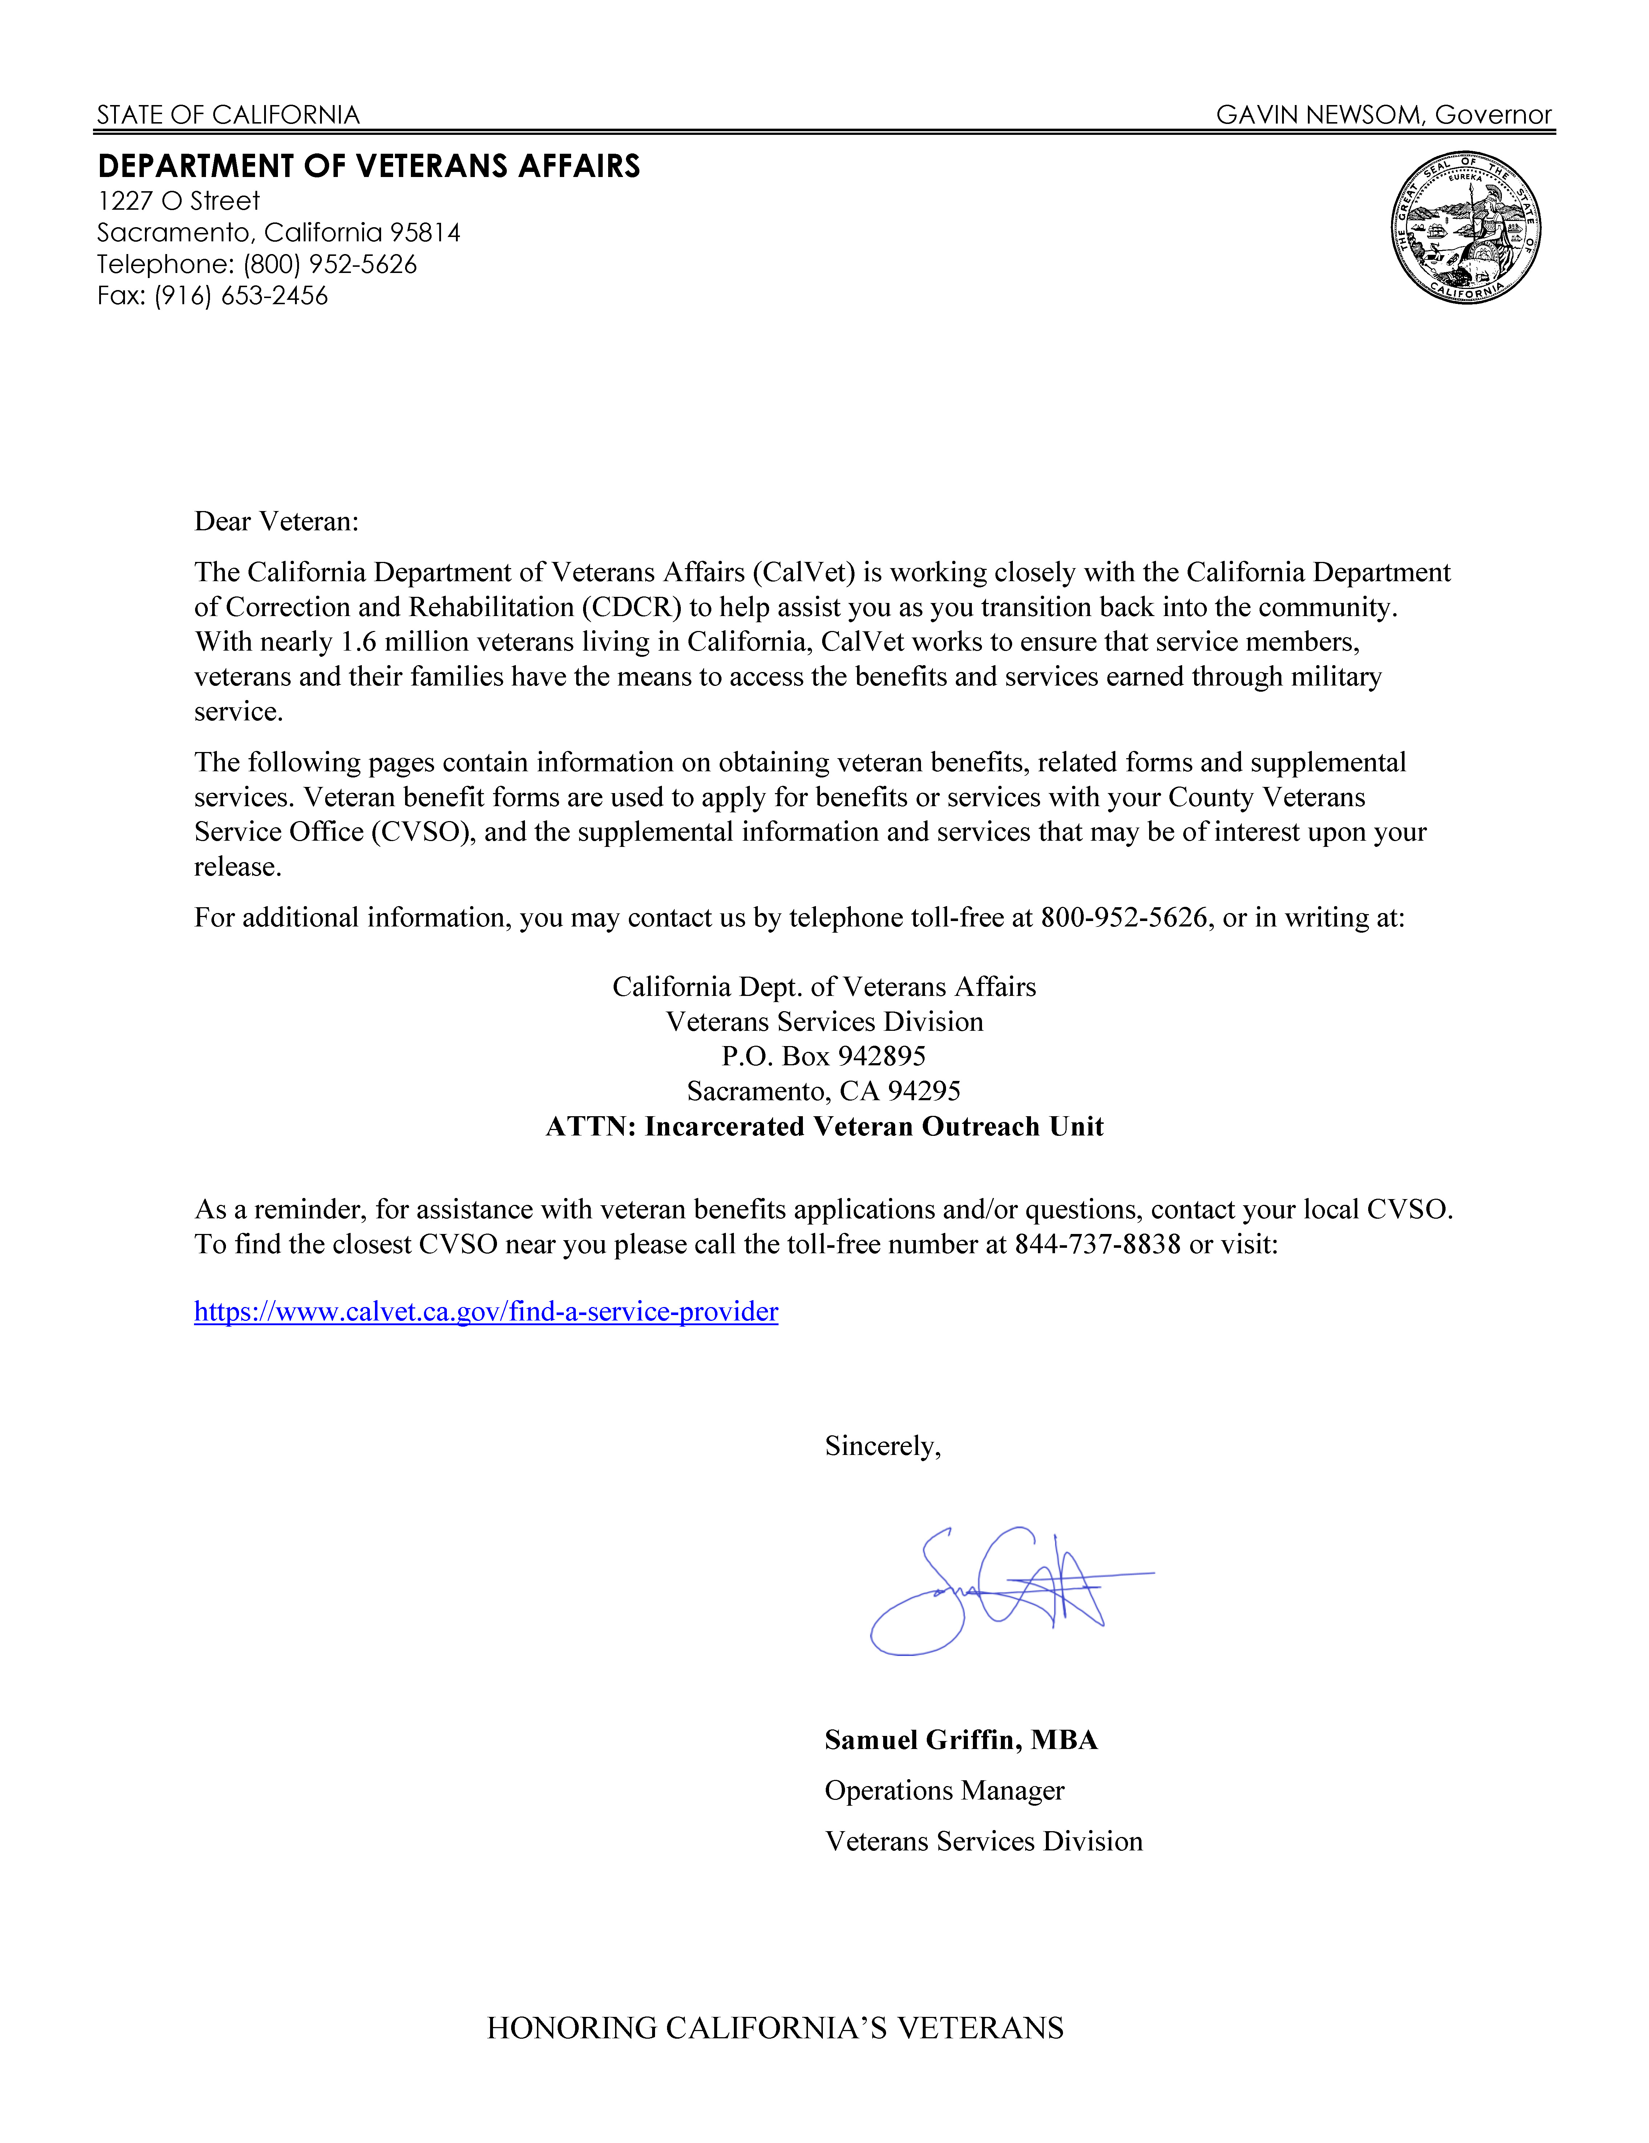
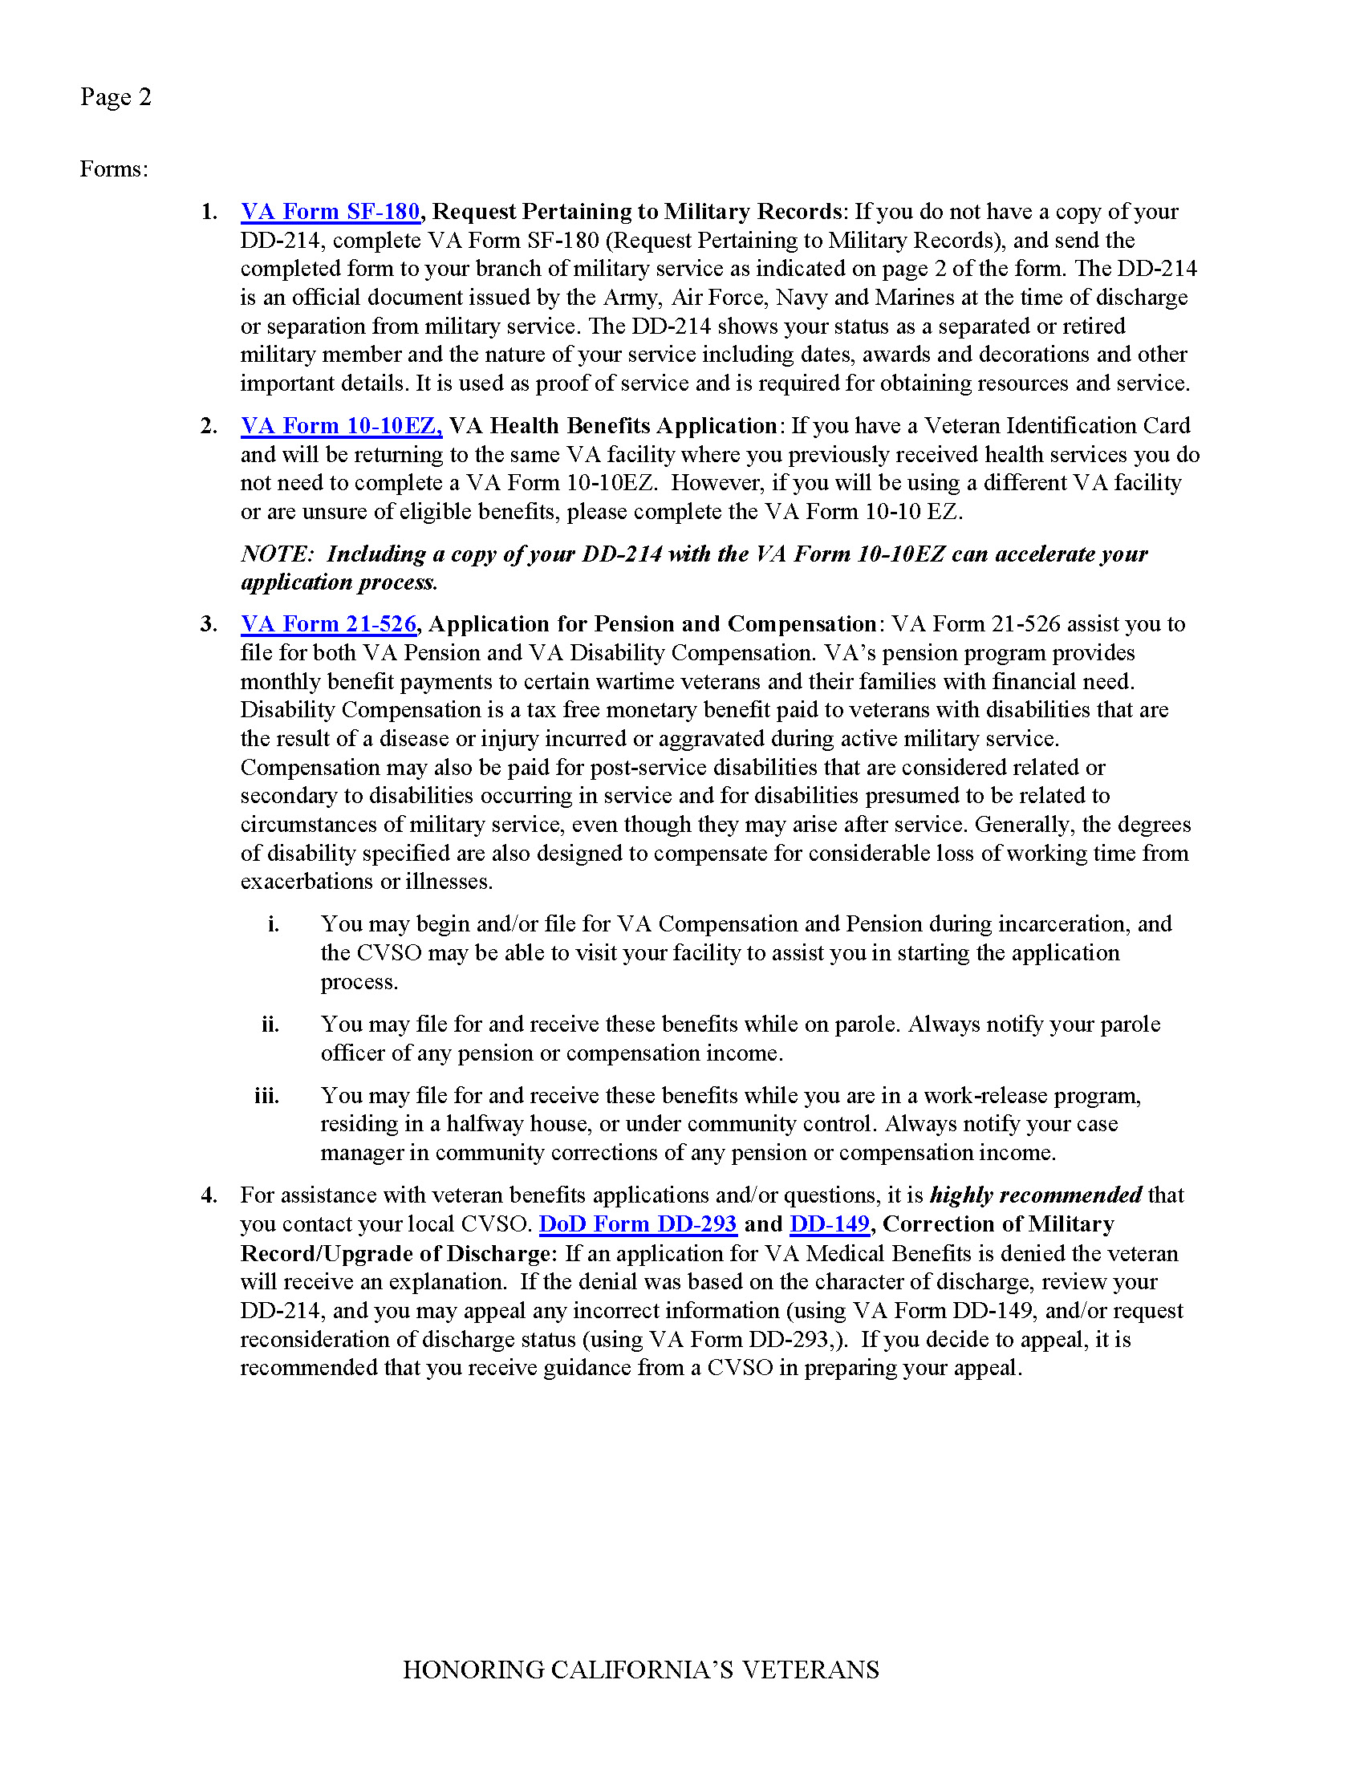
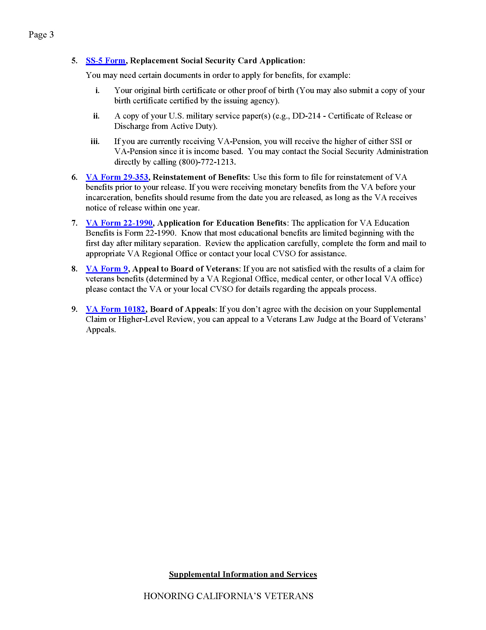
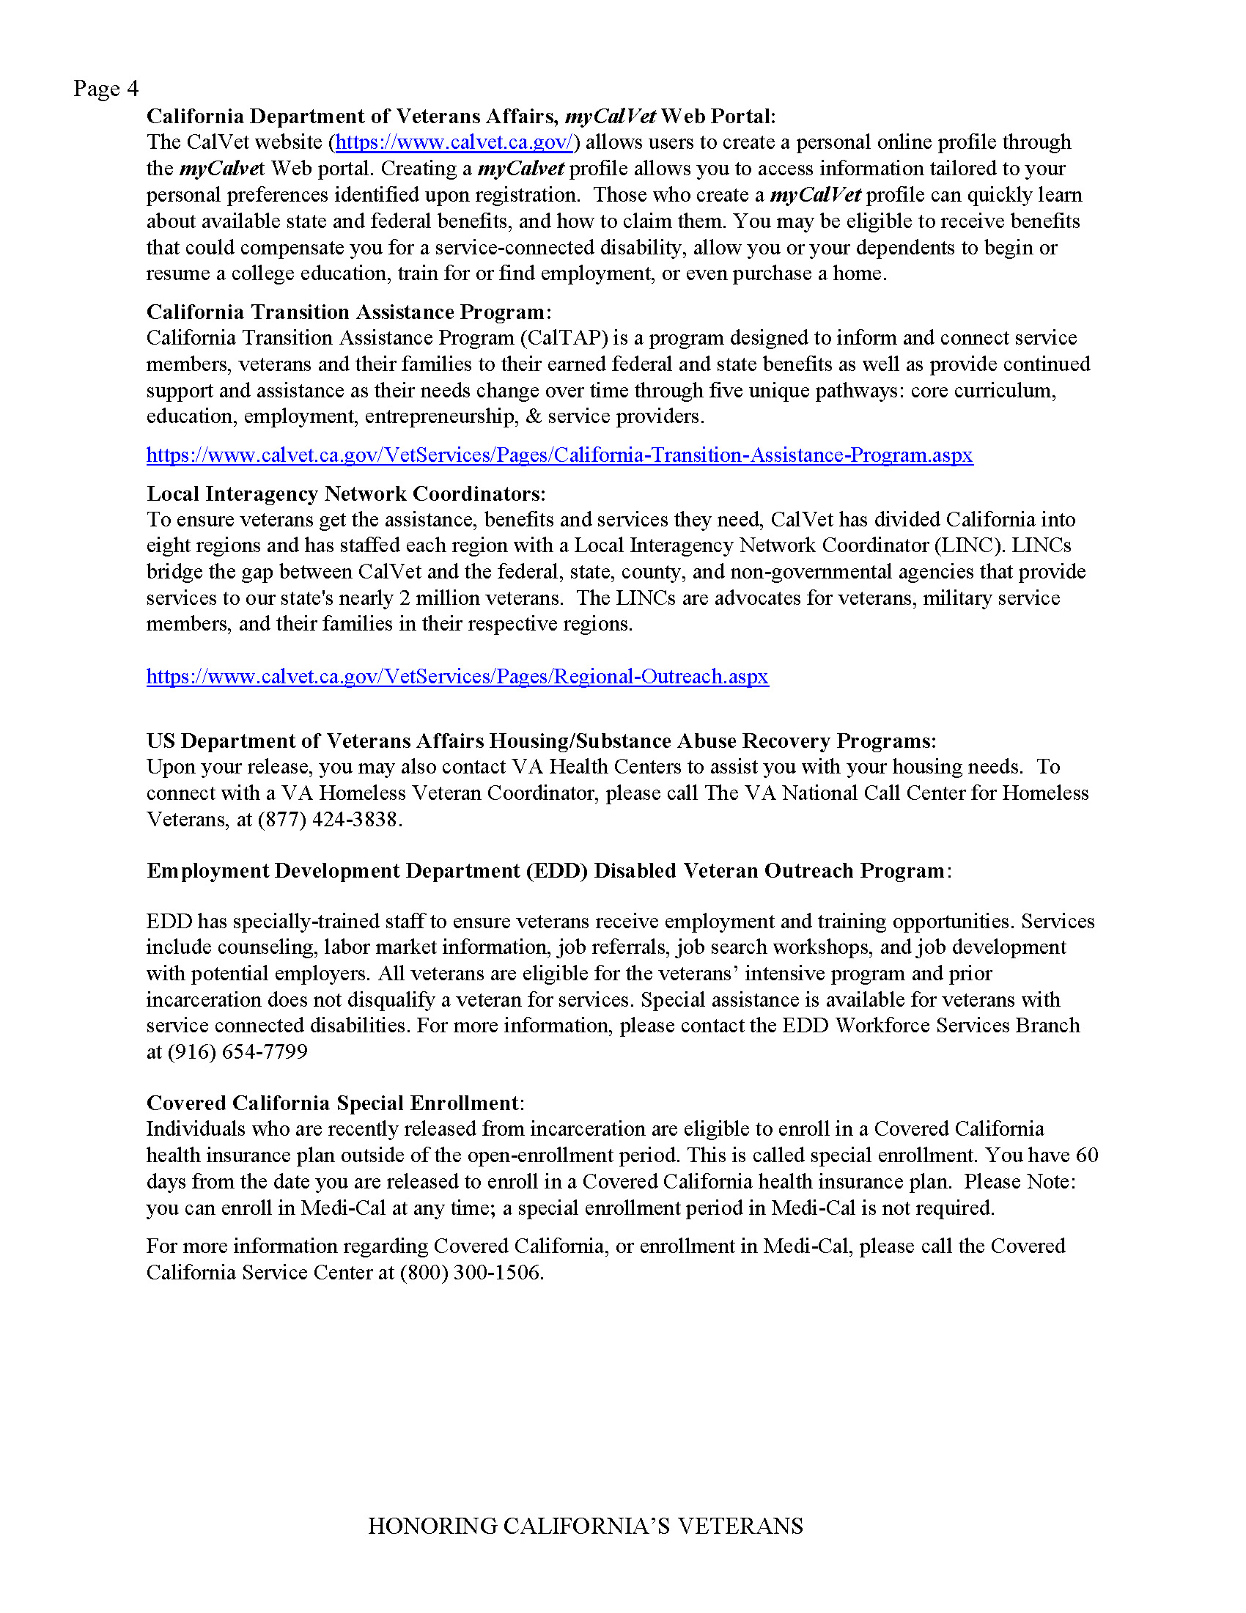
Incarcerated Veterans Program
District Offices Incarcerated Veterans Reps
Providing claims assistance
Directing veterans to CVSO’s prior to release
Data Sharing
Current Primary Location, OffenderID, First Name, Last Name, Gender, Scheduled Release Date, CDCNO, Latest Admission, Projected Release County, Scheduled Release Type, Ethnicity, VA Reported Veteran, SOMS Reported Veteran
Working with CDCR to add additional contact information data
Incarcerated Veterans Outreach Letter

Slide 10
Contact Information
Samuel Griffin
Operations Manager
Veterans Services Division
California Department of Veterans Affairs
samuel.griffin@calvet.ca.gov
(916) 503-8073
Pernell Sullivan
Mental Health Coordinator
Veterans Services Division
California Department of Veterans Affairs
pernell.sullivan@calvet.ca.gov
(916) 503-8305

Slide 11
Questions

