Slide 1

True Colors Personality Test
"Navigating Veteran Services with True Colors:
Understanding, Connecting, and Supporting"

Slide 2
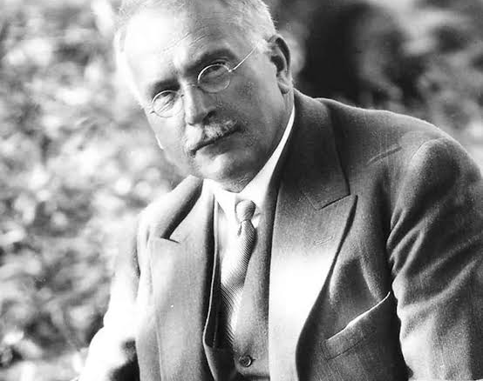
History:
Deep roots in the work of Psychologists who were looking to simplify personality typing
Started in early 20th century by Carl Jung
Built on by Myers-Briggs during WWII
Colors added in 1978 by Don Lowry
Frequently used tool by recruiters and large, corporate HR departments
Many different models, but interpretation remains the same

Slide 3
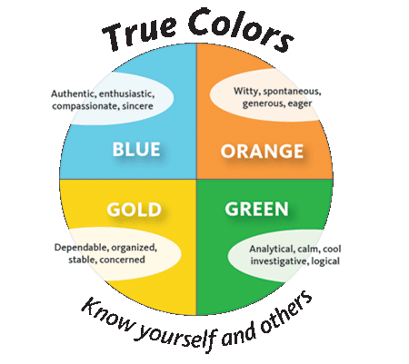
Overview:
Categorizes personalities into four distinct colors: Gold, Green, Blue, and Orange
Each color represents a cluster of personality traits and communication styles
Understanding these colors can help foster better communication, collaboration and self-awareness

Slide 4

Gold: “The Guardian”
Positive:
Reliable and responsible
Organized and detail oriented
Loyal and dedicated
Negative:
Can be rigid and resistant to change
May struggle with adaptability
Sometimes overly focused on rules and protocols

Slide 5
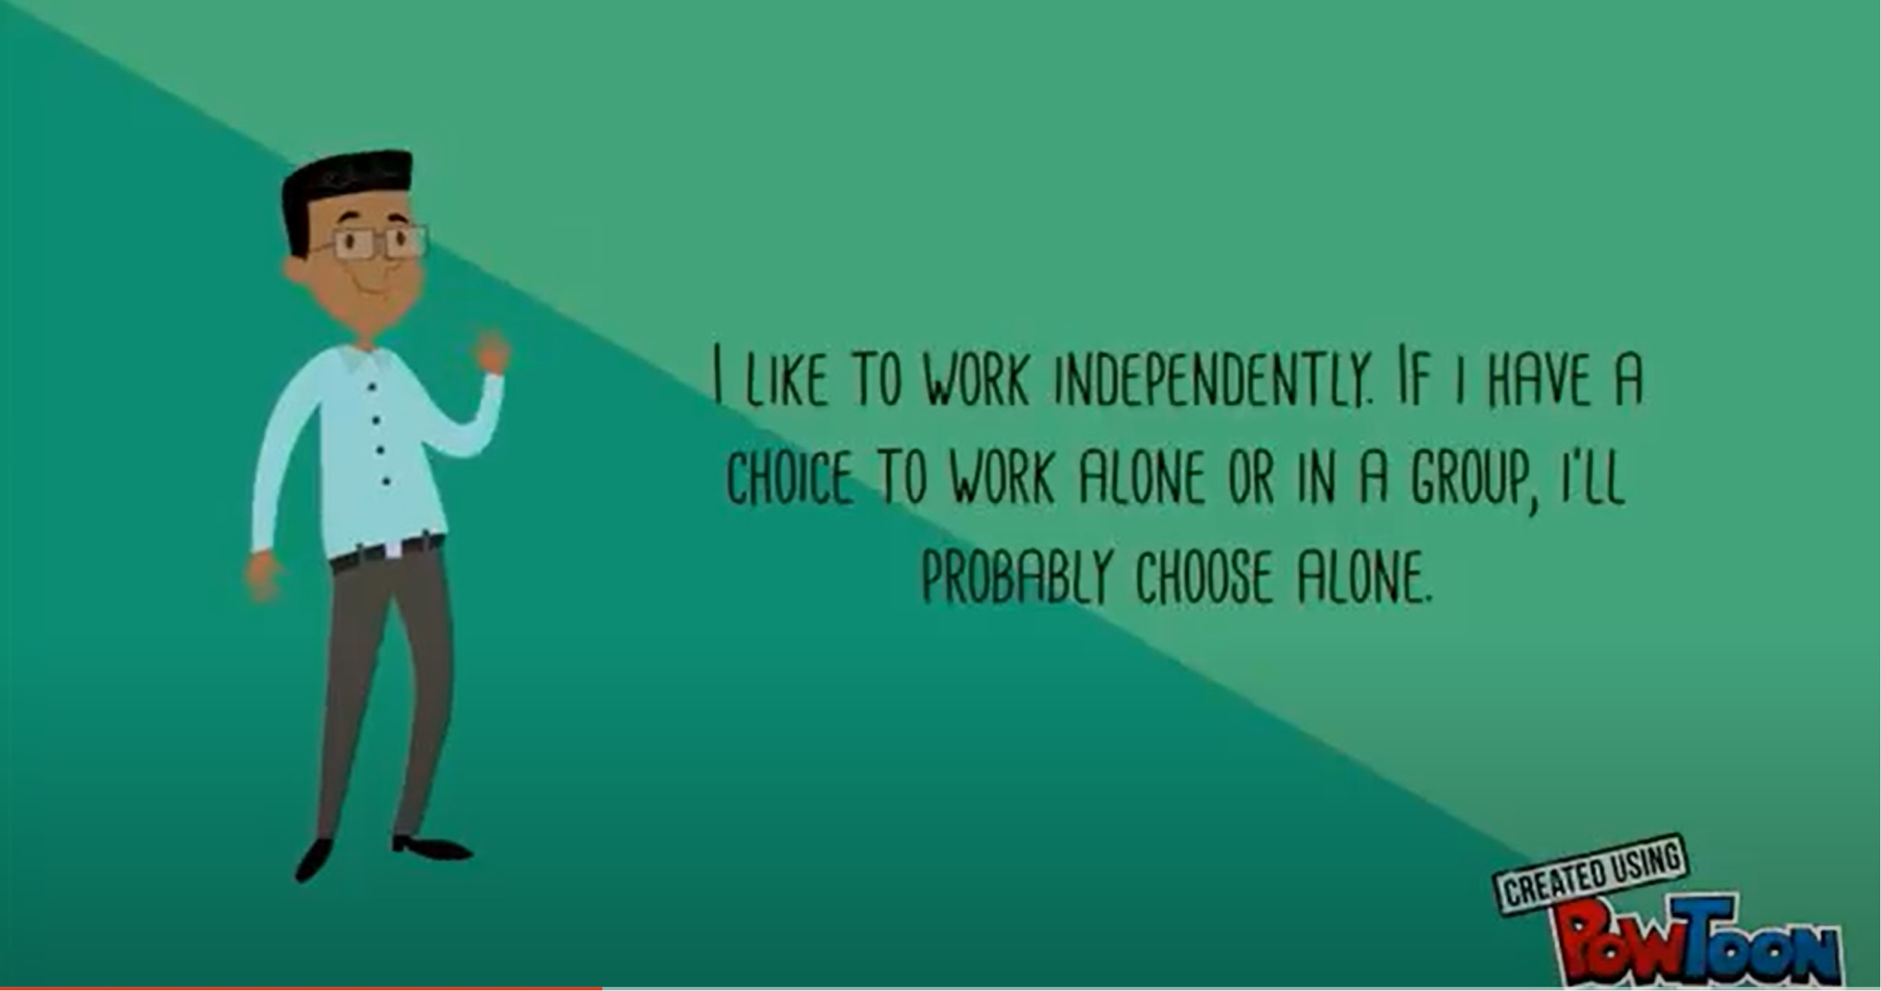
Green: “The Thinker”
Positive:
Analytical and strategic thinkers
Innovative and creative problem solvers
Independent and self-reliant
Negative:
May appear distant or aloof
Can by overly critical or skeptical
May struggle with expressing emotions or empathy

Slide 6
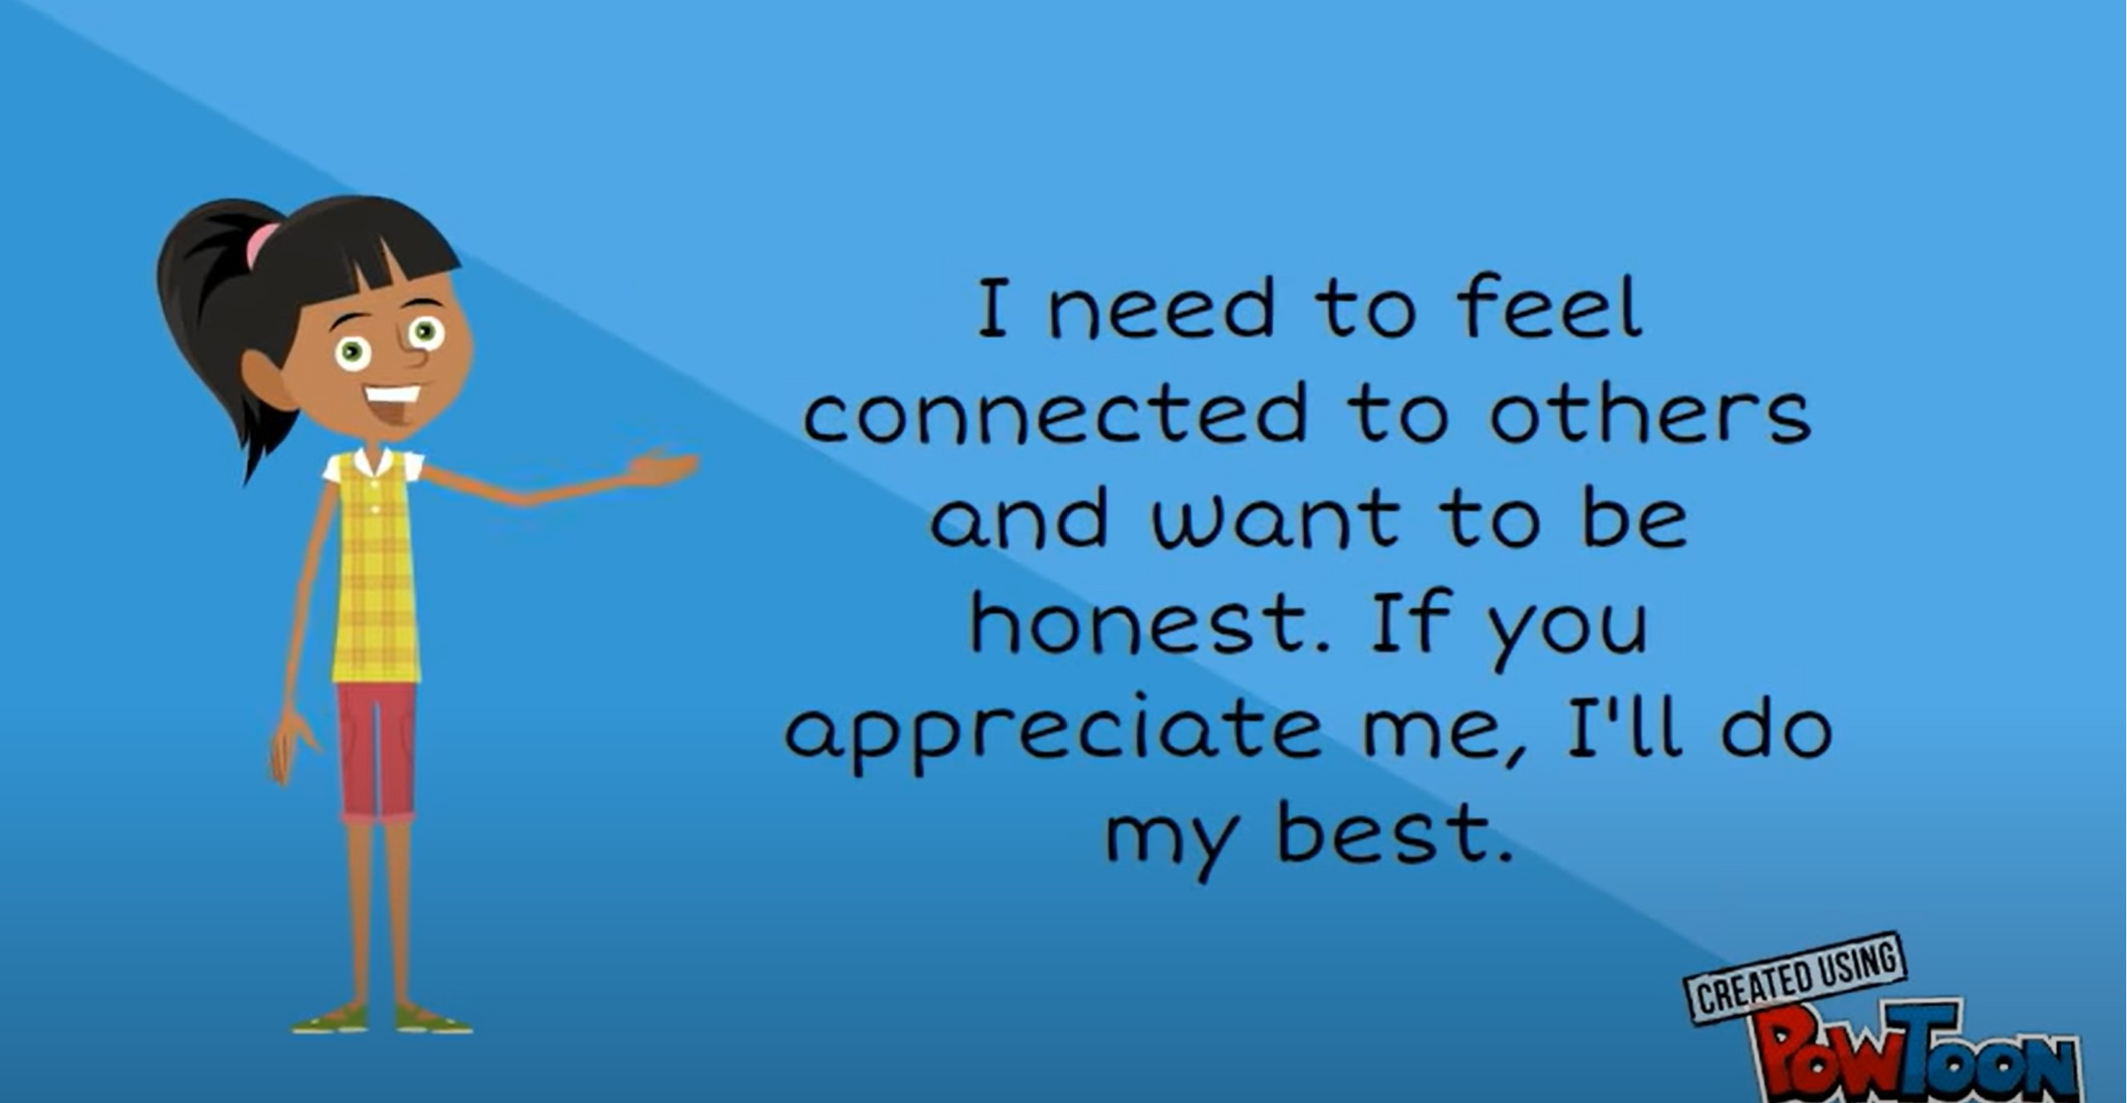
Blue: “The Nurturer”
Positive:
Compassionate and empathetic
Excellent Communicators and listeners
Team players who prioritize harmony
Negative:
May avoid conflict at the expense of honesty
Can be overly sensitive or emotional
May prioritize others’ needs over their own

Slide 7
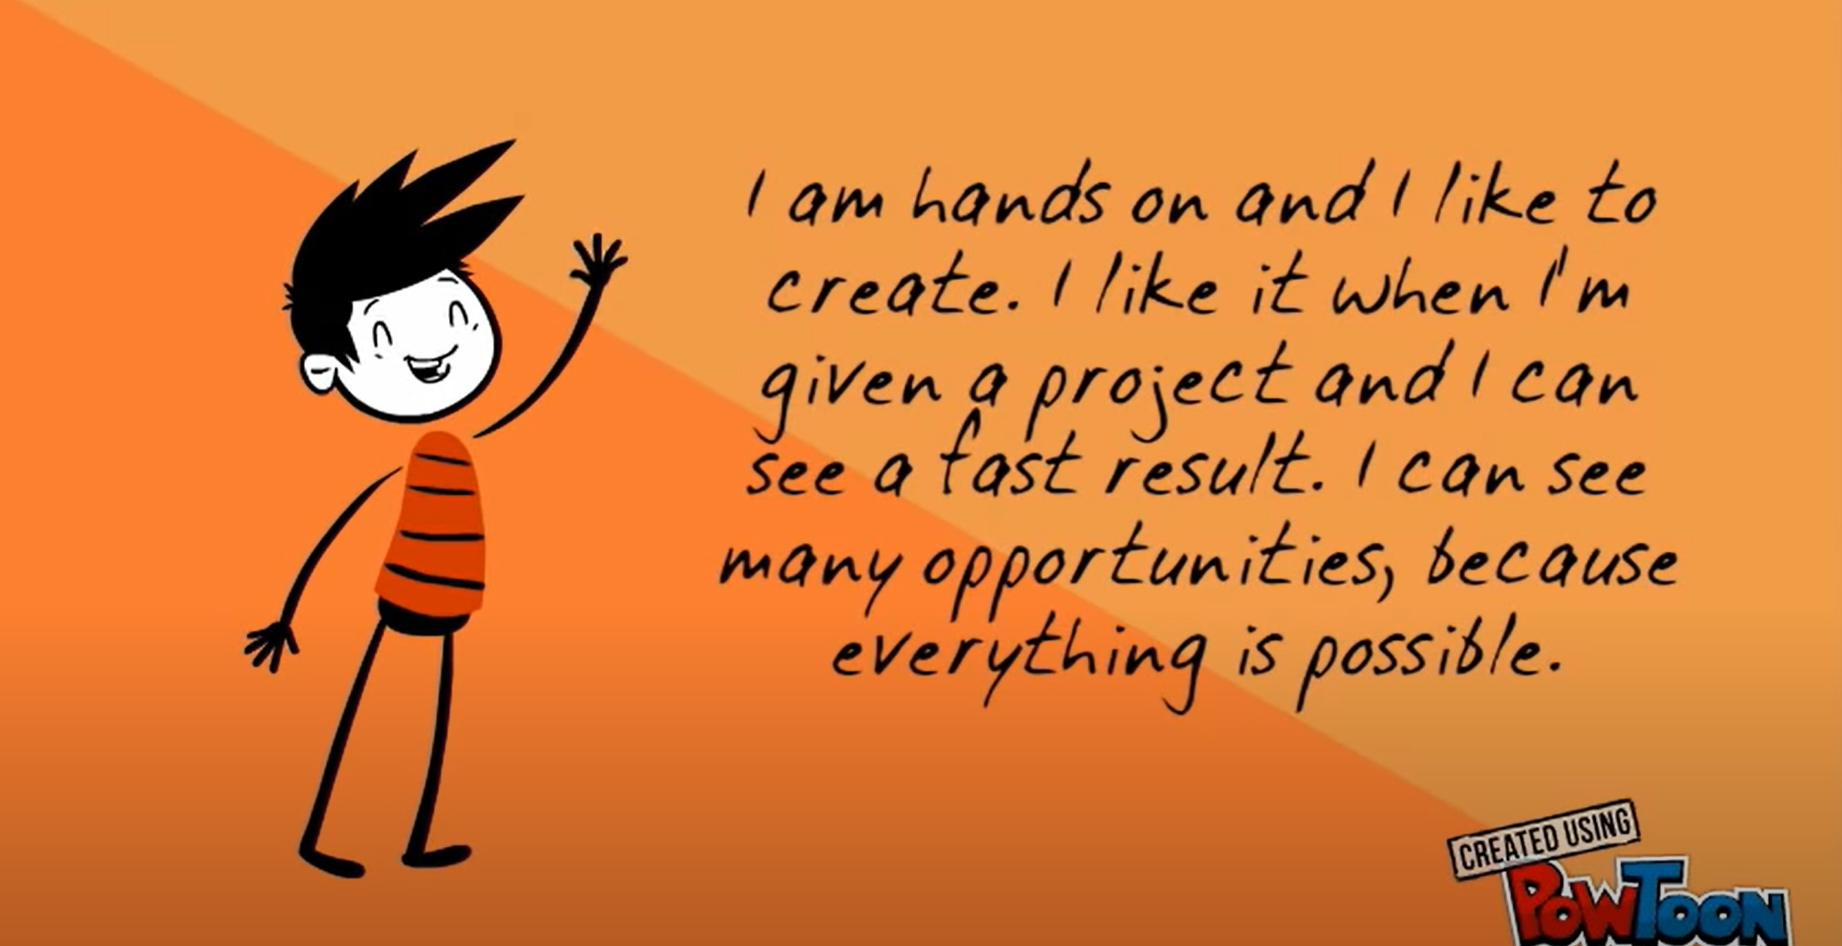
Orange: “The Adventurer”
Positive:
Energetic and adventurous
Spontaneous and fun-loving
Adaptable and flexible in various situations
Negative:
May struggle with commitment or follow-through
Can be impulsive and risk-seeking
May prioritize short-term gratification over long-term goals

Slide 8

Understanding Color Interactions
Individuals often have a primary and secondary color, influencing their behavior and interactions
Understanding color dynamics within teams and relationships is crucial for effective communications and collaboration
A harmonious blend of colors often lead to balanced and productive environments

Slide 9

Application in Various Settings
Workplaces: Helps team building, conflict resolution, and leadership development
Education: Guides educators in understanding students’ learning styles and adapting teaching methods
Relationships: Enhances understanding and communication between partners, friends and family members
Personal Development: Provides insight into career choices, goal setting and personal growth strategies

Slide 10
Test

Slide 11
Group Project

Slide 12

But How Does This Help ME??
The color personality model can be highly beneficial for Veteran Services Officers (VSOs) in various aspects of their work.

Slide 13
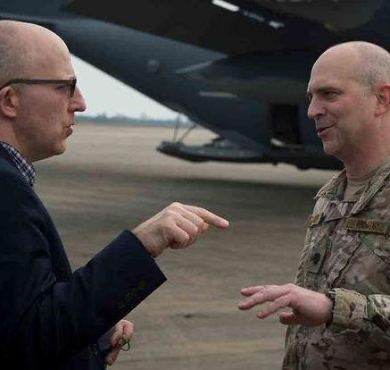
Communication with Veterans:
VSOs often interact with Veterans who may have diverse backgrounds, experiences and communication styles
Understanding the True Colors can help VSOs tailor their communication approach
For example:
A Blue Veteran may appreciate empathy and emotional support, while a Gold Veteran may prefer clear, structured information

Slide 14
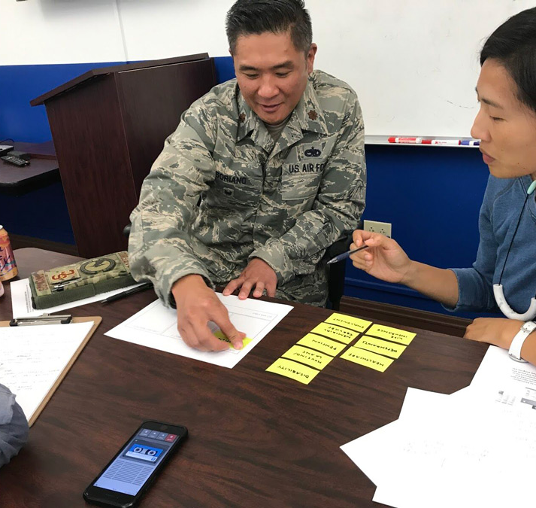
Building Trust and Rapport:
By recognizing and respecting Veterans’ personality preferences, VSOs can build trust and rapport more effectively
Engaging Veterans in a manner that resonates with their True Colors fosters a sense of understanding and connection

Slide 15
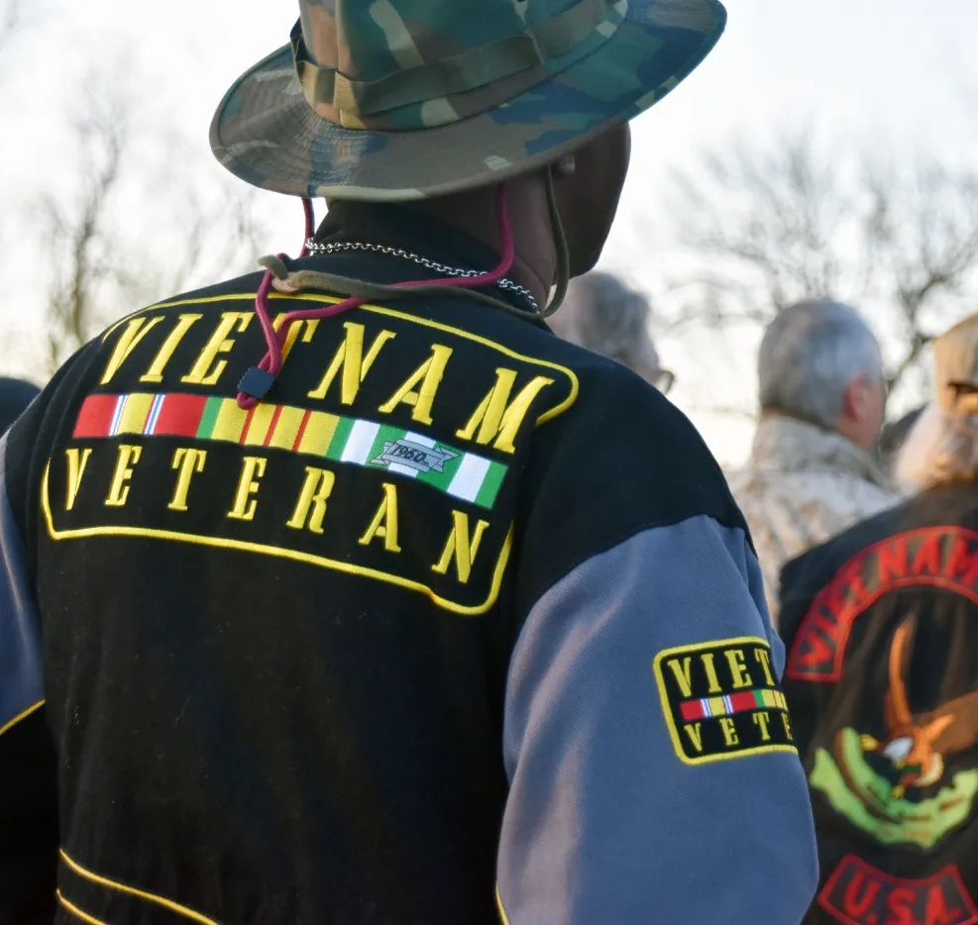
Navigating Conflict and Resolution:
In situations where there’s disagreement or conflict, understanding the True Colors of all parties involved can help VSOs navigate and resolve issues
VSOs can identify potential triggers and preferences to facilitate constructive dialogue and conflict resolution

Slide 16
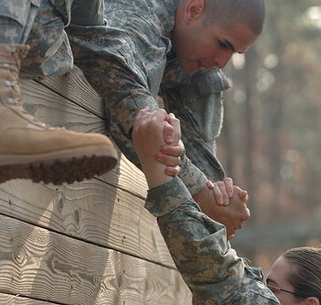
Team Collaboration:
VSOs often work within multi-disciplinary teams that include professionals from various backgrounds and specialties
Understanding the True Colors of team members enhances collaboration, communication, and cohesion within the team

Slide 17
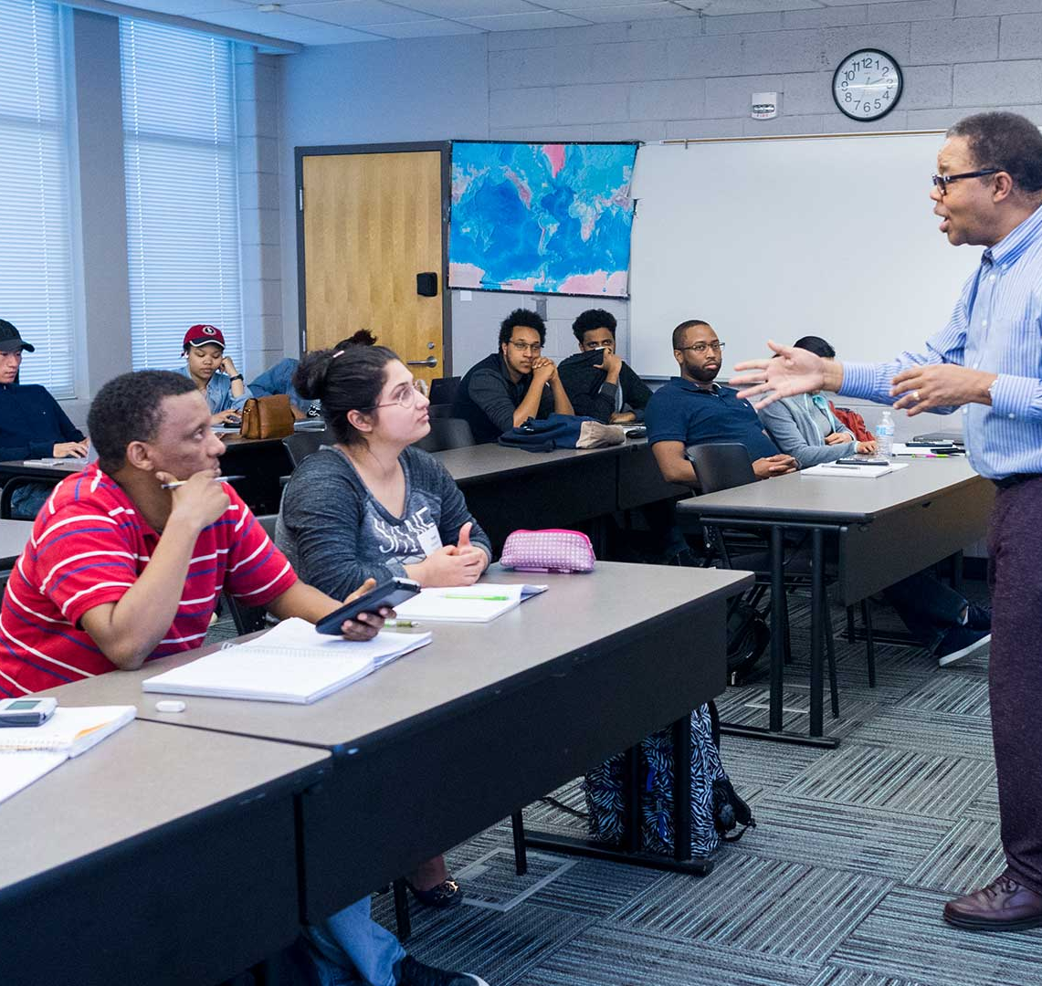
Training and Professional Development
Incorporating True Colors workshops or training sessions into professional development programs for VSOs can enhance their interpersonal skills
VSOs can learn strategies for effectively engaging with Veterans, colleagues, and stakeholders based on their true colors preferences.

Slide 18

Tailoring Services and Support
VSOs can adapt their support services based on Veterans’ True Color Preferences
For example:
Orange Veterans may prefer practical, hands-on assistance, while Green Veterans may appreciate detailed information and analysis

Slide 19
In Summary:
The True Colors model offers VSOs a practical framework for understanding and engaging with Veterans, colleagues and stakeholders more effectively.
By recognizing and respecting individual personality preferences, VSOs can enhance communication, build trust, and provide tailored support services to meet the unique needs of Veterans.

