Slide 1
VA CAREGIVER SUPPORT PROGRAM
Caregiver Support Program Overview
VALB Caregiver Support Program Contacts:
Main number: 562-826-8280
Fax: 562-346-3594
Email: longbeachcaregiversupport@va.gov
Notes:
~ Good Morning/Afternoon, it's a pleasure to be with you today to provide an overview of the Caregiver Support Program.

Slide 2

Overview
Introduction to VA Caregiver Support Program (CSP)
Program of General Caregiver Support Services (PGCSS)
Program of Comprehensive Assistance for Family Caregivers (PCAFC)
Informational Purposes Only
Notes:
I will cover an introduction to the VA Caregiver Support Program. There are two unique programs under the Caregiver Support Program, or CSP for short. We have the Program of General Caregiver Support Services or PGCSS and the Program of Comprehensive Assistance for Family Caregivers which we refer to as PCAFC.
The two CSP programs are administered under the Veterans Health Administration.

Slide 3
Where we Started, Where we are Headed…..
2008 – Caregiver Support Program established
2010 – Program of Comprehensive Assistance for Family Caregivers (PCAFC) and Program of General Caregiver Support Services (PGCSS) established under P.L. 111-163
2011 – Program officially accepts applications for PCAFC
2018 – MISSION Act of 2018 expands Veteran eligibility for PCAFC
2020 – Implement expansion of PCAFC eligibility (On or before May 7, 1975, on or after September 11, 2001)
2022 – Second Expansion – PCAFC – All Eras
Informational Purposes Only
Notes:
In late 2007, As military operations in Afghanistan and Iraq progressed, the provision of services and supports to family caregivers of veterans seriously injured in these conflicts moved to the forefront. Family caregiver issues became a focus of the President’s Commission on Care for America’s Returning Wounded Warriors, established by President G.W. Bush on March 8, 2007. In 2008, the VA Caregiver Advisory Board was established to develop the caregiver assistance program.
With the conflicts in Iraq and Afghanistan, new challenges presented themselves to our service members returning from combat with serious injuries that may have been fatal in previous conflicts. These service members require personal care services, which are often provided by family members and loved ones. In recognition of this significant challenge, in 2010, Congress enacted the Caregivers and Veterans Omnibus Health Services Acts of 2010 or PL 111-163. which required VA to establish specific supports for caregivers of veterans. Two programs were established, the Program of General Caregiver Support Services and the Program of Comprehensive Assistance for Family Caregivers. Collectively we refer to these two programs as the Caregiver Support Program. PCAFC was established/created for Family Caregivers of eligible Veterans who had a serious injury incurred or aggravated in the line of duty.
10 Years ago, the program began officially accepting applications for PCAFC.
2018 – In 2018, the VA MISSION Act required VA to expanded eligibility for the family caregivers' program to caregivers of Veterans of all eras in a phased approach, establish new benefits for designated Primary Family Caregivers and other changes that affected program eligibility and VA’s evaluation of PCAFC applications. These expansion efforts are being implemented in two phases. Veterans who were seriously injured in the line of duty before May 7, 1975 became eligible as of October 1, 2020 and two years later, October 1, 2022 Veterans who served and were injured in the line of duty between May 7, 1975 and September 11, 2001 are to become eligible. In other words, by 10/1/2022 all Veterans of all eras will be eligible to apply.

Slide 4
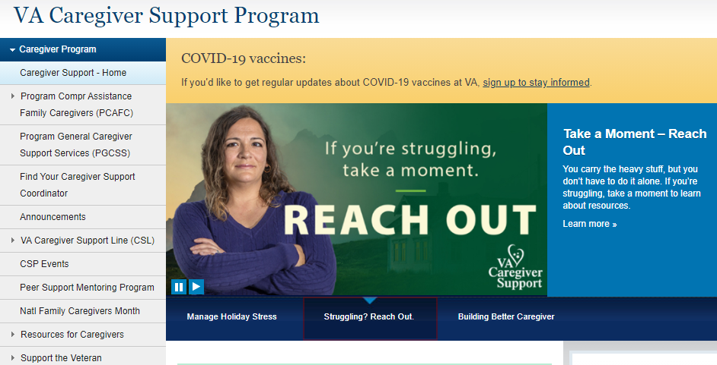
CSP Website
Program information
Zip code based interactive CSP Team/Coordinator locator
Contact info for Caregiver Support Line (CSL)
Resources for Caregiver (Tips and Tools, Resources by Topics, Self-Care)
PCAFC online application link
www.caregiver.va.gov
Notes:
As I move into the specifics about our two programs, I want to share with you some information about our amazing resources available to anyone interested in learning about CSP, as well as helpful education and information for caregivers. These are the Caregiver Support Program website the Caregiver Support Line.
The national CSP website provides information including:
Program information
Zip code based interactive CSP Team locator
Contact info for CSL
Resources for Caregiver (Tips and Tools, Resources by Topics, Self Care)
PCAFC online application link
As well as information about national calls, important updates and alerts and much more.

Slide 5

Caregiver Support Line (CSL)
The VA CSL responds to calls from caregivers, Veterans and community agencies seeking information about VA caregiver services.
Monday - Friday 8:00AM - 10:00PM (ET) and Saturday 8:00AM - 5:00PM (ET)
Staffed by VA professional staff
Links callers to their local Caregiver Support Team
Provides information about assistance through the VA
Offers supportive counseling when needed
1-855-260-3274
Notes:
The Caregiver Support Line is a toll-free number for caregivers, family members, friends, Veterans, and community partners to contact for information related to caregiving and available supports and services. Information on caregiver support services, counseling, and educational services can be provided as well as referrals to local Caregiver Support Program (CSP). The CSL is available Monday-Friday 8:00 am-10:00 pm ET and on Saturday from 8:00 am – 5:00 pm. The CSL is staffed by VA professional staff.

Slide 6

Program of General Caregiver Support Services
Program of General Caregiver Support Services (PGCSS) Mission:
To serve caregivers with respect and service excellence through a wide range of support, education and tools that empower them to care for themselves and the Veteran
Notes:
Now we’ll talk about the Program of General Caregiver Support Services, or PGCSS. The mission of PGCSS is to serve caregivers with respect and service excellence through a wide range of support, education and tools that empower them to care for themselves and the Veteran.

Slide 7

General Caregiver Definition
  Caregivers who participate in PGCSS are called General Caregivers.
A General Caregiver is a person who provides personal care services to a Veteran enrolled in VA health care who:
  Needs assistance with one or more activities of daily living; Or
  Needs supervision or protection based on symptoms or residuals of neurological care or other impairment or injury.
General Caregivers do not need to be a relative or live with the Veteran.
Notes:
Caregivers who participate in PGCSS are called General Caregivers.
This is a person who provides personal care services to a Veteran enrolled in VA healthcare who either:
Needs assistance with one or more activities of daily living; Or
Needs supervision or protection based on symptoms or residuals of neurological care or other impairment or injury.
They do not need to be a relative or live with the Veteran.

Slide 8
PGCSS Four Core Elements
Education and Support
Collaboration and Partnerships
Outreach
Resources and Referrals
Informational Purposes Only
Notes:
Let me give you a bit more detail about PGCSS.
We recognized that it was important that across VA, all caregivers have access to the same resources and services no matter where their Veteran received care and thus we established 4 core elements as you can see here. Education and Support, Collaboration and Partnerships, Outreach, and Resources and Referrals.
Education and Support – We provide one-on-one clinical support to help the caregiver care for the Veteran and themselves. This is based on the needs of the caregiver. Some caregivers may wish to have weekly check-ins over 6 weeks whereas others may want a monthly support call ongoing. We also provide support groups – Many sites offer topic specific support groups, targeted at bringing together caregivers facing similar circumstances or caring for someone with a specific diagnosis. These can be offered in a number of modalities, via video telehealth or phone as well as in person, when feasible.
Collaboration and Partnerships – Caregivers are present throughout VA and in our communities, so it's critical that we collaborate and maintain strong partnerships to be sure caregiver needs are met. These collaborations and partnerships happen at the national and local level. We often say ‘VA can do a lot, but we can’t do it alone’. This is why our trusted partnerships are so key.
Outreach – We want to be sure that caregivers know we are here for them! So we work to make sure we are putting out communications to alert caregivers as to what is available to them. We don’t want to wait for them to find us – we want to reach out and bring them in for support.
Resources and Referrals- PGCSS helps caregivers get connected to the right services and support for them, whether that be at VA or in the community. We want to be sure that caregivers and families have awareness and connection to the resources available that best meet their specific needs.

Slide 9

Education and Support
Skills Training
  Veterans Affairs (VA) S.A.V.E. Training
  Building Better Caregivers (BBC)
Mobile Support
  Annie Caregiver Text Program
One on One Coaching
  Resources for Enhancing All Caregivers Health (REACH) VA
  Health and Well-Being Coaching
S.A.V.E. Suicide Prevention Skills Training
Signs
Ask
Validate
Encourage & Expedite
Suicide Prevention Toolkit for Caregivers
Notes:
Training and support is offered through different opportunities via in person, online and telehealth sessions. I want to touch base on a few of our education and support options. We have:
-VA S.A.V.E is a suicide prevention training that equips caregivers to demonstrate care, support and compassion when talking with their Veteran who could be at risk for suicide. It offers important information as well as simple steps and actions caregivers can take.
-Building Better Caregivers is an online workshop with 6 weekly self-paced lessons, facilitator guidance, and group support for caregivers of Veterans with dementia, memory problems, post-traumatic stress disorder, or a serious brain injury.
-Annie Caregiver Text Program, which promotes self-care for both Veterans and their caregivers. Annie can help manage stress and support self-care by sending three text messages a week, with a focus on education, motivation, and activities to manage stress.
-REACH VA Caregiver Program, which provides caregivers with problem-solving skills, stress management techniques, and specific information on disease-related concerns that are customized for each caregiver.

Slide 10

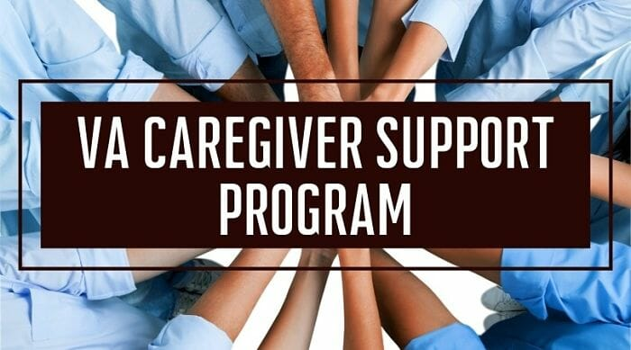

Education and Support continued
Group Support and Coaching
Services Provided Through PGCSS
Caregiver Self-Resilience Courses
CaregiversFIRST
Resources for Enhancing All Caregivers Health (REACH VA)
Peer Support Mentoring Program
Notes:
-Caregivers FIRST is a caregiver skills group training program with the goal of connecting caregivers with each other and to resources to help them feel more confident, capable, and supported in their caregiving role.
-The Peer Support Mentoring Program links caregivers to a peer who has experienced similar challenges and situations in order to provide additional support and guidance along the caregiving journey.
-I’ll review the website and Caregiver Support Line next.

Slide 11
Collaboration & Partnerships
Annual Caregiver Summit
Each VA Medical Center (VAMC) hosts an annual CSP Caregiver Summit. The purpose of the summit is to:
Understand the needs of caregivers in the local community
Identify both gaps and available resources
Bring together VA, local area non-profits and community agency participants
At the summit, these entities collaborate, share information, and network on behalf of caregivers.
CSP Resource Fairs
The annual Caregiver Family and Resource Fairs are held at every VAMC. These fairs connect caregivers with resources, programs, and services all at one event. The fairs have information and are attended by:
Representatives from VA programs
Local area non-profits
Community agencies
Notes:
Now we’ll move on to Collaboration and Partnerships.
The Caregiver Support Program at each local site hosts an annual summit for VA and community providers to include caregiver specific topics. The summit includes VA and external organizations that support caregivers and families. The goal is to create and increase awareness of the needs of caregivers in the local community and to provide available resources. We also have an annual caregiver and family resource fair at every VA facility for Veterans and Caregivers with a focus on caregivers and families on Veterans Health Administration, Veterans Benefits Administration, local non-profits, and county services.

Slide 12
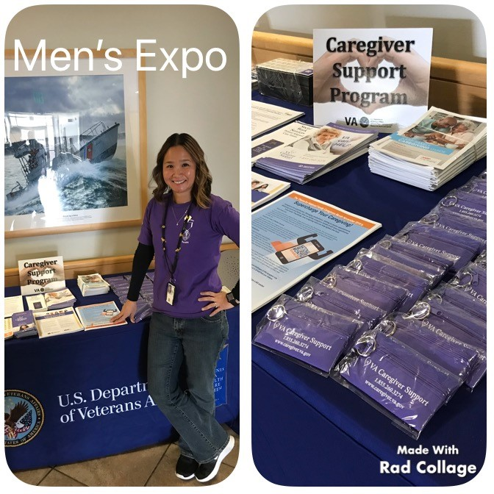
Outreach
Outreach to local hospitals, community agencies, and other events that support caregivers and Veterans.
Provide consultation, guidance, and subject matter expertise to community organizations regarding Veteran caregivers.
Notes:
CSP staff serves as subject matter experts and are outreaching to various organizations, agencies and stakeholders, including at events (in-person when able, or virtual). We do this year-round through planned events, as well as upon request.

Slide 13
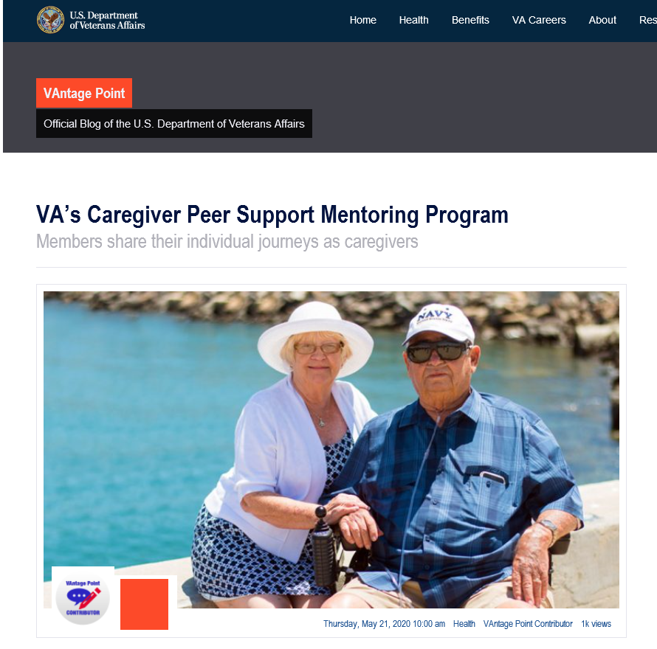

Resources and Referrals
Support from CSP Team members for referrals to programs and services:
Other VA (i. e. Whole Health, Mental Health, and many others)
Community organizations and partners
Notes:
CSP staff work first-hand with caregivers to connect them with CSP, VA, community and partner resources.
We have strong relationships with our VA and non-VA partners, to help caregivers address any number of issues or needs they may have.

Slide 14
Program of Comprehensive Assistance For Family Caregivers
Program of Comprehensive Assistance for Family Caregivers (PCAFC)
Notes:
Our 2nd program is the Program of Comprehensive Assistance for Family Caregivers or PCAFC. It's an honor to care for those who provide care for our nation’s Veterans through both PGCSS and PCAFC.

Slide 15
VA MISSION Act and Caregivers
The VA MISSION Act of 2018 was designed to improve Veteran access to health care.
The MISSION Act gives Veterans greater access to health care in VA facilities and the community, expands benefit for caregivers, and improves VA’s ability to recruit and retain the best medical providers.
The MISSION Act enhances VA support for Family Caregivers through the PCAFC.
Informational Purposes Only
Notes:
There were several changes made to the program because of the Mission Act of 2018 which was designed to improve Veteran access to healthcare. This includes expansion of PCAFC to all service eras in a phased approach.

Slide 16
VA MISSION Act Timelines
The MISSION Act of 2018 authorized VA to:
Prior to October 1, 2020, PCAFC was available to Veterans seriously injured in the line of duty on or after September 11, 2001.
The MISSION Act expanded PCAFC to eligible Veterans of all eras of service, in two phases:
Phase I: Eligible Veterans injured on or before
May 7, 1975
    Went live October 1, 2020
Phase II: Eligible Veterans injured between
May 7, 1975 - September 11, 2001
    Will launch October 1, 2022
Informational Purposes Only
Notes:
Prior to October 1, 2020, PCAFC was available to Veterans who incurred or aggravated a serious injured in the line of duty on or after September 11, 2001. The Mission Act authorized the VA to expand the PCAFC to eligible Veterans of all eras of service occurring in two phases. The first phase occurred on October 1, 2020 and expanded PCAFC to eligible Veterans who incurred or aggravated a serious injury or illness on or before May 7, 1975. Phase II will launch October 1, 2022, to include all eligible Veterans from any era.

Slide 17
PCAFC Eligibility Criteria
Eligibility Criteria
There are seven (7) Veteran eligibility requirements for PCAFC.
The Veteran or servicemember undergoing medical discharge, must
have a serious injury incurred or aggravated in the line of duty. We define serious injury as a 70% service-connected rating. This can be a single or combined rating. It can include a presumptive rating.
The Veteran must need in-person personal care services for a minimum of six (6) continuous months based on any one of the following:
  An inability to perform an activity of daily living;
  A need for supervision or protection based on symptoms or residuals of neurological or other impairment or injury; or
  A need for regular or extensive instruction or supervision without which the ability of the Veteran to function in daily life would be seriously impaired.
Informational Purposes Only
Notes:
PCAFC has specific eligibility requirements for Veterans and caregivers.
There are seven (7) Veteran eligibility requirements for PCAFC. I am just going to highlight a few of those here.
The Veteran or servicemember undergoing medical discharge, must have a serious injury incurred or aggravated in the line of duty. We define serious injury as a 70% service-connected rating. This can be a single or combined rating. It can include a presumptive rating.
The Veteran must need in-person personal care services for a minimum of six (6) continuous months based on any one of the following:
An inability to perform an activity of daily living;
A need for supervision or protection based on symptoms or residuals of neurological or other impairment or injury; or
A need for regular or extensive instruction or supervision without which the ability of the Veteran to function in daily life would be seriously impaired.
For more information about the eligibility requirements, please see the eligibility fact sheet on the caregiver support program’s website. www.caregiver.va.gov

Slide 18
PCAFC Services
Education and Training
Enhanced Respite Care
Mental Health Counseling
Beneficiary Travel (when travelling with Veteran for appointments)
Monthly Stipend (62.5% or 100% based on the level) – based on OPM General Schedule Grade 4, Step 1
Access to health care through Civilian Health and Medical Program of the Department of Veterans Affairs (CHAMPVA), if eligible
Financial planning and legal resources for Primary Family Caregivers.
  VA is aggressively working towards a contract solution, in the near future.
Informational Purposes Only
Notes:
PCAFC offers the same services and resources to caregivers of Veterans, as PGCSS.
In addition, PCAFC also provides a monthly stipend for the caregiver, mental health counseling that does not have to be related to the care of the Veteran, enhanced respite care for not less than 30 days, beneficiary travel, access to CHAMP VA if eligible, and education and training.
Related to Financial planning and legal resources, we are unable to provide an exact timeline for implementation of Legal/Financial services but are aggressively working towards a contract solution in the near future.

Slide 19

Suspension of Certain Discharges, Reductions, and Reassessments in PCAFC
Suspension on certain discharges, reductions, and reassessments in PCAFC as of June 9, 2022
VA review and examination of eligibility and stipend level criteria
Annual reassessments for identified needs, i. e.:
  Increase in the stipend level may be warranted
  Increased need for personal care services
    No reduction in stipend level or discharge
Review and appeal options for PCAFC
CSP website: www.caregiver.va.gov
This Photo by Unknown Author is licensed under CC BY-NC-ND
Notes:
Within PCAFC, reassessments are a part of the program.
Currently, there is a suspension on certain discharges, reductions, and reassessments in PCAFC, which took place on June 9, 2022.
VA has determined that annual reassessments completed with PCAFC participants are unnecessary for all Veterans and their Family Caregivers in PCAFC, at this time.
VA is reviewing and examining eligibility and stipend level criteria.
Facility CSP staff will continue to initiate a reassessment based on a request for a reassessment made by Veteran or Family Caregiver PCAFC participant.
For example, a request might be made because the individual believes an increase in the stipend level may be warranted or if evidence of an increased need for personal care services is otherwise discovered.
No reduction in stipend level or discharge based on eligibility and stipend level criteria will occur for PCAFC participant, based on such a reassessment, until further VHA decisions are made about the processes.
Review and appeal options for PCAFC remain the same and can be found on the CSP website: www.caregiver.va.gov.

Slide 20

PCAFC
PCAFC Application Process
Notes:
Now, let’s talk about how the application process works for PCAFC.

Slide 21
How To Apply
  Veterans and Caregivers may apply for PCAFC in the following ways:
    Complete the application online through: http://www.caregiver.va.gov
      For most, this is the fastest and easiest route!
    Access and download the application (VA Form 10-10CG). Mail to or walk the application into the local CSP Team.
    Mail the form and any supporting documents to:
      Program of Comprehensive Assistance for Family Caregivers
      Health Eligibility Center
      2957 Clairmont Road NE, Suite 200
      Atlanta, GA 30329-1647
    You may also contact your local CSP for assistance, Caregiver Support Team link via CSP Website.
Informational Purposes Only
Notes:
How does a Veteran and their caregiver initiate the PCAFC application process?
There are a few options:
-Complete the application online through: http://www.caregiver.va.gov.
-For most, this is the fastest and easiest route!
-Access and download the application (VA Form 10-10CG). Mail to or walk the application into the local CSP Team.
-Mail the form and any supporting documents to:
Program of Comprehensive Assistance for Family Caregiver
Health Eligibility Center
2957 Clairmont Road NE, Suite 200
Atlanta, GA 30329-1647
-Veterans/caregivers may also contact the local CSP team for assistance, Caregiver Support Team link via CSP Website.

Slide 22
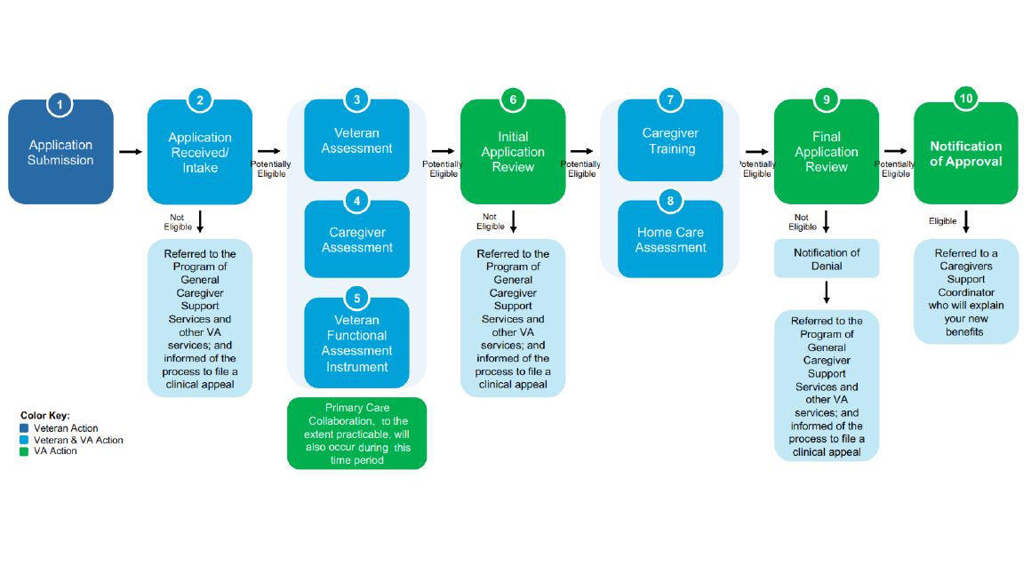
PCAFC Application Flow
Notes:
The first step, as already mentioned, is for the Veteran and caregiver to complete and submit their application for PCAFC.
Once an application is received by the Caregiver Support Program Team, a preliminary review is performed.
Following the preliminary review, a veteran assessment, veteran functional assessment, and caregiver assessment is scheduled and completed by the CSP team at the facility. The CSP team collaborates with the veteran’s Primary Care Provider for input about the Veteran’s needs.
The completed assessments are then reviewed by VISN Centralized eligibility and Appeals Team (CEAT) to determine initial eligibility. Our CEAT teams are located at the VISN level, which stands for Veterans Integrated Services Network. If CEAT determines initial eligibility is met the caregiver is referred to caregiver training. An initial Home-Care assessment will take place and CEAT verifies caregiver training completion and the results of the Home-Care assessment and makes the final eligibility determination and stipend level.
(ERPI_Application Factsheet_200930 (va.gov) – graphic pulled from this Fact Sheet)

Slide 23


Review and Appeal Options for PCAFC
Veterans and caregivers who disagree, in whole or in part, with a VA decision under the PCAFC, now have additional options available to appeal or request VHA review of the decision.
Notes:
Sometimes a Veteran and caregiver may disagree with the decision or determination.
If they disagree, in whole or in part, with a Department of VA decision under PCAFC, there are options for them to appeal or to request a Veterans Health Administration (VHA) review of the decision. Options depend on the date VA issued the PCAFC decision.
Previously, Veterans and caregivers could only appeal PCAFC decisions through the VHA Clinical Review Process (also known as the VHA Clinical Appeals Process).
Veterans and caregivers now have additional options available to appeal or request a VHA review of the decision.
Caregivers receive a letter explaining their options.

Slide 24

VHA Clinical Appeal Process - PCAFC
To initiate the Veterans Health Administration (VHA) Clinical Appeal Process, the Veteran and caregiver should contact the Patient Advocate at their local VA medical facility for more information on the Clinical Review Process.
*Find VA Locations | Veterans Affairs
Notes:
To initiate the Veterans Health Administration (VHA) Clinical Appeal Process, the Veteran and caregiver should contact the Patient Advocate at their local VA medical facility for more information on the Clinical Review Process.
To find your local VA medical center, you can use the VA Locator for your local VA medical center.

Slide 25
Additional Appeal and Review Options
If the Veteran/caregiver disagree with a PCAFC decision issued before February 19, 2019, they can now appeal to the Board. They can also seek review through the VHA Clinical Review Process.
If the Veteran/caregiver disagree with a PCAFC decision issued on or after February 19, 2019, they can utilize one of the following three options: Supplemental Claim, Higher-Level Review, or appeal to the Board. They can also seek review through the VHA Clinical Review Process.
Frequently Asked Questions (CSP Website):
Changes to Review and Appeal Options for Program of Comprehensive Assistance for Family Caregivers (PCAFC) Decisions (va.gov)
Notes:
To provide additional choices to Veterans and caregivers, VHA will continue to offer the clinical review process (also referred to as the VHA Clinical Appeals Process) if they disagree with one or more PCAFC decisions, regardless of when those decisions were made. This process will work in tandem with the additional VHA review options mentioned.
If a Veteran and caregiver disagree with a PCAFC decision issued before February 19, 2019, they can now appeal to the Board. They can also seek review through the VHA Clinical Review Process
If they disagree with a PCAFC decision issued on or after February 19, 2019, they can utilize one of the following three options: Supplemental Claim, Higher-Level Review, or appeal to the Board. They can also seek review through the VHA Clinical Review Process.
-Higher-Level Review is a review by an experienced decision maker within the Caregiver Support Program who was not involved in the prior decision.
-A Supplemental Claim is a request for VA to consider new and relevant evidence that was not of record when VA made its prior PCAFC decision.
-An appeal to the Board is a request for a Veterans Law Judge (VLJ) to review a decision by VHA.
Please note that there’s a very informative Frequently Asked Questions document on the CSP Website:
Changes to Review and Appeal Options for Program of Comprehensive Assistance for Family Caregivers (PCAFC) Decisions (va.gov)

Slide 26
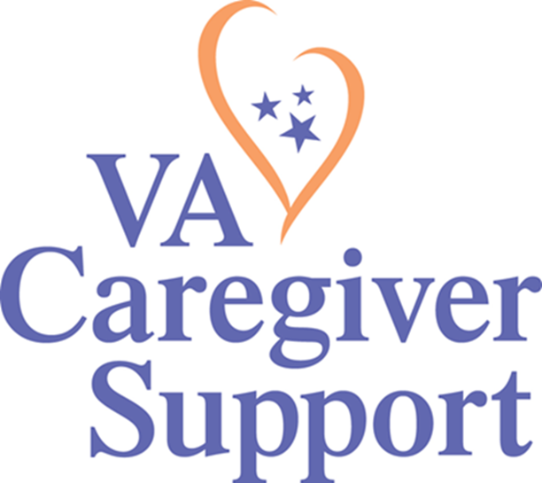
Thank you!
National Caregiver Support Line:
1-855-260-3274
To find your local Caregiver Support Program Team, or for more information, please visit:
www.caregiver.va.gov
Notes:
And that brings me to the end of my presentation. I hope this has been helpful for you. Please visit our website often as we add updates and new information regularly. Thank you.

