Slide 1


Fiduciary Hub
Briefed by: Bill Van Berckelaer
FID HUB Coach RO Salt Lake City 341
Date: October 22, 2024

Slide 2
Objectives
Understand and recall responsibilities of the Fiduciary Hub
Understand and define key terms
Know the eligibility requirements
Know the application process

Slide 3
References
M21-1 Part X, Subpart ii, Chapter 6, Section C - General Information on Incompetency and Fiduciary Cases
38 CFR Part 13 Fiduciary Activities
Public Law 108-454, Veterans Improvement Act of 2004
Fiduciary Program Manual (FPM) I.1.B. General Information on the Fiduciary Program
Fact Sheets - Veterans Benefits Administration (va.gov)
Veteran Rate Tables
Survivors Pension benefit rates

Slide 4
Fiduciary Hub
Key Terms: | Definition:
Beneficiary | A Veteran, his/her survivor, or adult helpless child, who has been awarded VA benefits but who is unable to manage their VA funds as a result of injury, disease, the infirmities of advanced age, or being less than 18 years of age.
Fiduciary | An individual or entity that has been appointed by VA to receive VA funds on behalf of a beneficiary for the use and benefit of the beneficiary and their dependents.
Dependent | The beneficiary’s spouse, child, or parent who does not have enough income to meet their needs for personal care and well-being and who obtains support for such needs from the beneficiary.
Relative | An adopted child or a person who is related to a beneficiary by blood or marriage.
Notes:
A VA fiduciary hub is a regional office of the VA fiduciary program. Each hub is responsible for vetting, hiring, and overseeing fiduciaries assigned to veterans in their region. The VA rater sends a request to the veteran’s local Fiduciary & Field Examination (F&FE) office to find a suitable fiduciary for the veteran. Once there is an approval with a proposed finding of incompetency, the fiduciary hub deals directly with the nominated fiduciary

Slide 5
Fiduciary Hub
What is the Fiduciary program?
• The fiduciary program provides oversight of VA’s most vulnerable beneficiaries
• Participants in the fiduciary program are unable to manage their VA benefits on their own
• This might be because of injury, disease, advanced age or youth
• VA appoints fiduciaries who manage VA benefits for these beneficiaries. VA also conducts oversight of VA-appointed fiduciaries to ensure VA beneficiaries’ needs are met
What Is a Fiduciary?
• A fiduciary is a person or entity appointed by VA to receive benefits on behalf of a
Beneficiary
When Is a Fiduciary Needed?
• Every beneficiary has the right to manage his or her VA benefits; however, if medical
evidence indicates they cannot manage their benefits, VA can appoint a fiduciary to
assist the beneficiary
• A fiduciary may also be appointed if a court declares a beneficiary unable to manage
financial affairs
Notes:
A VA fiduciary hub is a regional office of the VA fiduciary program. Each hub is responsible for vetting, hiring, and overseeing fiduciaries assigned to veterans in their region. The VA rater sends a request to the veteran’s local Fiduciary & Field Examination (F&FE) office to find a suitable fiduciary for the veteran. Once there is an approval with a proposed finding of incompetency, the fiduciary hub deals directly with the nominated fiduciary

Slide 6
Fiduciary Hub
“To protect the benefits paid to Veterans and beneficiaries who are unable to manage their financial affairs.”
- Fiduciary Program Mission
Responsibilities:
Assessing beneficiary’s personal welfare and ability to manage financial affairs
Determining, qualifying, and selecting a fiduciary
Arranging for utilization of VA benefit funds
Protecting assets from loss or diversion
Assuring fiduciaries assert and protect entitlement rights
Advising of potential federal and state benefits
Acting on behalf of Supervised Direct Pay beneficiaries
Protect federal funds and determining misuse
Conducting on-site reviews of certain fiduciaries
Assisting with other VA programs in developmental and investigations
Notes:
A VA fiduciary hub is a regional office of the VA fiduciary program. Each hub is responsible for vetting, hiring, and overseeing fiduciaries assigned to veterans in their region. The VA rater sends a request to the veteran’s local Fiduciary & Field Examination (F&FE) office to find a suitable fiduciary for the veteran. Once there is an approval with a proposed finding of incompetency, the fiduciary hub deals directly with the nominated fiduciary

Slide 7
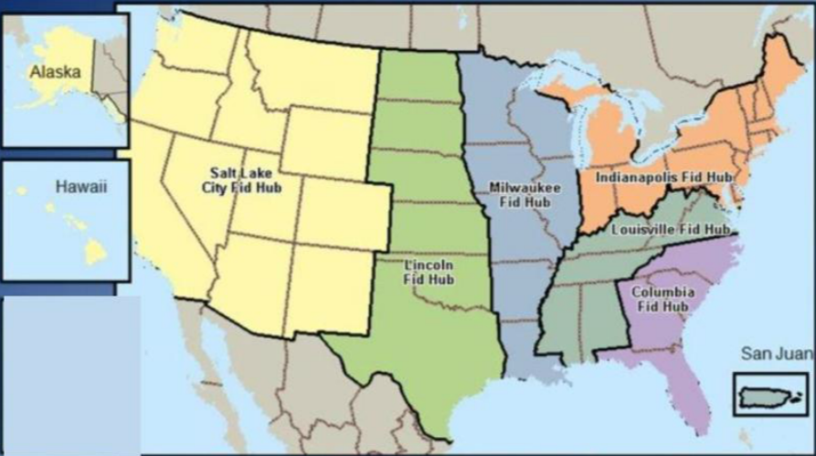
Fiduciary Hub
In order to determine and identify the correct hub of jurisdiction, consider the place of residence of the
minor or incompetent beneficiary for an initial appointment of a fiduciary, or
fiduciary, once one has been appointed.
If the beneficiary/fiduciary resides in ... | Then the hub of jurisdiction is ...
Alaska, Arizona, California, Colorado, Hawaii, Idaho, Montana, Nevada, New Mexico, Oregon, Utah, Washington, or Wyoming | Salt Lake City Fiduciary Hub in Salt Lake City, UT Contact Information: Phone: 1-888-407-0144, #6 VA e-mail: VAVBASLC/RO/FIDUCIARY/PROMULGATION (for RO requests for fiduciary appointment), or VAVBASLC/RO/FIDHUB (for all other fiduciary-related inquiries)
For more locations visit | X.ii.6.C.1.d. Hub Jurisdictions and Contact Information
Fiduciary Hubs: Columbia (SC), Indianapolis (IN), Lincoln (NE), Louisville (KY), Milwaukee (WI), Salt Lake City (UT)

Slide 8
Fiduciary Hub- Functional Areas
Promulgation
Expedite VA benefit payment actions
Complete determinations regarding a beneficiary’s ability to manage VA benefits
Various support tasks (i.e. updating systems, adjustments, end products)
Suspend, resume or discontinue benefits
Field Examination
Complete all field examinations/reports
Assess personal welfare, adjustment and ability to manage financial affairs
Qualify and select fiduciary
Recommend fees
Investigate misuse
Phone calls and mail
Accountings
Audit federal and court accountings
Prior fiduciary's accountings
Recommend changes of fiduciary
Miscellaneous diaries
On-site reviews
Misuse
Analyze misuse allegations
Establish appropriate end products
Develop misuse cases
Coordinate with other VBA departments
Prepare misuse determinations
Review reconsiderations
Refer misuse cases to appropriate agencies
Appeals
Process eligible fiduciary hub appeals
38 CFR 13.600

Slide 9
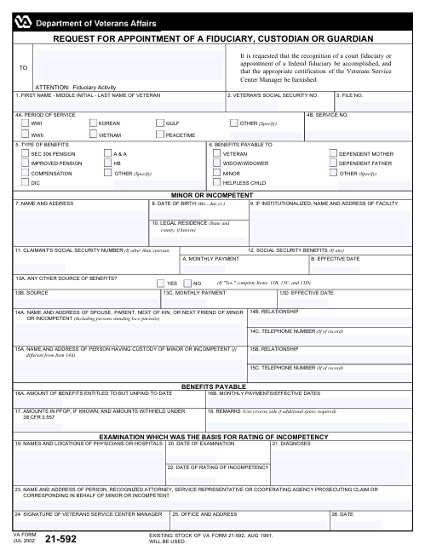
Fiduciary Hub
The rating activity at the station of origination (SOO) has sole authority to make the original competency determination (X.ii.6.A.1.a. Jurisdiction for Competency Determinations).
Competency determinations, see 38 CFR 3.353(b)
When seeking a fiduciary the following individuals may be considered:
A spouse or family member
Court-appointed fiduciaries
Another interested party, or
A professional fiduciary
VA Forms:
VBA-21-592 “Request for Appointment of a Fiduciary, Custodian or Guardian”
VBA-21P-4703 “Fiduciary Agreement”

Slide 10

Questions?
For more information on the VA Fiduciary Program, visit https://www.benefits.va.gov/fiduciary/index.asp

