Slide 1


Presenters
Katri Stone & Josh Peterson
Quality Review Specialists
Pension Management Center

Slide 2

Agenda
Pension Claims

Slide 3
Objectives
Understand and recall responsibilities of the Pension Management Center (PMC)
Understand and define key terms
Know the eligibility requirements
Identify pertinent information and how it effects entitlement
Recall how to access and read rate tables
Know the application process

Slide 4
References
Fact Sheets - Veterans Benefits Administration (va.gov)
Veteran Rate Tables
Survivors Pension benefit rates

Slide 5
Pension
VA helps Veterans and their families cope with financial challenges by providing supplemental income through the Veterans Pension and Survivors Pension benefit programs.
Payments are made to bring the Veteran’s or survivor’s total income to a level set by Congress.
Congress establishes the Maximum Annual Pension Rate (MAPR).
Payments are reduced by the amount of countable income of the Veteran, spouse and dependent children.
Unreimbursed Medical Expenses (UMEs) may reduce countable income for VA purposes.
Notes:
Disabled wartime Veteran with limited income may qualify for VA pension. Monthly pension payments are tax-free and can be used for anything including housing costs, bills and personal expenses. Even if you receive other benefits or a member of your family earns some income, you might still qualify if you meet the income and net worth. VA pension supplementals the income of wartime Veterans (age 65 or older) who meet minimum service requirements and age or non-service connected disability requirements along with income and net worthy limits set by law.
Surviving spouses of wartime Veterans who have not remarried and their dependent unmarried children may also benefit.
The unreimbursed expenses must exceed 5% of the applicable MAPR. Examples of common UMEs include, but are not limited to: Arch supports, Artificial limbs and teeth, Back supports, prescription and nonprescription drugs, Hearing aids and batteries

Slide 6
Veteran Pension Claims
Eligibility for Veterans Pension: Veterans who entered active duty after September 7, 1980, generally must have served at least 24 months or for the full period for which they called or ordered to active duty (with some exceptions), with at least one day during a wartime period.
For those separated prior to September 7, 1980, a Veteran must have at least 90 days of active military service, with at least one day during a recognized wartime period to qualify for a VA pension.
The 90-day active military service requirement does not apply to Veterans discharged from the military due to a service-connected disability. The Veteran’s discharge must have been under conditions other than dishonorable and the disability must be for reasons other than the Veteran’s own willful misconduct.
In addition to meeting the minimum service requirement, low-income wartime Veterans may qualify for pension if they meet certain service, income, and net worth limits set by law and are:
Age 65 or older, or
Permanently and totally disabled, or
A patient in a nursing home receiving skilled nursing care; or VA-approved medical foster home, or
Receiving Social Security Disability Insurance or Supplemental Security Income
*Cannot receive both compensation and pension
Current pension rates for Veterans
Notes:
A claimant may qualify to receive service-connected compensation or non-service-connected pension, but he/she can’t receive both at the same time. If entitled to both, the Department of Veteran’s Affairs will pay the greater benefit. Exception: some cases where two Veterans are married

Slide 7
Survivor Pension Claims
Eligibility for Survivors Pension:
Veteran met qualifying service
Relationship to the Veterans
Surviving spouse is not remarried
Surviving child is unmarried and under the age of 18
Or became permanently helpless before age 18, or
Is between age 18 and 23 and currently in school
Countable income is below the Maximum Annual Pension Rate (MAPR), and
Net worth limitations are met
If you qualify for this benefit as a surviving spouse or dependent child, we’ll base your payment amount on the difference between your income for VA purposes and a limit that Congress sets MAPR.
Your income for VA purposes is how much you earn, including your salary, investment and retirement payments, and any income you may have from your dependents. Some expenses, like non-reimbursable medical expenses (paid medical expenses not covered by your insurance provider), may reduce your income for VA purposes.
Your MAPR amount is the maximum amount of pension payable to a Veteran, surviving spouse, or child. Your MAPR is based on how many dependents you have and whether you qualify for Housebound or Aid and Attendance benefits. MAPRs are adjusted each year for cost-of-living increases. You can find your current MAPR amount using the links below.
Current Survivors Pension benefit rates
Notes:
There is no disability requirements for Survivors pension eligibility like there is with live pension. Just like with a Veteran, the claimant and all dependents’ income and assets are also considered when determining Survivors pension entitlement because it is an income and assets-based program. The claimant’s yearly family income must be less than the amount set by Congress

Slide 8
Pension Claims
Net worth is the sum of the claimant’s assets & income for VA purpose. Excessive net worth may be a bar to benefits.
Considered assets: Earnings Social Security Disability Retirement Income Interest or dividends Unemployment Withdrawal from Individual Retirement Account Business income Rental income | Not Considered assets: Primary residence Household objects and possessions Vehicle
Countable Income: Earnings Social Security Disability Retirement Income Interest or dividends Unemployment Withdrawal from Individual Retirement Account Business income Rental income | Countable Income Exclusion: VA benefits Welfare benefits or Social Security Supplemental Income Income tax refunds Payments to foster parents Loans Scholarships or grants Proceed from cashed-in policies or bonds Conversion of assets Profit from sale of primary residence Mineral royalties Timber sales

Slide 9
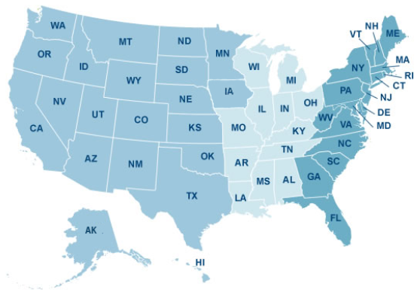
Pension
Recap:
Rate tables/entitlement rates vary based on:
Benefit type
Special Monthly Pension (SMP)
Dependents
Links to the rate tables for the monthly pension rate (MPR):
Current pension rates for Veterans
Survivors Pension benefit rates
Jurisdiction:
Pension Management Center (PMC)
Milwaukee (330) | St. Paul (335)
Alabama, Connecticut, Delaware… | Alaska, Arizona, Arkansas, California…
Notes:
Payments vary based on income and excludable expense such as health care. VA pension can provide a level

Slide 10
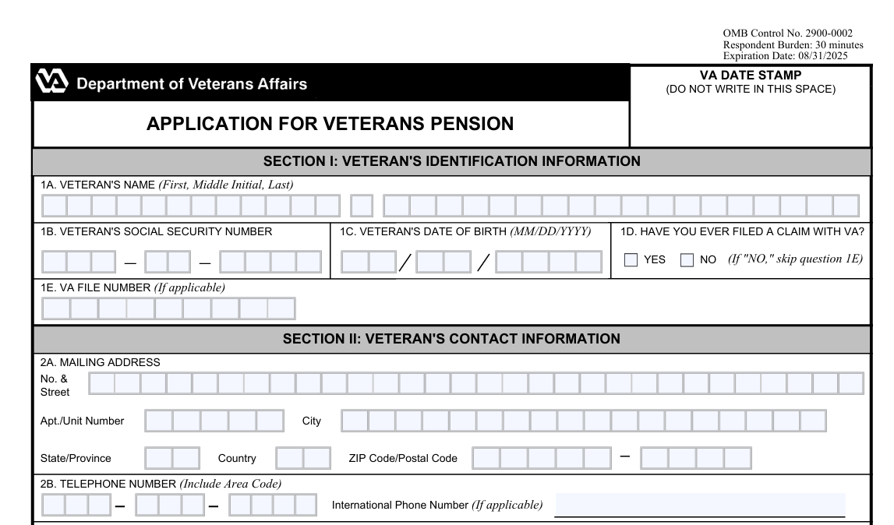
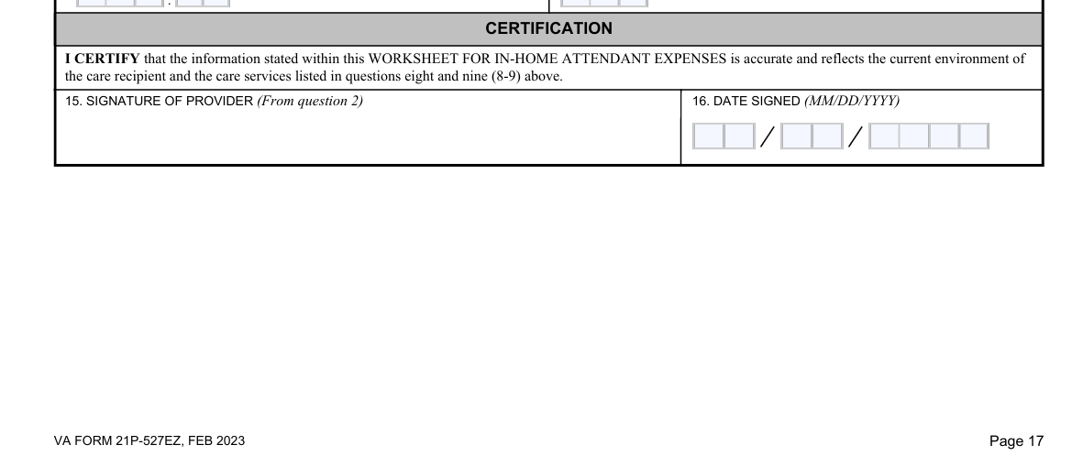
Pension Claims
How to Apply for Veterans Pension: To apply for Veterans Pension, download and complete VA Form 21P 527EZ, “Application for Veterans Pension.”
Additional forms:
VA Form 21P-534EZ (Survivors)
VA Form 21-2680 (Special Monthly Pension)
VA Form 21-0779 (Claimant in a Nursing Home)
VA Form 21P-8416 (Medical expenses)
You can mail your application to the address below:
Department of Veterans Affairs
Pension Intake Center
P.O. Box 5365
Janesville, WI 53547
For additional information on pension benefits visit www.va.gov/pension/.

Slide 11
Pension Claims
Assets are the fair market value of all property that an individual owns, including all real and personal property, unless excluded under 38 CFR 3.275(b).
Fair market value is the price at which an asset would change hands between a willing buyer and seller.
Evaluating Asset Transfers
Did the claimant report transferring assets for less than fair market value during the look back period
Would the asset transfer amount(s) have caused the claimant’s net worth to exceed the limit or further exceed the limit?
Example: A surviving spouse has a joint bank account with a nephew.
Result: Count one half of the joint account value as an asset for the surviving spouse.

Slide 12
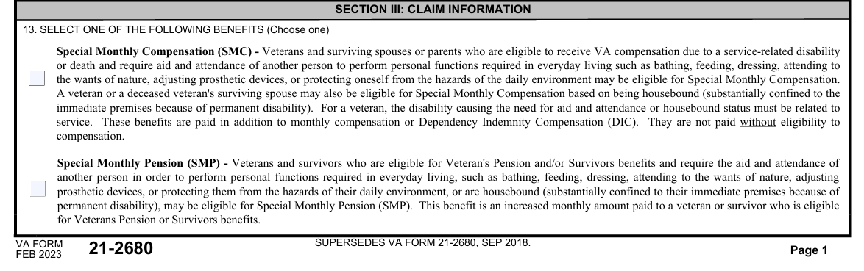

Pension Claims
Aid and Attendance and Housebound Benefits (Special Monthly Pension): Veterans who are eligible for VA pension and require the aid and attendance of another person, or are housebound, may be eligible for a higher maximum annual pension rate.
These benefits are paid in addition to monthly pension and they are not paid without eligibility for pension.
Since aid and attendance and housebound allowances increase the pension amount, people who are not eligible for a basic pension due to excessive income may be eligible for pension at these increased rates.
A Veteran or surviving spouse may not receive aid and attendance benefits and housebound benefits at the same time.
To apply for aid and attendance or housebound benefits, submit a VA Form 21-2680, Examination for Housebound Status
For additional information on aid and attendance and housebound benefits including how to apply please visit www.va.gov/pension/aid-attendance-housebound/.
Notes:
Veterans or their survivors eligible for basic VA pension may qualify for higher payments if they require aid of another person in performing activities of daily living or are housebound.

Slide 13
Additional Training
Talent Management System (TMS) Courses
Introduction to VA Pension (VA 4468828)
Training, Responsibility, Involvement, and Preparation of Claims (TRIP)
Fact Sheets - Veterans Benefits Administration (va.gov)

Slide 14

Questions?
For additional information on pension benefits, please visit www.va.gov/pension/
For specific claim inquires, please contact the Change Management Analyst at vbasdcpoa@va.gov

