Slide 1

U.S. Department of Veterans Affairs
Veterans Benefits Administration
CACVSO
June, 2024

Slide 2
Disability Claims Data
Overall Rating Inventory Data as of COB Saturday, June 1, 2024
Inventory: 949,272
Backlog: 278,563
In FY23, we completed 1,981,854 claims, which is 15.9% more than the record total we completed in FY22.
  So far in FY24, we have completed 1,666,800 claims, which is 27.9% more than at the same time in FY23.
In FY23, we received 2,433,729 claims, which is 39.3% more than the record total we received in FY22.
  So far in FY24, we have received 1,524,219 claims, which is 2.3% more than at the same time in FY23.
PACT Claims Data as of COB Saturday, June 1, 2024
1,689,739 PACT claims received since August 10, 2022.
1,365,855 PACT claims completed since August 10, 2022, of which 1,024,645 (75%) were granted.

Slide 3

VA is delivering more benefits, more quickly, than ever before
FY24 VA had
FY24 VA had
Prior to
In
8K
114
Days completing
(108 were in FY23 alone)
160
Days completing
Or More Claims
9K-
3
Days completing
9,999
66
Days completing
Claims
10K +
0
Days completing
70
Days completing
Claims

Slide 4
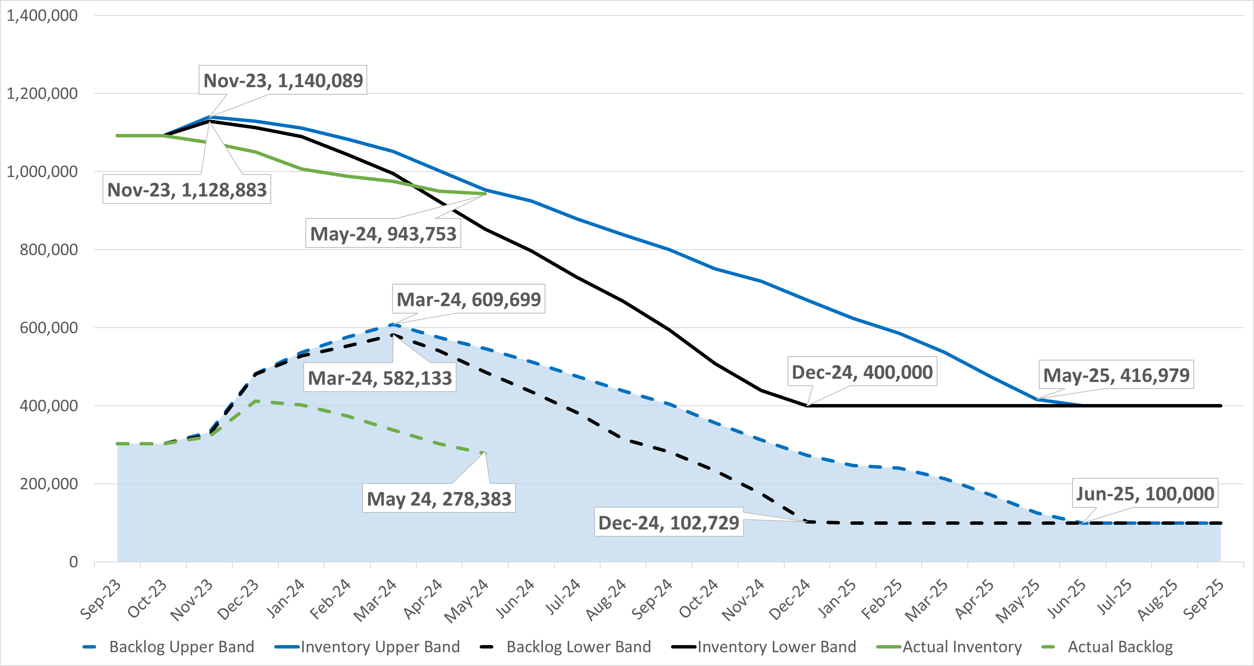
FY24 Inventory and Backlog
 | Expected (Lower Band) | Actuals | Delta
Receipts* | 1,436,013 | 1,517,696 | +5.7%
Hiring* | 1,172 | 1,229 | +4.9%
*Data through May 31, 2024

Slide 5
Medical Disability Examination Office (MDEO)
303% Growth

Slide 6
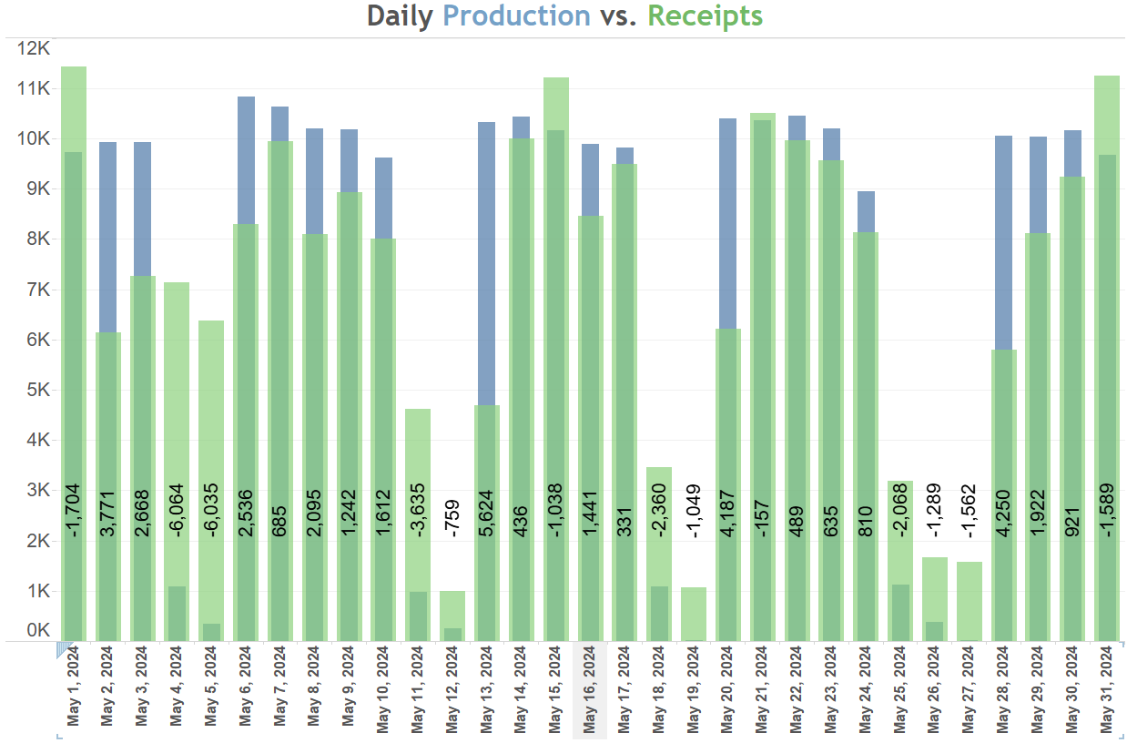
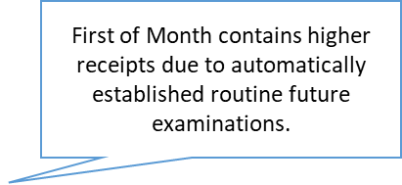


Slide 7


Pension and Fiduciary
Paid $3.5B in Pension benefits to over 280,000 Veterans & survivors in FY23
Veterans Pension Recipients by Period of Service in FY23
10%
Gulf War Era
15,025
4%
World War II
6,042
14%
Korean Conflict
21,524
72%
Vietnam Era
110,977
Provided fiduciary services to 107,650 beneficiaries in FY23
7
Notes:
Our Pension service provides a tax-free, financial need based benefit for wartime Veterans who are permanently and totally disabled or age 65 or older, and their eligible survivors.
As you can see from the slide, the majority of Veterans receiving pensions served in the Vietnam War, but there are some from the Gulf War era and even WWII.
Our fiduciary service provides oversight for VA's most vulnerable beneficiaries who are unable to manage their VA benefits as a result of injury, disease, advanced age, or less than 18 years of age through appointment of fiduciaries. ​
If a beneficiary is unable to manage his or her financial affairs, VA will appoint a fiduciary. The fiduciary, typically family or a friend of the beneficiary but can be other qualified individuals or organizations, must undergo an investigation of their suitability to serve. The fiduciary is responsible to the beneficiary and oversees financial management of VA benefit payments. ​
VBA conducts periodic on-site reviews to ensure fiduciaries are performing their duties satisfactorily and to protect beneficiaries from misuse of their benefits by the fiduciaries.

Slide 8

Home Loan Guaranty
VA’s Home Loan Guaranty program helps Service members, Veterans and their families obtain, retain, and adapt a home or refinance an existing home.
Benefits of VA home loans:
Purchase a home (existing or pre-construction) as a residence.
Interest Rate Reduction Refinancing Loan (IRRRL), also called the Streamline Refinance Loan, can help a homeowner obtain a lower interest rate by refinancing their existing loan.
Cash Out Refinance Loans allow a homeowner to borrow against available home equity.
Typically, no down payment and no mortgage insurance.
Reusable benefit.
VA’s Home Loan Guaranty Program also:
Provides Specially Adapted Housing (SAH) grants for Veterans with certain severe service-connected disabilities.
Issues direct loans to Native American Veterans or Veterans married to Native American non-Veterans living on Federal Trust land.
Helps borrowers in default avoid foreclosure.

Slide 9
NAR Settlement Update
Buyer’s Broker Commission
On October 31, 2023, a class action case Sitzer/Burnett v. NAR, a jury awarded the plaintiffs $1.785 billion in damages.
A significant advantage for Veteran looking to purchase a home is the VA Home loan. These loans offer competitive rates and terms, require no down payment, and do not necessitate private mortgage insurance-- making VA loans incredibly valuable.
VA’s Code of Federal Regulations (CFR) Series 38 C.F.R. § 36.4313(b) specifies that, generally, a Veteran cannot pay for real estate brokerage charges.
The NAR settlement has created uncertainty as to how buyer’s agents will be compensated and what amount of compensation is reasonable for such services.
VA stresses Veterans or their representation can continue to negotiate commissions with sellers. The NAR settlement DOES NOT prohibit the seller from paying the buyer’s agent’s commission, but it could make it more difficult for Veterans to have an offer accepted.

Slide 10
NAR Settlement Update
Buyer’s Broker Commission
In anticipation of NAR’s rule change in August 2024, VA has taken action to preserve a Veteran’s ability to remain competitive during the home buying process by enacting a temporary local variance for certain Buyer-Broker fees.
After real estate brokerage markets restabilize, VA will develop permanent policy, through a notice-and-comment rulemaking to revise 38 C.F.R. § 36.4313(b),

Slide 11
Insurance
12th largest Insurance provider in the U.S.
Insured 5.6 million Veterans, Service members, and family members in FY23.
Provided over $1.5 trillion in coverage under 10 lines of protection in FY23.
Paid insurance disbursements in an average of 4 days at 98% accuracy in FY23.

Slide 12
Transition Assistance Program (TAP)
The FY 24 version of the course not only highlights the value of using VA- accredited Veteran Service Organizations (VSOs) for claims assistance, but it also has 45-minute sessions built into the curriculum for up to 3 (three) VSO representatives: Each of the three representatives have 15-minutes to inform transitioning Service members about their free professional assistance that can help to develop claims and apply for the benefits they’ve earned and deserve —health care, disability compensation and more.
VSOs also provide information on the unique programs and resources available from their respective organizations.
How to get involved TODAY!
We urge you to participate in this initiative.
Connect with TAP Managers at a nearby DoD installation and use the VSO Registration Tool to find VA BAS courses and register to present: https://dvagov.sharepoint.com/sites/vbaoted/apps/vsoReg/vsoEventRegistrationMain.aspx.

Slide 13
Education
VA Education benefits advance the education and skills of Veterans, Service members, family members and survivors according to the following eligibility standards:
Post-9/11 GI Bill
After 9/10/2001 - served at least 90 aggregate days on active duty and still serving or honorably discharged; honorably discharged due to a service-connected disability after 30 days of aggregate service, or awarded the Purple Heart.
Fry Scholarship - A child or spouse of a person who, after 9/10/01, dies in the line of duty while serving on duty as a member of the Armed Forces, or from a service-connected disability while a member of the Selected Reserve.
Survivors and Dependents Educational Assistance Program
Available to eligible dependents of Veterans who are permanently and totally disabled due to service-related conditions, and of Veterans who died while on active duty or as the result of a service-related condition.
Montgomery GI Bill
Select Reserve
For Reservists with a six-year obligation in the Selected Reserve who are actively drilling.
Montgomery GI Bill
Active Duty
Enrollees pay $100/month for
12 months to receive monthly Education benefits after completing a minimum service obligation.

