Slide 1
Current State of Patient Advocacy at
Veterans Health Administration
Office of Patient Advocacy
Ann E. Doran, MHSM, MPA, CPHQ, CPHRM
HMC (AW/FMF), USN, Retired
Executive Director, VHA Office of Patient Advocacy
ann.doran@va.gov
(202) 461-7607

Slide 2
AGENDA
Background on the Office of Patient Advocacy
Introduction to Patient Advocacy
Transitions in models of advocacy
Major Initiatives
Patient Advocate Tacking System –Replacement (PATS-R)
Veteran Centered Complaint Resolution process
Servant Leadership
Patient Advocate Program Outcome Measures
Working with Congress
OPA Outreach- Internal and External
Current and Future work
Notes:
OPA was stood up in 2017 to

Slide 3
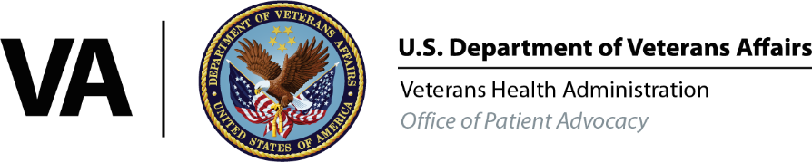
VHA OFFICE OF PATIENT ADVOCACY’S ROLE
The VHA Office of Patient Advocacy (OPA) was established on July 17, 2017, as required by the Comprehensive Addiction and Recovery Act (CARA), Public Law 114-198
This public law was instrumental in highlighting the importance of Patient Advocates and
their role to Veterans, families, caregivers, survivors, and other stakeholders
Veteran Centered
OPA’s Mission
Provide leadership and support to the Patient Advocate community, empowering compassionate service that honors the voice of the Veteran, their families, caregivers, and survivors.
Collaboration
Empathy
OPA
Core Values
Accountability
Integrity

Slide 4









VHA OFFICE OF PATIENT ADVOCACY’S ROLE
Implement responsibilities outlined in legislation
Develop Patient Advocacy policy
Deploy VHA’s complaint management approach
Provide Patient Advocacy Training with reporting
Modernize the Patient Advocate Tracking System Replacement (PATS-R) technology
Inform Senior Leadership on Veteran complaint national data trends
Conduct site visits to ensure alignment with OPA policy

Slide 5
VHA PATIENT ADVOCACY
There are approximately 650 Patient Advocates (PAs) across VHA. Most PAs are located at the VA medical facility. Some larger community-based outpatient clinics have dedicated PAs on site. PAs report to and are supervised by the local leadership. The Patient Advocate office has a direct reporting line to the VAMC Director (may report to an Executive Leadership Team member)
OPA provides policy, guidance, and job-related resources, but not direct supervision to field PAs
There is also a VISN Patient Advocate (VPAC) who supports standardization, training, and planning across facilities in their VISN
PAs collaborate with Service Line Liaisons or Service Line Advocates to resolve Veteran complaints
The Patient Advocate Tracking System-Replacement has helped facilitate cultural transformation where Patient Advocacy is Everyone’s Responsibility
The goal – resolving complaints at the lowest level, ensuring Veteran satisfaction

Slide 6
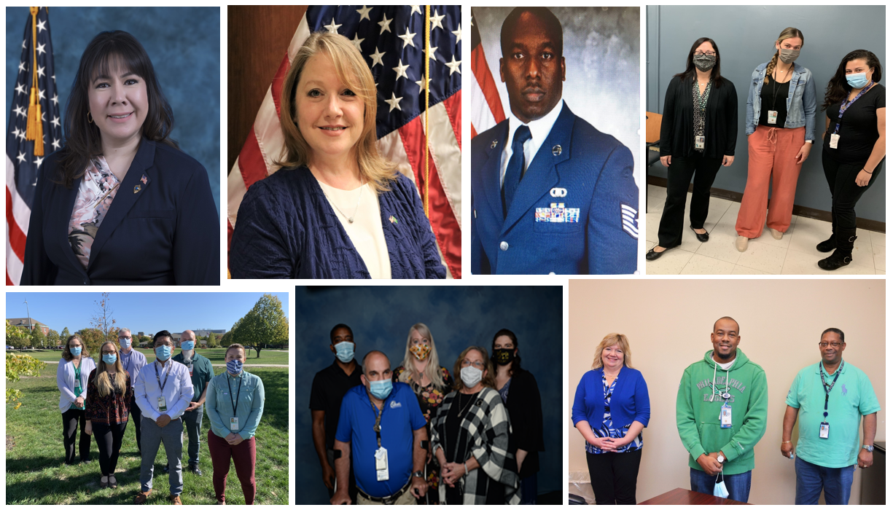
WHAT IS A PATIENT ADVOCATE?
The CARA legislation defines the role of a Patient Advocate to resolve complaints by Veterans with respect to health care furnished under the laws administered by the Secretary that cannot be resolved at the point of service or at a higher level easily accessible to the veteran.
A “liaison” between the Veteran and the hospital.
Advocate to ensure the Veteran’s voice is heard.
Works with other staff members to address questions and problems.
May be called: patient advocate, patient representative, patient liaison, patient relations, veterans experience, patient experience, consumer advocate, customer service rep, crisis resolution specialists, ombudsman, and others.
Are known as the ‘eyes and ears’ of the hospital.

Slide 7
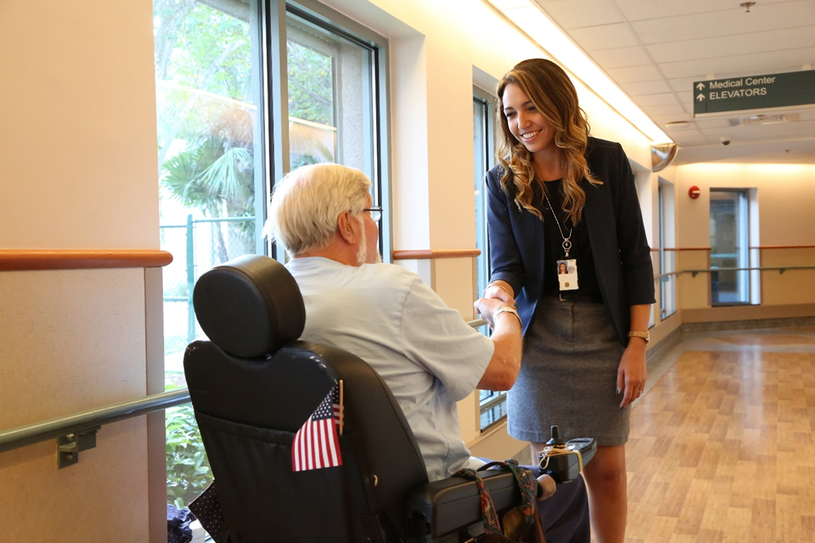
WHAT DOES A PATIENT ADVOCATE DO?
Managing the Grievance and Complaint process
Educating staff and Veterans on Patient Advocacy, rights and responsibilities
Explaining a variety of policies and procedures to Veterans
Participating in rounding for Veterans and staff
Providing excellent Customer Service
Using Mediation/Conflict Resolution when a patient and staff/provider are having difficulty in communicating
Providing de-escalation when a patient’s or family member’s behavior is escalating
Reporting suspected abuse or neglect
Providing support to, and facilitation of, the management of patients who are struggling with understanding their treatment plan or navigating the healthcare system
Reporting, trending and identifying needed system improvements to Leadership
Serving on various committees to share the Veterans voice

Slide 8
Transition of Patient Advocacy Model
Centralized
Usually is the single POC for all patient inquiries
De-Centralized
PA collaborates with service line leaders or liaisons on complaint resolution and service recovery
Improved Patient Experience
Trust is restored when the place where the service failure occurred enters into complaint resolution and service recovery
Complaint resolution is more comprehensive and more timely
Complaints are resolved at the lowest level (service line)
Complex complaints that cross multiple service lines are sent to PA for coordination and resolution
PA reviews and resolves all complaints/grievances
Response time is extended as complaint management is being conducted through email and phone calls with service lines.
Resolutions may not be comprehensive because the PA only has a snippet of what the real issue is
Patients receive comprehensive complaint resolution from the source of the complaint and can ask questions and have a greater understanding of what occurred and why

Slide 9
MAJOR INITIATIVES
Among the many projects and initiatives that OPA has worked on, the Patient Advocate Tracking System –Replacement (PATS-R) and the Veteran Centered Complaint Resolution process (VCCR) have the most direct impact upon our Veterans.
VCCR
PATS-R

Slide 10

PATIENT ADVOCATE TRACKING SYSTEM – REPLACEMENT
Cultural Transformation at its best!
A closed system – doing away with case management by email
Requires VAMCs to implement Service Level Advocates – providing resolution of issues at the lowest level (and earliest moment) possible
As all information is in one system, allows transparency across VHA
Eliminates redundant data entry through system integrations
Real time feedback allows for faster continuous improvements in targeted areas
Patient Advocate Tracking System- Replacement
Embeds a culture where
Patient Advocacy is Everyone’s Responsibility
Notes:
Requirement of the 2016 OIG report due to legacy system not being adequate for complaint capture, not being consistently used by Patient Advocates, and security issues identified

Slide 11
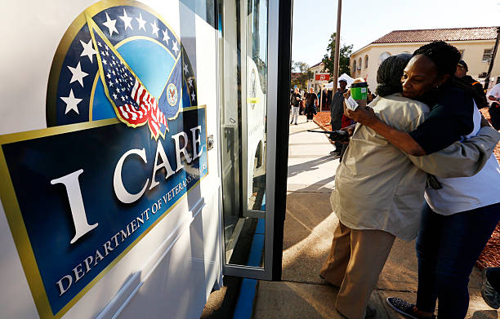
VETERAN CENTERED COMPLAINT RESOLUTION PROCESS (VCCR)
VCCR is VHA’s standardized holistic approach to connect with our Veterans to receive, identify, resolve, document, and communicate the resolution outcome of all complaint and inquiries.
The VCCR process integrates with PATS-R national deployment and aligns with both the Secretary and Under Secretary for Health’s vision for world class customer service and modernization.

Slide 12
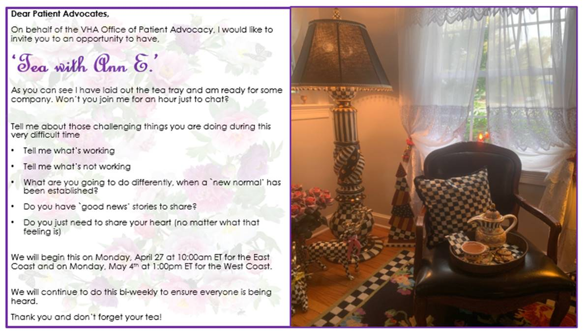
SUPPORTING PATIENT ADVOCATES

Slide 13
PATIENT ADVOCACY PROGRAM OUTCOME MEASURES
In June 2021 an EDM was signed by the Governing Board requiring VA Medical Centers to implement and monitor Patient Advocacy Program Outcome Measures. The purpose was to ensure that an effective, efficient, appropriately staffed Patient Advocacy Program was in place in each facility.
PA PROGRAM OUTCOME MEASURE
Patient Advocate Coverage
Comprehensive Complaint Resolution
Facility Wide Active Engagement in Patient Advocacy
Entry and Management of Congressional, Presidential Letters and Integration Cases
Process Improvement Driven by Veteran Feedback
Facility Staff Trained and Provisioned in PATS-R

Slide 14
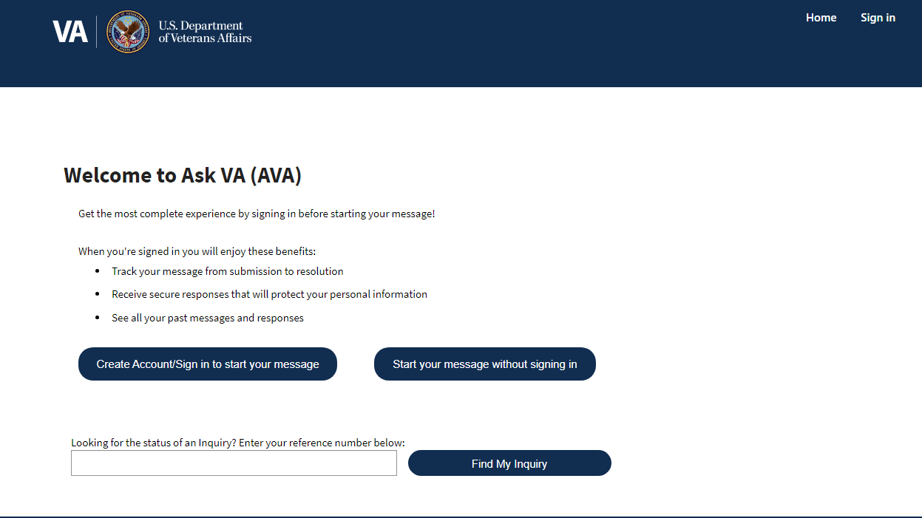
WORKING WITH CONGRESS
Public Law No: 117-175 requires the Director of the Office of Patient Advocacy to establish, not later than 18 months after the date of enactment, an information technology (IT) system that will allow Veterans or their designated representatives to electronically file a complaint that will be received by the appropriate patient advocate and to view at any time the status of the complaint, including interim and final actions that have been taken to address the complaint.

Slide 15
VA/OPA INVOLVEMENT
Workplace Violence Prevention Committee
LBTGQ Committee
Patient Experience Committee
Organizational Health Committee
VISN Executive Leadership Committees
Survivors Assistance and Memorial Support
Beneficiary Travel
Appeals modernization
Women's Health
Prosthetics
Harassment
ISTAND
DOD
COMPACT Act Committee
PACT ACT tiger team
Caregivers Support program

Slide 16
OUTREACH TO VETERANS
OPA has begun working with other VA offices who are holding Veteran summits, seminars, conferences, and outreaches to request to participate and educate Veterans about Patient Advocacy
In FY23-24 the OPA Leadership team has presented at different meetings to promote Patient Advocates at the local level:
CDCE annual conference
2023 VA Transition Summit
2023 OPA National VSO meeting to update on OPA program updates
Veteran listening sessions during OPA Field program assessments (x9)
Voluntary Services National Advisory Committee
2024 OPA National VSO meeting to update on OPA program updates (9/4/2024)
2024 quadrennial Women Veteran Healthcare Summit (9/5-7/2024)
2024 Suicide Prevention Keynote speaker
Beryl Institute
Additionally Patient Advocates are becoming more involved with outreach events in their communities to promote Patient Advocacy services.

Slide 17

PATIENT ADVOCATE NATIONAL CONFERENCE
5 Pre-conference activities
10 Keynote speakers
15 General Sessions
13 Break-out sessions
4 Fireside Chats
42 SESSIONS!
Goal: Educate, support, appreciate

Slide 18


Slide 19
CURRENT AND FUTURE FOCUS OPPORTUNITIES
Educate MCDs on VHA Directive 1003.4 revisions
Service Level Advocacy
Patient Advocate Workforce
Trended Data
Patient Advocate National Conference
Resume broader deployment of Service Level Advocacy
Assess and analyze program outcome measures
Outreach to Veterans
Engagement with VSOs
Promising Practices repository
QI initiatives on PATS-R documentation
On-site program assessments

Slide 20


It’s what we do!
I
C
R
E
Advocacy

