Slide 1
Veterans Housing and Homelessness Prevention (VHHP) Program
California Department of Veterans Affairs (CalVet)
California Department of Housing and Community Development (HCD)
California Housing Finance Agency (CalHFA)

Slide 2
Topics
Veteran Homelessness in California
Housing Affordability for Veterans in California
VHHP Program Overview
VHHP Program Performance
Statewide Tour of Completed VHHP Locations

Slide 3
Veteran Homelessness in California Defined Terms in Veteran Homeless Count (aka: PIT Count)
Veteran homelessness is tracked annually through a process called the Point in Time (PIT) Count carried out by Continuums of Care.
Bi-annually, a volunteer-based physical count of unsheltered living on the streets.
Emergency Shelter (ES) – temporary, no lease
Transitional Housing (TH) – up to 24 months stay, lease/agreement
Safe Haven (SH) – type of supportive housing for severe mental illness, hard-to-reach, prohibits illegal drugs

Slide 4
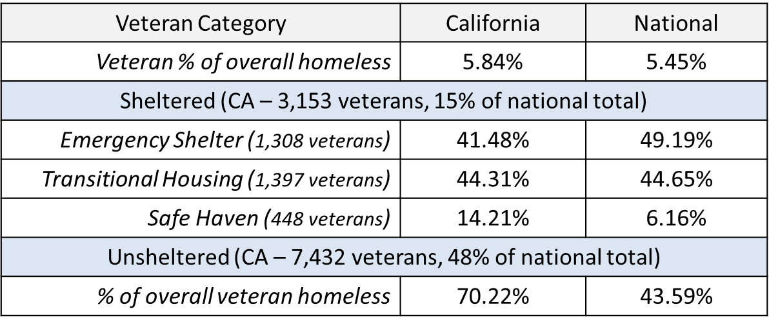
Veteran Homelessness in California 2023 Point in Time (PIT) Count (January 2023)
10,589 Veterans experiencing homelessness in CA (30% of Nation)
30% of Veterans experiencing homelessness find shelter in CA

Slide 5
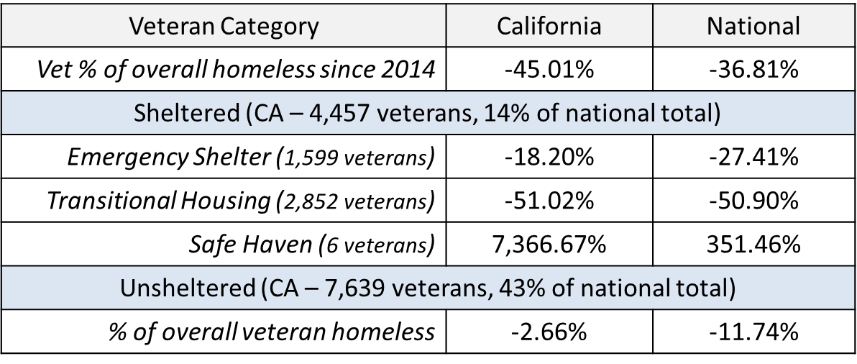
Veteran Homelessness in California Point in Time (PIT) changes since 2014
(2014) 12,096 Veterans experiencing homelessness in CA, 37% sheltered
Veterans were 10.6% of overall homeless in CA

Slide 6
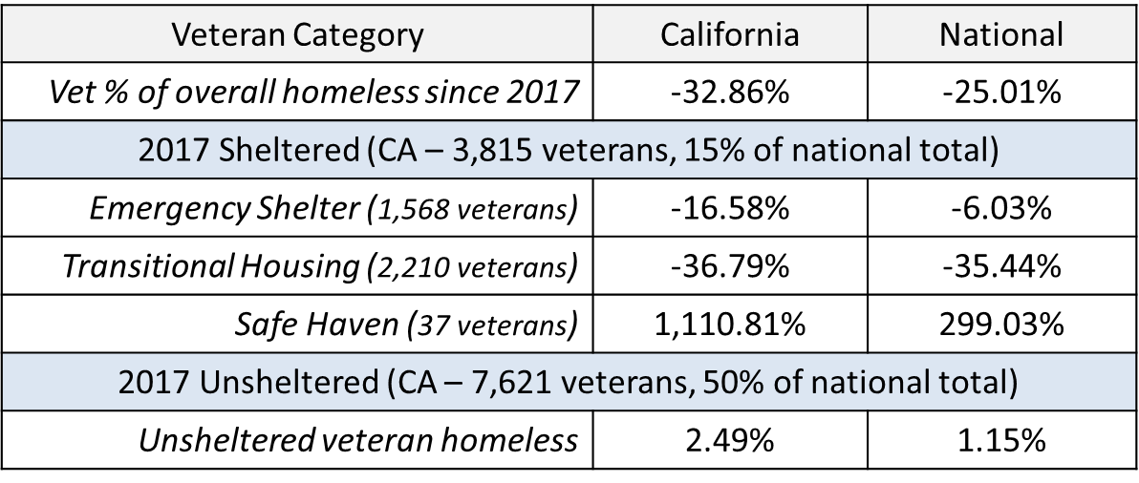
Veteran Homelessness in California Point in Time (PIT) changes since 2017
(2017) 11,436 Veterans experiencing homelessness in CA, 33% sheltered
Veterans were 8.6% of overall homeless in CA

Slide 7
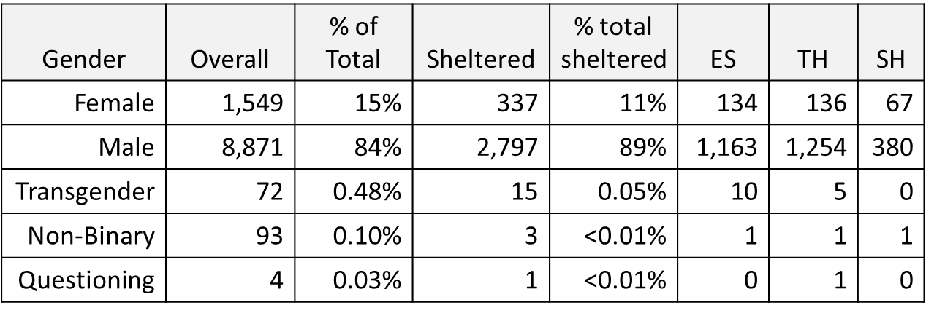
Veteran Homelessness in California Gender Analysis – California Sheltered Veterans
(2023) Male is only gender category sheltering more than total share of veteran homeless in CA

Slide 8
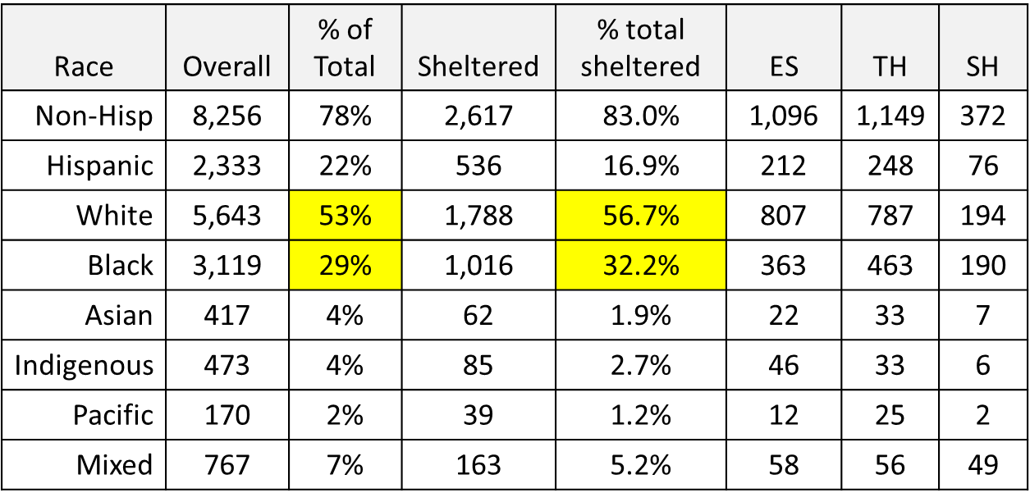
Veteran Homelessness in California Racial Analysis – California Sheltered Veterans
(2023) White and Black Veterans are the only race categories sheltering more than total share of veteran homeless in CA

Slide 9
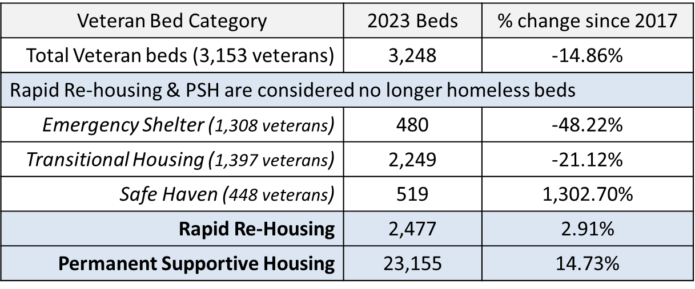
Veteran Homelessness in California Housing Inventory Count (HIC)
Like the PIT Count, The HIC is reported by Continuums of Care to US HUD during the last 10 days of January
(2023) Major increase in SH utilization, more Veteran TH beds than utilized
Notes:
No Veteran specific count in 2014.

Slide 10
Veteran Homelessness in California Summary on Veteran Homelessness after 10 years with VHHP
4% CA reduction veteran homelessness since 2014, compared to a national reduction of 13%.
1% increase since 2017, compared to 11% national reduction
% of homeless veterans sheltered has declined by 29% since 2014, 9% decline for general population.
--------------------------------------------------------------------------------
59% CA increase in general homelessness since 2014, compared to 13% national increase.
38% increase since 2017, compared to 19% national increase
% of general homeless sheltered has declined by 35% since 2014, with 109% increase nationally.

Slide 11
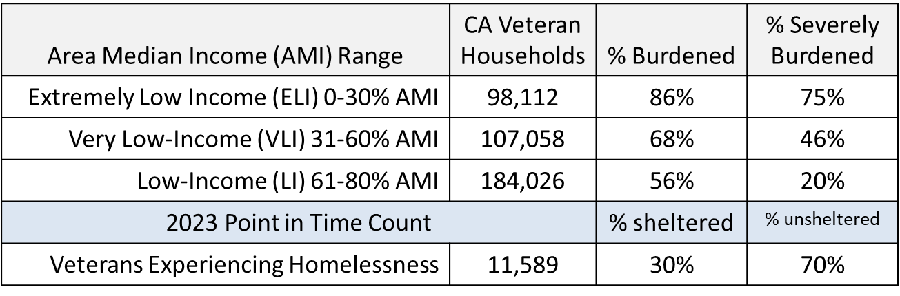
Housing Affordability in California
Veterans are burdened (SB) by housing costs in CA*
(Burdened = spending more than 30% of income on housing costs)
(Severely Burdened = spending more than 50% of income on housing costs)
*Public Use Microdata Sample (PUMS) data (US Census Bureau)

Slide 12
VHHP Program Overview
Proposition 41 passed in 2014 (AB 639)
$600 million through Notice of Funding Availability (NOFA) competitive award process
Affordable multifamily rental housing – new construction, acquisition & rehabilitation
Partnership between CalVet, the California Department of Housing and Community Development (HCD), and California Housing Finance Agency (CalHFA).

Slide 13
VHHP Program Overview Key Components of the VHHP Program
Permanent Loan Financing, Not a Grant
Prioritizes ELI (30% AMI), and homeless (permanent supportive housing (PSH), transitional housing)
Supportive services for veterans experiencing homelessness
Services coordination for income restricted tenants (general affordable housing)
Certified Disabled Veterans Business Enterprises (DVBE) receive at least 5% of total construction cost

Slide 14
VHHP Program Overview Key Eligibility Requirements for VHHP Funding
At least 50% of assisted units restrict occupancy to veterans with extremely low income (ELI)
At least 50% of ELI units to be PSH, with adequate Supportive Services Plan/Resident Services Coordination Plan
Housing First, Coordinated Entry System commitment
25% of total units restrict occupancy to veterans
10% of PSH units prioritized for veterans who are ineligible for VA health care
Experienced project sponsor, on-site lead service provider/resident service coordinator
Committed construction and permanent funding sources
Required site control and reasonable accessibility to public transit, public schools, public parks/facilities, and proximity to services and amenities

Slide 15
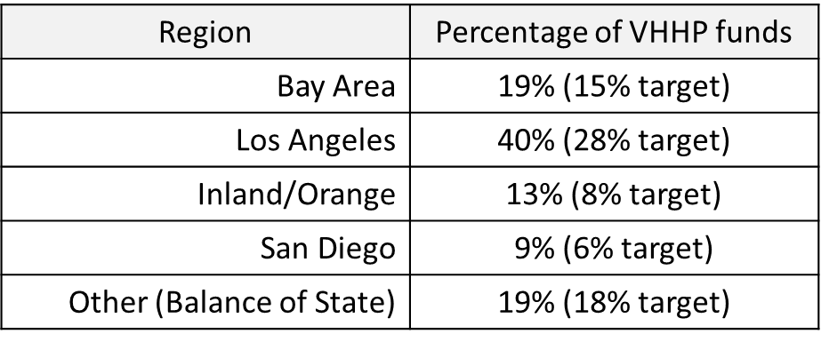
VHHP Program Goals & Progress Funding Distribution
Award $75 million annually
$79 million per round average
Prioritize developments in areas with especially high concentrations of California’s most vulnerable veterans while preserving funding for other areas
Leverage public and private fiscal resources, promote partnerships
85% of development costs leveraged from other sources, 52% of units are VHHP

Slide 16
VHHP Program Goals & Progress Income Level Targeting
House veterans at a variety of income levels, with a focus on veterans experiencing homelessness
(ELI (0-30% AMI), very low income (VLI) (31-50% AMI), low income (LI) (51-80% AMI))
Prioritize veterans with ELI, and PSH for veterans experiencing homelessness
83% permanent supportive housing, 17% general affordable
Income Range | % of VHHP units
Extremely Low-Income | 66%
Very Low-Income | 27%
Low Income | 7%

Slide 17
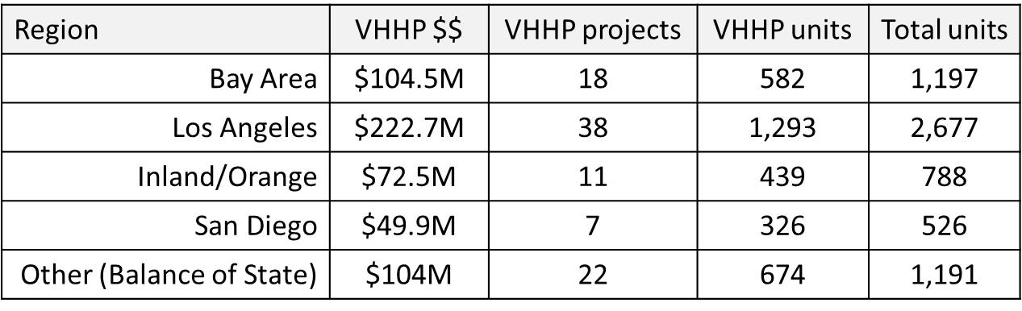
VHHP Program Goals & Progress VHHP Housing Estimates
Cumulative Totals for VHHP (through Round 7)
$553.6M awarded to 96 projects
Expected Housing Units
VHHP: 3,314, 53% HUD-VASH
Total: 6,379

Slide 18
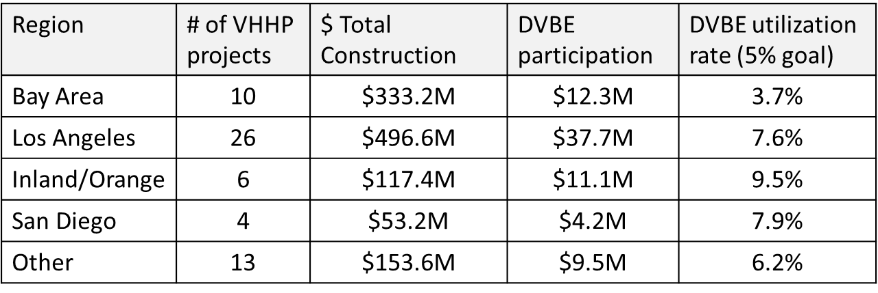
VHHP Housing Results & Economics With DVBE Utilization in VHHP
As of Dec. 2023:
56 VHHP assisted projects completed and leased or leasing
2,080 VHHP units currently leased or in process
Total (hard) cost of construction: $1.15 billion
Paid DVBE participation: $74.8 million, 72 DVBEs, 6.49%

Slide 19
Completed
VHHP
Projects

Slide 20
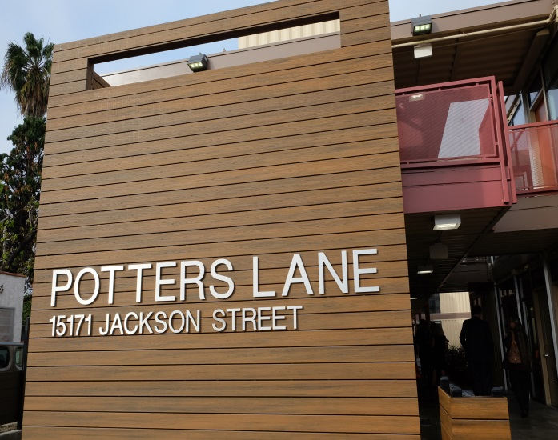
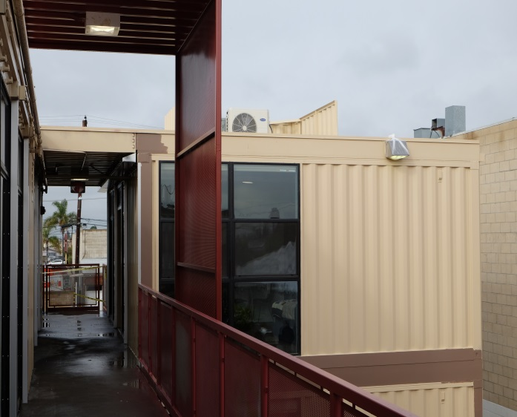
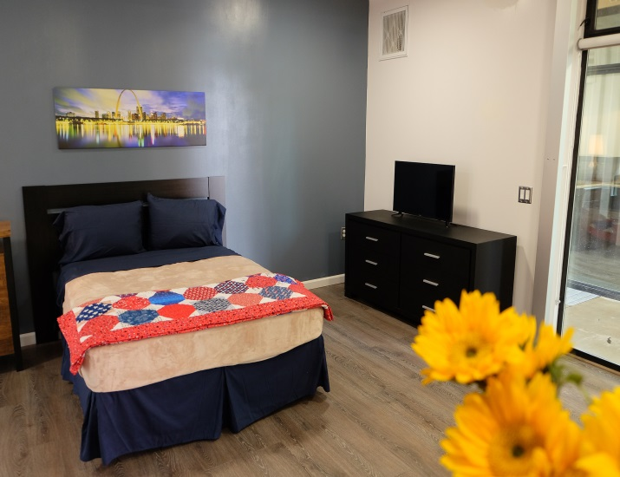
Potters Lane Midway City
VHHP Loan: $1.8 million
15 1BD Veteran Units (8 HUD-VASH)
100% Veteran
Modular system w/ shipping containers
Central activity courtyard
Gardening area

Slide 21
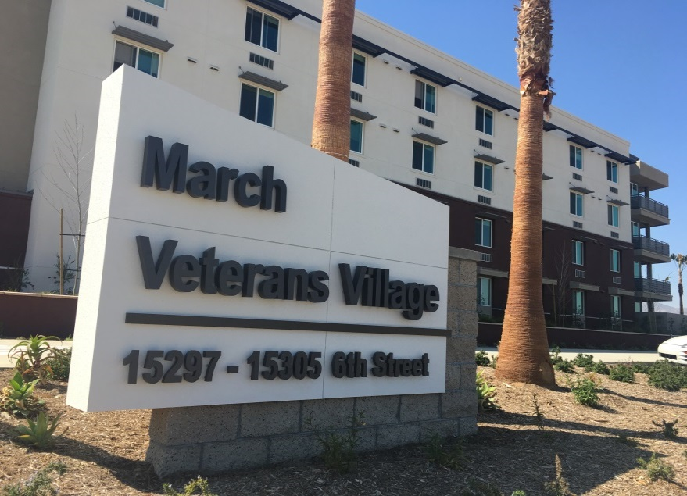
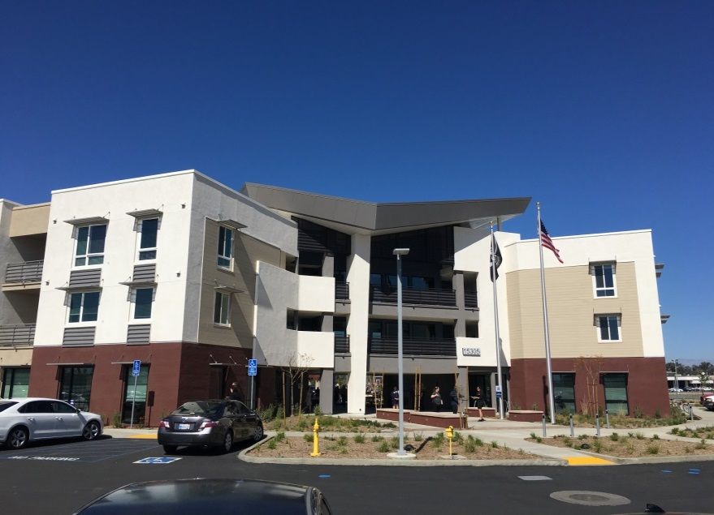
March Veterans Village Riverside
VHHP Loan: $8.2 million
136 Veteran Housing Units (66 assisted through VHHP – Supportive Housing)
70 units affordable housing (50-60% AMI)
Lead Service Provider: US Vets
Community Room

Slide 22
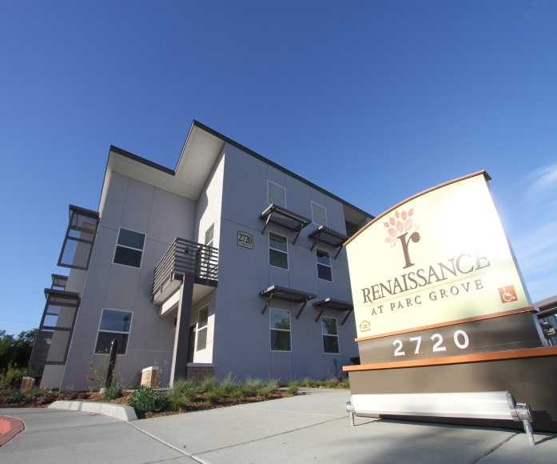
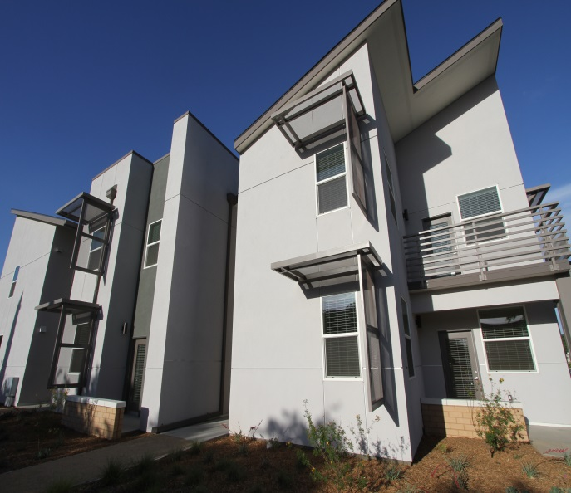
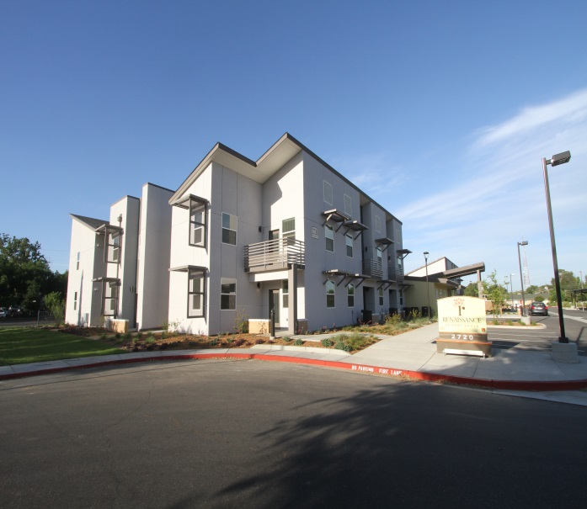
Renaissance at Parc Grove Fresno
VHHP Loan: $2.6 million
39 Veteran Housing Units (All Veteran)
Across the street from the VA Hospital and homeless services

Slide 23
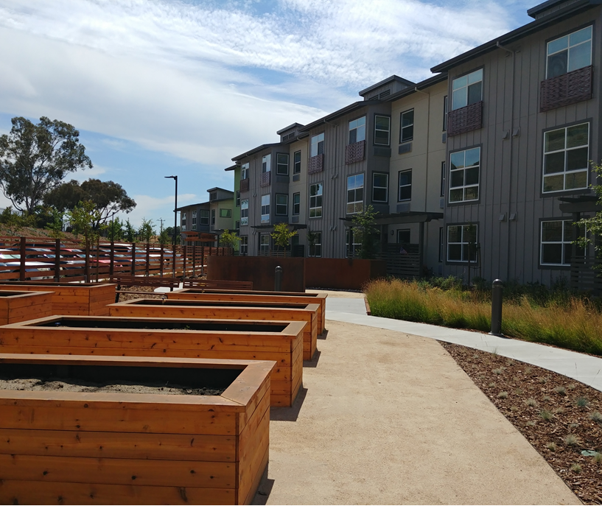
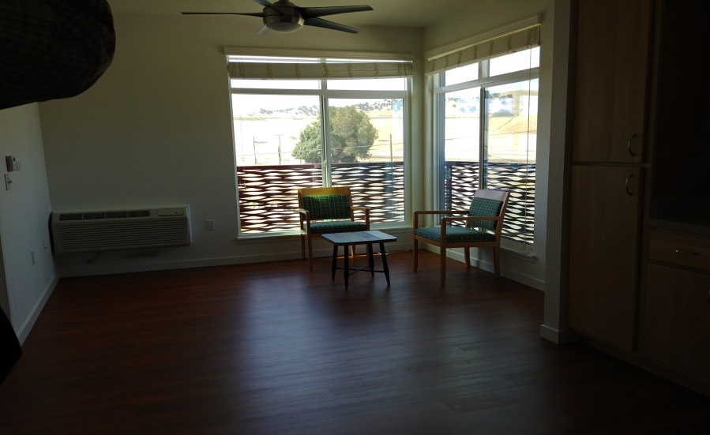
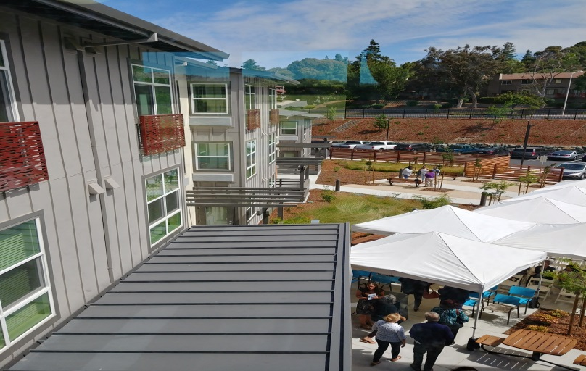
Tabora Gardens Antioch
VHHP Loan: $4.3 million
33 Veteran Housing Units (12 SH)
85 Total Units (all 1BD)
Computer Room
Activity Room
Garden with a Meditation Area

Slide 24
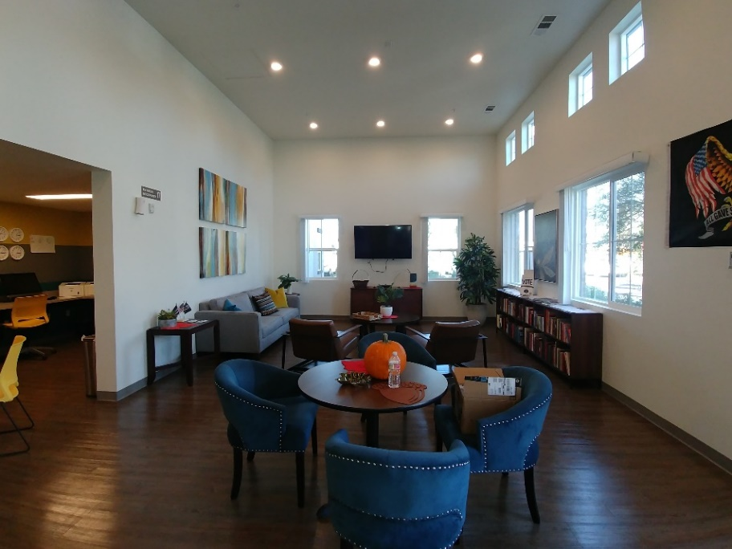
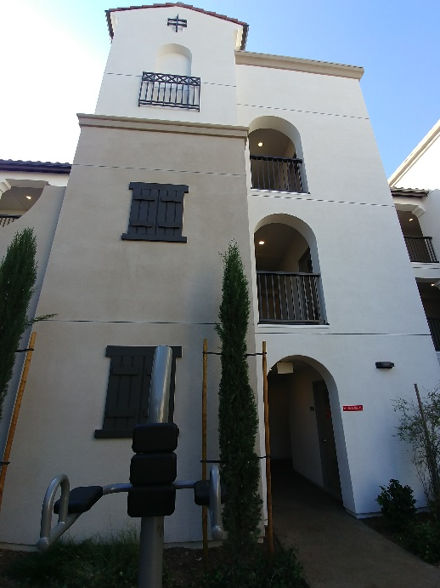
Liberty Village Beaumont
VHHP Loan: $3.8 million
37 Veteran Units (21 serving veterans experiencing homelessness)
On site HUD-VASH social worker

Slide 25
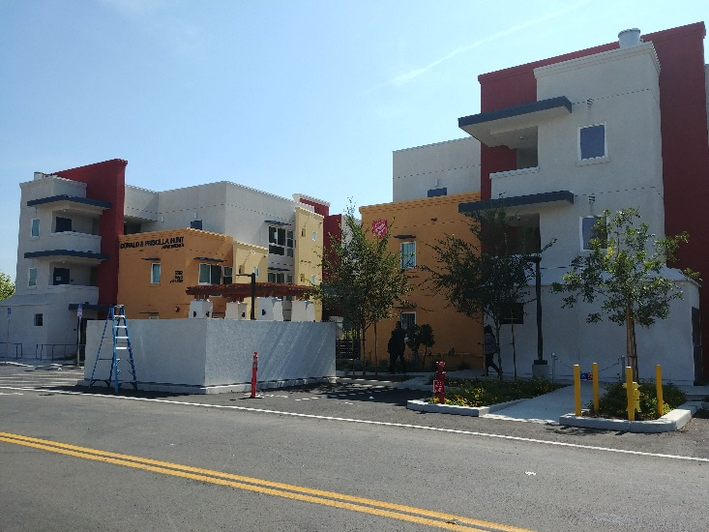
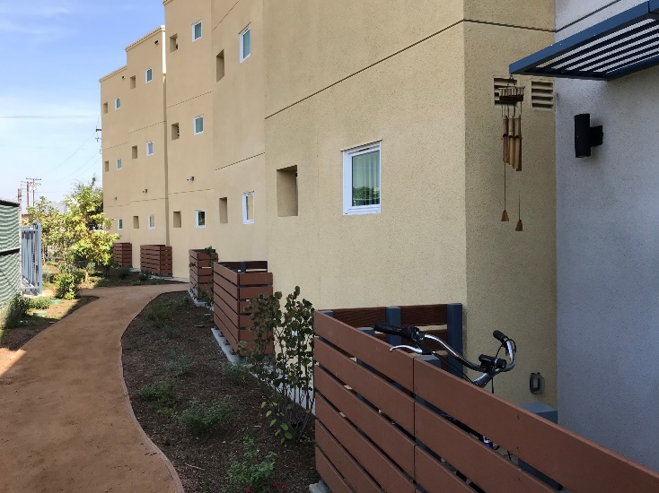
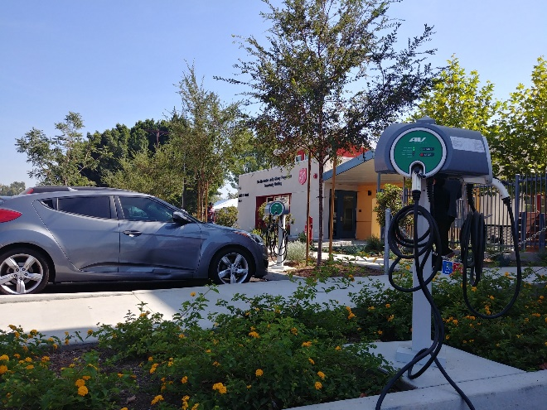
Donald & Priscilla Hunt Apartments Bell
Lead Service Provider: Salvation Army
VHHP Loan: $4.5 million
31 veteran units (all serving homeless) w/HUD-VASH
64 total units (50% AMI affordable housing

Slide 26
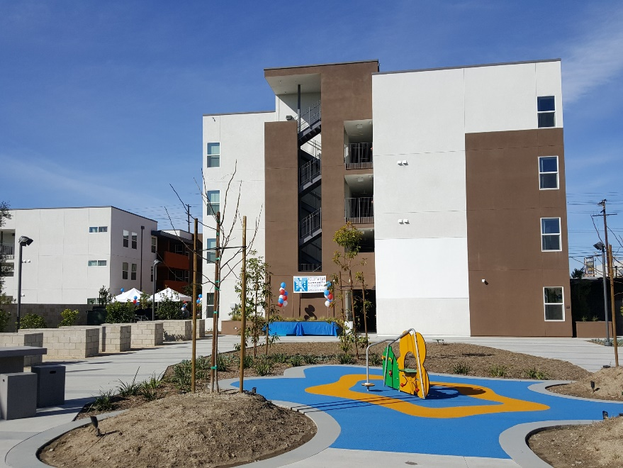
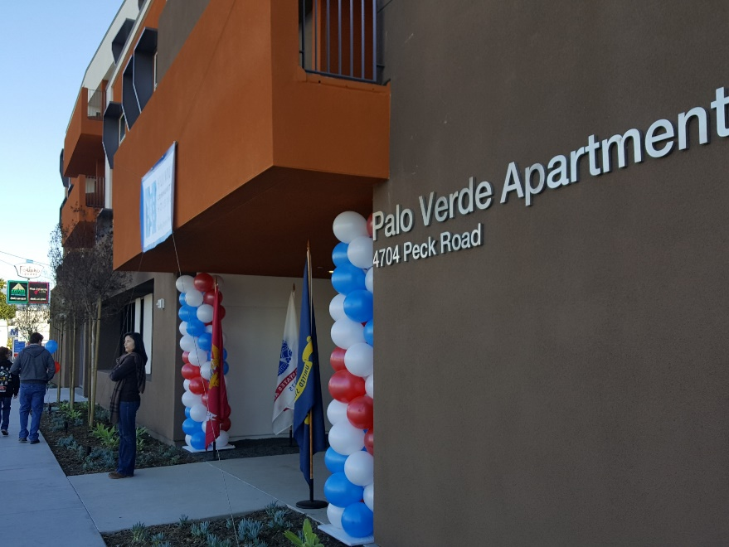
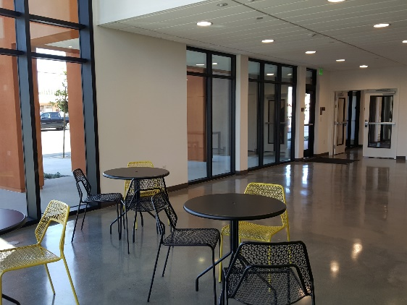
Palo Verde Apartments El Monte
VHHP Loan: $3.5 million
Services with New Directions for Veterans
Onsite computer lab
25 veteran units
48 total units (50% AMI affordable housing)
1, 2, & 3 BD apartments

Slide 27
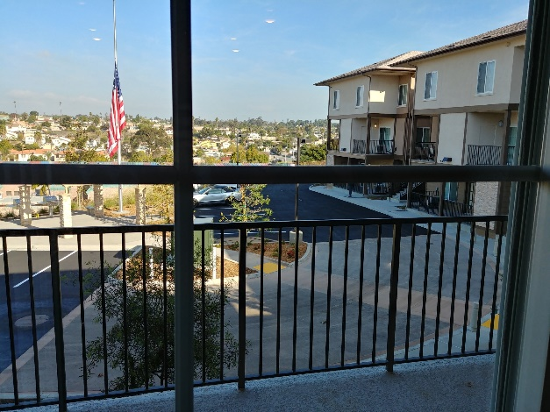
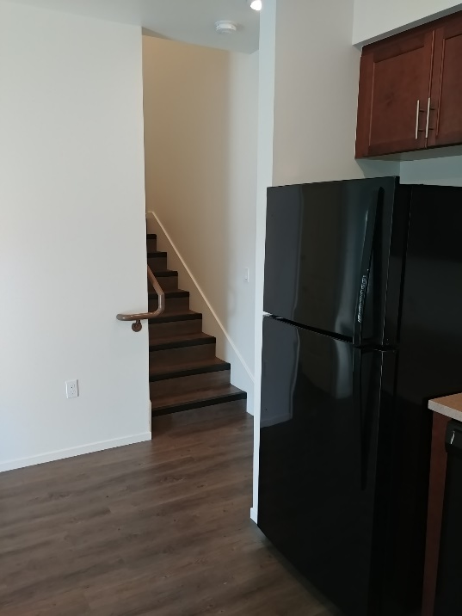
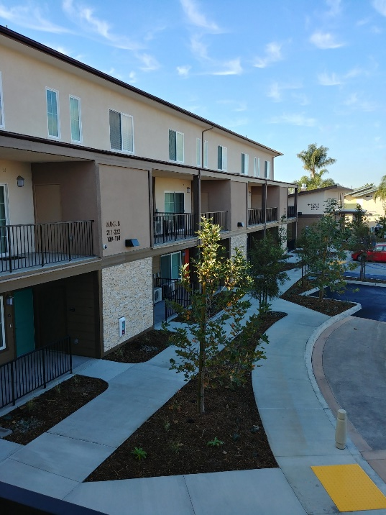
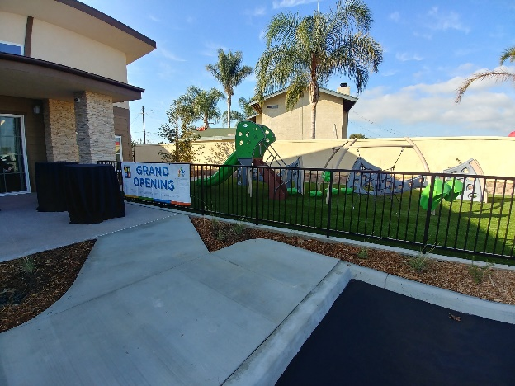
Vista del Puente Apartments San Diego
VHHP Loan: $3.4 million
26 Veteran units (all supportive housing)
51 Total units (8 affordable housing at 60% AMI)
1, 2, & 3BD units, family friendly

Slide 28
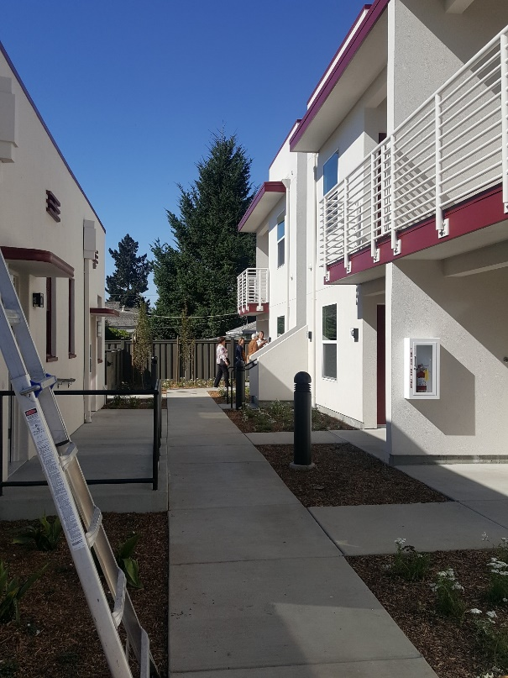
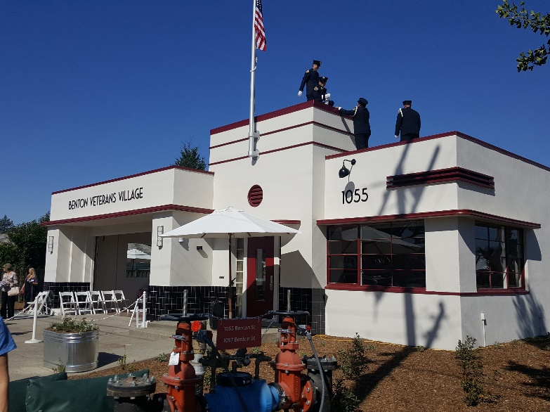
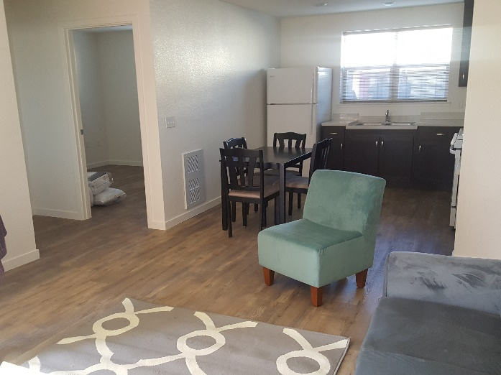
Benton Veterans Village Santa Rosa
VHHP Loan: $1 million
Converted fire station
6 Veteran units (HUD-VASH)

Slide 29
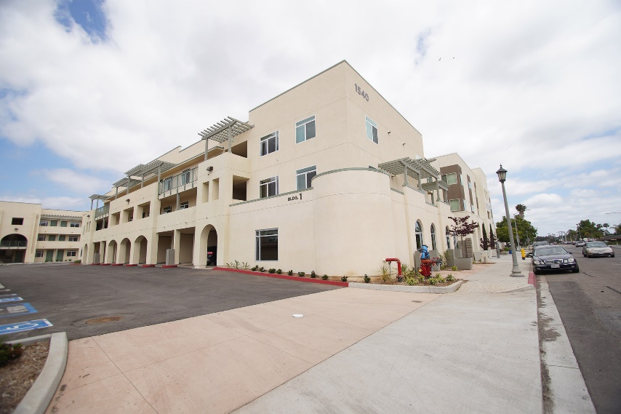
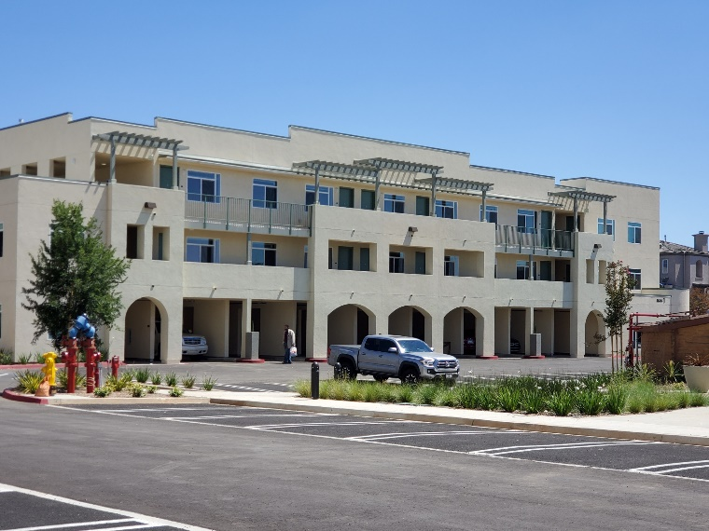
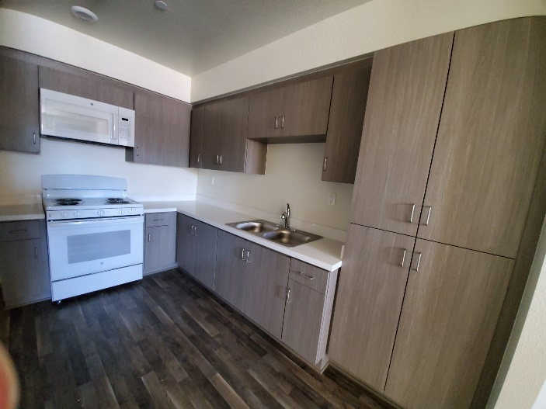
Veterans Village of San Diego Escondido
VHHP Loan: $6.5 million
54 veteran units, mix of permanent supportive housing and general affordable
Lead Service Provider: VVSD
Mix of 1, 2, and 3 bedroom units

Slide 30
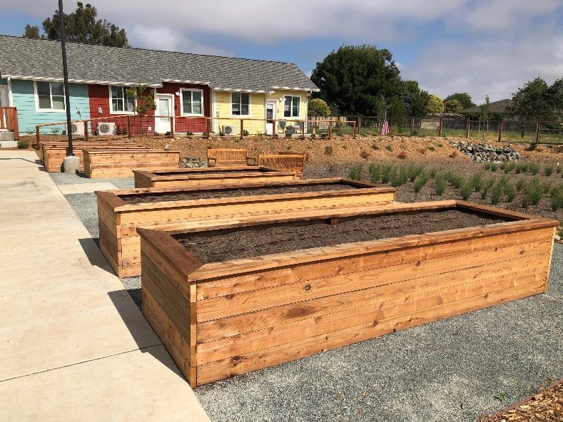
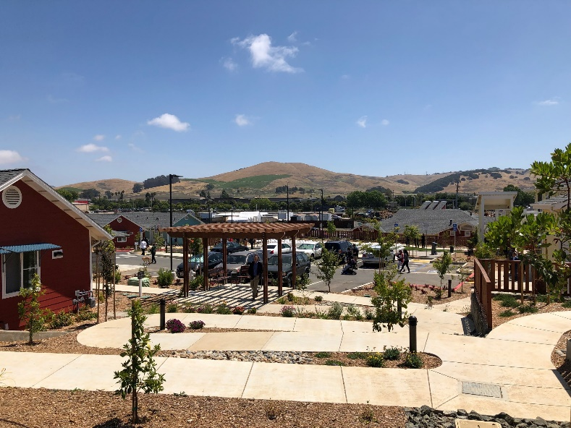
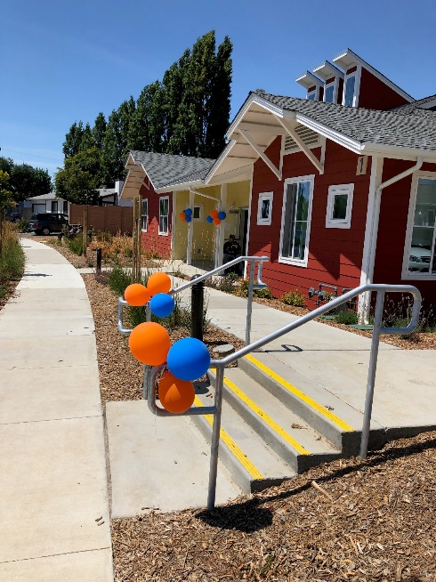
Valley View Senior Homes American Canyon
VHHP Loan: $2.8 million
22 veteran units for seniors with 30 or 60% of AMI
Close to variety of commercial, parks, American Canyon Senior Multi-Use Center and social services

Slide 31
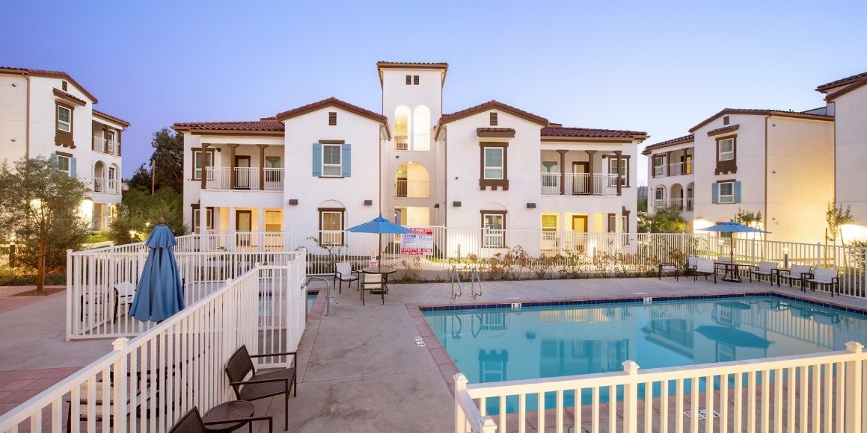
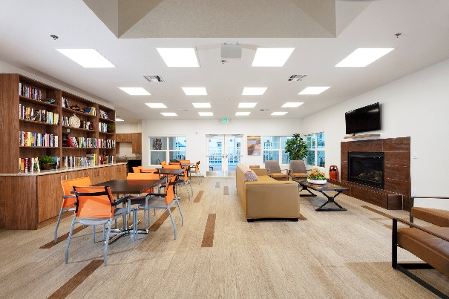
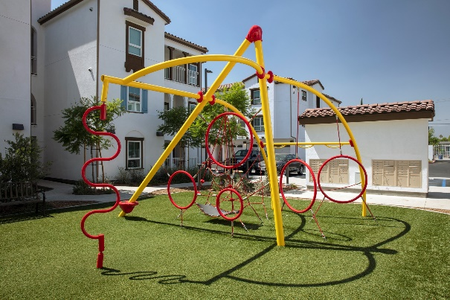
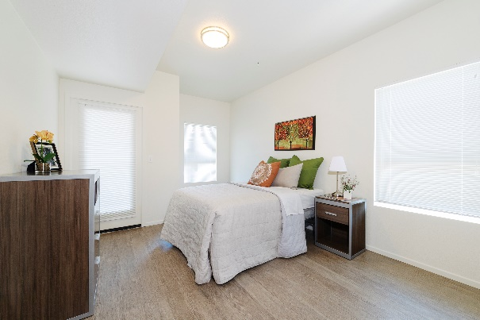
Loma Linda Veterans Village Loma Linda
VHHP Loan: $3.8 million
43 veteran units, 31 permanent supportive housing, 8 affordable at 30% AMI
Originally market rate apartment project
Close to Loma Linda VA Healthcare System

Slide 32
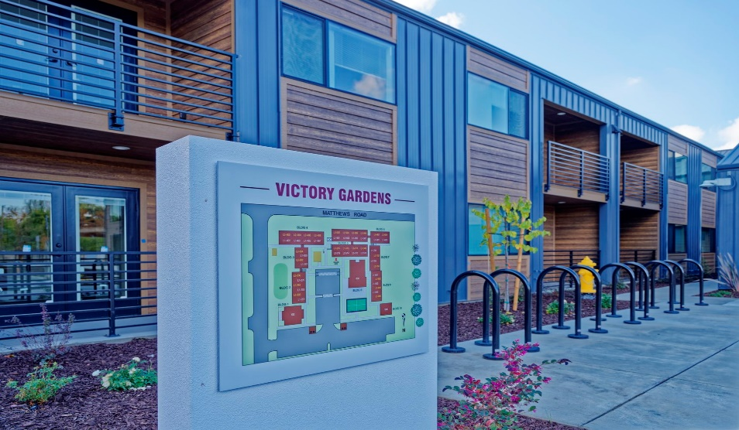
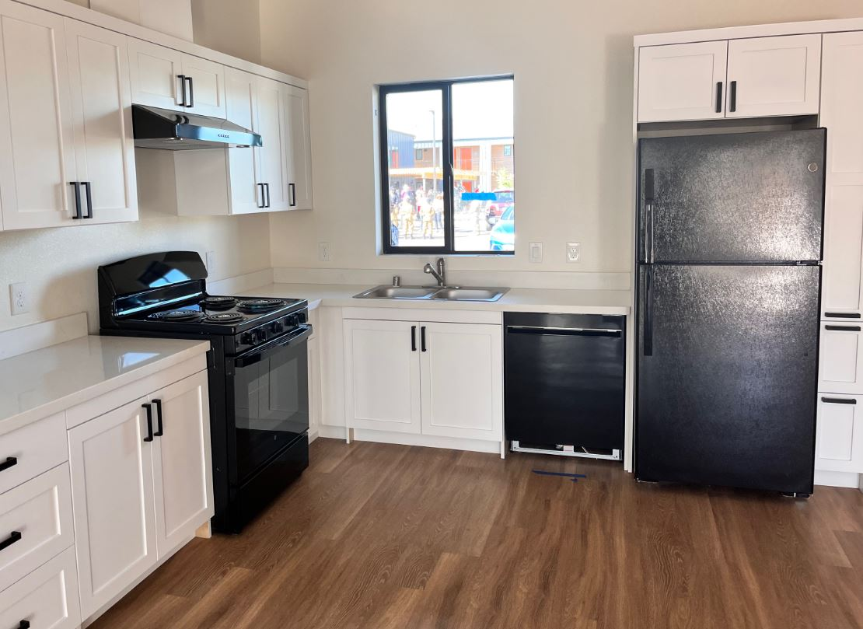
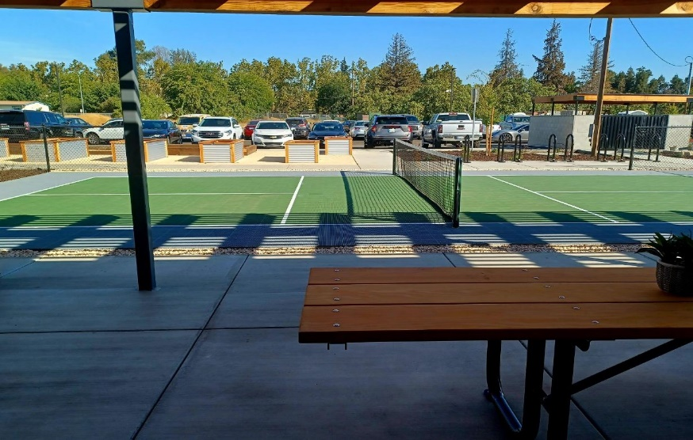
Victory Gardens French Camp
VHHP Loan: $6,802,600
41 One-Bedroom & 7 Two-Bedroom Units
48 HUD-VASH supported units
Community Garden, Computer Room, and Pickleball Court
Near new Stockton VA Clinic

Slide 33
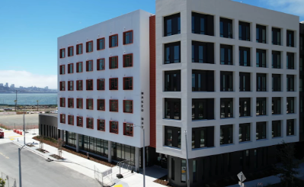


Maceo May San Francisco
VHHP Loan: $10 million
Lead Service Provider: Swords to Plowshares
Dedicated Veteran Housing with 24 Studios, 47 One-Bedroom, & 34 Two-Bedroom
28 HUD-VASH PBV Units
Includes common spaces, and gardens

Slide 34



Veterans Village of Cathedral City Cathedral City
VHHP Loan: $5,509,996
48 One-Bedroom, and 12 Two-Bedroom units
53 HUD-VASH PBV units
Pool, Bocce ball court, Horseshoe, community gardens, computer lab, and secure gated access

Slide 35


Templeton Place II Templeton
VHHP Loan: $1,065,804
10 Veteran units, with 5 units being supported by HUD-VASH
Units equipped with emergency call system, community room, and a community garden.

Slide 36
Contact Information
Sean Johnson, VHHP Program Manager
 916.653.2194
 sean.johnson@calvet.ca.gov
Pamela Norman, Supportive Services Plans
 916.651.7300
pamela.norman@calvet.ca.gov
Desiree Guluarte, DVBE & Outreach Coordination
 916.651.7381
desiree.guluarte@calvet.ca.gov
Judy Porter, Veterans Support to Self-Reliance Pilot
 916.503.8078
judy.porter@calvet.ca.gov
David Lopez, Data Management & Monitoring
 916.653.0211
 david.lopez@calvet.ca.gov

