Slide 1
Updates in VBA
02/13/2024

Slide 2



Slide 3


Slide 4
Agenda
PACT Act and Agent Orange exposure reminders
Exam and Contractor information
Hearing Loss—how do we figure this out?
Upcoming Rating Schedule Changes
Mental
Respiratory
Audio

Slide 5
Agent Orange Exposure
And the PACT Act

Slide 6
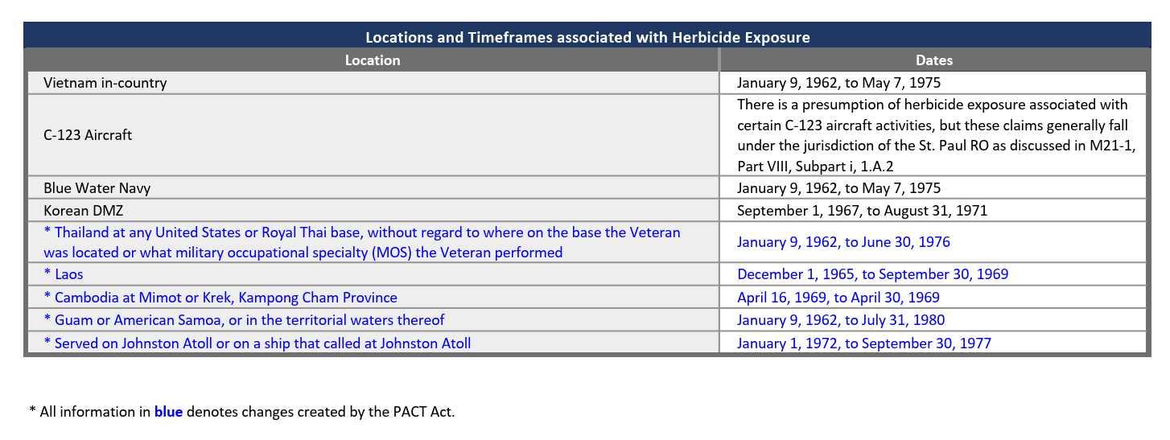


Slide 7

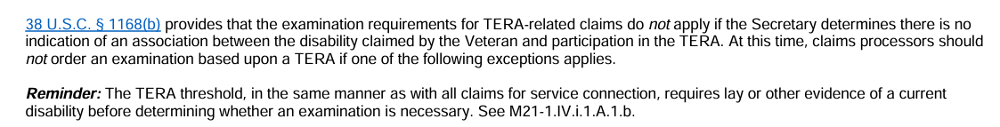
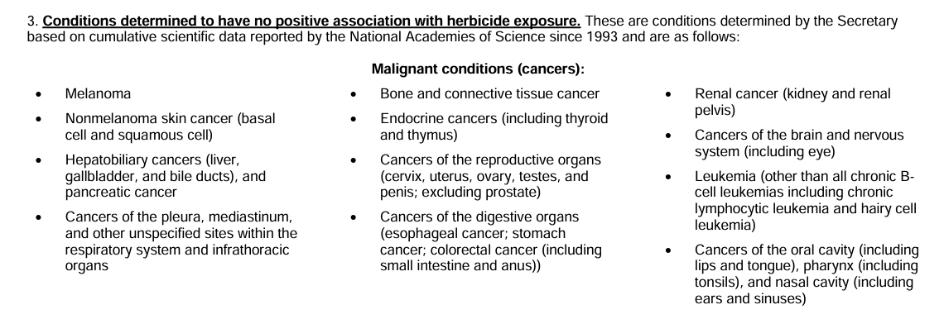

Slide 8
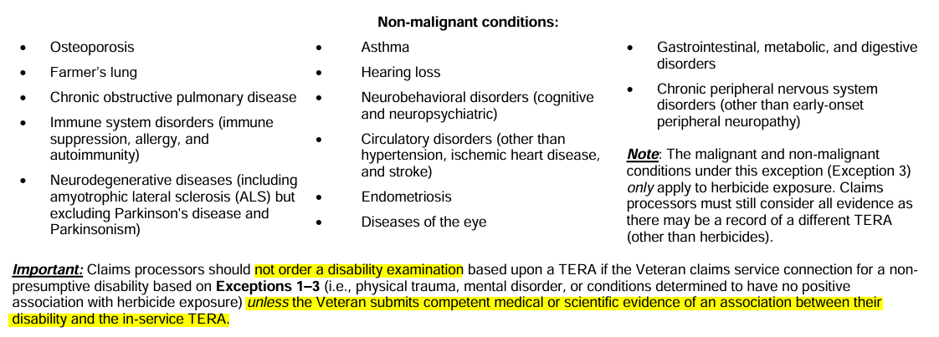

Slide 9
Attachments
PACT Act Information Page (va.gov)
Herbicide Exposure Job Aid
Gulf War Service Job Aid
TERA Exception Job Aid

Slide 10

Exam and Contractor Info
Information and Reminders from our very own local Exam Liaison

Slide 11
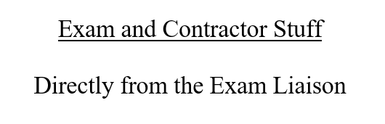
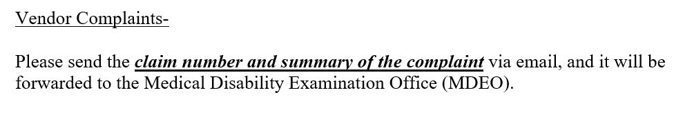

Slide 12
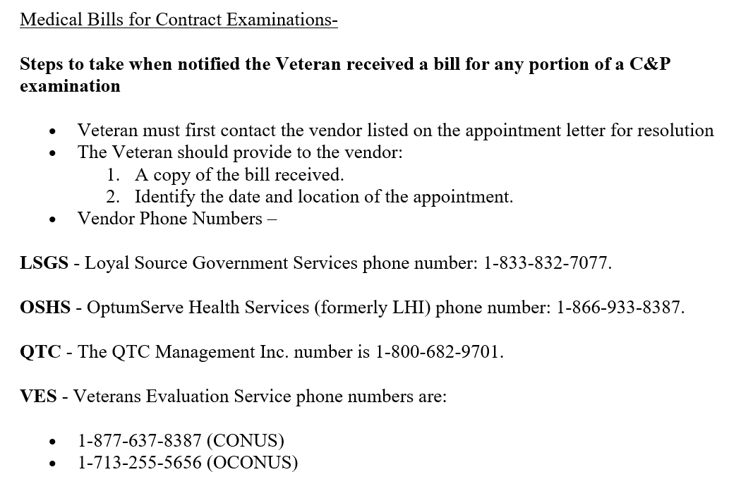

Slide 13
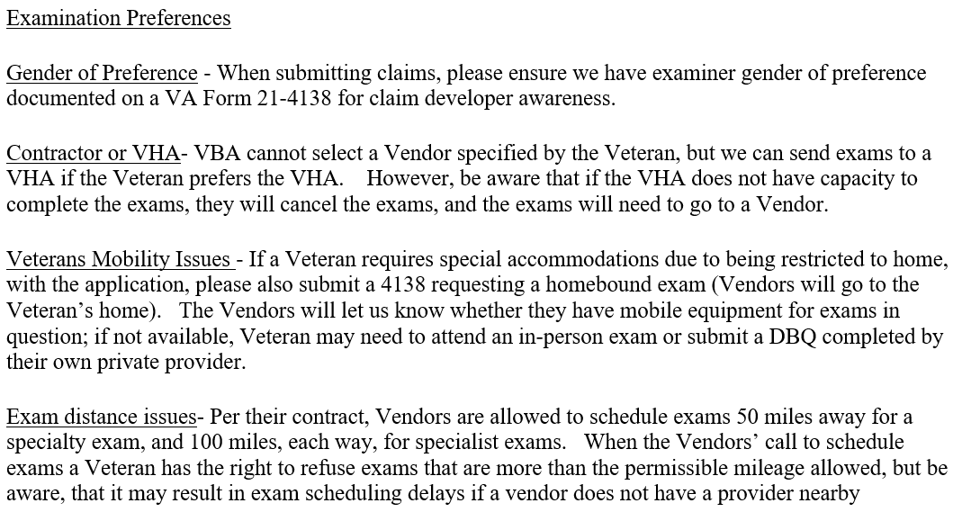

Slide 14
Hearing Loss
What constitutes hearing loss for VA purposes?
How do we calculate hearing loss evaluations?

Slide 15
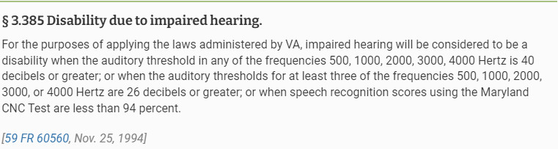

Slide 16


Slide 17
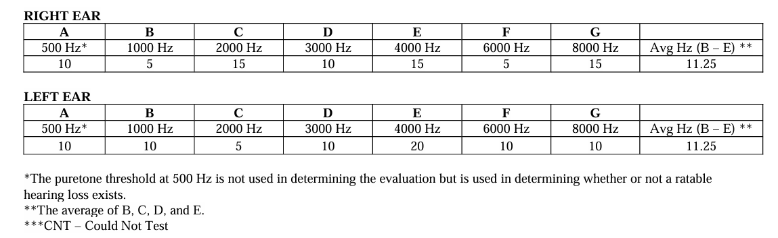


Slide 18
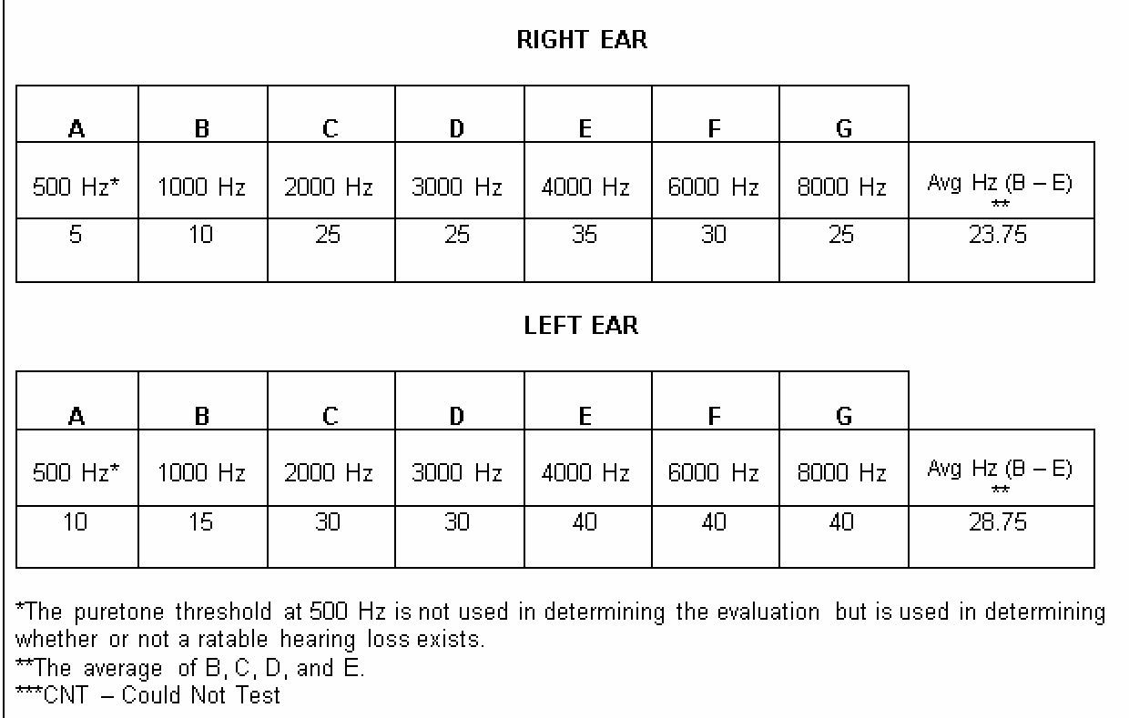
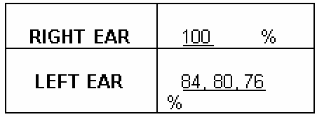

Slide 19




Slide 20

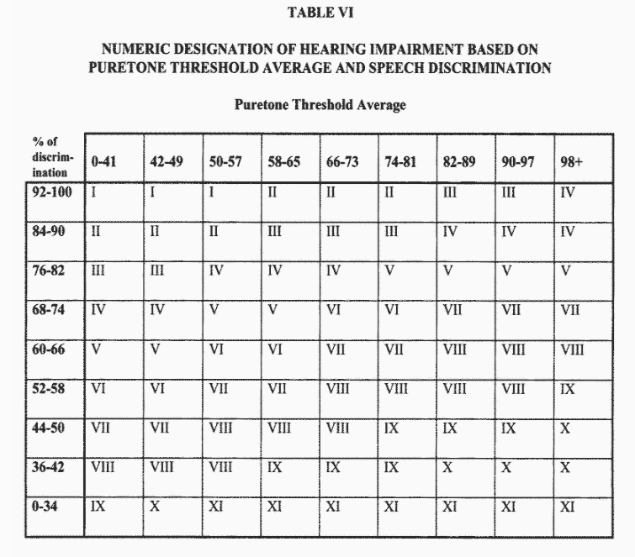

Slide 21
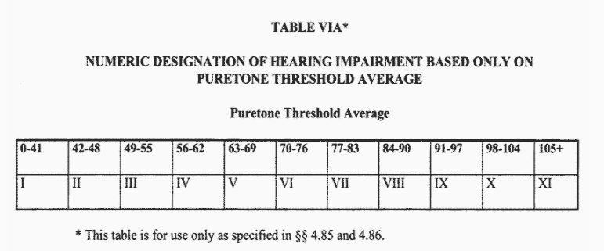

Slide 22
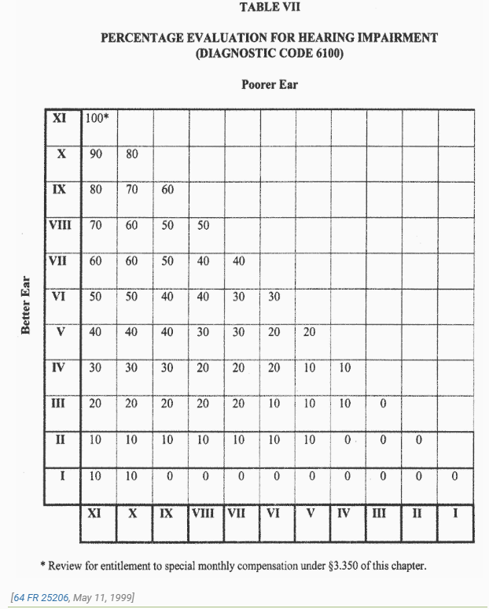

Slide 23
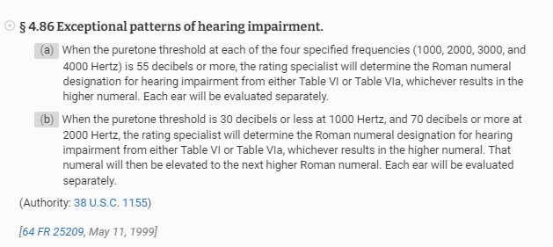

Slide 24


Slide 25
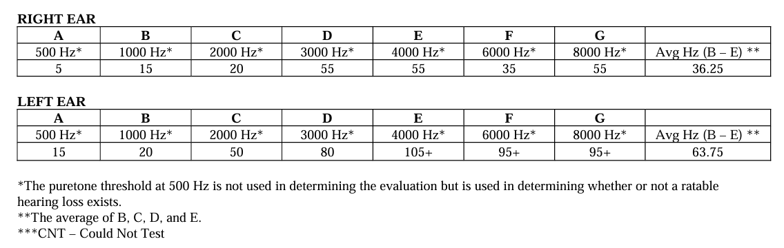

Slide 28
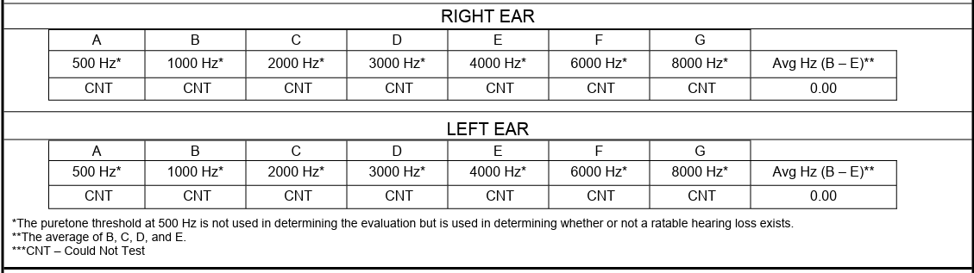

Slide 29
One more thing…
Favorable Findings:
If they do not meet the basic criteria for hearing loss as defined in 3.385, we will NOT provide a favorable finding that there is a current diagnosis, REGARDLESS of whether any doctor has diagnosed hearing loss or not.

Slide 30


Slide 31
Upcoming Rating Schedule Changes
Mental disorders rating schedule changes
Respiratory disorders rating schedule changes
Audio disorders rating schedule changes

Slide 32
Mental Disorders 38 CFR 4.130
Federal Register link: Regulations.gov
Comments must be received prior to 4/18/2022
Highlights—
General formula for evaluating mental disorders changing to be based on “Domains”---they appear similar to the TBI facets
Eating disorders will no longer have separate criteria—they are being incorporated into the Mental Disorders criteria
There will be no more 0% evaluation allowed
Evaluating mental health conditions based on a more robust and holistic approach that assesses how impactful the disability is to cognition, interpersonal relationships, task completion, life activities and self-care. Additionally, the proposed evaluation criteria include a 10% minimum evaluation for having one or more service-connected mental health conditions and will no longer require “total occupational and social impairment” to attain a 100% evaluation.

Slide 33
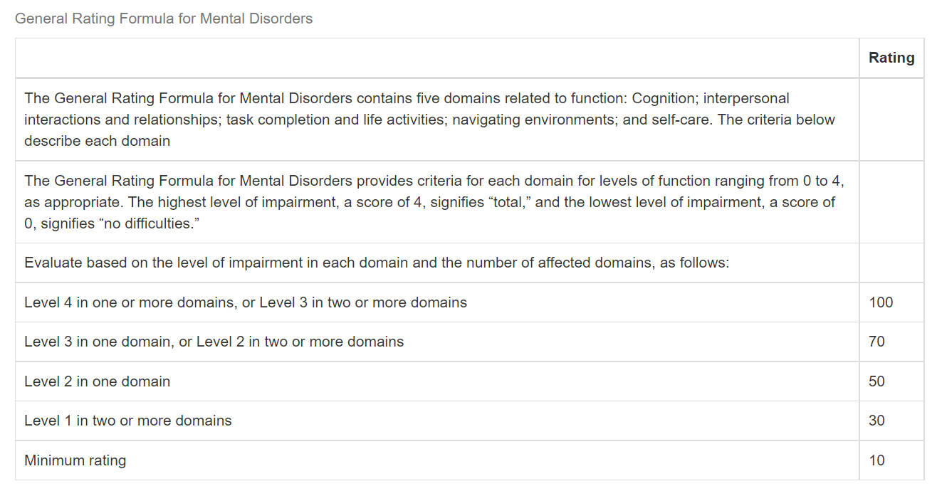

Slide 34
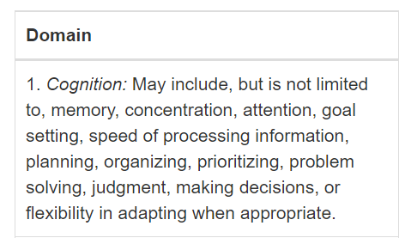
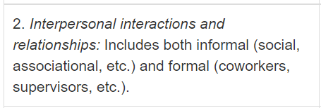
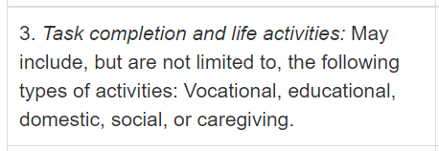
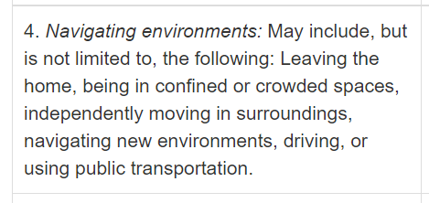

Slide 35
Respiratory Disorders 38 CFR 4.96 and 4.97
Federal register link: Regulations.gov
Comments must be received prior to 4/18/2022
Highlights—
**sleep apnea criteria changing**
Allergic rhinitis very different
Sinusitis name change and criteria based on duration of medication only (general formula)
No longer outpatient oxygen listed in 100% criteria
Modernizing the evaluative rating criteria for sleep apnea, using developments in medical knowledge to evaluate it based on its responsiveness to treatment, bringing the rating criteria for sleep apnea more closely in line with the stated purpose of the rating schedule.

Slide 36
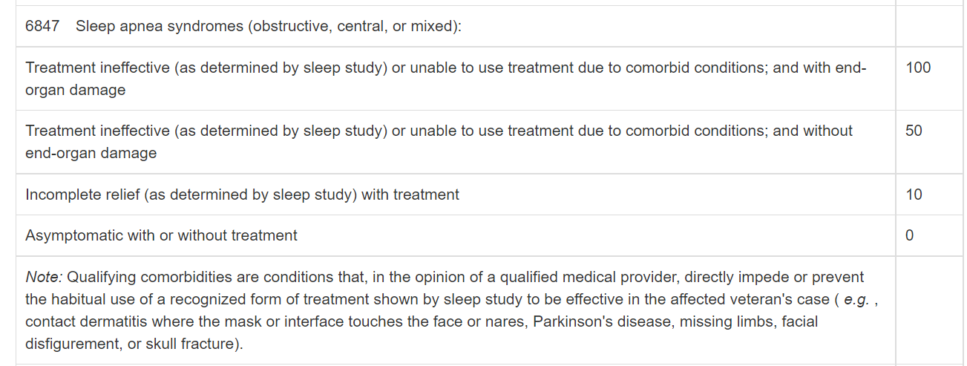

Slide 37
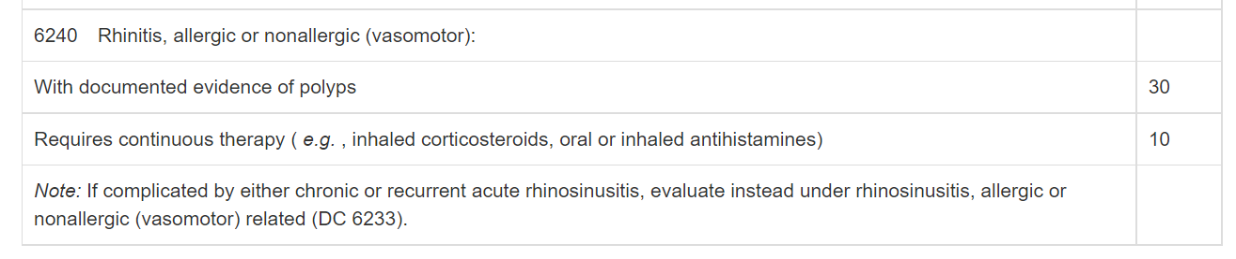
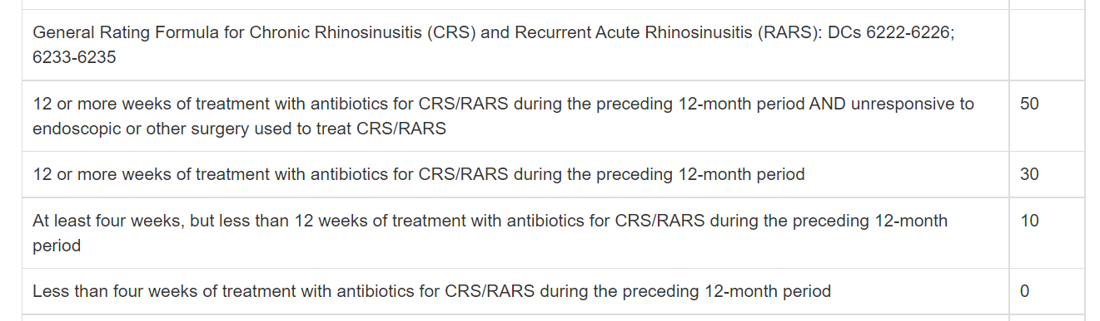

Slide 38
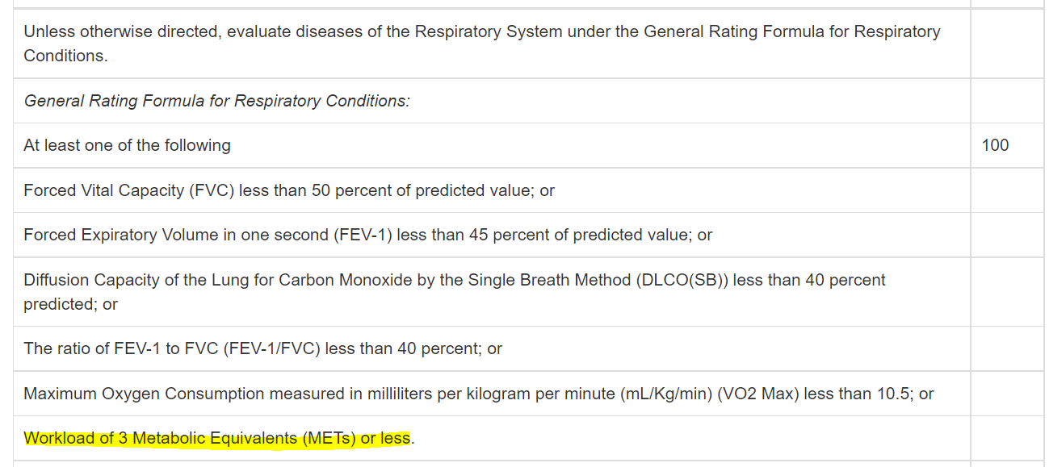

Slide 39
Audio disorders 38 CFR 4.87
Federal register link: Regulations.gov
Comments must be received prior to 4/18/2022
Highlights—
They are deleting DC 6260
Evaluating tinnitus (ringing in the ears) as a symptom of the underlying disease which causes it, rather than as a stand-alone disability.

Slide 40
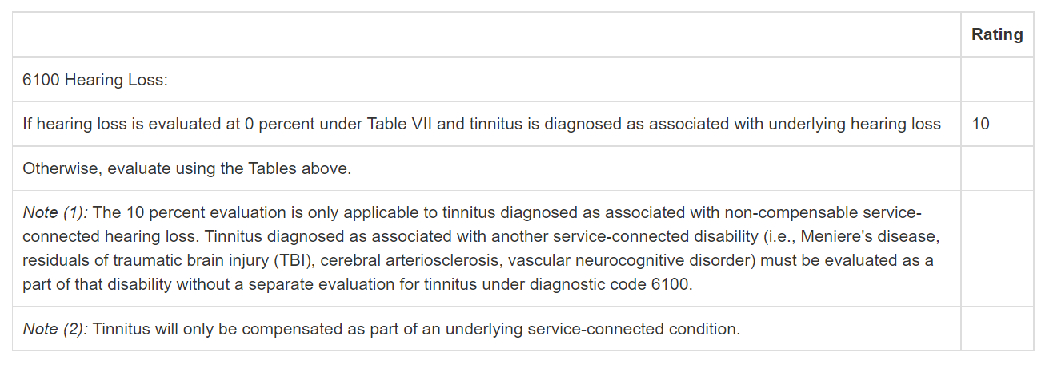

Slide 41


Slide 42


Slide 43


Slide 44
Oakland RO Employees
Calendar year 2023, the Oakland Regional Office has hired 77 new employees, 46 of which have been RVSRs.
This intense hiring has been a nationwide endeavor, and nearly every station has increased in size to accommodate the increased workload due to PACT Act.
The training process is very time consuming on trainers and mentors, which mostly comprise of the Quality Review Team.

Slide 45
And…
We have new hiring announcements out

Slide 46




Slide 47

Questions?

