Slide 1
Certifications for
Disabled Veterans License Plates
Overview and Guidelines
June 24, 2025

Slide 2
Disabled Person versus Disabled Veteran
CA Vehicle Code 295.7
  Permanent Blindness
  Loss or loss of use of limbs
  Unable to move without aid of assistant device
  100% SC disability impairing mobility
DV License Plate Certification (VSD 001)
Benefits and Limitations

Slide 3
Disabled Person vs Disabled Veteran
CA Vehicle Code (CVC) 5007(a) authorizes DMV to issue a special license plate to the following:
Disabled Veteran (DV)
As specified by CVC 295.7
In lieu of medical certificate, a certificate from the VA or CVSO/CalVet that applicant is a disabled veteran as described in CVC 295.7
  REG 256 V, CERTIFICATION FOR DISABLED VETERANS LICENSE PLATES, CALIFORNIA VEHICLE CODE CVC SECTIONS 5007, 9105
Disabled Person (DP)
As specified by CVC 295.5
Requires medical certificate per CVC 5007(c)
  DMV and doctor
  REG 195, Application for Disabled Person Placard or Plates

Slide 4
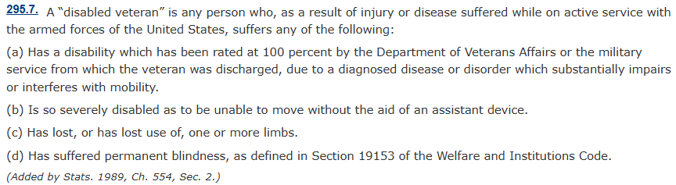
Disabled Veteran (DV) License Plate
Definition of disabled veteran:

Slide 5
Let’s go over those 4, in reverse order.

Slide 6
Permanent Blindness
( Per the Welfare and Institutions Code Section 19153)
19153.
The term, “blind person” means either a person who has not more than 20/200 central visual acuity in the better eye after correction, or a person who has visual acuity greater than 20/200 but with a limitation in the fields of vision such that the widest diameter of the visual field subtends an angle no greater than 20 degrees. Such blindness shall be certified by a licensed physician and surgeon who specializes in diseases of the eye or a licensed optometrist. (Amended by Stats. 1980, Ch. 261, Sec. 2.)
* Snipped from Eye Conditions DBQ
eCFR :: 38 CFR 4.79 -- Schedule of ratings—eye.
Does the veteran have a service-connected eye condition?
Check and read the special monthly compensation (SMC) paragraphs for blindness.

Slide 7
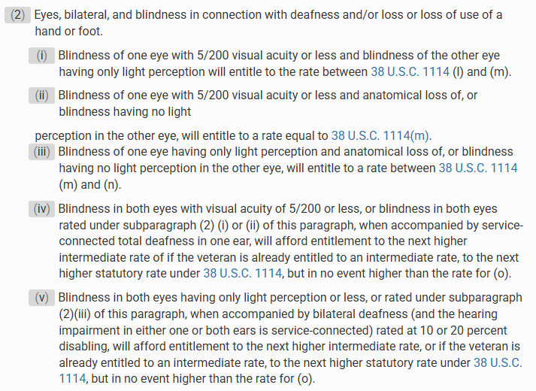
Here are higher level SMC’s involving the eye, per 38 CFR 3.350 (f)(2).

Slide 8
Has Lost, or Has Lost Use of, One or More Limbs
Look at the veteran’s list of service-connected disabilities, check for grants of SMC for the following:
Anatomical loss or loss of use of one hand, one foot, both buttocks, both hands, both legs, etc.
38 USC §1114(k) and 38 CFR §3.350
NOTE: SMC K for a creative organ does not impair one’s mobility.

Slide 9
Severely Disabled – Unable to Move Without the Aid of an Assistant Device
Service-connected disabilities that may require assistive devices:
Muskuloskeletal disorders
  Arthritis, muscular dystrophy, spinal injuries
  eCFR :: 38 CFR 4.71a -- Schedule of ratings—musculoskeletal system.
Neurological conditions
  TBI, Multiple sclerosis, cerebral palsy, Parkinson’s disease
  eCFR :: 38 CFR 4.124a -- Schedule of ratings—neurological conditions and convulsive disorders.

Slide 10
Severely Disabled (continued)
Service-connected disabilities that may require assistive devices:
Cerebrovascular accidents (stroke) causing paralysis or weakness on one side of the body, or amputation of limb
Peripheral arterial disease causing severe numbness or limb paralysis
  eCFR :: 38 CFR 4.104 -- Schedule of ratings—cardiovascular system.

Slide 11
Service Connected Disability Rated 100%
Due to diagnosed disease or disorder which substantially impairs or interferes with mobility.
Cardiovascular disease causing marked limitation of physical activity or unable to do any physical activity without discomfort (rated using METs)
  Severity Class III (marked limitation of physical activity) – when less than ordinary activity causes fatigue, palpitation, shortness of breath or chest pain.
  METs – metabolic equivalent of tasks – measures the energy cost of physical activities and assesses cardiovascular health.
  eCFR :: 38 CFR 4.104 -- Schedule of ratings—cardiovascular system.

Slide 12
SC Disability 100%... substantially impairs or interferes with mobility (continued)
Respiratory conditions that measure the forced expiratory volume (FEV-1/FVC) like COPD, emphysema, asthma.
  Oxygen may be prescribed for severe shortness of breath in stage III COPD/emphysema.
  FEV-1/FVC represents the percentage one’s lung capacity can expel in 1 second. The higher the percentage, the larger your lung capacity and the healthier your lungs.
  eCFR :: 38 CFR 4.97 -- Schedule of ratings—respiratory system.

Slide 13
SC Disability 100%... substantially impairs or interferes with mobility (continued)
CalVet VSD Bulletin 21-01, dated January 12, 2021, notes that:
A veteran with an overall disability rating of 100% from one or more injuries, diseases or disorders, and those awarded a disability compensation rate of 100% due to individual unemployability meet the definition of ‘SC disability rated at 100%’ if the injury, disease or disorder “substantially impairs the veteran’s mobility.”
  Veterans Services Division Bulletin

Slide 14
Disabled Veteran License Plate Certification
(VSD-001 in VetPro)
VSD-001, Veteran Status and Service Connected Disability Verification.
Veteran signature on Section 2.
County certification on Section 4.
County stamp with OGC # of the accredited representative on bottom right corner (where it says CVSO seal).
Scan proof of SC disabilities in VetPro or put appropriate note referencing RD that’s already in VP Attach Docs.
For 100% conditions that are not easily identifiable as mobility issues, provide reason why it is acceptable.

Slide 15
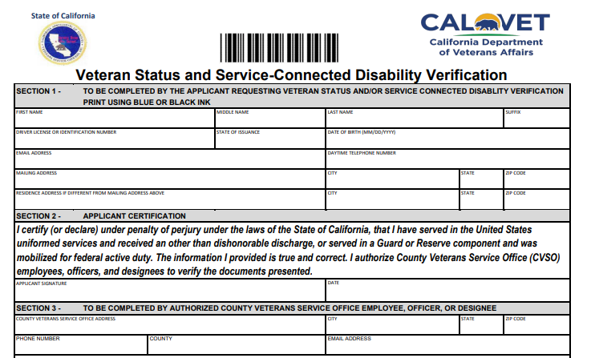
Veteran signs and dates here.

Slide 16
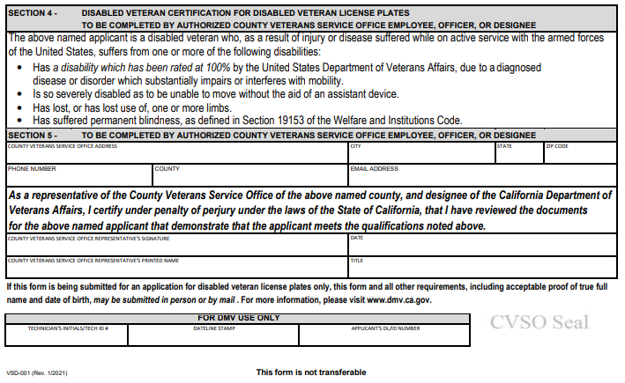
Certification by the County, as designee of CalVet, in this section.
Stamp the form here. Don’t forget to put your OGC #.

Slide 17
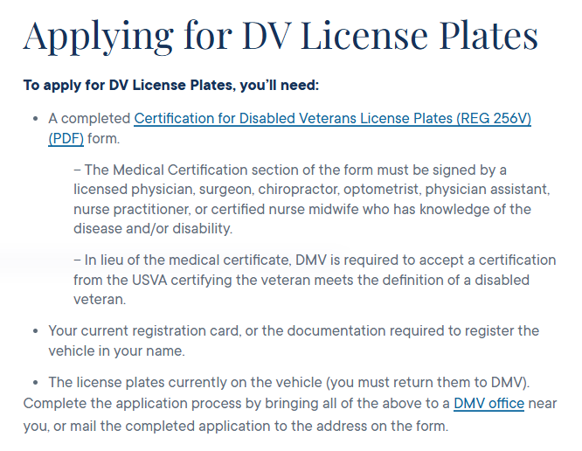
Disabled Veteran License Plates - California DMV
Per CVC 5007(c)(3) In lieu of medical certification identified in (c)(1), DMV shall accept a certificate from a County Veterans Service Officer, CalVet or USVA that verifies the applicant is a disabled veteran as described in CVC 295.7

Slide 18
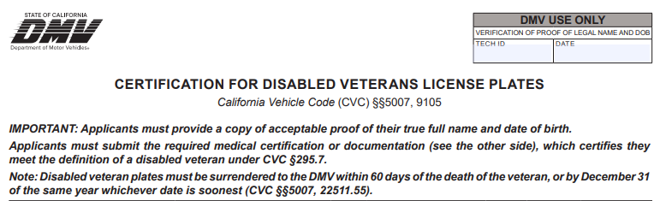

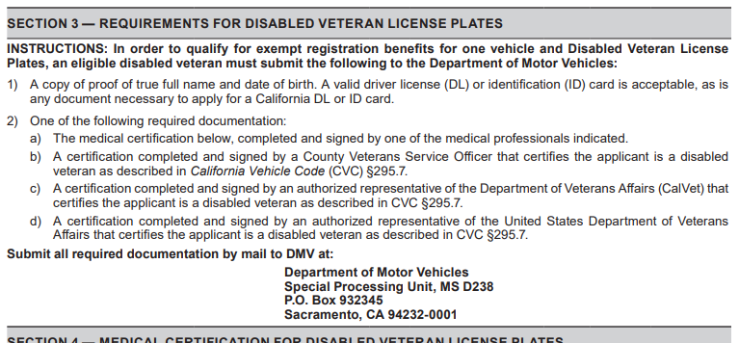




Slide 19
Benefits of the Certification
Eases mobility as it comes with parking privileges.
DV License Plates exempt from paying vehicle registration and license fees – one vehicle per veteran (CVC 9105).
Brings veterans into the county veterans service offices –opportunity to connect with them and encourage eligible veterans to apply for and utilize benefits.
Note: DV license plates must be surrendered to DMV within 60 days of the death of a disabled veteran, or by December 31 of the same year, whichever is soonest.

Slide 20
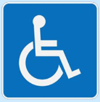
Parking Privileges of DV License Plates
Parking in spaces with the International Symbol of Access
Next to a blue curb authorized for persons with disabilities parking.
Next to a green curbs for as long as you need.
In an on-street metered parking space at no charge.
In an area that indicates it requires a resident or merchant permit.

Slide 21
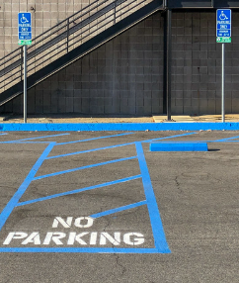
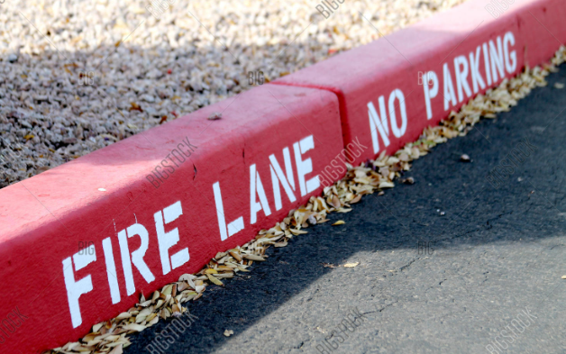
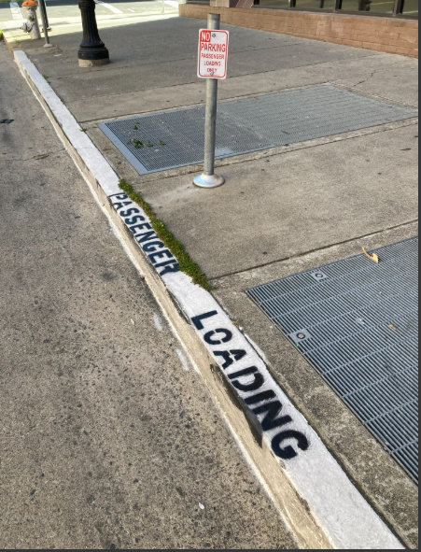
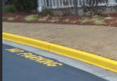
Parking Limitations of DV License Plates
May not park in spaces marked with a crosshatched pattern next to the International Symbol of Access.
Not next to red curbs.
Not next to yellow curbs.
Not next to white curbs.
Only for use of disabled veteran, cannot share with others.

Slide 22
Do We Issue DV Certification?
Veteran rated 100% for pension purposes.
No. DV plates are for SC disabilities.
VA granted veteran IU, and PTSD is highest evaluation at 70%.
If other SC conditions impair mobility – then Yes.
Otherwise – No.
Veteran rated 100% for one service connected disability.
If SC condition meets mobility impairment requirement – Yes.
Otherwise – No.

Slide 23
Is It Okay To Issue DV Certification?
Veteran lost use of left lower extremity, due to stroke. He is SC 0% for HTN, but not for LLE.
Veteran rated 10% for knee arthritis and wears brace due to instability.
No. But file a claim for residuals of stroke secondary to SC HTN.
If vet is granted SC for loss of use of LLE secondary to HTN, then Yes.
If they can move without the brace, NO.

Slide 24

Zmae Raymundo
District Manager, Oakland D.O.
Zheriemae.Raymundo@calvet.ca.gov
Alberto Alpasan
District Manager, Los Angeles D.O.
Alberto.Alpasan@calvet.ca.gov
Melaina Anker-Youngberg
District Manager, San Diego D.O.
Melaina.Anker@calvet.ca.gov
David Lawrence
Section Chief
David.Lawrence@calvet.ca.gov
Questions?

