Slide 1
Navigating VBMS
June 24, 2025

Slide 2
VBMS (Veterans Benefits Management System)
  Default page
  Search
  My History
  View Documents (Electronic Notification)
  Filter Criteria in All Claims Queue
  All Claims | My Claims and Bookmarking
  eFolder
VBA-SHARE

Slide 3
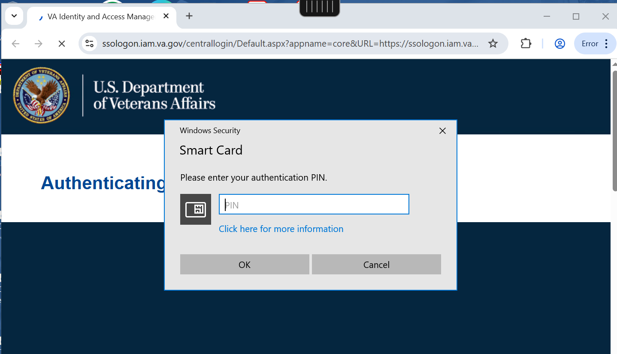
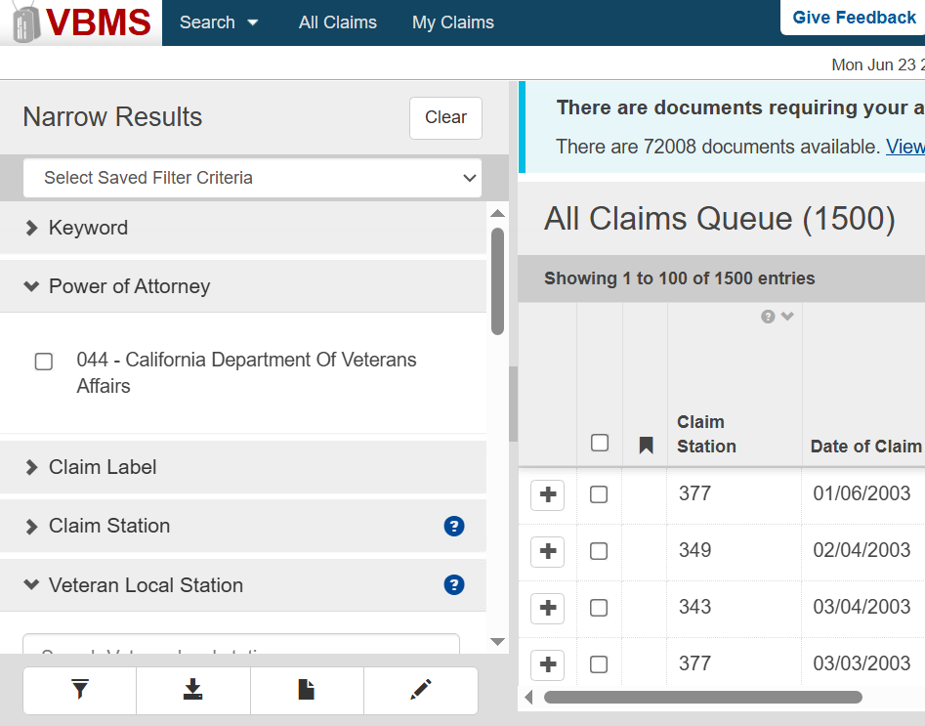
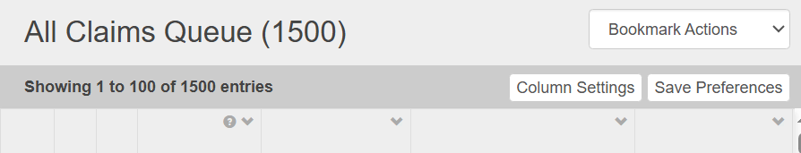
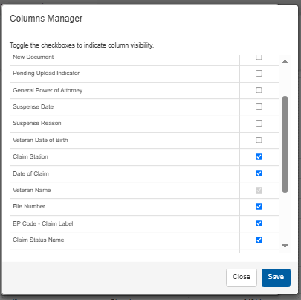
When you log on to VBMS, it will automatically show you the All Claims Queue default page.
You can adjust the columns you see here, by clicking on Column Settings and checking or unchecking the column options.
After choosing your preferred columns, click on Save and then Save Preferences.

Slide 4
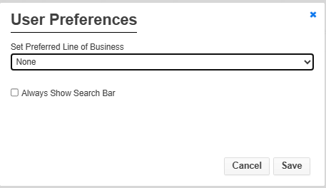
VBMS: Search
SEARCH – Use this to go straight to the eFolder, Veteran Profile or Claim. If you want the search bar to always be visible, change your setting using this icon:
  Click on User Preferences
  Check the box next to Always Show Search Bar
  And then hit Save.
  Afterwards, page will look like this:

Slide 5
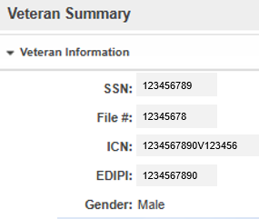
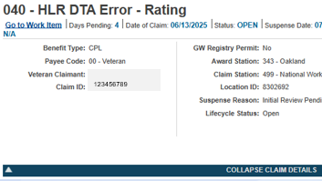

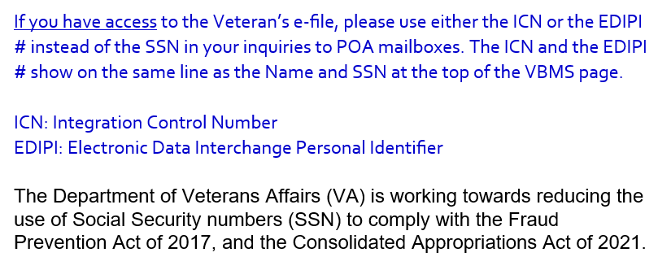
You can search using any these:
Veteran full name
Veteran SSN
VA File Number
EDIPI
ICN
Claim ID (Open Claim block only)
When communicating via email, VA is now using either the EDIPI # or Claim ID #.
This was an email from VARO Oakland a few months ago, asking us to do the same:
DROC has been using Claim ID when reaching out for HLR-IC

Slide 6
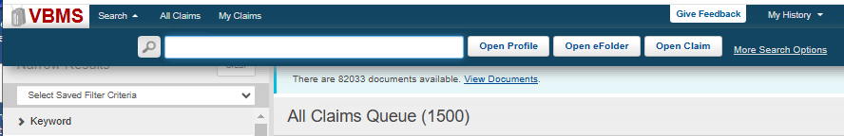
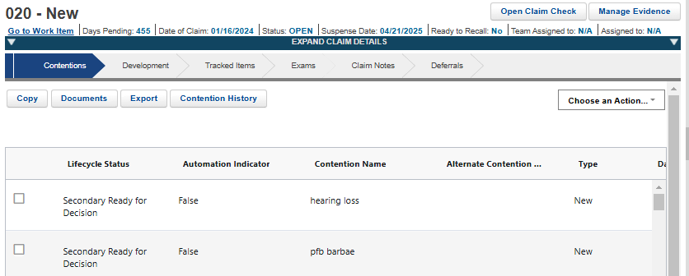
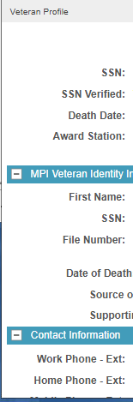
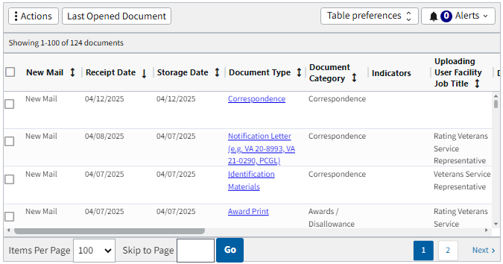
File #, SSN or EDIPI # here to search

Slide 7
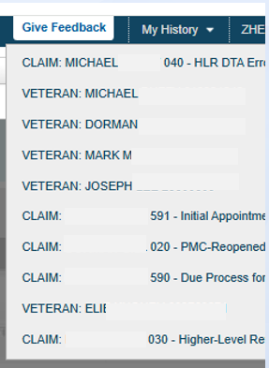
  VBMS: My History
My History will show you the last few cases you reviewed.
You can click on it to go back to that eFolder, Claim or Veteran Profile.
As you open more veteran cases and claims, the others will drop from this list.

Slide 8
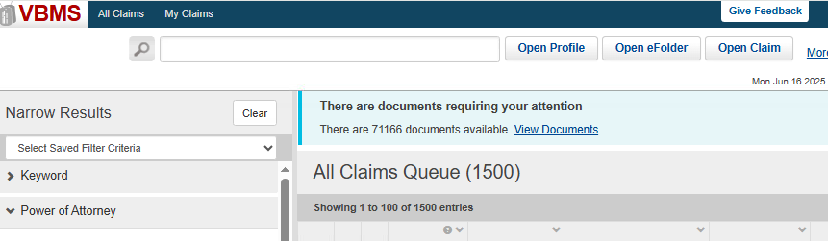
  View Documents (Electronic Notification)
When you log on to VBMS, first page is shows you is always the All Claims Queue.
Click on View Documents to look for recent VA letters for POA review (30-60 days).

Slide 9

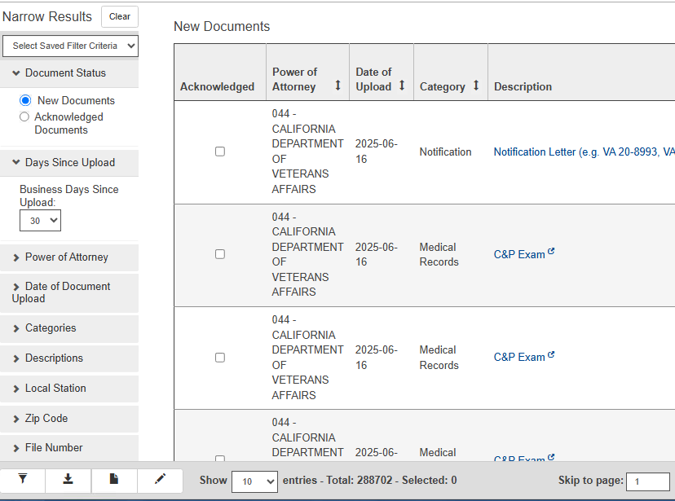
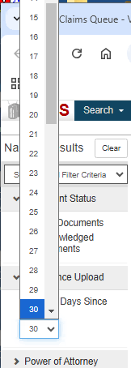
VBMS: View Documents
You can filter # of days from Letter upload
You can also set how many entries on the page (10, 25, 50 or 100).

Slide 10
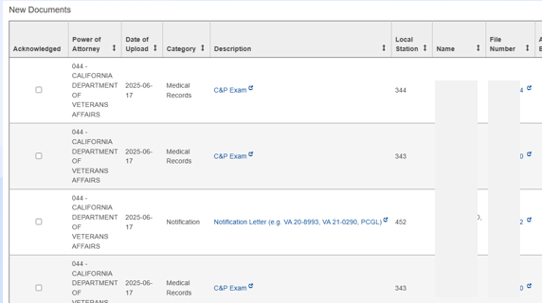
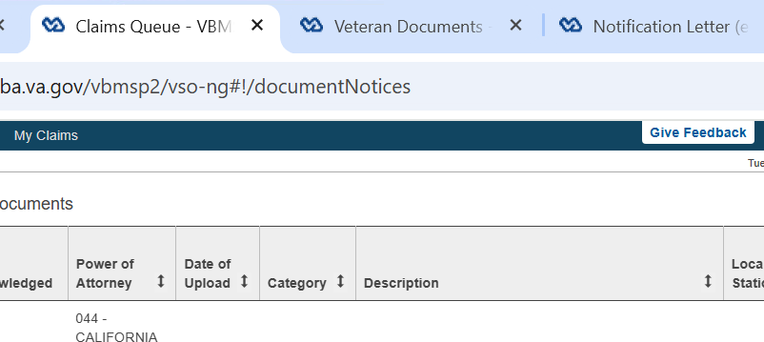
Clicking on this icon will open the veteran’s eFolder in a new window. Yes, you get to keep this New Documents window.
Click on this and it will open the actual document, in a new window:

Slide 11
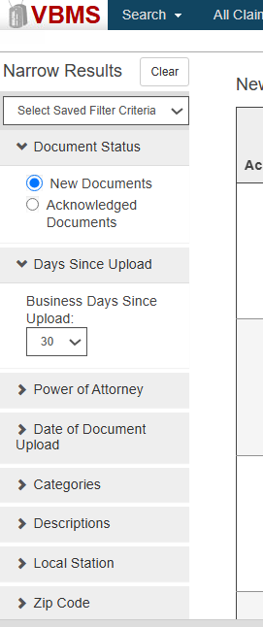
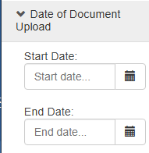
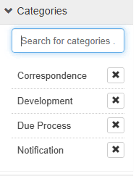
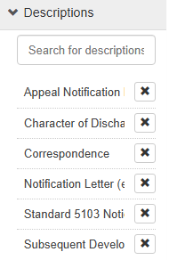

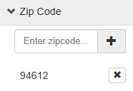
View Documents: Filter Criteria
After all your selections, hit the filter icon at the bottom.
343, 344, or 377

Slide 12
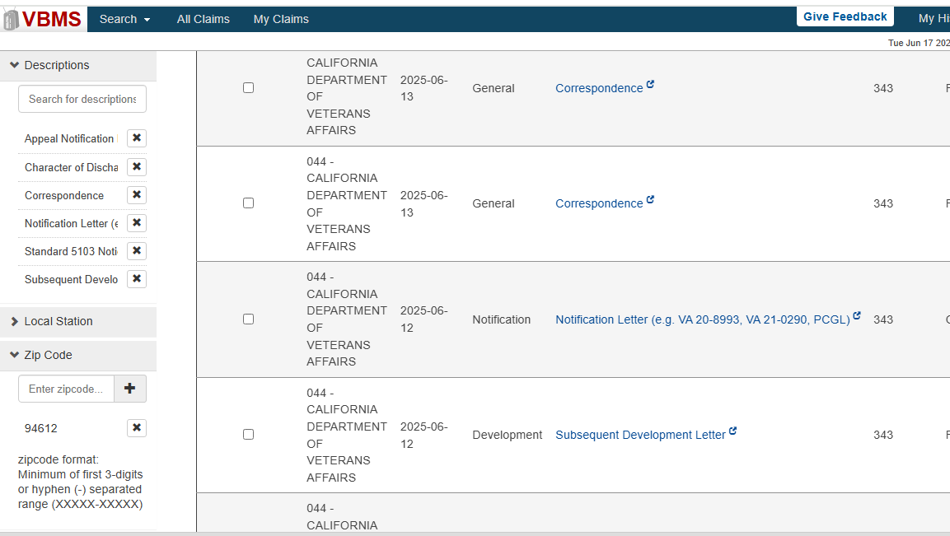
After hitting the filter icon, the queue now only shows documents I intend to review.
In this case, no C&P exam notices or medical records – just the different VA notices.

Slide 13
  VBMS Default page
  Search
  My History
  View Documents (Electronic Notification)
  Filter Criteria in All Claims Queue
  All Claims | My Claims and Bookmarking
  Veteran eFolder

Slide 14
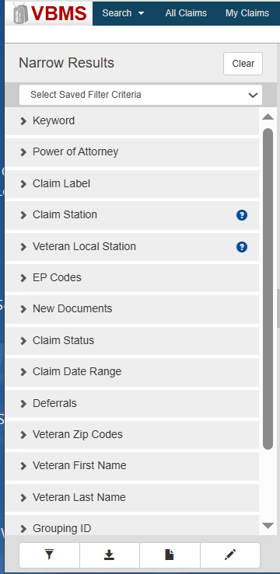
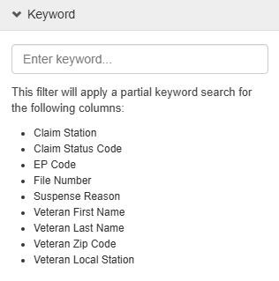
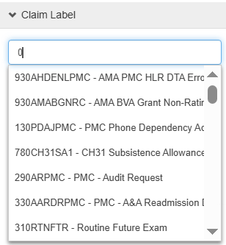
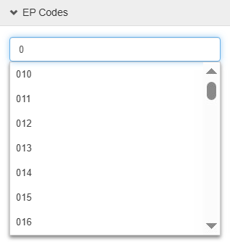
VBMS: All Claims - Filter Criteria

Slide 15
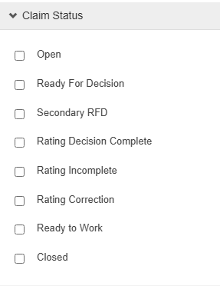
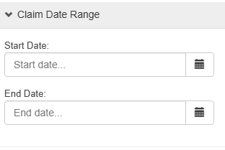
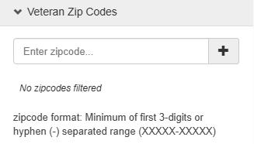
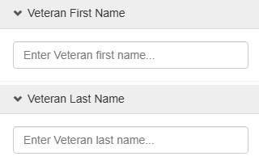
VBMS: All Claims - Filter Criteria (cont.)

Slide 16
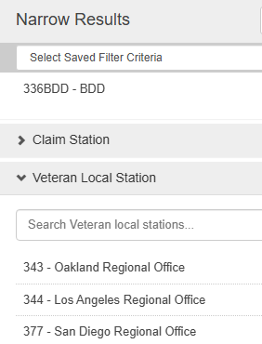

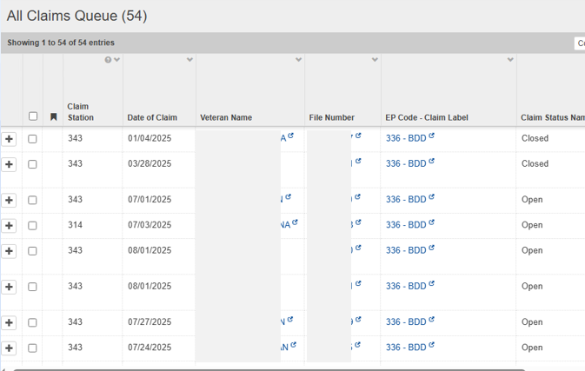
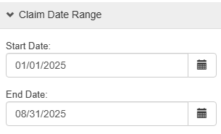
Click on the filter icon

Slide 17
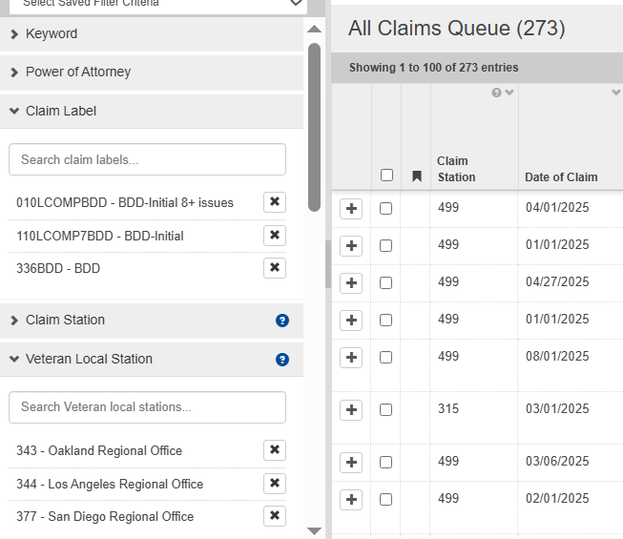
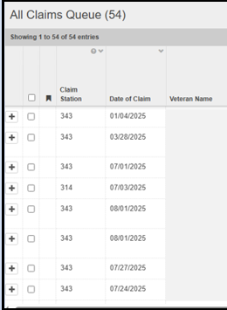
Adding filter conditions will change the results.
* Prior 54 to 273.

Slide 18

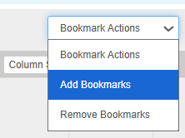
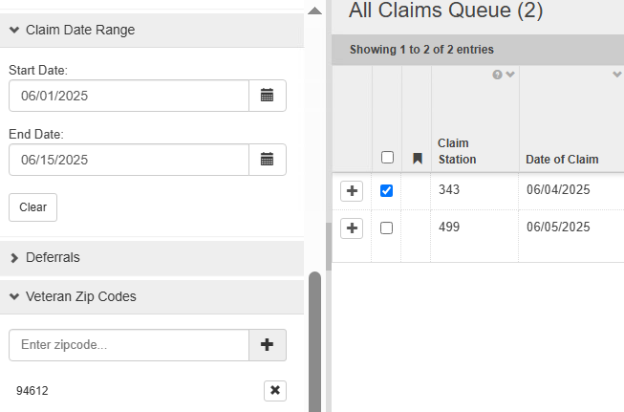
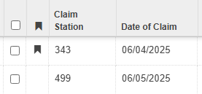
All Claims and My Claims
My Claims consists of cases you already bookmarked.
The case stays in the My Claims Queue, until you remove the bookmark.
All Claims Queue is the main page when you log on VBMS.
It will show all veteran records that you have POA for (if not filtered).
You can use the filter options to find cases you want to bookmark for your My Claims Queue.

Slide 19
Here’s another look at the filter options. You can even filter by name in the All Claims Queue, so you can bookmark the case for your My Claims Queue.

Slide 20
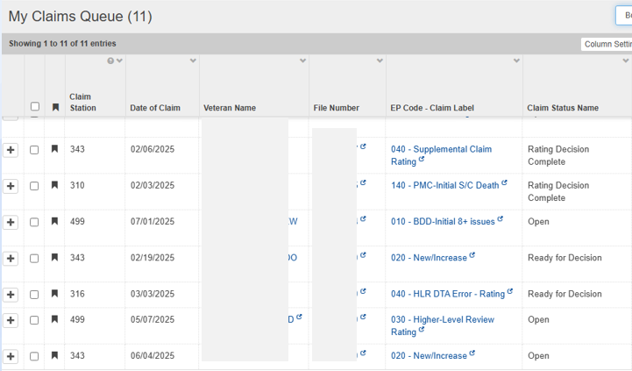
VBMS: My Claims
If you put a case in your My Claims Queue, you’ll be able to view and keep track of the status of your cases. No more individual searching.

Slide 21
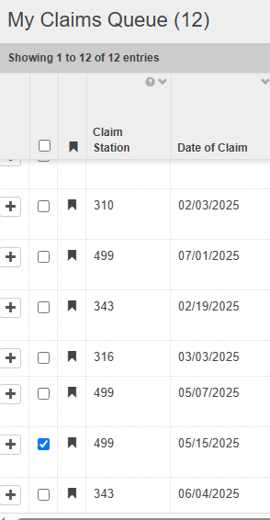
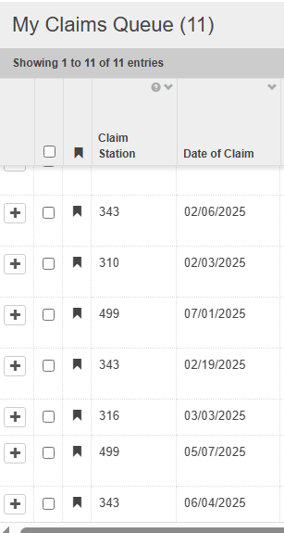
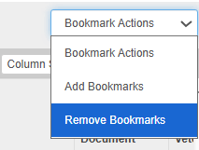

Slide 22
  VBMS Default page
  Search
  My History
  View Documents (Electronic Notification)
  Filter Criteria in All Claims Queue
  All Claims | My Claims and Bookmarking
  Veteran eFolder

Slide 23
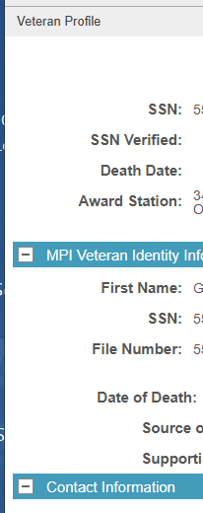
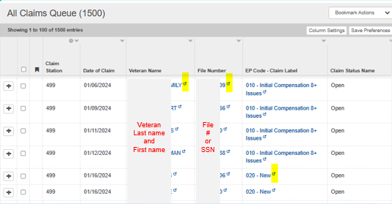
Opens
Veteran’s Profile Page
Opens Veteran’s eFolder (Documents Folder)
Opens Claim Page
From All Clams or My Claims, it’s the same.

Slide 24
File #, SSN or EDIPI # here to search
Claim ID can only work with Open Claim option.
Using the Search block, type the number and hit one of the 3 options.

Slide 25
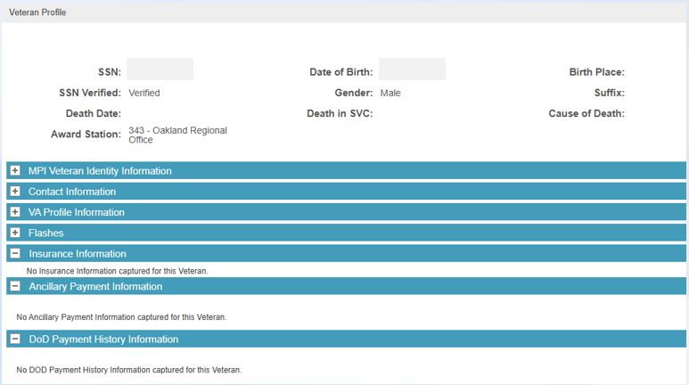
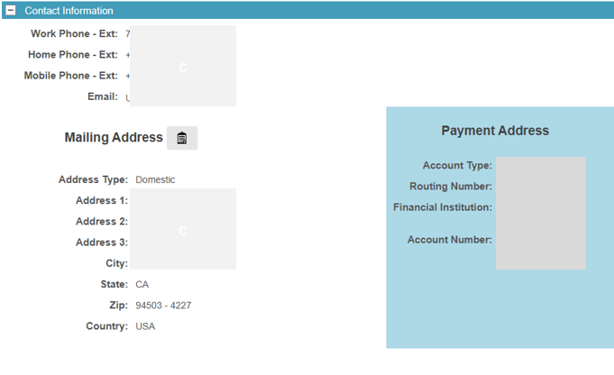
  VBMS: Veteran’s eFolder
The Veteran Profile page is just one of the options from the Veteran drop-down menu.

Slide 26
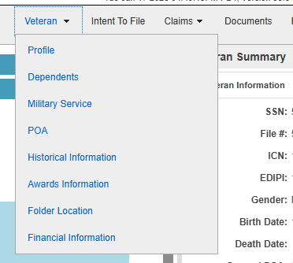
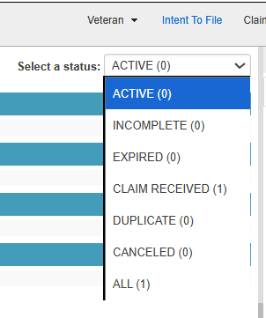

Veteran Drop-down menu
Intent to File status

Slide 27


Claims dropdown menu default will show pending claims.
Check box to see list of closed claims.

Slide 28



These two are not the same:
Claim Notes are specific to the claim.
Notes has everything.

Slide 29

Veteran’s Documents Page

Slide 30


Filtering Documents

Slide 31

Text Search in Documents

Slide 32


Choose one.
Less documents after text search.

Slide 33


Click on the document, and it will take you to the page or pages with that word.

Slide 34


To get back to full view of things, just hit Reset Filters.
Once you Reset Filters, it goes back to show you all documents in chronological order.

Slide 35
VBMS (Veterans Benefits Management System)
    Default page
    Search
    My History
    View Documents (Electronic Notification)
    Filter Criteria in All Claims Queue
    All Claims | My Claims and Bookmarking
    eFolder
VBA-SHARE

Slide 36



Be patient when pulling up SHARE, it takes several Mississippi’s to load.

Slide 37


If you can’t access VBMS, check SHARE Corporate Inquiries. If veteran is in the system, it will tell you the POA.
It could show:
POA code (074, 083, 097)
No POA, or
No Record.

Slide 38

POA Codes | National or State Organization Name
E5L | Indiana Dept. of Veterans Affairs
4R3 | Massachusetts Executive Ofc Vet Svcs
8FE | Michigan Veterans Affairs Agency
00V | Wounded Warrior Project
4R4 | Veterans of Vietnam War & Veterans Coalition
A21 | Military Officers Association of America
IP4 | Navajo Nation Veterans Administration
J3C | Veterans Voice of America
HW0 | Dale K Graham Veterans Foundation
Common POA Codes:
044 – CA DVA (CalVet)
071 – Paralyzed Veterans of America
074 – American Legion
077 – AmVets
083 – Disabled American Veterans
097 – Veterans of Foreign Wars
POA with 3 numbers as code are state or NSO. Mix number and letter is likely PVT ATTY or claim Agents – except for
M21-1, Part I, Subpart i, Chapter 2, Section C - System Updates for Power of Attorney (POA) Appointments

Slide 39


OGC - Accreditation Search

Slide 40

Questions?
Zmae Raymundo
District Manager
CalVet Oakland DO
Zheriemae.Raymundo@calvet.ca.gov
(510) 286-0627

Slide 41
Oakland District Office General Information
Oakland DO Point-of-Contact (POCs)
Appeals team:
For decision review guidance, email Steven –Steven.Smith@calvet.ca.gov
For hearing schedule confirmations & inquiries, email Cora – Leonora.Sarmiento@calvet.ca.gov
DO Review team:
The DO Reviewer of your claim activity
Diane.Susbilla@calvet.ca.gov
CDCR team:
Elizabeth.Hargove-Washington@calvet.ca.gov
Oakland Office (Main):
1301 Clay St. Suite 1130N
Oakland, CA 94612
Open Tue, Wed & Thurs
9:00 AM to 3:00 PM
Phone 510.286.0627
Fax 510.286.0653
Rancho Office:
3046 Prospect Drive
Rancho Cordova, CA
Only for hearings & appointments
Phone 916.364.6774 or 6796
Corporate inbox: Oakland.Oakland@calvet.ca.gov

Slide 42
Los Angeles District Office
General Information
LA District Office POC
11000 Wilshire Blvd. Ste. 505
Los Angeles, CA 90024
Open to the public:
Mon-Wed 8am to 3pm
(213) 620-2755
Corporate mail:
CDVALA@va.gov (you can send PII as long as you encrypt)
For issues relating to appeals (hearings or to discuss appeals issues):
Darlene Dunlap
Darlene.Dunlap@calvet.ca.gov
Darlene.Dunlap344@va.gov

Slide 43
San Diego District Office
General Information
New address:
8620 Spectrum Blvd. Rm 725
San Diego, CA 92123
Open to the Public:
Tue-Wed-Thur 8am-3:30pm
Public Line: (619) 857-5497
Fax Line: (858) 268-1014
San Diego Corporate Email:
state.vbasdc@va.gov
San Diego Office Point of Contacts (POC)
Claim Guidance, AMA Decisions/Guidance, Board hearings & Board Appeals, email Tony Devore Tony.Devore@va.gov
CDCR (Incarcerated Veterans), email Roberto Avila Roberto.Avila@calvet.ca.gov

