Slide 1
Data Collection and Insights
Michael Iadarola
Chief, Veteran and Community Engagement
Veterans Services Division

Slide 2
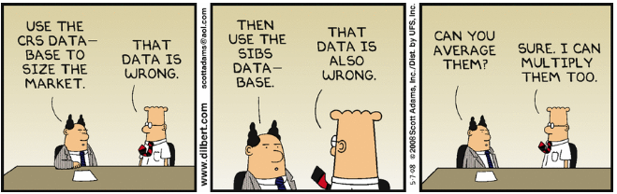


Slide 3



Slide 4



Slide 5
Overview
Why Data
Sample Data Set
Sample Report
CalVet Regional Report
Path Forward

Slide 6
Why Gather Data
Provides evidence for making informed decisions
Solve the problem, not the symptom
Improve efficiency
Understand customers, optimize products and services
Improve service to customers by using objective information instead of intuition alone

Slide 7
Sample Data Set

Slide 8
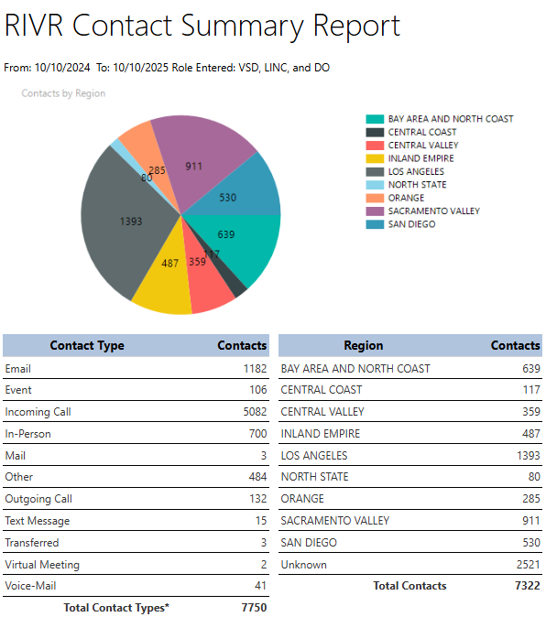
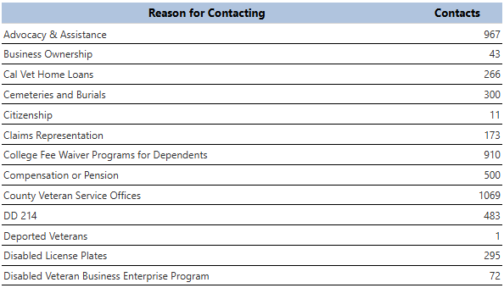
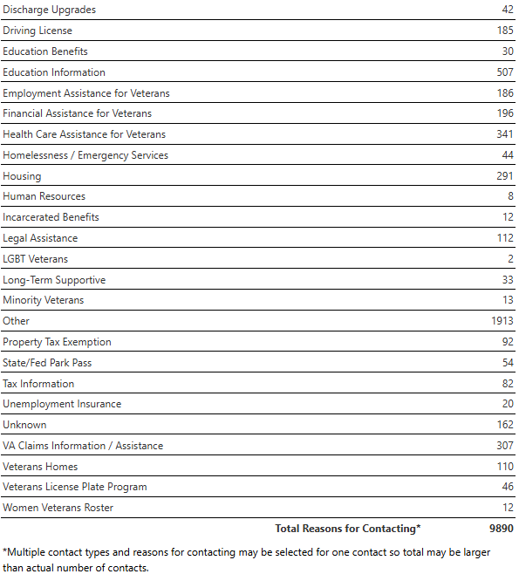
Sample Report

Slide 9
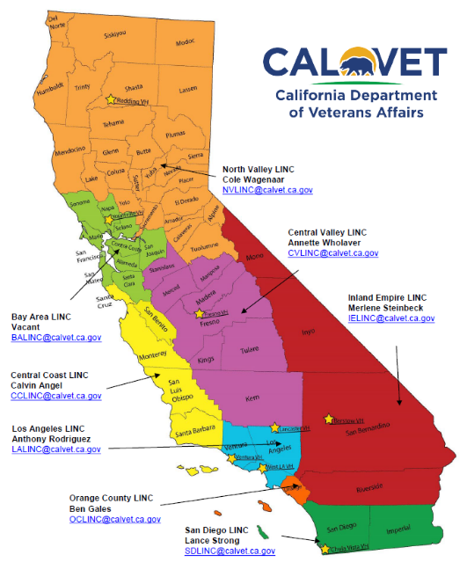
CalVet Regional Report
Generated in July 2025
US Census Data
2025
2035 Projections
Identified
Top Veteran Issues/Concerns
Gap Analysis

Slide 10
CalVet Regional Report
Most Common Issues
Aging Care
Education
Housing
Mental Health
Transportation
VA Issues
Veteran Suicide
Women Benefits
Most Common Gaps
Aging Care
Employment
Housing
Mental Health
Transportation
Women Benefits

Slide 11
Path Forward
Develop and refine next-gen VetPro to track important veteran data
Long Term Goals
Congruity/alignment in understanding veterans' needs across CalVet and CVSOs
Best use of available resources to meet those needs
Increase efficacy in outreach strategies and policy making

Slide 12
Summary
Why Data
Sample Data Set
Sample Report
CalVet Regional Report
Path Forward

Slide 13
Contact Information
California Department of Veterans Affairs​
www.calvet.ca.gov​
​
​
Michael Iadarola
Chief, Veteran and Community Engagement
Desk: 916-503-8306
Cell: 916-838-4393​
michael.iadarola@calvet.ca.gov

Slide 14
Mental Health Services Act Grant Program
Samuel Griffin
Chief, Training & Evaluation
Veterans Services Division

Slide 15
Program Overview
The Mental Health Services Act (MHSA) was passed by California voters in 2004 and is funded by a one percent income tax on personal income in excess of $1 million per year. It is designed to expand and transform California's behavioral health system to better serve individuals with, and at risk of, serious mental health issues, and their families.
$1.27M in grant funds available
https://www.calvet.ca.gov/VetServices/Pages/Mental-Health-Grant-Program-For-Counties.aspx

Slide 16
FY 24/25/26 Participating Counties
Alameda
Butte
Fresno
Los Angeles
Monterey
Nevada
Orange
Riverside
San Bernardino
San Francisco
San Luis Obispo
Santa Clara
Solano
Sonoma
Tuoloumne

Slide 17
FY 26/27/28 Grants
Request for Application (RFA) will be released in November with a return deadline of December 31st.
Applications are reviewed by a panel comprised of CalVet staff and will be rated on a 100-point scale. All final funding decisions will be made by the CalVet Deputy Secretary for Veteran Services.
Awarded counties will be notified by February 2026.

Slide 18
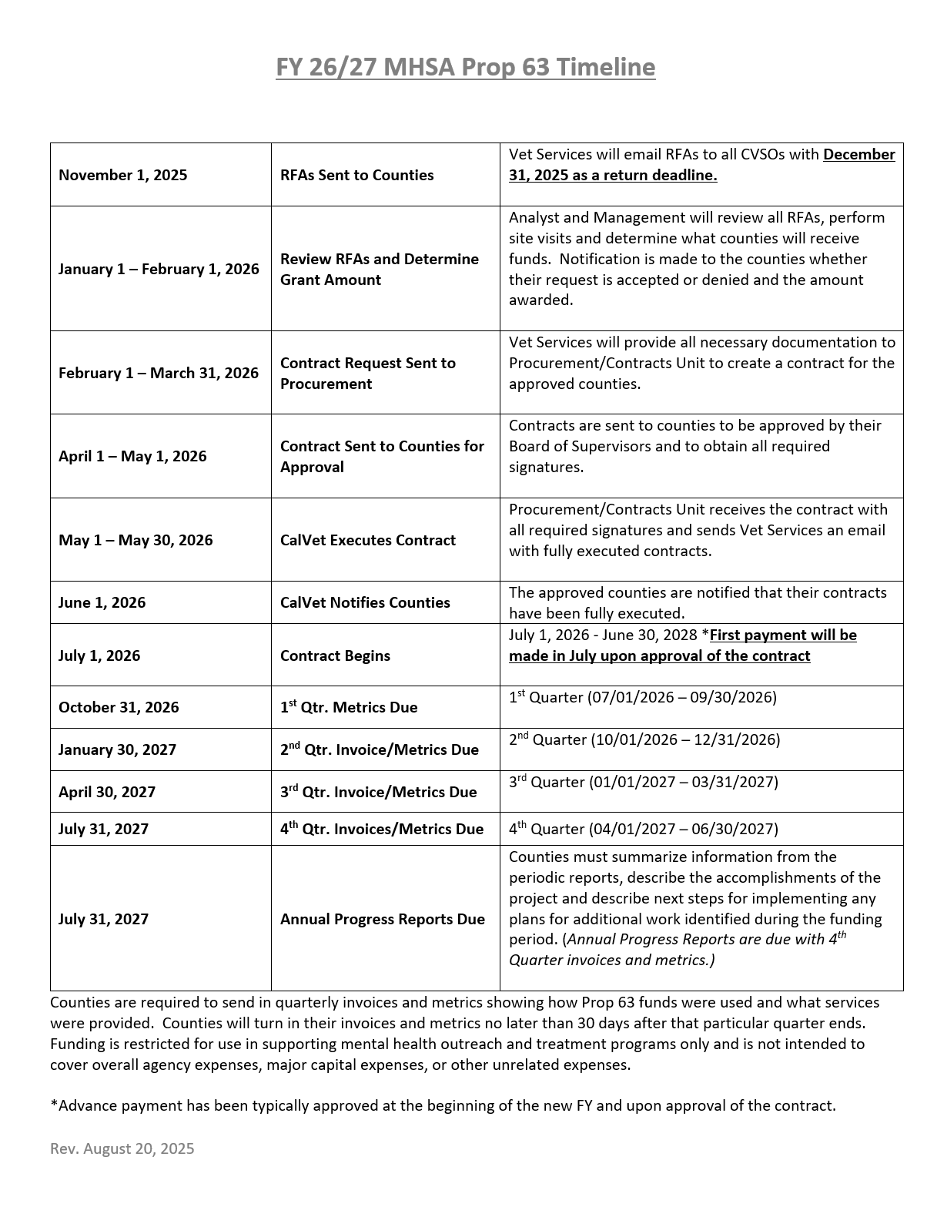
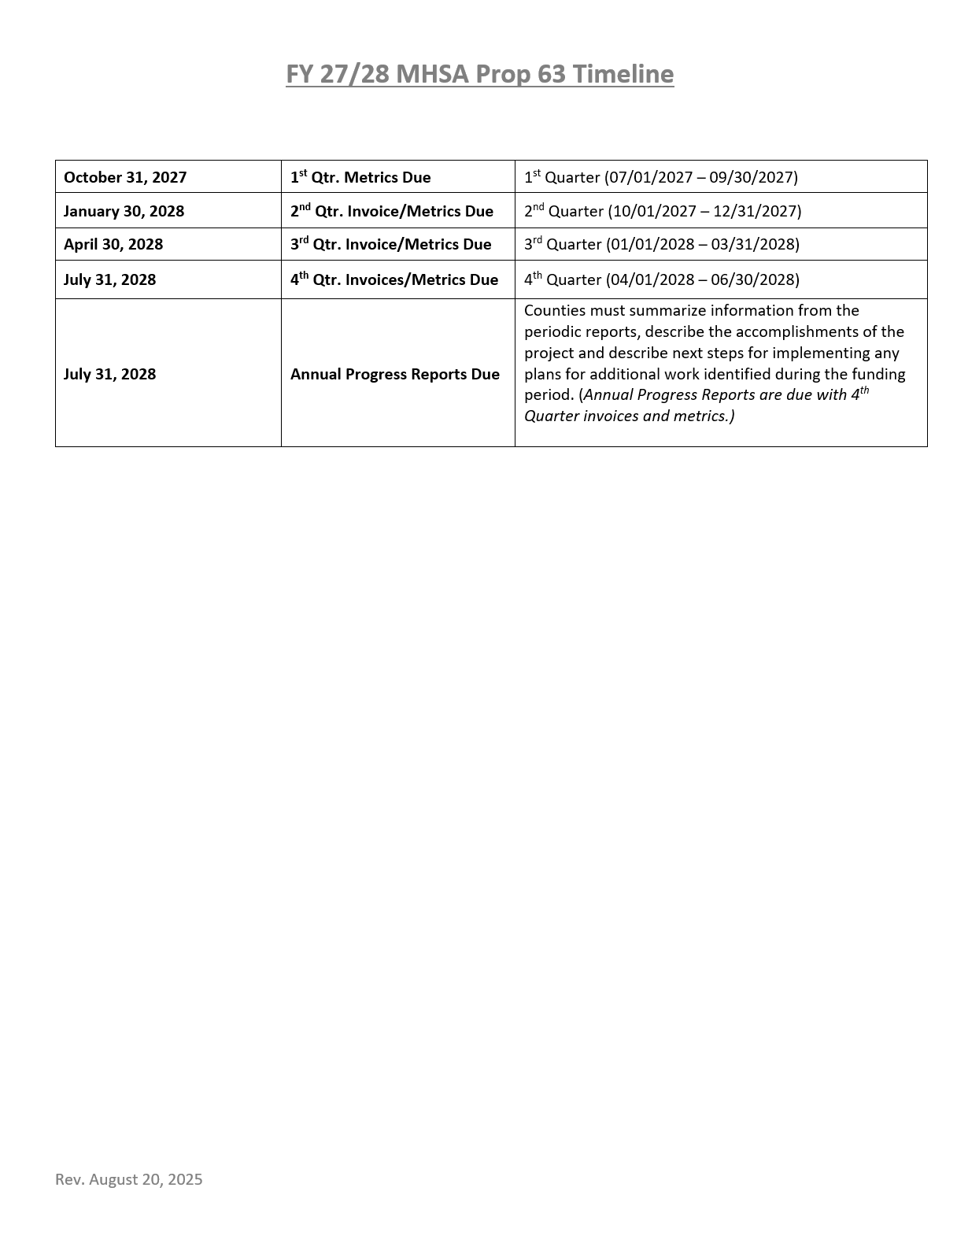

Slide 19
Funding Prioritization
Funding awards will be prioritized based on the following program models:
Applications that partner with California Community Colleges to directly provide veterans and their family members with no cost outpatient psychotherapy.
Applications that partner with nonprofit legal aid organizations to provide veterans and their families with pro bono legal assistance on discharge upgrades, eviction protections, immigration/naturalization.
Applications that directly provide outreach to senior veterans, particularly those in licensed Residential Care Facilities.
Applications that directly or through a community-based nonprofit, provide outreach to veterans who are LGBTQ+.

Slide 20
Funding Concerns
Fringe benefits above State/Federal average
Swag
Agency/unrelated expenses
Capital expenditures
Food and beverage
Costs outside of mental health outreach and treatment programs

Slide 21
Contact Information
Samuel Griffin
Chief, Training & Evaluation
Veterans Services Division
California Department of Veterans Affairs
samuel.griffin@calvet.ca.gov
(916) 503-8073
Phillip Leggett
Mental Health Coordinator
Veterans Services Division
California Department of Veterans Affairs
phillip.leggett@calvet.ca.gov
(916) 503-8327

Slide 22
Questions

