Slide 1
District Offices
October 21, 2025

Slide 2
Agenda
District Offices (DO) Programs and Data
Incarcerated Veterans Program
District Office-Reviewed VetPro Claims
Appeals and hearings
Board Data for CalVet-Represented Appeals
Last 7 slides shows staff list and POC’s for the District Offices

Slide 3
Incarcerated Veterans Program
Justice-involved incarcerated Veterans are STILL entitled to many of their VA benefits but often face challenges getting access to representation!
Who are we and what do we do?
Incarcerated Veterans Liaison Program (aka CDCR Liaisons)
Program was implemented in 2018, under CA SB 776.
We provide representation to the underserved incarcerated veteran population within CA Department of Corrections and Rehabilitation (CDCR) Facilities.

Slide 4
CalVet-CDCR Liaisons
CA SB 776 = MVC §715 and PC §2066
Military & Veterans Code (MVC) Section §715 – CalVet will provide 1 trained and accredited employee for every 5 state prisons to assist incarcerated veterans. Currently, that’s 7 accredited representatives for 32 CDCR facilities.
Penal Code §2066 – CDCR shall cooperate and collaborate with CalVet to ensure access, as reasonably necessary to perform their duties while at the prison, while taking all necessary safety precautions.
What services do we provide?
Assistance with claims, apportionments, C&P exam coordination, access to benefits etc.

Slide 5
Los Angeles District Manager
(10 Prisons)
Alberto Alpasan
Oakland District Manager
(18 prisons)
Zmae Raymundo
San Diego District Manager
(4 prisons)
Melaina Anker-Youngberg
CDCR Team Supervisor (Oakland)
Liz Hargrove-Washington
Los Angeles Region #1
VACANT
San Diego Region #1
Roberto Avila
Oakland Region #1
Sofia Martin Del Campo
Los Angeles Region #2
VACANT
Oakland Region #2
Mary Donovan
Oakland Region #3
Daryl Neff
Oakland Region #4
Tera Ireland

Slide 6
Incarcerated Veterans Program Data
 | Claims Filed | VAEs held | In-Person Interviews | Letters to veterans | Retro | Adjusted Monthly | Full Monthly Entitlement
State FY 22-23 | 364 | 288 | 223 | 1022 | $ 3,058,513 | $110,377 | $ 202,116
State FY 23-24 | 430 | 427 | 401 | 986 | $ 356,044 | $ 48,234 | $ 146,213
State FY 24-25 | 618 | 418 | 687 | 1387 | $ 377,005 | $ 59,097 | $ 130,197
Jul-Sep 2025 * | 185 | 179 | 284 | 354 | $ 305,444 | $ 49,391 | $ 61,557
* Most of the numbers, if sustained the next 3 quarters, will continue to show an increase.

Slide 7
Incarcerated Veterans Program Data
What are these numbers?
Why are they important?
A metric for us to track progress
Captures most important elements of Rep’s duties (claims, exams, prison visits, etc.)
Gives a snapshot of where we are, how we’re doing and how we can improve.
Provides historical data to measure future progress against past progress

Slide 8
District Office Review of Claims
VSO’s co-located with VAROs, historically received claims from the local offices under their respective jurisdiction.
(Old) Paper process – Counties mail to CalVet D.O. with 3 transmittal copies: (1) goes back to County with CalVet date stamp showing when we submitted it to the VA mail room, (2) stays with CalVet (having same date stamp), and (3) attached to the claim or evidence packet when it is submitted to the VA.
(Current) Electronic method – Counties submit electronic package to the D.O. using VetPro.

Slide 9
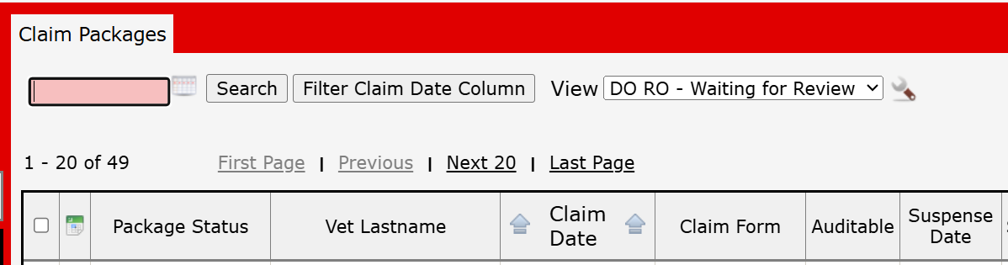
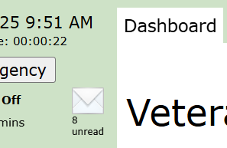
District Office Review Queue
how does it work?
County packages VA Forms and scanned documents or evidence as one claim activity.
After reviewing the attachments to the claim activity, click on Submit for Review and Save to electronically send it to the DO for review.
CalVet DO staff will review claim from the queue. If all is good, we submit to the VA. If not, we return to the County for necessary and suggested corrections.

Slide 10
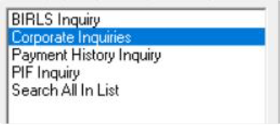
What Do We Review?
VBMS eFolder – if we have access, we check if there is current pending claim and/or prior decision on the contentions claimed.
SHARE – when we don’t have VBMS access, to check whether the veteran
Has NO POA
Has POA – NSO or accredited attorney/agent (code of mixed letters & numbers)
Has NO RECORD

Slide 11
Reviewed Electronic Claims
 | Oakland DO | Los Angeles DO | San Diego DO
State FY 22-23 | 14,414 | 13,212 | 4,275
State FY 23-24 | 17,442 | 20,065 | 6,456
State FY 24-25 | 23,476 | 19,662 | 10,558
Jul-Sep 2025 | 8076 | 5423 | 3083

Slide 12
DO Review Monthly Average

Slide 13
Returned Claims
Returned Claims % | Jan-Jun 2024 | Jul-Dec 2024 | Jan-Jun 2025 | Jul-Sep 2025
Oakland District Office | 7.5% | 9% | 8.5% | 8.6%
Los Angeles District Office | 10% | 9.5% | 9% | 5.1%
San Diego District Office | 10% | 4.5% | 6.5% | 5.5%
Unsigned forms
Incomplete forms
Wrong prescribed forms
Oak: 2692 x 8.6% = 231 monthly
LA: 1807 x 5.1% = 92 monthly
SD: 1027 x 5.5% = 56 monthly

Slide 14
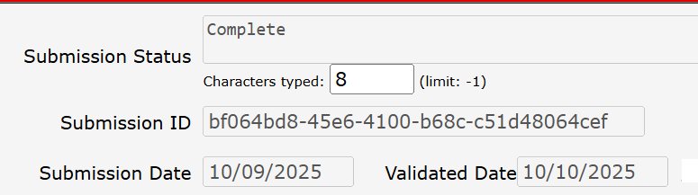
VetPro vs Quick Submit
Quick Submit – Claim submission status can only be seen by the representative via their own Quick Submit log on.
VetPro – Claim submission status can be seen by your office. If the representative that submitted the claim is out-of-office when a veteran checks status, you can confirm by checking VetPro.
If submitted via DO Review – District Office staff has a window to the claim, which is useful if we are assisting you address issues with the VA

Slide 15
District Office Appeals Team
What Do We Do?
BVA Hearings
VSC Hearings – due process or pre-determination
Public Contact – includes client walk-ins, phone/email inquiries, and VA/other VSO request for assistance.
Why Us?
A second set of eyes
Less emotional; more objective.
Either reinforce what you already told them or lay it down as we see it.
Tracking our cases, we see trends (such as hearing schedule and decision wait times).
Passionate, but
no false hopes.

Slide 16
Hearings
 | Oakland DO | Los Angeles DO | San Diego DO
State FY 22-23 | 447 | 271 | 95
State FY 23-24 | 315 | 239 | 78
State FY 24-25 | 451 | 198 | 98
Jul-Sep 2025 | 70 | 37 | 38
Please reach out to us if the appellant reaches out to you. Remember, even when we are notified early, we still have to work our cases according to the hearing date.
If you are hosting the virtual hearing in your office, let us know if rep will stay with appellant. We need to notify BVA Coordinator and Judge that there is an observer.

Slide 17
Board Data for CalVet Representation
Full Grant | Partial Grant | Remand | Denied | Other | No Decision | Total Appeals
390 | 130 | 310 | 169 | 229 | 1647 | 2875
Full & Partial Grants = 42% |  | 25% | 14% | 19%
(Total Appeals with Decisions Issued) 1228 |  |  |  |  | 1647
42% |  |  |  |  | 67%
Appeals–hearing lane received Oct 2019 to Sep 30, 2025:
Total: 2,875
Decisions Issued: 1,228
No Decision: 1,647
1,647 pending.
It takes 3.5 years!

Slide 18
BVA Docket dates
Hearing dockets
Oldest docket date waiting for a BVA Decision is September 16, 2019 (as of 1st October) – also there are 100 AOD cases are ahead of that appeal.
Hearings scheduled this month have November 2021 to February 2022 docket dates.
FYI, half of Oakland hearings held April 2024 are still waiting on BVA Decisions (early 2021 docket dates).
Evidence Review docket – oldest is February 11, 2021
Direct Review docket – oldest is April 5, 2021

Slide 19
Board Data for Hearings
*Federal FY is Oct to Sep
343-344-377 dockets only
July 2022 – Reopened to walk-ins

Slide 20
District Managers
Alberto Alpasan
Los Angeles District Manager
Alberto.Alpasan@calvet.ca.gov
LADO@calvet.ca.gov
(213) 620-2755
Melaina Anker-Youngberg
San Diego District Manager
Melaina.Anker@va.gov
State.VBASDC@va.gov
(619) 400-0070
Zmae Raymundo
Oakland District Manager
Zheriemae.Raymundo@calvet.ca.gov
Oakland.Oakland@calvet.ca.gov
(510) 286-0627
Questions?
Note: POCs for each District Office begins on the next page.

Slide 21
Oakland DO Staff list
Appeals Team
Office Technician: David Pham
Steven Smith, Assistant District Manager
Leonora (Cora) Sarmiento
Agnes Manalo (retiring Oct 31)
Elizabeth Grassetti
Akeesha Barrett
Liam Williams (Rancho office)
Joseph Klabouch (Rancho office)
Judy Cortez-Garcia
Vacant (prev Cristina)
Review Team
Diane Susbilla, Team Supervisor
Daniel Vilhauer
John-Eric Gabagat
Walter Huey
Teri Markus

Slide 22
Oakland DO Staff list
Incarcerated Veterans Team
Liz Hargrove-Washington, Team Supervisor
Mary Donovan
Tera Ireland
Sofia Martin Del Campo
Daryl Neff
Email us: Rep4incarceratedvets@calvet.ca.gov

Slide 23
Oakland District Office General Information
Oakland DO Point-of-Contact (POCs)
Appeals team:
For decision review guidance, email Steven –Steven.Smith@calvet.ca.gov
For hearing schedule confirmations & inquiries, email Cora – Leonora.Sarmiento@calvet.ca.gov
Review team:
The DO Reviewer of your claim activity
Diane.Susbilla@calvet.ca.gov
CDCR team:
Elizabeth.Hargove-Washington@calvet.ca.gov
Oakland Office (Main):
1301 Clay St. Suite 1130N
Oakland, CA 94612
Open Tue, Wed & Thurs
9:00 AM to 3:00 PM
Phone 510.286.0627
Fax 510.286.0653
Rancho Office:
3046 Prospect Drive
Rancho Cordova, CA
Only for hearings & appointments
Phone 916.364.6774
Corporate inbox: Oakland.Oakland@calvet.ca.gov

Slide 24
Los Angeles DO Staff list
Alberto M. Alpasan, Jr. – District Manager
Front Office – Heather Maciel
Appeals Team
DO Review Team
Darlene Dunlap, Appeals Manager
Maria Alatorre
Babes Navarra
Delores McLemore
Joberde Metellus
Isaac Escobar
Vacant
Porcia Andrada Eileen Dizon
Esther Luna Isabella Alejandrino
CDCR Team
Vacant (2 positions)
Sandra Matrecitos (temp cover)

Slide 25
Los Angeles District Office General Information
LA District Office POC
11000 Wilshire Blvd. Ste. 505
Los Angeles
Open to the public:
Mon-Wed 8am to 3pm
(213) 620-2755
Corporate mail:
CDVALA@va.gov (you can send PII as long as you encrypt)
For issues relating to appeals(hearings or to discuss appeals issues):
Darlene Dunlap
Darlene.Dunlap@calvet.ca.gov
Darlene.Dunlap344@va.gov

Slide 26
San Diego DO Staff List
Melaina Anker-Youngberg
District Manager
Claim Support-Appeals
Office Technician: Monica Flores
Tony Devore, Claims Support Supervisor
Angel Bribiesca
Judith (Judy) Roach
Arnold Cantong
Eugenia Agis
Nikki Sada
Justin Louie
Vacant
CalVet-CDCR Liaison
Roberto Avila

Slide 27
San Diego District Office General Information
San Diego District Office
8620 Spectrum Blvd. Rm 725
San Diego, CA 92123
Open to the Public:
Tue., Wed., Thur. 8am-3:30pm
Public Line: (619) 857-5497
Fax Line: (858) 268-1014
San Diego Corporate Email:
state.vbasdc@va.gov
San Diego Office Point of Contacts (POC)
Claim Guidance, AMA Decisions/Guidance, Board hearings & Board Appeals, email Tony Devore Tony.Devore@va.gov
CDCR (Incarcerated Veterans), email Roberto Avila Roberto.Avila@calvet.ca.gov

