Slide 1
Intent to File
(38 CFR §3.155)
October 21, 2025
CA CVSO Fall Training Conference

Slide 2
Why are we reviewing 38 CFR § 3.155?
To understand the intent to file (ITF) better.
To be more responsible with ITF submissions.
    Not just submitting ITF, but to also do our due diligence to ensure the ITF submitted made it into VBMS and tagged properly by VA.
    Check whether our submitted ITFs are duplicate.
This is a refresher for seasoned representatives, and provide better basics for new trainees.

Slide 3
Discussion Points
Intent to File (ITF) requirements
Ways to submit ITF
Incomplete application form (non-electronic)
VA responsibility with ITF
Duplicate ITF

Slide 4

38 CFR § 3.155 (b) – Intent to file a claim.
A claimant or his/her duly authorized representative may indicate a claimant’s desire to file for benefits by submitting an intent to file a claim to VA.
An intent to file a claim (ITF) must provide sufficient identifiable biographical information to identify the claimant.

Slide 5
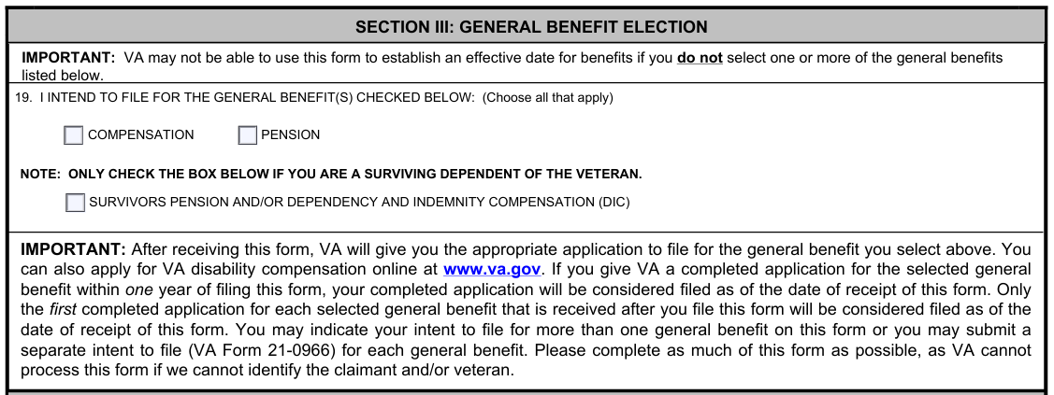
38 CFR § 3.155 (b) – Intent to file a claim.
ITF must identify the general benefit – compensation, pension or survivor’s benefit.

Slide 6
What are the two requirements again?
An intent to file a claim (ITF) must provide sufficient identifiable biographical information to identify the claimant.
ITF must identify the general benefit – compensation, pension or survivor’s benefit.
Next:
Per 38 CFR § 3.155(b)(1), an ITF can be submitted in one of three ways.

Slide 7
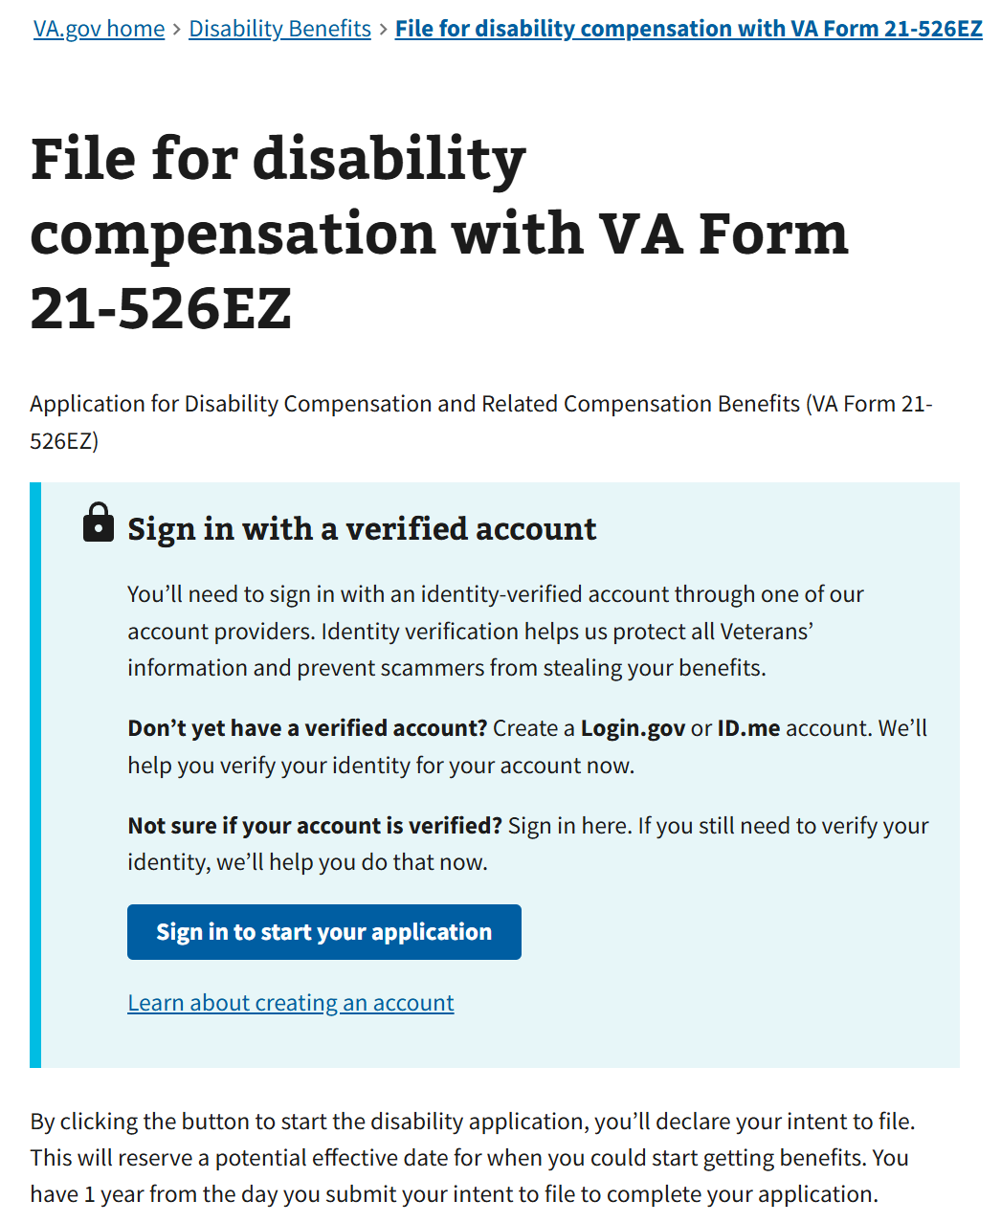
How can the ITF be submitted?
Saved electronic application.
  Application form accessed and started on www.va.gov, then saved for completion later.

Slide 8
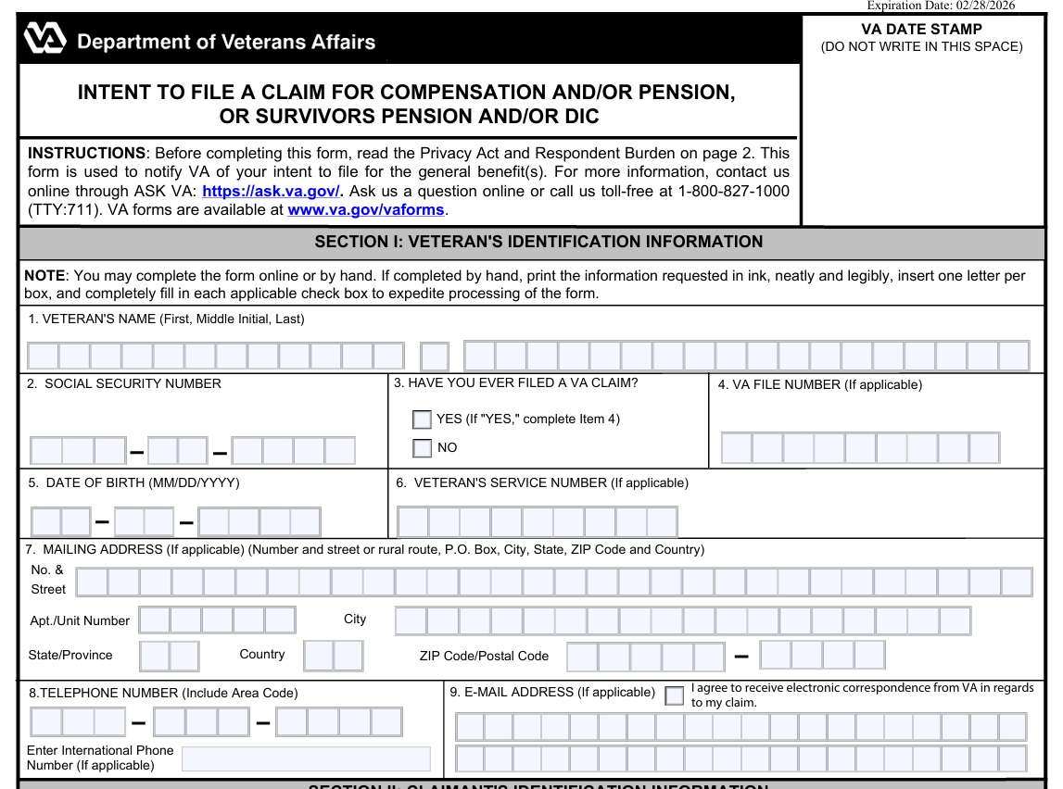
How can the ITF be submitted?
Written intent on prescribed intent to file a claim form.
  VA Form 21-0966.

Slide 9
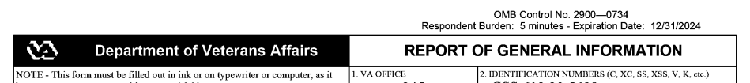
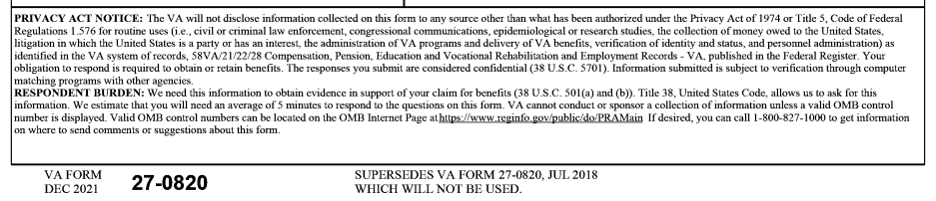
How can the ITF be submitted?
Oral intent communicated to designated VA personnel and recorded in writing.
  Federal VA personnel designated to receive such communication – 800# or VA public contact staff. Not CalVet, not CVSO.

Slide 10
What are the three ways again?
Saved electronic application.
Written intent on prescribed intent to file a claim form.
Oral intent communicated to designated VA personnel and recorded in writing.
Always check for an active ITF in the system. The client might not know they have one on file, but we should be able to see that in VBMS:
  If we are actively checking after submission of the ITF
  Or if we check during or immediately after first contact with the client.

Slide 11
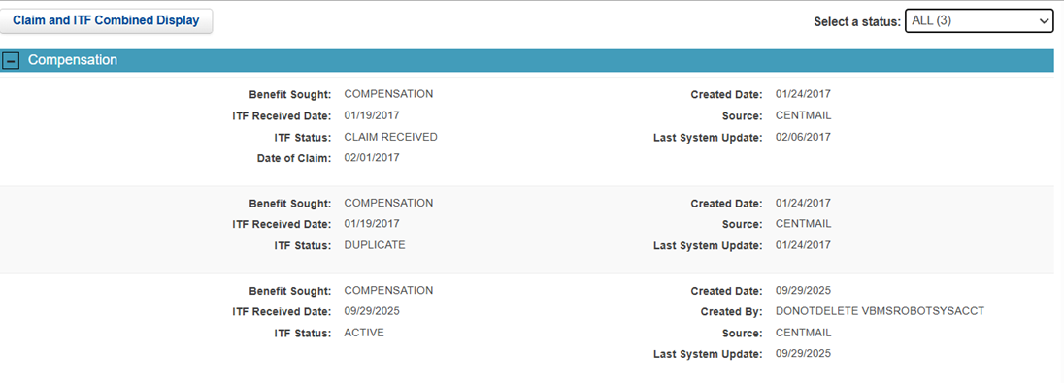

Slide 12
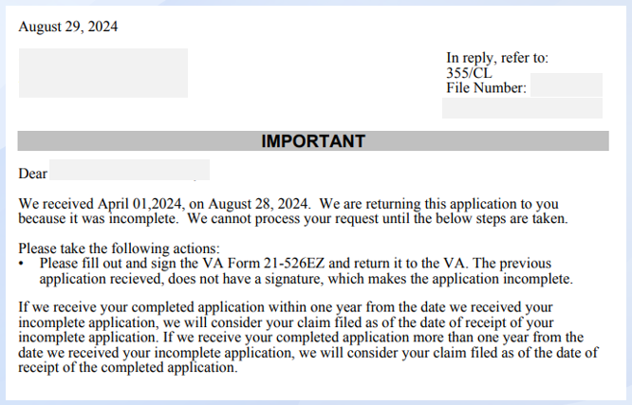
38 CFR § 3.155(c):
Incomplete application form received by VA, notify the claimant of the information necessary to complete the application form.
If complete claim is submitted within 1 year of the receipt of the incomplete application, VA will consider it filed as of the date of VA received incomplete form.
Until when does claimant have to submit complete claim?
March 2025

Slide 13
VA Responsibility With ITF
Complete ITF will create active ITF status in VBMS and notify claimant of the information necessary to complete the appropriate form (VAF 21-526ez, 527ez, 534ez).
No complete VA form within 1 year of ITF?
  ITF status will switch from active to expired, and no further action required from VA.
  No letter will be sent to remind claimant before expiration.
ITF signed by VSO/POA, but no current valid VAF 21-22 for said VSO/POA = invalid ITF.

Slide 14
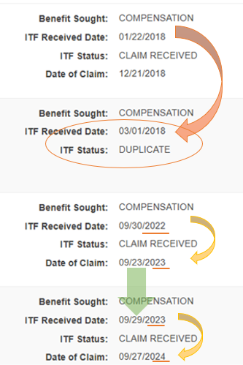
Duplicate ITF
38 CFR §3.155(b)(6)
VA will not recognize more than one ITF concurrently for same benefit.

Slide 15
Examples of ITF Issues
Incomplete ITF used to grant, and it was caught later by VA as CUE and they proposed to sever SC for condition.
Incomplete VA Form 21-0966 (ITF) identified immediately, but no response from veteran.
ITF active when veteran and VSO signed 21-22, which was submitted with ITF-comp.
  Formal claim submitted past 1 year of the 1st ITF,
  And within 1 yr of VSO-submitted ITF.
  VA grant is only effective receipt of VAF 526ez.

Slide 16
Examples of ITF Issues
0995 took ITF, but vet and another VSO meant that for 526ez new claim. New condition grant effective receipt of 526ez.
The VA Form 21-0966 (ITF)
is a dumb form – it follows whatever it smells first.

Slide 17
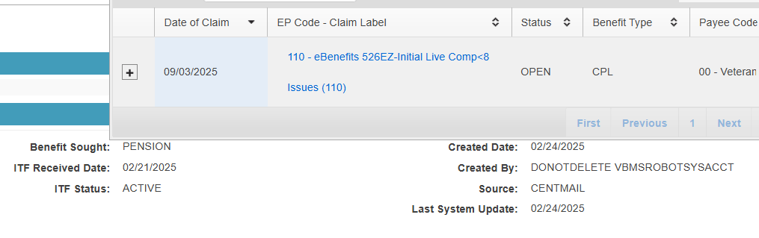
What do you notice with this snip from VBMS?

Slide 18
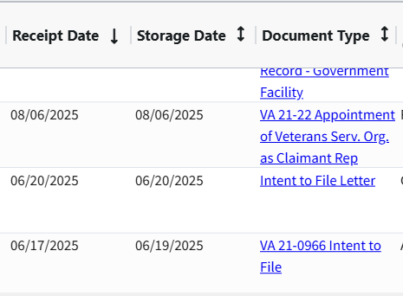
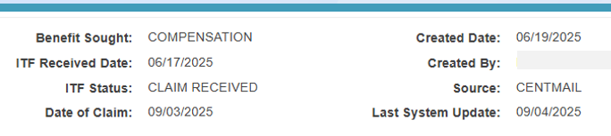
How about this one, what do you think happened here?

Slide 19
Questions?
Zmae Raymundo
Oakland District Manager
Zheriemae.Raymundo@calvet.ca.gov
Oakland.Oakland@calvet.ca.gov
(510) 286-0627

