Slide 1
Decision Review Request: SUPPLEMENTAL CLAIM 38 CFR § 3.2500 Review of Decisions 38 CFR § 3.2501 Supplemental Claims M21-1, Part II, Subpart iii, Chapter 2, Section B - Supplemental Claims
October 21, 2025

Slide 2
What is a Supplemental Claim
A complete claim from a Department of Veterans Affairs (VA) benefit where the claimant or his/her representative disagrees with the VA’s decision(s).
Supplemental claims may also be filed based on a new theory, service connection previously claimed, now claiming as a secondary condition
Supplementals claims evidentiary record must include new and relevant evidence that was not of record as of the date of notice of the prior decision.
Supplemental claims must be submitted on a VA Form prescribed by the Secretary
Why is this information important?
To Avoid

Slide 3
Supplemental Claim Common Discrepancies
Listing VA health care records that have already been considered in the prior decision
Resubmitting a veteran's personal statement already taken into consideration
Quoting Title 38 regulations already considered by the Rating Veterans Service Representative
Disagreeing with a VA contracting Examiner’s negative medical opinion without a contradictory positive Nexus Letter
Listing the condition on the prescribed form without new and relevant evidence
What is the outcome without N&R Evidence?

Slide 4

“Confirmed and Continued Denial”

Slide 5
New and Relevant Evidence
Best Practice Include:
A simple definition: Information the VA did not have at the time of the decision which proves your case
Examples of N&R Evidence:
Lay/buddy statements i.e., buddies the veteran previously served with, family, friends, religious leaders
Medical evidence i.e., recent private medical evidence, VHA/community care treatment records (not previously considered)
Alternative treatment i.e., acupuncture, chiropractic care, homeopathy, massage therapy, herbal medicine etc.
Nexus letter’s from treating providers not previously considered and not part of the current record at the time of the prior decision
Change in law that occurred after the prior decision and is beneficial to the veteran’s claim

Slide 6
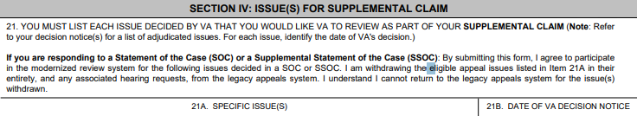
Supplemental Complete Claim Packet
File a supplemental on VA Form 20-0995 Decision Review Request: Supplemental Claim
Attach a VA Form 21-4138 Statement in Support of Claim:
Identifying the benefit being sought i.e., service connection (direct or presumptive), secondary, IU etc.
Action being required reopen, Admin review etc.
Include an updated personal statement from the veteran addressing current severity, and the impact on quality of life (if applicable)
List the supporting evidence that is being included with the supplemental claim
Section IV: Issue(s) for Supplemental Claim Box 21A Specific Issues, only list the specific issue(s), do not write the narrative reason for the supplemental, this makes it difficult for the AI system to establish the proper condition being claimed

Slide 7
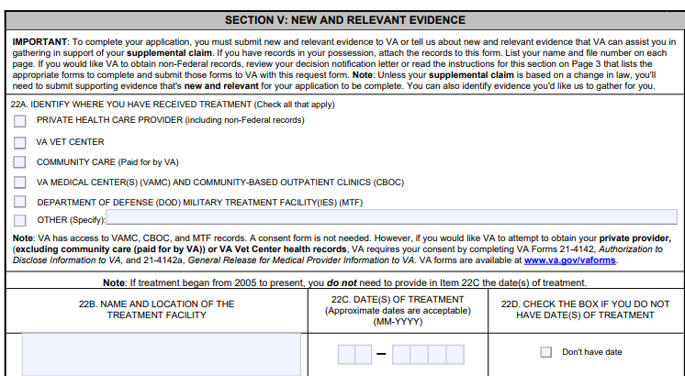
Supplemental Complete Claim Packet
Section V: New and Relevant Evidence 22A Identify where you have received treatment, check all appropriate boxes that apply & complete box 22B, 22C (for treatment prior to 2004), 22D (no date of treatment)
Reminder!
Include Private Medical Evidence or VA Form 21-4142/4142a (Release of Authorization)

Slide 8
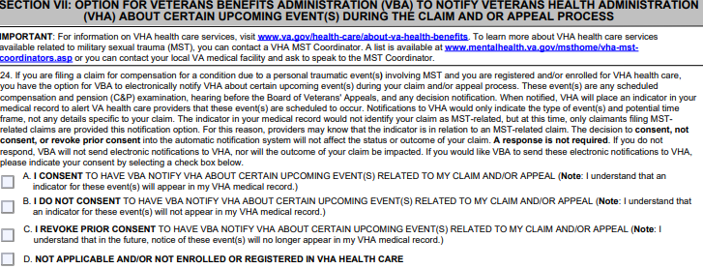
Supplemental Complete Claim Packet
Section VII: OPTION FOR VETERANS BENEFITS ADMINISTRATION (VBA) TO NOTIFY VETERANS HEALTH ADMINISTRATION (VHA) ABOUT CERTAIN UPCOMING EVENT(S) DURING THE CLAIM AND OR APPEAL PROCESS, Check the appropriate box.

Slide 9
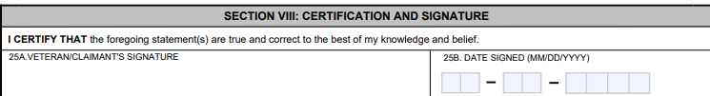
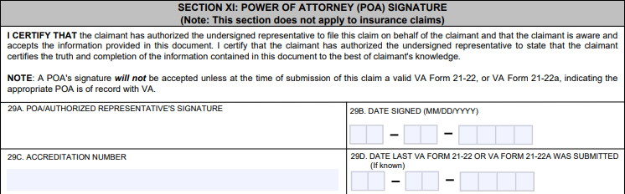
Don’t forget to Sign
Section VIII: Certification and signature, box 25A Veteran/Claimant
Section XI: Signature of Power of Attorney (POA) Signature

Slide 10
Example of Statement in Support of Supplemental Claim

Slide 11

Complete Supplement Claim leads to better Outcomes and more of these:

Slide 12

Questions
This Photo by Unknown Author is licensed under CC BY

Slide 13
Decision Review Option Higher Level Review 38 CFR §3.2601
October 21, 2025

Slide 14
The Appeals Modernization Act (AMA)
Effective February 19, 2019, AMA was implemented to provide three Decision Review Options:
Veterans Benefit Administration | Board of Veterans Appeals
Supplemental Claims (VAF 20-0995) | Notice of Disagreement (VAF 10182)
Higher Level Review (VAF 20-0996)

Slide 15
Higher Level Review (HLR)
A Higher-Level Review is a de novo review of a prior VA decision identified on a VA Form 20-0996
A Higher-Level Review is a closed record review, new evidence may not be introduced to the record
A Higher-Level Review is not an appeal
HLRs is used when an error in either fact or law has been identified
Error in fact – VA failed to consider evidence of record or procedural errors
Error in law – VA failed to apply the law correctly
A VSO/Representative may sign the VA Form 20-0996
An ITF can not be used for HLR

Slide 16
Higher Level Review Requirements
A completed VA Form 20-0996
Indicate the issue or issues that a HLR is being requested
Must be submitted within one year from the VA decision that a Higher-Level Review is requested
If an Informal Conference is requested, item 16A and 16B must be completed
If an Informal Conference with the veteran’s representative is requested, item 17A, 17B and 17C must be completed

Slide 17
Informal Conference
An informal conference is an over-the phone contact, which allows the claimant or the veteran’s representative to identify any errors in fact or law
Only one informal conference may be conducted, when requested
A Decision Review Operations Center (DROC) will make two attempts to schedule an informal conference
A Decision Review Officer will conduct the informal conference and decide one the issue/issues

Slide 18
Higher Level Review Returns
Once a Duty to Assist error is identified in a Higher-Level Review, a Decision Review Officer will complete a VA Form 20-0999
The DRO will indicate the identify the error and the reason/reasons for the HLR return
The claim will be returned for development as indicated on the 20-0999; the EP will be changed from 030 to 040
VA will re-adjudicate the claim once development is completed

Slide 19
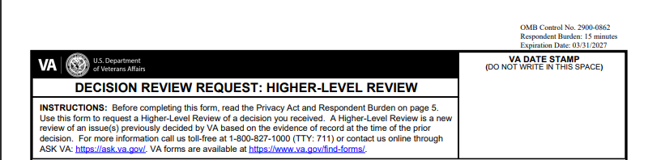
VA Form 20-0996
A completed and signed VA Form 20-0996 is required when requesting a Higher-Level Review

Slide 20
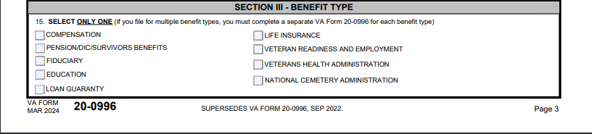
VA Form 20-0996
Indicate which benefit type, submit separate VA Forms 20-0996 if more than one benefit type is being considered for a Higher-Level Review

Slide 21
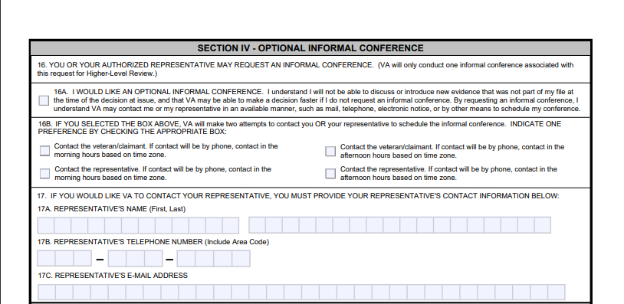
VA Form 20-0996
Consider if an informal conference is needed

Slide 22
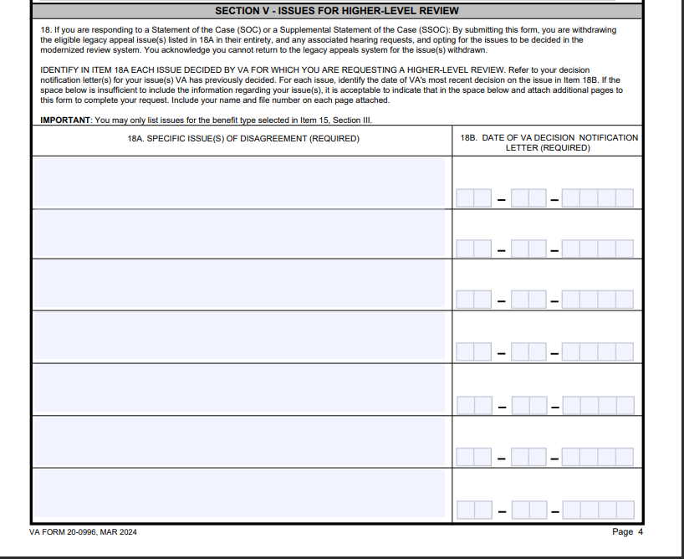
VA Form 20-0996
Clearly indicate the issues

Slide 23
HLR Best Practices
Clearly indicate what issue or issues that is being presented for Higher-Level Review
Ensure that the HLR is within the one-year decision review period (from the date of the VA Rating Decision)
You can provide a statement to point out the error in fact or law in lieu of an informal conference – advisable to not do both
Analyze the case and decide if a Higher-Level Review is the appropriate review option – VA decisions are evidence based, consider a Supplemental Claim

Slide 24
Questions?

