Slide 1
VetProWeb
Fall Conference 2025
Panoramic Software. Inc.

Slide 2
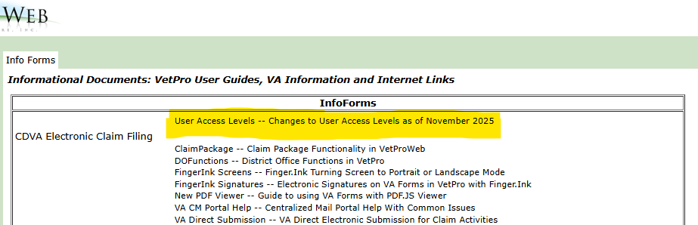
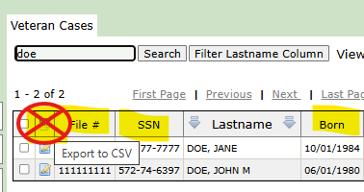
User Level Access Changes
User Levels MOST affected
Vet Rep
Supervisor
Clerical
Unused or Deprecated Levels removed
ALL user levels – no PII allowed via Veteran Grid Export
Please see Info Forms > User Levels - Changes to User Access Levels as of November 2025 for details.

Slide 3
VETPRO – Timeline Path to “2.0”
Year 1991
VetPro “1.0” – VetProDOS – In the beginning… Born in California, Panoramic Software branches out from Public Guardian/ Public Administrator HSA base application. Art VonWaldburg develops software solution for SFO CVSO.
Year 2000
VetPro “2.0” – VetProSQL – Microsoft Windows and SQL server platform.
Year 2005
VetPro“3.0” – VetProWeb is LIVE !– Use VetPro, anytime, anywhere with internet access! 15 counties converted from previous platform with 49 users
Years 2010 - 2019
VetProWeb for CALVET – All CA Counties using ONE application for Claims and reporting. On boarding process begins FY 10/11, resulting in 57 agencies/400+ users by 2013
CalVet development and maintenance of paperless, remote, mobile functionality and system modernization
Claim Package and DO Review
Finger.Ink
VA Direct Submit
“Big Data” for California Veteran Services -- Audit Reports > Legislature Reports
Years 2019- 2022
Remote Email signatures for VA Forms -- finally allows for truly remote veteran interaction for claim processing.
College Fee Waiver Portal – Enhances and secures DVS 40 Fee Waiver process. California College certifying officials become VetPro users. CalVet, Panoramic and CVSO’s across the state partner to react quickly to address critical vulnerability to key State Veterans’ benefit program

Slide 4
VETPRO – Timeline Present and Future
Years 2019 - Present
VETPRO National is LIVE (VetPro “4.0”). Our “NEXT GENERATION” application platform for County VSRs to serve Veterans and file claims efficiently
Q1 2025 – Auto-Establish of VAF 21-22/ 21-22a marks a significant milestone in automating and streamlining the benefits application process for VSRs and veterans.
Years 2022 - 2025
VetPro”5.0” Requirements and Design for California’s VETPRO “2.0”: Intake Module (Reception Queue/Visitor Phone Calls )
and County Form Letters
Years 2024 - 2025
VetPro”5.0” Requirements and Design for VETPRO “2.0” Exclusive California modules:
DO Review, Audit Reports and WLU tracking,
Legislature Metrics
Veteran Discovery/Transfer
Begin building modules
Year 2026
VetPro”5.0” Requirements and Design for VETPRO “2.0” Exclusive California modules:
Intake Module (Reception Queue/Visitor Phone Calls )
County Form Letters
Complete building modules and integrate
Assemble training materials and videos
Q1 Year 2027
California “Next Gen” Go live! – Application up and running
Data Mapping and Migration
User Training and migration

Slide 5
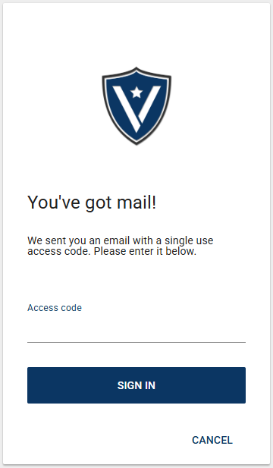
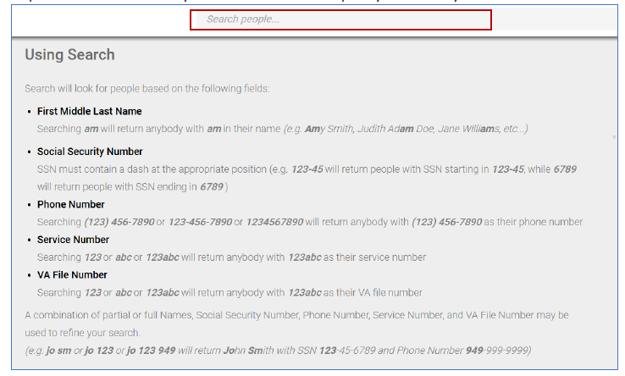
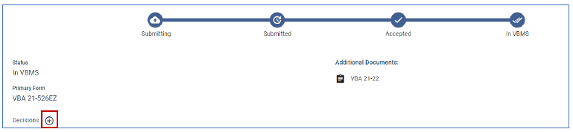
VETPRO User Interface – “LOOK and FEEL”
Enhanced Secure Logon with No Password to remember! Once authenticated, users may choose to receive 6-digit codes via email or SMS text.
Dynamic “Smart Search” feature
Intuitive Action space for reviewing Claim components, Submission Status and ability to instantly “Auto-Establish” certain VA forms in VBMS (e.g. 21-22, 21-0966)
Robust Performance and Ad Hoc Reporting. Create and save frequently needed queries for simple consistent data results

Slide 6


Thank you for serving Veterans!
Notes:
Thank you for your time and thank you for serving Veterans!

