Slide 1
CVSO Statutes, Regulations, and Policy Review
Presented by:
Sean Johnson / Asst. Deputy Secretary / Veterans Services Division
Nancy Noriega / County Support Unit Manager / Veterans Services Division

Slide 2
Presentation Objectives
Shared understanding around laws, regulations, and policies guiding the relationship between U.S. Department of Veterans Affairs, CalVet, and CVSOs
Shared understanding around the roles and responsibilities inherent within the system of veterans’ claims support and representation
Description of processes and procedures of the County Support Unit

Slide 3
Federal Regulatory Definitions
Accreditation: the authority granted by VA to representatives, agents, and attorneys to assist claimants in the preparation, presentation, and prosecution of claims for VA benefits
Claim: application made under title 38 United States Code (U.S.C.), and implementing directives, for entitlement to VA benefits, reinstatement, continuation, or increase of benefits, or the defense of a proposed agency adverse action concerning benefits.
Claimant: a person who has filed or has expressed to a representative, agent, or attorney an intention to file (VA Form 21-0966) a written application for determination of entitlement to benefits provided under 38 U.S.C., and implementing directives.
Complete Claims Service: representation of each claimant requesting assistance, from the initiation of a claim until the completion of any potential administrative appeal.
Representation: the acts associated with representing a claimant in a proceeding before VA pursuant to a properly executed and filed VA Form 21-22, “Appointment of Veterans Service Organization as Claimant's Representative,” or VA Form 21-22a, “Appointment of Individual as Claimant's Representative.”

Slide 4
The Shared Mission of USDVA, CalVet, and County Veterans Service Officers
Federal
State
The Public
Local
Plurality
“Someone who shares the same physical body with other individuals”
The system is the body
Veterans at the center
USDVA
CalVet
Veterans
Counties

Slide 5
U.S. Department of Veterans Affairs
VA Outreach Duty
38 U.S.C. § 6301 et seq. – Charges VA with duty to seek out eligible veterans/dependents for purpose of providing earned benefits and services (a.k.a. – Outreach Services Program).
38 U.S.C. § 6306 – Explicitly charges VA Secretary to “cooperate and use the services of” any state or local governmental agency.
VA Power to Regulate Veteran Service Representation
38 U.S.C. § 5904 – Authorizes VA Secretary to recognize, requires VA Secretary to prescribe regulations pertaining to representative qualifications and standards of conduct.

Slide 6
CalVet
CalVet Mission
MVC § 695 – Authorizes CalVet to cooperate and contract with VA and other federal officials in carrying out CalVet’s mission, particularly for processing of claims.
MVC §§ 699-699.5 – Authorizes CalVet mission, particularly for processing of claims, and compels CalVet and counties’ cooperation.
Veterans Services Division County / Claims Support
MVC §§ 699.5(b)-(d) – Recognizes CVSO partnership and financial responsibility. Sets baseline collective county expense threshold for State budget appropriation ($5 million).
MVC § 972 – Establishes subvention program.
MVC §§ 972.1-972.5 – Establishes fixed appropriation for subvention program.
Establishes requirement for formula based allocation.
Establishes Veterans Service Office Fund.
Authorizes Medi-Cal Cost Avoidance subvention

Slide 7
Participating Counties
County Veterans Service Officer (CVSO)
Military & Veterans Code (MVC) § 970 – Authorizes counties to appoint a CVSO, which shall be a veteran. Further establishes CVSO duty to administer local aid.
MVC § 971 – Establishes CVSO duties to assist veterans and their families in pursuing claims and obtaining both federal and State benefits.
County Veterans Service Offices
MVC § 972 – Authorizes counties discretion to support county veterans service offices, at county’s expense.
MVC § 699.5(c) – Requires counties electing subvention participation to document claims activity.

Slide 8

California Public Veteran Claims Services System Structure Summary
California support
MVC § 695 – Authorizes CalVet to cooperate and contract with VA and other federal officials in carrying out CalVet’s mission, particularly for processing of claims.
MVC §§ 699-699.5 –Authorizes CalVet mission.
MVC §§ 972-972.5 – Establishes financial incentives for county participation.
Federal benefits
38 U.S.C. § 6301 et seq. – Outreach Services Program
38 U.S.C. § 5904 –VA Secretary to regulate representation

Slide 9
Shared Mission Statutory Basis Summary
Federal Benefits/Oversight
38 U.S.C. §§ 5902-5904; 38 C.F.R. Part 14
Secretary of VA
VA Office of General Counsel
State Support/Oversight
Subvention Program (MVC § 972.1, § 972.5)
Veterans Service Office Fund (MVC § 972.2)
VetPro
Policies on Accreditation, Claims Submission, and Representation
County Implementation
County veterans service office discretion
CVSO Appointment (MVC § 970)
County veterans service office option (MVC § 972)
Preparation, presentation, prosecution of claims (MVC § 971)
USDVA
CalVet
Veterans
Counties

Slide 10
CA Compared to Other States
California financially supports CVSOs through:
County Subvention Program
Veterans Service Office Fund
Medi-Cal Cost Avoidance
Mental (Behavioral) Health Services Act
29 of 50 states assist veterans in preparation, presentation, and prosecution of claims before the VA through CVSOs

Slide 11

CVSOs in Texas
Texas law defines “office” vs “officer”
CVSO required in counties with population over 200k, county discretion under 200k
Roughly 200 of 254 counties have a CVSO
Texas law enumerates certification training and annual continuing training
Texas Veterans Commission
Oversees training and accreditation of CVSOs
“Fund for Veterans’ Assistance” competitive grants (similar to MHSA, but also available to nonprofits)
Specifically not to be used for claims support

Slide 12
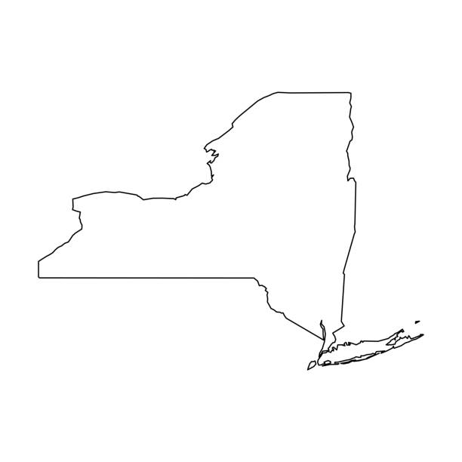
CVSOs in New York
Mandates that each county have a CVSO
No uniform accreditation training. Has options through New York Dept of Veterans Services (DVS) or NACVSO
Accreditation maintained through monthly and annual training
New York DVS has state representatives in Veterans Resource Centers in tandem with CVSOs
No subvention, but grants for other services

Slide 13
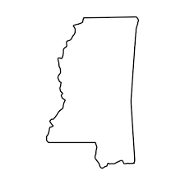
Veterans Services in Mississippi
In Mississippi, veterans can file VA claims at both the state and county levels.
Mississippi Veterans Affairs has 10 offices. Five of 82 counties have veterans services offices.
State accreditation with fiduciary duty.
Counties certified through MS Veterans Affairs and accredited through NACVSO/other national organizations.
No state funding, only benefits.

Slide 14
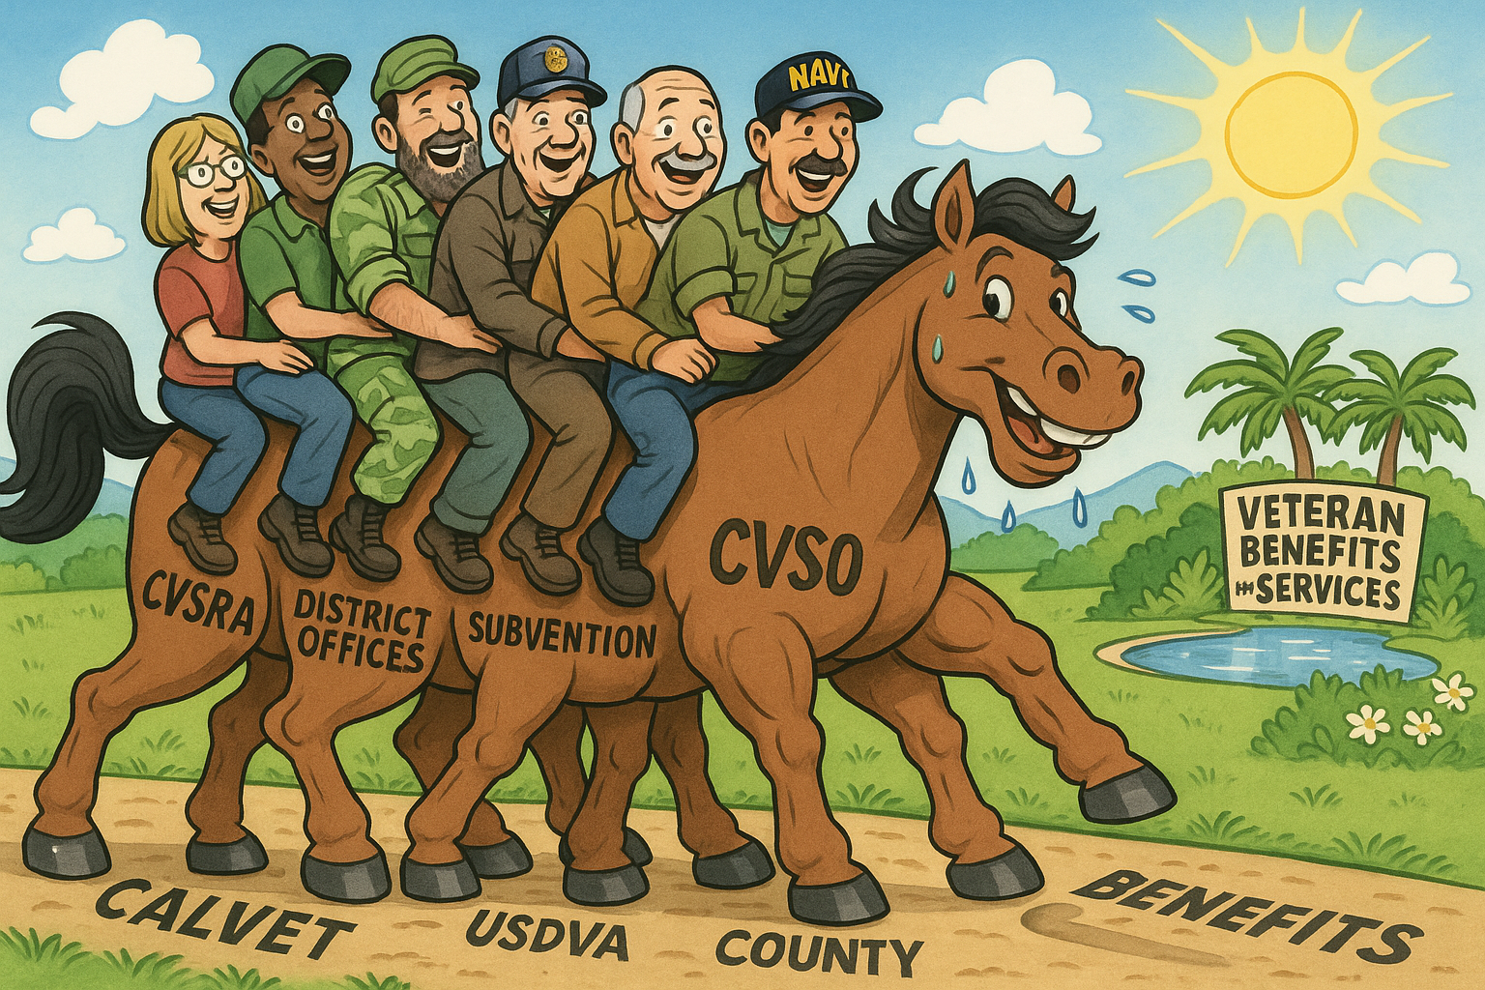
Veterans Services Division Claims/County Support
California Veterans Service Representative Academy
District Offices Claims Support/Appeals Teams
Subvention Program
Image created with artificial intelligence (AI) seeking representation of the system. The composition of the veterans and animal depicted is the result of AI, and not CalVet AI training.

Slide 15
Veteran Service Organization Recognition
38 U.S.C. § 5902 – Recognition of representatives of organizations
Federal authority giving VA Secretary power to recognize
Authorizes VA Secretary discretion on furnishing “space and office facilities”
Establishes organizational power of attorney as means for representation
38 C.F.R. § 14.628 - Recognition of organizations requirements
Primary purpose serving veterans
Substantial commitment to serve veterans
Significant capacity for direct services to serve veterans
Maintain policies and capability for Complete Claims Service

Slide 16
CalVet as State Veterans Service Organization
38 C.F.R. § 14.628(d) – Requirements for Recognition
Primary Purpose Serving Veterans – met through MVC §§ 699-699.5
Substantial Commitment to Veterans – met through MVC §§ 60-90.2, 699-699.5
Significant Capacity to Serve Veterans – met through above and MVC §§ 972-972.5, including VetPro
Maintain Policies and capability for Complete Claims Service – met through CCRs and operational policies such as Accreditation Policy, Representation Policy, and Claims Submission Policy

Slide 17
Authority to Represent
38 U.S.C. § 5902 authorizes representation under federal law
38 C.F.R. § 14.630 – Authorization for a Particular Claim
Specific claim-based power of attorney representation (VA Form 21-22)
Compliance with standards on claims representation (38 CFR § 14.632, CalVet Representation Policy)
38 C.F.R. § 14.631 – Powers of Attorney
VA Form 21-22 authorizes access of sensitive information to representative and organization (§14.630(a)&(b))
Representative/Organization duty bound to veteran, limited withdrawal:
would not adversely impact the claimant's interests
claimant persists in a course of action that the organization or individual providing representation reasonably believes is fraudulent or criminal and is furthered through the representation of the organization or individual
claimant fails to uphold an obligation to the organization or individual providing representation regarding the services of the organization or individual
other good cause

Slide 18
VA Accreditation through CalVet VSO
38 C.F.R. § 14.629 – Requirements for accreditation of service organization representatives
Good character and reputation
Demonstrated ability to represent claimants
Member in good standing or paid employee committed to working at least 1,000 hours annually
Successful completion of VA Office of General Counsel approved accreditation training
Regular supervision and monitoring or annual training for continued qualification

Slide 19
Representative Standards of Conduct
38 C.F.R. § 14.632 – Standards of conduct for persons providing representation before the Department
Good faith execution of duties (due diligence, promptness)
Competent representation before VA (CVSRA)
Additionally, do not:
Circumvent a rule of conduct through the actions of another
Engage in conduct involving fraud, deceit, misrepresentation, or dishonesty
Violate any of the provisions of 38 U.S.C or 38 C.F.R.
Enter into an agreement for, charge, solicit, or receive a fee that is clearly unreasonable or otherwise prohibited by law or regulation
Solicit, receive, or enter into agreements for gifts related to services for which a fee could not lawfully be charged
Delay, without good cause, the processing of a claim at any stage of the administrative process
Mislead, threaten, coerce, or deceive a claimant regarding benefits or other rights under programs administered by VA
Engage in, or counsel or advise a claimant to engage in acts or behavior prejudicial to the fair and orderly conduct of administrative proceedings before VA
Disclose, without the claimant's authorization, any information provided by VA for purposes of representation
Engage in any other unlawful or unethical conduct

Slide 20
County Support Processes & Procedures

Slide 21
Participating County
Has appointed a CVSO with staff and operations within a County Veterans Service Office consistent with 12 CCR § 452
Accepts obligation (Annual Certificate of Compliance) to provide all information requested by CalVet in pursuit of reporting requirements established in Military and Veterans Code Section 972.1(c)
Maintain VetPro access and appropriate documentation of claims activity
Maintain accounting of County funds supporting county veterans service office capacity
Adhere to reporting per CalVet Procedure Manual for Subvention and Medi-Cal Cost Avoidance

Slide 22
Annual Certificate of Compliance
12 CCR § 451(a)(3); § 452(c)(4)
CVSO Role
Must be a Veteran…
Accredited 18 months…
Loss of Accreditation = Loss of Funds ..
Delegation of Authority Letter
Released in June
Executed form due no later than January 31 of the following year.

Slide 23
Semi-Annual Net County Cost Form
12 CCR § 451(a)(2); § 452(c)
Why this form is needed by CalVet – 50% rule-David will discuss this further
What's required on the form
Form due dates (July 31st & January 31^{st)}

Slide 24
Semi-Annual Claim for Subvention Funds
An Invoice to CalVet
Signed by County Auditor/Controller
Declares Office Expenditures for the Prior 6 Months
Documents Supporting the Semi-Annual Claim
Semi-Annual Workload Report (DVS 16)
Daily Activity Report (DVS 19)
Subvention Award Register (DVS 20)
Medi-Cal Cost Avoidance Awards Register (DVS 20MC)

Slide 25
College Fee Waiver
MVC §§ 890 - 899 & 980
Education Code § 66025.3
What the Program Is / What It Covers
Who is Eligible / Eligibility Requirements
Common Plans (A, B, C, D)
Document / Application Requirements & Process
College Fee Waiver Delegation of Authority*
*Only Accredited Staff May be Delegated Authority

Slide 26
College Fee Waiver Delegation Authority
Delegates authority to senior CVSO staff allowing them to sign CalVet DVS 40 College Fee Waiver Program Approval and Denial Letters.
Must be Issued on official CVSO letterhead with date and authorizing official’s name/title.
New letter required every 6 months before period starts.
Letter must be updated if delegated staff leave CVSO.
No sub-delegation allowed.
Delegated staff must be CalVet-accredited.

Slide 27
Procedure Manual for Subvention and Medi-Cal Cost Avoidance
A document that explains how to carry out specifics tasks and serves as a reference guide to ensure that work is done consistently, correctly, and efficiently by all CalVet and County employees.
Consistency: Establishes Standardized Procedures
Training: Provides onboarding guidance, supports staff development.
Quality Control: Provides mechanisms for reviewing and verifying the accuracy of claims, reports, and services delivered.
Accountability: Outlines responsibilities and performance expectations for county accredited reps. and CalVet.

Slide 28
California Veterans Service Representative Academy Registration
CVSO/VSR Accreditation requirement
Registration process/procedure
CVSRA Training Coordinator
Documentation/Attestation
Approval notice

Slide 29
California Veterans Service Representative Academy Format
CVSRA is designed to comply with 38 CFR § 14.629(a)(2)(ii) requiring successful training completion and 38 CFR § 14.632(b) requiring competent and prompt representation. The following are the elements of the CVSRA:
Registration
In-class training
OJT
Examination
VA OGC recognition

Slide 30
CVSRA Completion for Accreditation
Prepare for 4 days of training
OJT Guide
Examination and County Support assistance
Submission of VA Form 21 to CalVet/OGC

Slide 31
Accreditation Policy Summary
Guidance for all participating county employees seeking accreditation:
Deputy Secretary of the Veterans Services Division is the statewide Certifying Official, responsible for conduct of representatives accredited through CalVet.
No representation until accreditation
Primary purpose serving veterans (at least 1,000 hours annually) in the preparation, presentation, and prosecution of claims for VA benefits
Successful completion of California Veterans Service Representative Academy (CVSRA)
Compliance with CalVet VSR Veteran Representation Policy

Slide 32
Accreditation Maintenance
Adherence to 38 CFR § 14.631 standards of conduct
Recertification: restoring accreditation after revocation
CalVet sanctioned training conferences

Slide 33
CVSO Accreditation Disclosure to CalVet
Notification is required when:
An accredited representatives departs
Time-base workload is less than 1,000 hours
A standards violation

Slide 34
Accreditation Revocation/Suspension
Suspension = Action taken by Deputy Secretary in capacity as Certifying Official
Revocation = Action taken by VA OGC in response to prohibited actions of an accredited representative either directly by OGC or by recommendation from the Certifying Official
Accreditation will be suspended pending investigation of violation of CalVet policies and procedures
Revocation of accreditation may occur on ground of fraud, frivolous claims, unlawful/unethical activities, accepting compensation in any form for assistance
Deputy Secretary retains authority to withhold subvention funding to county as a consequence of revocation

Slide 35
Representation Policy Summary
Guidance for representatives through CalVet:
Recognized accreditation by OGC
Standards of conduct for representatives recognized via VA Form 21-22, under CalVet POA (remember…individual and organization)
Transmit all appropriate correspondence, applications, evidence, etc., pertaining to individual claims for benefits administered by the VA according to Submission Policy

Slide 36
Bulletins
Annual Income Threshold for Plan B Fee Waiver
Conference Sanctioning Memos
Policy Changes
Other Necessary Communications
https://www.calvet.ca.gov/VetServices/Pages/CVSO-Bulletins.aspx

Slide 37
Summary of Reporting To County Support Unit
CVSO departure, appointment
VetPro
January 31st & July 31st (Semi-Annual Reporting deadline)
DVS-16
Net County Cost Form
Semi-Annual Claim for Subvention Funds
Sub/Medi-Cal Certificates of Compliance (Due January 31, 20XX)
Report to Legislature

Slide 38
CalVet Subvention Process, Audit Program, and Updates
Presented by:
Manny LaValle / Auditor / Veterans Services Division
David Lawrence / Section Chief / Veterans Services Division

Slide 39
Presentation Objectives
Subvention Program Overview
Audit Process Overview
Updates to Audit Process
Funding Allocation Processes (Formula, Medi-Cal Cost Avoidance, VSOF)
Q&A / Discussion

Slide 40
Subvention Program Overview
Funding to offset cost of operating a county veterans services office based on audits required per 12 CCR § 453(a)
Established to support county-level delivery of veterans’ benefits and services
Encourages counties to assist veterans in obtaining benefits

Slide 41
Subvention Program Eligible Activities
Claims preparation and submission
Outreach to veterans and dependents
Assistance with benefits counseling and appeals
Administrative functions that directly support veterans services
Exclusions: general county operations, non-veteran-related outreach

Slide 42
Subvention Audit Process Overview
Current Subvention Audit Overview
New College Fee Waiver Audit
New Spot Audits (targeted review)
What to expect moving forward.

Slide 43
Audit Process Overview

Slide 44
CalVet CVSO Audit
Purpose: ensure proper use of state funds and program compliance. Find areas that need training. Find areas that require updates in regulations.
Audit frequency: every 6 months, or as needed.
Conducted by CalVet Veterans Services Division - County Support Unit.
Focus areas include Subvention and Medi-Cal Cost Avoidance, VetPro, staffing, College Fee Waiver and compliance

Slide 45
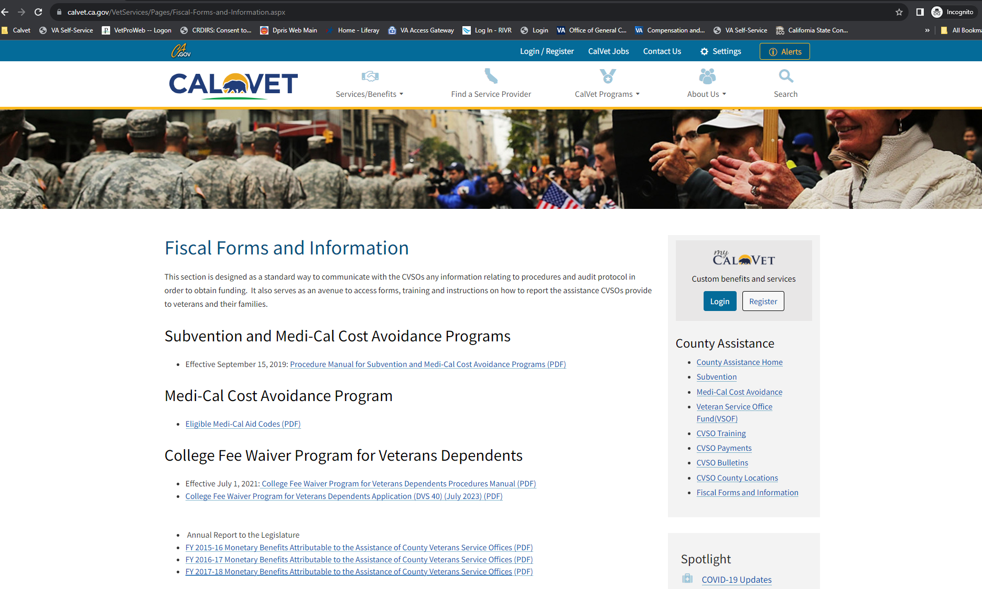
CalVet CVSO Audit

Slide 46
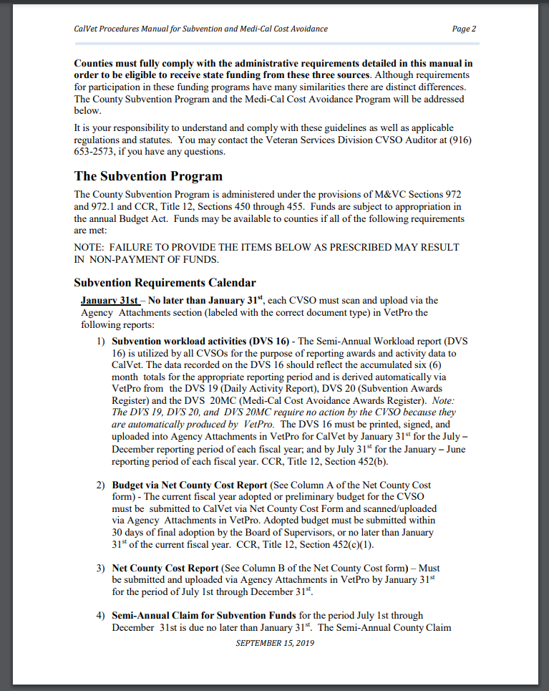
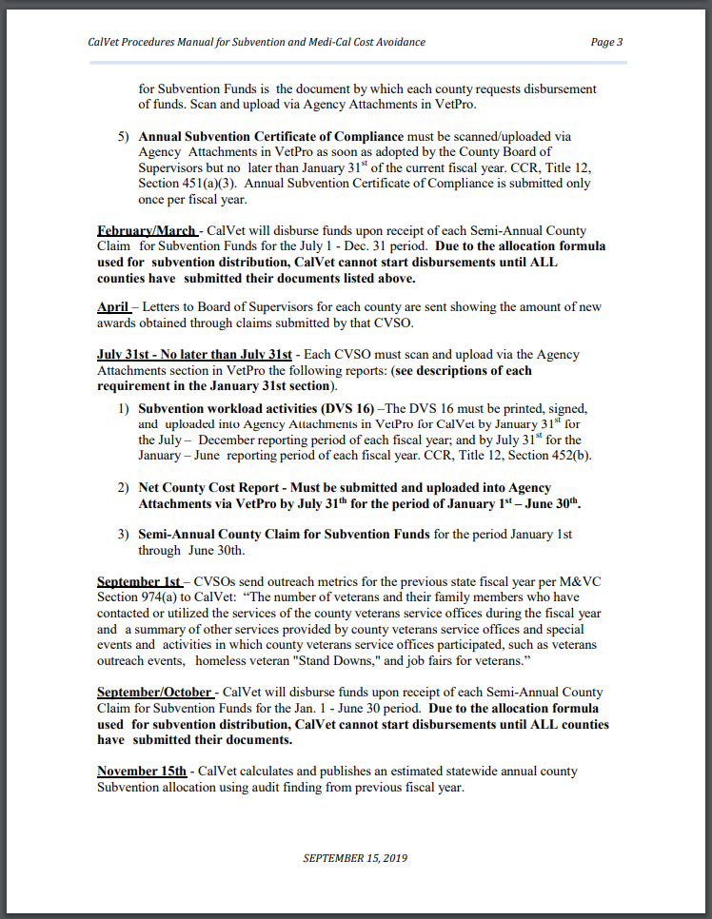
Subvention Audit – Fiscal Year (July 01, 2024 – June 30, 2025)
February 1st (7/1/24 – 12/31/24)
August 1st (1/1/25 – 6/30/25)

Slide 47
Audit Process Overview, cont.
More general overview
January 31 – Audit Documents Due
February 1 – Counties are assigned to Auditor
Feb 1 – May 20 appx.
Auditing Conducted
March 1-15
2 week response window
March 20-
Close out e-mail from Audit Team
June 1 – Final DVS 16 and total WLU sent to management.

Slide 48
Audit Process Overview, cont.
More specific overview
Your County Audit begins, documents are downloaded.
WLU’s are split by form and type.
Sampling is selected (10-25%)
Findings are documented.
Email is sent with findings and due date.
Close out email is sent after 2 week period.

Slide 49
How County Support Uses County Support Forms
Subvention workload activities (DVS-16) – Printed, signed, and uploaded into Agency Attachments in VetPro (January 31st and July 31st)
Budget via Net County Cost Report – Attached in VetPro (January 31st)
Net County Cost Report – Attached in VetPro (January 31st and July 31st)
Semi-Annual Claim for Subvention Funds – January 31st
Annual Subvention Certificate of Compliance – January 31st

Slide 50
CalVet CVSO Audit – Audit Sample Size
All numbers are found in the Subvention Procedure Manual
10% of all claims filed by your county.
Can be increased to 25% for high error rate claims (20-0995, 21-4138, “m” forms for Benefit Enhancement)

Slide 51
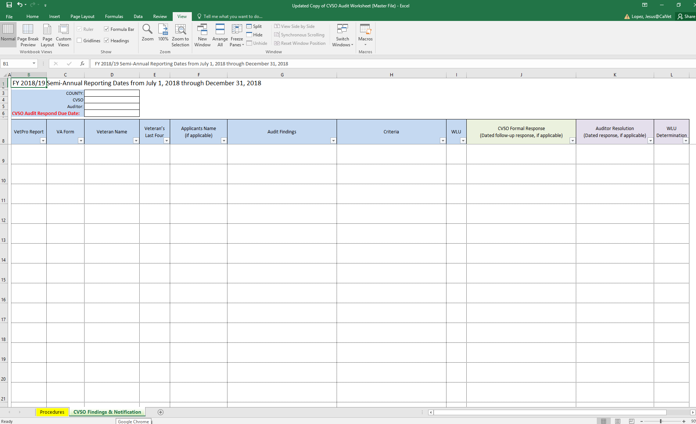
Audit Findings

Slide 52
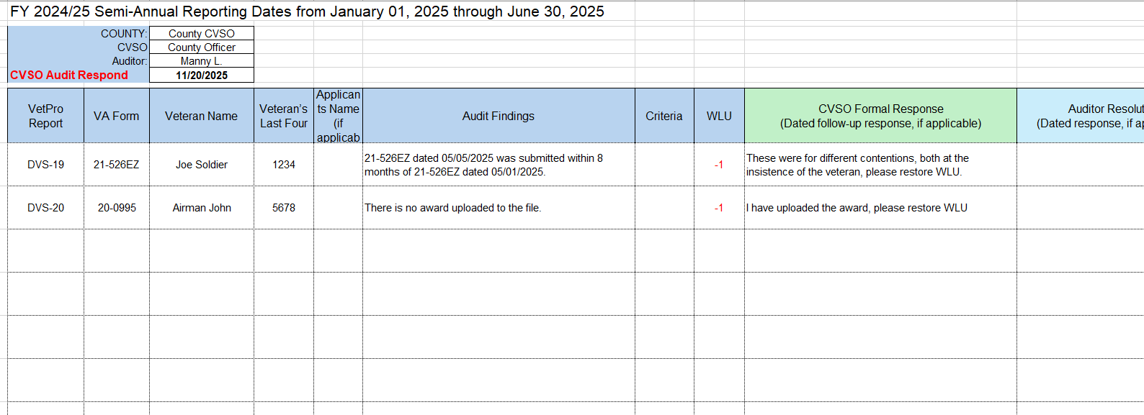
Audit Findings

Slide 53
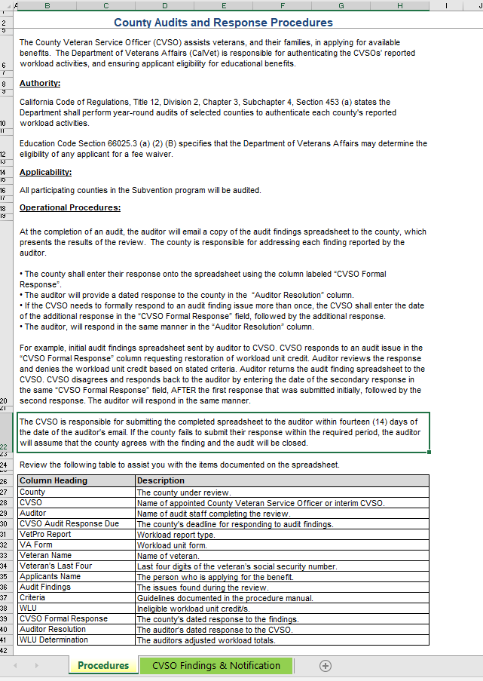
Audit Findings

Slide 54
Appeal Process
The process begins with the 14-day response window, always respond to avoid the appeal process. Work with your Auditor.
After the 14-day response period and working with Auditor, if still in disagreement you may contact the Deputy Secretary of the CalVet Veterans Services Division, P.O Box 942895, Sacramento, CA 94295.
Appeal must be on county letterhead (not simply an e-mail), include details as to what the specific issues are that are being appealed. The appeal must be submitted within 14 days of the closeout email.

Slide 55
Communication
Communicate with your auditor or County Support Staff
Always respond to protect your WLU’s.
If you do not understand an audit finding ask for assistance.

Slide 56
Updates to Audit Process

Slide 57
New College Fee Waiver Audit
Were conducted prior to 2018.
Ensure integrity and accuracy with the CalVet College Fee Waiver Program.
Helps establish areas which need improvement/training.
We will be following the College Fee Waiver Program For Veteran Dependents Procedures Manual, July 1, 2018.
https://www.calvet.ca.gov/VetServices/Pages/College-Fee-Waiver.aspx

Slide 58
CFW Audit Supporting Documents
We are looking at:
Application
Tax documents
Delegation of Authority letters
Birth certificates
Approval/Denial letters
VetPro documents
Eligibility

Slide 59
New Targeted Audits
We are establishing “red flags” which could trigger a spot audi.
These are to tackle problems/issues as soon as possible before they become greater issues.
Example: We notice that claims are being signed by non-accredited representatives during a subvention audit, it could initiate a Spot Audit on accreditations/VetPro access levels.
Other examples could include: Delegation authority letter audit, VetPro access audits, forms and documents audits, MC05 forms audits, VSD001 form audits, etc.

Slide 60
VetPro Access Level Review
Purpose: Verify individuals have the correct access level based on their position/role within the county veterans service office.
Trigger(s): During Subvention Audit, Auditors notice a new employee that is not listed on CACVSO Roster. Further review shows that employee is unaccredited and has Administrator Access within VetPro.
Procedure(s): Notify CVSO for specific county of the Spot Audit taking place.
All VetPro users for that county will be reviewed for accreditation, duty statements and titles and VetPro access necessities.

Slide 61
Accreditation Status Review
Purpose: Process to ensure we revoke accreditation and VetPro access for individuals who have left a CVSO office.
Trigger(s): During an Audit, it is discovered that a county employee is signing claims and is unaccredited per the OGC website.
Procedure(s): Notify CVSO for specific county of the Spot Audit taking place.
A list of current staff roster will be requested of the county, it will be cross checked with CACVSO and all accreditation documents will be requested from the CVSRA Training Coordinator.

Slide 62
Claims Submission/Representation Conduct Review
Purpose: Verify and investigate standards of conduct with respect to CalVet VSR Veteran Representation and Claims Submission policies.
Trigger(s): CalVet discovery of policy standards violation.
Procedure(s): Notify CVSO for specific county of the alleged violation and need for conduct review.
A list of current staff roster and other relevant information will be requested of the county by County Support Unit.
Upon completion of the investigation, CVSO will be notified of VSD Deputy Secretary determination of the conduct, the action(s) that will be taken, and the remedy.
Actions taken to include suspension and/or revocation.
Remedies will vary, but will focus on strengthening understanding of policies.

Slide 63
What to expect
We will announce when the first College Fee Waiver audit will begin, with plenty of advance notice.
We will contact the CVSO prior to a Spot Audit beginning, along with the results.
We will continue subvention audits semiannually.

Slide 64
In the meantime
Ensure Delegation of Authority letters follow proper regulation guidelines.
Ensure all documents are being uploaded to VetPro to avoid any issues.
Ensure you review VetPro access levels for all users in your county.
Ensure you have copies of the Subvention Procedure Manual and the CFW Procedure manual.
Ensure your accredited staff is handling the workload for claims and CFW applications.

Slide 65
Funding Allocation Processes

Slide 66
Subvention Funding Components
Pro Rata Share – Your county’s share of Pro Rata funds equals the number of workload units your office generated compared to the total number of workload units generated statewide.
Administrative Funds – A flat amount of $20,000 given annually to all counties, serves as baseline funding.
Training Funds – Counties can receive training funds up to $12,000 annually to support attendance at the three annual conferences, as well as participation in the CalVet California Veterans Service Representative Academy.
Subvention 50% Rule - As outlined in the California Code of Regulations (CCR), Title 12, Section 5000, this rule authorizes CalVet to provide subvention payments to counties in an amount not to exceed 50% of the annual budget of the County Veterans Service Office. (Excludes Training funds)

Slide 67
Calculating Pro Rata Funding Example
Assumptions:
Total Subvention Funds Available: $5,000,000
Total Workload Units Statewide: 100,000 units
Workload Units by County:
County A: 30,000 units
County B: 25,000 units
County C: 20,000 units
County D: 15,000 units
County E: 10,000 units

Slide 68
Calculating Pro Rata Funding Example Cont.
Step 1: Calculate % of Total Workload Units
County Workload Units % of State Total
A 30,000 30%
B 25,000 25%
C 20,000 20%
D 15,000 15%
E 10,000 10%

Slide 69
Calculating Pro Rata Funding Example Cont.
Step 2: Calculate Pro Rata Funding Share
County % of Total WLU Subvention Allocation
A 30% $1,500,000
B 25% $1,250,000
C 20% $1,000,000
D 15% $750,000
E 10% $500,000

Slide 70
Breakdown of Annual Subvention Appropriation
FISCAL YEAR
2024-25
 | Per County | Total (all counties)
Total Subvention Appropriation |  | $11,000,000
Less "Training" Allocation | $12,000 | $648,000
Less "Admin" Allocation | $20,000 | $1,080,000
Available "Performance" Allocation |  | $9,272,000

Slide 71
Veteran Service Officer Fund (VSOF)
A state-established fund that provides supplemental financial support to County Veterans Service Offices across California.
Financed through the sale and renewal of California’s veteran-themed license plates.
Purpose of these funds is to enhance county-level efforts in assisting veterans with claims, benefits, and services.
VSOF funding is subject to annual state appropriations and specific program eligibility requirements.

Slide 72
Veteran Service Officer Fund (VSOF) Cont.
Funds VetPro licensing costs for every CVSO across the state.
Funds the 800-phone line used to refer veterans to CVSOs.
Each county gets $500/conference for a maximum of $1500/ fiscal year.
Provides funding for the Mentorship Program.
Remaining Funds are distributed to counties via a Pro Rata calculation.

Slide 73
Medi-Cal Cost Avoidance
County Veterans Service Offices in California can receive funding through the Medi-Cal Cost Avoidance program.
This program aims to reduce state Medi-Cal expenditures by helping veterans access their federal health care benefits.
$838,000 is distributed annually via a Pro-Rata share calculation.

Slide 74
Key Takeaways
Subvention = partnership between CalVet and counties
Accountability ensures continued funding and public trust
Ongoing collaboration strengthens the program
Commitment to continuous improvement and support for veterans

Slide 75
Questions / Discussion

Slide 76
COMPREHENSIVE INVESTIGATION INTO VETERAN SUICIDE: IDENTIFICATION AND REPORTING
Gino Galvez, Ph.D.
Co-Principal Investigator
California State University, Long Beach
October 20, 2025

Slide 77

Agenda
Background
Study Objectives
Methodology
Timeline
Research Team
Deliverables
Relevance to CVSO
Questions

Slide 78
Before we get started…
Please consider how this project aligns with, enhances, or intersects with the work you do in your role as a CVSO.

Slide 79

Background
Veteran death by suicide is recognized a national mental health crisis and a top clinical priority for the VA.
VA's commitment to this goal is reflected in its policies, extensive resources, and a national strategy aimed at reducing the rate of veteran suicide.
Veterans are more likely to die by suicide than nonveterans. While veterans compose 7.6% of the US population, nearly 14% of American adult suicides are among veterans. (Ruiz et al., 2023)
Annual VA reporting provides insights, but there are challenges in gathering this data. Current estimates range from 17 to 44 veterans per day.
So, what is the actual number?

Slide 80
Background
Why Accurate Data on Veteran Suicides Matters
Targets prevention: Identifies high-risk groups and guides effective interventions.
Guides resources: Directs funding and services where they’re most needed.
Measures impact: Tracks progress and evaluates prevention efforts.
Supports research: Strengthens understanding of causes and treatment strategies.
Builds trust: Promotes transparency, accountability, and informed policy decisions.

Slide 81

Background
California is one of the three U.S. states with the largest veteran populations (1.47M). (National Center for Veterans Analysis and Statistics, 2023)
California Veterans Health Initiative Research Surveillance Team (CVHI-RST) - Research
Collaboration between the California Department of Veterans Affairs (CalVet) and California State University, Long Beach
Overall vision of this project is for the State of CA to lead the nation in providing the most accurate and comprehensive reporting on veteran suicides.

Slide 82

Study Objectives – CVHI-RST Research
This project focuses on three key areas:
Improving the accuracy of veteran suicide data,
Understanding the factors contributing to higher rates of suicide among certain veteran populations, and
Developing targeted interventions and evidence-based policy recommendations.

Slide 83
Secondary Outcomes
Participation/non-participation in National Violent Death Reporting System (NVDRS)
Variability in Veteran Status Identification
Classification of Overdose Deaths
Data Reporting Timelines: Outline suicide death reporting timelines for the CDPH and VA
Impact of Active-Duty Service Members
Identification of Key Risk Factors

Slide 84
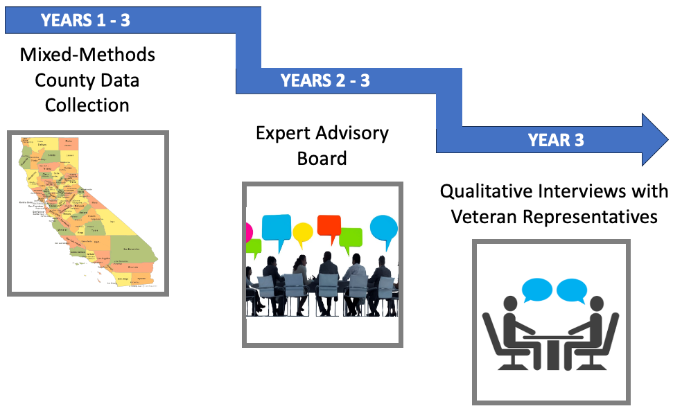
Methodology
Data Collection:
Period-of-Performance: 6/15/25 – 12/31/27

Slide 85
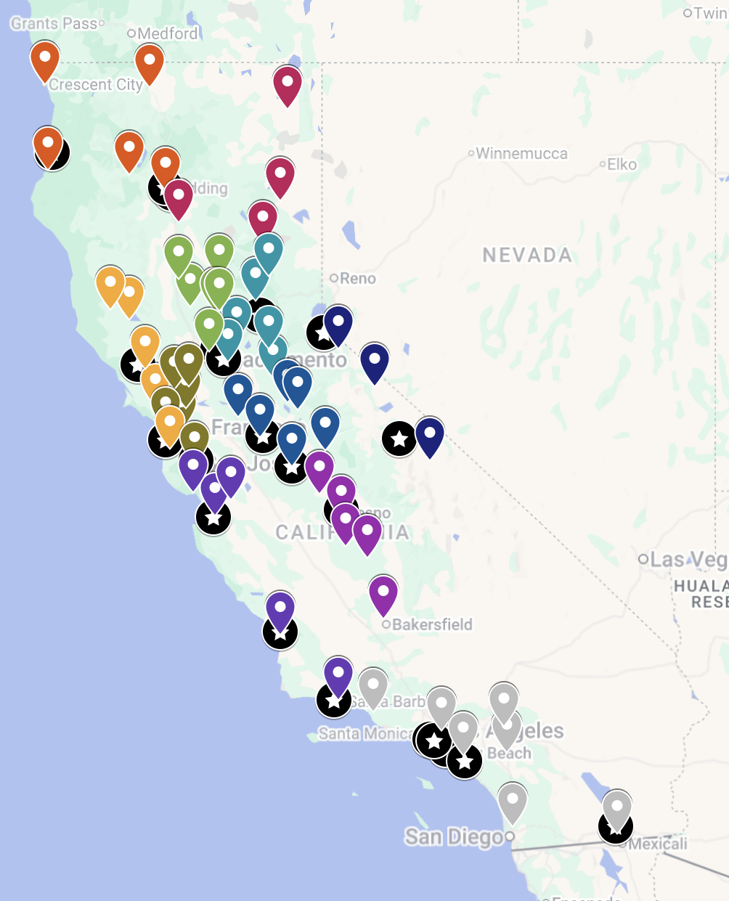
Methodology Cont’d
Collaboration with coroner’s or medical examiner’s offices to
understand their specific reporting processes and requirements,
assess discrepancies, and
improve data consistency.

Slide 86

Methodology Cont’d
Data Collection:
Sources: County death records, state health department databases, federal VA records.
Protocol: Identify standardized
data entry fields, and align
different collection methods
for consistency.

Slide 87

Methodology Cont’d
Data Analysis:
Statistical Analysis: Apply statistical techniques, such as multiple regression analysis, logistic regression, and survival analysis to uncover trends and patterns in suicide data.
Geospatial Analysis: Utilize GIS technology to visually analyze and represent geographic data on veteran suicides to detect spatial patterns and regional disparities.

Slide 88

Methodology Cont’d
Data Interpretation:
Advisory Board
Establish a team with diverse expertise to discuss preliminary study findings and implications. Hold quarterly stakeholder sessions to refine study approach.
Advisory Consortium:
Veterans Integrated Service Networks (VISN 20, 21, and 22)
California Association of CVSOs (CACVSO)
County Health Officers Association of California (CHOAC)
California Health and Human Services (CHHS)
Veterans Resource Centers
Tribal Health Programs
And more…

Slide 89





Research Team - Snapshot
1 PI, 2 Co-PIs at CSULB
CalVet CVHI-RST
1 Administrative Coordinator at CSULB
Research Analysts at CSULB
3 Data Scientists at UC Berkeley
Internal Advisory Board
Advisory Consortium

Slide 90

Research Team – CSULB
Jeremy Ramirez, DrPH, MPH, MIDS(c), EMBA(s) - PI
Veteran, US Army
Assistant Professor of Health Informatics
California State University, Long Beach
Erlyana Erlyana, PHD - Co-PI
Professor of Health Care Administration
California State University, Long Beach
Gino Galvez, PHD - Co-PI
Professor of Psychology
California State University, Long Beach

Slide 91
CALVET CVHI-RST Research Team
Roberto Herrera, MPH
Deputy Secretary, Co-chair of CVHI-RST
Veterans Services Division
Sean Johnson, MPPA
Asst. Deputy Secretary, District Offices, Housing, & County Support
Veterans Services Division
David Lawrence
Section Chief, County Support Section
Veterans Services Division

Slide 92

Deliverables
Quarterly and Annual Research Performance Progress Reports
Quarterly Advisory Consortium Meetings
Annual in-person Meeting (Sacramento)
Veteran Suicide Data Reporting Assessment
Data Collection Protocols Report
High-Risk Population Identification Report
Policy Recommendations Report

Slide 93
Relevance to CVSOs
1. Improving Accuracy of Veteran Identification
Many coroner offices rely on CVSOs or their databases to confirm veteran status when completing death certificates.
Our project’s standardization efforts can help CVSOs ensure that veterans are correctly identified across counties, reducing missed or misclassified cases.

Slide 94
Relevance to CVSOs
2. Data-Driven Policy to Improve Local Services
The findings from our project will feed into statewide policy recommendations, which CVSO can use to advocate for funding, training, and outreach improvements in counties.
Consistent and reliable data empowers CVSOs to make evidence-based cases for better local veteran mental health resources.

Slide 95
Relevance to CVSOs Cont’d
3. Enhancing Collaboration Between Coroners, CVSOs, & CalVet
Our project aims to map the flow of veteran suicide reporting and identifies gaps in communication.
CVSOs can play a key role in bridging coroner data with benefits systems, ensuring families get the benefits they are entitled to.

Slide 96
Relevance to CVSOs Cont’d
4. Training and Best Practices
The project’s deliverables (e.g., policy briefs, standardized protocols) could become training tools for CVSO offices, especially around:
Verifying veteran status;
Communicating with coroners and medical examiners; and;
Understanding suicide data and trends within their communities.

Slide 97
Relevance to CVSOs Cont’d
5. Shared Commitment to Prevention
CVSOs play a vital role in veteran welfare and crisis prevention. By identifying key trends and risk factors, this project aims to empower CVSOs to take a more proactive role in suicide prevention and postvention efforts.

Slide 98
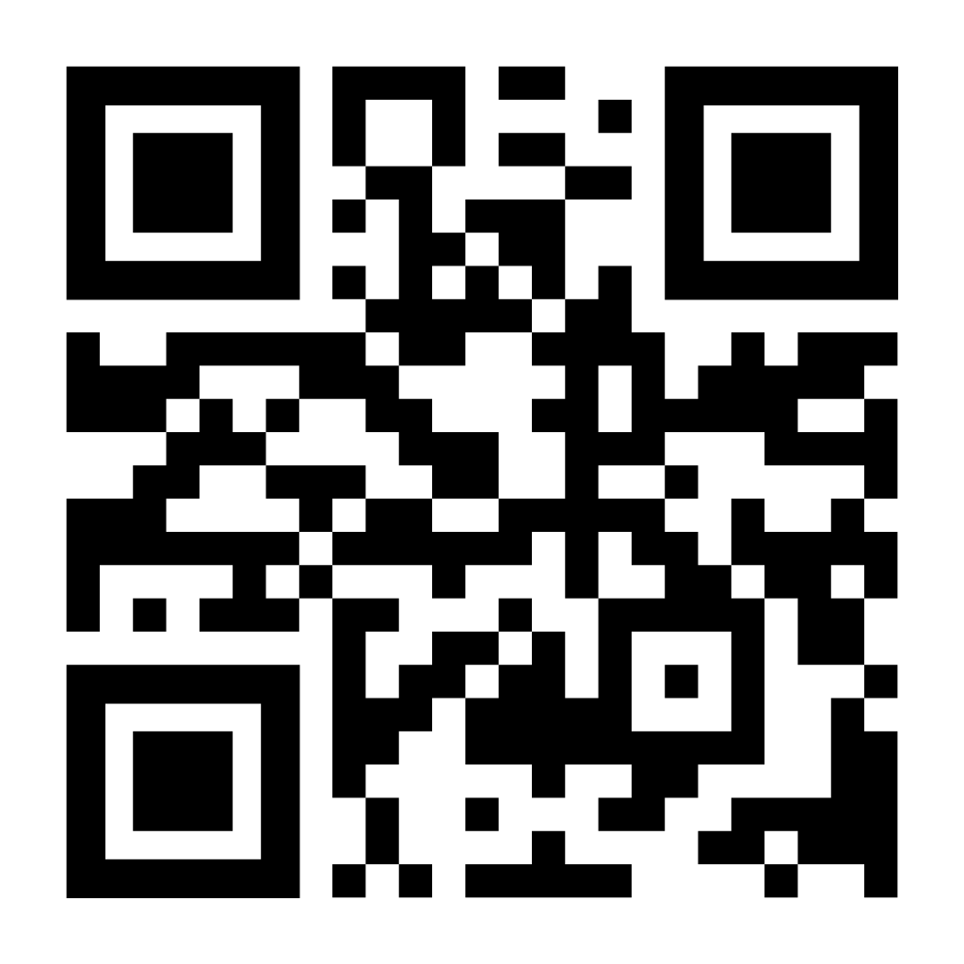
Opportunities to collaborate?
Share your contact information, questions, and comments with us:
Notes:
https://forms.gle/P5o9gqE5tP9BKWRVA

Slide 99

Questions?

