Slide 1
District Offices
February 2026

Slide 2
Agenda
CalVet Data
  DO-Reviewed Claims
  Hearings
  Board Data for CalVet Appeals
Incarcerated Veterans Program
Common Errors and Trends
Higher-Level Review Reminders
Last 7 slides shows staff list and POC’s for the District Offices

Slide 3
Reviewed Electronic Claims
 | Oakland DO | Los Angeles DO | San Diego DO
State FY 22-23 | 14,414 | 13,212 | 4,275
State FY 23-24 | 17,442 | 20,065 | 6,456
State FY 24-25 | 23,476 | 19,662 | 10,558
Jul-Dec 2025 | 11,056 | 10,382 | 5470

Slide 4
Returned Claims
Returned Claims % | Jan-Jun 2024 | Jul-Dec 2024 | Jan-Jun 2025 | Jul-Dec 2025
Oakland District Office | 7.5% | 9% | 8.5% | 9.3%
Los Angeles District Office | 10% | 9.5% | 9% | 4.6%
San Diego District Office | 10% | 4.5% | 6.5% | 4.8%
Returned Claims Monthly Average:
Oak: 1843 x 9.3% = 171
LA: 1807 x 5.1% = 80
SD: 912 x 4.8% = 44

Slide 5
Hearings – BVA and Due Process
 | Oakland DO | Los Angeles DO | San Diego DO
State FY 22-23 | 447 | 271 | 95
State FY 23-24 | 315 | 239 | 78
State FY 24-25 | 451 | 198 | 98
Jul-Dec 2025 | 148 | 66 | 45

Slide 6
Hearings – BVA and Due Process
Note:
Due Process and Pre-determination hearings only need a 2-week notice. Some VAROs are nice enough to give a 30-day notice, but most do not. Some VARO’s send our office email notices, others do not.
If your veteran comes to you with their hearing appointment letter or email stating the date of the hearing, please reach out to us to verify if they are in our hearing list. If yes, we’ll let you know who the assigned representative is. If not, we’ll add to our list and assign it for review.
For BVA, we usually assign cases the month prior the hearing schedule.
If you are hosting the BVA virtual hearing in your office, let us know if your staff will stay with appellant. We need to notify the BVA Coordinator and Judge that there is an observer.

Slide 7
Board Data for CalVet Appeals
VA FY is Oct to Sep | Full Grant | Partial Grant | Remand | Denied | Other | No Decision | Total Appeals
FY 2019-25 | 390 | 130 | 310 | 169 | 229 | 1647 | 2875
FY 19-1.23.26 | 441 | 139 | 340 | 182 | 244 | 1658 | 3004
Oct 25 to Jan 26 | 51 | 9 | 30 | 13 | 15 | 11 | 129
Take note:
118 Decisions issued between 10/1/25 and 1/23/26, but still 11 more under cases waiting for decision.
Based on above, wait time will continue to increase.
Please make sure to inform clients of this, when they are choosing the disagreement to the Board (VAF 10182).

Slide 8
Current Docket Dates
Hearing dockets
Oldest docket dates waiting for a BVA Decision are still from September 2019 – and there are still over 80 AOD cases before those in queue.
Hearings scheduled this February are for April to June 2022 docket dates.
We are also still waiting on BVA Decisions for hearings that were held between April to June 2024.
Evidence Review docket – oldest docket dates are from February 2021
Direct Review docket – oldest docket dates are from April and May 2021
Note: For Evidence and Direct dockets, the oldest cases are VHA issues.

Slide 9
Incarcerated Veterans Program
 | Claims Filed | VAEs held | In-Person Interviews | Letters to veterans | Retro | Adjusted Monthly | Full Monthly Entitlement
State FY 22-23 | 364 | 288 | 223 | 1022 | $ 3,058,513 | $110,377 | $ 202,116
State FY 23-24 | 430 | 427 | 401 | 986 | $ 356,044 | $ 48,234 | $ 146,213
State FY 24-25 | 618 | 418 | 687 | 1387 | $ 377,005 | $ 59,097 | $ 130,197
Jul-Dec 2025 | 780 | 329 | 442 | 717 | $ 400,350 | $ 61,028 | $ 120,836

Slide 10
Incarcerated Veterans Program
Challenges | Solutions
VAE Scheduling - Background paperwork from contractors, for providers to enter prisons, submitted with errors/omissions due to constant turn-over of contractor personnel. This causes delays and cuts into the 30-day exam scheduling window. | Constantly identifying and connecting new contractor supervisors with CDCR supervisors.
Delays with correction requests to VA for pay errors and discrepancies. | CalVet rep case management, plus a lot of patience and perseverance.

Slide 11
Common Errors and Trends
Hurriedly completed VA Forms that are submitted without reviewing the contents often show:
  Inaccurate veteran information, important blocks missing (like File # for VAF 10182), missing dates (such as appointment dates on VAF 21-22).
  Blank forms from our view – which means the form is not signed. This is not new. This does not mean the form itself is blank – it just appears blank to DO Reviewers. If that unsigned forms is submitted as is to VA, they will issue return-for-application (RFA) letters or worse get developed then dropped midway for RFA letters.
Sample on next slide.

Slide 12
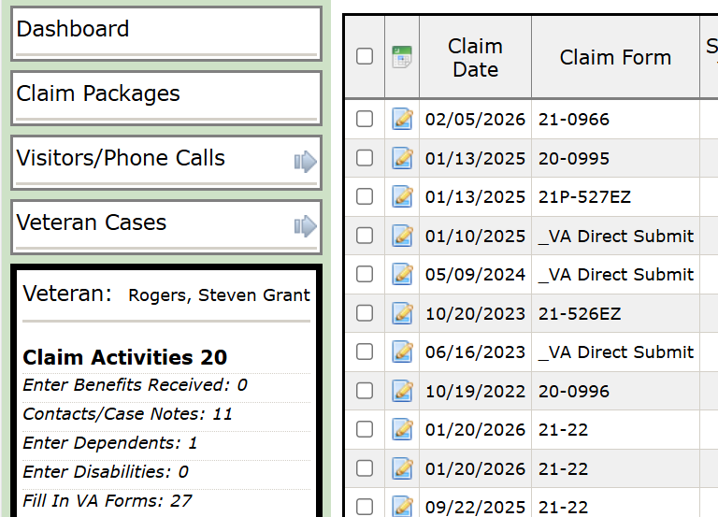
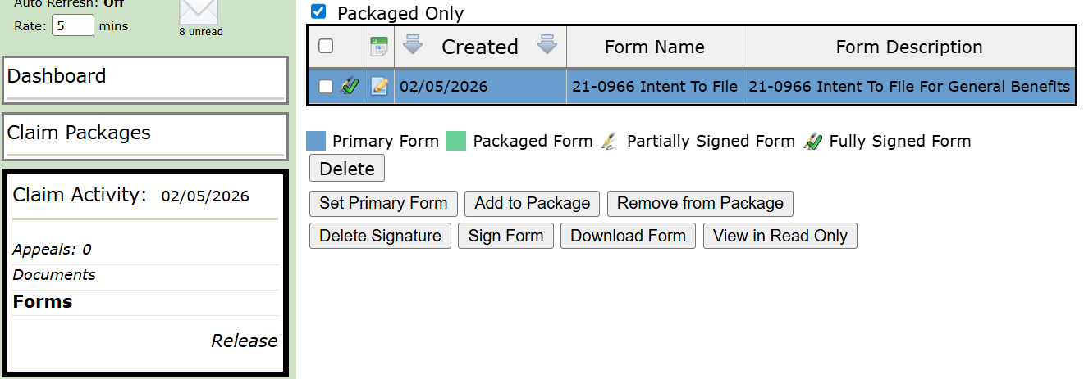
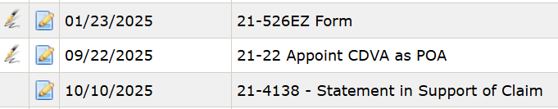
Fully signed form.
Signed, but form has more than 1 signature block.
No signature on this form – will be blank when we click on this form (next slide).

Slide 13
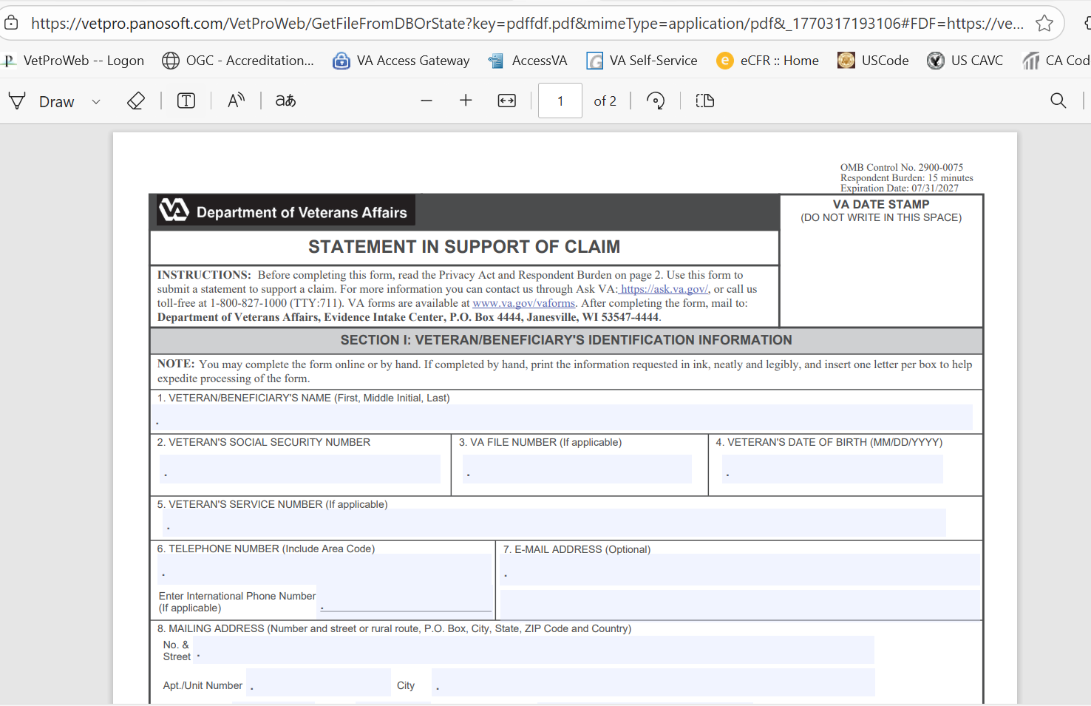
This is what the DO Reviewers see when they click to view a form with no signature. It looks blank.
If you view from the Claim Activity page, you will see it this way too.

Slide 14
Common Errors and Trends
VA back to quick RFA (return for application letters), even when form is valid. Those we’ve seen, it’s because vet has multiple cases open or successive submissions for different issues.
Marking the VAF 21-526EZ as Fully Developed Claim (FDC) when:
  Veteran has been separated from service for more than one year
  No supporting evidence
  No VHA facility listed on the 526EZ, and
  No VAF 21-4142/4142a for private medical records.

Slide 15
Common Errors and Trends
Filing a supplemental claim without new and relevant evidence leads to quick confirmed and continued denials:
  No VHA or private medical provider listed on the VAF 20-0995
  No medical or other relevant record/statements attached
  Note: Personal statement or disagreeing with an examiner’s opinion is not new and relevant evidence.

Slide 16
Common Errors and Trends
VAF 21-22 issues in VBMS - Some are updating one business day after submission, others require manual update of the VBMS because the VAF 21-22 is of record, but the system did not establish appropriate access.
  If the 21-22 is validated in VetPro, but no VBMS access within 5 business days (veteran cases) – please do not resubmit. Reach out to our district office POCs.
  This includes those where VA requests us to initiate IT ticket.
  For original survivor cases, PMC has asked us to wait 3 weeks before reaching out for manual VAF 21-22 updates.

Slide 17
Higher Level Review Reminders
DROCs started using VERA scheduling system for informal conferences.
DROCs will send a link via text or email to the claimant and the representative.
The expectation is that the veteran/claimant and POA coordinate on who will be at the informal conference.
IF your claimant wants CalVet to be at the informal conference, please advise the clients not to click the VERA link to self-schedule.
  The first party to schedule secures the informal conference, and disables the link to prevent duplication.

Slide 18
Higher Level Review Reminders
If the scheduling link is not used within 48 hours, it will expire and the DROC scheduler will contact the veteran or representative, based on the VAF 20-0996 entries.
  Scheduling an informal conference in VERA through the link is voluntary.
  If the link is not used, VA staff will make up to two (2) telephone attempts to ensure the veteran or representative can participate in the informal conference.

Slide 19
District Managers
Alberto Alpasan
Los Angeles District Manager
Alberto.Alpasan@calvet.ca.gov
LADO@calvet.ca.gov
(213) 620-2755
Melaina Anker-Youngberg
San Diego District Manager
Melaina.Anker@va.gov
State.VBASDC@va.gov
(619) 400-0070
Zmae Raymundo
Oakland District Manager
Zheriemae.Raymundo@calvet.ca.gov
Oakland.Oakland@calvet.ca.gov
(510) 286-0627
Questions?
Note: POCs for each District Office begins on the next page.

Slide 20
Oakland DO Staff list
Zmae Raymundo, District Manager
Appeals Team
Front Desk: David Pham
Steven Smith, Assistant District Manager
Leonora (Cora) Sarmiento
Elizabeth Grassetti
Akeesha Barrett
Constance Santos (new)
Janice Suarez (new)
Dillon Bezehertny (new)
Liam Williams (Rancho office)
Joseph Klabouch (Rancho office)
Review Team
Diane Susbilla, Team Supervisor
Daniel Vilhauer
John-Eric Gabagat
Walter Huey
Teri Markus

Slide 21
Oakland DO Staff list
Incarcerated Veterans Team
(aka CDCR team)
Liz Hargrove-Washington, Team Supervisor
Mary Donovan
Tera Ireland
Sofia Martin Del Campo
Daryl Neff
Email us: Rep4incarceratedvets@calvet.ca.gov

Slide 22
Oakland District Office General Information
Oakland DO Point-of-Contact (POCs)
Appeals team:
For decision review guidance, email Steven –Steven.Smith@calvet.ca.gov
For hearing schedule confirmations & inquiries, email Cora – Leonora.Sarmiento@calvet.ca.gov
Review team:
The DO Reviewer of your claim activity
Diane.Susbilla@calvet.ca.gov
CDCR team:
Elizabeth.Hargove-Washington@calvet.ca.gov
Oakland Office (Main):
1301 Clay St. Suite 1130N
Oakland, CA 94612
Open Tue, Wed & Thurs
9:00 AM to 3:00 PM
Phone 510.286.0627
Fax 510.286.0653
Rancho Office:
3046 Prospect Drive
Rancho Cordova, CA
Only for hearings & appointments
Phone 916.364.6774
Corporate inbox (for inquiries): Oakland.Oakland@calvet.ca.gov

Slide 23
Los Angeles DO Staff list
Alberto M. Alpasan, Jr. – District Manager
Darlene Dunlap - Assistant District Manager
Front Office – Heather Maciel
Appeals Team
DO Review Team
Maria Alatorre
Babes Navarra
Delores McLemore
Joberde Metellus
Salvador Escobar
Jonathan Martin
Porcia Andrada Eileen Dizon
Esther Luna Isabella Alejandrino
CDCR Team
Vacant (2 positions)
Sandra Matrecitos (temp cover)

Slide 24
Los Angeles District Office General Information
11000 Wilshire Blvd. Ste. 505
Los Angeles, CA 90024
Open to the public:
Mon-Wed
8am to 3pm
(213) 620-2755
Corporate mail: CDVALA@va.gov
(you can send PII as long as you encrypt)
LA District Office POC
For issues relating to appeals(hearings or to discuss appeals issues), email:
Darlene.Dunlap@calvet.ca.gov
Darlene.Dunlap344@va.gov
For DO Review questions or concerns, email:
Esther.Luna@calvet.ca.gov
Esther.Luna@va.gov

Slide 25
San Diego DO Staff List
Melaina Anker-Youngberg
District Manager
Claim Support-Appeals
Office Technician: Monica Flores
Tony Devore, Claims Support Supervisor
Angel Bribiesca
Judith (Judy) Roach
Arnold Cantong
Eugenia Agis
Nikki Sada
Justin Louie
Brandon Rogers (new)
CalVet-CDCR Liaison
Roberto Avila

Slide 26
San Diego District Office General Information
San Diego District Office
8620 Spectrum Blvd. Rm 725
San Diego, CA 92123
Open to the Public:
Tue., Wed., Thur. 8am-3:30pm
Public Line: (619) 857-5497
Fax Line: (858) 268-1014
San Diego Corporate Email:
state.vbasdc@va.gov
San Diego Office Point of Contacts (POC)
Claim Guidance, AMA Decisions/Guidance, Board hearings & Board Appeals, email Tony Devore Tony.Devore@va.gov
CDCR (Incarcerated Veterans), email Roberto Avila Roberto.Avila@calvet.ca.gov

