Slide 1
College Fee Waiver (CFW) Program Overview
David Lawrence
Nancy Noriega
California Department of Veterans Affairs
Veterans Services Division

Slide 2
California Code of Regulations
Title 12. Military and Veterans Division 2. Department of Veterans’ Affairs Chapter 3. Veterans’ Services
Subchapter 3.5 College Fee Waiver Program
§ 440. Approval Periods - Waivers are granted on a year-to-year basis and must apply each academic year if they want to continue benefits.
Academic Year – Starts on the first day and ends on the last day of the school's academic year.
§ 441- Effective Dates of Benefits - Once an application is received during an academic year, the waiver may be effective from the beginning of that same academic year but does not apply retroactively to prior academic years.
§ 442 – Appeals; Appellate Authority –
Right to appeal- If an applicant is not satisfied with a decision, they have the right to appeal.
First appeal level – Deputy Secretary of Veterans Services Division.
Time limit – Writing appeals must be received within 90 days of the date of the letter informing applicant of denial.

Slide 3
Military & Veterans Code Section 890-891
§ 890. Definitions
Veteran – Persons killed in action, died or totally disabled because of service, missing in action .. From various U.S. armed forces
Dependent - Natural, adopted child, stepchild, unmarried surviving spouse, spouse of totally disabled veteran.
§ 890.3 Pending VA Disability – A pending USDVA disability claim does not result in permanent denial of the CalVet College Fee Waiver. Retroactive approval may be granted once a disability rating is awarded.
§ 891 Eligibility Criteria for Dependents
Dependents who served honorably in the US Armed Forces may get an extension to age 30.
Dependents must be over the age of 14 or have entered the 9th grade.
No age restrictions for spouses or surviving spouses.

Slide 4
California Education Code
§ 66025.3 (a) (3) Provides that mandatory systemwide tuition and fees shall not be charged to any dependent or surviving spouse who has not remarried any member of the California National Guard.
Who qualifies – Dependent/spouse and surviving spouse
The benefit – Waiver of mandatory systemwide tuition and fees at any public institution (Cal State, UC campus, Community College).
§ 66025.3 (a) (4) – Provides tuition and fee waiver for Medal of Honor recipients and their qualifying children attending California public colleges.
Who qualifies – Undergraduate student or undergraduate student who is a child of a Medal of Honor recipient.
The benefit – Waiver of mandatory systemwide tuition and fees at any public institution (Cal State, UC campus, Community College).

Slide 5
College Fee Waiver (CFW) and Subvention Procedure Manuals
The CFW Procedure Manual establishes standards, procedures, and oversight requirements for CalVet-accredited staff at County Veterans Service Offices (CVSOs) administering the College Fee Waiver Program. It guides eligibility determinations, documentation verification, approval or denial decisions, and recordkeeping in accordance with statutory authority.
The Subvention Procedure Manual provides the administrative and fiscal framework for CalVet’s statewide oversight of CVSOs, including subvention funding allocation, performance expectations, and documentation standards.
Because College Fee Waiver eligibility and processing directly impact workload, reporting, and accountability, subvention funding and oversight are directly tied to CFW determinations.
Together, these manuals ensure that:
College Fee Waivers are administered consistently across counties
Eligibility determinations are legally supported and properly documented
CVSOs remain compliant with state law and CalVet policy
State subvention funding is supported by documented, auditable benefit activity

Slide 6
Now, The Benefit
Waives mandatory system-wide tuition and fees at any state funded school (UC, CSU, CA Community College)
Open to dependents of disabled veterans with rating of 0% or above.
Dependents must be CA residents
Apply at County Veteran Service Offices.

Slide 7
CalVet Fee Waiver Plans
Plan A
Veteran must be 100% disabled
Open to spouse
Child (14-27 years old) 30*
Cannot collect Ch.35
No income restriction
Plan B
Veteran is service connected.
The child’s annual income, which includes AGI, plus the value of support provided by a parent, may not exceed the state income threshold according to the FTB.
Can collect Ch. 35
No age limit

Slide 8
CalVet Fee Waiver Plans Cont.
Plan C
Any dependent spouse or child of a member of the California National Guard, who in the line of duty while on active service to the state, was killed, died of a disability resulting from an event that occurred while in active service to the state, or was permanently disabled as a result of an event that occurred while in the service.
Plan D
Medal of Honor recipients and children of MOH recipients under the age of 27 may qualify. Benefits under Plan D are limited to undergraduate studies only, and applications are subject to both income and age restrictions.

Slide 9
Letters of Denial & How to Appeal

Slide 10
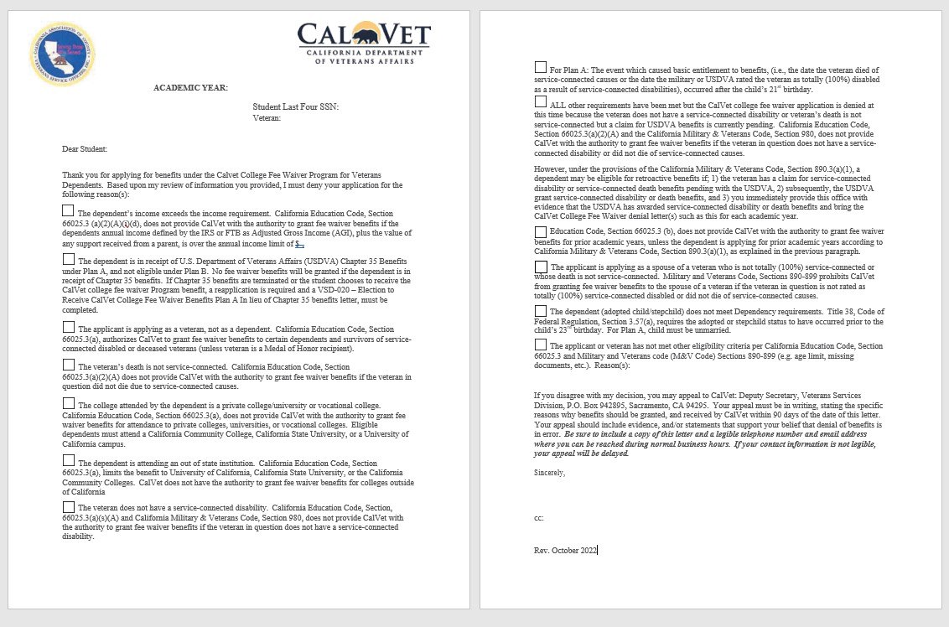

Slide 11
Other Fees…
The CFW program does not cover tuition for courses and programs that receive no state funding (self-funded).
Mandatory system wide tuition and fees vary with each school and are based on each school’s own definitions and written guidelines.
The law does not prohibit schools from charging “Campus-Wide or Campus-Specific Fees”, which would not be covered by a CFW.
Encourage applicant to research their classes before enrolling.

Slide 12
Frequently Asked Questions (FAQ’s)
Is there a particular grade point average required to qualify/apply for College Fee Wavier (CFW)?
If student drops one or multiple classes, does student have to reimburse CalVet?
Do students have to be enrolled in classes first, in order to apply/qualify for CFW?
If the student is attending multiple schools, can CVSO issue multiple grant letters?
Can the student use Plan A and Plan B in different years or must the student use the same Plan each year?

Slide 13
FAQ’s Continued
Can the veteran or student qualify for the CFW if they have a criminal record?
What fees are waived? My local school does not want to waive XX fees.
Can I receive grants from public or private entities and the CFW at the same time?
Do I have to apply in the county that I live in or where I go to school?
Is there a cap to the number of years the college tuition fee waiver may be used?
Can the college tuition fee waiver be used on graduate programs?

Slide 14
California Department of Veterans Affairs
1-800-952-5626
www.calvet.ca.gov
David Lawrence
Nancy Noriega
CFW@calvet.ca.gov

