Slide 1



Military Sexual Trauma
Mayumi Kimura, LCSW
Deputy Secretary of Women Veterans Affairs
Notes:
Who here served? Have family that served? Who already works in the veteran space.
CVSOs = My network
You may have had MST training or overview before, I hope this will add to and widen your perspective

Slide 2
Military Sexual Trauma (MST)
Definition:
Sexual assault or sexual harassment experienced during military service
MST may occur:
on/off duty
on/off base
by military or civilian perpetrators
Notes:
Should be Military-related sexual trauma
Can be a stranger, someone we know, a superior, our spouse, our friend

Slide 3
Military Sexual Trauma (MST)
Common misconceptions:
MST is an experience, not a diagnosis
Not only “rape cases.”
Not dependent on formal reporting
MST can happen to anyone
Notes:
Not rape cases – Combat = not always fire fight
Not dependent on formal reporting – but we all understand that it can create complexities
MST can happen to anyone, but does affect certain groups of inappropriately
Think again, Trauma is in the eye of the beholder and is an experience, not for anyone else to decide or discount. It’s more about how it effects us and not the event itself.
However, PTSD as a diagnosis has criteria for what a trauma, but it’s quite vague on purpose

Slide 4
Military Sexual Trauma (MST)
1 out of 4
Reported history of military sexual trauma
Notes:
1 in 4 for women. 1 in 50 for men

Slide 5
The Unique Experience of MST
Notes:
The military ethos, the bonds between us, and moral injury is at the crux of why MST has the potential for so much harm
As a clinician, we may categorize trauma (childhood, sexual, combat, complex, complicated grief), because each can have unique impact and potential pathways for care
Impact three of the most important relationships.
The one with ourselves (shame, guilt, purpose, meaning)
The one with others (connection, trust, intimacy)
And the one we have with navigating the world (safety, belonging, hope)

Slide 6
Military Ethos
I will always place the mission first
I will always find the solution
I will never surrender
I will never leave a brother behind
Notes:
Military Ethos or Warrior Ethos
- Military ethos unspoken, but collectively understood and followed as core values of service members
What makes MST unique compared to sexual trauma outside of military service?
Mission above self. Risk to team dynamics – May not always be fear of being believed, it may be because we know how everything might change. (Children and not reporting because they know that it will destroy the family)
I’ll think myself through this. If I could have survived…. Than I can figure this out, too
I have proven myself as competent, skilled, and equal – but then I am overpowered, controlled, taken advantage. I tell people what’s on my mind, but then I didn’t speak up about this. How do I reconcile this with who I thought I was?
Military ethos – Conflicting messages of being family. About loyalty. The same individuals we feel are our brothers may be the ones who hurt us.

Slide 7
Moral Injury
How could they let that happen?
No one can be trusted
Why didn’t I stop it?
I’m not a good person
Notes:
Moral Injury:
When a person experiences, witnesses, or is forced to participate in actions that go against their deeply held moral or ethical beliefs, often resulting in guilt, shame, betrayal, or spiritual conflict.
Examples:
Participating in or witnessing abusive or dehumanizing behavior
Witnessing harm to innocent (especially children, civilians, animals, peers)
Being ordered to stay silent about harm
Feeling complicit in systemic injustice (e.g., rules of engagement, neglect of vulnerable populations)
Being betrayed by leadership or trusted systems (institutional betrayal)
Impact of Moral injury
Deep self-blame or moral rigidity (Example of bootcamp)
Intense anger or withdrawal from systems
Disgust toward service, military, or anything military/veteran-related
Replaying events obsessively

Slide 8
The Impact of MST
Notes:
Although MST can and have a high risk of certain conditions and risks, it is still a spectrum of how it affects everyone.
One can have experiences of MST or any trauma and journey through a life of success, fulfillment, and thriving.
- But some individuals may not realize there is a potential link to some of the conditions and issues they experience
And anecdotally, for those I have worked with personally, some of the most severe presentations of PTSD were related to MST for women and men

Slide 9
MST-related Risks and Issues
9x higher incidence of rheumatic conditions
Higher incidences of sleep conditions, chronic pain, gastrointestinal issues, sexual dysfunction
Female Sexual Arousal Disorder (FSAD)
Notes:
This is not exhaustive and the research keeps coming out, but think of it like Agent Orange. This means keep your ears and eyes open.

Slide 10
MST-related Risks and Issues (cont’d)
5x more likely to develop PTSD
Elevated risk of premature death, driven in part by death associated with SUD, such as suicide and overdose
MST is a major risk factor for homelessness, intimate partner violence, and suicide and suicide-related behaviors

Slide 11
Best Practices
Notes:
Comes down to safety in choice and control.
Trauma-informed approach, means treating everyone as if there is a potential of trauma history

Slide 12
Trauma-Informed Practices
Be cognizant of the environment
Explain the process
Set realistic expectations
Don’t pry for details, but offer guidance
Listen without judgement
Let them guide decision-making and offer choice
Be prepared with resources
Notes:
- Environment, simple intro, welcoming space (dog lovers are hard to distrust), choice (door open, this seat okay, I’m going to reach over)
Explain the process
Walk them through the process for the appointment and what you’re going to be doing
I’m going to just ask some demographics, and we’ll talk a little bit about your service
Then I’ll walk you through some options and what we’ll need for next steps
I might ask you some tough questions, so feel free to share how ever much or little you feel comfortable
At anytime you feel like something isn’t making sense, you can just ask why I’m asking or what the information is for
Walk them through the VA claims process
Set realistic expectation
Be honest in your abilities
Be honest about the experience “It’s going to feel like you’re being judged or questioned”
Remind them that this is not a judgement of truth, but rather a checklist related to condition, military connection, and severity
Be honest about the complexity of their case (sexual assault cases in court, choice)
Reassure them of what you can do and what options are available
I’m going to do the best I can to help you and if I feel like its outside of my scope, I will reach out to my network of CVSOs and providers to help
Sometimes these claims don’t go the way we think the should for all kinds of different reasons sometimes out of control, but if that happens, there are other avenues we can take, but we’re going to do the best we can.
Don’t pry for details, but provide guidance and choice
Sometimes people experience inappropriate or uncomfortable situations that stick them. It’s terrible, but its not uncommon. Sometimes it’s a big event and other times it can be a lot of smaller ones that add up. But we know that they happen, and we know it affects health, relationships, work. Do you feel like you experienced anything like this?
“Share whatever you feel comfortable sharing with me and sometimes that can help organize your thoughts for when you write your statement”
“You also have a choice of writing the statement and I can take a look and offer suggestions based on what I know the VA might be looking for”
“You don’t need to remember all the details, and you can even say that in your statement”
Share what details would be helpful, like timeframes (summer of 2009), units and scope of work, structure of unit, etc
Share strategies
If this is something you haven’t really shared, you may want to make sure you have some downtime after this or after writing a statement
Things may come for you as you start thinking about it more, so bring a notebook with your or record it in your phone
It might be helpful to work with a counselor through this process because it can be a roller coaster and sometimes, we don’t know how it’ll hit us. Also, talking with someone can help communicate this clearly at the comp and pen, they may also provider a letter of support
Listen without judgement and don’t interrupt
Pause, validate, rather than comfort or feel the need to relieve distress (Grief and loss of loved one)
Normalize the response – That makes a lot of sense why you’re so angry/started drinking/didn’t report, etc. I think most people would in that situation.
Share observations without assigning labels or judgement (“This seems like it's really hard to talk about,” “It sounds like you’ve been through a lot,”)
Maintain awareness of your own feelings or beliefs about the situation
Unimaginable, not unbelievable – 90% of what I’ve heard is unimaginable, because its hard to truly imagine what I have never experienced
I cannot understand the experience or impact, but I can understand pain and suffering
When our dogs have died and we’re expected to go to work the next day
Teenage heartbreak – we can see things in hindsight and experience, so we might say things like, “you’ll find someone else” “you’re still young,”
But we have all been there and you can’t tell me that pain wasn’t real
Make no assumptions, give choice
Can be in the moment:
Do you want to take a break?
Would you like to move to a private space?
Would you prefer we keep the door open or close?
Can be about the process:
Do you have a preference with you’d like to work with (male/female)? Men tended to want to work with women.
Pros and cons of the options. Do you want to move forward?
If they do, be honest. Okay, let me help you get connected, but you might have to wait a couple more days/weeks for an appointment. In the meantime, would you like me to submit the Intent to File?

Slide 13
Resources to have on hand
CalVet
Women Veterans Division
VA MST Coordinators
Community-based Partners
Notes:
Having a one-sheet or business cards on hand to share.
“This is not an easy process, and you might be okay right now, but just in case you don’t later, can I share this with you?” or “Can you call this group/person? We work closely with them and they help a lot of veterans we work with”
Crisis Line, Warm Lines (call with them)
VA Medical Centers MST Coordinators
Know that MST care is available without SCD
Vet Centers
Calvet CVHI mental health providers
Free outpatient therapy for veterans and their families, regardless of discharge
WVD – Connect them with resources including providers, communities, etc
Legal assistance – Complex cases
----------------
Have resources for yourself:
Talk to another CVSO or someone who understands the work
Talk to a counselor, unbiased, nonjudgmental
Think about it as layers of a pancakes that need to be taken off once in a while
Share with your support system, “Had some tough stories today. It’s put me in a weird mood.”

Slide 14

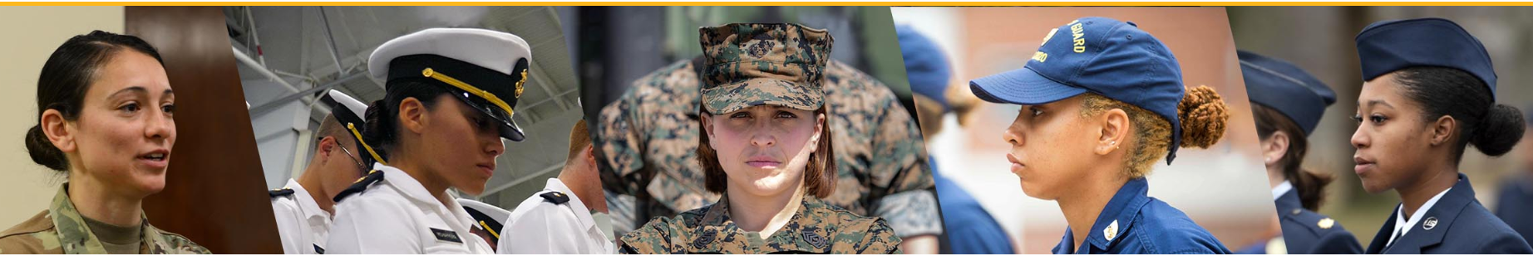
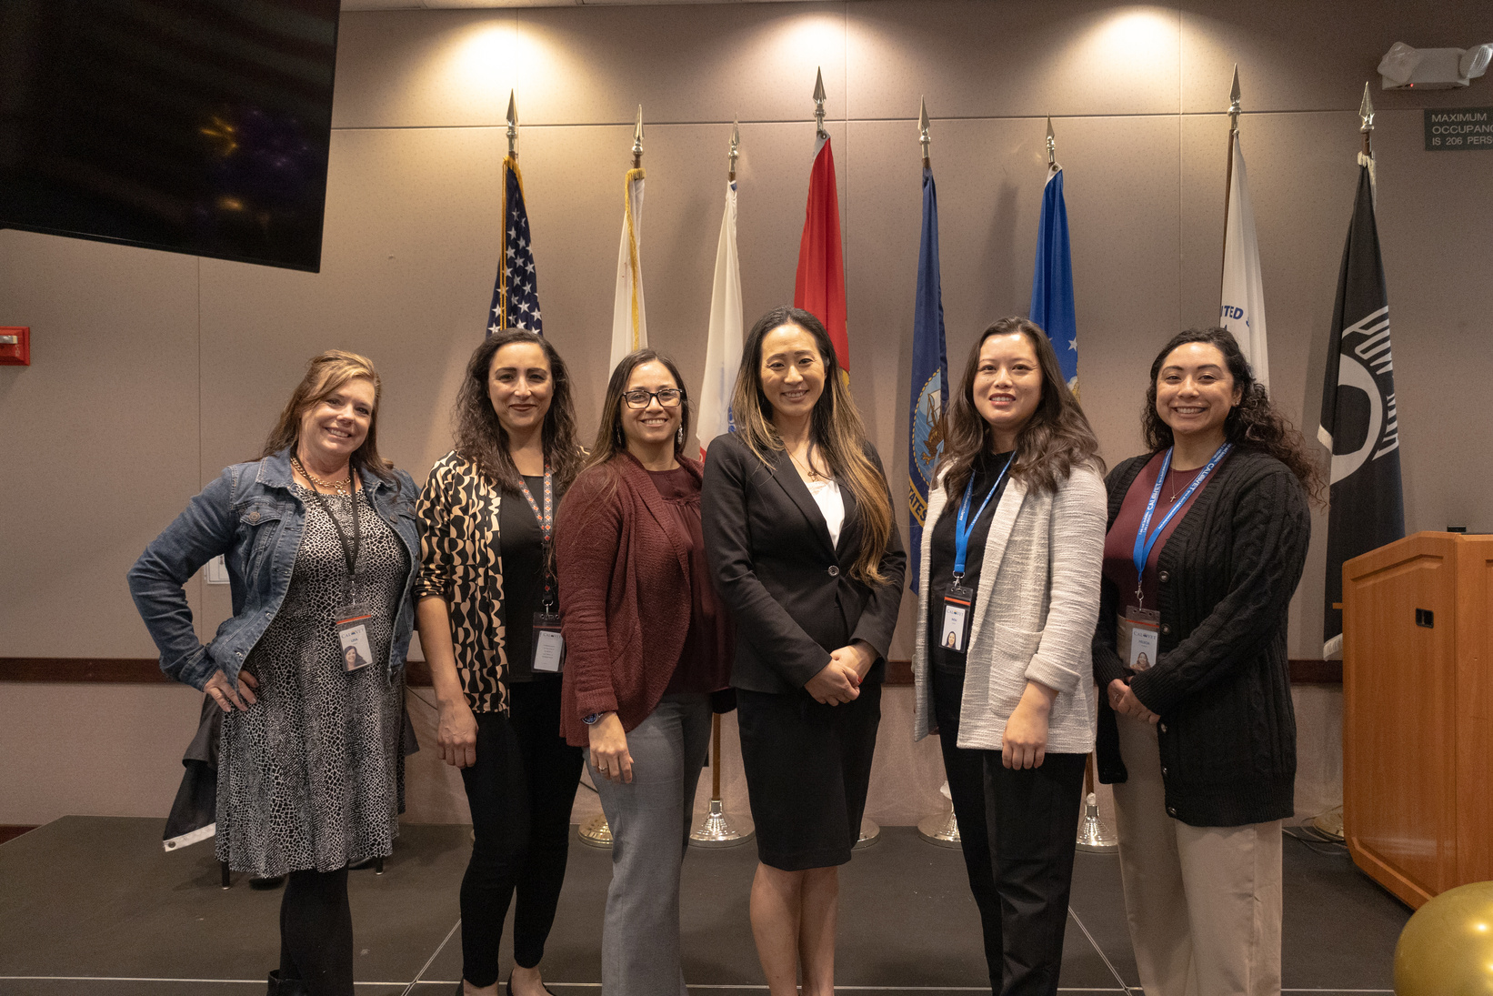
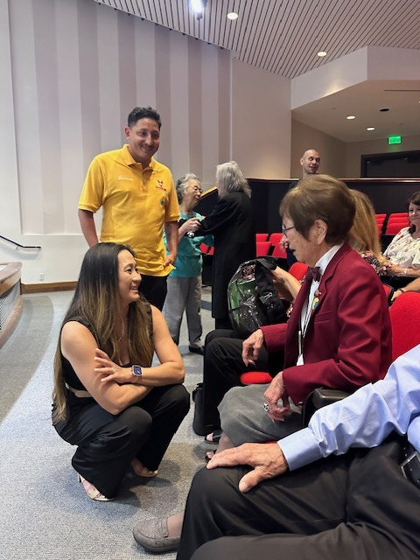
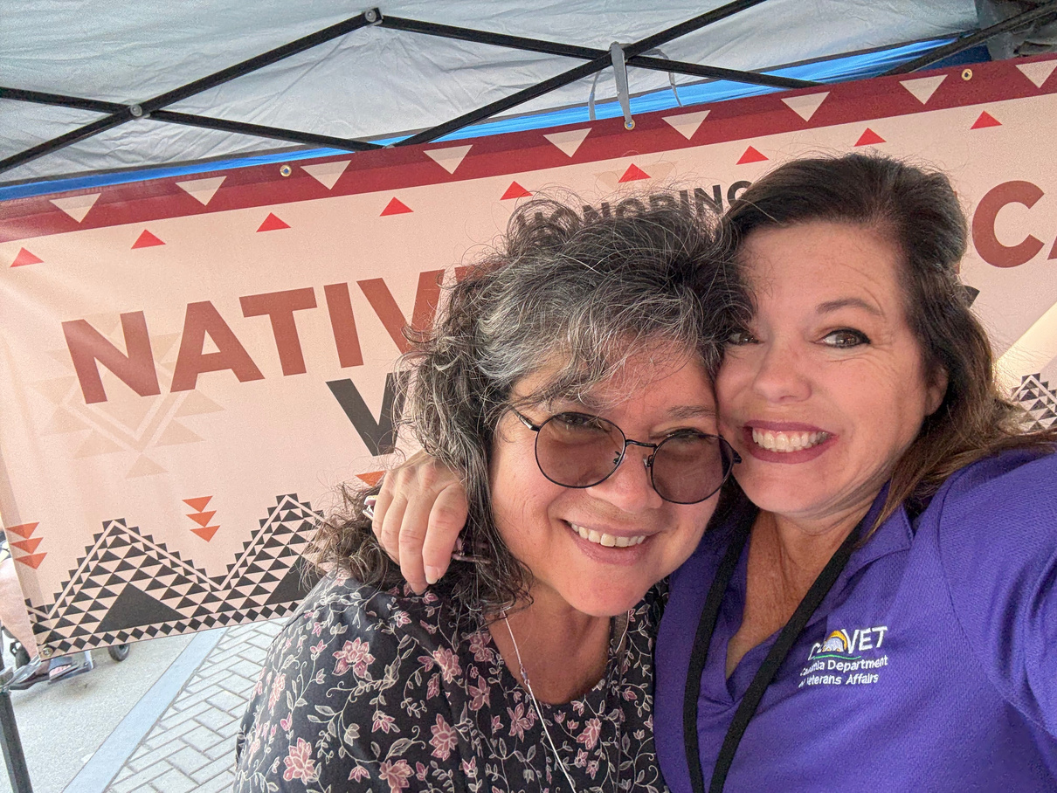
Women Veterans Division
2
Notes:
State-level leadership and guidance
Inform policy and programs – both externally and internally
Outreach to women veterans, partners, and providers
Ensuring that the needs of women veterans are integrated into planning and service delivery across all systems,
so ALL California veterans and their families are the most CONNECTED, PROTECTED, AND RESPECTED in the nation

Slide 15
Women Veterans Division
Gender-specific care
Employment
Housing
Family Support
Underrepresented Women Vets
Notes:
Survey
Trailblazers and Reception

Slide 16
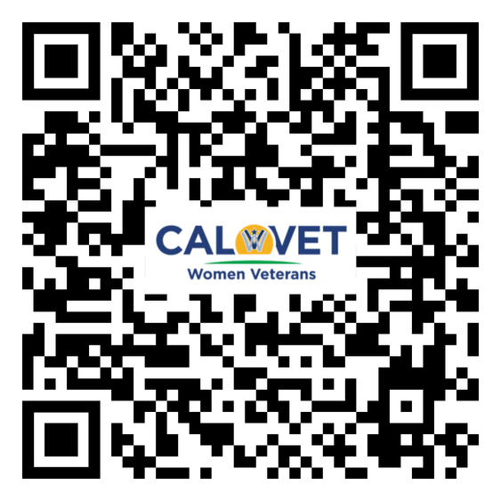
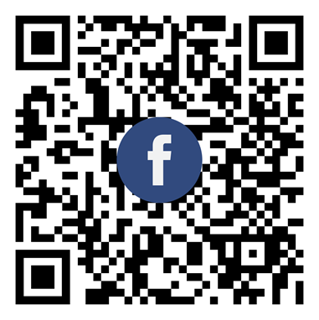
CalVet Women Veteran Division
womenveterans@calvet.ca.gov
(916) 653-1402
11

