Slide 1
MUVD Updates and Data Driven Initiatives
Ricky Pal
California Department of Veterans Affairs
Deputy Secretary, Minority & Underrepresented Veterans

Slide 2
MUVD Updates
New Supervisor within the Division
Meetings with minority leaders
Mapping minority organizations
2026 Tribal Veterans Mental Health Summit

Slide 3
Minority Veterans Demographics

Slide 4
California Veterans Population
California minority veterans are 754,831 or 47% of all veterans

Slide 5
Minority Veterans Data

Slide 6
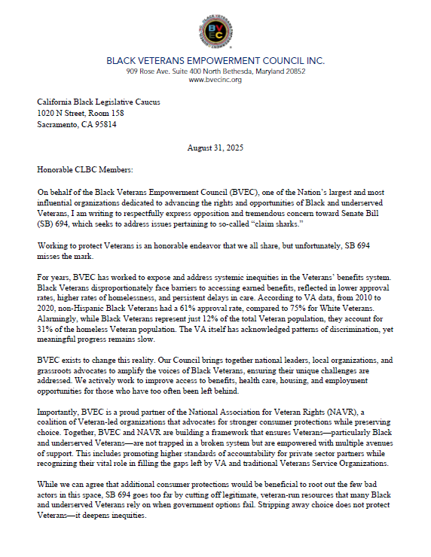
“Express opposition and tremendous concern towards (SB) 694….”
“Black Veterans disproportionately face barriers to accessing earned benefits….”
“veteran-run resources that many Black and underserved Veterans rely on when government options fail. ….”
Notes:
Sharing concerns on how 694 would impact their communities.

Slide 7
Data-Driven Equity for Minority Veterans
Are there inequities?
Targeted outreach and support
Access to state and federal benefits and services
Accountability and trust
Notes:
Access to state and federal benefits and services
Data shows whether minority veterans face barriers in accessing VA healthcare, disability compensation, education benefits, or housing assistance. Without racial demographics, unequal denial rates, longer wait times, or under-utilization of benefits can go unnoticed.
Disability claims fairness
Studies have found racial disparities in disability ratings and claim approvals. Collecting demographic data allows oversight bodies to detect bias, correct flawed evaluation processes, and ensure veterans are compensated fairly for service-connected injurie
Targeted outreach and support
If data shows minority veterans are less likely to enroll in VA care or use mental health services, agencies can design culturally competent outreach instead of assuming a one-size-fits-all approach.
Accountability and trust
Many minority veterans come from communities with historical reasons to distrust institutions. Transparent data collection and reporting help build accountability and demonstrate that disparities are taken seriously, not ignored.

Slide 8
Using Demographic Insight to Drive Veteran Programs

Slide 9
From Data to Impact: Practical Solutions
Standardized demographic fields across all programs and partner agencies to ensure consistency
Partner with trusted community organizations serving CA’s minority and underrepresented veterans
Train community providers in cultural competency to improve care for linguistically and culturally diverse veterans

Slide 10

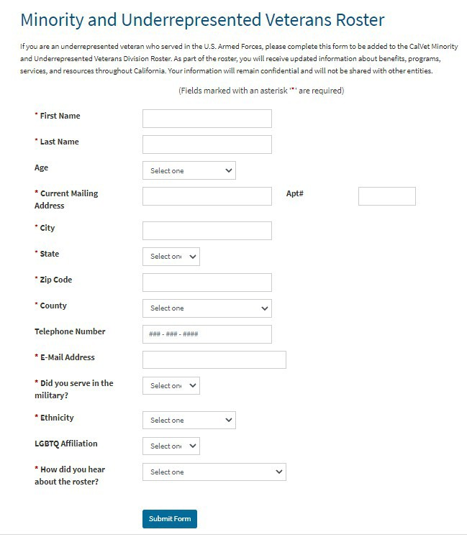
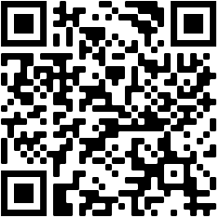
Minority and Underrepresented Veterans Roster
Receive updated information about benefits, programs, services, and resources throughout California
Since it’s launch, over 12,500 minority and underrepresented veterans have joined.
Sign up for our Roster!

Slide 11

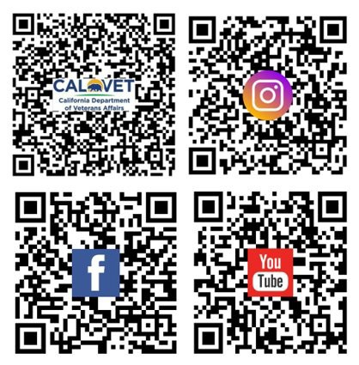


California Department of Veterans Affairs 916-651-3054
www.calvet.ca.gov
Rakesh “Ricky” Pal 916.767.1267
rakesh.pal@calvet.ca.gov

