Slide 1
Navigating VBMS (as a VSO)
February 2026

Slide 2
VBMS (Veterans Benefits Management System)
Search
Veteran’s Record
Claims History
Documents Page
All Claims | Filtering and Bookmarking
My Claims

Slide 3
VBMS (Veterans Benefits Management System)
Search
Veteran’s Record
Claims History
Documents Page
All Claims | Filtering and Bookmarking
My Claims

Slide 4
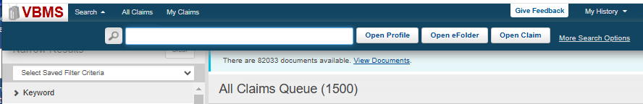
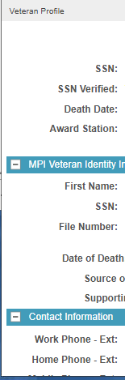
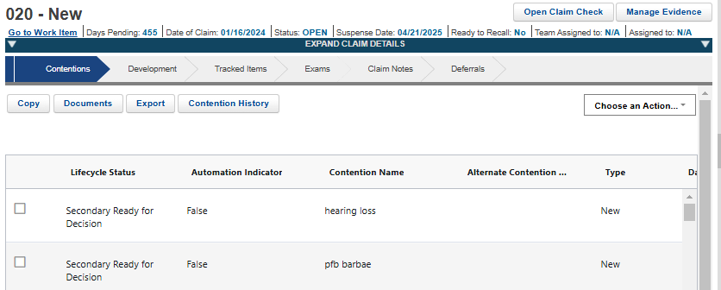
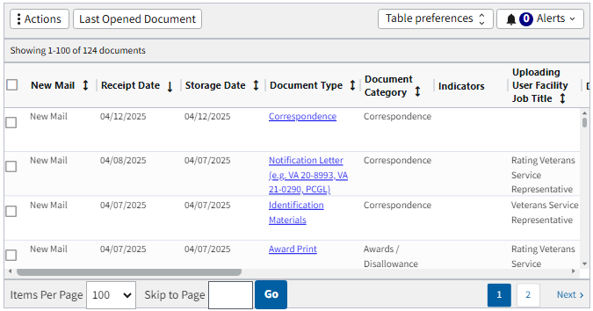
File #, SSN or EDIPI # here to search
Claim ID can only work with Open Claim option.
Using the Search block, type the number and hit one of the 3 options.

Slide 5
VBMS (Veterans Benefits Management System)
Search
Veteran’s Record: Profile Page and More
Claims History
Documents Page
All Claims | Filtering and Bookmarking
My Claims

Slide 6
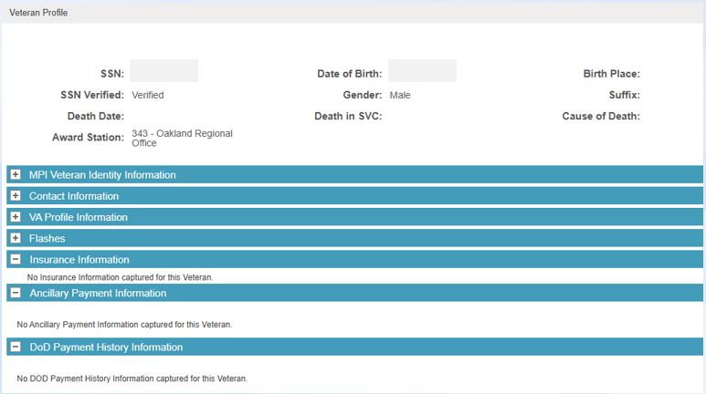
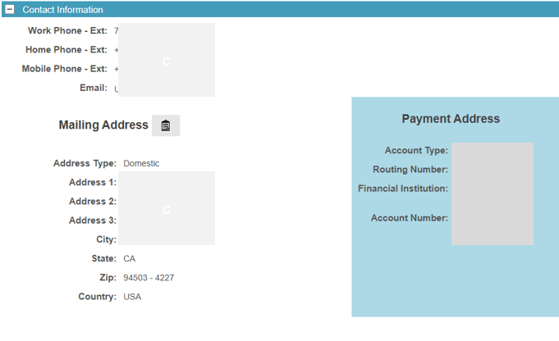
Veteran’s Record: Profile Page
The Veteran Profile page is just one of the options from the Veteran drop-down menu.

Slide 7
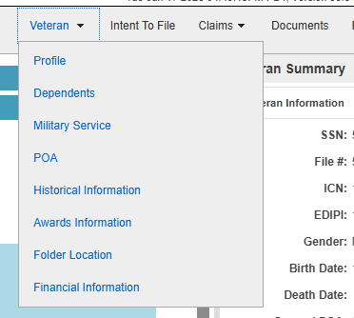
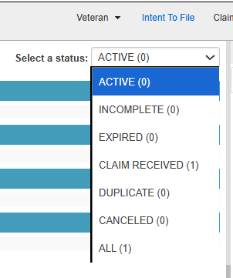
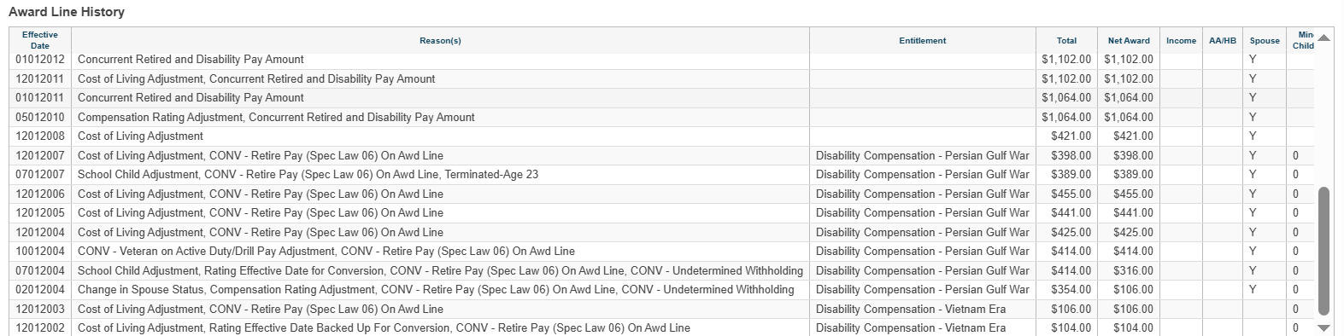
Veteran Drop-down menu
Intent to File status

Slide 8
VBMS (Veterans Benefits Management System)
Search
Veteran’s Record
Veterans Claims History
Documents Page
All Claims | Filtering and Bookmarking
My Claims

Slide 9
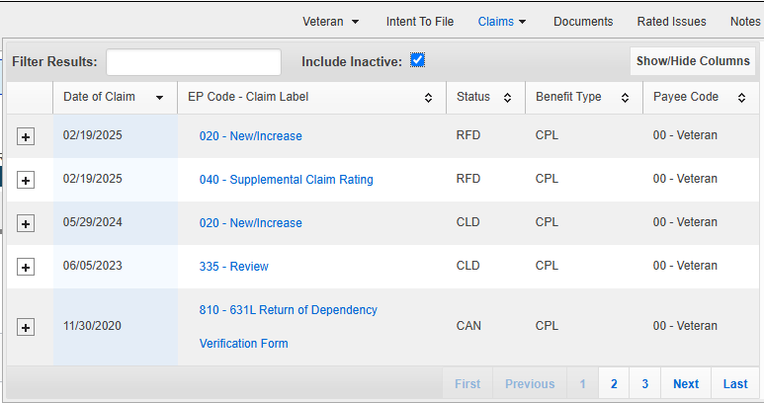
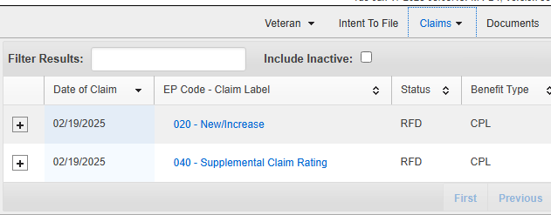
Veteran’s Claims History
Claims dropdown menu default will show pending claims.
Check box to see list of closed claims.
Box checked shows
closed claims
Default only shows pending claims.

Slide 10
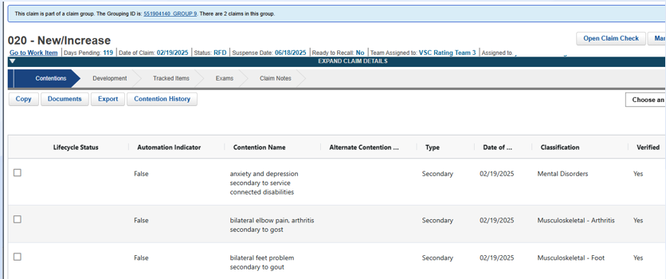

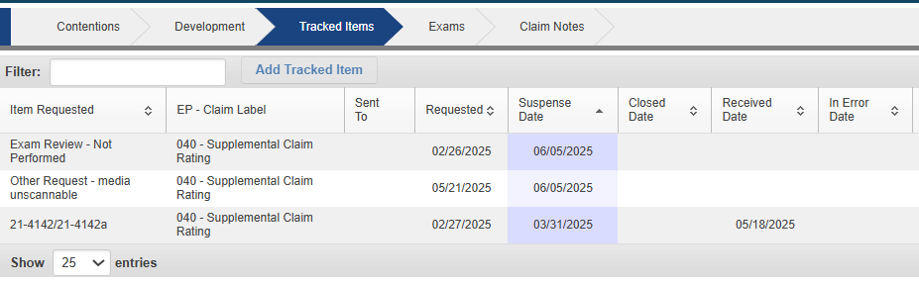
These two are not the same:
Claim Notes are specific to the claim.
Notes has everything.

Slide 11
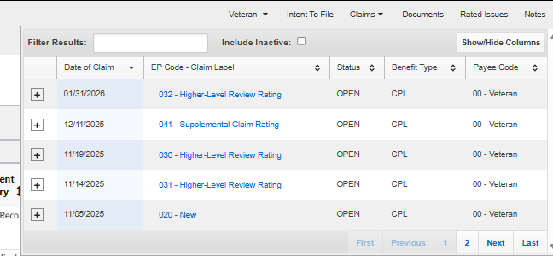
Let’s show from here again.
To check what’s happening with a claim, we click on the claims dropdown.
Then choose the pending claim we want to check on.

Slide 12
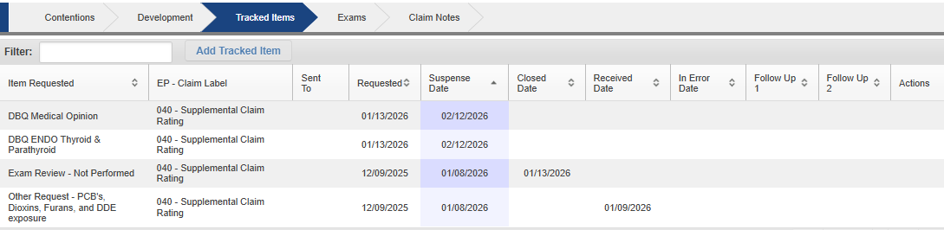
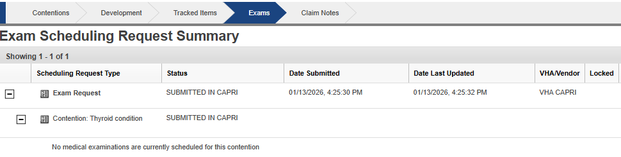
Default will show Contentions page, but other tabs also available when checking claim status.
Useful to check:
Tracked Items
Exams

Slide 13
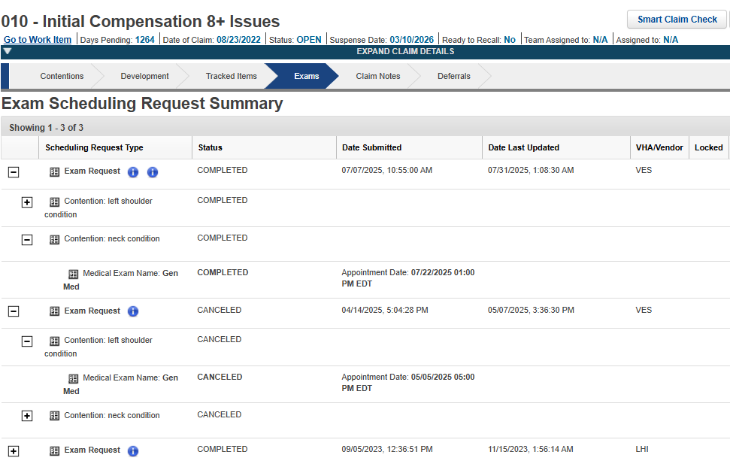




Slide 14
VBMS (Veterans Benefits Management System)
Search
Veteran’s Record
Claims History
Documents Page
All Claims | Filtering and Bookmarking
My Claims

Slide 15
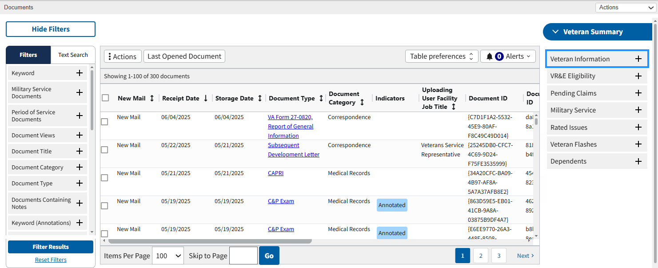
Veteran’s Documents Page

Slide 16
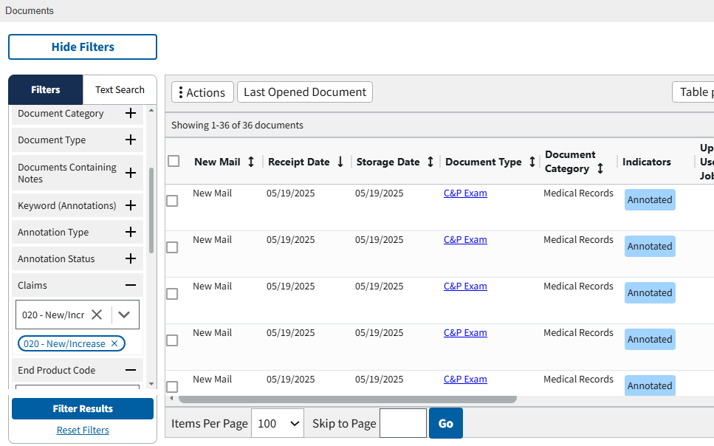
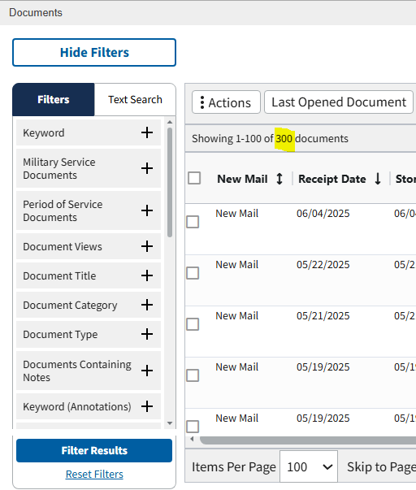
Filtering Documents

Slide 17
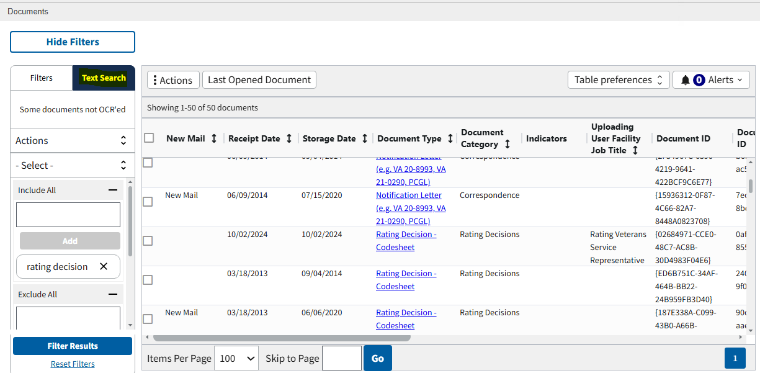
Text Search in Documents

Slide 18
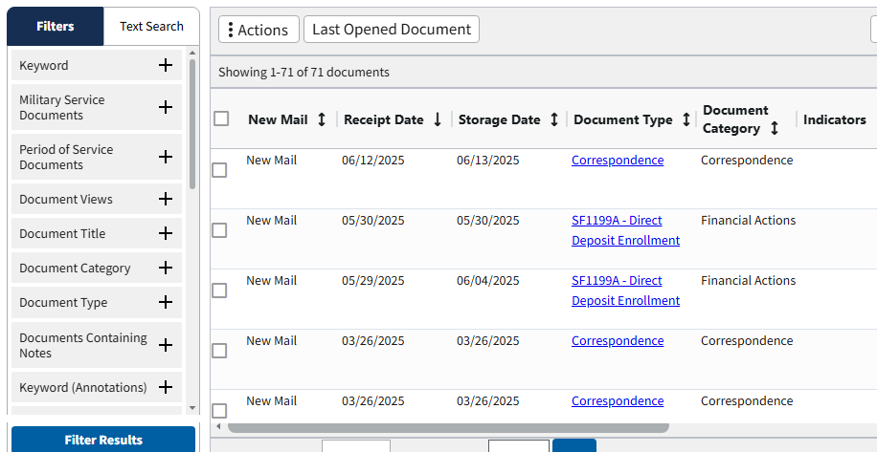
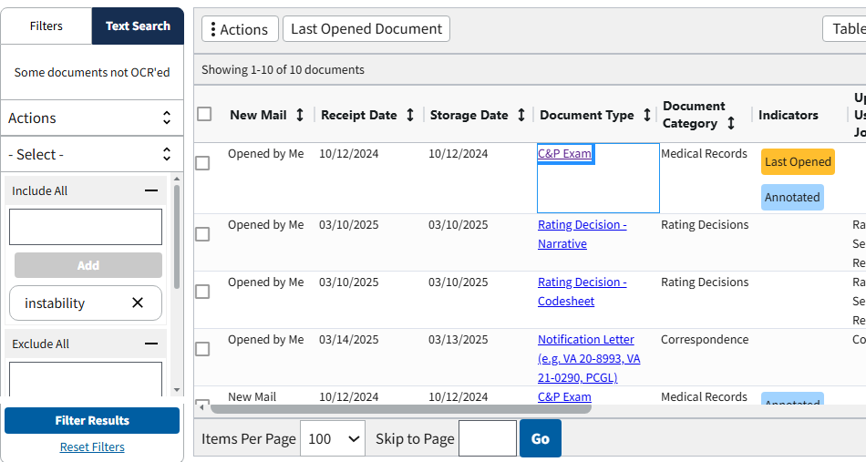
Choose one.
Less documents after text search.

Slide 19
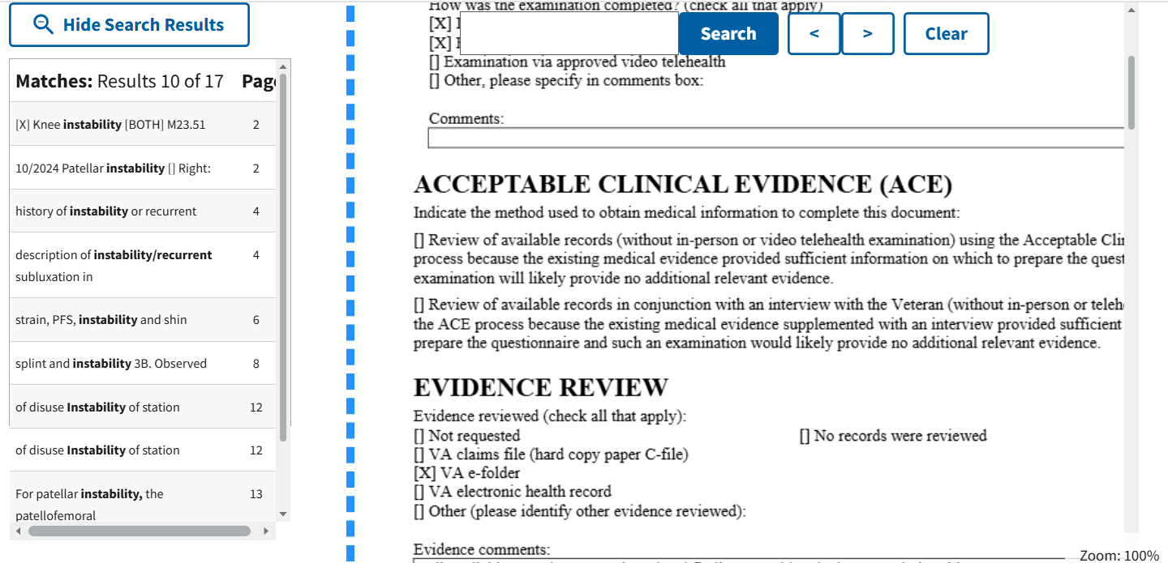
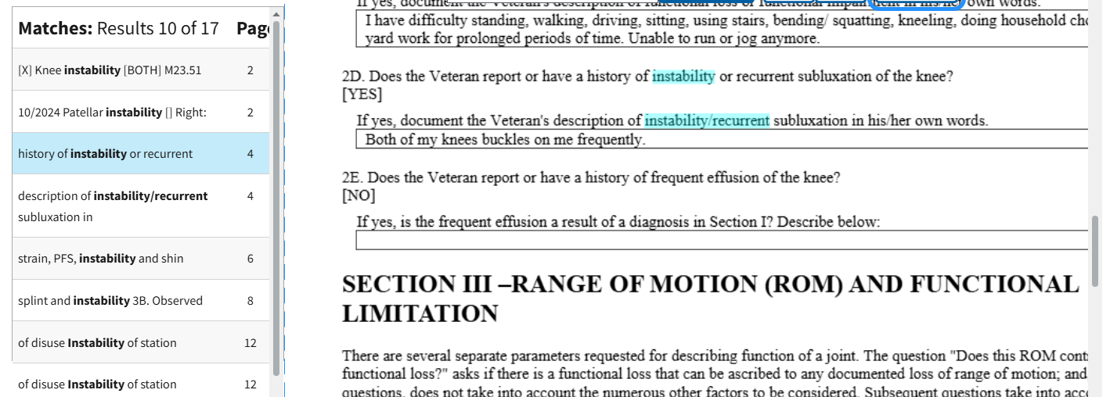
Click on the document, and it will take you to the page or pages with that word.

Slide 20
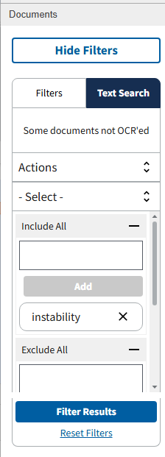
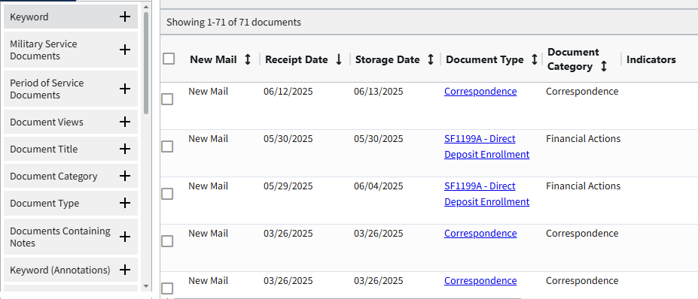
To get back to full view of things, just hit Reset Filters.
Once you Reset Filters, it goes back to show you all documents in chronological order.

Slide 21
VBMS (Veterans Benefits Management System)
Search
Veteran’s Record
Claims History
Documents Page
All Claims | Filtering and Bookmarking
My Claims

Slide 22
All Claims | Filtering and Bookmarking
The best way to keep track of claims is by bookmarking VBMS.
Bookmark the veteran’s file, so it shows up in My Claims.
Puts cases in one place, to quickly see the claim status.
No need to pull up the cases one by one using the Search function.

Slide 23
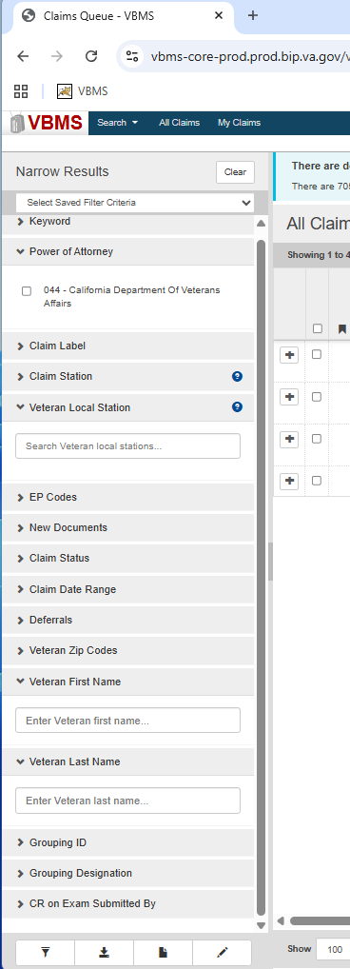
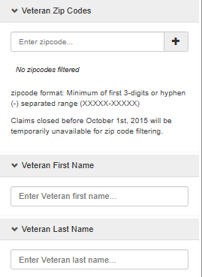
While on the ALL CLAIMS Queue, you can search by:
Zip Code
Zip Code search should narrow to all those in said jurisdiction. Might be useful to add additional filter to lessen results.
Veterans First Name
Veterans Last Name
Name search should narrow down to all that veteran’s claims or all veteran’s of the same name (if common)

Slide 24
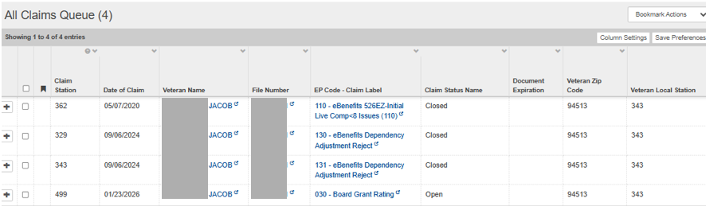
This is an example of filter results by full name:

Slide 25
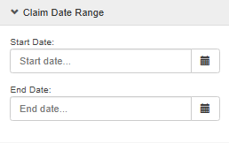
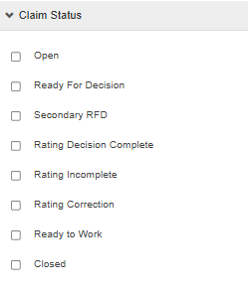
Claim Date Range and Claim Status are other filter options to lessen search results or be more specific/targeted in Zip Code search.

Slide 26
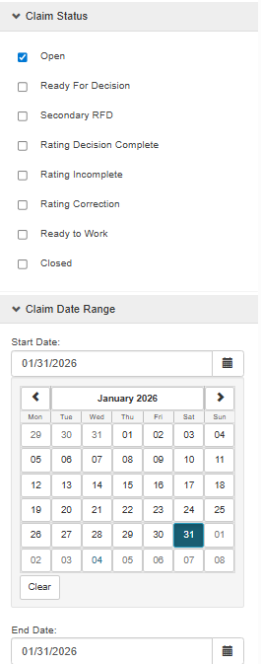
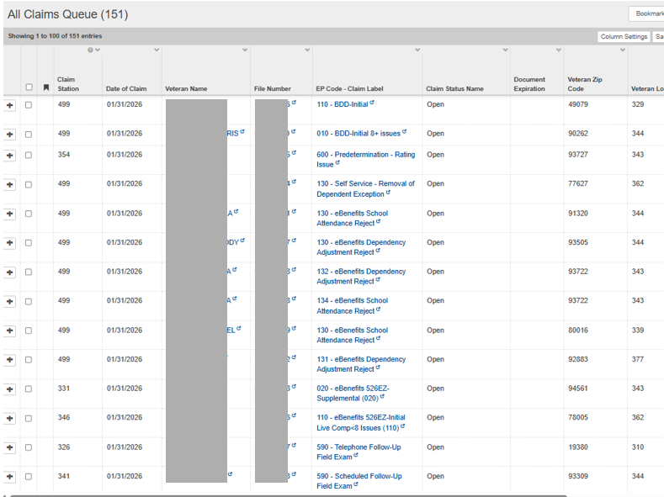

This is the result of a claim date and claim status filter search:
Different veterans with claims received 1/31/26, with Open as status.

Slide 27
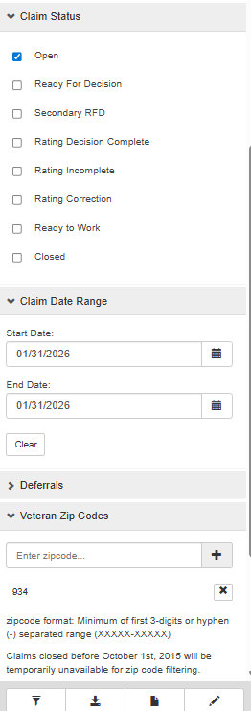
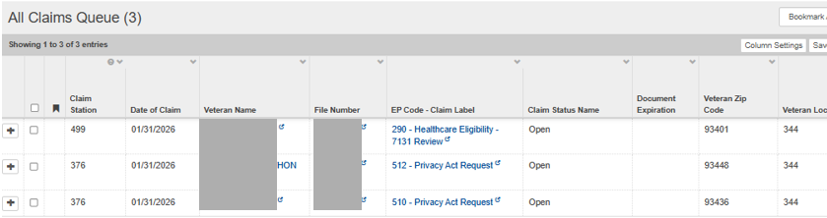


This shows a filter by:
Claim Status
Claim Date Range
Zip Code (first 3-digits)

Slide 28
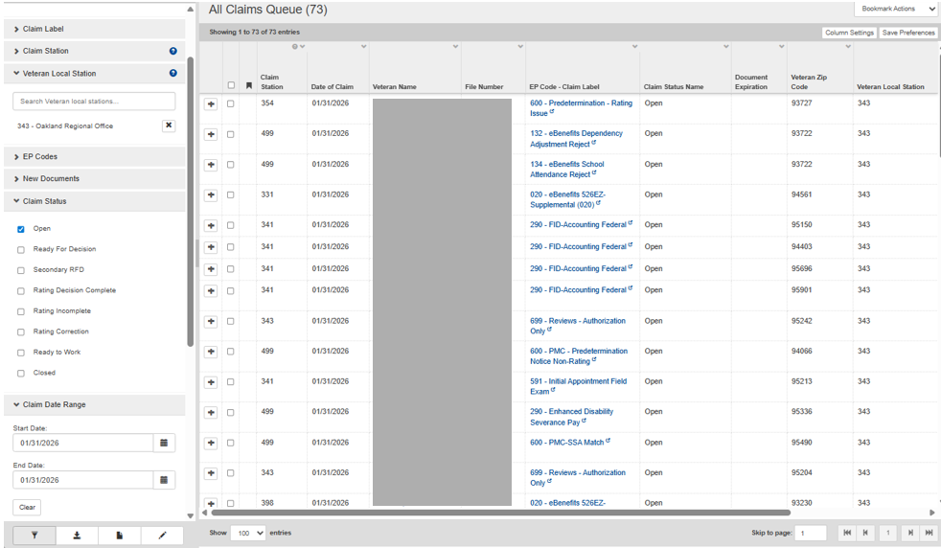
This one uses Claim Status, Claim Date Range and Veteran Local Station.
Click the box here for the veteran you want to bookmark for your My Claims Queue.

Slide 29

Check the box
Click Add Bookmarks
This icon will show up afterwards to indicate that this has been added to your My Claims Queue.

Slide 30
VBMS (Veterans Benefits Management System)
Search
Veteran’s Record
Claims History
Documents Page
All Claims | Filtering and Bookmarking
My Claims

Slide 31
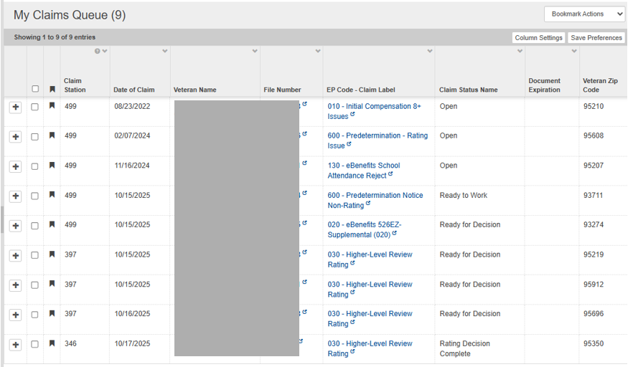
This is where you can access the My Claims queue. If you do not have any cases bookmarked, it will be empty.
If you already bookmarked cases, this is how it will look.

Slide 32
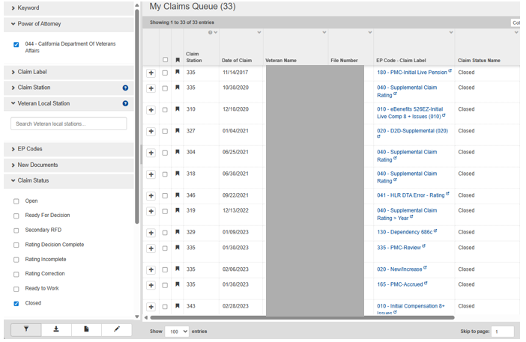


There is also a filter column for all cases in your My Claims Queue.
The only reason we would keep a closed case is when there is a pending appeal with the Board.
Otherwise, we suggest removing the bookmark for the case.

Slide 33
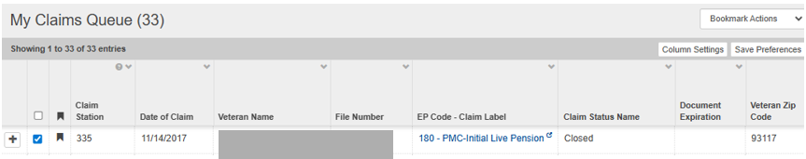
To remove the case from your
My Claims Queue:
Check the box
Then go to the Bookmark Actions dropdown
Choose Remove Bookmarks

Slide 34

Questions?
Zmae Raymundo
District Manager-Oakland
Zheriemae.Raymundo@calvet.ca.gov
(510) 286-0627; (510) 301-7078

