Slide 1
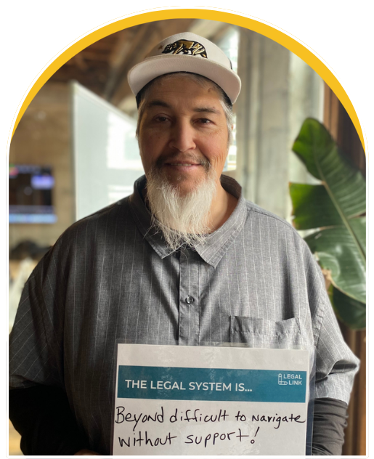


Legal First Aid® for California CVSOs
Addressing legal barriers to veteran stability —
early, often, and through trusted partners
June 2026
x
Notes:
I’m Kate Crowley Richardson, ED of Legal Link. Prior to joining Legal Link, I was the Legal Director at Swords to Plowshares ..
My name is Gabriela Perez and I'm the Director of Partnerships and Development at Legal Link.

Slide 2
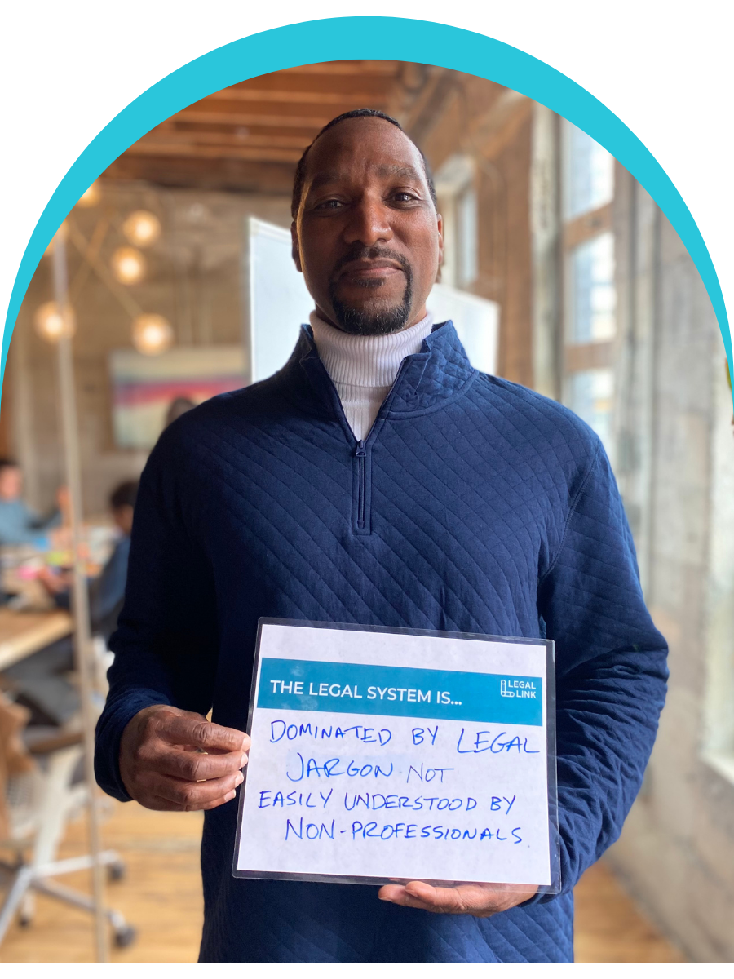
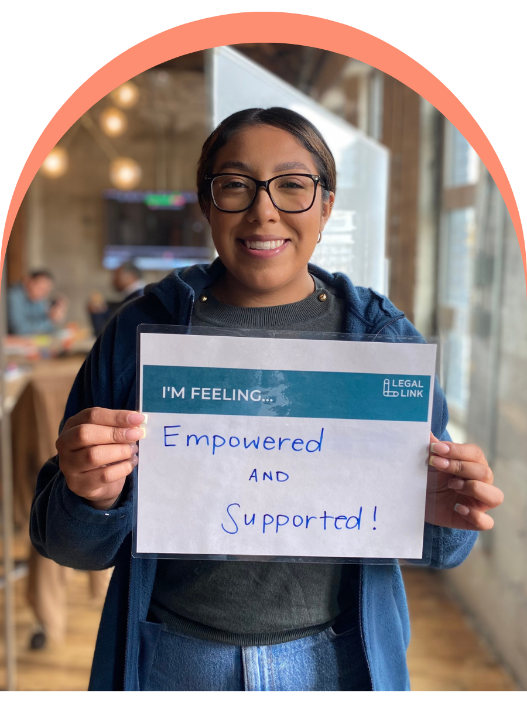
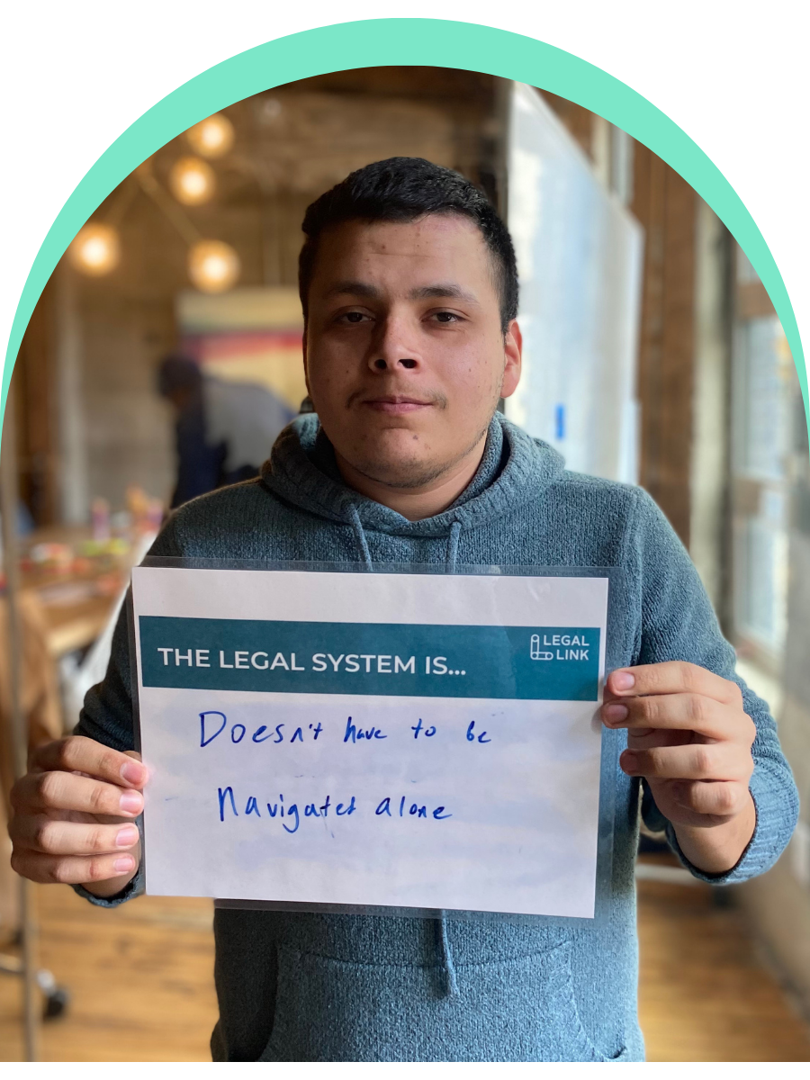
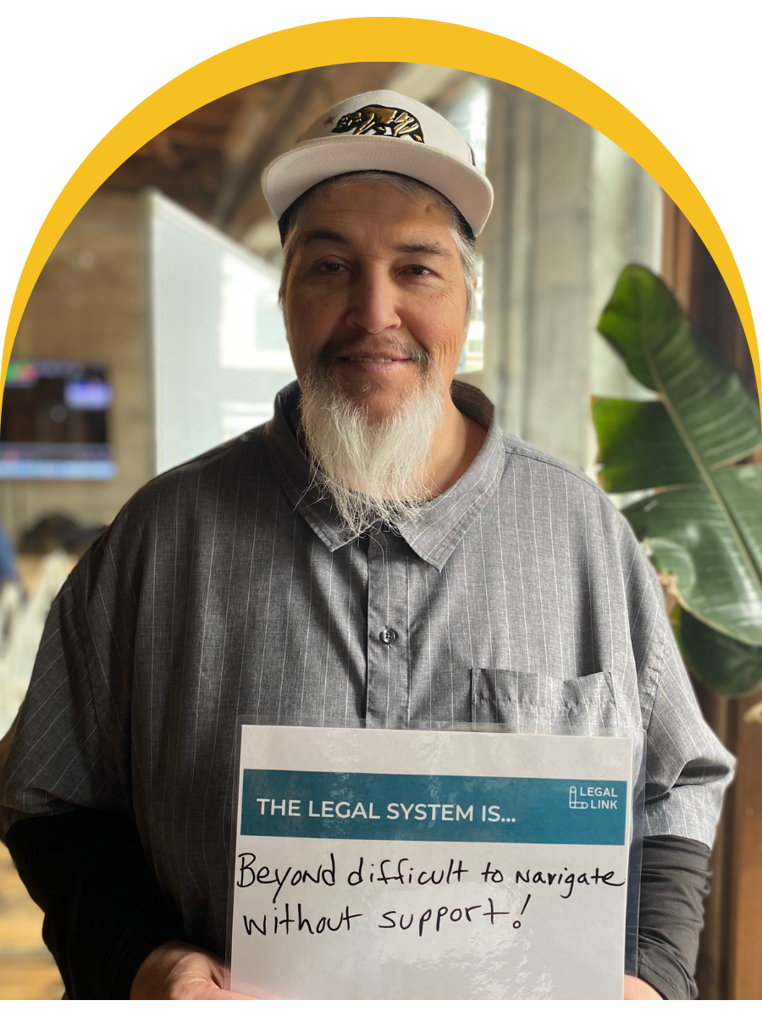
Legal Education as Empowerment
Notes:
From Knowing Your Rights to Using Them
Set the scene — We've all seen Know Your Rights trainings. They're valuable — but they often stop at information. Someone walks away knowing what the law says, but not necessarily feeling like they can do anything with it.
Name the gap — There's a difference between knowing your rights and feeling empowered to use them — especially for veterans navigating systems that can feel bureaucratic, opaque, or even adversarial. A veteran who received a less-than-honorable discharge may not even know they have options. Someone struggling with housing instability may not connect that to a legal remedy."
The shift we're talking about — Legal empowerment education is about moving people from passive recipients of information to active agents who feel confident, supported, and authorized to act, whether that's pursuing a discharge upgrade, appealing a benefits denial, or knowing when to call a lawyer.
Why this matters for your work — As CVSOs, you're already the most trusted point of contact for many of the veterans you serve. You're not just case managers, you're advocates. You're uniquely positioned to not just refer veterans to legal help, but to be part of building that legal confidence directly.
Our Legal First Aid program was designed with this gap in mind — a certification, ongoing support, and a network so that CVSOs aren't just trained once and left on their own.
The guiding lens "What would it look like if legal learning were designed not just to inform, but to empower, so that every officer feels equipped to spot a legal issue and take that first critical step?"

Slide 3
Describe the legal system
in one word
Notes:
I want you to think about one word that describes the legal system for you. The first word that comes to mind. Got your word? Ok now….

Slide 4
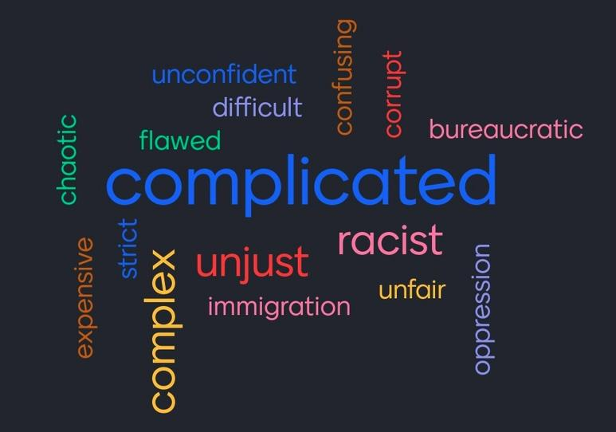
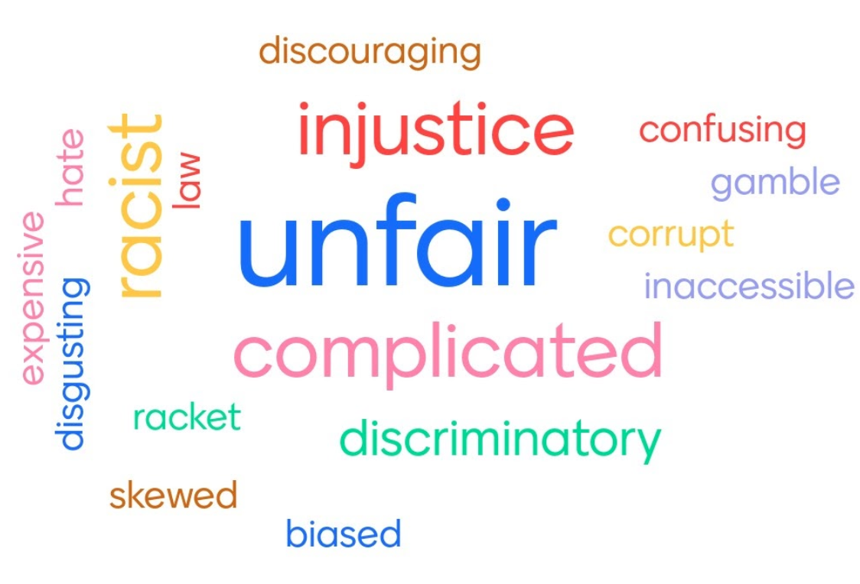
Notes:
Now, take a look at the words on this screen.
These come from recent Legal First Aid trainings we’ve delivered across the country. In each training we give, we ask participants to name the first word that comes to mind when they think about the legal system—and we see the same words again and again: complicated, unjust, unfair, racist, confusing, corrupt, expensive, biased, inaccessible….Using your reaction button on zoom or raising your real or virtual hand, how many of you see your word
This is an important and powerful moment to acknowledge that this is the baseline we’re starting from - the legal system is not working on a basic level for the vast majority of people. And there is a real and well-earned lack of trust in the system.

Slide 5

THE JUSTICE GAP
Notes:
Let’s talk about the justice gap. Most people assume this just refers to the fact that if you can’t afford to pay a lawyer, you can’t get a lawyer, and there aren’t enough free / legal aid lawyers. Which is true….

Slide 6

NOT ENOUGH LEGAL AID LAWYERS TO MEET THE NEED
Notes:
We do have a shortage of legal aid attorneys. How extreme is this shortage? Let’s look at the numbers…

Slide 7

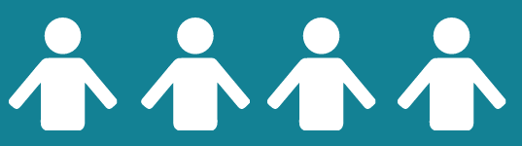

NEED FOR LEGAL AID LAWYERS
1 private lawyer : 200+ people
1 legal aid lawyer : 3,300+ people in poverty
Notes:
In the US, we see a shocking ratio of available legal help for those most in need:
For people who are NOT LOW-INCOME, there is one private lawyer (not free or a lawyer you can hire/pay) for every 244 people.
For people who ARE LOW-INCOME, there is one legal aid (free) lawyer for every 3,300 people in need. (ABA, 2025) IN NEW YORK, y’all are in a slightly better situation with 1 legal aid attorney for every ~1,389 people in poverty
So there continues to be a palpable lack of funding for legal aid attorneys to serve our low-income communities.

Slide 8

THE LEGAL DELIVERY SYSTEM IS COMPLICATED
Notes:
In addition - the legal delivery system is also incredibly complicated - with numerous courts, agencies, organizations, deadlines, and eligibility rules. It is easy to be in the wrong place at the wrong time, and to not get the support you need. Finding help, or navigating the system can be very complicated.
For example, there are over a 100 state-funded legal aid organizations in California, and over 2,000 entities providing legal assistance in the state alone that do a slice of legal work for a slice of the population - getting to the right one at the right time can be an impossible challenge.

Slide 9
of low-income people in the United States do not get the legal help they need.
80%
.
of people do not seek help for their civil legal issues outside of their immediate social network
Notes:
We want to acknowledge the other major - and less talked about - barriers to seeking and receiving legal help:
Yes, there are real and perceived cost barriers and a shortage of free / legal aid lawyers, but as sociologist Becky Sandefur writes: “Lawyers are only part of the problem. They are also only part of the solution.”
Yes, the legal system is complicated, as we just discussed.
BUT ALSO…
Two major barriers we see both in the research and echoed in people’s lived experiences are: KNOWLEDGE barriers and TRUST barriers
Researchers have looked at extent to which people know that legal professionals can help resolve civil legal problems. What we find is that the vast majority of legal issues don’t get identified as legal - ppl think of them as money trouble, family problems, or just bad luck.
Researchers have also explored people’s beliefs about the civil legal system - the vast majority of ppl who do identify legal issues DO NOT turn to lawyers, they turn to trusted people in their social network
In fact, 8/10 ppl don’t seek out help on legal issues outside of their immediate social network.

Slide 10
92%
of low-income people in the United States do not get the legal help they need.
Notes:
As a result, we see this staggering and appalling statistic - which is that 92% of low-income Americans do not get any - or enough - legal help with their (substantial) civil legal problems.
ONLY 8% of people get the legal help they need.

Slide 11
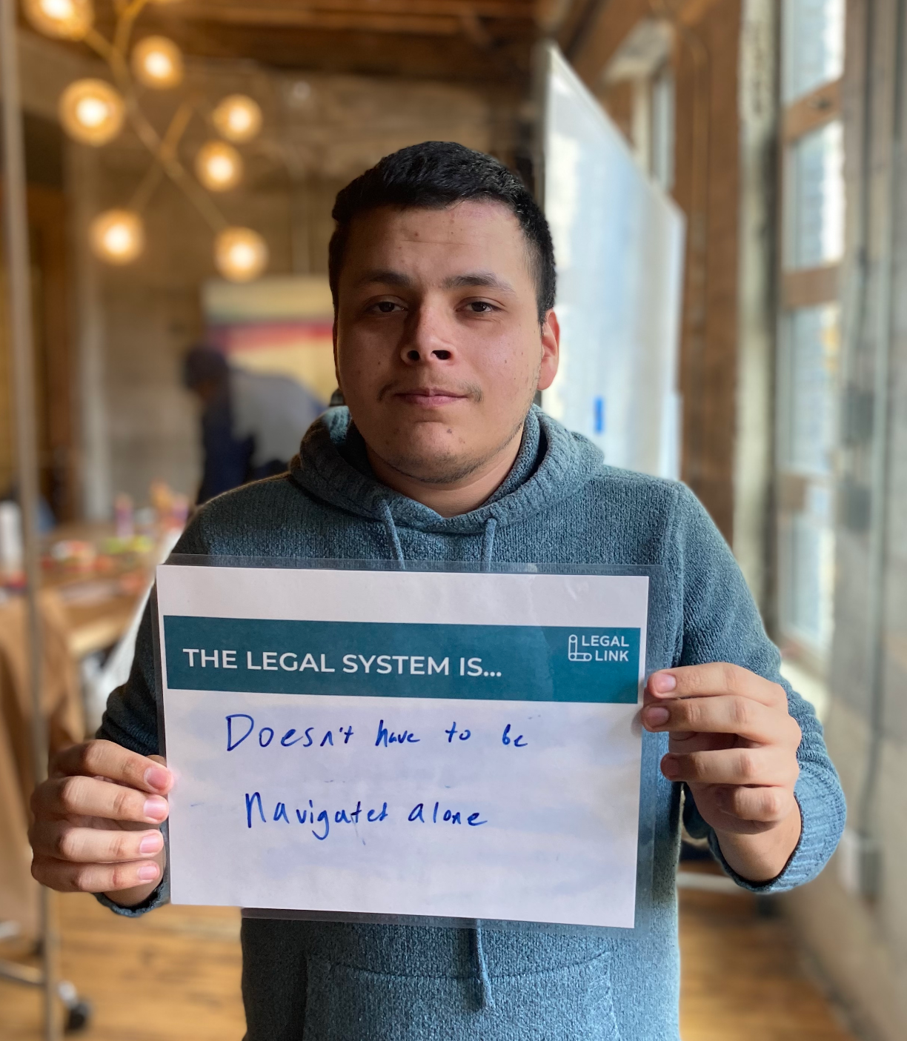
OUR MISSION
To remove legal barriers that prolong poverty by adding critically needed capacity to the legal ecosystem.
Notes:
At Legal Link, we focus on removing legal barriers that prolong poverty by building capacity within the legal ecosystem—especially in the places the legal system doesn’t normally reach.
We do this by training and supporting trusted, community-based providers through our Legal First Aid® curriculum.
We know the legal system doesn't reach everyone who needs it.
Especially veterans, who may be navigating bad paper discharges, benefits denials, housing instability, family law issues, and the compounding effects of service-related trauma, all at once and often without knowing legal remedies exist.
So instead of trying to add more lawyers, we build capacity in the people already doing the work. Frontline providers who are already trusted, already in the room, already the first call someone makes when things go wrong. After more than a decade of iteration and evaluation, we've seen what happens when those providers are equipped with the right tools. They become critical legal advocates for their communities.
The good news in the midst of all of those negative statistics I just showed you is that YOU ARE ALL THE TRUSTED PEOPLE for veterans in your communities across the state. YOU are in unique positions of trust. And that’s why we found a partnership with the CA CVSOs to be a natural fit…

Slide 12
CACVSO Legal First Aid® Certification Program
The Challenge
Civil legal problems are widespread among low-income veteran households: 71% face at least one civil legal problem, 48% face five or more, and 29% face ten or more. These include eviction, debt, family instability, record barriers, and benefits issues—threats that can destabilize housing and livelihoods.
The Opportunity
Legal Link will deliver the first Legal First Aid® training to 200 CVSO staff in California, equipping staff to identify legal issues early, respond safely within their roles, and connect veterans to trusted legal resources—helping prevent crises and stabilize families.
Notes:
Veterans rarely face just one legal problem. A benefits denial can trigger housing instability. A bad paper discharge can block access to healthcare. A debt in collections can cost someone their driver's license and their job. These issues compound, and by the time they reach a crisis point, they're much harder to resolve.
CVSOs are uniquely positioned to interrupt that cycle early. You're already the most trusted point of contact for many veterans navigating these systems. But without systematic legal navigation training, even the most dedicated officer may not recognize a legal issue for what it is, or know what to do with it.
That's exactly the gap Legal First Aid® was built to fill. And here's what I want you to hear clearly: we are bringing this training to California CVSOs for the first time, and we want you in the room.
This isn't a one-time workshop you complete and forget. It's a certification, a network, and ongoing support. Officers who go through Legal First Aid® come out with a shared language, a practical framework for spotting legal issues, and a direct connection to legal resources they can actually use. You won't be expected to practice law. You'll be equipped to recognize when the law is relevant and know exactly what to do next.
The veterans you serve have already done the hard work of asking for help. This training makes sure you're ready to meet them there.
Before we give some details about how you can sign up for the training, I want to preview a bit of the curriculum to give you a concrete sense of what it covers and what skills you’ll gain.

Slide 13
LEGAL FIRST AID® CERTIFICATION
Notes:
Let’s talk about LFA curriculum and certification.

Slide 14
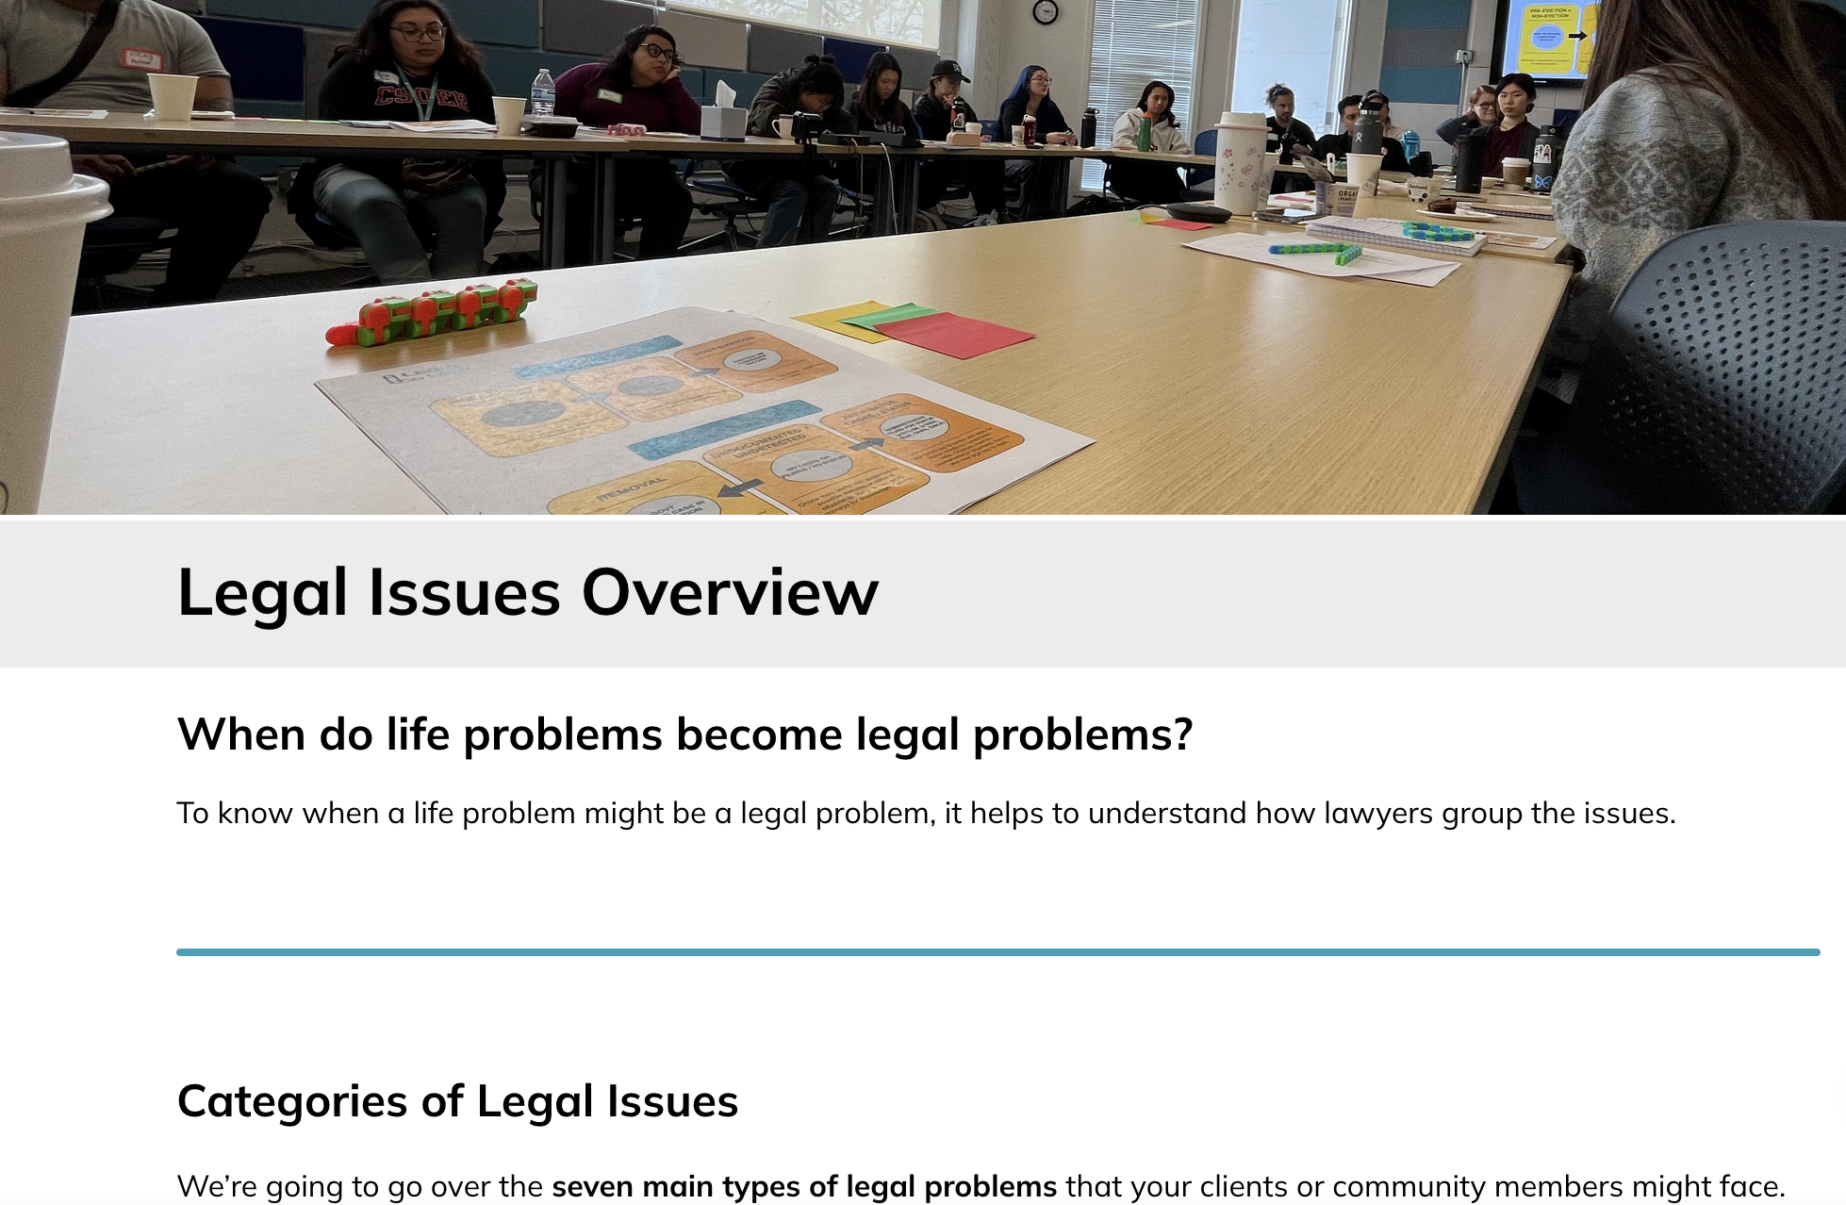
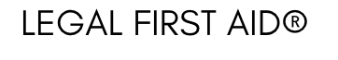
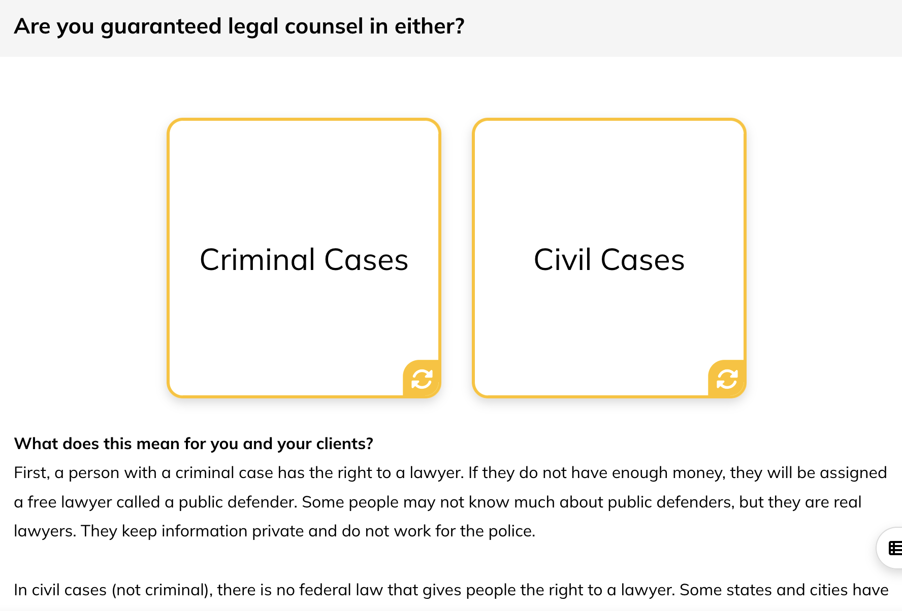

Notes:
To get practical in terms of what the Legal First Aid training looks like: It's a two-part curriculum.
Part I is virtual and self-paced, completed before the live session (approx takes 1-1.5 hours to complete).
Part II is a live Zoom skills session with interactive activities that go beyond breakout rooms, creating space for cross-pollination across different organizations.
Together, they introduce core Legal First Aid® principles and give participants a practical foundation for identifying and responding to legal needs in their everyday work.
We cover:
An overview of the access-to-justice problem and Legal Link's response
The A.I.D. Method (Ask, Investigate, Deliver), a simple framework for approaching any legal issue
Rules and ethics like confidentiality and knowing the boundaries of your role, which we make accessible and engaging
A high-level overview of common legal issues and key takeaways
And a curated set of legal resources community partners can actually use
We then run a live, interactive practice session focused on skill-building, everything from spotting overlapping legal issues in everyday life problems to preparing someone for a legal meeting. The goal is confidence, not expertise.
With certification, participants are better able to:
Recognize the access-to-justice gap and their role in closing it
Identify when a life issue has a legal solution
And take appropriate action through resources, referrals, and next steps that are well within the scope of their role
Let me share a couple of brief examples of what this looks like on the ground.
Housing: A mother with a housing voucher keeps being turned away by landlords. A trusted caseworker recognizes this as illegal source-of-income discrimination, knows how to document it, and supports the client in filing a complaint with the Civil Rights Dept. That case is then referred to a housing rights organization, investigated, and ultimately results in units being set aside specifically for voucher holders.
Discharge Status: A veteran separated with an Other Than Honorable discharge has spent years believing he isn't entitled to any benefits. CVSO recognizes that his discharge may be eligible for a DOD DU AND a VA COD based on evidence of untreated PTSD at the time of separation. The CVSO supports him to apply for a COD with the VA - he gets service connected disability compensation rated at 70%, starts receiving that monthly income, gets tx for his PTSD at a local VA clinic, and the CVSO also helps him gather service records, connects him to a veterans legal aid organization, and get representation from a culturally competent attorney who is able to help him with his DU to the BCMR. He successfully upgrades his discharge. For the first time, he can access VA healthcare, housing assistance, and service-connection he thought he’d never access.
Benefits Denial: A veteran receives a denial letter for disability benefits. She assumes the decision is final and moves on. An officer recognizes the letter as an initial denial, not a closed door, explains her appeal rights, and helps her request her records. With proper documentation of a service-connected condition, her claim is approved on appeal. That monthly benefit becomes the difference between housing stability and eviction.
Child Support Debt: A client accrued $70,000 in child support debt while incarcerated because he couldn't complete paperwork due to low literacy. A caseworker recognizes that this debt should have been paused, supports the client in contacting the county, and helps get the debt reduced to $3,000 on a manageable payment plan. The client gets his driver's license reinstated, secures a job, and for the first time feels the system working with him.
In all cases, when people lack the shared language to name a harm, they can't challenge it. And systems rely on that silence.
When confusion turns into clarity, and isolation turns into action, that's legal empowerment.

Slide 15

A.I.D. METHOD
ASK
INVESTIGATE
DELIVER
WHO is helping the client?
WHAT is the story?
WHEN does the client need help?
WHERE is this issue taking place?
WHY is this an issue now?
Get oriented
Review documents
Look deeper
Identify legal issues
Connect to key resources
Prepare clients for legal + related meetings
Support clients during legal + related meetings
Notes:
The A.I.D. Method is the practical backbone of everything we teach. It's three steps: Ask, Investigate, Deliver.
Ask is about getting the full picture before jumping to solutions, who is involved, what's the story, when and where is this happening, why now.
Investigate is about getting oriented, reviewing any documents, and looking a little deeper before drawing conclusions.
And Deliver is where action happens, identifying the legal issue, connecting the client to the right resources, and helping them prepare for and navigate what comes next. It's simple on purpose.
The goal is a framework that becomes second nature, something a caseworker can run through in their head during a regular client conversation without it feeling like a checklist.

Slide 16
TOP 7 LEGAL
ISSUE AREAS
Family + Relationships
1
Housing
2
Immigration
3
Criminal
4
Benefits
5
Work
6
Credit + Consumer
7
Notes:
Veterans rarely come to you with a single, isolated problem. Legal issues compound. A discharge status affects benefit eligibility, which affects housing, which affects family stability, which affects mental health. Understanding how these issues intersect is what separates a referral from a real intervention.
Discharge & Benefits
Bad paper discharges (Other Than Honorable, Bad Conduct Discharge, Dishonorable) and benefit exclusions
Discharge upgrade pathways (Board for Correction of Military Records, Discharge Review Board, Military Sexual Trauma/PTSD)
VA benefits denials and the appeals process
Character of discharge determinations
Housing
Veteran-specific vouchers (VASH) and landlord discrimination
Eviction defense and housing instability post-separation
Homelessness and shelter access tied to discharge status
Family Law & Civil
Child support debt accrued during deployment or incarceration
Survivor benefits and dependent eligibility
Criminal
Veteran Treatment Courts and diversion programs
Expungement and record clearing for service-connected conduct
Debt & Financial
Predatory lending targeting veterans and military families
Medical debt from non-VA care
DollarFor.org for hospital financial assistance

Slide 17




4 CORE BUILDING SKILLS
IDENTIFY Legal Issues
CONNECT
to Key Resources
PREPARE Clients for Legal + Related Meetings
SUPPORT Clients During Legal + Related Meetings
Notes:
These four skills are what certification is really about. Identify, Connect, Prepare, Support. They're not legal skills, they're human skills with a legal lens.
A frontline provider doesn't need to know how to argue a case. They need to recognize when something has a legal dimension, know where to send someone, help that person walk into a meeting ready, and make sure they don't have to navigate it alone. That's it. And in our experience, when those four things happen consistently, outcomes change dramatically.

Slide 18

LEGAL INFORMATION VS. ADVICE
STOP
Legal Advice
PROCEED WITH CAUTION
General, Accurate Information You Provide
GO
Referrals + Printed Information
Notes:
One of the first things we cover in training is a distinction that sounds simple but is actually one of the most important guardrails in this work.
Legal information is something anyone can share, what the law says, what a process looks like, what options exist. Legal advice is telling someone what they should do in their specific situation, and that's the practice of law.
Frontline providers aren't expected to give legal advice, and they don't need to. Knowing that distinction actually frees people up. It clarifies the role and removes a lot of anxiety around what you can and can't do.

Slide 19

ROLE OF JUSTICE WORKERS
Spot a legal issue
in a life pattern.
Prepare & support clients for legal & other meetings
Know when a lawyer is needed & how to refer.
Provide trusted support in community settings.
Provide accurate & helpful resources.
Provide language & accessibility support
Notes:
I want to take a moment to name something.
Each member of the CVSO staff serves as a critical link between a veteran and the systems meant to serve them. You may not think of yourself as a legal advocate, but when you help a veteran navigate a benefits claim, flag a denial worth appealing, or simply know the right question to ask, you are already doing more than paperwork. Legal First Aid® is about sharpening that instinct and giving you the language and tools to take it one step further.

Slide 20
Sign-Up to get Legal First Aid® Certified
In-Person Training Opportunity
Fall Conference
October 13-14, 2026
Riverside, CA
Virtual Training Opportunity
Via Zoom
2027
Notes:
DROP LINK IN CHAT:
Sign up here to get Legal First Aid® certified: https://forms.gle/mtZiV4PAdNEecJyv7

Slide 21

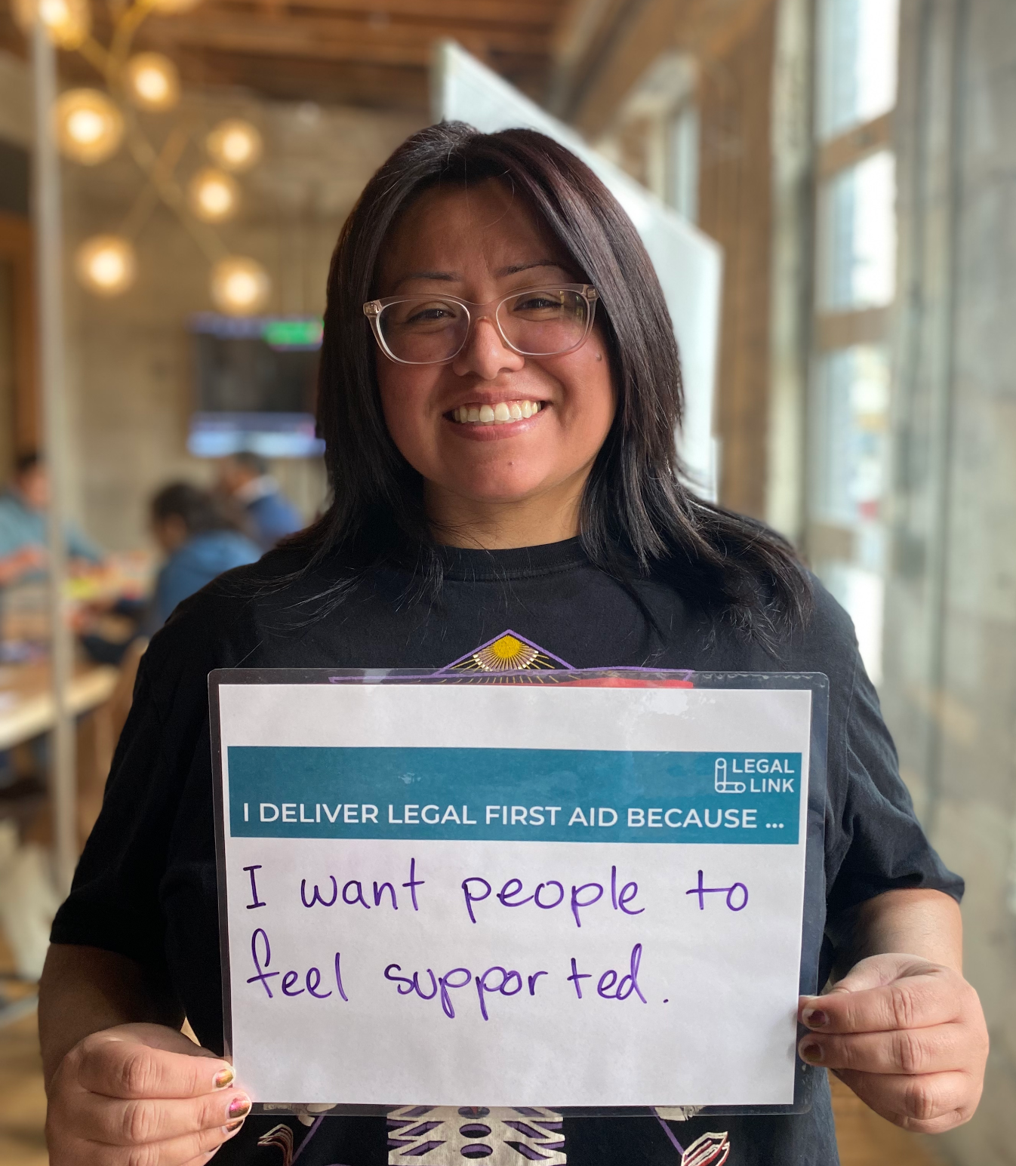
THANK YOU
Notes:
This Legal First Aid® training for California CVSOs is made possible through the generous support of the May and Stanley Smith Charitable Trust, whose investment reflects a shared commitment to ensuring the people closest to veterans have the tools to serve them well.

