Slide 1
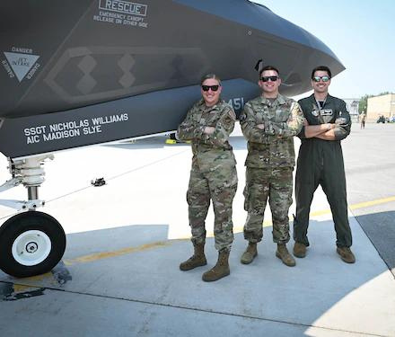
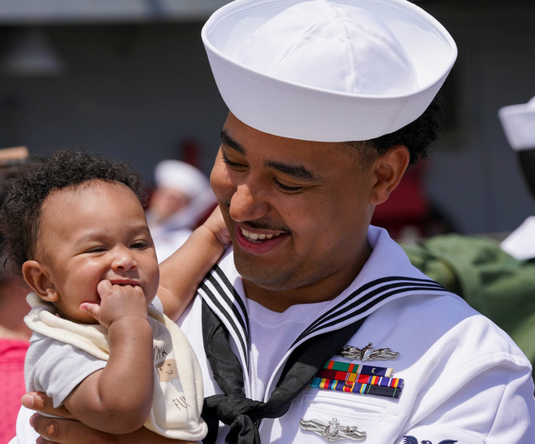
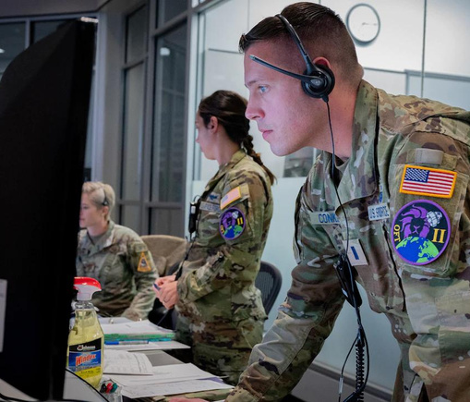


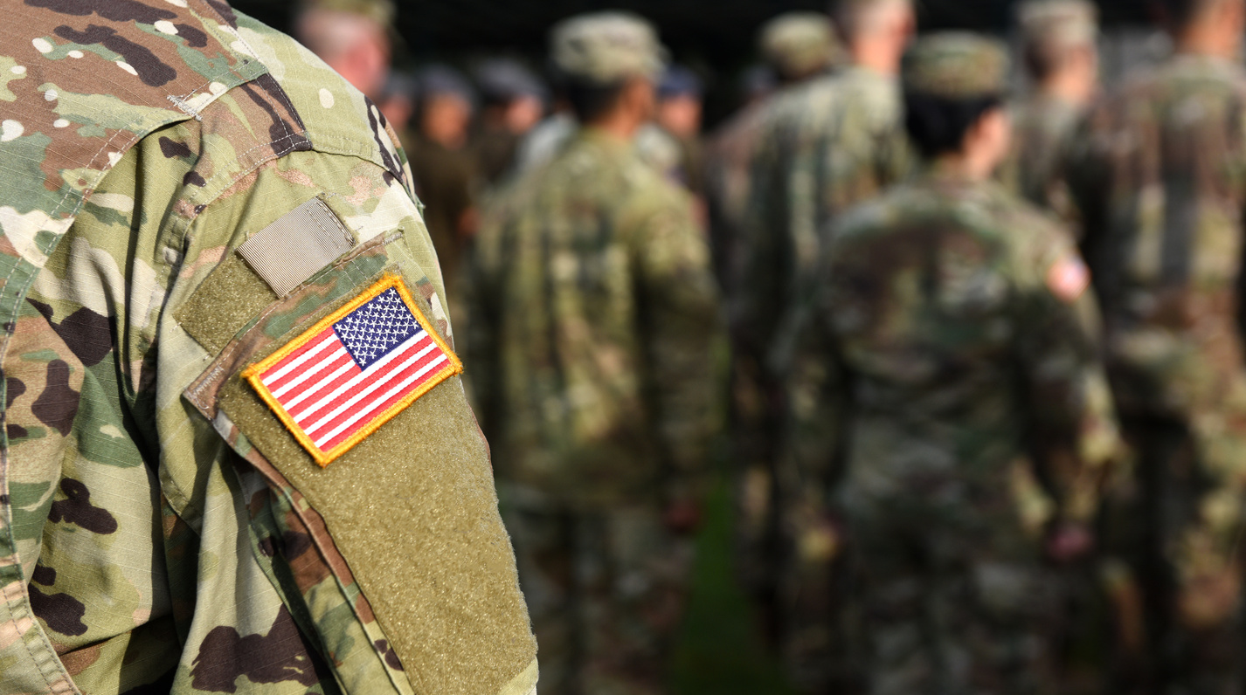
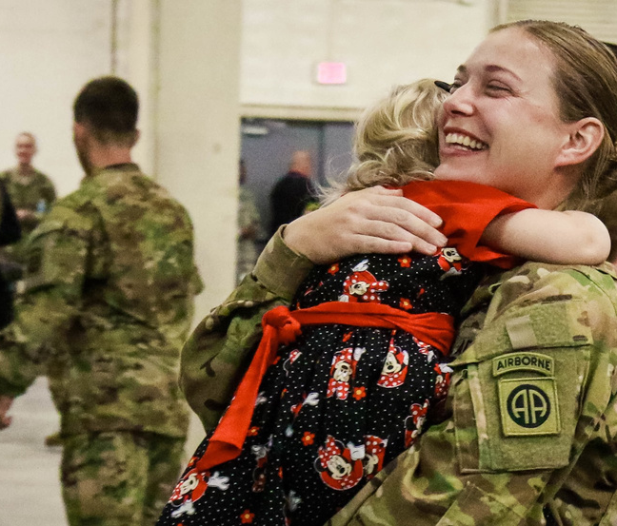
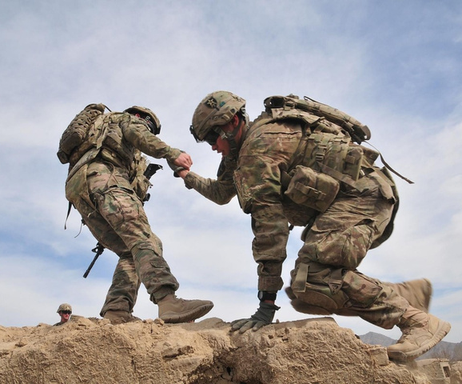
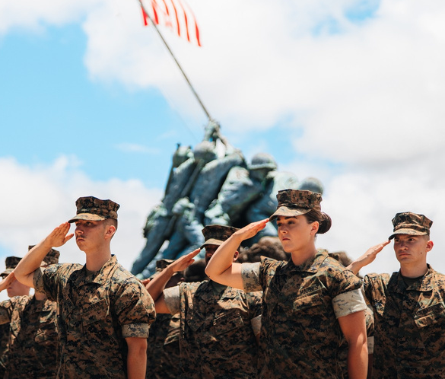
Guiding Transitions with Purpose
An Evidence-Based Approach to Foster Connectedness and Mitigate Reintegration Difficulties for Transitioning Service Members
www.onwardops.org
© 2026 The ETS Sponsorship Program
Notes:
Welcome and thank you for joining.
Onward Ops is a steady partner for service members as they transition from military to civilian life. We connect them to trusted resources, volunteer Sponsors, and community organizations, providing guidance and support throughout.

Slide 2

THE DEADLY GAP
18–34 Year-Old Veterans: Suicide Rate Nearly 3x Higher Than Peers
  First-year post-separation suicide rates climbed from 34.8 (2010) to 46.2 per 100,000 (2021).
47.9
per 100,000
(2)
(2)
  The largest suicide rate gap between Veterans and civilians occurs among ages 18–34.
16.5
per 100,000
(1)
(2023)
(2)
  Suicide was the 12th-leading cause of death for Veterans in 2022. Suicide was the 2nd-leading cause of death for Veterans under age 45-years-old.
(2023)
Civilians
Veterans
(2)
Ages 18-34
Ages 18-34
We must bridge that gap
(1) Source: CDC WONDER, Underlying Cause of Death, 2023; combined age groups 18–24 & 25–34.
(1) Context: National Council for Suicide Prevention, 2023 Annual Data Sheet.
(2)Source: 2024 National Veteran Suicide Prevention Annual Report, U.S. Department of Veterans Affairs (VA)
© 2026 The ETS Sponsorship Program
Notes:
This data shows the stark reality behind why our work matters.
In 2022, Veterans ages 18 to 34 have a suicide rate nearly three times higher than their civilian peers. It highlights how the first year after leaving the military—the “Deadly Gap”—is a particularly vulnerable time and why connecting Veterans to support early is so critical.
For Veterans under 45, suicide is one of the leading causes of death. These numbers make one thing clear—we have to bridge this gap, and early, trusted human connection is central to how Onward Ops supports Veterans during transition.

Slide 3


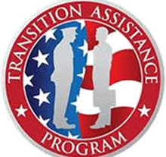

A TRUSTED GUIDE
THROUGHOUT TRANSITION
Supporting Every Step from Service to Civilian Life
States
Communities
Local Support
Onward Ops exists as the bridge between the last day in service and a successful civilian transition
Mentor
© 2026 The ETS Sponsorship Program
Notes:
Onward Ops isn’t a service provider—we’re a connector. We link service members to trusted community organizations and a volunteer Sponsor if they choose, working closely with the VA, DoD, and local partners to provide continuity and human connection. Our role is to guide, support, and keep Veterans connected so they can access the right resources at the right time.
Some Veterans need a lot of help, but almost all could use a little. The current transition process hasn’t delivered the outcomes they deserve. Issues like unemployment, homelessness, and suicide are largely avoidable—and they affect both today’s Veterans and the next generation considering military service.

Slide 4

HUMAN-CENTERED SUPPORT
Everything starts with the individual. We stay connected—support doesn’t end after a single referral.
Assess risks and needs early
Identify gaps and barriers
Connect to timely, relevant resources
Match with trained volunteer Sponsors
Follow up to maintain connections
© 2026 The ETS Sponsorship Program
Notes:
Everything we do starts with the individual. We assess risks, identify gaps, and connect service members to the right resources at the right time. Transitioning service members can also be connected with trained volunteer Sponsors, followed over time, and supported in a way that fits their unique situation. Most importantly, we stay connected—our support does not end after a single referral.

Slide 5

WHAT MAKES
ONWARD OPS DIFFERENT
Built for continuity and prevention.
Early, Seamless Enrollment
Local Matching
Certified Sponsors
Enroll 6–12 months before separation through VA and DoD partnerships, ensuring continuous support into civilian life.
Veterans are paired with trained Sponsors and community resources in their destination location for personalized, local support.
All Sponsors are VA-trained and certified, ensuring credible, consistent, non-clinical support.
Rapid Healthcare Connection
Community-Level Awareness
Secure Digital Tools
High-risk Service Members are connected to VA healthcare within 24 hours when needed.
States and local communities are notified in advance of incoming Veterans, enabling proactive outreach and coordination.
Each enrollee receives a free IL-4–secure Google Workspace dashboard to manage their transition safely and digitally.
© 2026 The ETS Sponsorship Program
Notes:
We’re not here to check a box—we’re here to walk alongside Service Members. Our model is built on flexibility, timing, and real human connection. We remain a steady, quiet partner until support is needed, then activate quickly and personally. Through early enrollment, local matching, and secure dashboards, Onward Ops provides continuity and prevention during high-risk transition periods.

Slide 6


A NATIONWIDE SUPPORT NETWORK
We work with trusted partners to connect service members to the right people and resources wherever they transition—building a relationship-driven safety net across communities.
Connect with community partners, veteran organizations and volunteer Sponsors
Provide nationwide coverage and local guidance
Strengthen community-level awareness and readiness
© 2026 The ETS Sponsorship Program
Notes:
We work with a network of trusted partners to ensure service members have access to the right people and resources wherever they are transitioning. Our approach is about relationships, not just resources, we are creating a safety net across communities.

Slide 7



































Our Partners
© 2026 The ETS Sponsorship Program
Notes:
These logos represent the partners who make our work possible. Through public, private, and nonprofit collaboration, they provide the resources and expertise that allow us to reach more service members, deliver timely support, and ensure no one transitions alone.

Slide 8
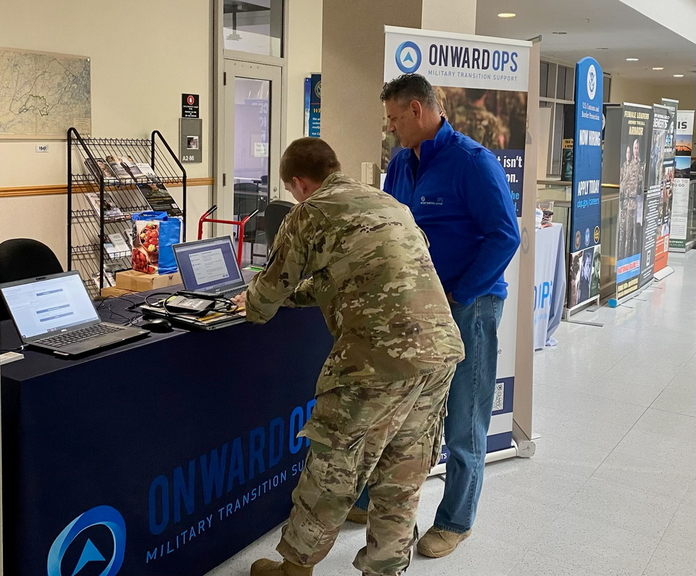












THE POPULATION WE SERVE
Gender
Age Range
Marital Status
Single
20-29
Married
30-39
Divorced
Separated
40-49
50+
81%
15%
Top 12 Destinations
Top Action Plan Items
  Texas
  Colorado
  California
  Florida
  New York
  Georgia
  North Carolina
  Arizona
  Pennsylvania
  Ohio
Employment
Job fairs, networking, veteran hiring & internships
Destination
Transition Outlook
Education
Applying for and using GI Bill
Medical
Needing to register with VHA
Family
Finding life insurance
Of active duty service members have identified a post military destination.
Of active duty service members expressed significant concerns and worries about their upcoming transition.
Social
Fitness & gym groups
© 2026 The ETS Sponsorship Program
Notes:
Here we highlight the population we serve. We support service members at a critical transition point—moving from uniform into their next chapter. While many know their next steps, our data shows ongoing concerns around employment, benefits, health care, and family stability. Our role is to step in early, reduce uncertainty, and connect them to the right support at the right time.

Slide 9
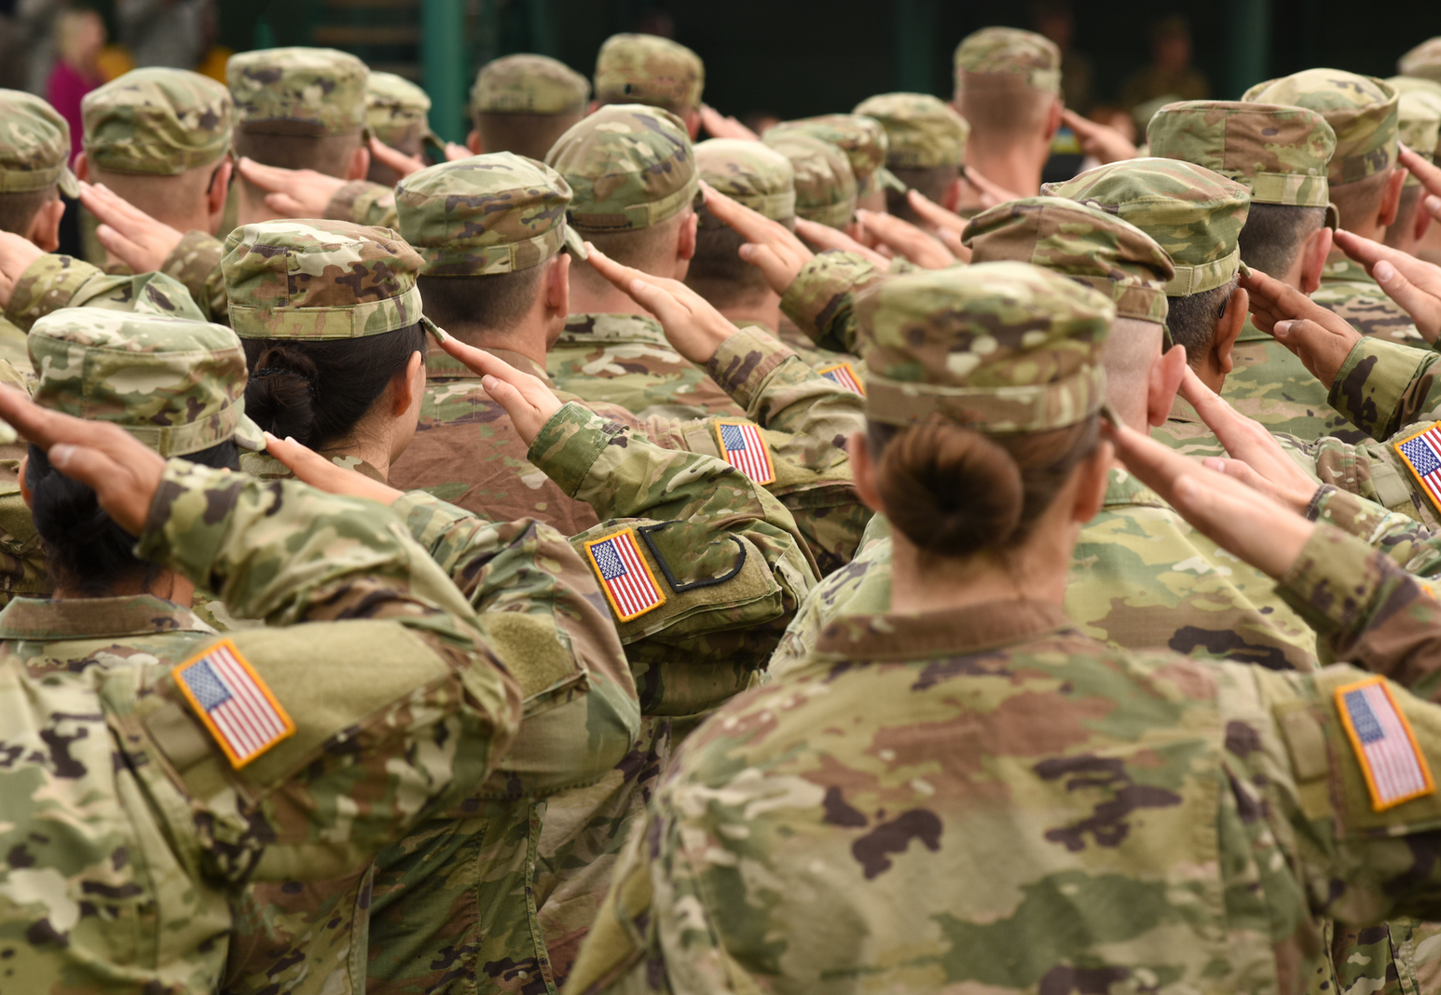
REAL PEOPLE.
REAL OUTCOMES
32,883+
411+
18,300+
Transitioning service members screened for suicide risk
Veterans at imminent risk for suicide identified and referred to care
Veterans assisted with enrolling in VA Healthcare
20,899+
2,889+
Transitioning service members enrolled and supported
Veterans assisted with essential needs support
Onward Ops Insights January 2026
© 2026 The ETS Sponsorship Program
Notes:
Behind every number is a service member or veteran who needed support at a critical moment. Through early identification and action, we’ve connected veterans at risk to care, screened thousands of transitioning service members, helped enroll veterans in VA health care, and supported those facing food insecurity or housing instability. These outcomes show the impact of meeting people early and ensuring no one navigates transition alone.

Slide 10




GET INVOLVED
Partner
with Onward Ops
Volunteer
as a Sponsor
Support
the Mission
  Collaborate with us
  Strengthen transitions
  Create community impact
  Guide a Veteran
  Provide steady support
  Build confidence and connection
  Donate to the Onward Ops Foundation (501.c3)
  Charitable Arm of the Program
  Expand access to resources
team@onwardop.org
onwardops.org/sponsor
onwardops.foundation/
© 2026 The ETS Sponsorship Program
Notes:
You can get involved with Onward Ops by partnering with us to strengthen transitions and create community impact, volunteering as a Sponsor to guide and support veterans, or donating to the Onward Ops Foundation to sustain and grow our programs. Every action helps expand access to resources and ensures no service member navigates transition alone.

